Slide 1

Studbook Admin Functionality
Notes:
Studbook Admin Functionality

Slide 2
Gaining Studbook Admin Access
You must be listed on the Studbook Administration List for you to have access to all the studbook functionality
  Species360 Global Admin can add you
  An existing Studbook Admin at your institution/regional association can add you
You will have access to:
  Studbook News Feed (limited to regional associations)
  Studbook Keeper List
  Studbooks and the data contained in them
  Studbook Charts
  Data Entry Monitoring (for your studbooks only)
Your responsibilities include:
  Manage Studbook Roles
  Adding/Editing Taxonomy
  Assign person to studbooks
  Assign access to Studbook News Feed
  Request Studbook migration into ZIMS
    Get current studbooks assigned to a migration Sprint
  Request from scratch data download for new studbooks
On the husbandry side, Species360 recommends studbook keeper be assigned the Population Manager (Species360) role

Slide 3
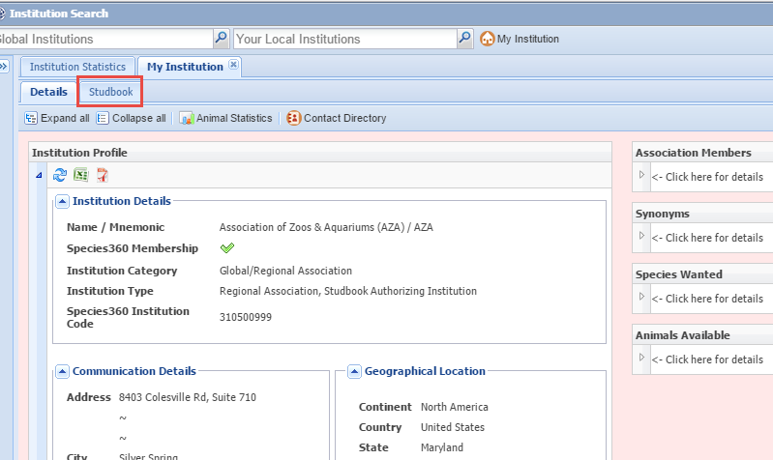
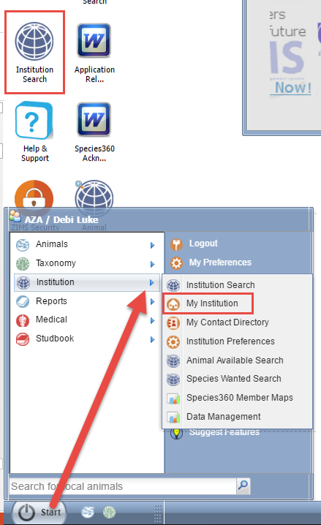
Finding Your Studbook Tab
All admin functions are performed from the Studbook tab. To open the Studbook tab either select the
desktop icon for Institution and then
select the My Institution tab, or go to
Start > Institution > My Institution. If you do not see it you will need
to be added to the Administration
List (covered later).

Slide 4
Studbook Tab
The Studbook Tab has the following grids:
  Studbook List
  Studbook Keeper News Feed (not visible for institutional studbooks)
  Studbook Roles
  Administration List

Slide 5
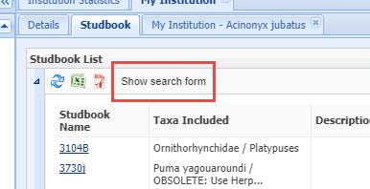
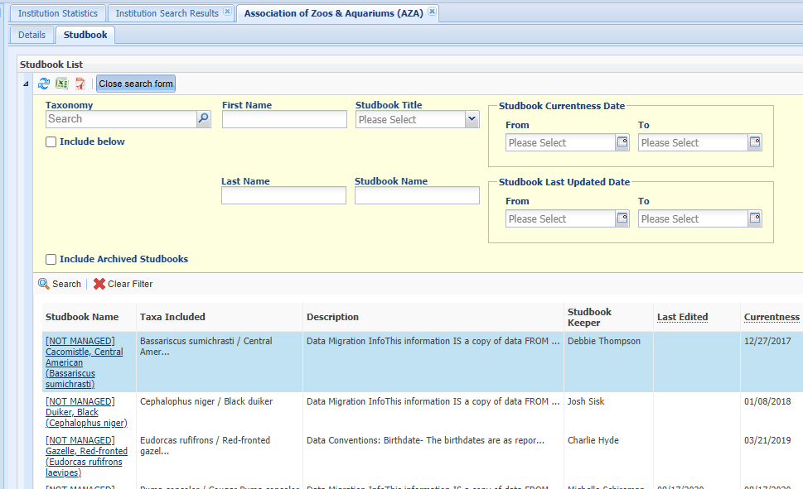
Studbook Tab – Studbook List
This tab will display all the Studbooks managed by your Association or Institution that have migrated to ZIMS. To search for specific Studbooks, use the Show Search Form tab at the upper left to open the search filters available. ZIMS will find partial matches.

Slide 6
Studbook List Visibility
If you are a Regional Association, you will not see Institutional studbooks that are in your region on the studbook tab list.
If you are an Institution, you will not see Regional Association studbooks your institution maintains on this list unless you are the Studbook Keeper.
You can request access to these studbooks by the Institution/Regional Association that manages them, they will only be accessible through the studbook module.

Slide 7
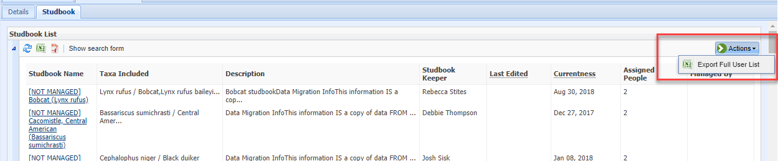
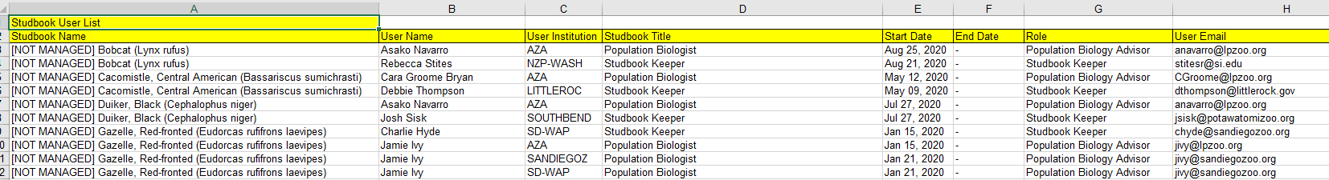
Export User List
From the Actions Menu in the Studbook List you can export a full list of
Users. This export will be to Excel.

Slide 8
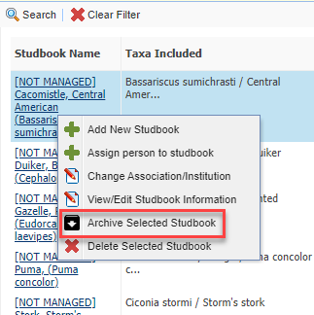
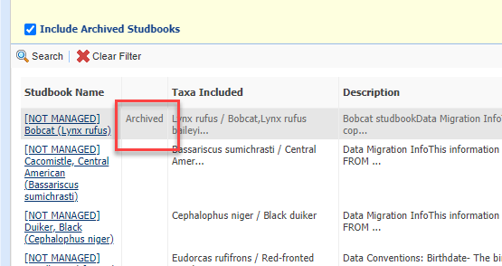
Archiving Studbooks
Studbook Administrators can mark a studbook
as Obsolete if it is no longer being managed or in
use. Right click on the Studbook and select
Archive Selected Studbook. Archiving will remove
the studbook from the active studbook list. To
view Archived studbooks check the Include
Archived Studbooks box in the Search form. The
list will display with a column for Archived. To
Unarchive right click on the studbook and select
Unarchived Selected Studbook.

Slide 9
Archiving Studbooks
If you export the studbook list with the Include Archived Studbooks checked, the column will be included in the export.
All archived studbooks can still be accessed by the Studbook Admin and any users that are assigned an active Role.
If you do not want anyone accessing the studbook, all assignments should have an end date assigned.
An Archived studbook will not display in the Studbook Global Search tool. If it is Unarchived, it will display in the tool.

Slide 10
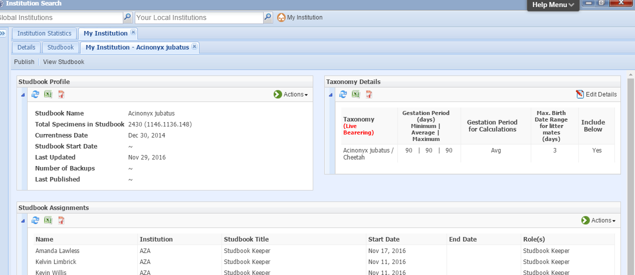
Opening Studbook Details
Selecting the Studbook Name hyperlink will
open the Studbook Details where you can see
a brief overview of the Studbook including
total specimens and gestation/incubation
periods as well as any Studbook Assignments.

Slide 11
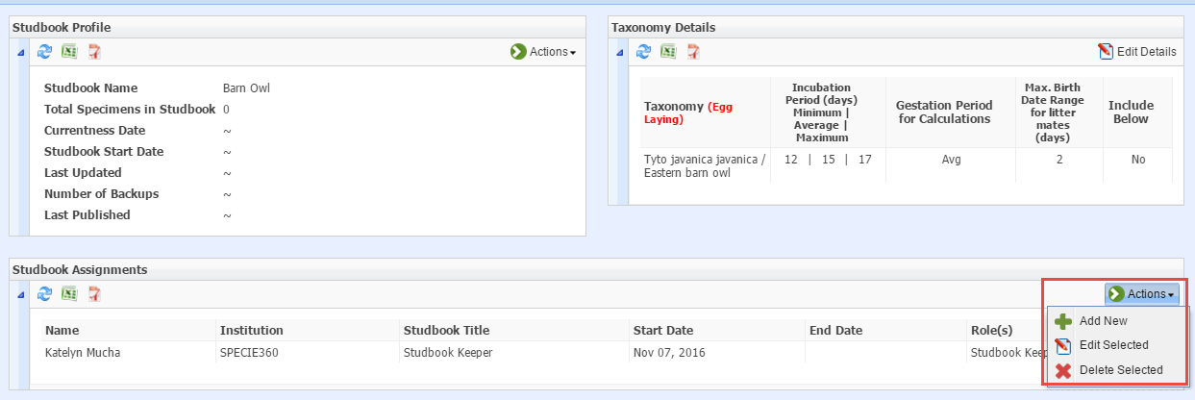
Assign Users to Studbook
From within the studbook record you can assign Users in the Studbook
Assignments grid > Actions > Add New. You can also make assignments
from the studbook list itself by highlighting the appropriate studbook
and select Actions > Assign Person to Studbook. Assignments are not
limited to Studbook Keeper only. You can assign Vet Advisors and SSP
Coordinators to name a few options.

Slide 12
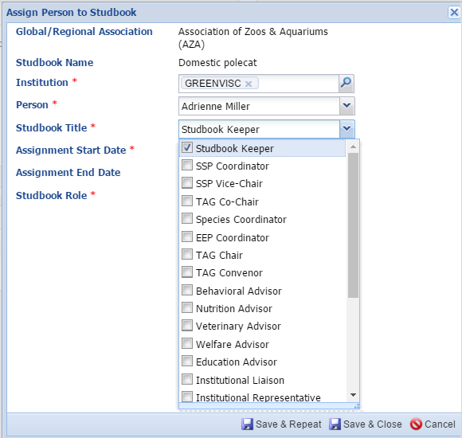
Assign Users to Studbook
The Association/Institution and Studbook Name will default and is not editable from this screen. You can assign access to people outside of your regional association/institution as long as they have a ZIMS account. Only persons associated with the institution you enter will display in that field for selection. There are many choices for assignment in the Studbook Title dropdown beyond the Studbook Keeper title.

Slide 13
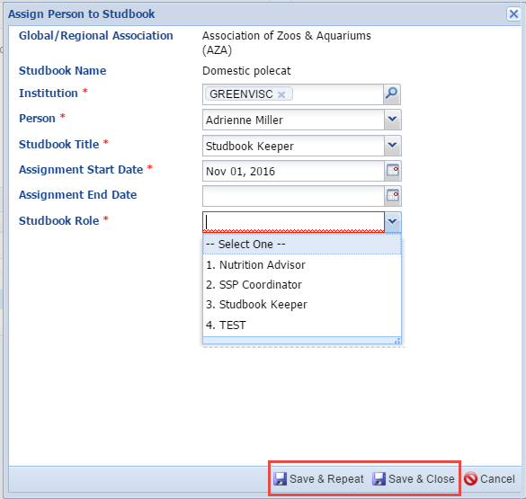
Assign Users to Studbook
The Assignment Start Date
would be the date the Studbook
was approved for the Studbook
Keeper or the date that other
positions were assigned. Any Roles
that you have created will be
available for selection. See following
slides for Role information. If you
want to assign multiple persons
select the Save & Repeat option.

Slide 14
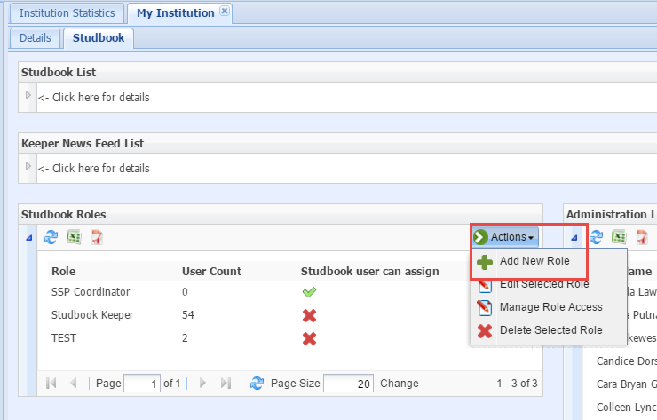
Studbook Tab - Roles
Studbook Admins are charged with
creating their own Role access for their
Studbooks. These Roles are across the
board for all Studbooks they manage.
To add a Role, under the Studbook tab,
open the Studbook Roles grid and select
Actions > Add New Role.

Slide 15
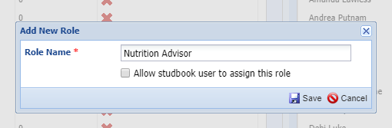
Adding a Role
The role Name must be unique for the studbook role list. It may be
easier to name the Role the same as one of the Studbook Title
options available when assigning a User to the Studbook. The
functionality to allow studbook keepers to assign Roles to
their own studbooks is not yet developed.

Slide 16
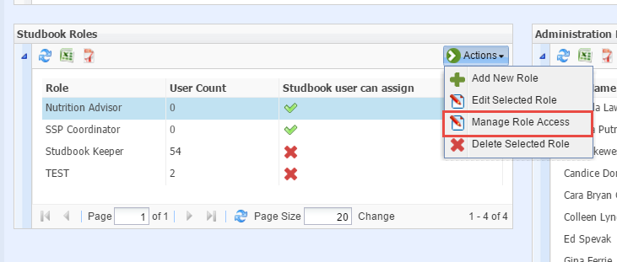
Creating Role Access
You then need to create ZIMS access for this Role.
To do this select Actions > Manage Role access after
you have highlighted the appropriate Role.

Slide 17
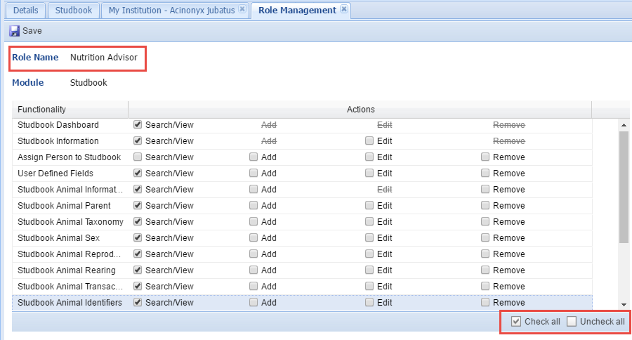
Manage Role Access
Here we are assigning the Role access for
our Nutrition Advisor. Access is provided
by Search/View, Add, Edit and Remove.
We do not want our Nutrition Advisor
Role to be able to add or change any data
so we have given only Search/View access to
the topics we feel are relevant to this
position. The option to quickly check or
uncheck all boxes is available.

Slide 18
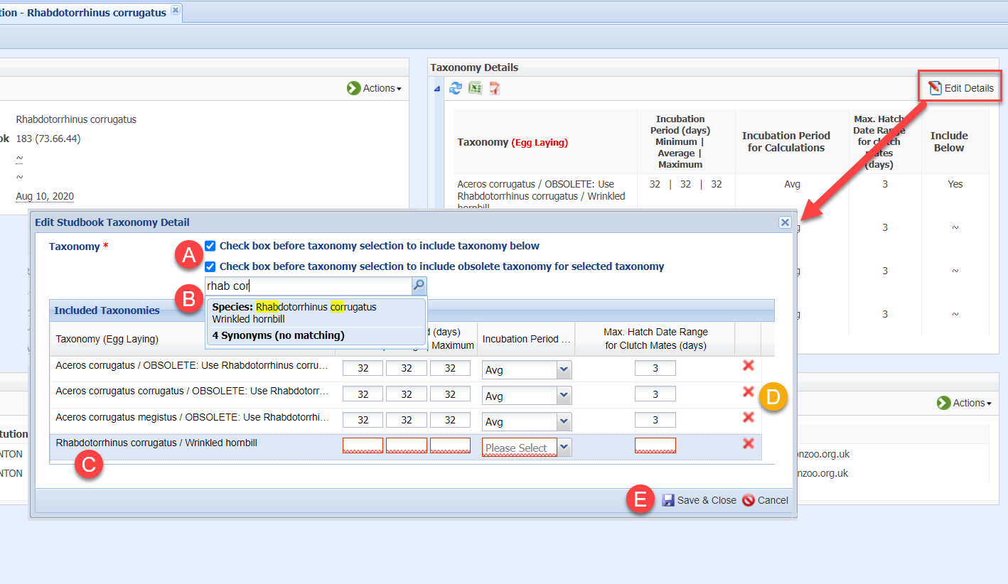
Adding/Editing Taxonomy
Select Edit Details in the Taxonomy Details box.
Check the two tick boxes
Type the scientific name you wish to add
Complete the reproductive information fields
To delete taxonomy use the red x icons
Save & Close

Slide 19
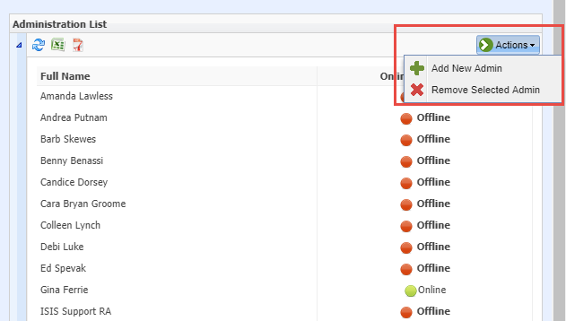
Studbook Tab - Administration List
You will not have access
to this studbook information
unless you are listed in the
Administration List. The
Species360 Global Admin or
an existing Studbook Admin can add
you to the list using the
Administration List grid.

Slide 20
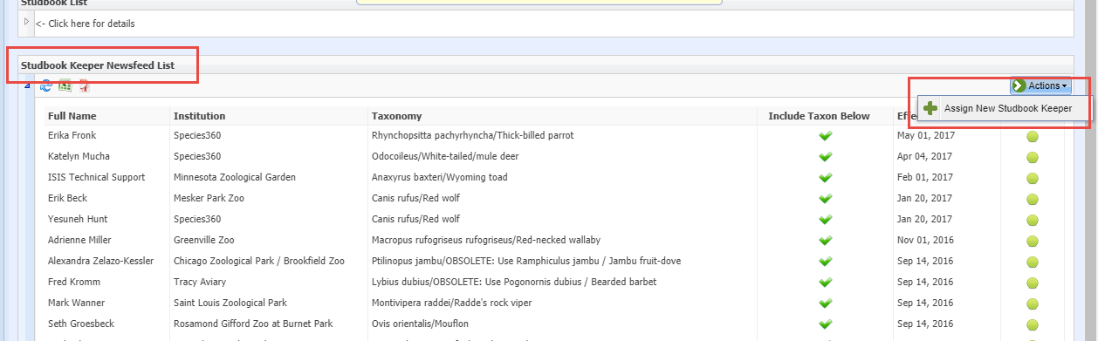
Studbook Tab - News Feed
The Studbook News Feed is only accessible for Regional Associations. The News Feed allows Studbook Keepers who have not yet migrated to view recent additions or edits to their studbook at the institutional level. Use the Studbook Keeper Newsfeed grid to give access to view this. Studbooks that have migrated have access to this information in Suggested Animals and Pending
Updates so they do not have to be listed here.

Slide 21
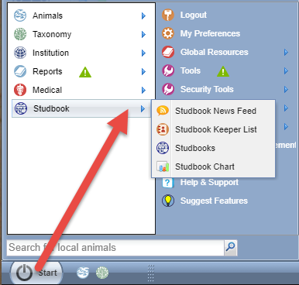
Access to Studbook Data
To look at the actual
Studbook data go to
Start > Studbook >
Studbooks. You can
drag this icon to the
desktop if you find
you are opening
Studbooks frequently.

Slide 22
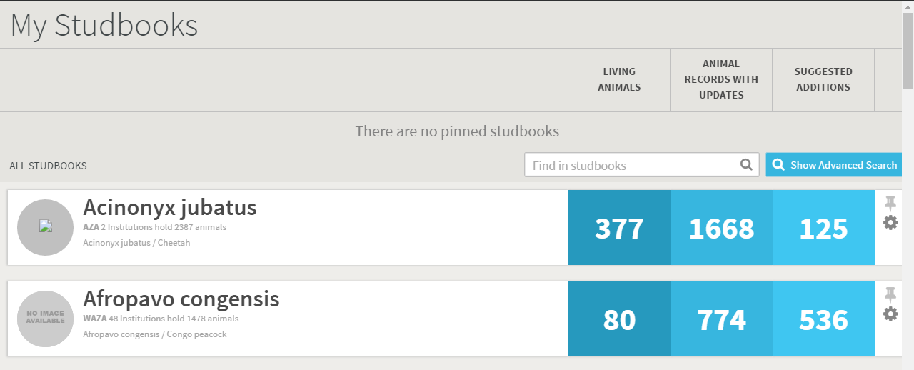
Access to Studbook Data
A list of all of the Studbooks managed by your Regional Association or Institution will display if you have been added to the Administration List. You may see additional studbooks outside of your Regional Association or Institution if you were assigned to them by their studbook admins. The number of Living Animals, Animal Records with Updates (this means the institution has made updates not yet accepted into the studbook) and Suggested Additions (possible new animals for the Studbook) is displayed.

Slide 23
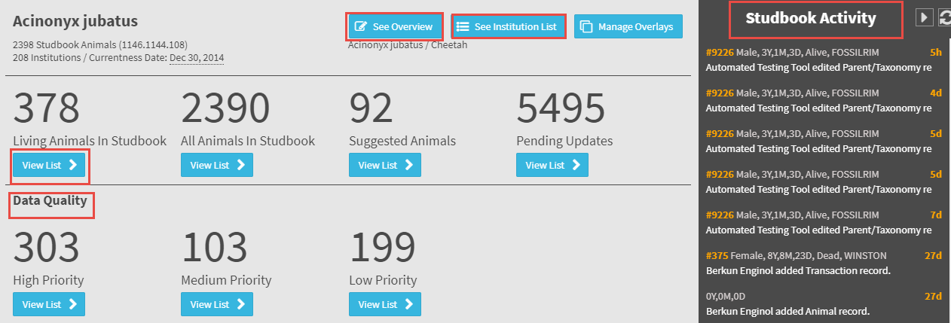
Access to Studbook Data
Selecting the species will take you into the main studbook dashboard.
On the right is recent activity recorded in the Studbook. The See Overview
button displays a brief description of the studbook. The See Institution List
button takes you into the Institution List for that Studbook. You also view
the Data Quality of the Studbook here. Selecting the View List button
will take you into a results grid for the topic.

Slide 24
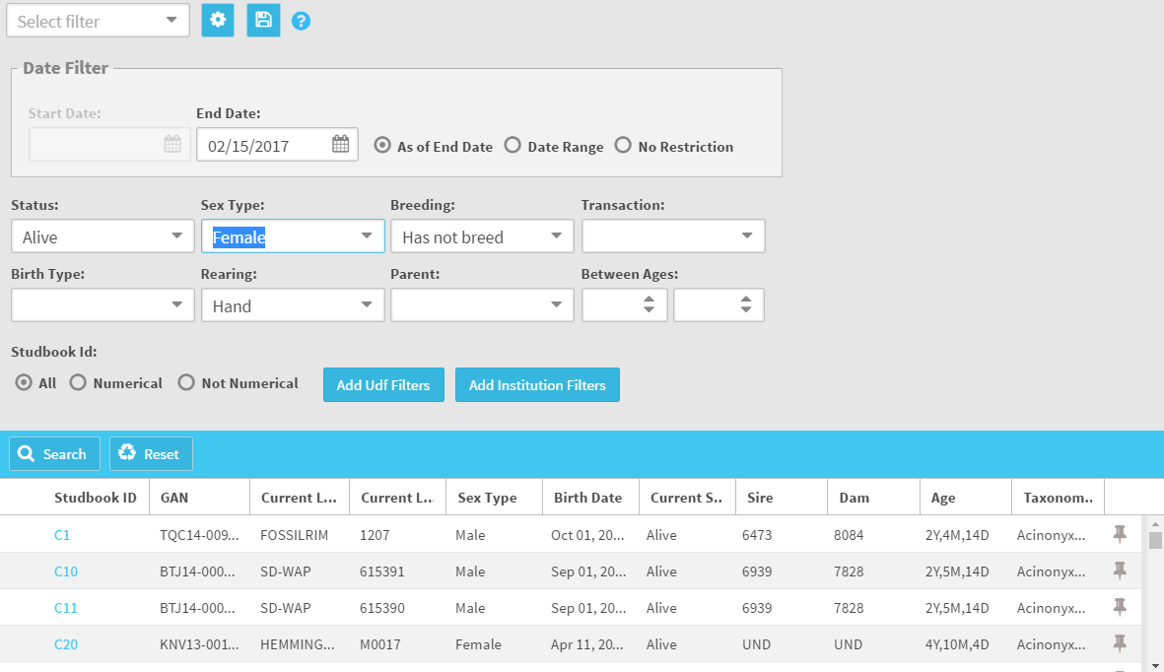
Access to Studbook Data
A list of the studbook animals
will display. Above the list is
an expandable search box to
help you find animals that
match specific filters. The
Studbook IDs are hyperlinks
into the record.

Slide 25
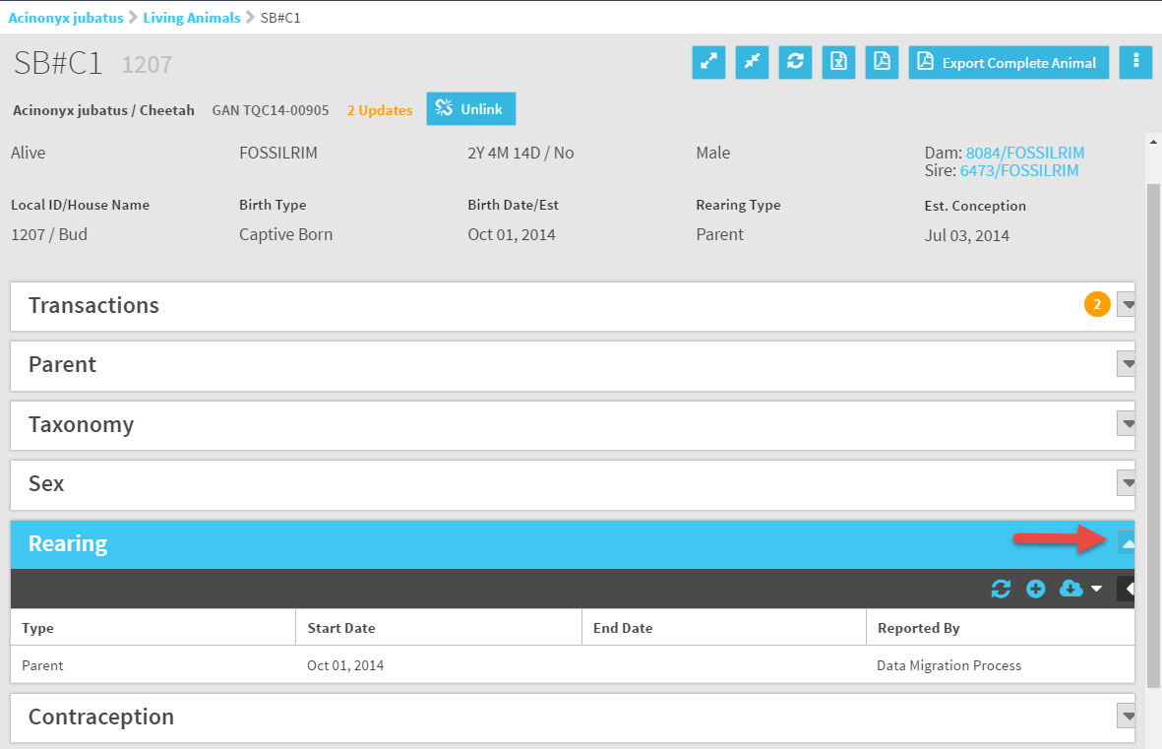
Access to Studbook Data
Selecting the Studbook ID hyperlink will open
the record. Use the arrows to expand the
various grids to view the data recorded.

Slide 26
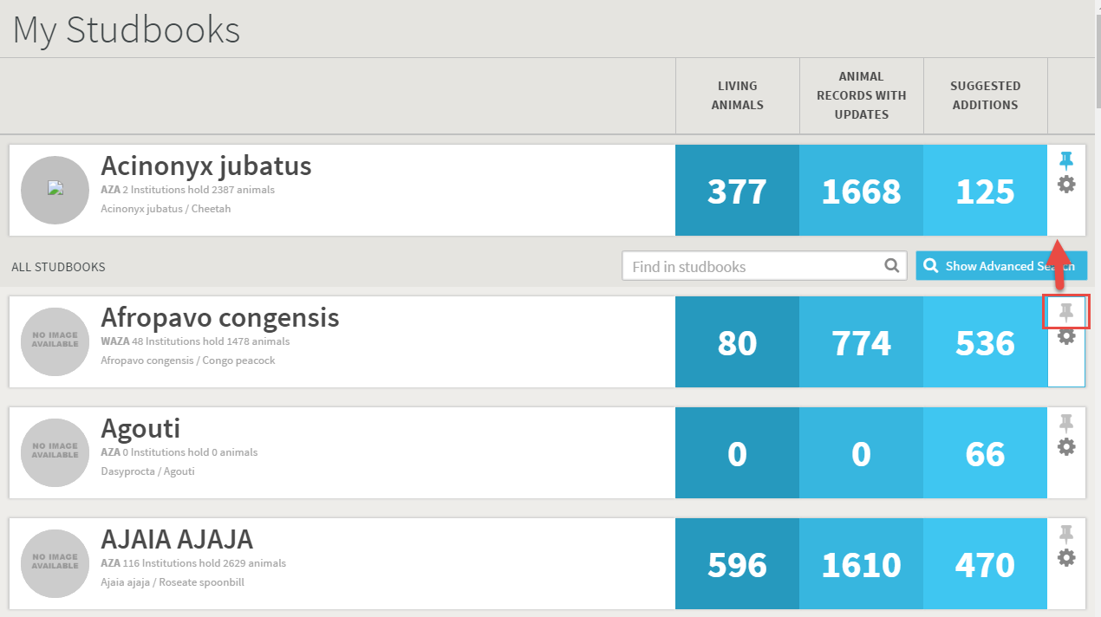
Pinning Studbooks
If there is a Studbook that you access frequently you can “pin” it to the top of the list by selecting the pushpin icon. Pinned Studbooks load faster for your
convenience.

Slide 27
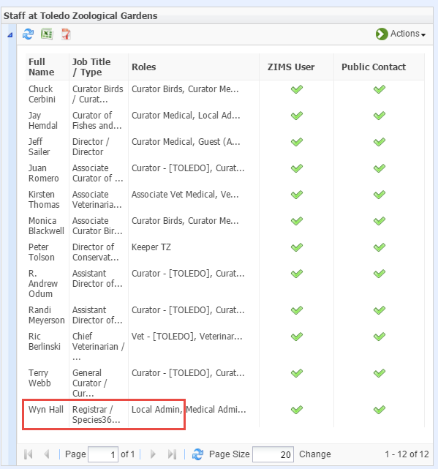
To Find a Local Admin
You may need to find a Local Admin at another regional association or institution to request access to their studbook or request they create an account for someone you want to gain access to your studbook. To find who is the Local Admin at another facility you will search for that institution and
open the Staff grid. Look for who is assigned the Role of Local Admin. Remember that not all institutions make their Staff globally visible.

Slide 28
Good News! Things that are not your responsibility!
A Studbook Keeper cannot log into ZIMS
A Studbook Keeper does not have access to the Studbook Keeper List or the Studbook Charts
Tell them to:
  First: check with their Local Admin as they may not have been assigned the proper Role
  Second: check with support@Species360.org

Slide 29

Contact Support@species360.org with any questions
www.Species360.org

