Slide 1
Studbook Pending Updates

Slide 2
Pending Updates
Pending Updates: Updates that populate in studbook animal records for animals that are linked to a Husbandry animal.
Only studbook animals linked to a Husbandry animal can have pending updates.
Pending Updates accepted into the studbook are fully editable and changes made do not impact husbandry records.
If a Husbandry animal is deleted or the studbook animal unlinked the accepted data will remain in the studbook.
Pending updates are not errors, they highlight the differences between the studbook and Husbandry records.
Users can review pending updates as time allows – no action is required on these updates immediately after migration

Slide 3
Pending Updates After Migration
After the studbook animals are linked to Husbandry animals during migration, ZIMS will search for husbandry data that differs between the two animal records and create pending updates.
System Links animals based on the following:
Mnemonic/local ID pairings in transactions in Husbandry and the Studbook
Studbook ID/taxonomy matching in Husbandry and the Studbook
Transponder/taxonomy matching in Husbandry and the Studbook
At this time, if the Studbook record and the Husbandry record do not have at least one of these record types that match, the system will not suggest a match

Slide 4
Pending Updates After Migration
Only studbook animals that are linked to Husbandry animals will have pending updates.
After initial migration, the number of pending updates reflects all of the differences between the studbook and linked Husbandry animals.
The system calculates pending updates for all animals of any status (living, dead, LTF, etc.).
As linked animals in the studbook are updated in Husbandry the total number of pending updates will change to reflect new updates.

Slide 5
Animal Record Types - Pending Updates
Pending Updates Do populate for the following record types:
Transactions
Parent
Taxonomy
Sex
Contraception (from Husbandry module not Medical module)
Rearing
Transactions
Pending Updates Do Not populate for the following record types:
Identifiers
UDFs
Animal Notes
Death Information (in death event)

Slide 6
Husbandry Data Conventions
Husbandry institutions may have different conventions on how they enter records into ZIMS.
Species360 provides documentation and training on best practices but data entry may vary.
Examples of data entry differences that may impact studbook data when accepting it into the studbook: Conventions on animals hatched/born on the same day, transfer date recordings, recording animals in groups vs. individuals.
Just like when adding animals to your legacy studbook, it is important to review the data being entered into the studbook.
If you have questions about the animal or the data entered, contact the institution.
If you have questions about data entry practices in ZIMS, contact Species360 support.

Slide 7
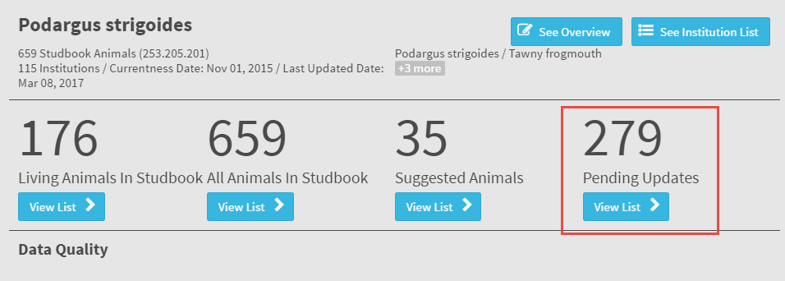
Pending Updates Navigation
The Pending Updates List can be accessed from the dashboard or left hand navigation

Slide 8
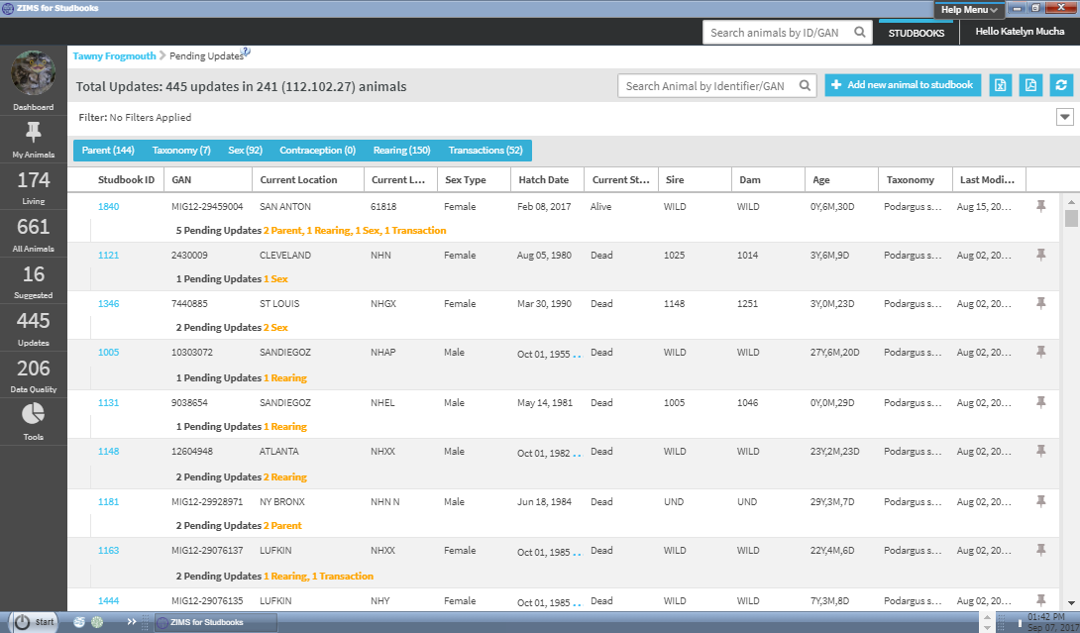
Pending Update List
Total count of pending update count will display for each animal in the list.
The total count is followed by a breakdown of each update by record type.
User can navigate to animal detail to see more information about the pending update and take action (accept/reject) the record (select Studbook ID).

Slide 9
Pending Update List
User can filter the list just like the animal list and also toggle buttons that allow the user to search for specific pending update types
User can select one or more of these toggle buttons

Slide 10
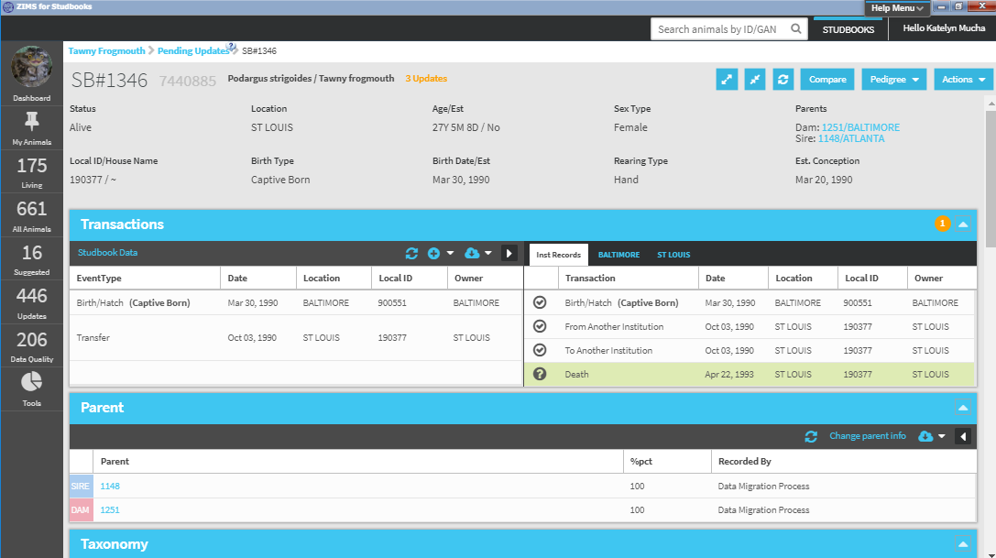
Pending Update List
The total number of updates for the animal will display in the basic animal details
This number will be updated as the user accepts/rejects pending updates
Orange notifications in the grids indicate the number of updates per grid.

Slide 11
Pending Update List
The top left corner of each record box will display the number of pending updates per record type
This number will be updated as the user accepts/rejects pending updates
Sometimes these numbers are overinflated from multiple institutions reporting the same data – often resolved once one is accepted.

Slide 12
Pending Update List
Boxes with pending updates will expand automatically when user navigates from Pending update list.
Default tab will display all Husbandry institutional records
If multiple institutions have reported, subsequent tabs break down records by institution.
Select tabs to view only that institution’s records

Slide 13
Accepting/Rejecting Pending Updates
Selecting the “?” allows you to Accept the data update (institution record) into the studbook or Reject the update.
The following options are displayed under the “?” icon:
Accept Update, Accept with Edit, Reject
If a Pending Update record includes an Institution that is Local to Husbandry but not entered into your Studbook, you will not be able to accept the record until you add it to your Studbook Local Institution list.
Once accepted, the record will be studbook data and can be edited as needed.

Slide 14
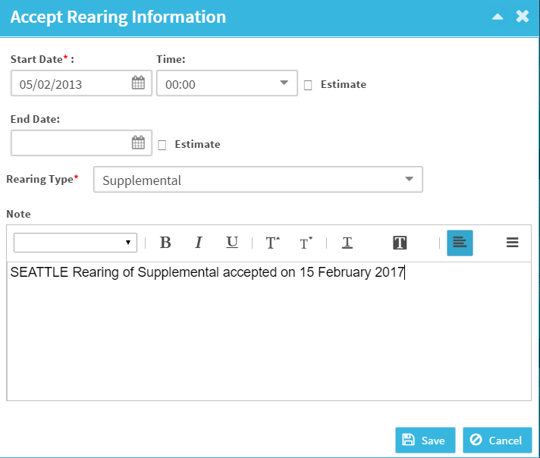
Accept with Edits vs. Accept
Selecting “Accept with
Edits” creates a pop-up screen where the user can edit or add information to the record.
Example: adding a note to the record.
Selecting “Accept” automatically populates the record into the studbook.
If the Husbandry record is missing any information required in the studbook record, the pop-up will open and user must enter required fields prior to saving.

Slide 15
Accepting/Rejecting Parent Updates
For Parent pending updates the accept options are slightly different.
Accept update: Accepts single record into the parent grid
Accept All: Accepts all the parent pending updates into the studbook with one click.
This option is especially useful when there are multiple parent records recorded by an institution for a sire/dam. It prevents the user from having to accept multiple times.

Slide 16
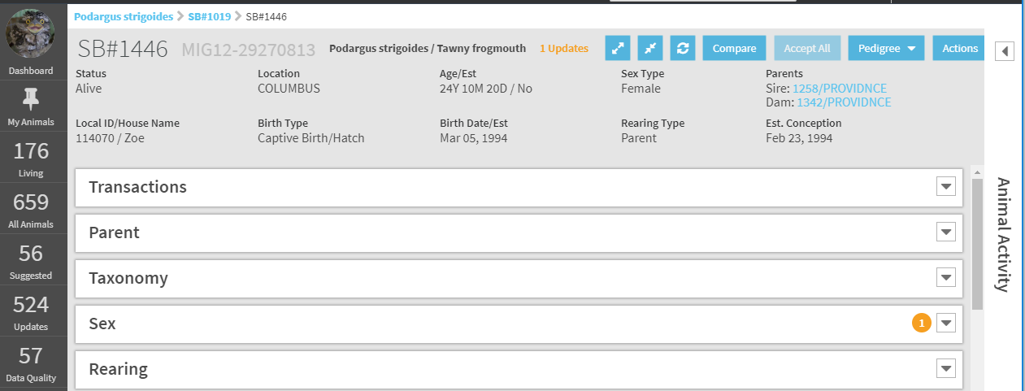
Animal Detail – Accept All
Accept All button allows user to automatically accept all pending updates for an animal.
This option is only available for animals that have been held at one institution.
If the button is not active, the user must review and manually accept the pending updates.
Available from the Animal Detail but is best used when accepting a new animal to the studbook.

Slide 17
Accept/Reject Institutional Record
Accepting an Institutional record will change the “?” into a checkmark and the information will be displayed on the left side Studbook Data (top).
Rejecting the institutional record will change the “?” icon to an reject and the record will NOT display in the Studbook Data (Bottom).

Slide 18
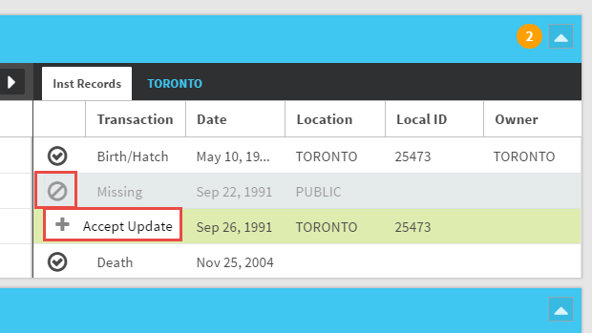
Reject Institutional Record
If a record has been rejected, the rejected record remains visible in the institution transaction view.
The studbook user can decide later to accept the record into the studbook.

Slide 19
Match Conflicts
Sometimes Husbandry and Studbook data is very close, but not an exact match. In an effort to reduce the number of pending update notifications work, ZIMS creates match conflicts.
Match conflicts will to match the Husbandry/Studbook records not populate a pending update.
They display in red text in the institution view.
User does not need to take any action on these conflicts (they are informational only) unless they want to edit the studbook data.
Match conflicts only require data type to match.
Transactions – Date, holder, owner and local ID can be conflicts.
Taxonomy – Date and Taxonomy Determination can be conflict.
Sex/Rearing – Date can be conflict.

Slide 20
Pending Update Rules - Transactions
There are some transaction terms that are available in Husbandry but not Studbooks.
ZIMS maps these transactions accordingly when user accepts them:
Appeared in Husbandry → Maps to Transfer when user accepts into the studbook.
Rescued in Husbandry → Maps to Transfer when user accepts into the studbook.
Wild Capture → If the studbook already has a wild capture, the subsequent ones will map as recapture.
Retrieval of Missing in Husbandry → Maps to Return from LTF when accepted into the studbook.
Missing in Husbandry→ Maps to Go LTF when accepted into the studbook.
Some transactions are not applicable to studbooks, the records in Husbandry do not populate as pending updates in the studbook:
From Lay
OFF SPECIES360
Merged into group

Slide 21
Recapture vs. Retrieval of Missing
Note: Recapture and retrieval from missing are transaction options in Husbandry records. These transactions will display as pending updates in your studbook. In some cases these transactions are used interchangeably by Husbandry institutions.
Husbandry definitions:
Recapture: An animal that escaped or was released to the wild then brought back into captivity.
Retrieval from Missing: An animal that has been found after going missing.
In Studbooks:
Carefully determine how the Husbandry record should be added to the studbook.
If an animal is missing the user should enter it as LTF with a note. If the animal was found then a return from LTF should be added to bring the animal back into the population.
If an animal was released and then brought back into the population that transaction should be recorded as recapture.

Slide 22
Transactions in Husbandry that Cannot be Accepted
There are three Husbandry transaction types that cannot be accepted into the studbook. These records are visible to the user but they are grayed out - there is a hover over explaining the record type.
Reported Holder/Owner: User can see reported change in holder or owner. Only physical transactions can be entered into the studbook at this time.
Studbook Keeper can enter this information in the animal notes if needed.
Pre-birth (from lay and fetus identified): Studbooks does not support pre-birth at this time but the record is displayed in the institutional grid for informational purposes.
Groups (merged/split): Studbooks does not support groups at this time but group merges are displayed in the institutional grid for informational purposes.

Slide 23
Private Collection Animals Pending Updates
Animals held in Private Collections in Husbandry are not linked during migration or available for the user to link to studbook animals.
However, if the animal was held by multiple institutions and not all of those institutions managed the animal in a private collection, then the institution information that is not private will be available to the studbook.
Only the non-private collection information will display for animals that have been held in both public and private collections.
If an animal is moved from a private to a public collection, the Husbandry information on that animal will now be visible within the studbook.
If a public animal is moved to a private collection, the Husbandry information will no longer be visible within the studbook.
If the animal is only in a private collection then the link between the studbook animal and the Husbandry animal will be removed. Any information accepted into the studbook will remain.
Parents for animals in the studbook that are in private collections are not displayed in the studbook. User will need to contact the institution and manually enter those records.

Slide 24
Pending Update Rules – Taxonomy
A taxonomy that is not managed in the studbook, but entered by the institution will display in the grid but the user cannot accept it into the studbook.
User can only reject this record
If this taxonomy is managed by studbook, contact your regional association to have it added to your studbook. Once it is added the taxonomy record can be added to your studbook.

Slide 25
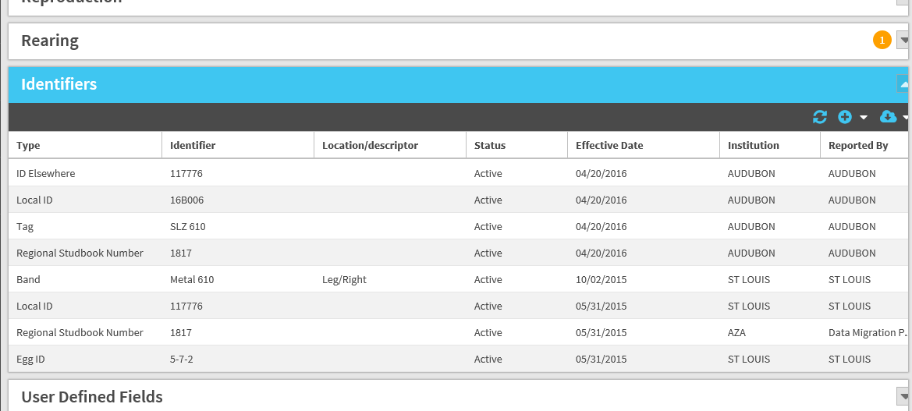
Identifiers Auto Populate
Pending updates do not populate for Identifiers. Instead, for linked animals, any identifiers that have been entered in the Husbandry module will automatically be visible in the studbook, the user does not need to re-enter them.
If the user unlinks a studbook animal from the Husbandry animal, only the identifiers entered into the studbook will remain in the studbook. All identifiers entered by the institution will no longer be visible.

Slide 26
Pending Update Rules - Parents
Parents reported in Husbandry are tricky to map because there are many ways to enter parents for an animal in Husbandry.
How ZIMS predicts pending updates for parents depends on how they were entered in Husbandry.
ZIMS provides suggestions to help inform the user about who the parents are and how they were entered in Husbandry.
There are 9 different types of parent pending updates that can be accepted into the studbook.

Slide 27
1.Some Rules: System Predicts Link to Studbook Animal
ZIMS Predicts Parents are Linked to a Studbook Animal:
Prediction displays if:
Institution entered the GAN as the parent in Husbandry that is linked to an animal in the studbook.
User has accepted the institutional parent record into the studbook.
Actions Available: No action needed, records in studbook and institution match and you are good to go!

Slide 28
2. System Predicts Wild Parent
ZIMS Predicts Parents are WILD:
Prediction displays if:
Institution selected “WILD” button when entering parent information in Husbandry record
Institution entered a Non-ZIMS parent in husbandry then entered “wild” as the location or local ID, example: WILD/123, India/Wild
Actions Available: Accept/Reject
If user accepts, the record will be accepted into the studbook as a WILD parent

Slide 29
3. System Predicts UND Parent
ZIMS Predicts Parents are Undetermined (UND):
Prediction displays if:
Institution selected “Undetermined” or “Indeterminate” button when entering parent information in Husbandry record
Institution entered a Non-ZIMS parent in husbandry then entered a variation of undetermined as the animal’s location
Examples: UNKNOWN/123, UNK/123, UNDETERMINED/123, INDETERMINATE/123
Actions Available: Accept/Reject
If user accepts, the record will be accepted into the studbook as a UND parent

Slide 30
4. System Predicts Linked Parent
ZIMS Predicts the Parent is Linked to a Studbook Animal:
Prediction displays if:
The institution has entered a parent that is recorded in the studbook (studbook animal is linked to the GAN entered in Husbandry.
Actions Available: Accept/Reject
If user accepts then the parent edit box opens and the studbook ID will now display in the studbook.

Slide 31
5. System Predicts Non-ZIMS Animal – No Match
Non-ZIMS animal – System Cannot Predict Match:
This will not display as a Pending
Action Available: None

Slide 32
6. System Predicts Non-ZIMS Animal – Match
Non-ZIMS animal – System Predicts Match:
Prediction displays if:
Institution entered a Non-ZIMS parent in husbandry with a Mnemonic/Local ID pairing that matches a studbook animal Mnemonic/Local ID pair.
Example: Denver/1234, if there is an animal in your studbook with this mnemonic/local ID the system will suggest that animal as the parent.
Actions Available: Accept/Reject
If user accepts then the parent edit box opens and the suggested studbook ID will now display in the studbook.

Slide 33
7. System Predicts Animal on Suggested Animal List (Local or Global) with a Link
Animal on Suggested List with Suggested Link:
Prediction displays if:
Parent entered by the Husbandry institution is on the Suggested List (local or global) and has a suggested match to an animal in the studbook.
The system cannot automatically show the pending update as a match to the studbook parent record until the Suggested GAN is linked to the studbook animal. Once the animals are linked the pending update will be removed.
Actions Available: Accept/Reject
Accept opens screen that allows user to link Suggested and Studbook Animal.
Rejection removes the pending update but the Suggested animal remains on the Suggested List.

Slide 34
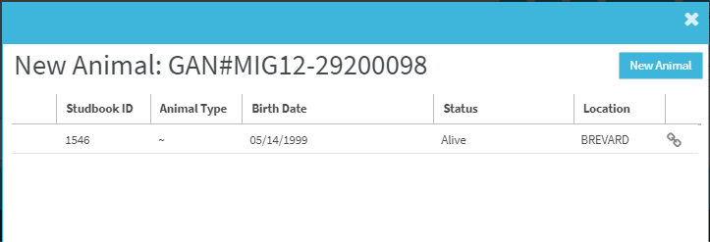
7. System Predicts Animal on Suggested Animal List (Local or Global) with a Link Continued
If user accepts this pending update a screen will open with two options:
Link the animal on the Suggested List with the studbook animal the system is suggesting.
If linked, the pending update will be removed and the Husbandry animal is removed from the Suggested List.
Add the Suggested Animal as a new draft animal (choose this if the Husbandry animal should not be linked to the system suggested match).
If selected, a draft animal will be added to the studbook and the DRAFT# will be accepted into the parent studbook record

Slide 35
8. System Predicts Animal on Suggested Animal List (Local or Global) without Link
Animal on Suggested Animal List (Local or Global) without Suggested Link:
Prediction displays if:
Parent entered by the Husbandry institution is on the Suggested List (local or global) and does NOT have a suggested match to an animal in the studbook.
Actions Available: Accept/Reject
Accept opens screen that allows user to add the animal as a draft.
If selected, a draft animal will be added to the studbook and the DRAFT# will be accepted into the parent studbook record
Rejection removes the pending update but the Suggested animal remains on the Suggested List.

Slide 36
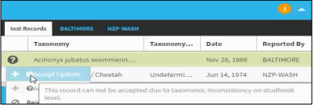
9. System Predicts Invalid Taxon
System suggests Invalid Taxon:
Prediction displays if:
The Husbandry animal linked to the studbook animal has a taxonomy that is not included in the studbook.
Action Available: Reject
User cannot accept this taxonomy into the studbook until the taxonomy is included as a managed taxonomy by the regional association. Once the taxonomy is added to the studbook definition, this pending update can be accepted into the studbook.

Slide 37
Animals Not Getting Pending Updates
There are two situations where pending updates for animals in the studbook will not populate.
First, the last holder may not be a ZIMS institution and therefore no updates are available.
Second, the animal may be managed as a group in the Husbandry module of ZIMS. Currently studbooks do not handle group records so no updates from groups will be displayed.
In both these scenarios a warning message will display in the Basic Information screen in the Animal Detail.

Slide 38
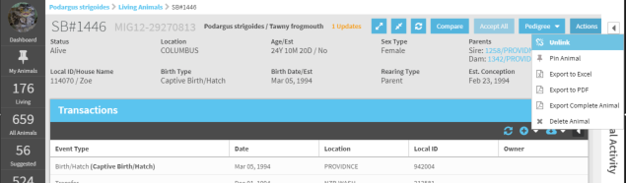
Unlink Studbook Animal from Husbandry Animal
If you made a mistake while linking, you can unlink the studbook animal from the Husbandry animal by selecting Unlink from the action bar.
Unlinking a Husbandry animal will remove the institution records that are visible in the Animal Detail.
Any pending updates that have been accepted into the studbook records will remain in the studbook after unlinking.
The unlinked Husbandry animal will populate on the Suggested Animal List (if the taxonomy in Husbandry still matches the studbook taxonomy).

Slide 39
Contact Support@species360.org with any questions
www.Species360.org

