Slide 1
Studbook Overview

Slide 2
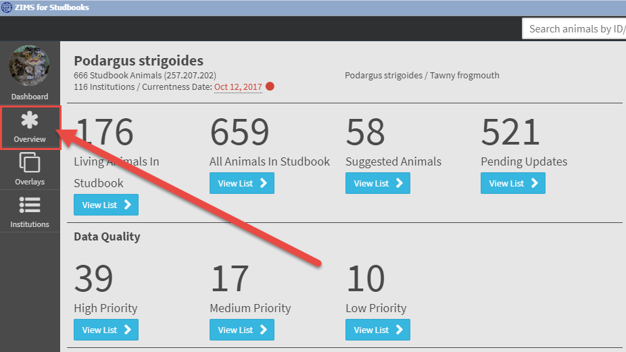
Studbook Overview
The Overview screen contains basic information about the studbook and features that impact the studbook data overall.
Overview includes: incubation/gestation periods, taxonomy, currentness date, assignments, and user defined fields.

Slide 3
Studbook Overview: Basic Information

Slide 4
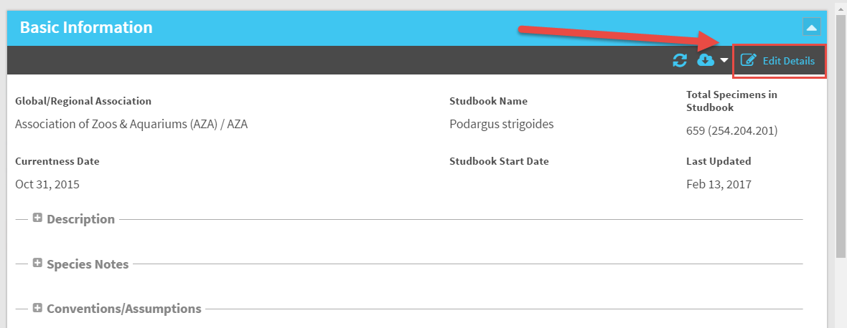
View/Edit Basic Information
To edit the overview of your Studbook select the Edit Details button in the Basic Information grid.

Slide 5
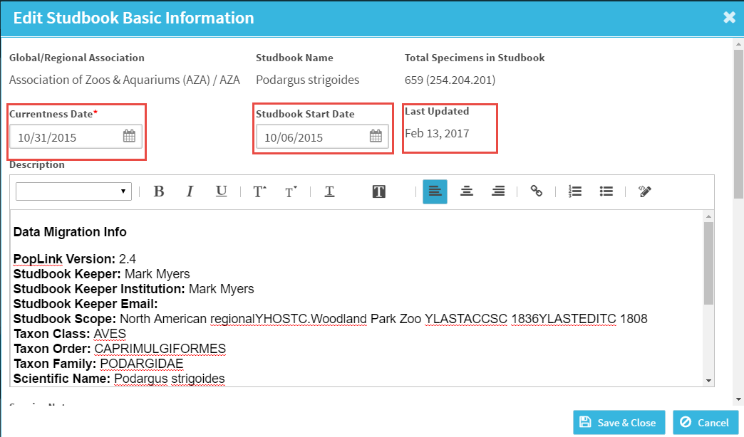
Basic Information Dates
Currentness Date: Entered by user, date the studbook was last fully updated – editable. Date entered here will impact the data quality check on the Dashboard.
Start Date: Date the studbook was started – editable.
Last Updated Date: Sourced directly from when the last animal was added, edited, deleted in the studbook. System calculated, cannot be edited.
Studbook Name: Can only be changed by the regional association.

Slide 6
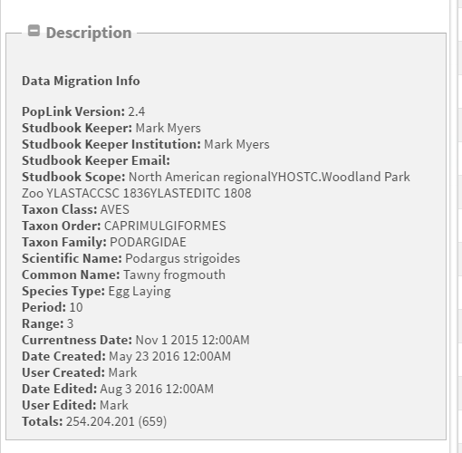
Studbook Description
Under the basic information screen there is the option to add a description to the studbook.
If the Studbook was migrated the description from the legacy studbook will populate here.
This information reflects the data at of the time of migration and does not automatically update.
If the Studbook is new the description will be blank.
This box is free text and information can be added/edited/deleted.

Slide 7
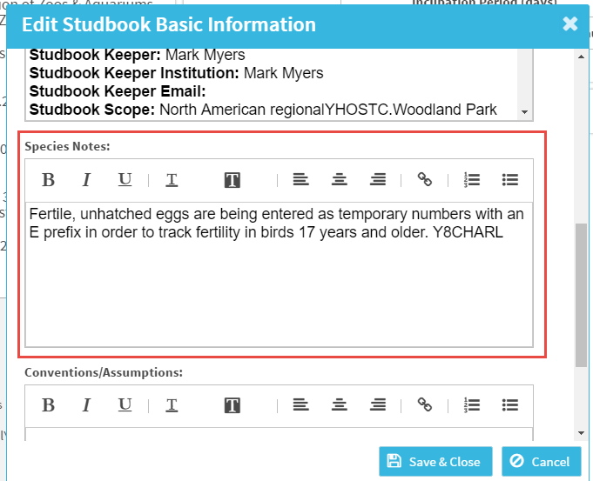
Studbook Species Notes
Under Basic Information is a box to enter Species notes. This is a free text box where you can add/edit notes specific to the species in the studbook.
Example: this Studbook is using a temporary numbering system to identify fertile eggs that did not hatch.
For migrated studbooks all the information in the legacy studbook under “Species Notes” will migrate to this box.

Slide 8
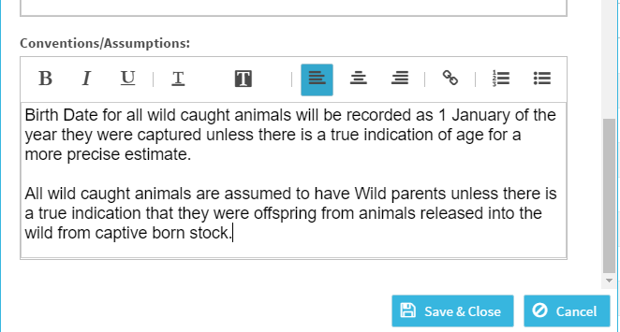
Studbook Conventions/Assumptions
Under Basic Information is a box to document any Conventions and Assumptions that you are following in your Studbook.
This box is intended to help split out species notes (notes about the species, biology, etc.) and conventions and assumptions maintained in the studbook.
Example: Studbook has noted how they handle some data regarding wild caught animals.

Slide 9
Studbook Overview: Taxonomy

Slide 10
View/Edit Studbook Taxonomy
Taxonomy Details Box: Located under the Studbook Overview. Allows users to view the taxonomy assigned to the Studbook.
Taxonomy can only be added or removed by the regional association sponsoring the studbook. Contact your regional association representative to have taxonomy for your studbook edited.
This grid can be downloaded to pdf or Excel.

Slide 11
View/Edit Gestation/Incubation Period
To edit the gestation or incubation period select Edit Details in the Taxonomy Details grid.
All studbooks will migrate with the same gestation/incubation period entered in the legacy studbook in minimum, average, and maximum boxes.
User can edit/delete as appropriate – Average is the only required field.
User can also edit which period you want to use for calculations.
Currently this number is being used to calculate an animal’s estimated conception date and several data quality checks.
Each taxonomy can have a different incubation gestation period.

Slide 12
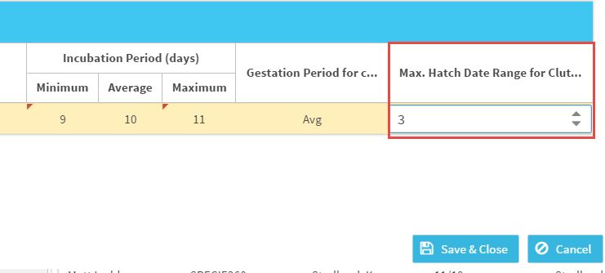
View/Edit Maximum Birth/Hatch Date Range
Taxonomy also where you set the maximum number of days between Births/Hatches for litters and clutches.
At this time, this is not being used for calculations in the studbook – but will be used for future reports and data quality tools

Slide 13
Studbook Overview: Assignments

Slide 14
View Studbook Assignments
View all the people who have been assigned access to the studbook under Assignments in the Studbook Overview:
Name/institution: Institution where user is located
Studbook Title: The user’s position with the studbook (Studbook Keeper, Coordinator, etc.)
Start Date/End Date: Date the users access to the studbook started or ended
Role: Role assigned to the user, this dictates their level of access to the studbook (edit, read-only, etc.)

Slide 15
Edit Studbook Assignments
At this time, only Regional Association Administrators can to add/remove assignments to the studbook.
Contact your Regional Association representative to request access to a studbook.

Slide 16
Studbook Overview: User Defined Fields

Slide 17
View User Defined Fields
All UDFs from legacy software will migrate to the studbook.
Using the “+” icon button you can Add new UDFs.
Double click on existing UDFs to edit.
UDFs must be defined in this location in the Overview Screen prior to entering the UDF for an individual animal.
UDF Name, created date, date created by display and list is sortable
Hover over notes icon on the left to view notes about the UDF without opening the record.

Slide 18
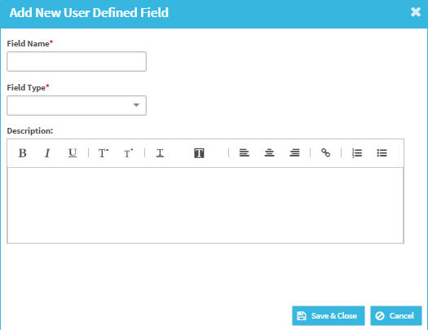
Add User Defined Field
Select “+” icon to add a new UDF
To add new UDF the following is required:
Field Name: Name of the UDF
Field Type: Two options
Combo Box: User defines the UDF values that display when adding a UDF to an animal. (highly recommended).
Text Field: There are no defined UDF values, the user can enter any text in the UDF value.
User cannot add UDFs with the same name and Field Type to Studbook.
Depending on the Field type chosen, the screen will change. Species360 highly recommends using the Combo Box option for standardization.

Slide 19
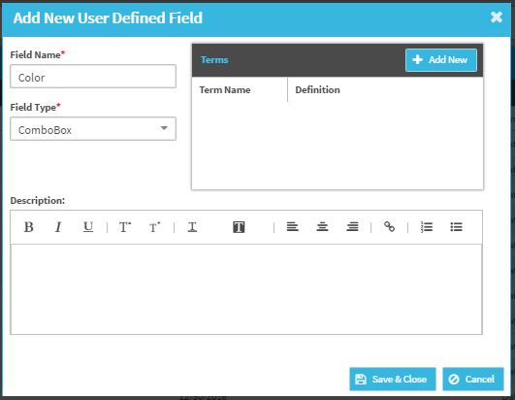
Add User Defined Fields
Combo Box: When user selects to add a UDF with a combo box, they must enter the terms they would like to display in the animal records for this UDF type.
User can define as many terms as needed by selecting the “add new button”
User cannot enter duplicate term types
Term Name is required
Term Definition: Optional but highly recommended. This allows the user to define the term so if the studbook passes hands the next user will understand how the UDFs were applied.

Slide 20
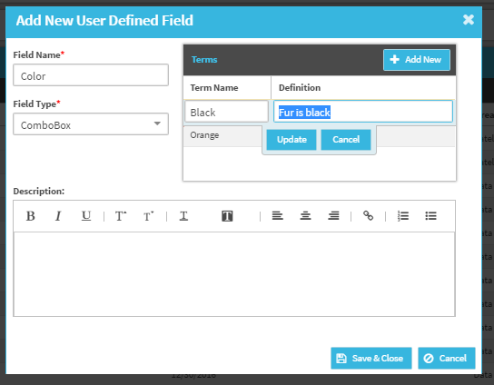
Add User Defined Fields
Combo Box Example:
UDF Name = Color
Field Type = Combo Box
Terms = Orange, Black, White, Tan, Brown
Definition = user can define what each term means
Description = user can enter additional notes about UDF overall.
Must select Update to save
All terms entered on this screen will be dropdown options when assigning the UDF “Color” to an animal in the studbook.
Adding more options for defining UDFs and notes, should make tracking of UDFs through time and easier as a studbook changes Studbook Keepers.

Slide 21
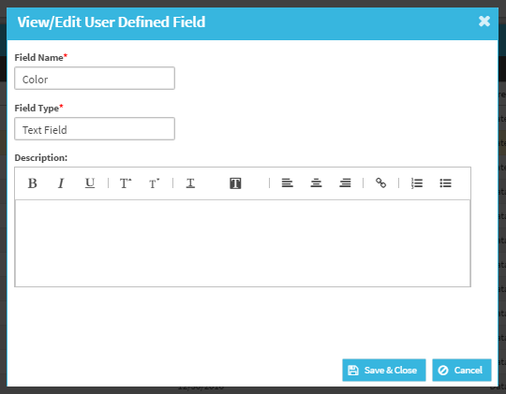
Add User Defined Fields
Text Field: When user selects to add a UDF as a text field, they do not need to define terms.
When entering a text field UDF for an animal, the user can enter any free text.
This can cause bad data entry and we recommend only using free text UDFs when absolutely necessary (example: tracking numbers that cannot be defined)
Text Field Example:
UDF Name = Color
Field Type = Text Field
No Terms or Description needed
User will be able to enter any text in the “Color” UDF in the animal’s records
Example: Orange, Green, Geren, Blue, Education…
System will not check for definition

Slide 22
Edit User Defined Fields
Select and double click on the UDF and the view/edit screen will open

Slide 23
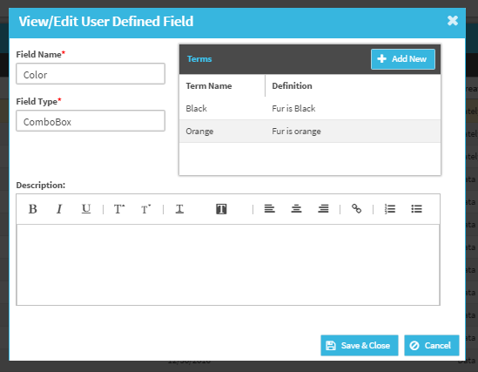
Edit User Defined Fields
Field Name: Editable – any change here changes the name throughout the system.
Field Type: Not editable. Once chosen this cannot be changed.
Term Name: Editable - User will receive a warning if they try to edit a Term Name.
If user chooses to edit the Term Name, all historic records in the studbook with the old term name will be changed to the new term name.
Description: Editable.

Slide 24
Delete User Defined Field
Delete is not an option at this time for a defined UDF. This is to assure that the historical UDFs remain intact. If a user deleted a UDF from this screen, it would remove all UDFs in the animal records for that UDF.
Please contact support@species360.org if there is a UDF you would like deleted from your studbook.

Slide 25
Studbook Overview: Studbook Number Settings

Slide 26
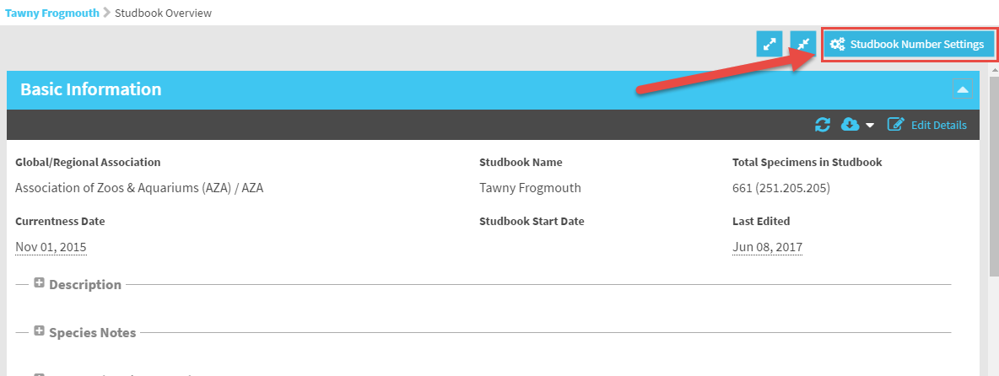
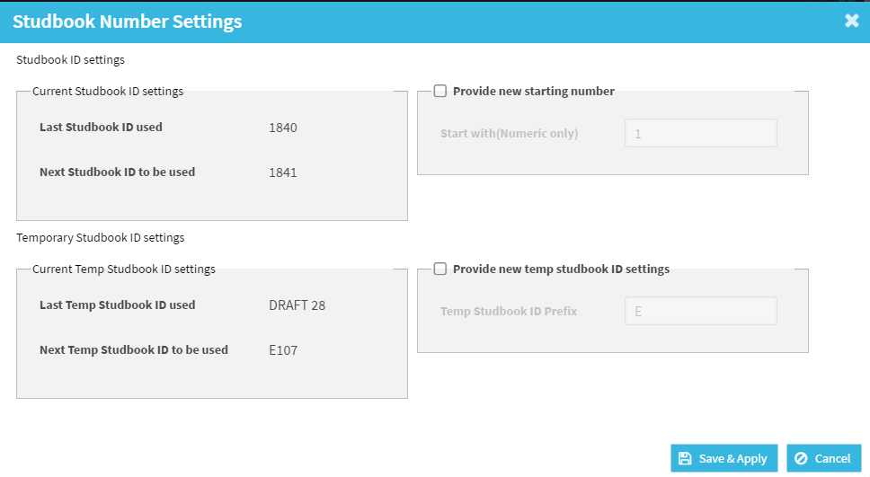
Studbook Number Settings
Select the Studbook Number Settings button to access the pop-up window for these settings.

Slide 27
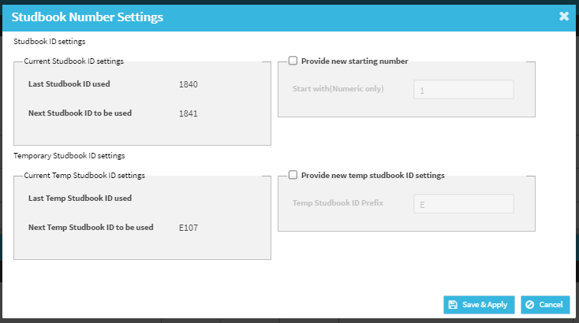
Studbook Number Settings
Last SB ID used will be calculated as follows:
Newly migrated studbook: Will display the highest studbook number in the studbook.
New studbook: Will be blank.
Studbook being managed in ZIMS: Last studbook number assigned to an animal in the studbook.
Next Studbook ID to be used is the one the system will automatically generate for the user when they add an animal.

Slide 28
Studbook Number Settings
User can choose to add new starting number by checking the “Provide new starting number” box
Number in this box must be numeric (no letters) and not previously used in the studbook
When user adds the next animal to the studbook it will use number entered here
It is recommended that users only use this box if they would like to skip a specific set of numbers in their studbook.

Slide 29
Studbook Number Settings
Last temporary SB ID used will be calculated as follows:
Newly migrated studbook: Will display the highest temporary number in the studbook.
New Studbook: Will be blank.
Studbook being managed in ZIMS: Last temporary Studbook ID assigned to an animal in the studbook.
Next Temporary Studbook ID to be used is the one the system will automatically generate for the user when they add an animal. If there are no temporary numbers in the studbook then this box will be empty at migration and the next temporary ID will be T1.

Slide 30
Studbook Number Settings
User can provide new temporary SB ID prefix.
Default is “T” but if migrated studbook already uses a prefix then that letter will be the default through migration.
System only allows one letter followed by numbers as a temporary ID
Example: cannot have APLHA123 only A123

Slide 31
Contact Support@species360.org with any questions
www.Species360.org

