Slide 1
Overlays

Slide 2
ZIMS Updates!
This PowerPoint is up-to-date as of: 17 January 2019
ZIMS is developed using an “agile” method
This means that new ZIMS updates are delivered every two weeks.
Use the link below to check if there have been any updates to this topic since the date above:
http://training.species360.org/updates/

Slide 3
What is an Overlay?
Studbook Overlays allow you to add assumptive data to your master (true) studbook to assist with analysis. The most common use is to record possible parents
for UND (undetermined) parents or limit to a single animal when MULT parents are listed. They allow you to answer the “What if?” questions you may have about your
studbook data.

Slide 4
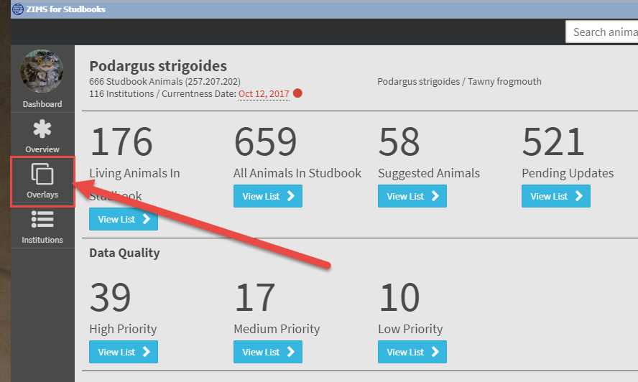
Creating an Overlay
To create or manage your overlays
select Overlays from the left hand
studbook dashboard (above) that
opens when your main dashboard
is open. Then select New Overlay
(below).

Slide 5
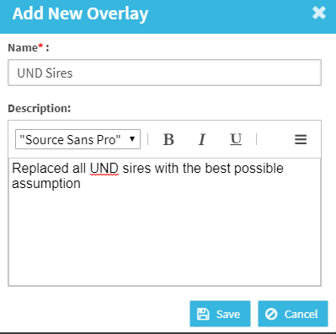
Name and Describe the Overlay
Because you may have multiple Overlays,
name the Overlay so you can identify it in
the list.
Add a description to indicate the types of changes you will be making within the overlay.
Overlays must have a unique name.

Slide 6
Managing the Overlay
From the Overlay list you can:
Edit overlay the name and description
Delete the Overlay: Removes the overlay from the studbook (cannot undo this action).
Copy the Overlay: Creates a duplicate of the selected overlay. Use this option if you want to start from previous overlay edits.
Apply the Overlay: Select this button to “turn on’ the overlay.

Slide 7
Opening the Overlay
If the Overlay is applied the arrow will change to a square. To work in the Overlay use the
breadcrumbs in the upper left to take you back to the studbook dashboard (top). The
dashboard in Overlay mode is much simplified and only displays Living Animals and All
Animals (bottom). Suggested Animals, Pending Updates, Data Quality and Studbook
Activity are not available in the dashboard in Overlay mode. Pending Updates will display
in the animal details but you will not be able to take action on them.

Slide 8
Finding the Records
When overlay is applied, there will be an orange banner at the top of all screens to remind the user overlay mode is on.
The first breadcrumb name changes to display the overlay name.
Because for this Overlay we are going to replace UND Sires in our living population
with our best assumption we have selected Living Animals in Studbook > View List >
Tools > Unknown Pedigree Report.

Slide 9
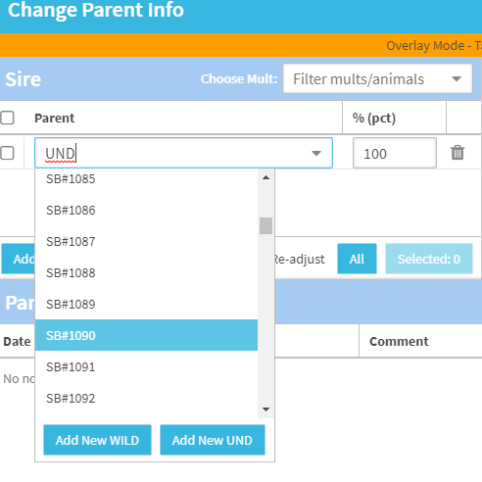
Edit Data
Editing in overlay mode works the same as in the master studbook.
Select the hyperlink to the record to start recording your Overlay data.
In Overlay mode you can make changes to Transactions, Parents, Sex and Notes and all other animal detail boxes are read only.
Here we have selected Change Parent Info.
When you Save you will receive a reminder that you are in Overlay mode and your changes will only be applied to that specific Overlay.

Slide 10
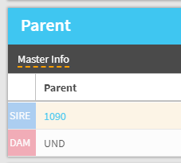
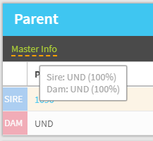
Viewing Edits
Once you have changed data, the top
of the grid will display Master Info (top).
Hovering over Master Info will let you
know what the original information was
(bottom).

Slide 11
Displaying Additions
If you add a new record instead of editing, the grid will display in light orange for
the overlay data. Notes you recorded on the data entry screens will display in the
Notes section in light orange.

Slide 12
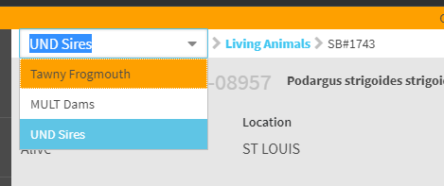
Multiple Overlays
When in Overlay mode you can use the breadcrumbs to get back to your master studbook or navigate to another Overlay should you have multiple
Overlays.
You will be kept in whatever record you were at the time that you selected to change Overlay views.

Slide 13
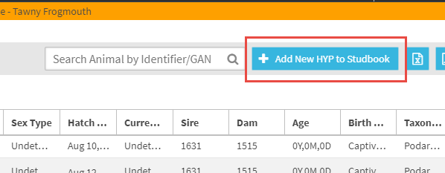
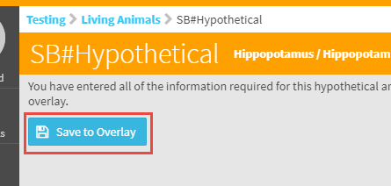
Hypothetical Animals
To create a new hypothetical animal record select the Add New HYP to Studbook from either Living Animals or All Animals (top). The requirements
are the same as adding a new animal into your true studbook and you must complete the Transactions, Parents, Taxonomy, Sex and Rearing fields. Once these are completed you will
have the option to save the new record into the Overlay (bottom). ZIMS will automatically assign it the next available Hypothetical SB#. A Hypothetical animal can be used as a Parent but it cannot be used as part of a MULT Parent. Hypothetical animals display as true studbook
animals in overlays unlike DRAFT
records in the true studbook that will not display.

Slide 14
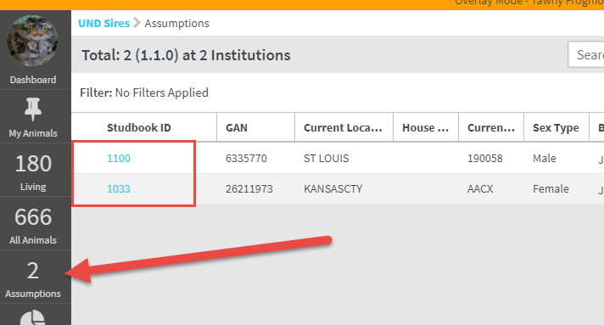
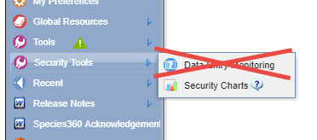
Finding the Edits/Additions
You can find any animals that
have been edited in the Overlay
by selecting Assumptions on
the left hand dashboard where
the number of assumptions will
display. One important thing to
note is that you can use Data Entry
Monitoring to roll back true
studbook data but you cannot use
it to roll back Overlay data. Although
you can Edit Master data you
cannot Delete it.

Slide 15
Contact Support@species360.org with any questions
www.Species360.org

