Slide 1
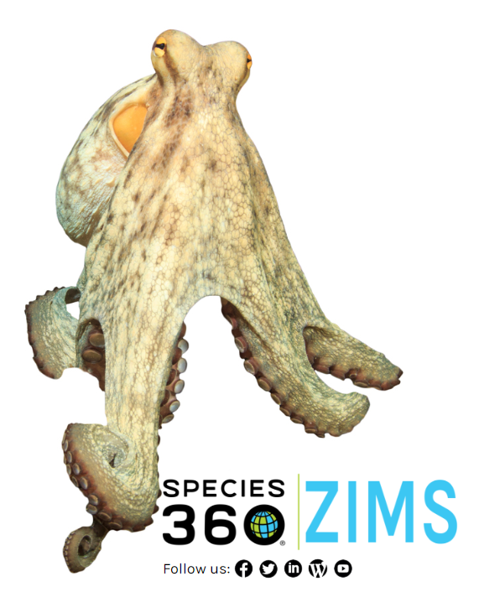
Introduction to ZIMS for non-ZIMS Using
Studbook Keepers
An Overview of ZIMS Concepts

Slide 2

Concept 1 – Internet based
ZIMS was created using six basic
concepts. The first concept is that
ZIMS is internet based which has
many positives over applications
that need to be installed. First, ZIMS
can be accessed from any computer
that has internet access. No more
vacations! This also makes support
easier as support staff can look
directly into your studbook records to
see what you see to help you. Also,
application updates are automatic so
everyone is working in the same version.
Being internet based allows instant
data updating with no submissions
required.

Slide 3

Concept 2 – Single Accession and Single Record
The second concept is that an animal or group is accessioned into ZIMS only once. As it moves from institution to institution “Visits” are created in the global
record, there are no additional accessions that need to be linked as animals move. A Global Accession Number (GAN) is
created by the ZIMS application. This GAN will never change even if the animal moves between institutions. The GAN ensures that the institution and the studbook keeper are talking about the same animal. Each facility still assigns a Local ID.
In the end there can be only one.

Slide 4

Concept 3 – Business Rules
Concept 3 is Business Rules. ZIMS
operates following Business Rules
to make sure the User, or the
application, doesn’t do anything
that is illogical. For example if you
have recorded a death of a late
term egg, then you cannot record
a hatch. These Rules were developed
by the programmers to ensure the
application functioned logically
technically and by animal Subject
Matter Experts to ensure the animal
data was logical.

Slide 5
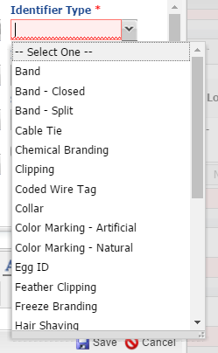
Concept 4 – Data Standards
Another concept was to restrict the use
of free text fields as they make searching
difficult because you may record different
verbiage than another institution. Data
Standards are pre-filled lists which
Users select from, so everyone selects
from the same terms. These lists were
developed by Subject Matter Experts
and fine tuned by User suggestions as
they find the need for additional terms.

Slide 6
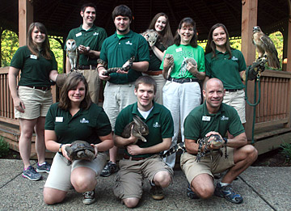
Concept 5 – Institution Management
The fifth concept is that ZIMS is
designed to help you manage
beyond your animal collection.
Your animals are the driving
force behind ZIMS but there
is functionality such as helping
you manage your Permits and
Transponder Inventory, Enclosures
and Life Supports, and your Staff
and Contacts.

Slide 7

Concept 6 – Role Based Access
Roles are the final concept driving ZIMS.
Roles dictate what access the User has
in the application. In other words, what keys you have to open what doors. Your Role is your access to whether you can Search/View, Edit, Add or Remove data. Husbandry Roles are usually assigned by the Local Administrator. Medical Roles are assigned by the Medical Admin. Studbook Roles are managed and assigned by your Regional Association.

Slide 8

The 6 Concepts of ZIMS
Internet Based
  Global sharing!
Single Record
Logical
Standardized
Entire Institution
Role Based Access

Slide 9
What does ZIMS Look Like?
You need to log in
  Species360 support will create a User Name and Password for you
  Regional Associations will assign the studbook
ZIMS is designed to be user friendly
There are desktop icons for quick access
There is a Start menu with actions you can take
What you see depends on what Role you have been assigned.
  If you only have access to ZIMS for Studbooks you will only see the Studbooks Module.

Slide 10
How Do ZIMS Husbandry Records Talk to ZIMS Studbook Records?
Suggested Animals
  New animals entered into ZIMS that match the studbook taxonomy will populate in the studbook to be added by the user.
Pending Updates
  Updates to animals already in the studbook will display when changes have been made in Husbandry.
Identifiers
  When entered into ZIMS identifiers will automatically be entered into the studbook.

Slide 11
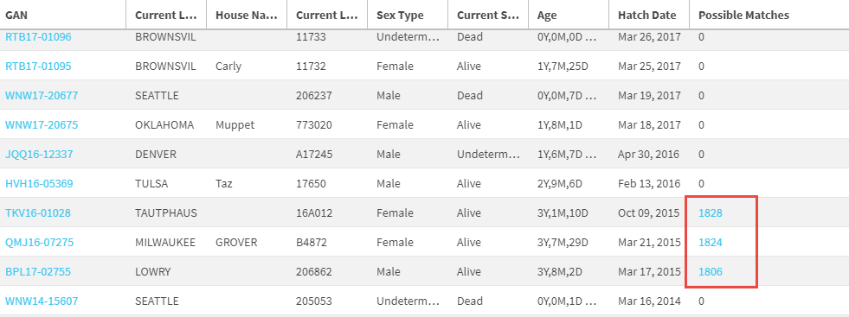
Suggested Animals
When new animals are entered into ZIMS, such as births and hatches or acquisitions
from non-ZIMS using facilities, they will automatically show up in your Suggested
Animals list. If ZIMS thinks there is a possible match for that animal already recorded
in the studbook, that studbook number will be displayed. You have the option to link
these records. Or, you can record as a new animal, manually link with a different
record or reject the entry.

Slide 12

Contact Support@species360.org with any questions
www.Species360.org

