Slide 1
Getting Started in ZIMS for Studbooks

Slide 2
ZIMS Updates!
This PowerPoint is up-to-date as of: 17 January 2019
ZIMS is developed using an “agile” method
This means that new ZIMS updates are delivered every two weeks.
Use the link below to check if there have been any updates to this topic since the date above:
http://training.species360.org/updates/

Slide 3
Getting Help
Every institution has a designated support person to assist them with ZIMS
This person will also be your contact for any questions/help with Studbook set up
You can contact them at support@Species360.org
Your email will automatically be directed to your designated support person
Species360 can only advise on ZIMS functionality, your Regional Association should be contacted for Best Practices

Slide 4
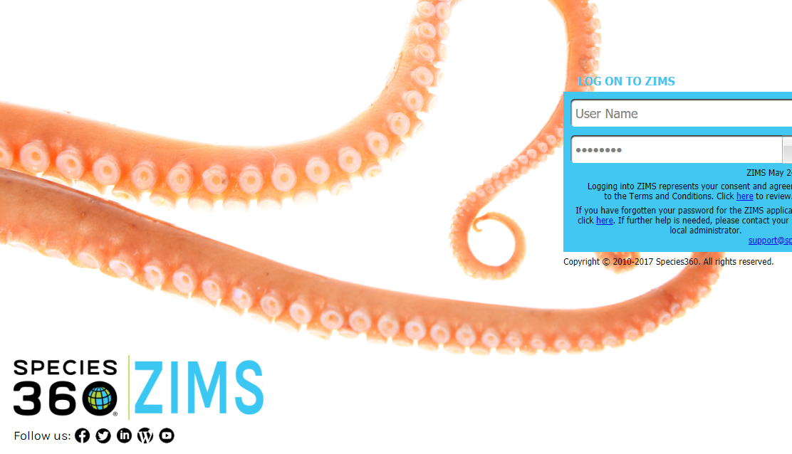
Logging Into ZIMS
To access ZIMS go to zims.species360.org.
To log in, you will need your User Name and Password.
These are created by your institution’s Local Admin. If you do not have a login, contact your Local Admin.
Once logged in, you can change both your Password and User Name under Start > My Preferences > Account Settings > Change Password.
Notes:
Updated

Slide 5
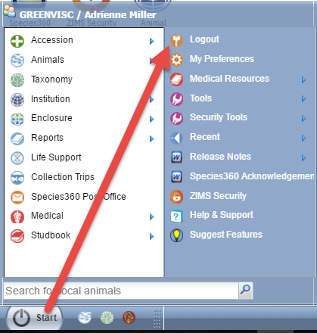
Logging Out
To keep your data secure
always remember to Logout of ZIMS.
The Logout option is found under the Start menu.
Notes:
Updated

Slide 6
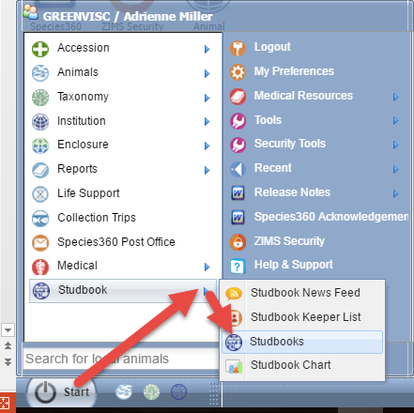
Finding Your Studbooks
Under the Start menu you will
find the Studbook options:
Studbook News Feed: Provides institutional updates for a taxonomy (Studbooks Module is replacing this feature)
Studbook Keeper List: Allows you to search or Studbook Keepers in ZIMS by various filters.
Studbooks: Is the main Studbooks Module where you will access your studbooks.
Studbook Chart: Graph of the number of Studbook Keeper Assignments in ZIMS.
As a shortcut, you can drag Studbooks icon to your desktop and access the module from there.
Notes:
Updated

Slide 7
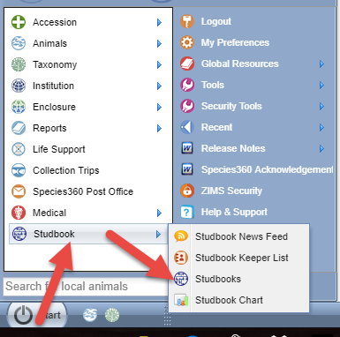
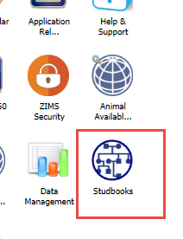
Opening Your Studbook
To open your Studbooks go to: Start>Studbook>Studbooks
You can drag this icon to the desktop for quick access to your Studbooks
Notes:
Updated

Slide 8
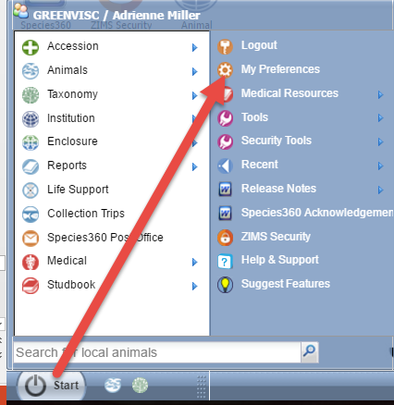
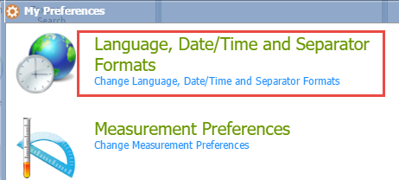
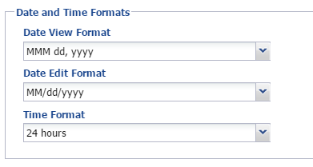
Date Type Customization
To customize your Date entries
go to Start>My Preferences>
Language, Date/Time and
Separator Formats. Complete
the Date fields as you wish them
to be. Remember to Save. These
will take effect the next time you
log in.

Slide 9
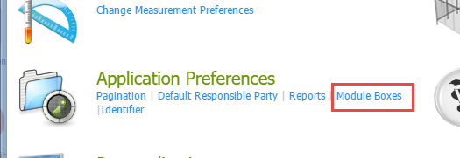
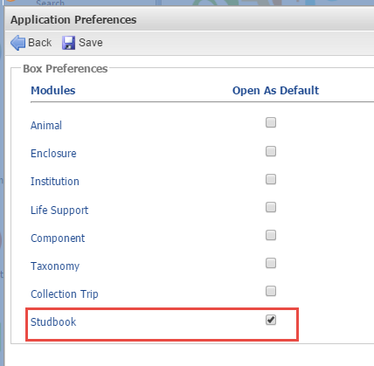
Expand Module Boxes
To set the event boxes as expanded by default follow the following steps:
In the main ZIMS screen, select My Preferences →Application
Preferences → check the box for studbooks→ save
Opening all event module boxes in Studbooks will expand all boxes automatically and user will not have to individually open the boxes.

Slide 10
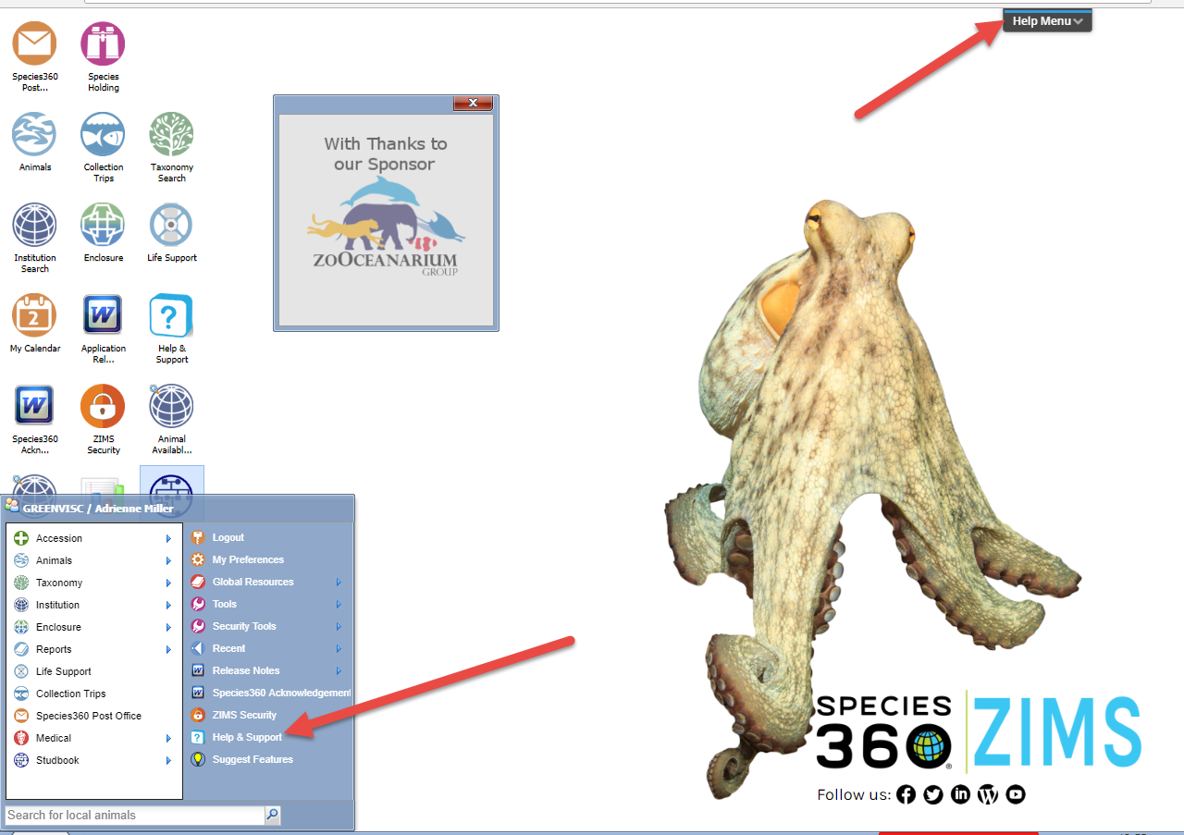
Getting Help
There are two places to
get help should you need it.
You can go to Start>Help &
Support or select the Help
Menu in the upper right
of all screens.

Slide 11
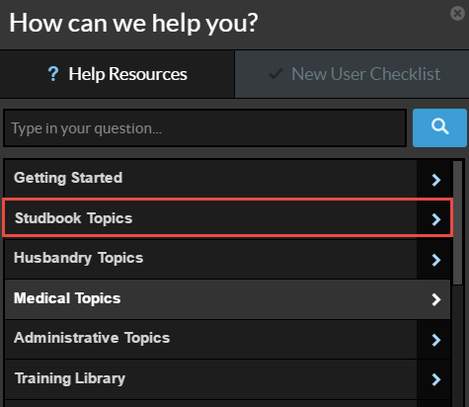
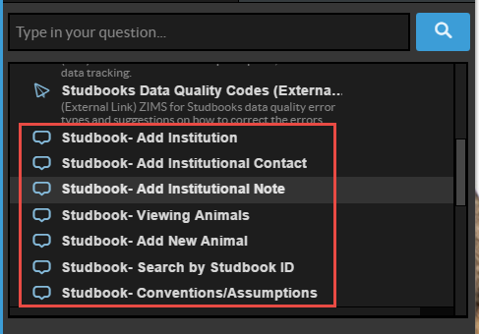
Getting Help
Select Studbook Topics or type in Studbooks in the question field. Some of these
Help topics are pdf documents or PowerPoints. The ones at the bottom are called
WalkMe. WalkMe will take you through the topic step by step in ZIMS to actually
enter the data.

Slide 12
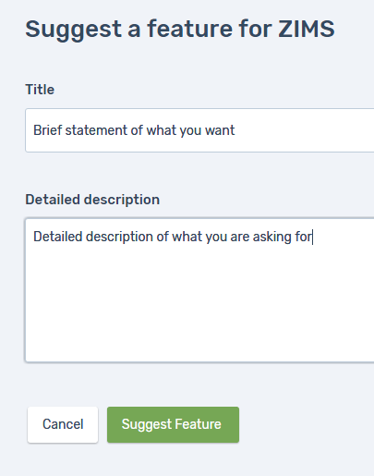
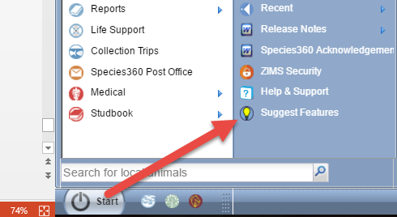
Suggest Features
Also under the Start menu you will find
Suggest Features. Selecting this opens an
application called Receptive. Receptive
gathers all the good ideas that ZIMS Users
have suggested for the application. If you
have an idea for ZIMS Studbooks this is
where you can submit it.

Slide 13
Contact Support@species360.org with any questions
www.Species360.org

