Slide 1
Data Entry Monitoring

Slide 2
ZIMS Updates!
This PowerPoint is up-to-date as of: 17 January 2019
ZIMS is developed using an “agile” method
This means that new ZIMS updates are delivered every two weeks.
Use the link below to check if there have been any updates to this topic since the date above:
http://training.species360.org/updates/

Slide 3
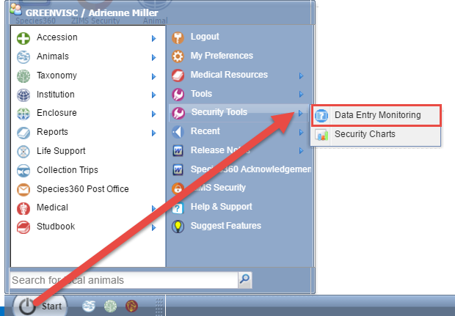
Data Entry Monitoring
You can monitor data entered
into your studbook over the past
three months using Data Entry
Monitoring. Data Entry Monitoring is different from Studbook Activity (found within the studbook) because DEM allows you to “roll back” any data that was incorrectly entered. Data Entry Monitoring is found under Start > Security Tools. Access to DEM is provided when the Regional Association assigns a Studbook Role to you. If you do not have access, they may need to update your role.

Slide 4
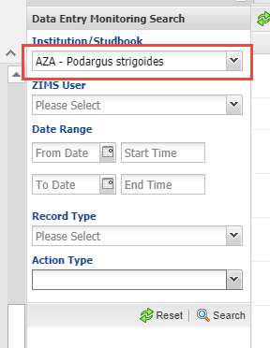
Select the Studbook
Use the expandable search box to get to DEM for your studbook. under the Institution/Studbook dropdown, any studbooks assigned to you will display. Select the appropriate studbook to continue.

Slide 5
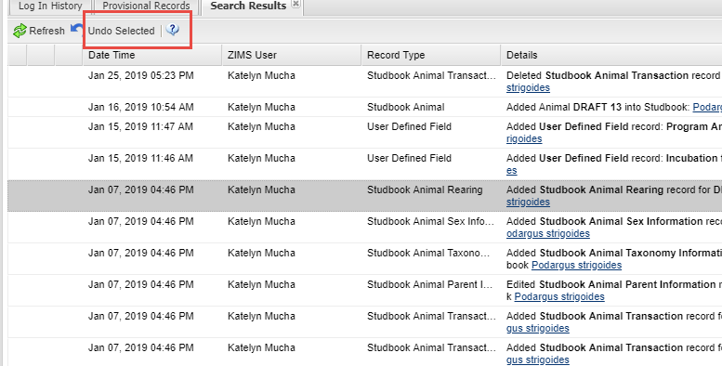
DEM - Roll Back
High-light the entry you
want removed (rolled
back) from the studbook.
Then select Undo Selected.
The data will be removed
in the record. DEM does not
track data that is rolled back
within the record.

Slide 6
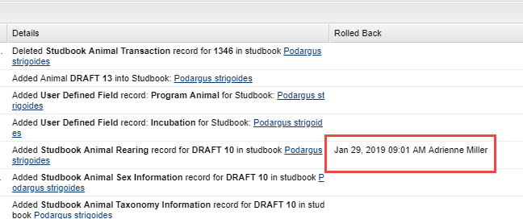
DEM – Roll Back
The details of the roll back
(date, time and person) will
display in the right hand
column. IMPORTANT: You
cannot undo a Rolled Back
record. If it was Rolled Back
you will need to re-enter the
data in the record.

Slide 7
Data That Cannot be Rolled Back
Pin/Unpin Studbooks and Records
Overlays – all data recorded
Dismiss Data Quality error

Slide 8
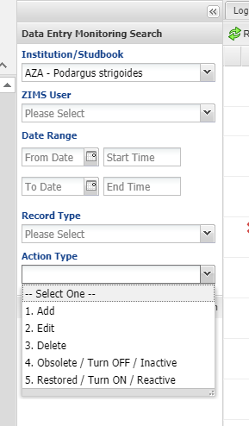
DEM – Search
Using the left hand expandable search box, you can filter your DEM search. This dropdown will only populate with the studbooks the studbook keeper has been assigned. Regional Association studbook admins have all studbooks at their association by default. If the user also has access to the data entry monitoring for their institution, it will appear alphabetically.
You can select a date range to filter by. You can also select the action type to narrow down results
Obsolete and Restored do not apply

Slide 9
Contact Support@species360.org with any questions
www.Species360.org

