Slide 1

Add Studbook Animal

Slide 2
Add Animal to Studbook
Draft Animal: Animal that is added to the studbook and does not currently have all the data entered that is required to save as a “true” studbook animal (animal with Studbook ID)
  All animals added to the studbook will be draft animals.
  User must enter all required fields and promotes them to permanent studbook animals.
  Draft animals are not used in any calculations or exports until they are permanent animals and do not show in the Animal List or Pending Updates List.
  Drafts will show in the Data Quality list and will display errors.
  User can navigate away from the draft animal at any point after creation and it will automatically save.
Two ways to add an animal to the studbook:
  Manually Add Animal: User chooses to add animal to the studbook with out any associated institutional records.
  Add Animal from Suggested List: User chooses to add animal to the studbook from the Suggested Animal List.
Notes:
All animals added to the SB are drafts

Slide 3
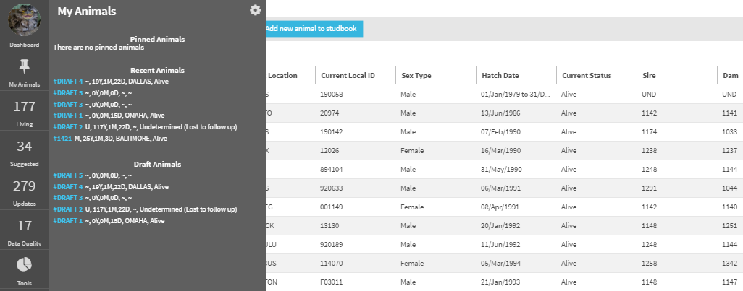
Draft Animals
User can access draft animal records from the “My Animal” button in the left hand navigation.
Selecting the Draft# will navigate to the draft animal detail screen.
Draft animals with errors will also display on the Data Quality List.

Slide 4
Add Draft Animal to Studbook
Manually Add Draft Animal:
Choose this option when you know the animal you want to add is not currently in the studbook or will not be entered into Husbandry.
  Example: Animal is at a non-ZIMS institution or the animal is at a ZIMS institution but has not been entered into the studbook by the institution
Select the “Add New Animal to Studbook” Button from the list screens
Draft animal will be created and no institution records will be in the animal detail.

Slide 5
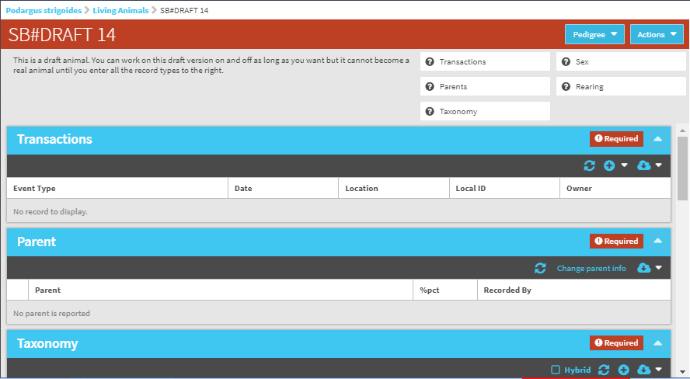
Manually Add New Animal
After you add an animal, a draft animal will be created
System assigns newly added animal a draft number – the numbers are created in sequence and numbers are not reused

Slide 6
Manually Add Draft Animal to Studbook
There are six mandatory fields needed when adding an animal to the studbook. User cannot save the animal with a permanent ID until all of these mandatory fields are completed.
At least one record must be reported in each field.

Slide 7
Manually Add Draft Animal to Studbook
User can click the boxes in the overview area to quickly open “add” screen for each required record type.
Or user can navigate to each box and add records as they would for typical animal records

Slide 8

Add Transactions for New Animal
In the transactions grid, user will be prompted to add a birth transaction. A birth transaction is required in ZIMS prior to adding any other record type.

Slide 9
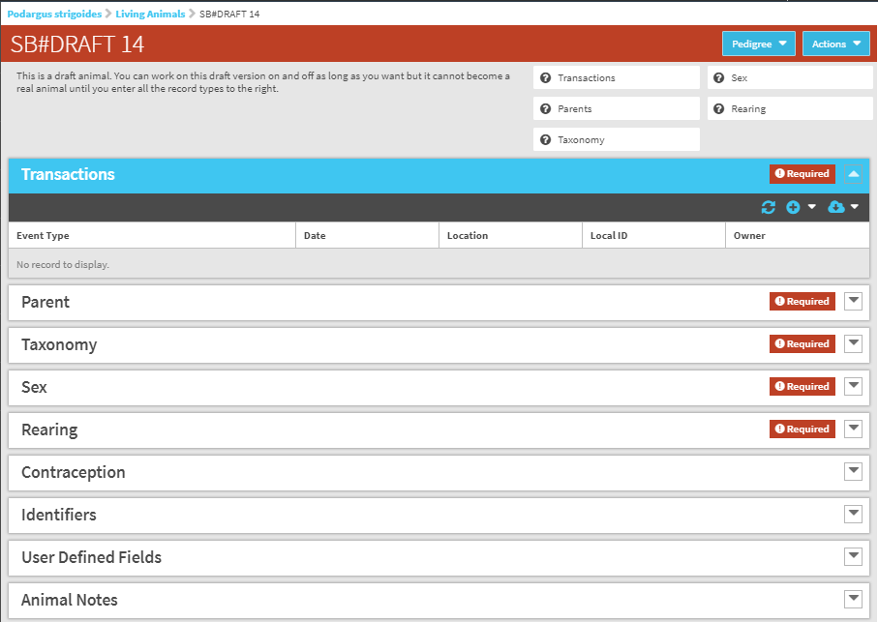
Manually Add Draft Animal to Studbook
Contraception, Identifiers, UDF, and Animal Notes can be entered by the user at this time as well, but are not required fields to save the draft animal to the studbook.
Notes:
You can enter as many records as you want at one time

Slide 10
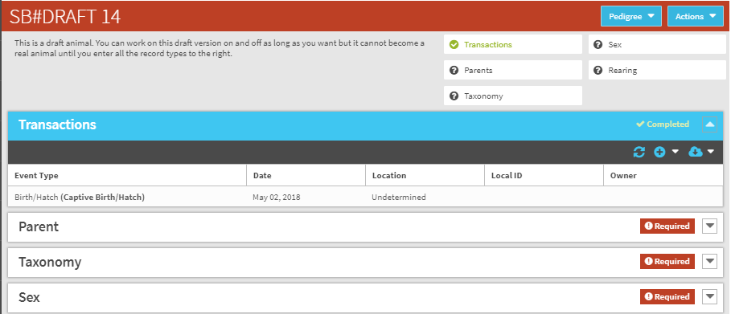
Manually Add Draft Animal to Studbook
As user enters records into required fields, the boxes on the top overview turn green with a check to indicate that record type has been completed.
The record level boxes will change to “completed” to indicate the record type has been completed.
Additional records for the animal can be added, but only one is required to save the animal to the studbook.

Slide 11
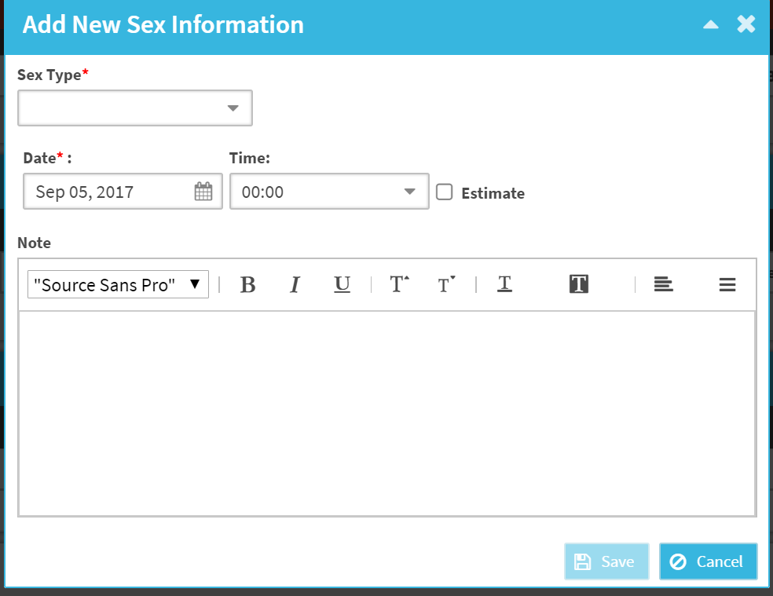
Manually Add Animal – Autopopulate Records
If user enters a birth transaction, then the birthdate will populate for all newly entered records in each record box.
If there is only one taxonomy managed in the studbook, then taxonomy will automatically load when adding the taxonomy record.

Slide 12
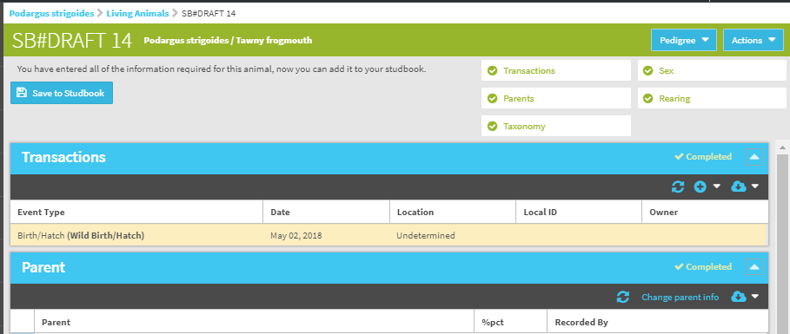
Manually Add Draft Animal to Studbook
Once the user enters at least one record of all of the required record boxes:
  All record types will turn green with check marks to indicate the animal can now be assigned a studbook ID.
  The “Save to Studbook” becomes available.
If the user deletes a record from a box, the “Save to Studbook” button is removed and user must re-enter record in order for the button to return.

Slide 13
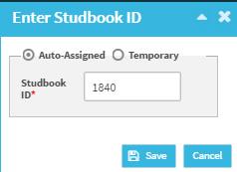
Manually Add Draft Animal to Studbook
When user selects “Save to Studbook” a pop-up opens where user can decide on the Studbook ID to assign to the animal.
  System will auto-assign the next permanent or temporary number in the sequence
  Or the user can manually enter the Studbook ID they choose.

Slide 14
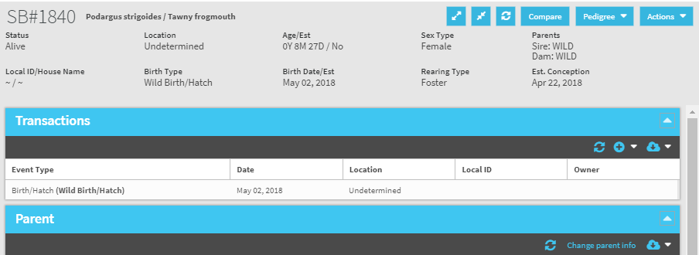
Manually Add Draft Animal to Studbook
When user selects the save button – the animal is saved to the studbook with a permanent ID or Temporary ID.
The animal is removed from the Draft Animal list in “My Animals” and now is under Recent Animals.
Animal is now visible in the animal lists and is included in calculations .
Can be linked to a Husbandry animal in the future.

Slide 15
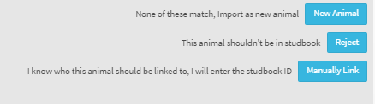
Add Draft Animal to Studbook
Add Draft Animal from Suggested List:
  Select “New Animal” in the Suggested Animal Overview Screen.
  Institutional records for that animal will be populated in the institution grid, user will then have to accept/reject or manually add records for the animal
    Choose this option when the animal in the Suggested list should be added to your studbook as a new animal and does not currently exist in your studbook
      Example: New birth or transfer from non-ZIMS institution

Slide 16
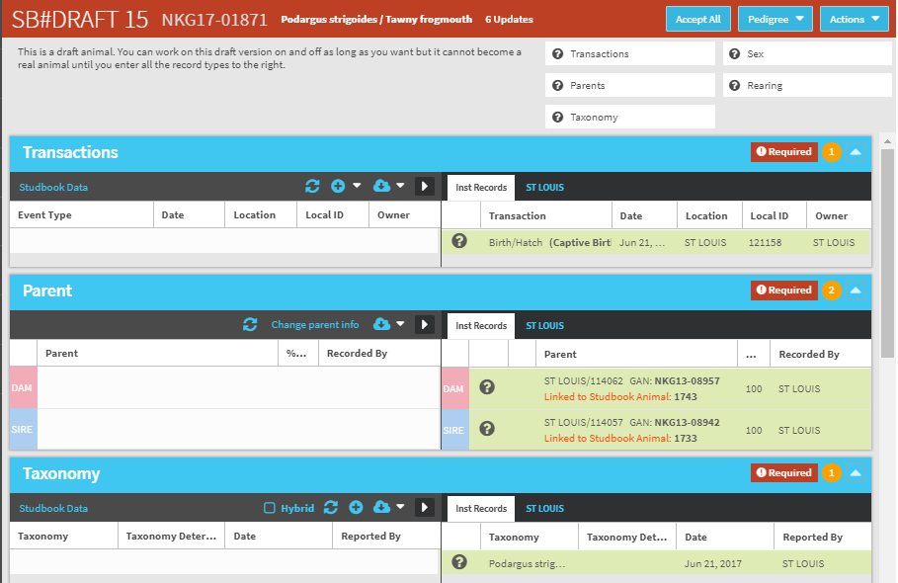
Add Animal from Suggested List
When added from the Suggested List, the animal is automatically linked to the Husbandry animal.
The institution records are visible and can be accepted into the draft animal record.

Slide 17
Add Animal from Suggested List
Once the draft animal is created from the Suggested Animal, the same rules apply as when the user manually adds animal, except the user has the option to accept the institutional records or add their own by selecting the “+” icon.

Slide 18
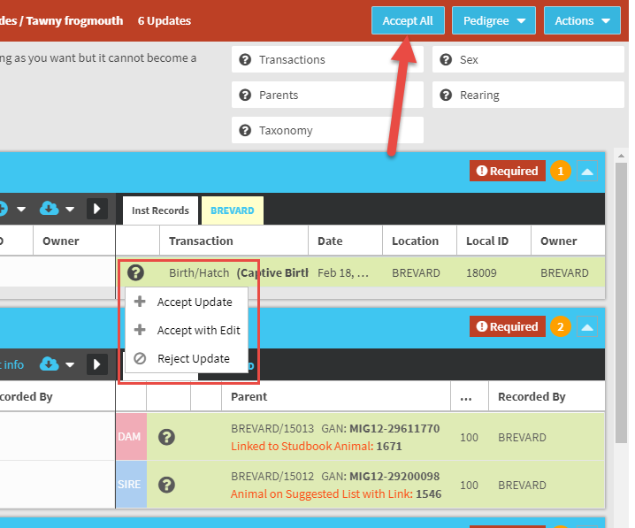
Accept All Institutional Records
Selecting the Accept All button accepts all institution records at once.
Only available for animals that have been at one institution.
Allows users to add new births quickly.
Animals that have been at multiple institutions will not have this option.
Records missing required fields will not be automatically accepted.

Slide 19
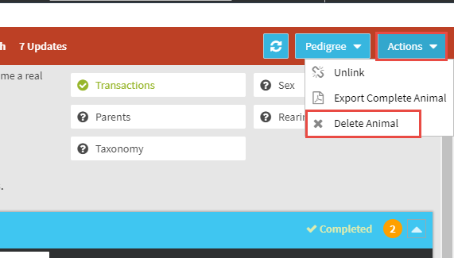
Delete
Should you wish to delete the Draft and not Save to Studbook, or Delete a complete animal record select
Delete Animal under the Actions menu.
Once deleted, the Draft# of the deleted animal will not be reused.
If the draft animal was linked to a Husbandry animal, the Husbandry animal will go back to the Suggested Animal List
A completed/finalized Studbook ID can be reused after animal’s record is deleted, but note, rolling back the deletion of an animal’s record from the data entry monitor will fail after you use the ID for a new animal
You cannot delete an animal record that is listed as a parent for another animal in your studbook. To delete the record first remove the parent from any other studbook records before attempting to Delete Animal.
It is not recommended to delete a record unless truly necessary. Use Labels/UDFs to record complicating factors instead of creating uncertainty into your studbook data.

Slide 20

Contact Support@species360.org with any questions
www.Species360.org

