Slide 1
Know Your Audience
Preparing for Regional Association Trainings

Slide 2
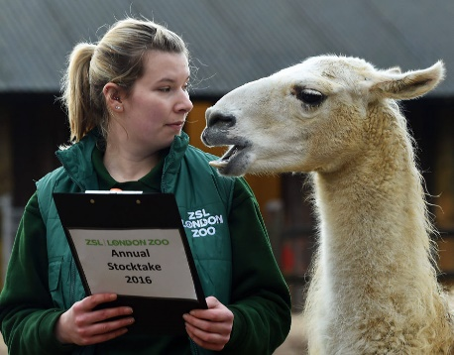
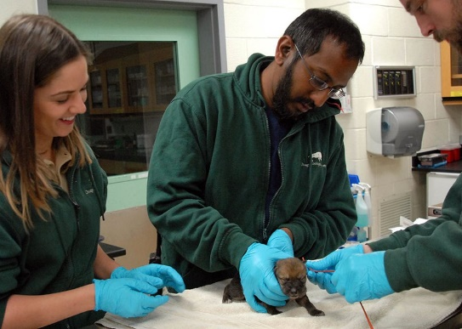
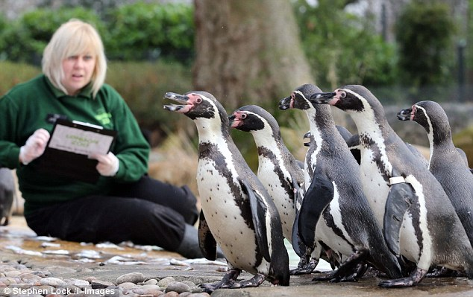
Your Audience Could Be…
Your audience may be very diverse unless you have
selected to present training for a specific Staff set.
They will be approaching ZIMS from very different
views and with different needs. Throw in varying
degrees of computer skills and ZIMS experience and
a successful session can be quite a challenge. We
have learned over the years though that a mixed
audience is often beneficial overall as they exchange
views and ideas with each other.

Slide 3
Pre-Training Survey
A pre-training survey can be very helpful
You will need to know:
Who they are
Where they are from
How involved their records keeping duties are
What ZIMS modules (husbandry, medical, studbook) they are familiar with
Number of years experience with using ZIMS
Special seating requirements
What they want to get out of the training
Plus other information as needed
Try to get this info at least 2 weeks prior to start

Slide 4
Instructor/Attendee Ratio
Presentation
PowerPoint, Lecture, Panel Discussion, etc.
1 instructor/10-30 attendees
Walk-throughs
Instructor led data entry, attendees follow along and enter their own data
2-3 instructors/10 attendees
Extra instructors needed to keep all up to speed
Exercises
Attendee data entry without instructor guidance
2-3 instructors/10 attendees

Slide 5
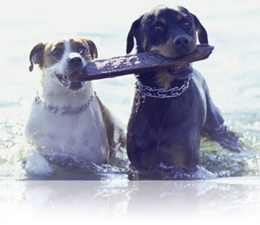
Advantages to Pairings
Fewer computers needed so fewer power sources needed
Fewer institutions to create
Fewer log ins to create
Working with a partner with
more or less ZIMS experience
can be beneficial to both
Working with a partner with
different job skills can be eye opening
New friendships can be made!

Slide 6
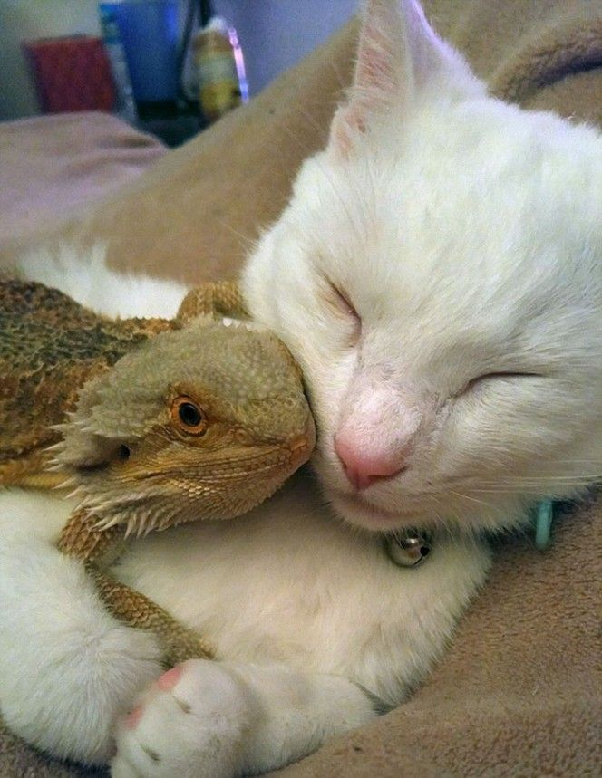
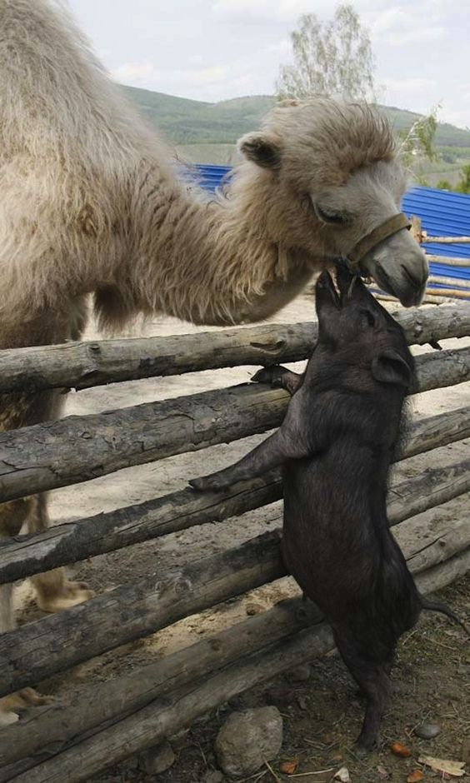
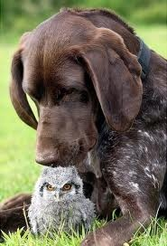
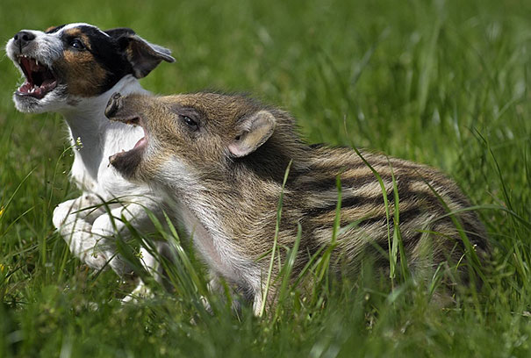
Diversity Works!
We have found that pairing attendees
with partners of differing skills and
job experience often works better than
pairing like to like. Pairing a Keeper with
a Veterinarian or a Curator with a Registrar
expands the horizons for both parties.
And pairing someone with little ZIMS
experience with someone who is an expert
in ZIMS, if the expert is willing to mentor,
can be very beneficial.

Slide 7
Any Questions?
On Knowing Your Audience

