Slide 1
Host & Application Preparation
Preparing for Regional Association Trainings

Slide 2
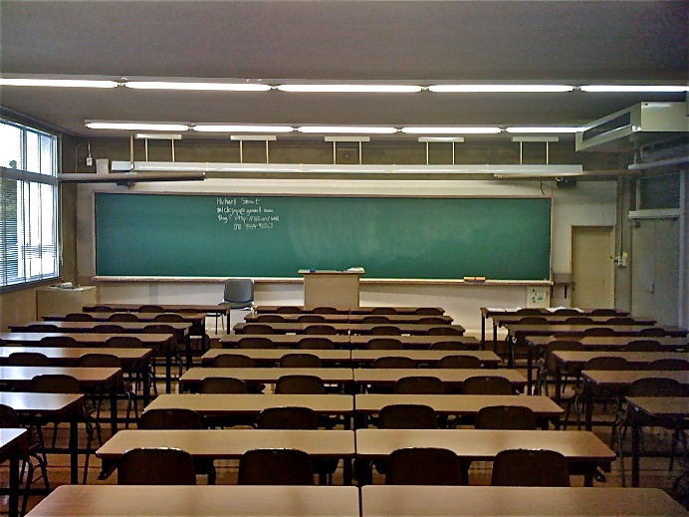

Successful Training is Dependent Upon Successful Preparation!
You can actually never be too
prepared for a training session.
Generally the better prepared
you are the better the session
will go. You need to make sure
that your physical space is ready,
and there are some preparations
you will need to do in the ZIMS
database itself. Being prepared
does not mean that nothing will
go wrong in your sessions. If that
happens, don’t panic and just go
with the flow.

Slide 3
Room Preparation
Is the space sufficient?
  Attendees should not be blocked in by their seating
  Is there room between computers and pairs for note taking, etc.
Is the set up good for all?
  Are there supports or anything blocking view of the instructor or screen
  Will some attendees be too far to either side to view the screen
Check the lighting
  Can the room be darkened enough to view the screen
  Do you know how to operate the lights
Room temperature
  Can it be manually controlled for comfort
  If not do you know who to contact to do so

Slide 4
Computer Sources
There are three ways that computers can be sourced. All have their upsides and downsides
Contract/Rental
  Upside = everyone should be working on the same hardware
  Downside = Cost
  Downside = You don’t always get want you want (see examples in What
  Can Go Wrong)
  Recommendation = If Species360 staff is going to be present we recommend some overlap time with the hardware installers to assure all is working properly
  Recommendation = Order at least one extra computer as a backup should one not work
Bring Your Own
  Upside = No cost
  Downside = Everyone is working on different hardware
  Downside = They don’t always bring what you ask them to
Loaned from company or Association
  Upside = No cost
  Downside = Often very outdated
Recommendation for All – Be VERY clear with the hardware requirements
  Wireless ability preferred
  Google Chrome installed (the recommended browser for ZIMS)
  No tablets

Slide 5
Computer Set Up
Need broadband internet access, >2 Mbs wired or wireless
  If wired make sure you have enough cables
  If wireless check the room for “dead” spots
  Confirm the speed
Make sure all log ins work (you do not have to have the actual computers they will be doing to check this)
Provide a second monitor and keyboard if possible
Check LCD projector for compatibility with the presentation computer
Make sure you have sufficient power cords for all computers and that they work and are secured safely

Slide 6
Application Set Up
Contact training@Species360.org with the number of institutions you will need to have created by them
  Remember if they are working in pairs they need to know only the number of pairs.
  It is a good idea to request a couple extra institutions. If you don’t use them, no problem, but if you get last minute sign ups you will be prepared
Let training@Species360.org know who at your Regional Association will be entering the Staff members and assigning Roles.

Slide 7
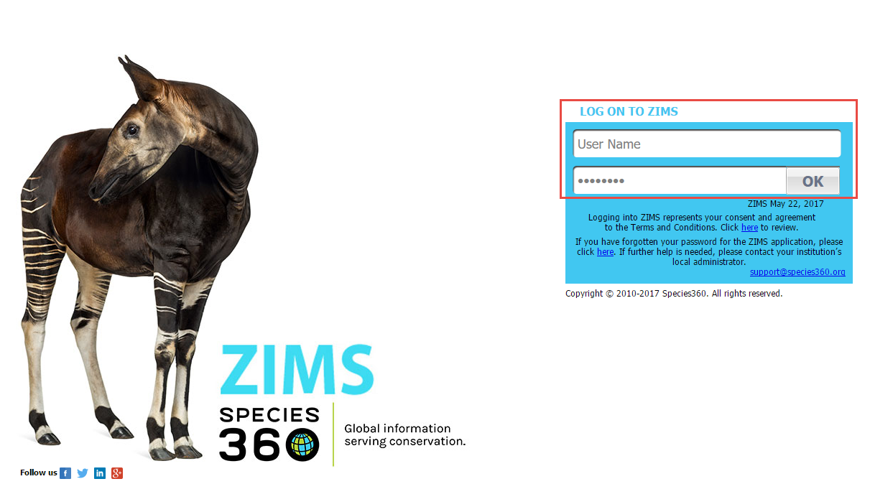
Log In
Once Species360 has created your log in information
you will be able to access ZIMS. Log in with the User
Name and Password that you were given. You can
change your Password by going to Start > My
Preferences > Account Settings > Change Password.

Slide 8
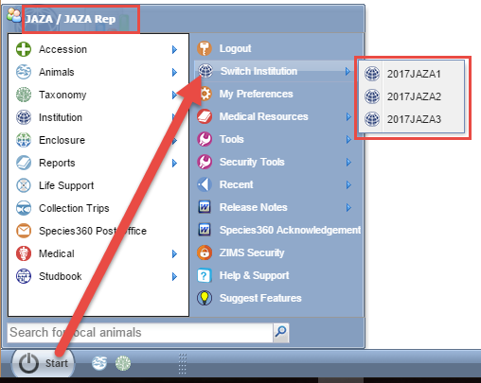
Switch Institution
Once Species360 has created
the desired number of
institutions you will be able
to easily move between
them to create your Staff and
assign them Roles. Go to
Start > Switch Institution
and select the appropriate
institution that you want to
be in. For this PowerPoint
we are using the Japanese
Association of Zoos and
Aquariums (JAZA) for our
examples. Species360 has
created 3 Child institutions
under the umbrella of JAZA.
You can tell what institution
you are in by looking at the
upper left hand corner.

Slide 9
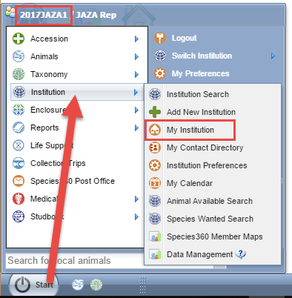
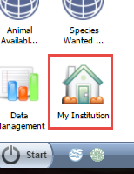
My Institution
We have selected to go into
2017JAZA1 institution. Go to Start
and confirm that you are in the
correct Child institution as
displayed in the upper left hand
Corner. Go to Institution > My
Institution. If you want, you can
drag this to your desktop for instant
access later.

Slide 10
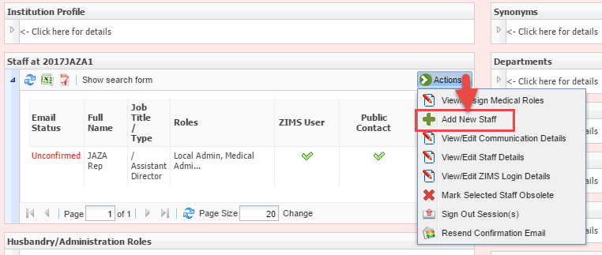
Staff List
In the Staff listing you will see that you are already there because when
Species360 created the institution they assigned the Staff member
you told them to as their Local Admin. Select Actions > Add New Staff.

Slide 11
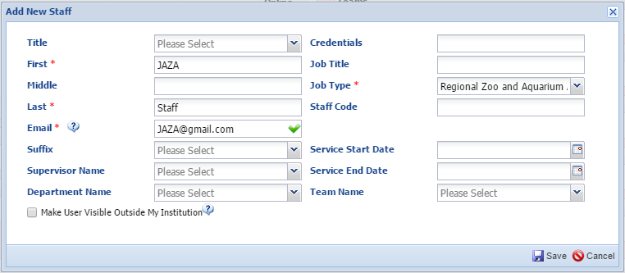
Add New Staff
Complete at least the mandatory fields (red asterisk). A unique and true email will need
to be entered for each Staff member. If these were actual Users you would also want to
complete the non-mandatory fields and possibly check the box to make them visible
outside your institution. After you Save you will receive a message that a confirmation
email will be sent. You cannot log into ZIMS until you have confirmed your email.

Slide 12
An Email Trick
If you are using actual names for your Staff you can use their email addresses and they will receive the confirmation email
If you are making up fictitious Staff there is a trick to creating multiple gmail accounts that all point to one actual account. This means that you will receive the confirmation email.
  Create the master account first. EXAMPLE: JAZAEmail@gmail.com
  When you are recording the emails for your staff members use that email name followed by a “+” and additional characters. EXAMPLE JAZAEmail+JAZA1@gmail.com and JAZAEmail+JAZA2@gmail.com and so on
  The email confirmation for all will be sent to you to confirm

Slide 13
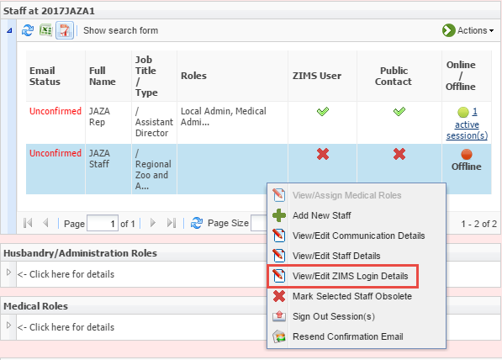
Assigning Husbandry Role
You will now need to
assign the Staff member
ZIMS Roles. Highlight
the name and either right
click or go to the Actions
button. The same options
will appear either way.
Select the View/Edit ZIMS
Login Details option.

Slide 14
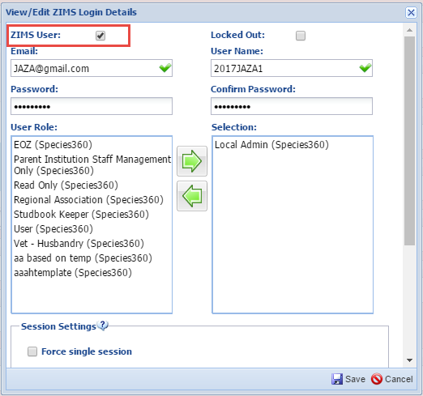
Assigning Husbandry Role
You will need to check the
ZIMS User box to activate
the screen. The email you
previously entered will prefill.
The User Name must be
unique and cannot be edited.
To keep it simple we suggest
using the name of the institution,
in this case 2017JAZA1. The
Passwords can be the same for
all Staff. We suggest to keep it
simple and use PASSWORD1.
Select the Local Admin
(Species360) Role from the left
side and move it to the right side.
Select Save.

Slide 15
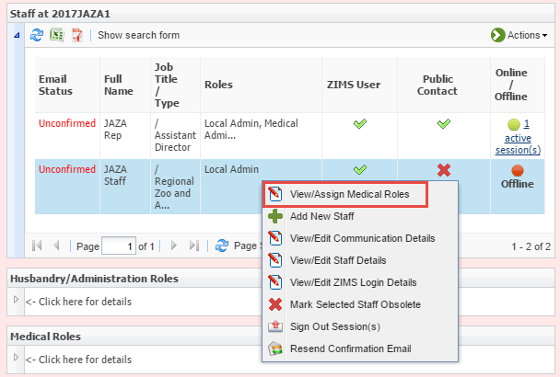
Assigning Medical Role
You then want to assign
a Medical Role. Because
the Staff member has a
Husbandry Role assigned,
the View/Assign Medical
Roles option is now
activated for selection.

Slide 16
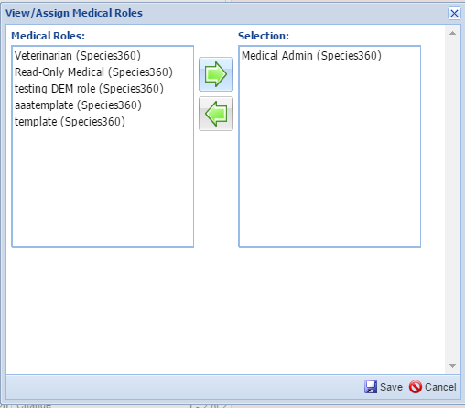
Assigning Medical Role
The Medical Role assignment
only requires you to select
the Role. The User Name,
Email address and Password
are all pulled from the
Husbandry Role previously
recorded. If you want to add
another Staff person repeat
these steps. When you are
done go to the Start menu
and switch to the next
Child Institution.

Slide 17

What Could Possibly Go Wrong?
Computers
  Rented computers all had viruses
  No power cords were available
  Wireless cards needed to be swapped out

Slide 18

What Could Possibly Go Wrong?
Attendee Issues
  Did not know the password to open the borrowed computer
  Brought tablet (not yet fully compatible with ZIMS
  Forgot their power cable
  Had no admin privileges (could not access wireless connections or websites)
  Had limitations on software installation

Slide 19
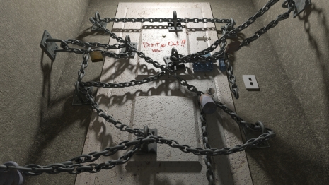
What Could Possibly Go Wrong?
Infrastructure
  Fire alarm went off during session
  Internet was lost
  Electricity was lost
  Room was locked and no one had access
  Room was in use for another meeting

Slide 20
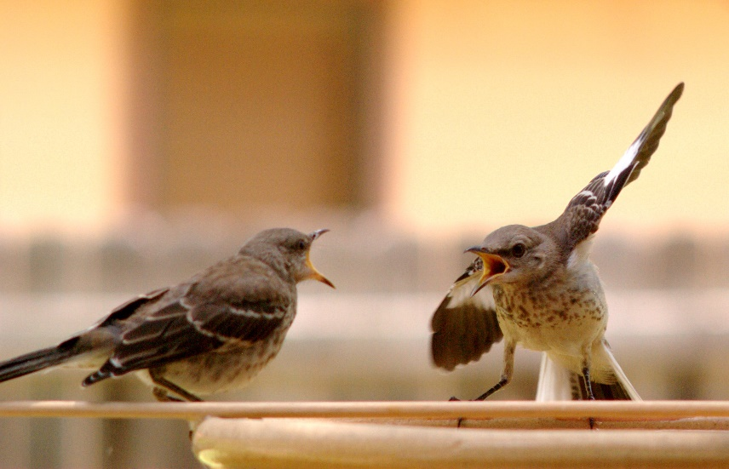
What Could Possibly Go Wrong?
Presentations
  Attendee disagreed with instructor
  Instructors disagreed with each other
  Partners did not work well together
  PowerPoint slides got out of order

Slide 21
Any Questions?
On Host and Application Preparation

