Slide 1
Studbook Keeper News!
Keeping Studbook Keepers Up-to-date with the latest News Flashes!

Slide 2
ZIMS Updates!
This PowerPoint is up-to-date as of:
November 15th 2019
ZIMS is developed in an “agile” method
This means that it is updated every two weeks, sometimes with additional releases in between!
Use the link below to see if there have been any updates to this topic since the date above:
http://training.species360.org/updates/

Slide 3
What is Studbook News Feed?
Studbook News allows studbook keepers to easily see data entered into the ZIMS Husbandry module that may not yet be reflected in their studbook
This could be current data, or historical catch up
Studbook Keepers no longer have to rely on ZIMS institutions responding to periodic questionnaires to provide updated data on their species of interest

Slide 4
Important Note!
Studbook News should be used by Studbook Keepers who have not yet migrated their studbook into ZIMS
Once migrated, Pending Updates will take the place of Studbook News

Slide 5
Why Does it Matter?
Many studbooks are a few years behind in events
Impacts management recommendations, especially for species with short generation periods
Many breeding recommendations are relying on outdated information
Studbook Keeper News helps the Studbook Keeper get current quickly

Slide 6
Historical Data
Also allows checking for historical data on their species
More institutions are joining Species360 and incorporating their data, some which may be quite old, into the Species360 database
Studbook Keeper News allows studbook keepers to close some missing gaps and solve pedigree mysteries

Slide 7
How do Studbook Keepers get Studbook News?
Institutions
  Need to give their staff members who are Studbook Keepers access to ZIMS by making them a ZIMS User and providing login status. We recommend a Read Only or Eye on ZIMS Role.
Regional Associations –
  Need to assign the relevant studbook to the Studbook Keeper
Studbook Keeper signs into ZIMS and see the Studbook Keeper News!

Slide 8
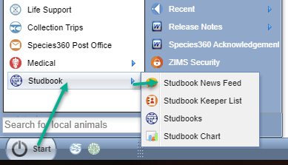
How do You See Studbook News Feed?
To see the Studbook News Feed go to Start > Studbook > Studbook News Feed

Slide 9
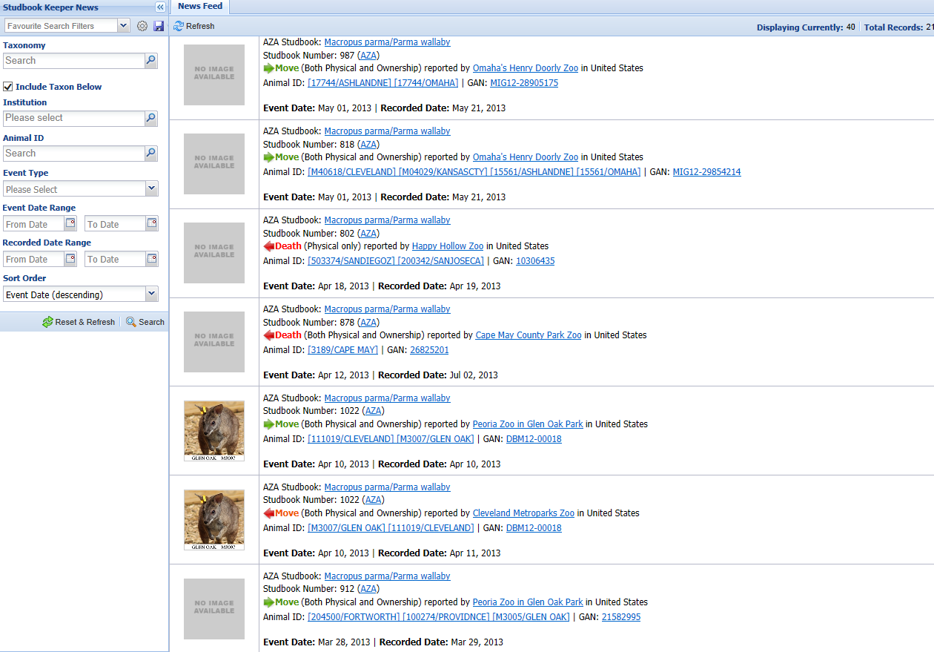
What will Studbook Keepers See?
You can filter what is displayed
by using the left hand Search
box. The species, institutions
and Animal ID/GAN are all
hyperlinks. Incoming transactions
are noted with a green arrow,
outgoing transactions are noted
with a red arrow.

Slide 10
Filtering What is Displayed
Taxonomy
  If you have multiple Studbooks
Institution
  You can review activity for a single institution
Animal ID
  You can review activity for a single animal
Event Type
  You can filter by Births, Deaths and Moves
Event Date Range
  When the event occurred
  Useful for recent activity
Recorded Date Range
  When the event was recorded
  Useful for catching historical activity that may have recently been entered
Sort Order
  Can sort by Event or Recorded Date, ascending or descending

Slide 11
All the news that’s fit to print!
Studbook Keeper News

