Slide 1
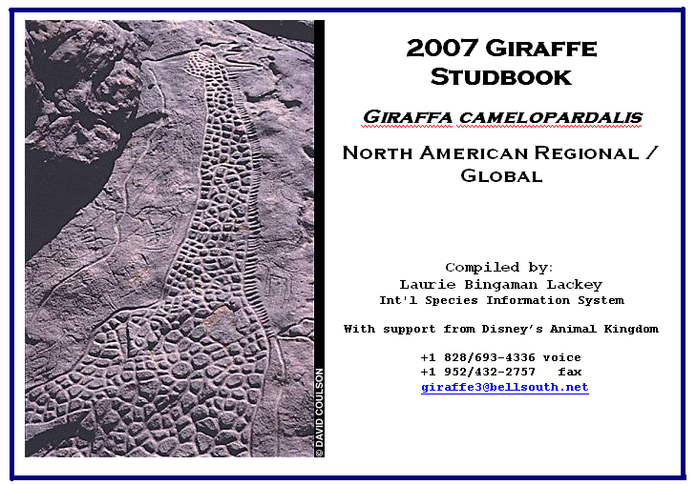
Studbook Databases
Development and
Maintenance

Slide 2
ZIMS Updates!
This PowerPoint is up-to-date as of:
November 12th 2018
ZIMS is developed in an “agile” method
This means that it is updated every two weeks, sometimes with additional releases in between!
Use the link below to see if there have been any updates to this topic since the date above:
http://training.species360.org/updates/

Slide 3
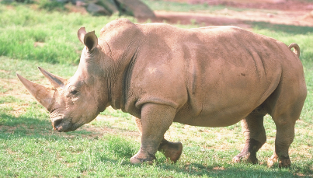

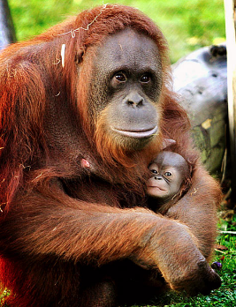
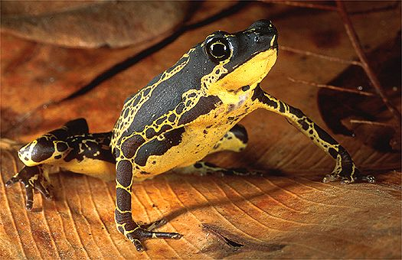
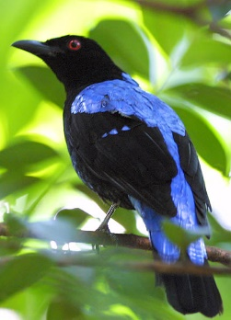

Studbook: Species Database
Studbooks:
One Species, Many Facilities
Institutional Records:
One Facility, Many Species

Slide 4
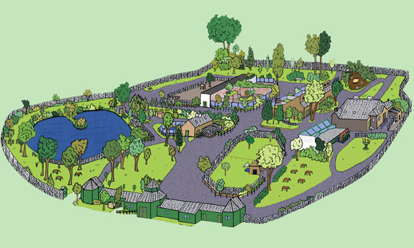
Why have studbooks ?
Zoos have data for their animals, isn’t that enough information?

Slide 5
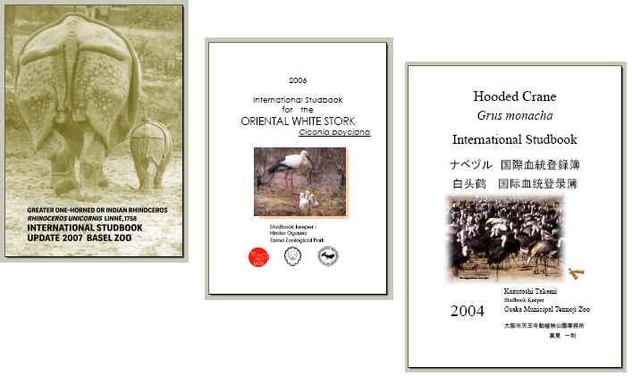
Studbook: Benefits
Data is easily available to all zoos

Slide 6
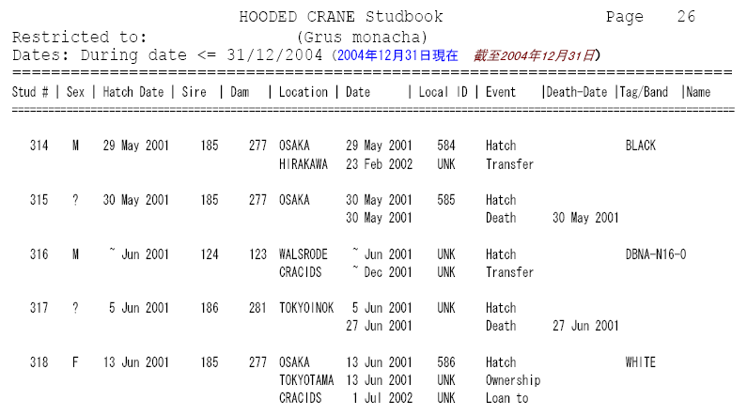
Studbook: Benefits
Data is easily available to all zoos

Slide 7
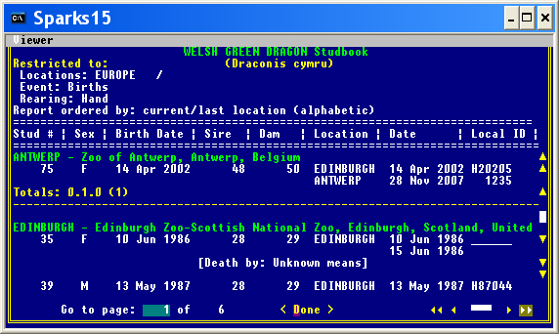
Studbook: Benefits
Allows data to be sorted and filtered

Slide 8
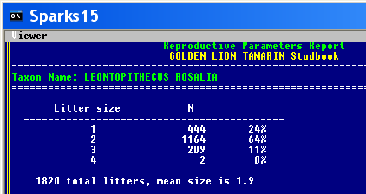
Studbook: Benefits
Collected data allows population-level analysis, with adequate sample sizes

Slide 9
Studbook: Benefits
Can detect population trends related to husbandry and animal health
The giraffe studbook keeper noticed that male giraffes were dying from blocked urethras and burst bladders. No single zoo had more than one death, but more than 20 males had died.
There is now a research programme investigating diets and other possible causes of this major cause of death for male giraffe.
Studbook keepers can notice trends that single institutions cannot.

Slide 10
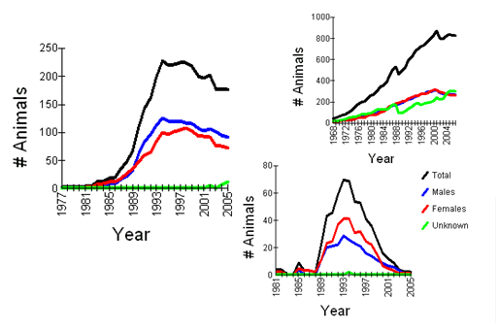
Studbook: Benefits
Can analyze demographic rates

Slide 11
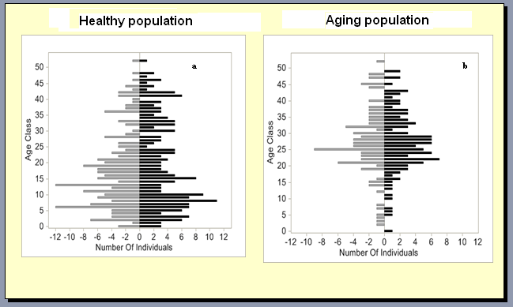
Studbook: Benefits
Can evaluate population structure

Slide 12
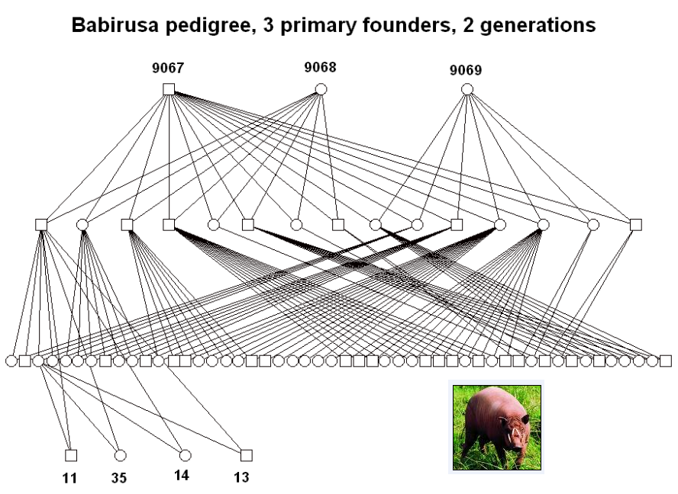
Studbook: Benefits
Can determine relatedness among individuals

Slide 13
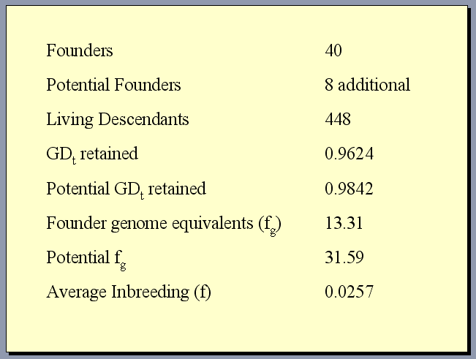
Studbook: Benefits
Necessary for genetic management

Slide 14
Studbook: Contents
Core Information:
Origin (birth/capture), sex, parent IDs, rearing
Life Events:
Transfers, loans, management plans, death
Special Data:
Identifiers – tags, tattoos, house names
Notes on collection, behavior, reproduction
Causes of death, museum information
User Defined Fields:
Taxonomy, management, research, etc

Slide 15
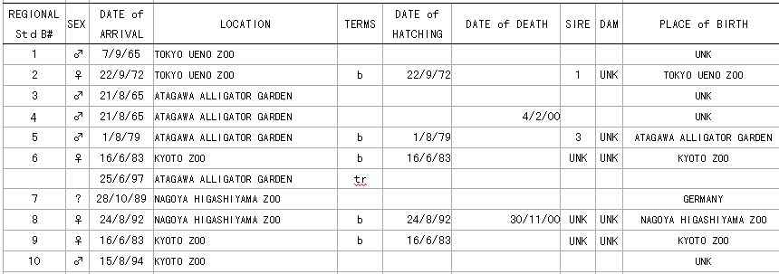
Studbooks have been kept in Word and Excel and other formats.

Slide 16
Studbook format:
There are now almost 1400 studbooks worldwide using the Sparks format. This allows easier analysis of the data with standard software.

Slide 17
Studbook Keeper: Tasks
Data collection from institutions (all current and historical specimens)
Data entry into SPARKS
Data assumptions and investigation
Data validation and reconciliation
Studbook publication and distribution
Updating studbook data
  And repeat every year forever…

Slide 18
Data Collection Sources
Species360 institutional data –
>3 million animals from 911 institutions in 86 countries
Pre-existing international studbook
Data from all holding institutions (current and historical)

Slide 19
Data Collection Sources
ARKS Taxon and Specimen Reports from individual zoos
Other possibilities: Keeper notes and memories, museum records, newspaper articles with pictures of new arrivals or cute baby animals
Soon: ZIMS- integrated database (animal records, veterinary records, studbooks)

Slide 20
Data Entry
Species360 compilation of available data
Careful hand entry of additional information
Standardization
(Species360 mnemonics, guidelines for data entry)
Look for links between “pieces” of specimens (importance of unique identifiers)
Date estimation (time period, mid-points)
Document all assumptions
Assign permanent studbook numbers

Slide 21
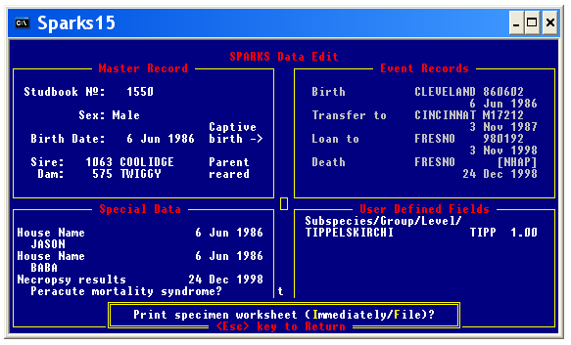
Species360 Single Population Analysis & Record Keeping System

Slide 22
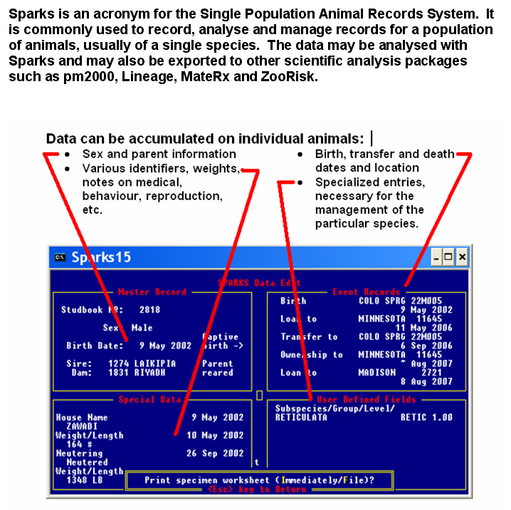

Slide 23
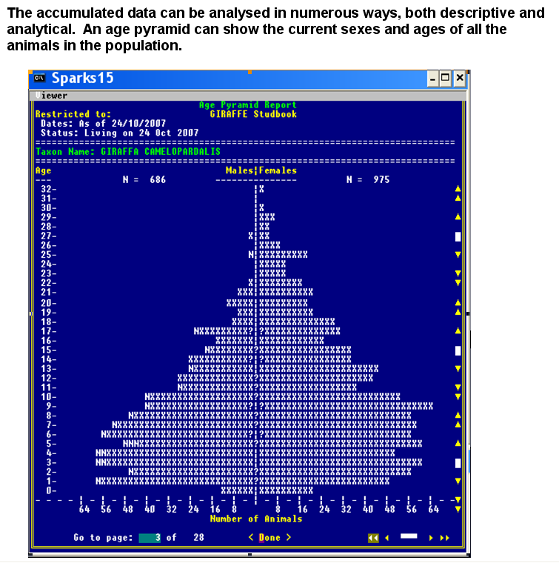

Slide 24
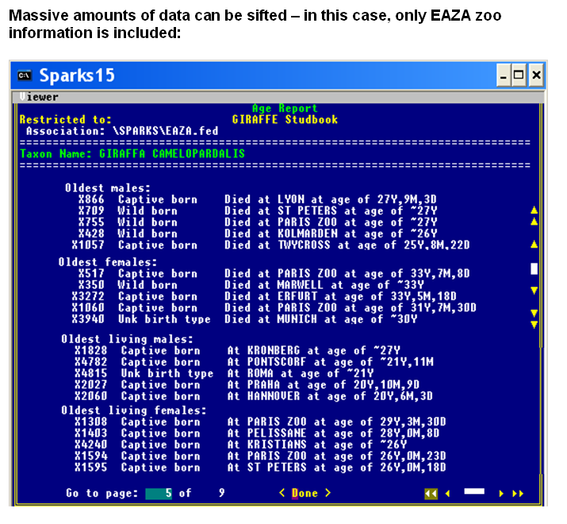

Slide 25
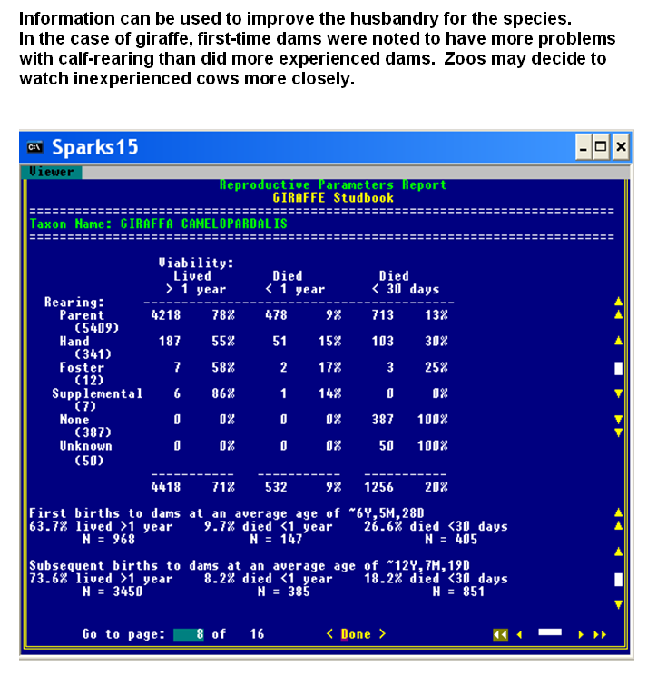

Slide 26
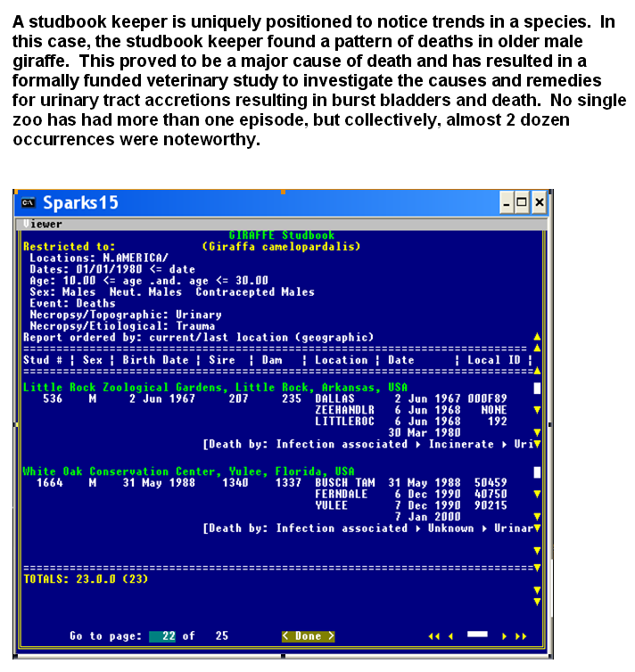

Slide 27
Contact Species360 Support
International Species Information System
support@Species360.org

