Slide 1
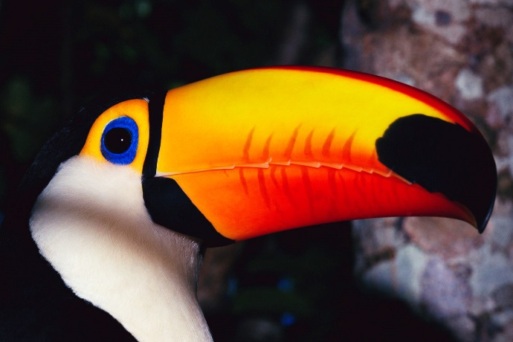
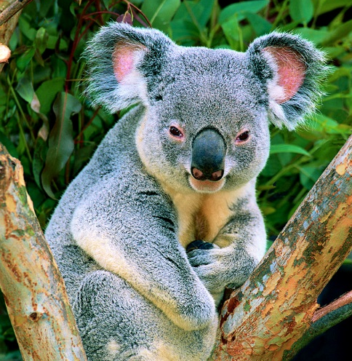
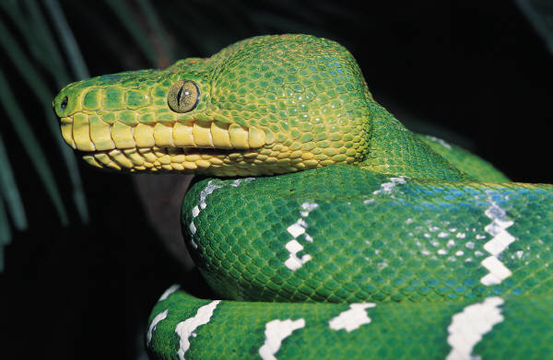
Regional Association Overview
Reports and Tools Available in ZIMS
at the Regional Association Level

Slide 2
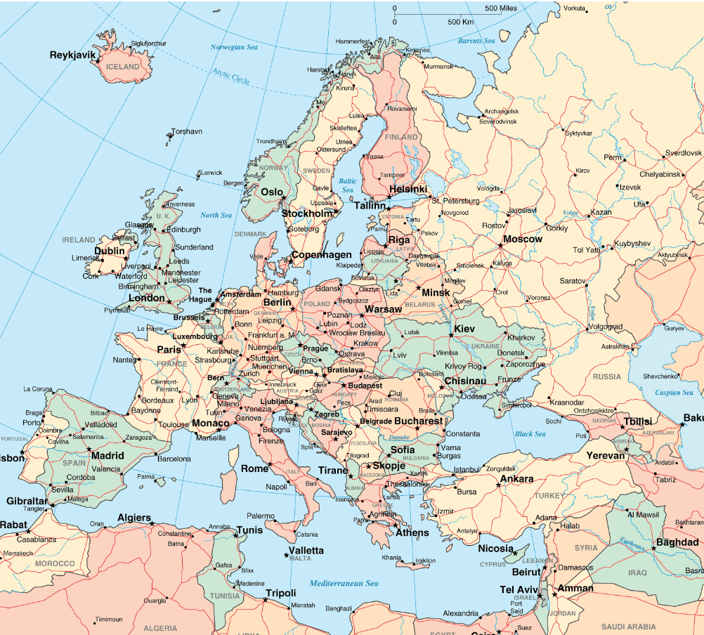
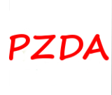

Slide 3
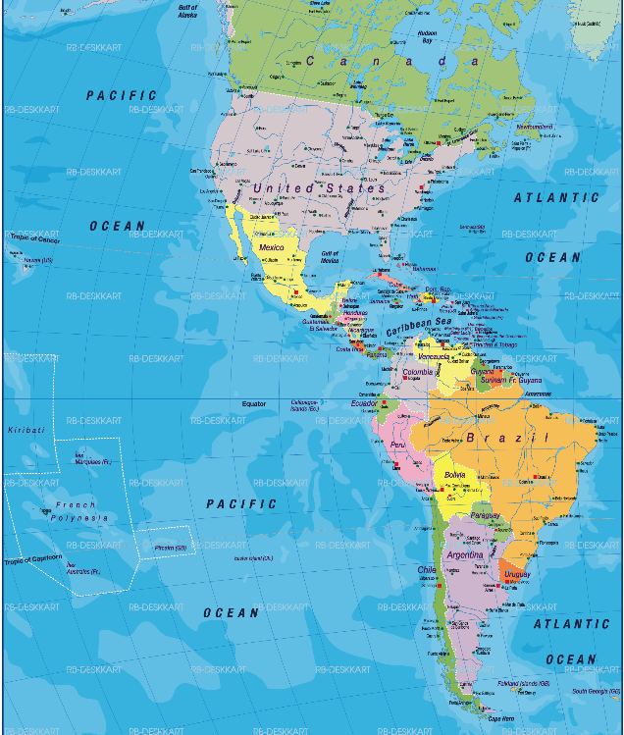
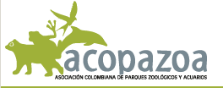

Slide 4
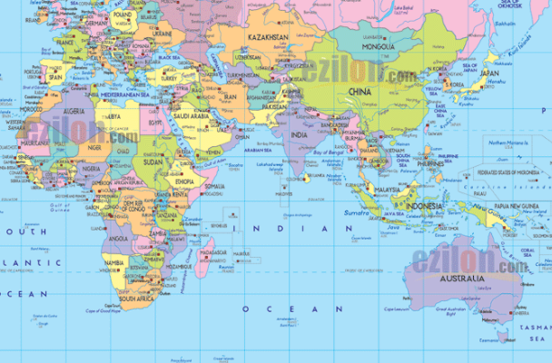

Slide 5
Regional Association Role
Your access to ZIMS is determined by the ZIMS Role that you are assigned.
One of the Species360 template Roles that ZIMS deploys with is Regional Association.
This Role, in addition to other functionality, allows you to add your association staff members to ZIMS.
However, the Species360 Global Administrator will assign the ZIMS Role. Role assignment does not occur at the Regional Association level.
Contact Species360 should you have an association staff member to whom you would like a ZIMS Role assigned.

Slide 6
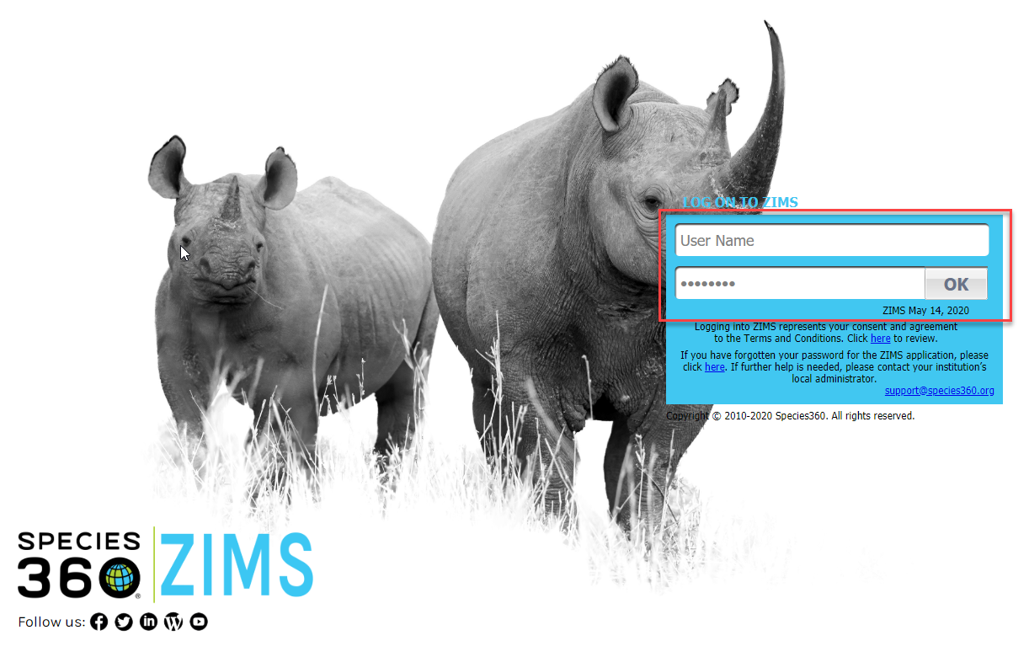
Logging In
To use ZIMS go to zims.species360.org. You will need to log in. Your User Name and Password will be created by the ZIMS Global Administrator. You can
change your Password and User Name under My Preferences. Once someone has been given ZIMS
access at the Regional Association level they can add other staff members.

Slide 7
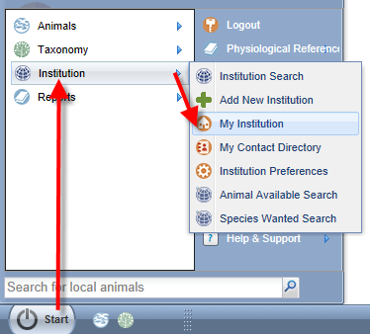
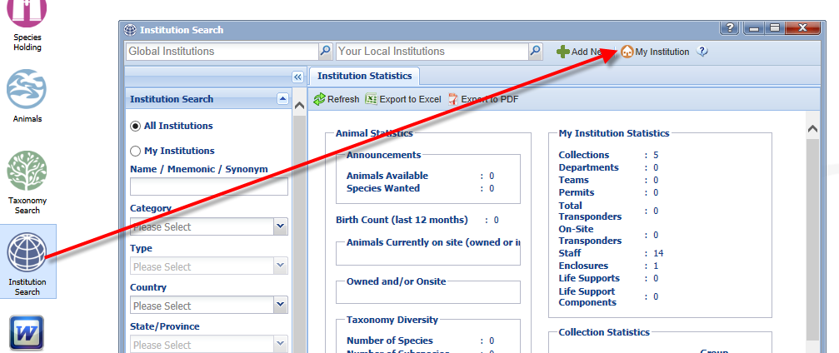
Opening your Association Page
To view your Association information you will
need to open My Institution. To open My
Institution you can go Start>Institution>
My Institution (left) or select the
Institution Search icon and then the My
Institution tab (below).

Slide 8
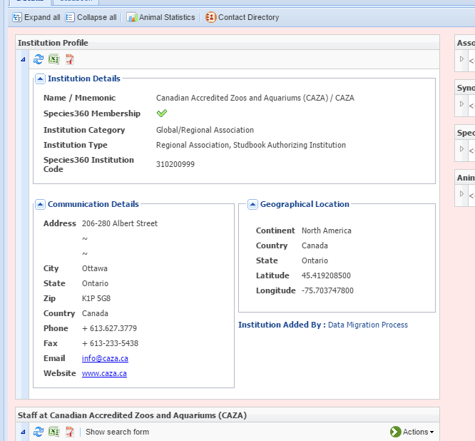
Institution Profile
The Institution Profile provides
details on your Association.
This should be confirmed and
if any changes are needed
contact Species360. Other
Associations/Institutions can
view this information and may
use it to contact you so make
sure the information is
complete and accurate.

Slide 9
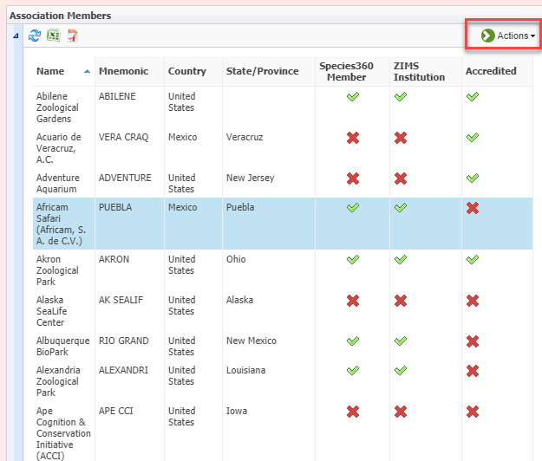
Association Members
The members of your Association
are displayed in the Association
Members grid. The columns can be
sorted by ascending or descending
order. There is a column to indicate
if the institution is a member of
Species360 and one to indicate if
they are ZIMS users. This information
is added by the ZIMS Global Admin
and you cannot edit it. There is also
a column to indicate if the facility is
accredited by your Association. You
can edit this information using the
Actions button. The Actions button is
also where you can Add or Delete
your Association members.

Slide 10
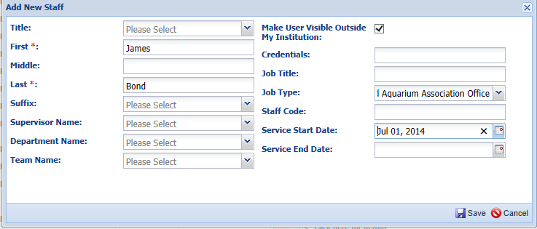
Staff Members
Your staff listings are found under the “Staff at” grid. To add a staff member select Actions>Add New Staff. The mandatory fields are marked with a red asterisk. If you check the “Make User Visible Outside My Institution” checkbox, when others look at your institution information they will see that staff member’s information. Once the staff is added, if you want them to have a ZIMS Role please contact Species360.

Slide 11
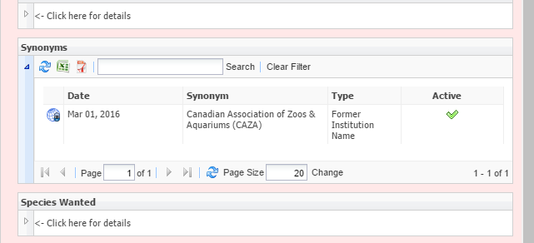
Synonyms
Over time many Associations change their name. The Synonym grid
will display any of these previous names. If anyone searches by the
synonym they will be directed to your current one.

Slide 12
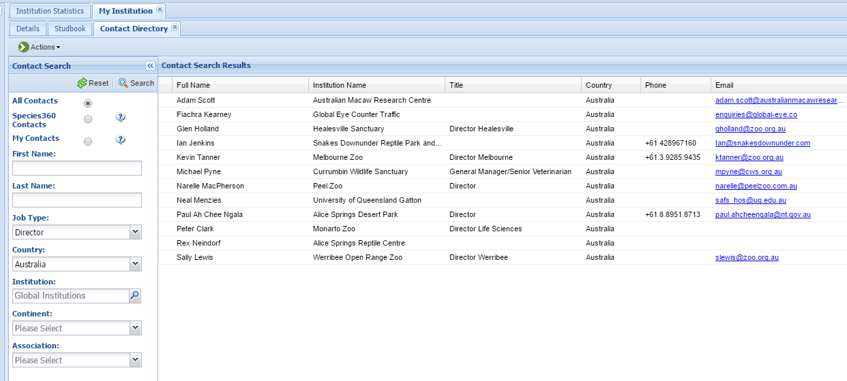
Contact Directory
The Contact Directory is found when you are in the Details tab. The directory can help
you find staff members throughout the world. They must be marked as Visible Outside
My Institution to display here.

Slide 13
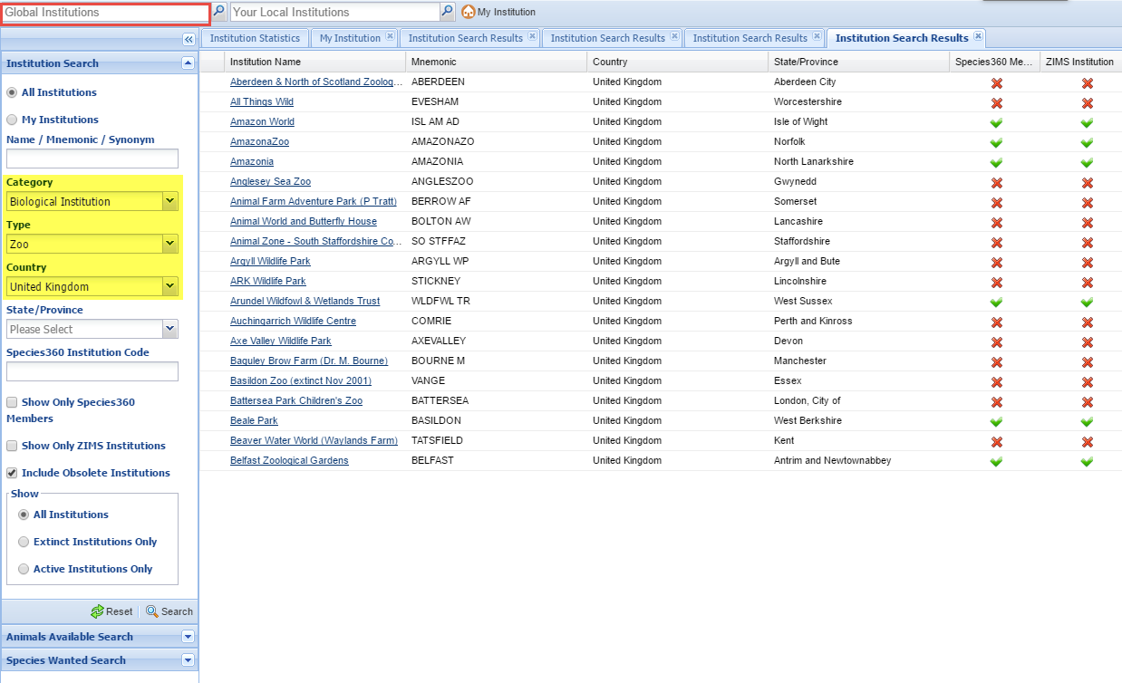
Finding Institutions
Using the Institution Search functionality you can search by
various fields to find institutions. In the results grid the
institution name is a hyperlink into the institution record.
You can also search using the Global Institution search box
in the upper left.

Slide 14
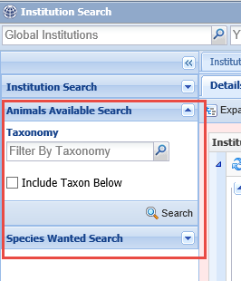
Institution – Animals Available and Species Wanted
Institutions can list Animals Available (specific
individuals or groups that they wish to place
elsewhere) or Species Wanted (species they
would like to add to their collections. You can
search for these under the Institution Search.
Some Associations are replacing their previous
system of identifying these animals and species
with this ZIMS tool.

Slide 15
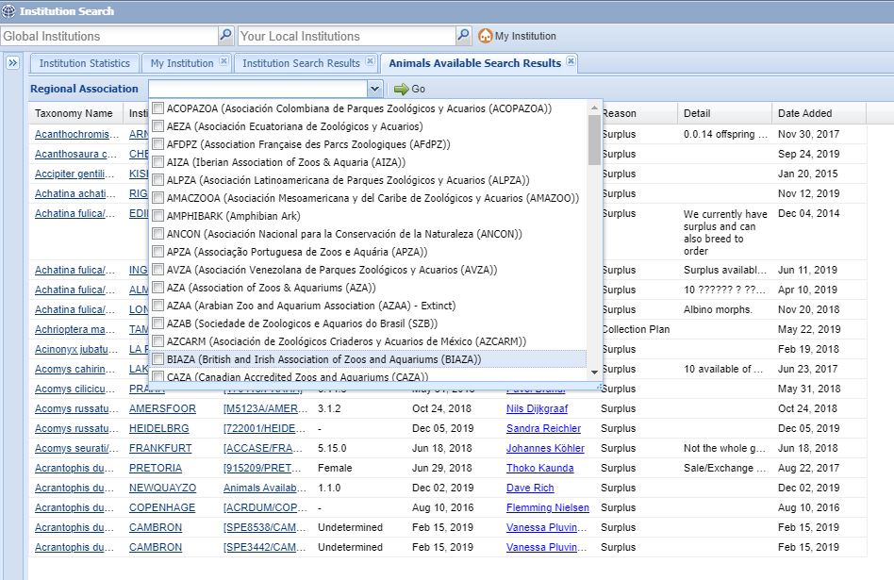
Institution – Animals Available
The default for the results grid is all institutions but you can further filter the results by selecting a specific Regional Association(s). The third column from the
left is the Global Accession Number (GAN) of the animal and selecting that will take you into the global record. The Date Added column allows you to search
by recent entries.

Slide 16
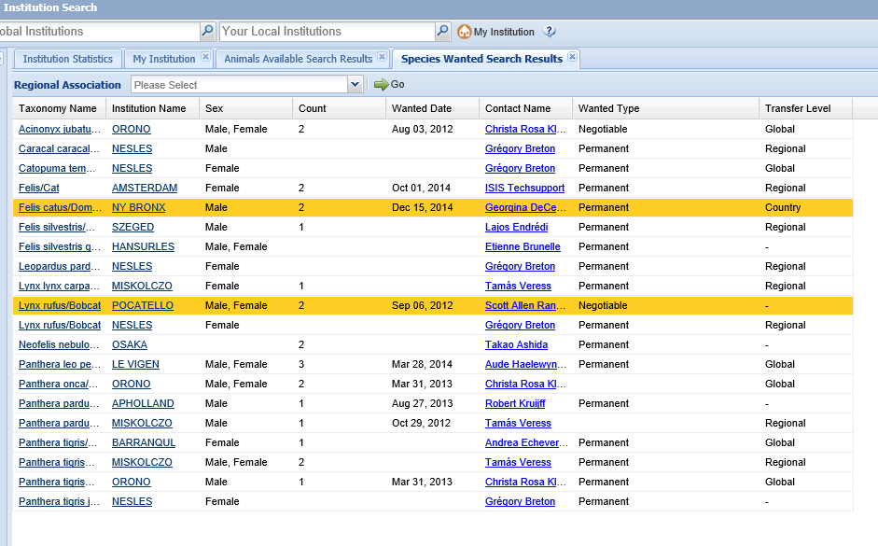
Institution – Species Wanted
In the Species Wanted search result grid you can see how many and the
sexes for the species an institution is looking to add to their collection. You
can also see the date they are wanted and the transfer level the institution
is willing to do. For both Animals Available and Species Wanted a yellow
row indicates the institution is within your region.

Slide 17
Animal Charts
Animal Charts (Start > Animals > Charts) were designed to answer questions that people repeatedly asked Species360.
We figured you were also getting the same questions about your Association members
The Charts help answer questions about what percentage of your collection is:
At risk in the wild (using IUCN Red List)
Captive/Wild born
CITES listed
Specific taxonomic class
They help answer questions on your Association members’ contribution to conservation
You can compare your member percentages with all of the ZIMS data

Slide 18
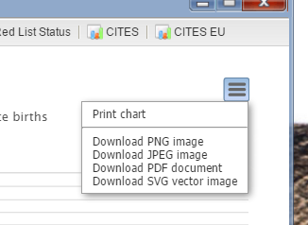
Animal Charts
To properly interpret the
Animal Charts note any
disclaimers at the top. This
Animal Chart is displaying
your local animals but all
Groups and Undetermined/
Indeterminate births have
been excluded.
Using the hamburger icon
in the upper right you can
download all the charts to
several formats to use as
desired in documents or
presentations.

Slide 19
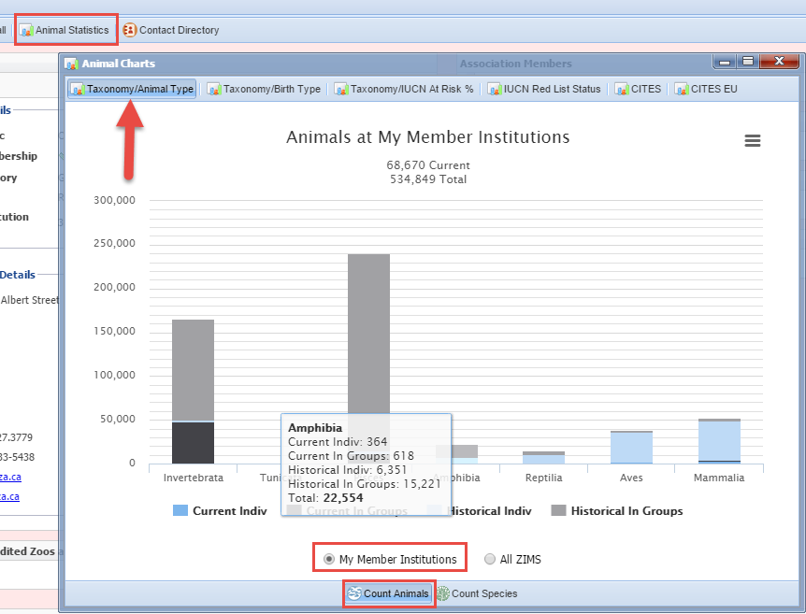
Taxonomy/Animal Type
The Taxonomy/Animal Type
Chart displays the count by
number of animals or by
number of species by Class.
It separates out by Groups
or Individuals and Current or
Historical records. Hovering
over the bars will display the
actual count for each
Class. This Chart can be run
at the My Member Institutions
level or all of ZIMS. This Chart
is showing the member
animal count.

Slide 20
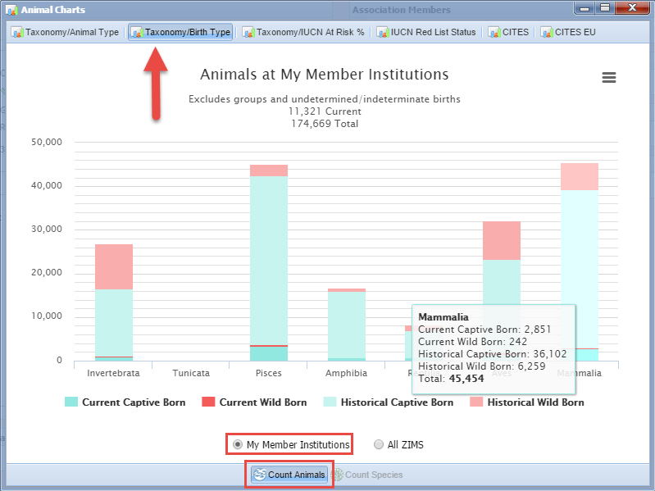
Taxonomy/Birth Type
The Taxonomy/Birth Type
Chart displays the number
of Captive or Wild births
by Current or Historical
records. This Chart can be
run only by the number
of Animals and not by
Species. As in the last chart,
hovering over the bar will
display the actual numbers.
This Chart can be run for
both My Member Institutions
or All ZIMS. Here we see the
member animal count.

Slide 21
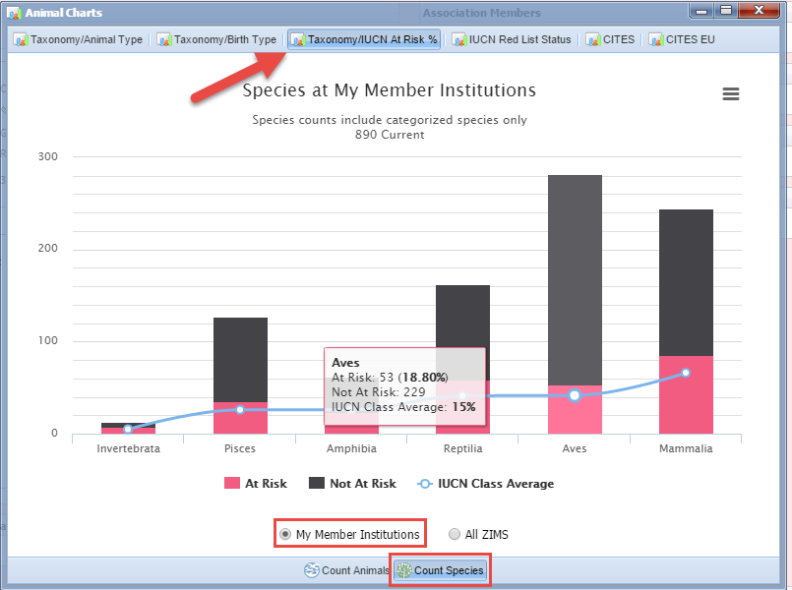
Taxonomy/IUCN At Risk %
The Taxonomy/IUCN at Risk %
Chart shows the conservation
focus of your members using
IUCN At Risk status. Data deficient species or ones where the Taxonomy doesn’t list a status are not included in the calculation. Any species that are above “least concern” are included in the “at risk” number. The line
through the dots shows what
the IUCN Class average is. This Association’s members are well above average in their species with an IUCN status of At Risk, indicating a commitment to conservation.

Slide 22
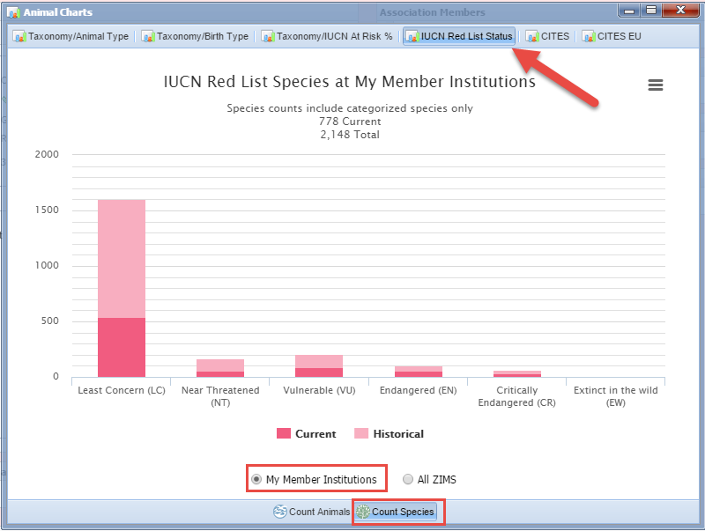
IUCN Red List Status
The IUCN Red List Status
looks at the number of
animals or species using
the IUCN conservation
status categories. As for
the other Charts, this
can be run at the member
level or All ZIMS. This
Chart is displaying the
member species count.

Slide 23
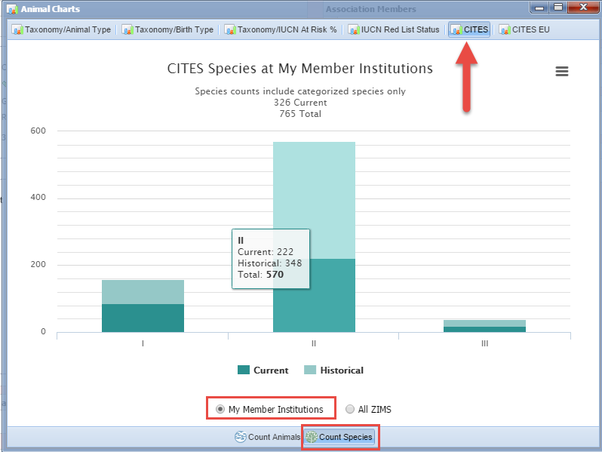
CITES
The CITES Chart shows
the count of animals or
species currently or
historically held for each
of the three CITES listings.
Here we are looking at the
member species count.

Slide 24
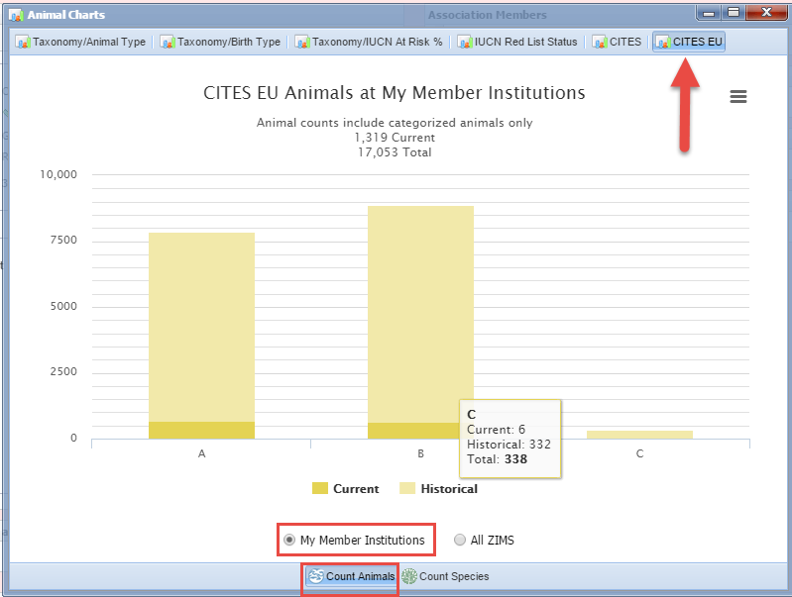
CITES EU
The number of animals
or species listed by
CITES EU is also available
as a Chart. Here we are
looking at the animal count
in member institutions.

Slide 25
Studbooks
The Studbook tab opens up information on the studbooks that your
Association manages. This tab will display ONLY if you have been
given Studbook Administration rights by the ZIMS Global Administrator.

Slide 26
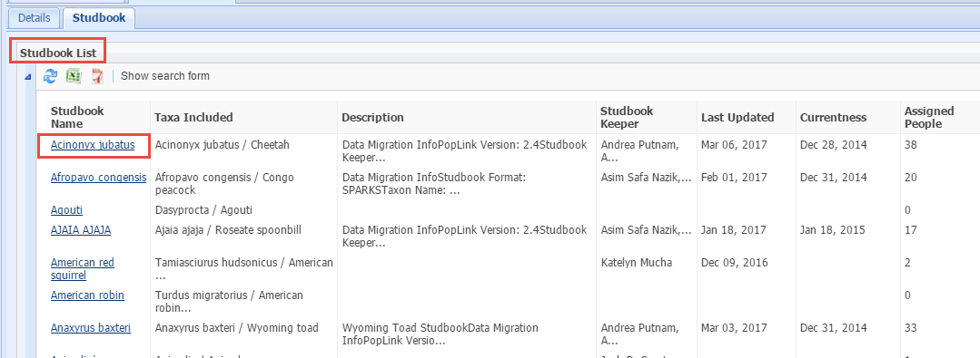
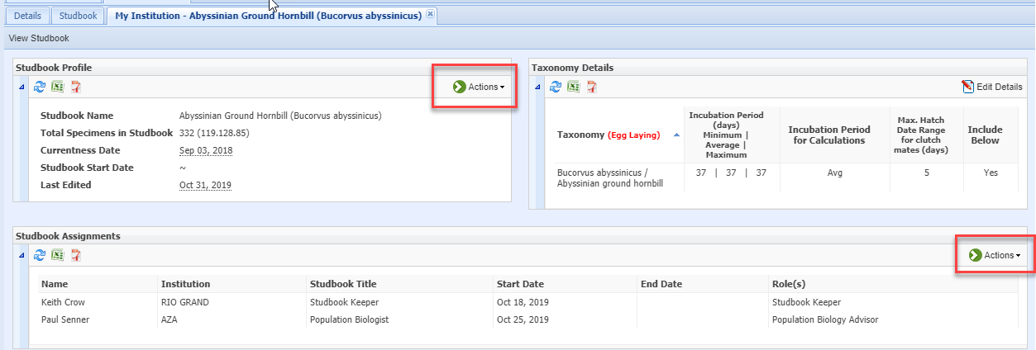
Studbook List
Your Association’s studbooks are
displayed in the Studbook List
grid. Selecting the species
hyperlink will take you into the
details of the studbook, but not
the studbook data itself. You can
edit the Studbook Name, Currentness
Date and Start Date under Profile >
Actions. You can also make Studbook
Assignments.

Slide 27
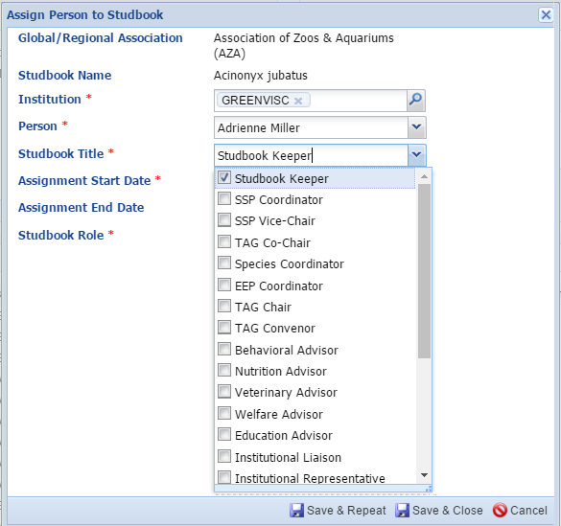
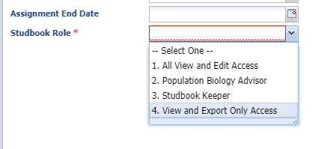
Studbook Assignments
The Studbook Title is the relationship
the person has to the studbook such
as Studbook Keeper, SSP Coordinator
or Nutrition Advisor. The Studbook Role
allows you to assign what type of access
that title has to the Studbook.

Slide 28
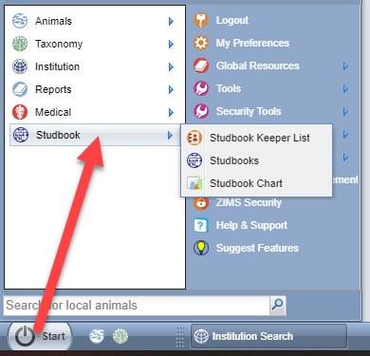
More Studbook Information
Under the Start menu you can find
the Studbooks and Global Studbook Search. This is displayed for all with a Regional Association Role, you do not have to be a Studbook Administrator to see it.

Slide 29
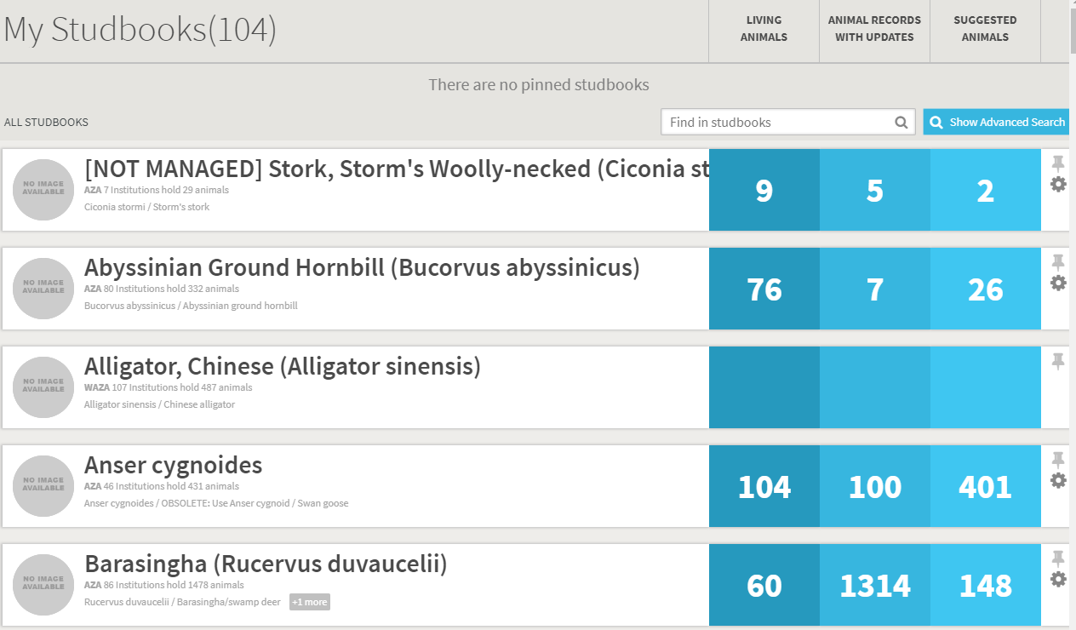
Studbooks
Selecting Studbooks will bring up a list of the Studbooks managed by your Association.
Clicking on the Studbook name will open the actual Studbook.

Slide 30
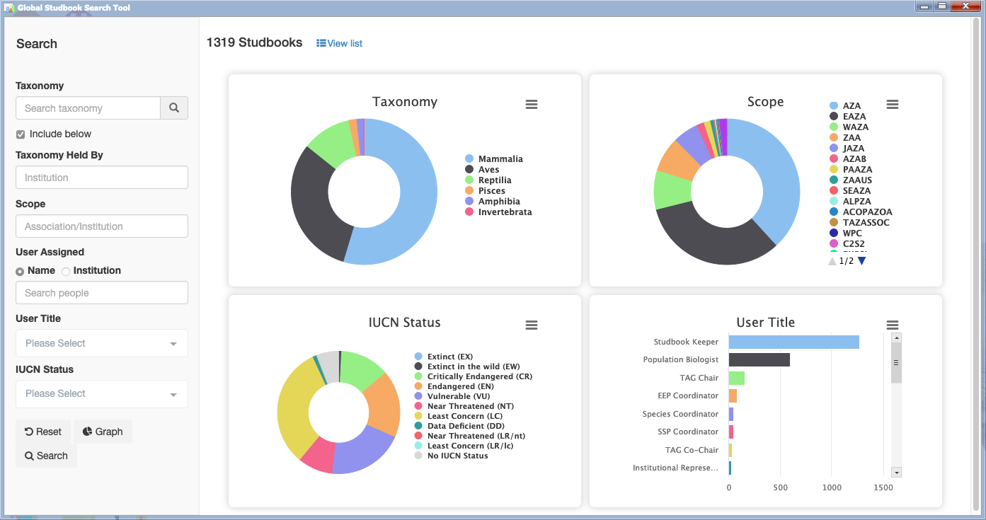
Global Studbook Search
You can now see the current statement of how many species are managed in ZIMS for Studbooks, including the following data:
Taxonomies managed in ZIMS for studbooks
Current count of animals in the book as well as their IUCN status
Which regional organization has oversight on the book (scope)
Which organization hosts the book
The staff managing the program, their role and contact information
This replaces the Keeper Search and Studbook Charts

Slide 31
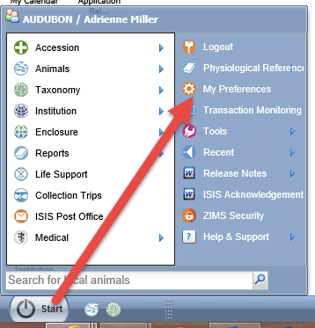
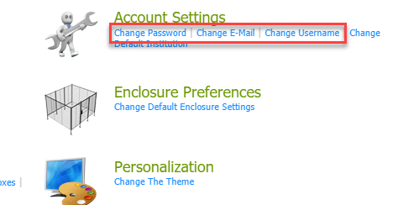
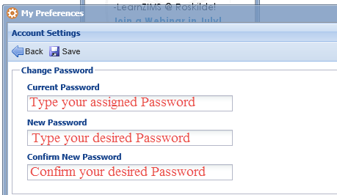
Changing Your Info
You can change your Password, E-mail
and User Name under Start > My Preferences.

Slide 32
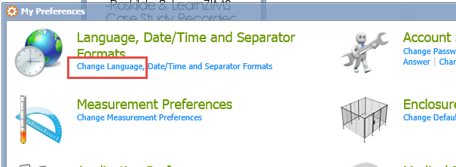
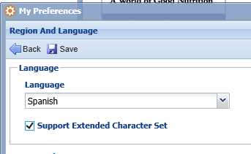
Selecting Language
We have released ZIMS in Spanish,Russian
and Japanese! To change your language go to
Change Language in My Preferences. Select your desired language and Support Extended Character Set. The field titles and Data Standards will display in that language. Any Notes entered in English will remain as entered.

Slide 33
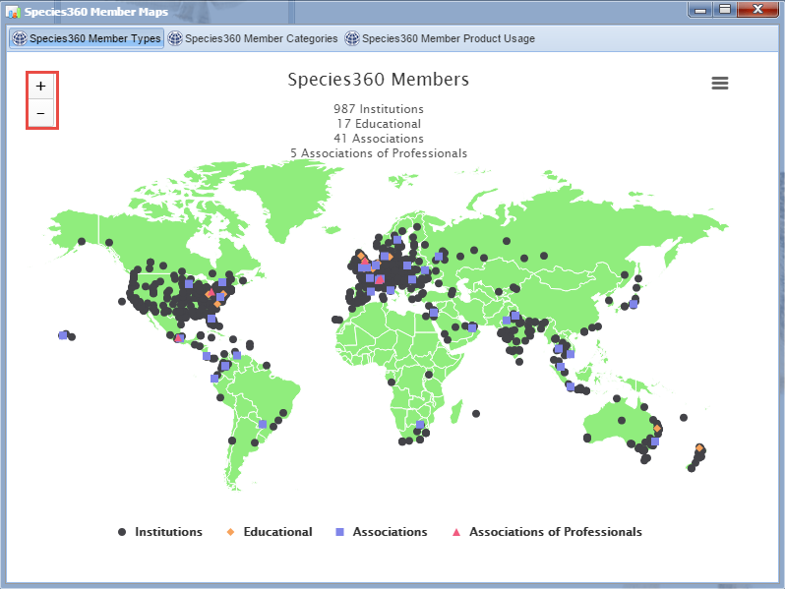
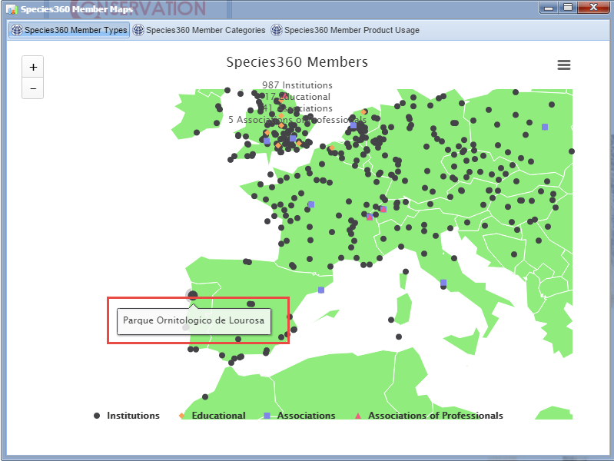
Member Maps - Types
The Species 360 Member Maps show members using various
parameters. These maps are found under Start>Institution>
Species360 Member Maps. You can view by member Type.
You can zoom in using the “+”. Hovering over the place markers
you can view the institution.

Slide 34
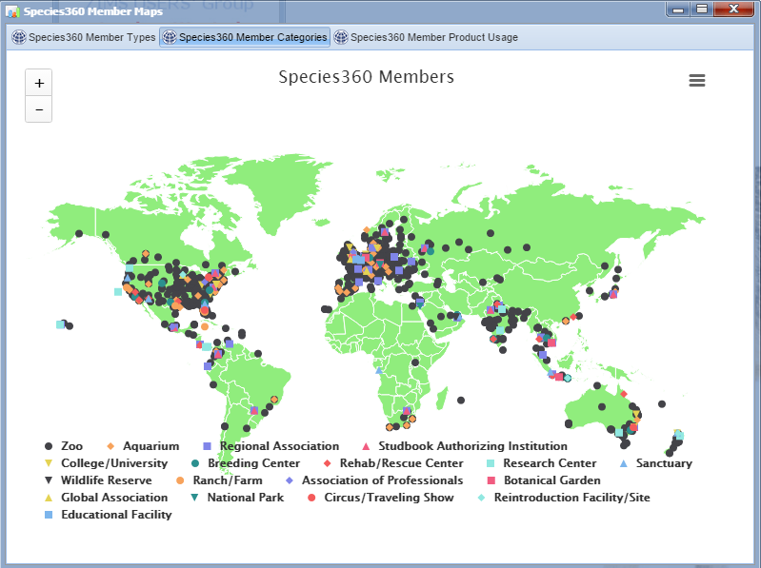
Member Maps - Category
You can also view by
member Category
which is a further
breakdown of member
Type

Slide 35
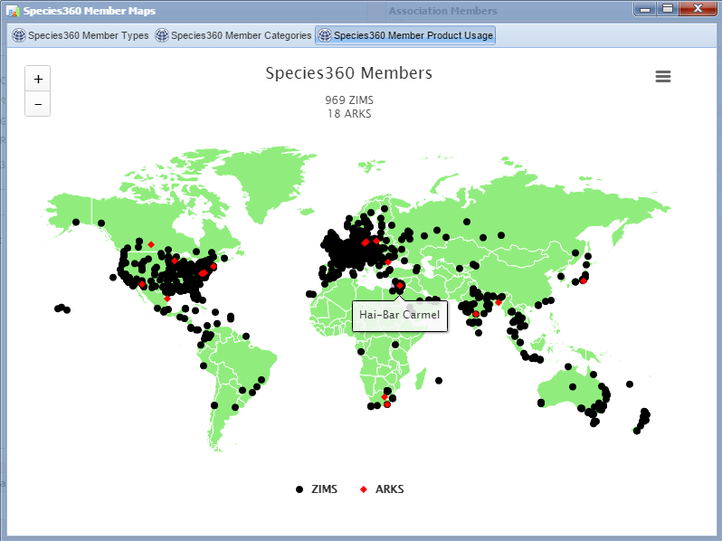
Member Maps - Product Usage
Although most institutions
are using ZIMS there are still
a few that are submitting
ARKS records. This map
helps to identify those
facilities.

Slide 36
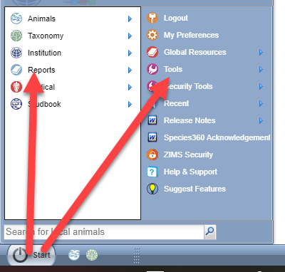
Reports & Tools - Navigation
Reports and Tools are both found under the Start menu

Slide 37
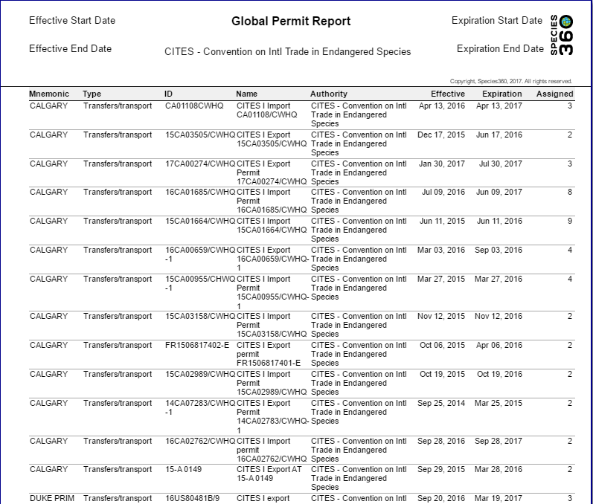
Reports – Global Permit
Institutions can mark their
Permits as Local (only visible
by their facility) or Global
(visible by all). Marking a
Permit as Global helps others
find them and is very
helpful for permits such as
the European BALAI permit
that helps facilitate quick
transactions between
permitted institutions.

Slide 38
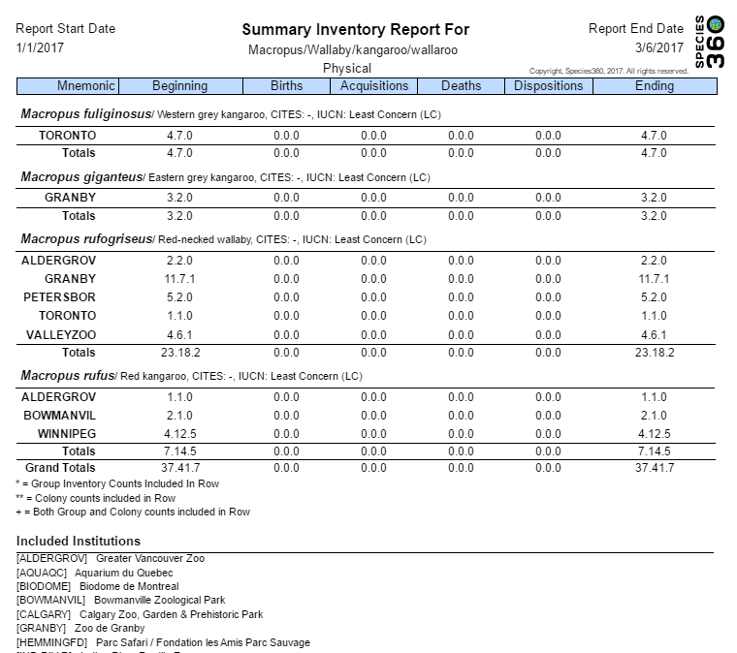
Reports – Multi-Facility Inventory
The Multi-Facility Inventory
report allows you to run an
Inventory report for your
Association members. The
counts will be separated out by
institutions or you can ask
for a total count without the
institutions being identified.
There are columns for Beginning
and End counts, Births,
Acquisitions, Deaths and
Dispositions. The totals are
displayed at the bottom of
each Species or Sub-species.

Slide 39
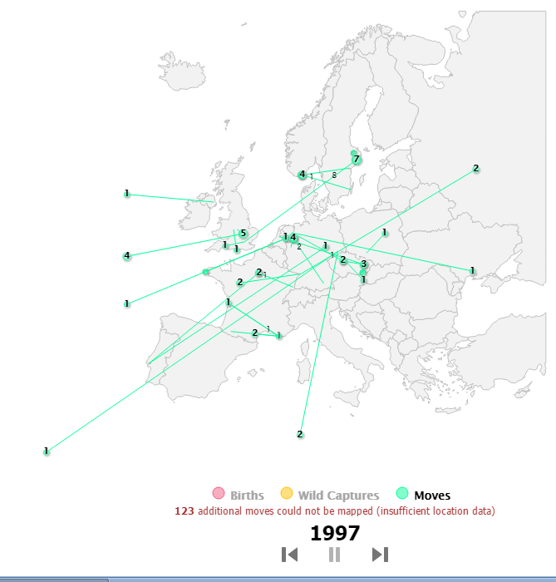
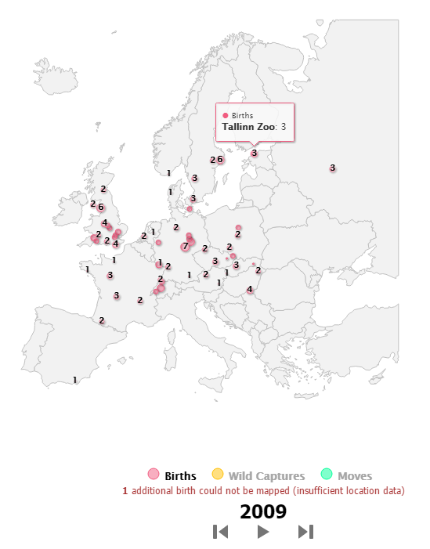
Reports - Species Event History
The Species Event History is a video displaying all the Births, Wild Captures and
Moves of a species. This can be run at several levels from Global to your institution.
The video can be stopped and restarted or fast forward and fast backward.
Hovering over the numbers will display further information as per the scope.

Slide 40
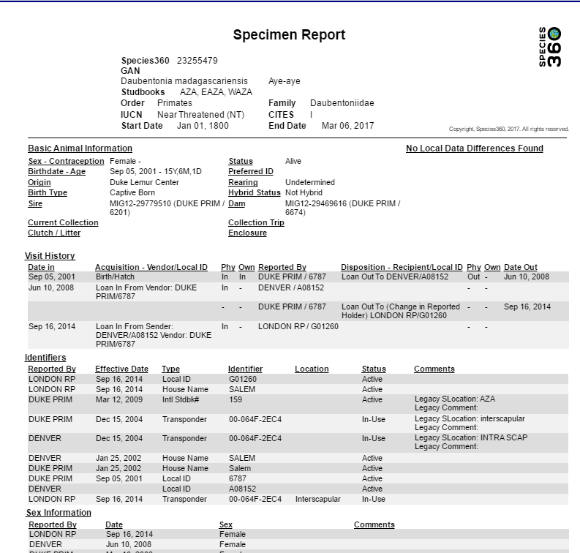
Reports - Specimen
A Specimen Report shows
the information recorded on
a single individual or a group.
You have the option to filter
by many topics such as
measurements, notes,
rearing and management
plan so the report displays
only what you need to view.
You will see the Global view
of the record.

Slide 41
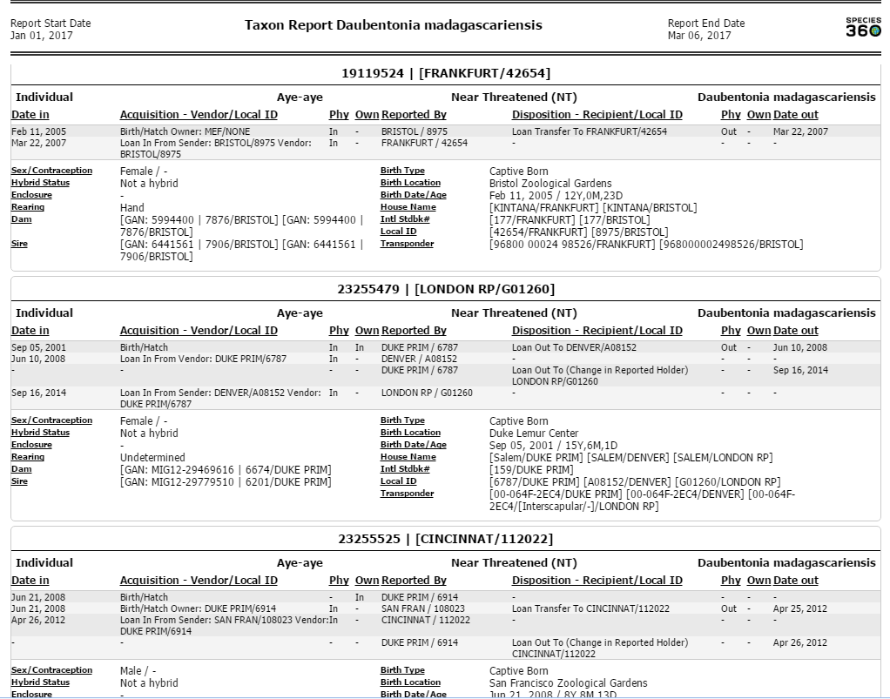
Reports - Taxon
A Taxon Report displays the
information on a specified
taxonomy. There are options
to include identifiers and
notes as well as filtering by
specific institutions.

Slide 42
Tools – Pedigree Explorer (Parents)
Pedigree Explorer allows you to find Parents, Descendants and Siblings for a specific animal. The graph above is for Parents and this animal can be traced back to its grandparents on its mother’s side and its great-grandparents on its father’s side. Females are in pink, males are in blue and undetermined sexes are in grey.

Slide 43
Tools - Pedigree Explorer (Descendants)
This animal has produced
seven offspring. One of
these offspring produced
another seven grand
offspring.

Slide 44
Pedigree Explorer (Siblings)
Siblings are displayed as
offspring under both parents.
If they are found under both
parents (red arrow here) they
are full siblings. If they are found
under only one parent (green
arrow here) they are half siblings.

Slide 45
Tools – Taxonomic Inconsistency
The Taxonomic Inconsistency Tool allows you to easily see if there are any
inconsistencies in the taxonomy of the individual’s ancestors. In this flamingo
record we see that a grand sire and a grand dam were of different species
than the animal in focus. If this is correct then the animal should not be
recorded to the taxonomic level that it was. If this is incorrect then the
records of the grand parents should be corrected.

Slide 46
Global Resources
The ZIMS Global Resources use the 40 plus years of data recorded by Species360
members to provide valuable pooled information. They are found under the Start
menu and divided up by Animal Management/Husbandry (AMH) and Medical
Resources (MR).

Slide 47
AMH - Species Holding
Species Holdings allows you to look for institutions
currently holding specific species. The search can be
filtered by Global, Continent, Country or Association.
The institutions are hyperlinks to their institution page
so you can gather information on them. The animal
numbers are also hyperlinks that will allow you to view
the global record of each animal.

Slide 48
AMH – Age Distribution
The Age Distribution report is a
graph of ages of living animals
by sex. It can be run at the
Global, Continent, Country or
Association level. A good Age
Pyramid has a lot of young
animals at the bottom and
fewer on the top. The oldest
living animal can also be seen.
The right side represents females
and the left side males.

Slide 49
AMH – Weight Comparison
The Weight Comparison graph allows you to view a graph for a single animal, compare the weights of a single animal with the global weights for that species or look at all of the global weights recorded. The boxes indicate where two thirds of the weights recorded are. The
whiskers are the outlier measurements. The animal in
focus is the blue line.

Slide 50
AMH – TAG Export
This report offers current physical holdings of Species360 member institutions in a downloadable spreadsheet. It is intended to help support strategic collection planning, such as that done by various Association Taxon Advisory Groups. It can be run at the Global, Continent, Country and Association level. It is exported to Raw Excel so the data can be manipulated. The first tab is the Raw Data, the second tab shows the IUCN summary for the taxonomy.

Slide 51
AMH – Population Overview
The Population Overview report is a
one-screen per taxon overview of the
state of the animal population,
including key metrics on genetics and
demographics, and indicators of the
underlying data quality. This report
can be run at the Global, Continent,
Country and Association level.

Slide 52
MR – Anesthesia Summaries
The Global Anesthesia Summaries
allow Vets to see what anesthetic drugs
have been used for specific species.

Slide 53
MR – Drug Usage Extract
The Drug Usage Extract allows Vets to
find various drugs used on specific
species. Selecting the View hyper-
link will take you to details regarding
the usage.

Slide 54
MR – Expected Test Results
The Expected Test Results display test results from healthy animals to assist with interpretation of results by Veterinary Staff. Results are divided into five categories (tabs).

Slide 55
Thank you!
Regional Associations Rock!

