Slide 1

Species360 Insights
Data Access Overview

Slide 2

Species360 Insights Access
Your ZIMS access is at the Read Only level
The role has access to:
  Animal:
    Animal Charts
  Global Resource & Tools
    Age Distribution
    Population Overview
    Species Event History
    Species Holding
    TAG Export
    Weight Comparison Report
  Medical Related
    Anesthesia Summaries
    Drug Usage Extracts
    Expected Test Results

Slide 3
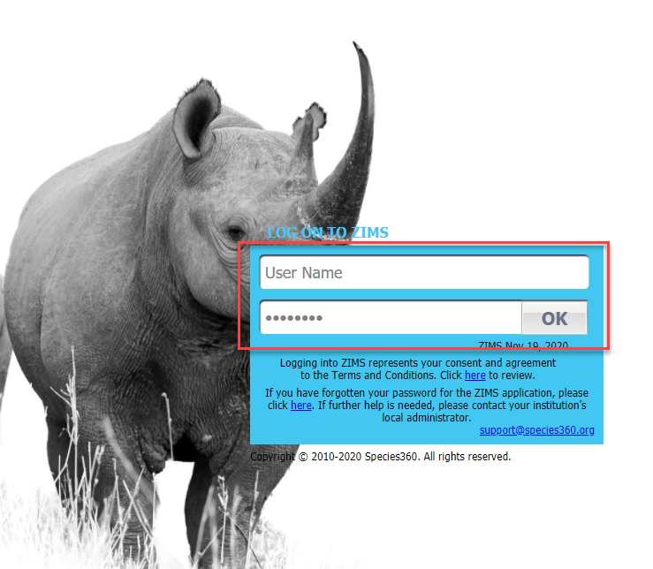
Logging In
To use ZIMS go to zims.species360.org. Your User Name and Password will be created by the ZIMS Global Administrator. Once you are logged in you can change your Password and your User Name by going to Start > My Preferences > Account Settings.

Slide 4
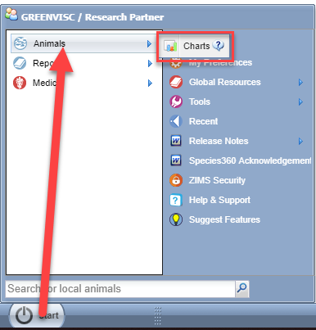
Animal Charts
The Animal Charts are found
under Start > Animals > Charts.
These charts look at all the
animals recorded in ZIMS by:
Animal Type (entity)
Birth Type
IUCN at Risk %
IUCN Red List Status
CITES/CITES EU listing

Slide 5
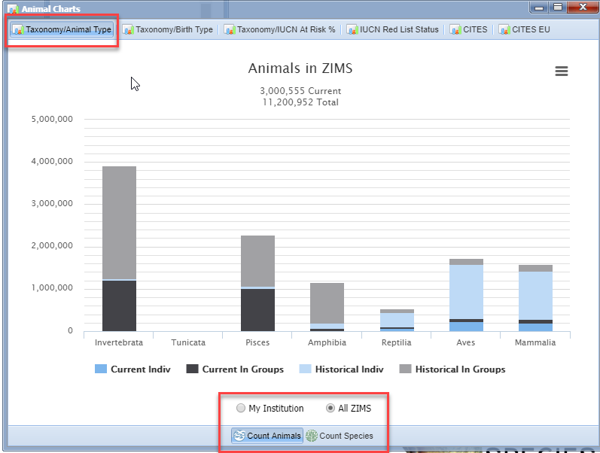
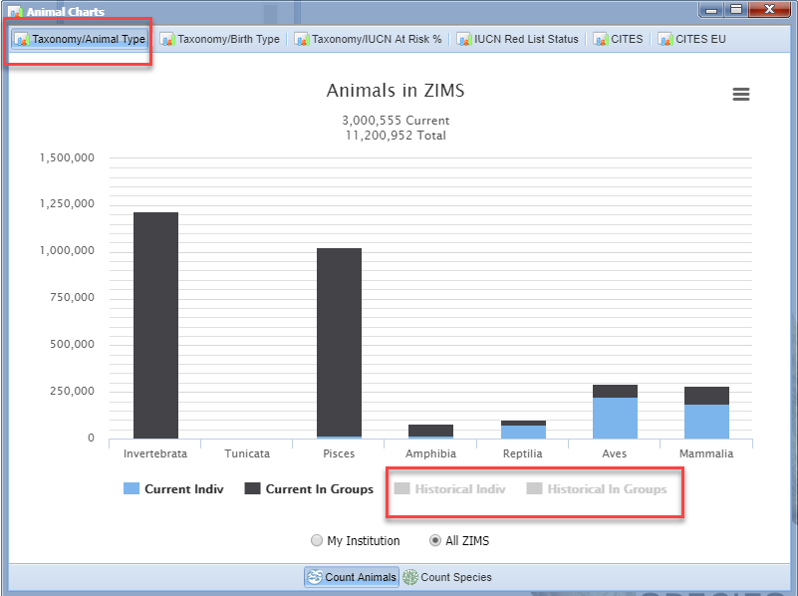
Taxonomy/Animal Type
The Charts display by Animal Count or by Species Count. You can select All ZIMS or, if you are associated with an institution, you can select My
Institution. This Chart is for Taxonomy/Animal Type. On the right we deselected any historical counts and are viewing only current numbers.

Slide 6
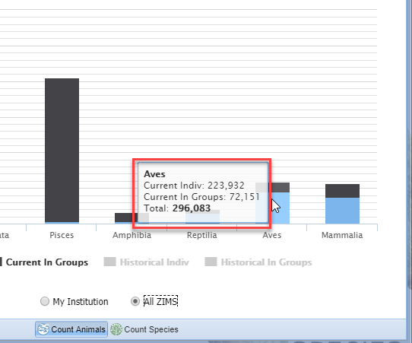
Taxonomy/Animal Type
Hovering over the bars
will display the number
of animals (or species).
There are almost 300,000
living birds recorded in
the ZIMS database.

Slide 7
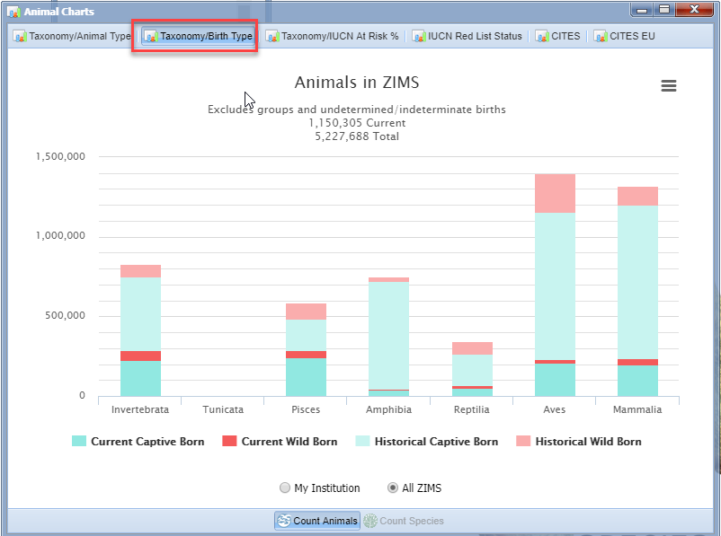
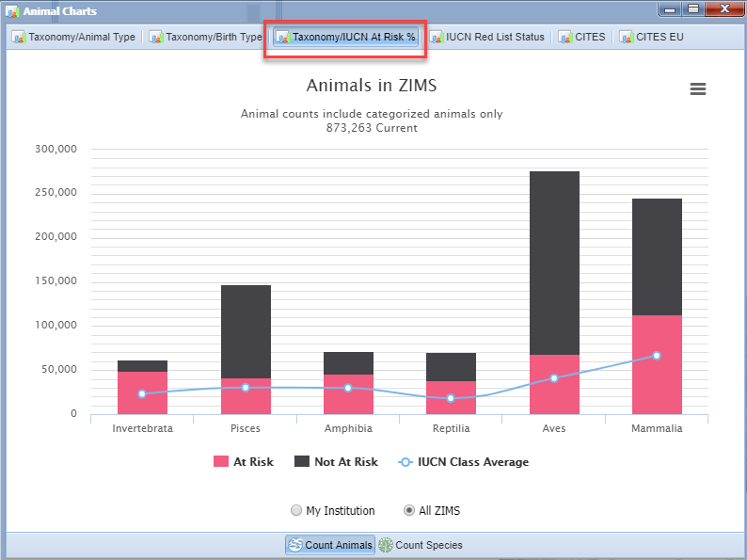
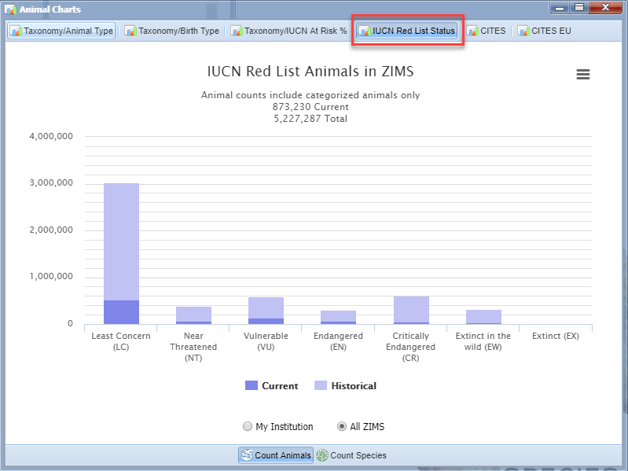
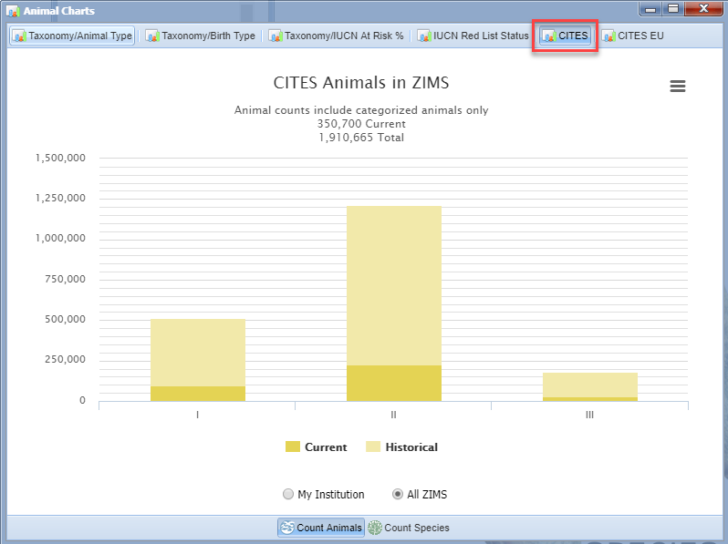
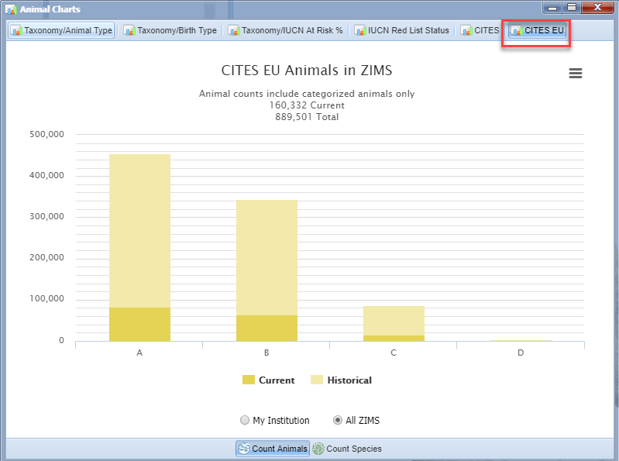
Animal Charts
These are examples of the
rest of the Animal Charts
available.

Slide 8
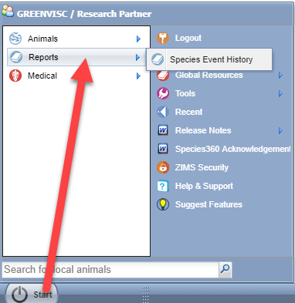
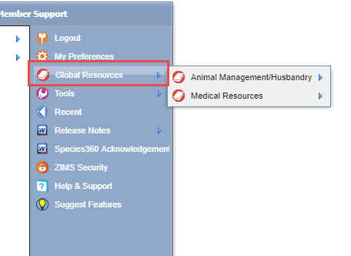
Reports, Global Resources & Tools
The other functionality that you have access to is also found under the Start menu. Select Start > Reports for the Species Event History or Global Resources, depending on what you are looking for.

Slide 9
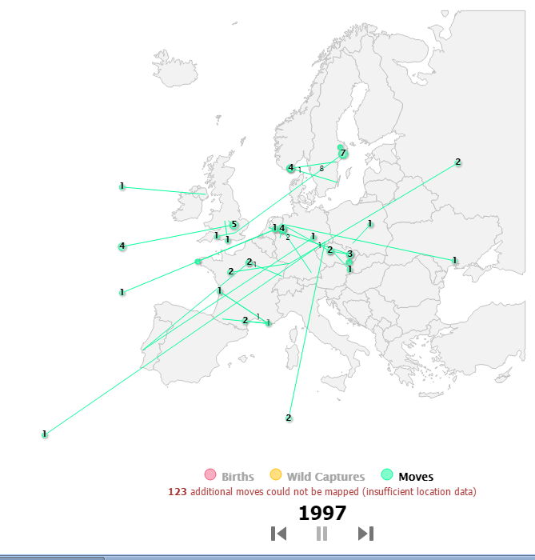
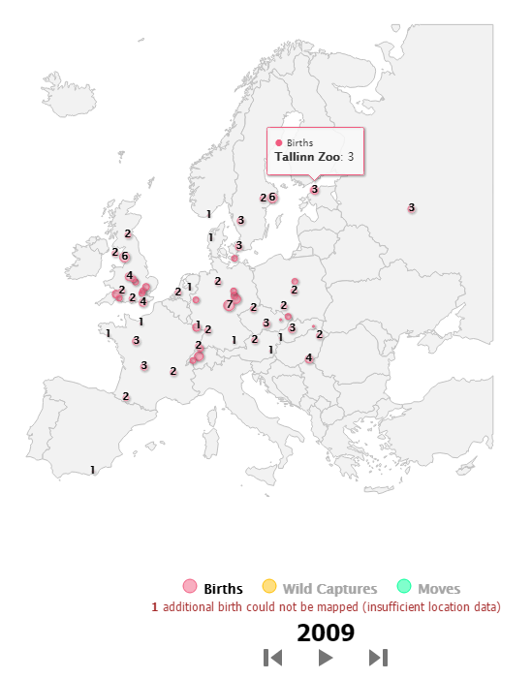
Reports - Species Event History
The Species Event History is a video displaying all the Births, Wild Captures and
moves of a species. This can be run at several levels from Global to My Institution.
The video can be stopped and restarted or fast forward and fast backward.
Hovering over the number will display the institution name.

Slide 10
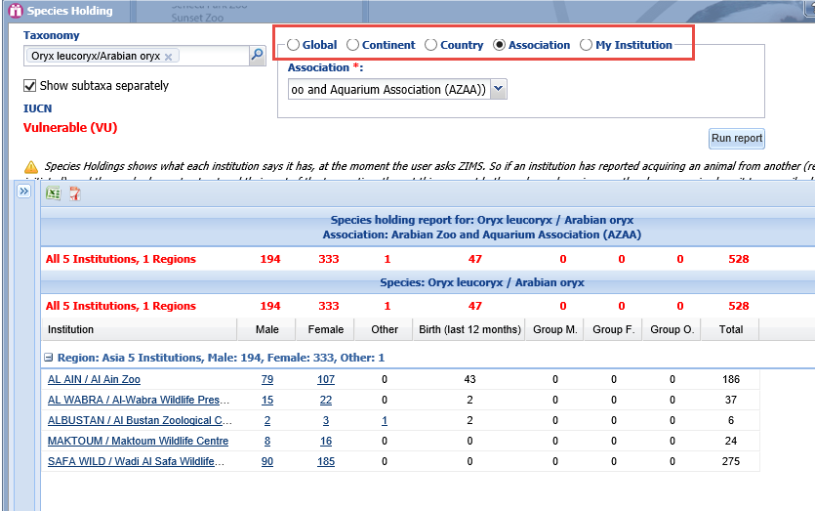
Global Resources Animal Management – Species Holding
Species Holdings allows you to look for institutions
currently holding specific species. The search can be
filtered by Global, Continent, Country, Association or
My Institution.

Slide 11
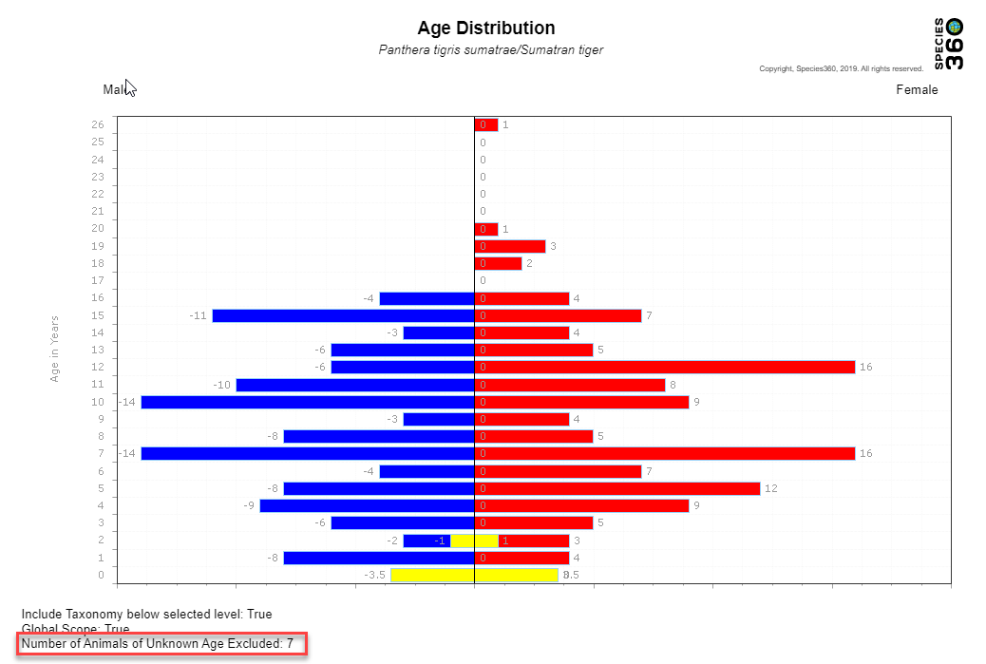
Global Resources Animal Management – Age Distribution
The Age Distribution report is a
graph of ages of living animals
by sex. It can be run at the
Global, Continent, Country,
Association or My Institution level.
A good Age Distribution has a lot
of young animals at the bottom and
fewer on the top. The age of the
oldest living animal can also be
seen. The right side represents
females and the left side males. The
number of animals excluded due to
unknown or estimated birth/hatch
dates displays at the bottom.

Slide 12
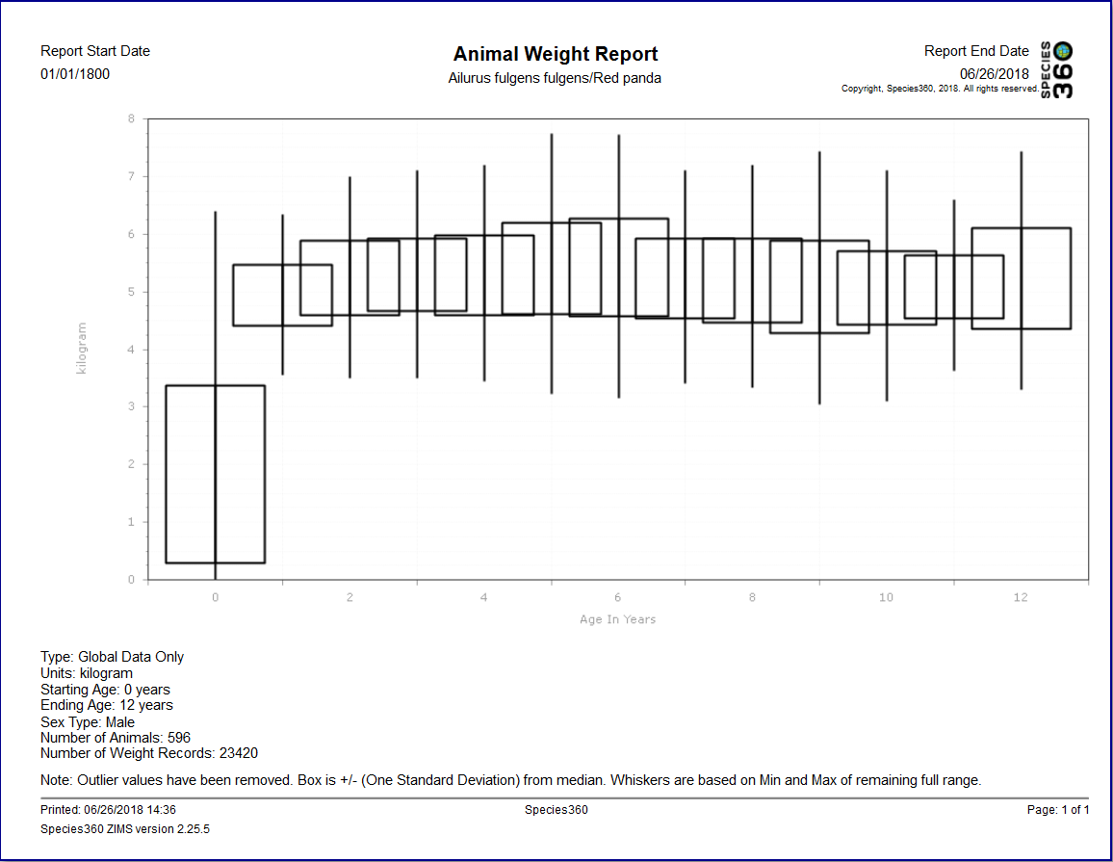
Global Resources Animal Management – Weight Comparison
The Weight Comparison graph allows you to view a graph of the global weights recorded for a species. The boxes indicate where two thirds of the global weights are recorded. The whiskers are the outlier measurements. If
you want to compare a single animal against the global
weights you will need to know the Global Accession Number (GAN).

Slide 13
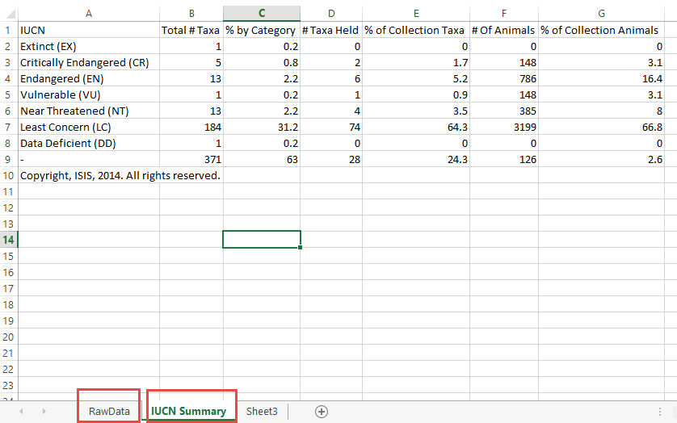
Global Resources Animal Management – TAG Export
This report offers current physical holdings of Species360 member institutions in a downloadable spreadsheet. It is intended to help support strategic collection planning, such as that done by various Association Taxon Advisory Groups. It can be run at the Global, Continent, Country, Association and My Institution level. It is exported to Raw Excel so the data can be manipulated. The first tab is the Raw Data, the second tab shows the IUCN summary for the taxonomy.

Slide 14
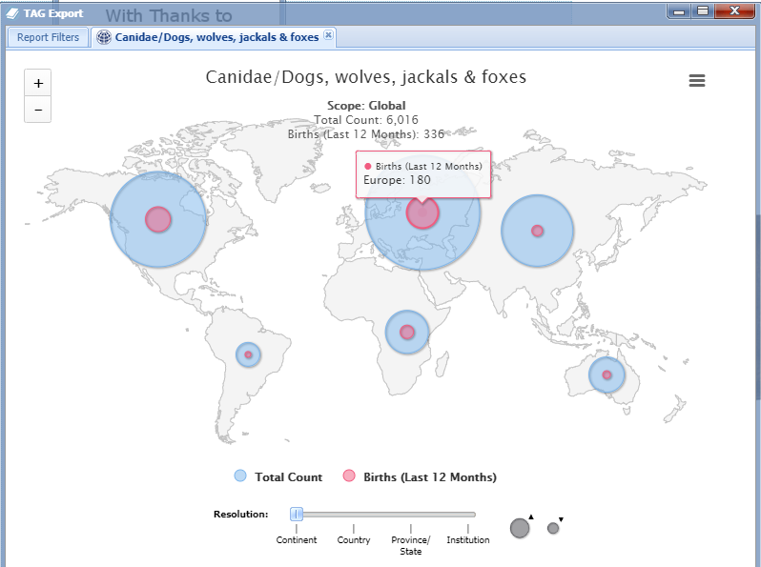
Global Resources Animal Management – TAG Export
You can select to View in Map.
This map displays the regions
and the births during the last
year as well as the total counts.

Slide 15
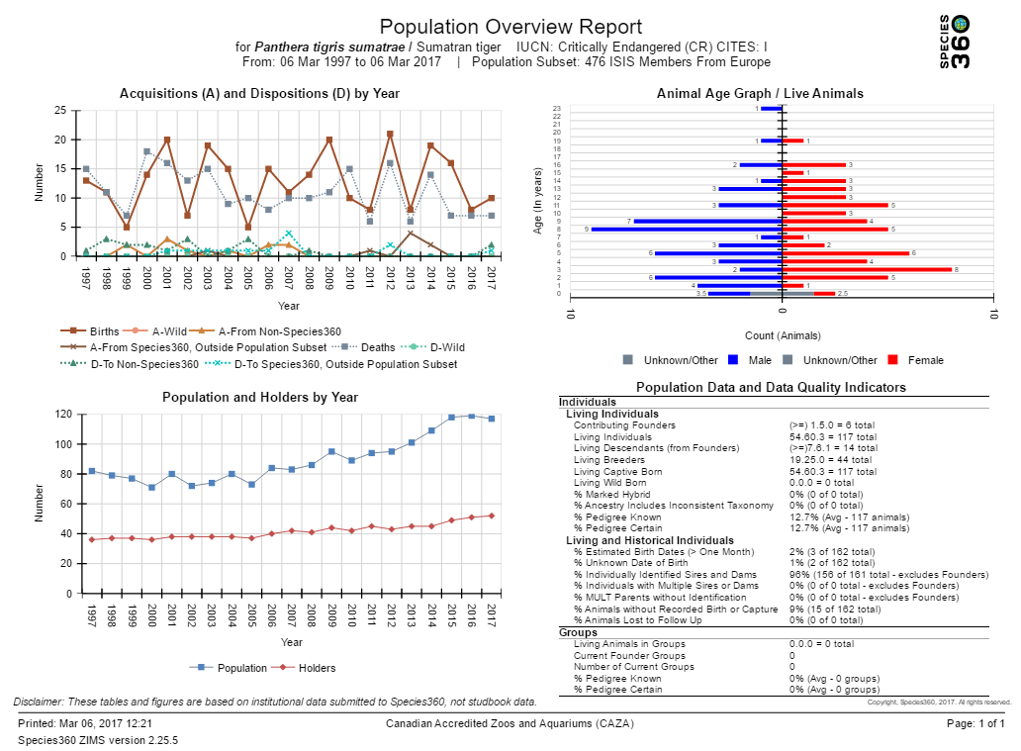
Global Resources Animal Management – Population Overview
The Population Overview report is a
one-screen per taxon overview of the
state of the animal population,
including key metrics on genetics and
demographics, and indicators of the
underlying data quality. This report
can be run at the from Global to My
Institution level.

Slide 16
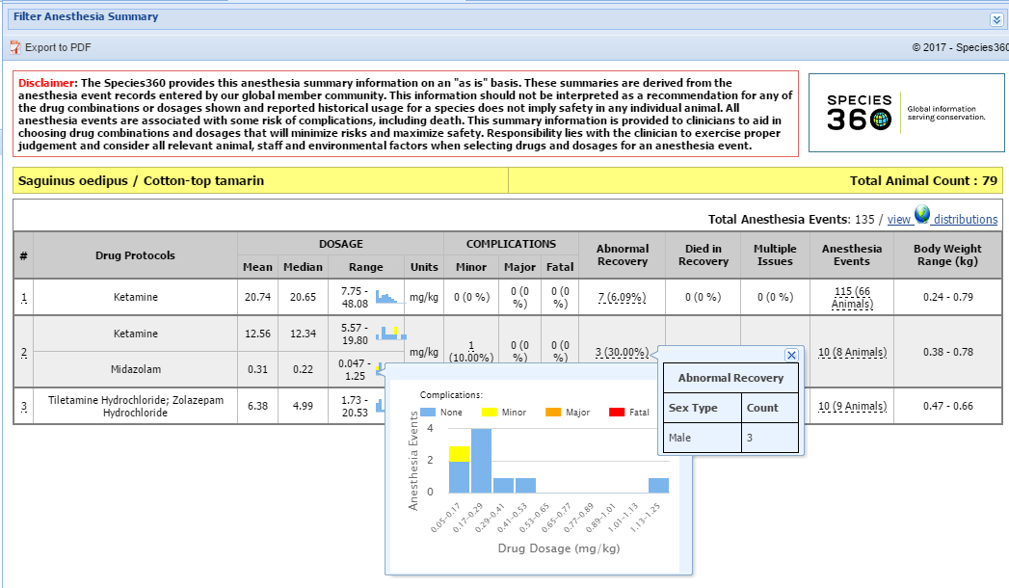
Global Resources Medical –
Anesthesia Summaries
The Medical Resources use data collected
by Species360 members over the years. The
Global Anesthesia Summaries allow vets to
see what anesthetic drugs have been used
for specific species and if there were any
complications associated.

Slide 17
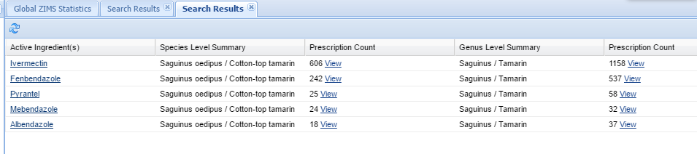
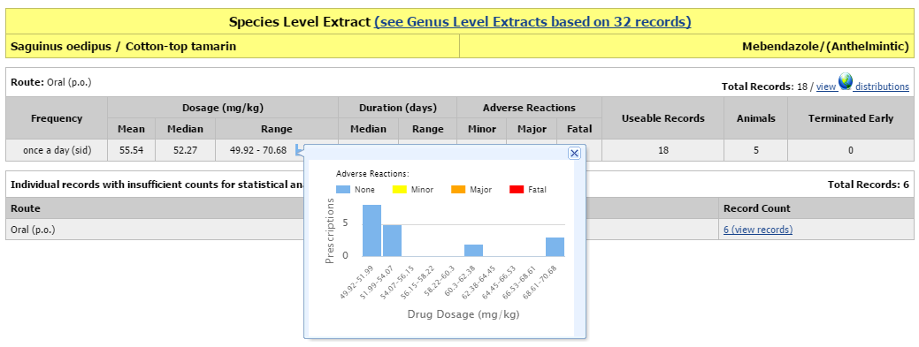
Global Resources Medical –
Drug Usage Extract
The Drug Usage Extract allows vets to
find various drugs used on specific
species. Selecting the View hyper-
link will take you to details regarding
the usage.

Slide 18
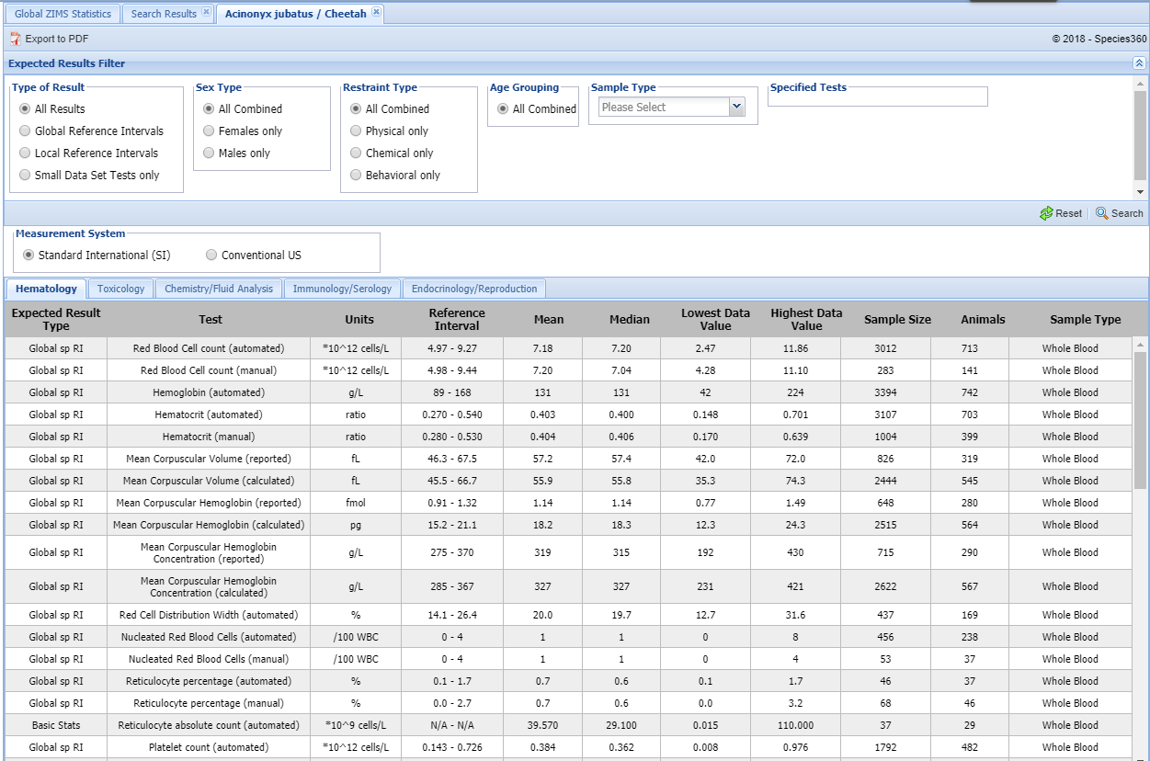
Global Resources Medical –
Expected Test Results
The Expected Tests Results allow
searching by species and test.
The results display test results
from healthy animals – a “normal”
Health Status. The filters allow for
fine-tuning the results. Global
Reference Intervals have a sample
size of at least 40. Basic Stats have
a sample size of 15-39.

Slide 19

While access to individual animal data beyond these reports is not a part of the Species360 Insights & ZIM for Education Subscriptions, occasionally we may be able to help with more in-depth data requests. You will be informed if there are any associated costs.
Contact Support@species360.org

