Slide 1
5001 - Batch Functionality
SAVING TIME WITH DATA ENTRY

Slide 2
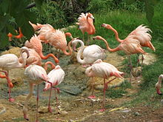
Accessions
Accessioning multiple animals can be made easy by using Batch Accessions. In a Batch Accession
all information is duplicated into how many records you indicate there will be. If you have auto-
Increment Local IDs checked you simply need to tell ZIMS how many Local IDs to generate.
If you are manually entering Local IDs you will record them here. So if you received flamingos
from the same institution you could enter them in one step using Batch Accession. Remember
all the information is duplicated in each record except for the Local ID, so you only want to use
this functionality when the records will be very similar. If much of the information is
different it is recommended that you use the Save & Repeat option so you do not have to
remember to go back into each record to edit data.

Slide 3
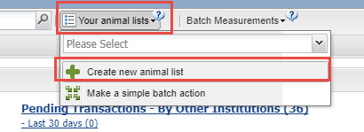
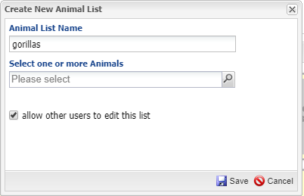
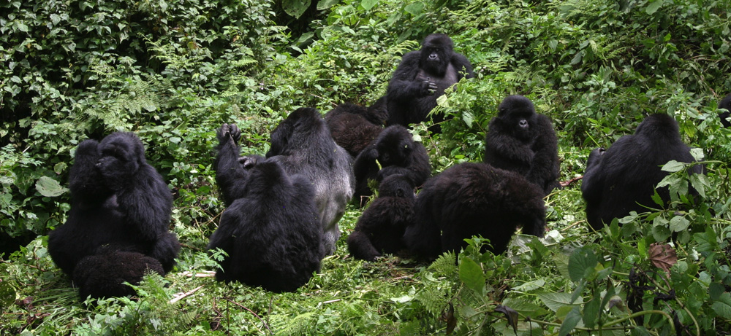
Animal Lists
You can also perform a variety of Batch Actions on individuals or groups once accessioned.
For multiple animals that you would make multiple entries on you can create a list. In the
Animals module select Your Animal Lists > Create new animal list. The list name must be
unique. Record the animals either by typing in a GAN or Identifier or using the lookup.
All lists are shared by default but if you want others to be able to edit the list you must
check the box.

Slide 4
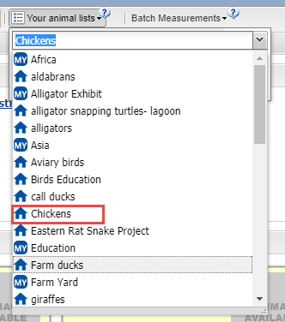
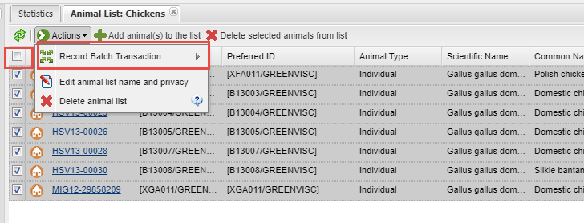
Animal Lists
Your list will now appear in the drop down to select
from. By default all members are checked but you
can uncheck them all using the box at the top. Once
your animals are selected click the Record Batch
Transaction button. Select the Transaction Type and
Single Entry (the entry will go into all the records with
one click) or Custom Entry (you will go through each
record to record the data).

Slide 5
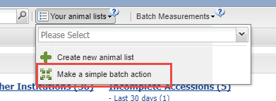
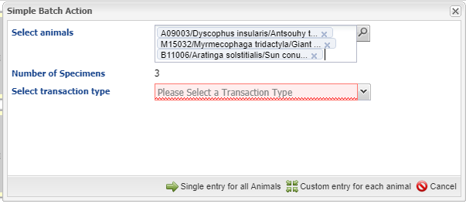
Simple Batch Entry
You do not have to have a list created to record
a Batch Action. From Your Animal Lists select
make a simple Batch Action. Select the animals
by typing in GANs or Identifiers or use the
look up feature. Select the Transaction Type and Single or Custom entry and record your data.

Slide 6
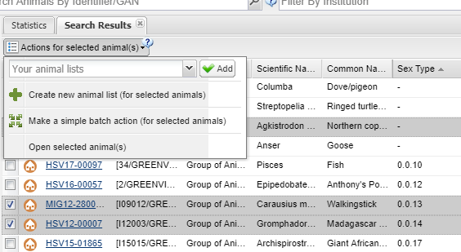
Batch Actions from Searches
From your search results grid you can also select an Animal List, create a new list for the animals selected, or make a Simple Batch Action for the animals selected.

Slide 7
Batch Actions for Enclosures, Life Supports & Components
The same functionality for Batch
Actions is available for Enclosures,
Life Supports and Components. The
action types are different than for
Animals but the basic flow is the
same.

Slide 8
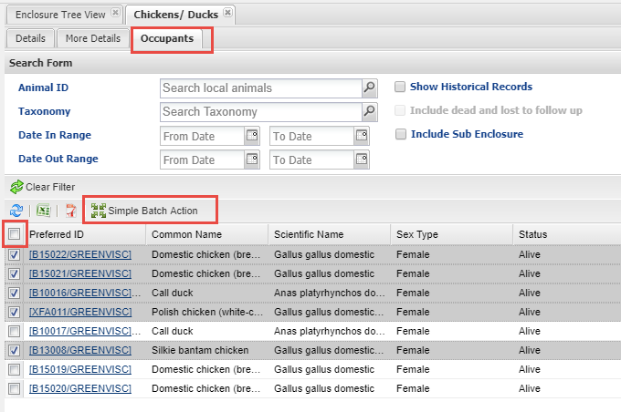
Batch Actions from Enclosure Occupants
To use this functionality
open the Enclosure record
and select the Occupants
tab. The results grid will
display the current animals
in the enclosure. If you need
to include historical occupants,
or want to filter the list, use
the Search form. Check all the
appropriate records. You can
Check All or Uncheck All by
selecting the box at the top
of the list. Then select Simple
Batch Action.

Slide 9
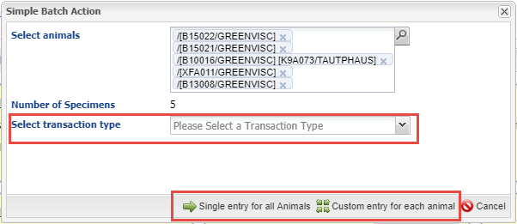
Create the Batch Action
Select the Transaction Type and whether you want a Single Entry for all or a
Custom Entry. You can add more animals to the list using the lookup or by
simply typing the GAN or an Identifier into the Select Animals grid.

Slide 10
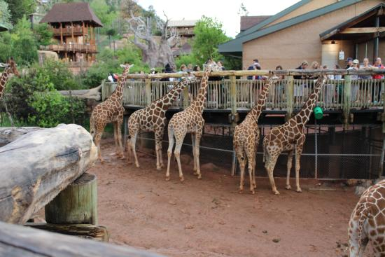
Complete the Batch Action
Then complete the
Batch Action. Since
the Enclosure Occupants
list automatically updates
as animals come in or go
out you don’t have to
think about keeping an
Animal List based on an
enclosure updated.

Slide 11
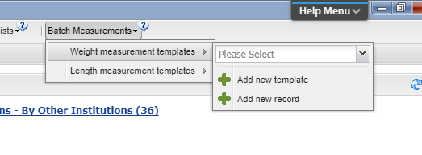
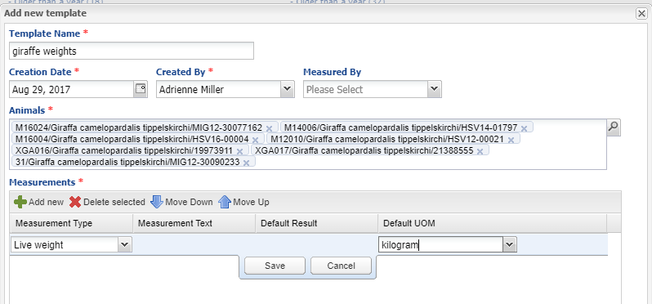
Animal Measurement Templates
For batch animal measurements
you can create templates to
save even more time. From
the Animals module > Batch
Measurements select Weight
or Length > Add new template.
The name should be unique.
The Creation Date does not
affect the dates you can record
when using the template. Select
the Animals, Measurement Type
and Unit of Measure.

Slide 12
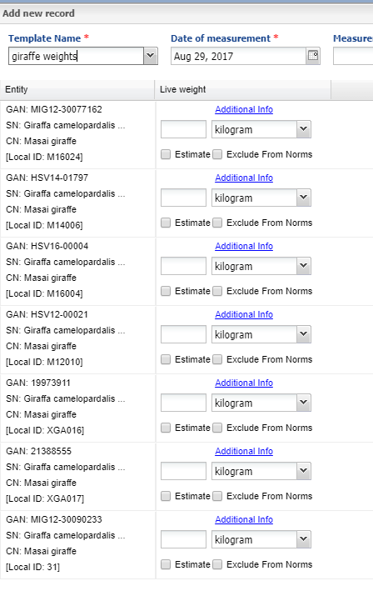
Using the Template
To use the Template select Batch
Measurements > Weight or Length >
Add New Record. Select the desired
Template from the drop down list.
Record the data and Save. You do not
have to record a measurement for all
the records but you will receive a
message when you Save if any are empty.

Slide 13
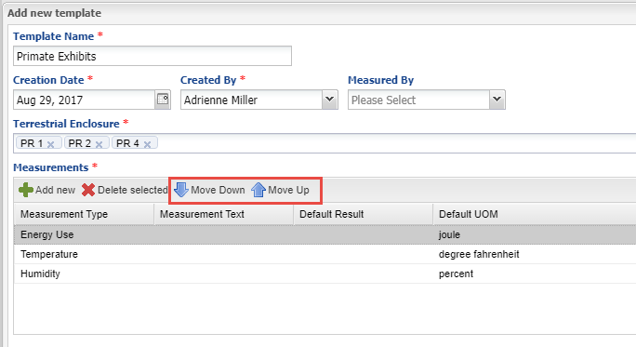
Enclosure Measurement Templates
Measurement Templates can also be created for enclosures. Open the Enclosure module > Environmental or Water Quality Template > Add New Record. Name the Template and
select the enclosures. If you chose Environmental Measurements only Terrestrial enclosures will be selectable. If you chose Water Quality Measurements Only Aquatic enclosures will be selectable. Use the Move Down and Move Up arrows to arrange the
Measurement list to your liking.

Slide 14
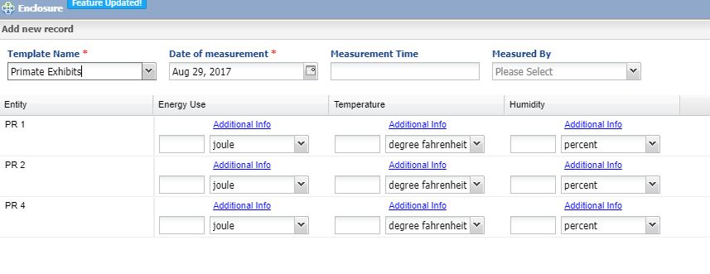
Using the Template
To use the Template select Add New Record and chose the Template Name from the
drop down list. Fill in your data and Save.

Slide 15
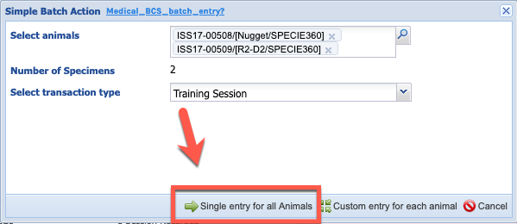
Editing Records
Notes and Observations, Enrichment and Training sessions: When creating records using a batch action with the option of single entry for all animals, you can edit the individual record afterwards.
Note on data entry monitoring. If you edit an individual record but then use data entry monitor to roll back the original batch entry, the individually edited entry will also roll back. If you roll back the individual edit, this will revert to being a part of the batch record.

Slide 16
Any Questions?
SAVING TIME WITH DATA ENTRY

