Slide 1
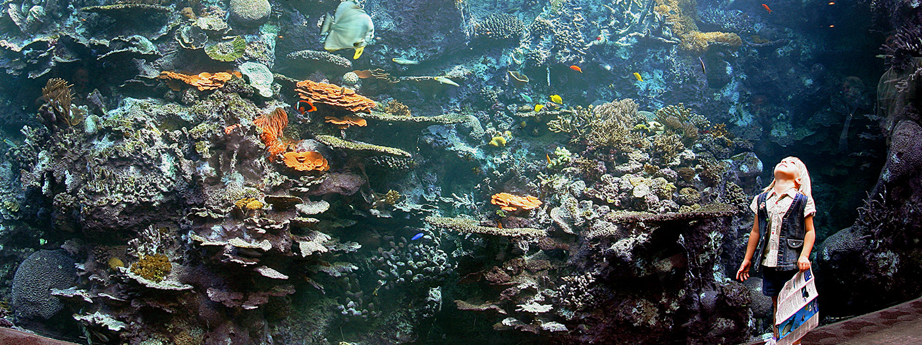
5000 Aquatic/Aquarium Functionality in ZIMS
What ZIMS can do for your water worlds!!

Slide 2
ZIMS Updates!
This PowerPoint is up-to-date as of: April 22 2019
ZIMS is developed in an “agile” method
This means that it is updated every two weeks, sometimes with additional releases in between!
Use the link below to see if there have been any updates to this topic since the date above:
http://training.species360.org/updates/

Slide 3
What can ZIMS do for your Aquatic life?
Group Management
Individual Management
Enclosure Management
Life Support and
Component Management
Water Quality
Collection Trips
Aquarist Daily Log
Reports

Slide 4
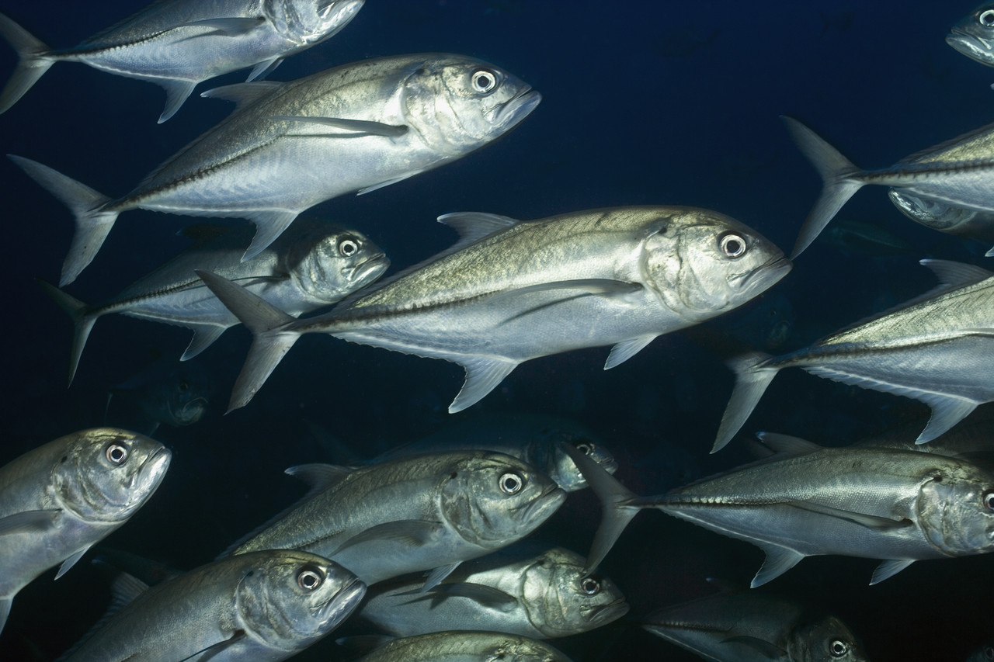
GROUP MANAGEMENT
Although aquariums will have
Individual animals recorded,
the majority will be managed
in Groups. A Group has multiple
members, numbers can be
actually counted or estimated,
the members cannot be
individually identified and are
usually of the same species.

Slide 5
Groups – No Tracking
These Groups can be tracked at multiple levels, depending on what information you need to know about the group. Tracking is basically what kind of details you are maintaining on your group numbers. This group has no tracking, you want only to see the number of members in it.

Slide 6
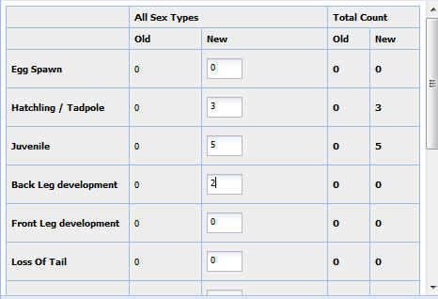
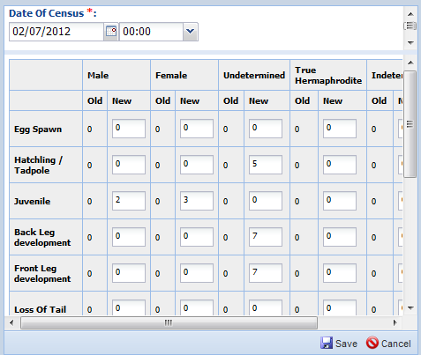
Groups – Tracking
As tracking is added the data entry screens
become more complex.
UPPER LEFT - tracking by Sex
LOWER LEFT – tracking by Life Stage
LOWER RIGHT – tracking by Sex and
Life Stage

Slide 7
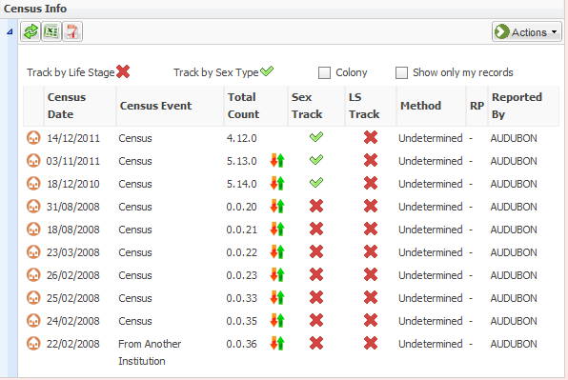
Groups – Tracking in Census Grid
How your group is being tracked will
display in the Census Info grid. This
group is being tracked by Sex Type.
You can change the tracking of a group
when you record a Census, you are not
bound to the tracking you used when
you started the group. Recording a Census
Count in this grid creates a group count
reset. As members are added or subtracted
from the group using My Transactions flow,
ZIMS will use the most recent Census
recorded to calculate the current number
in the Group.

Slide 8
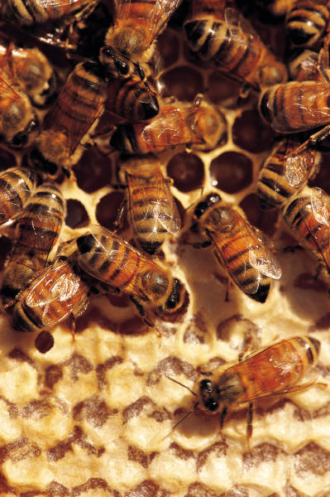
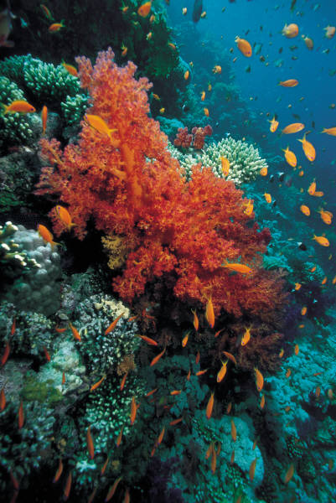
Groups – Colonies
A colony is a group with too many members
to count or record. Colony members often
work together to sustain themselves such as
honeybees and fire ants. A colony can also be
one entity of many parts or fragments such as
corals. By default the Colony Inventory Count
is “1” for each colony. This count can be changed
in Institution Preferences. To change a group into
a colony simply check the Colony checkbox in the
census grid. When accessioning a new group there
is a checkbox to indicate it is a Colony.

Slide 9
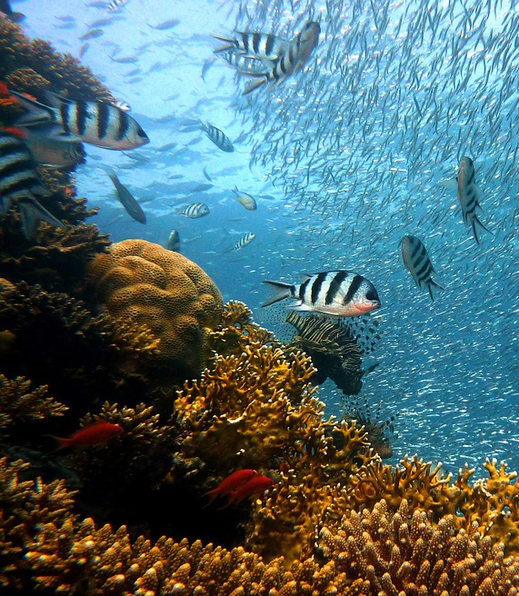
Groups – Full versus Partial in My Transactions
Full
Happens to entire group
Initial acquisition of the group
Final disposition of the group
Partial
Happens to part of the group
Add members
Merges
Acquisitions/Births/Hatches
Remove members
Splits
Dispositions/Deaths

Slide 10
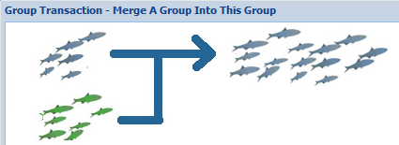
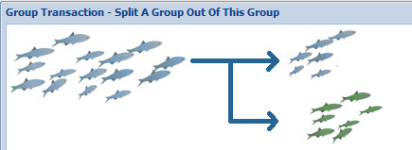
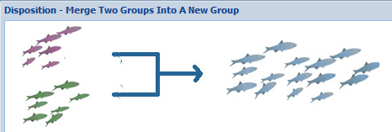
Groups – Watch the icons
For many of the partial transactions you will see
graphics that represent what you are doing to
help avoid confusion. Look at the graphics to
confirm your action before completing the
transaction.

Slide 11
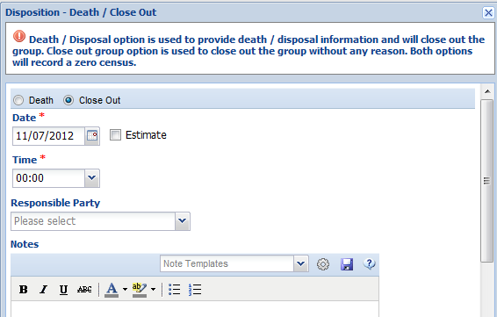
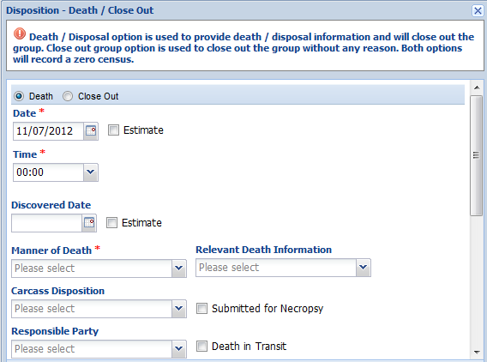
Groups – Closing Out
If you perform a Full Disposition/Death on a
group it will by default be Closed Out and no
longer display in reports. However, if you do a
Partial Disposition/Death, even if it brings the
count down to 0.0.0, the group will continue to
display on your reports. If you do not wish to
see it there you should mark it as Closed Out.
This is especially useful for historical groups that
remain on your records. The census of the group
does not have to be zero to mark it as Closed Out.

Slide 12
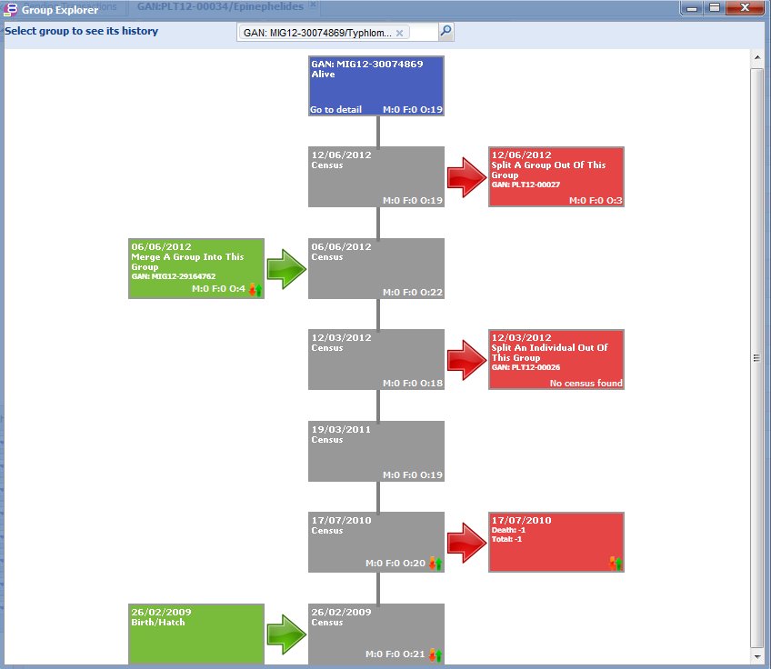
Groups – Group Explorer
A feature that allows you a quick
visual of what has been happening
in your groups is Group Explorer.
It is a graphic of your censuses and
splits and merges of your groups.
Group Explorer is found under the
Tools in the Start menu. Additions
to the group are shown on the left.
Removals from the group are
shown on the right. The merges and
splits are hyperlinked so you can go
directly into the records involved.
The final census is also a hyperlink
so you can go into the record for
the group in focus.

Slide 13
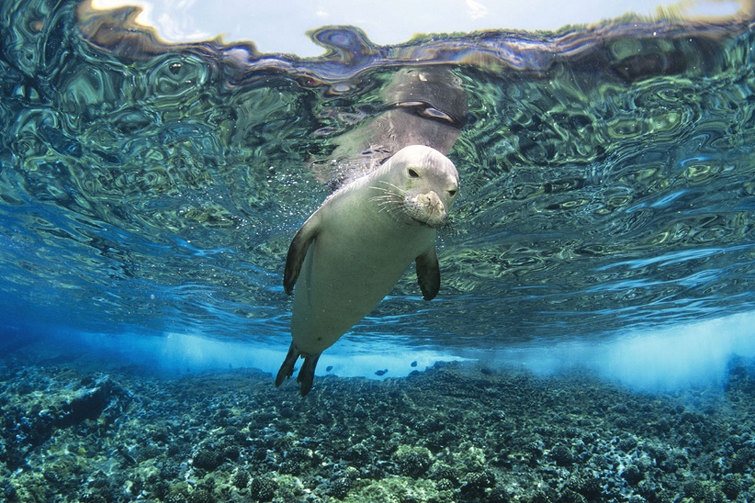
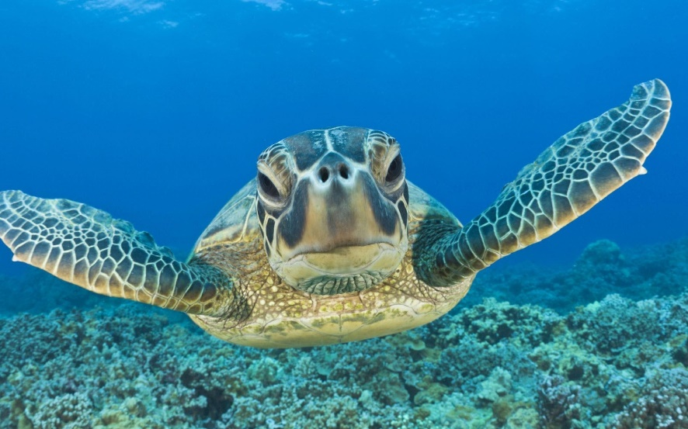
INDIVIDUAL ANIMAL MANAGEMENT
ZIMS also has functionality designed to help you manage those animals
that you can identify as individuals and that each have their own record.

Slide 14
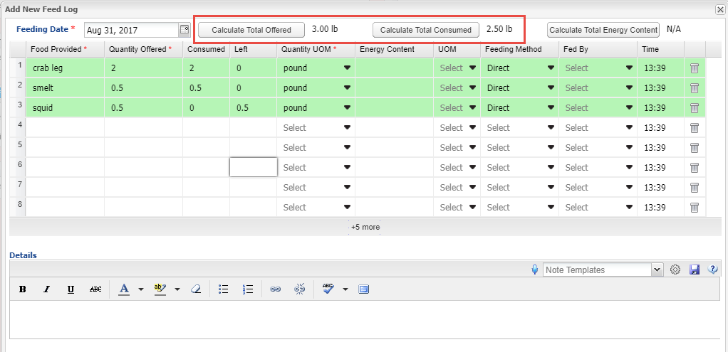
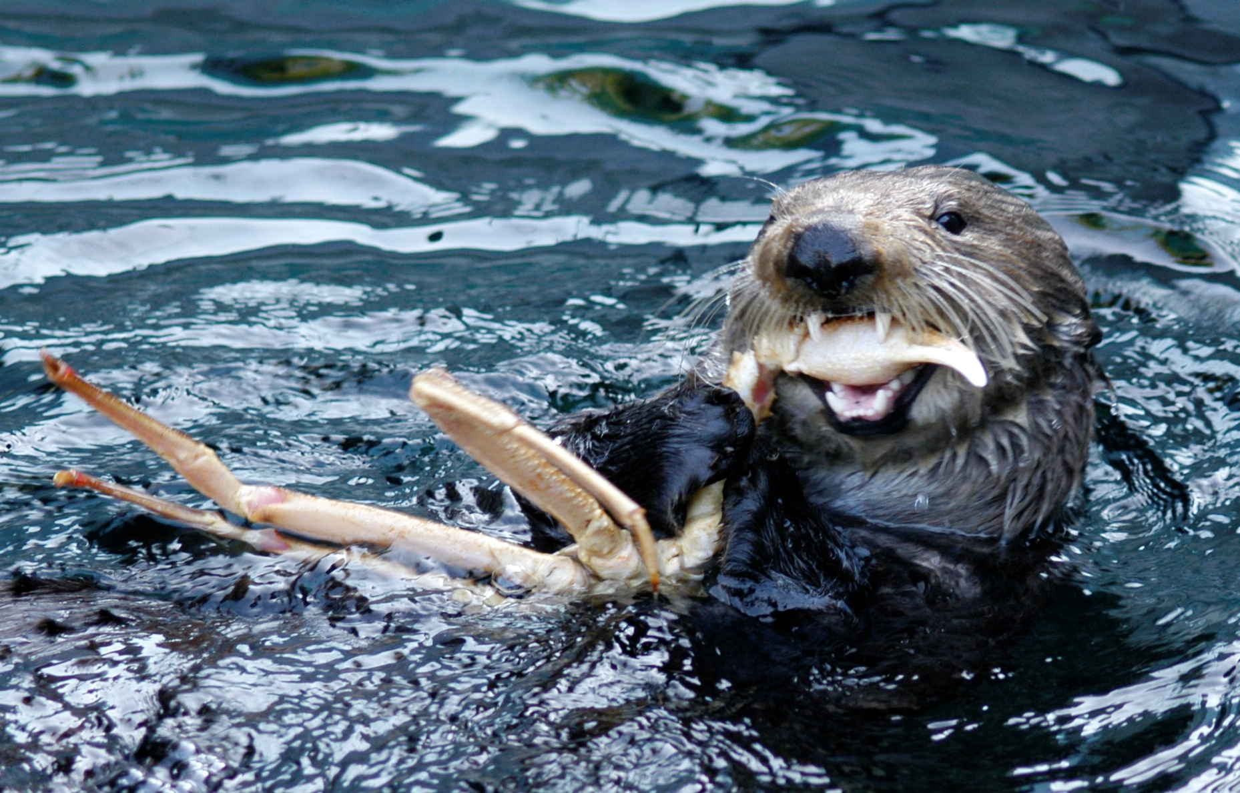
Animals – Feed Log
The animal Feed Log is a grid where
multiple food items can be recorded.
If the Units of Measure are the same
ZIMS can calculate the Total Offered
and the Total Consumed and the
Energy Content.

Slide 15
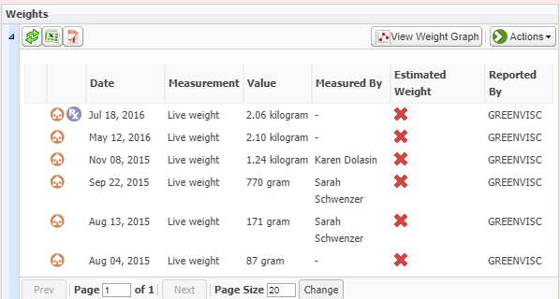
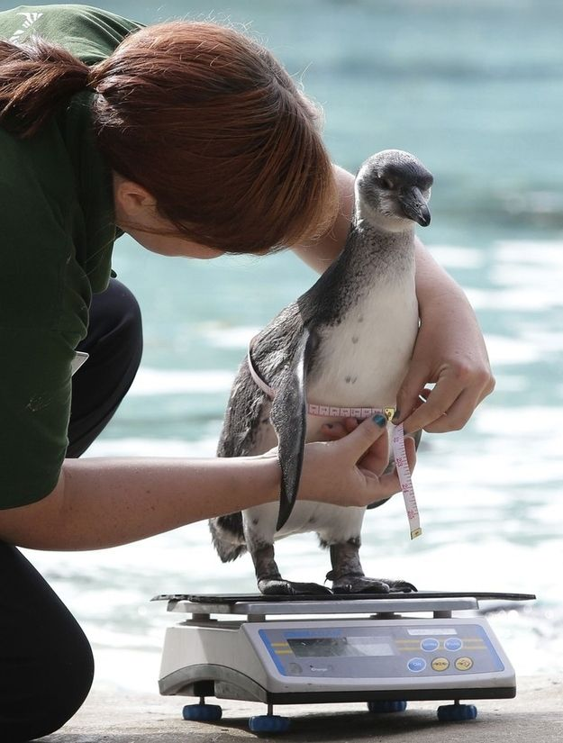
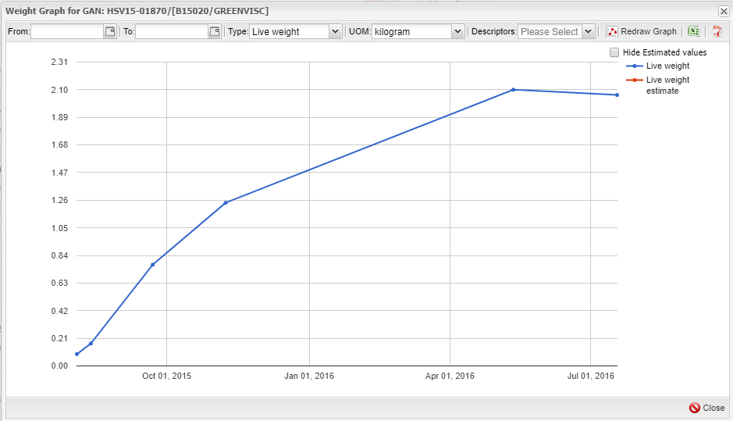
Animals - Measurements
ZIMS can track your animal weights
and lengths. Both of these can be
viewed as a graph for a quick way
to see if the animal is growing
properly or maintaining its
desired weight or girth.

Slide 16
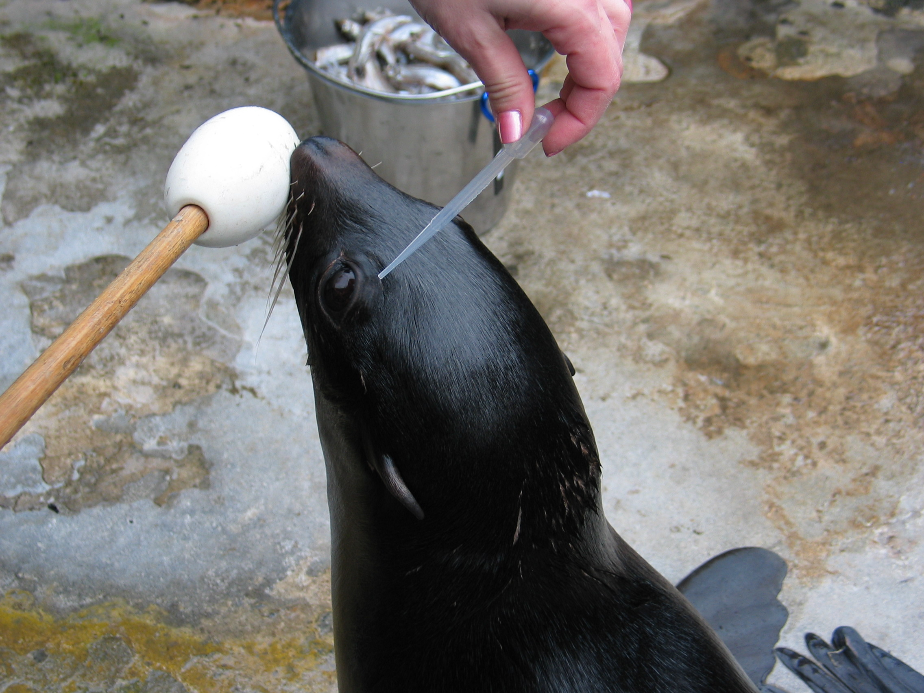
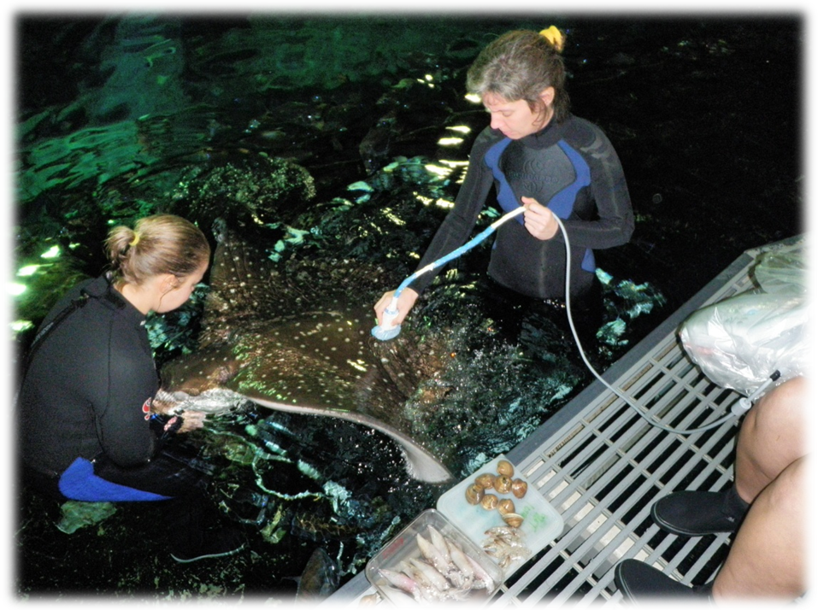
Animals – Training & Enrichment
Training is beneficial to all animals, making their husbandry and medical care easier
on keeper staff and veterinarians. And Enrichment will improve the health and
well being of almost all species. ZIMS has a Training and an Enrichment module to
capture this information.

Slide 17
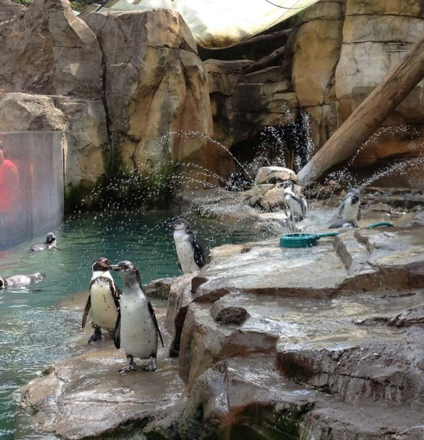
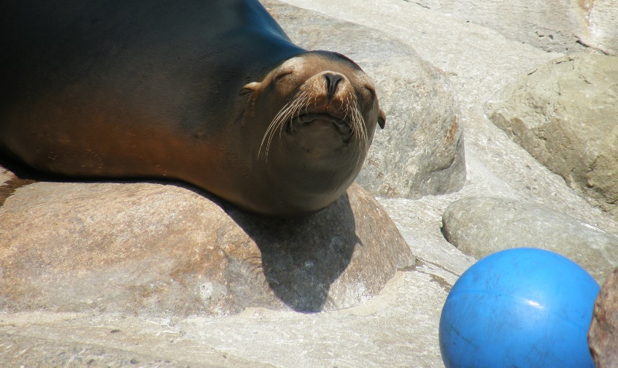
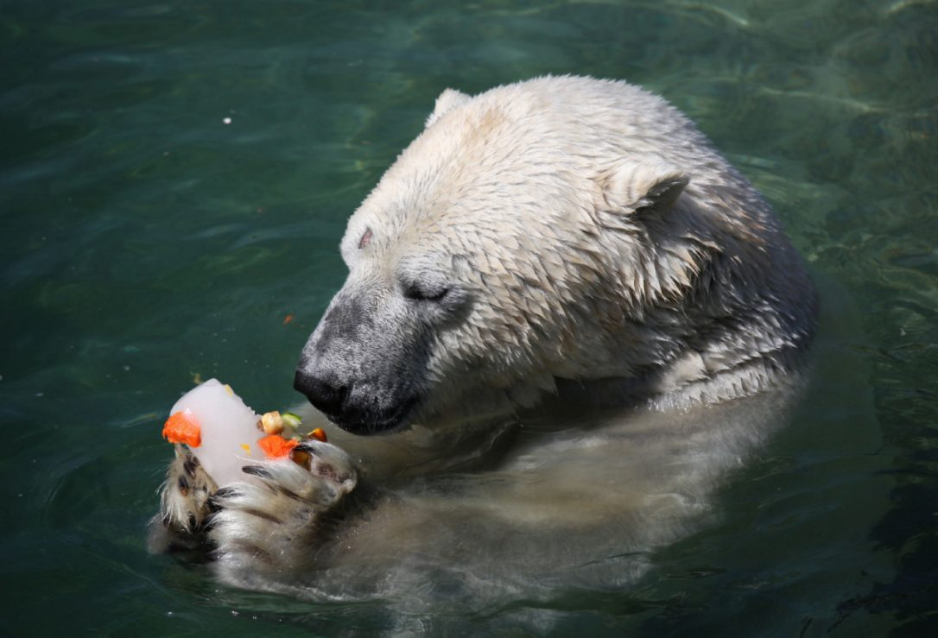
Animals – Training & Enrichment
The process is similar for recording these topics. You
first record the behavior you want to train or the
enrichment item you will be using. This creates local lists
you can select from. You then assign a behavior or an
item to the animal. You then record training or enrichment
sessions for that behavior or using that item.

Slide 18
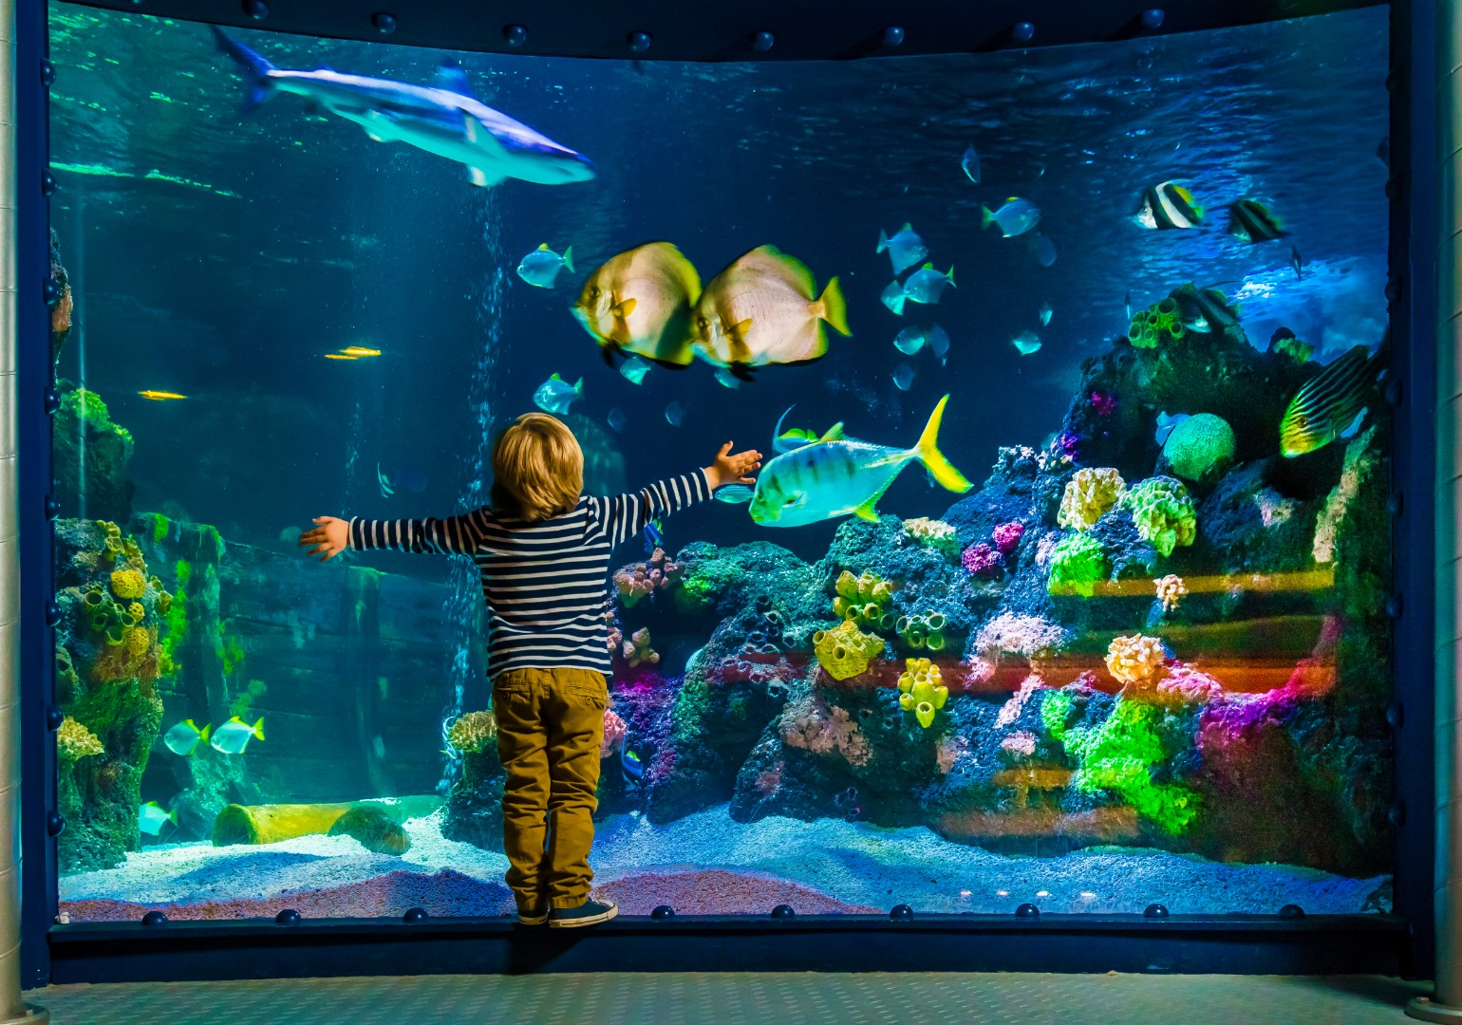
ENCLOSURE MANAGEMENT
In addition to animal
management, ZIMS also
helps you manage your
enclosures, tanks and
life support systems.

Slide 19
Enclosure - Treatment
You can add a treatment to an Aquatic enclosure. First a Prescription must be created for the Enclosure in the Medical module. Staff other than Vets can be given the access to create an
Enclosure Treatment.

Slide 20
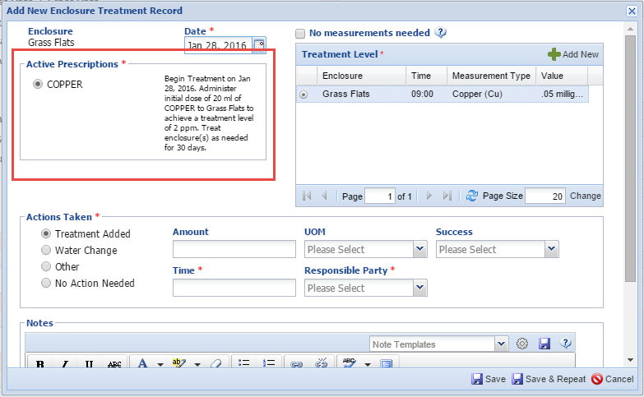
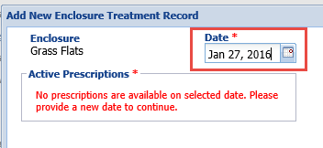
Enclosure - Treatment
The actual treatment is recorded in the Enclosure record in the Husbandry
modules. The Prescription will display in the upper left of the data entry screen. If the date entered is before the start of the scheduled treatment you will get a message that there are no prescriptions at that time.

Slide 21
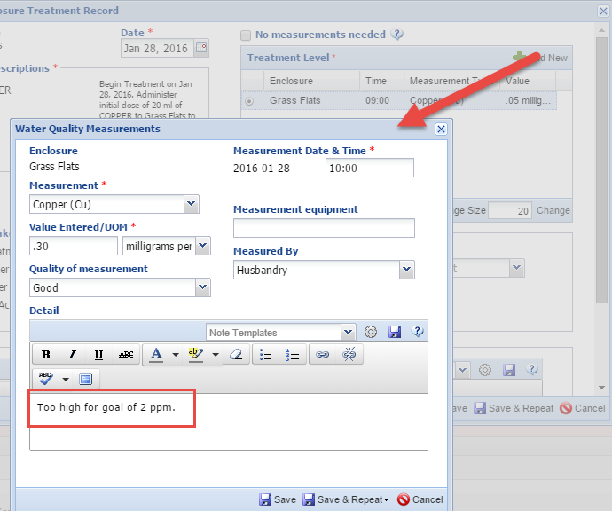
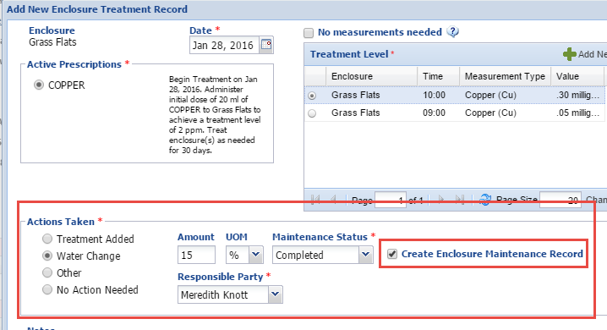
Enclosure - Treatment
You can record new measurements, capture
Actions Taken and create Enclosure Maintenance Records.

Slide 22
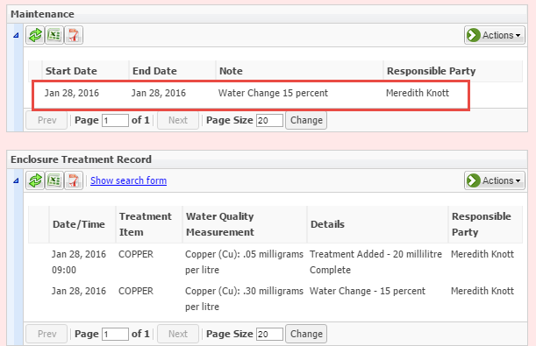
Enclosure - Treatment
The Enclosure Treatment will display in the Treatment grid and the Water Change will display in the Maintenance grid.

Slide 23
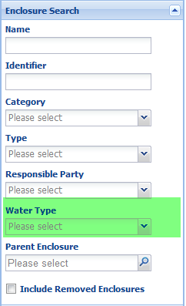
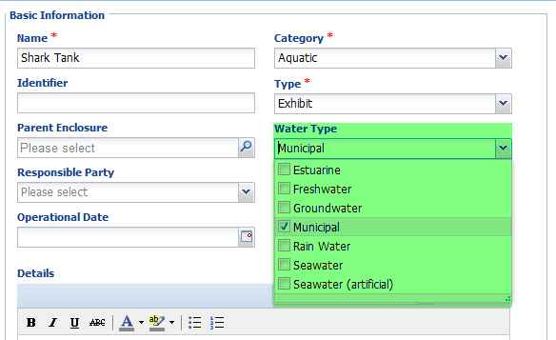
Enclosure – Water Type
When you add a new aquatic enclosure you can record what Water Type it is. This can be
edited should it change. It is a multiple select dropdown data standard so should you
record a building with multiple tanks you can indicate multiple types. This is a searchable
field so you can pull up all your tanks with a specific water type(s).

Slide 24
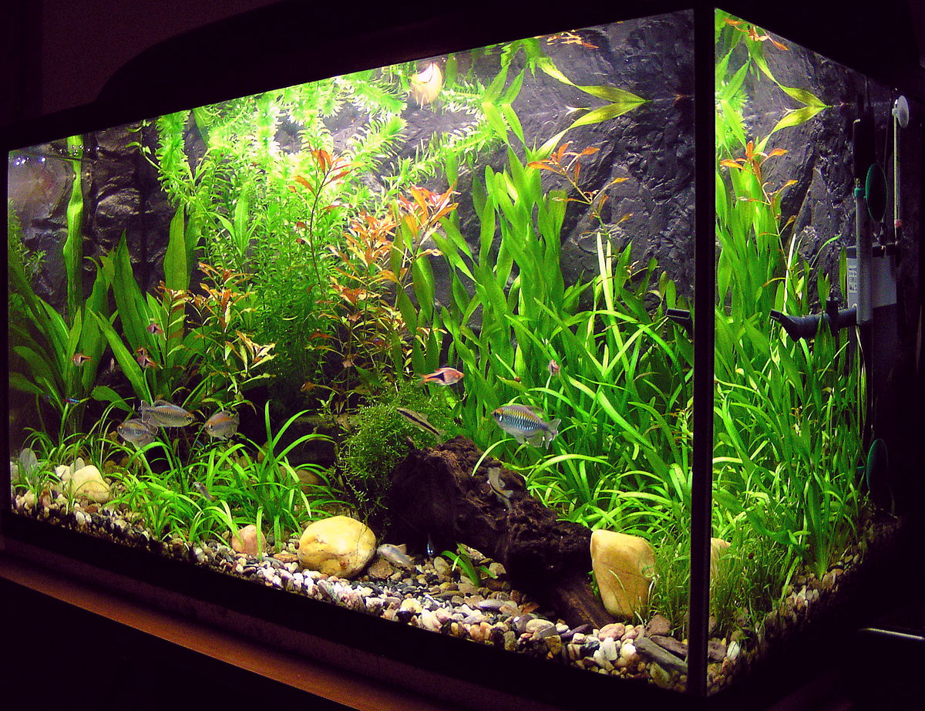
Enclosures – Dimensions & Barriers
You can also record the dimensions
and the barriers for your enclosures
and tanks. The dimensions let you
know if it is big enough for the
intended occupants or if it will fit
where you want to move it. The
barriers let you know if it is the
proper material and if it is strong
enough.

Slide 25
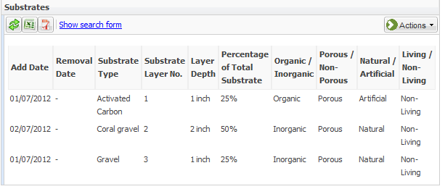
Enclosures - Substrates
Knowing what substrates are on the bottom of your tanks may impact what you use to
treat the water. And knowing when the substrates were added may influence when it is
time to remove them and replace with fresh ones. In addition, the grid will note whether
these substrates are organic or inorganic, porous or non-porous, natural or artificial and
living or non-living. Using the search form you can find any substrates that have been replaced.

Slide 26
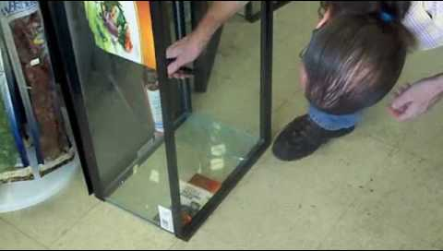
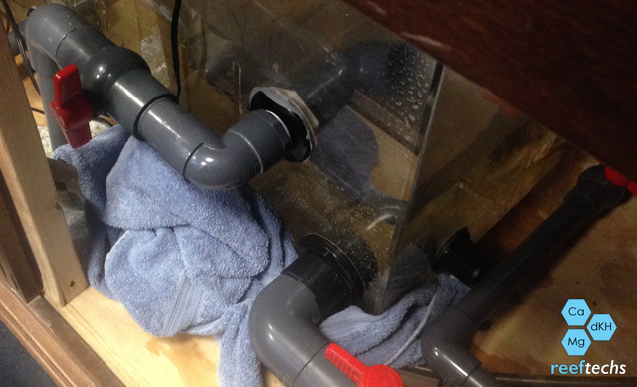
Enclosures - Maintenance
In ZIMS you can track enclosure and tank maintenance. You will be able to track
work orders and tell if maintenance is proceeding in a timely manner. You can
also track exhibits and tanks that are requiring more maintenance than normal.
For maintenance that may impact the animals held in the enclosure you can
select to have the information recorded on the enclosure to also go into the
animal record.

Slide 27
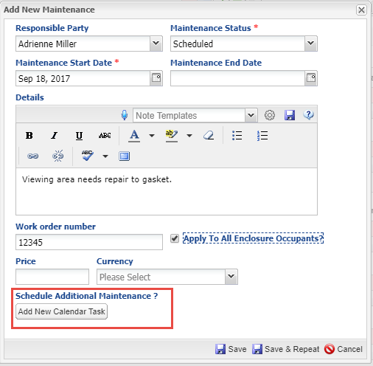
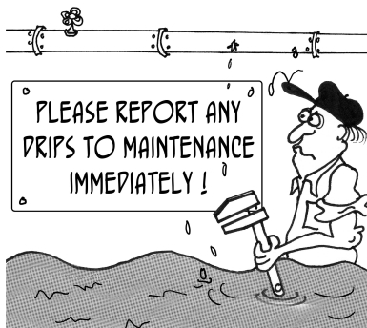
Maintenance
Keeping everything in working order is very important. You can schedule maintenance
tasks on your Calendar directly from the Add Maintenance screen.

Slide 28
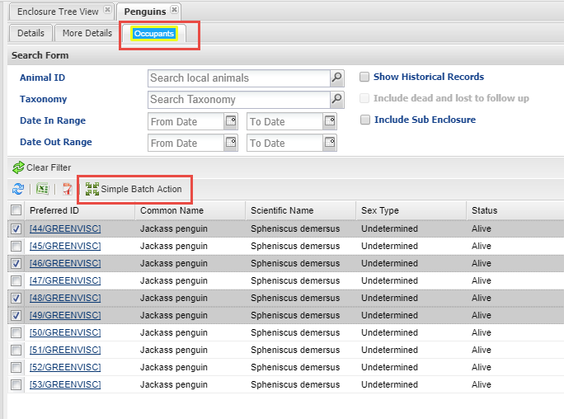
Enclosures - Occupants
Using the Occupants tab in the
enclosure record you can see
what animals are currently
occupying the enclosure. Using
the search form you can find
historical occupants by taxonomy
and date range. Using the Simple
Batch Action option you can
quickly record data on all or some
of the enclosure occupants.

Slide 29
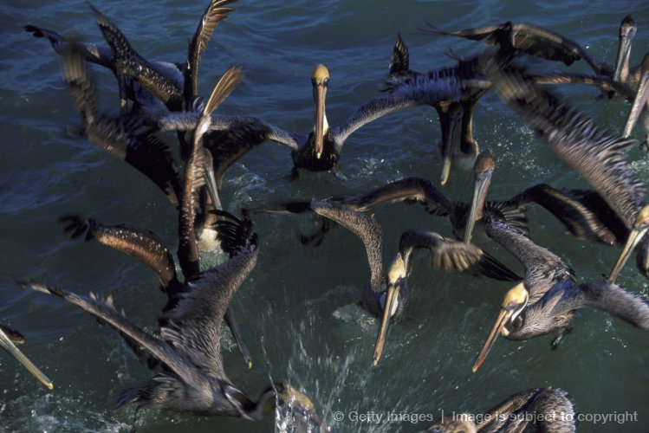
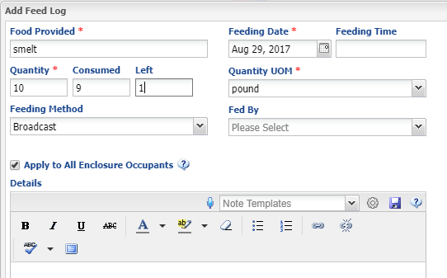
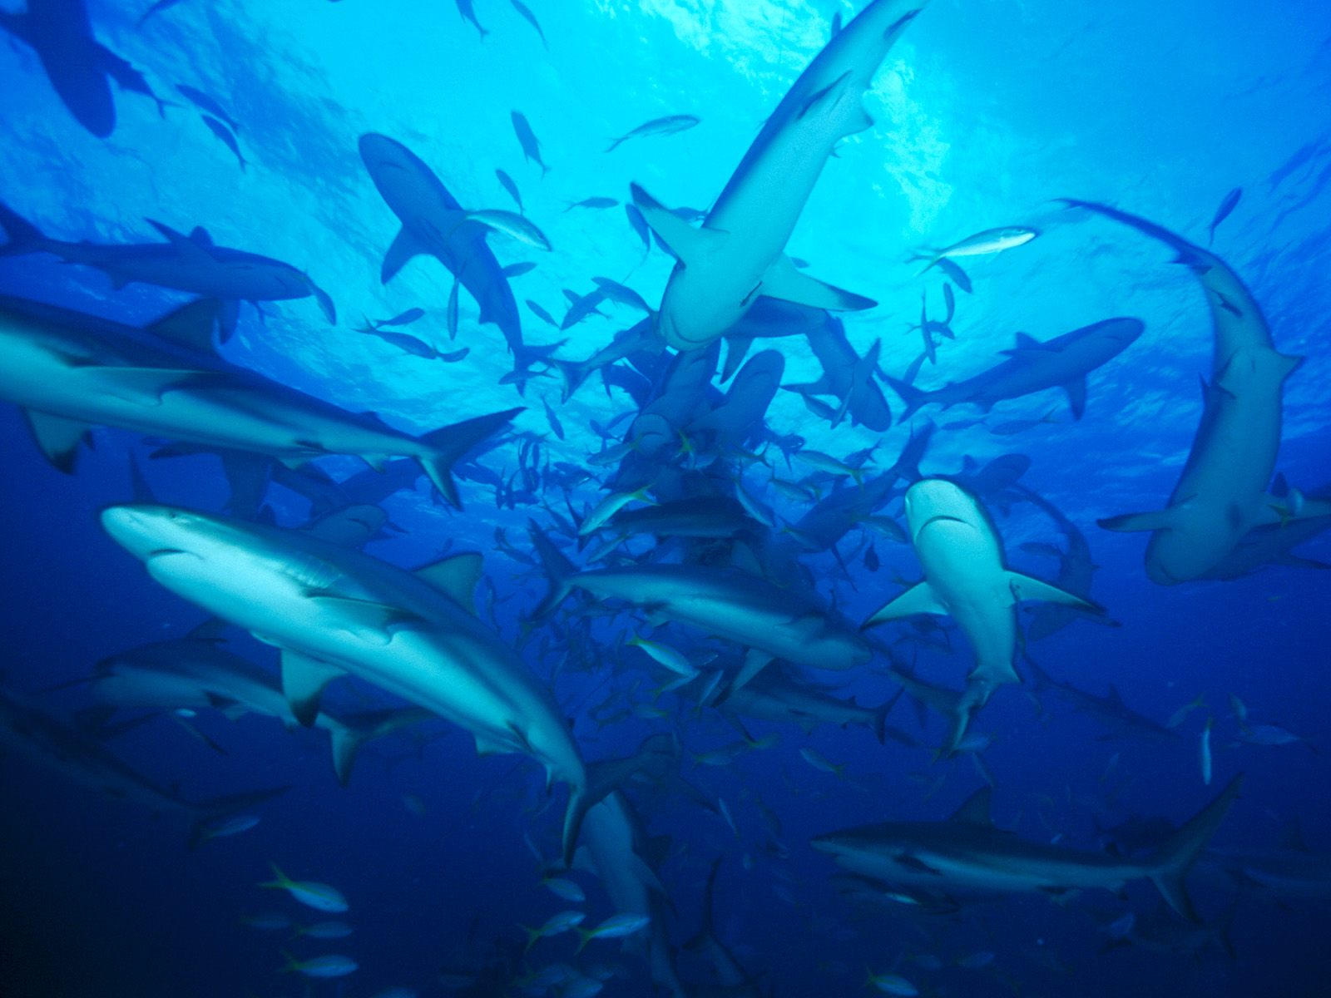
Enclosures – Feed Log
You can record a Feed Log against an enclosure and then apply it to all the occupants within that enclosure at the time. This will automatically place the record of the feeding into the record of
every individual or group currently inhabiting the enclosure.

Slide 30
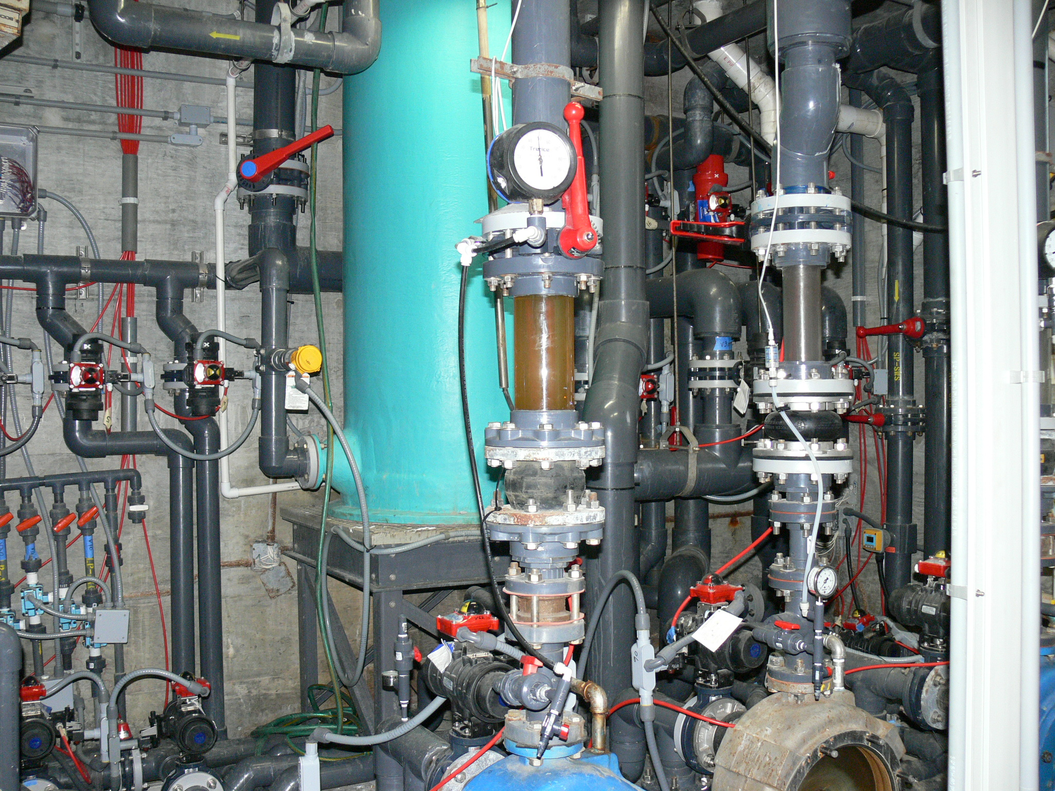
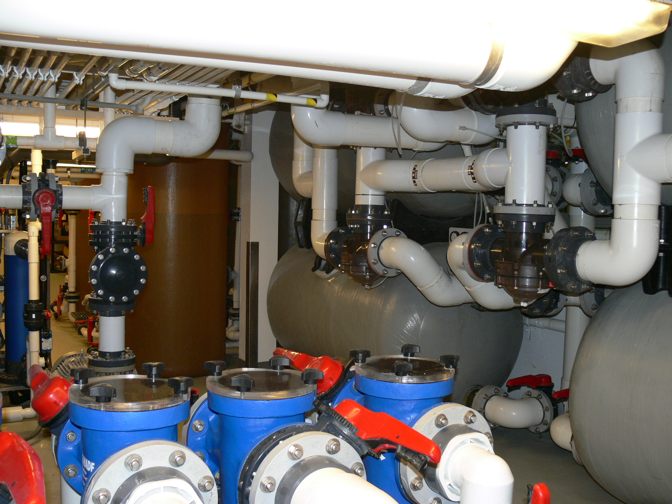
LIFE SUPPORT MANAGEMENT
One topic very important to aquariums
and those managing aquatic life is the
ability to maintain information on the
life supports that keep the animals
healthy and happy. Although terrestrial
enclosures do use life support, it is the
aquatic enclosures that rely very heavily
on life supports to sustain the life of their
animals.

Slide 31
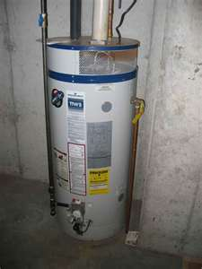
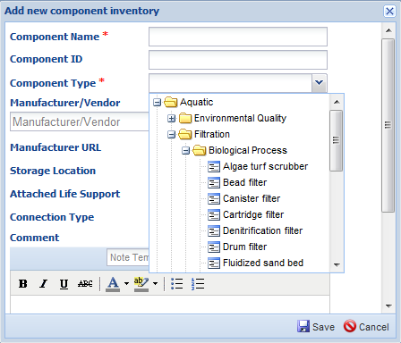
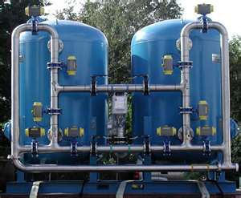
Life Support – Components
Components include items such as pumps, filters, lighting and water and air temperature
Controllers. Your various components that make up your life supports are maintained in
an inventory where you can track Make, Model and serial number. You can add your
components directly to the inventory or add them from the life support record itself.
The component type is a cascading dropdown where you can stop anywhere on the list
to select. So you could select simply Filtration or go down to Biological process filtration.
If you know the exact type you could select the actual component such as a bead filter.

Slide 32
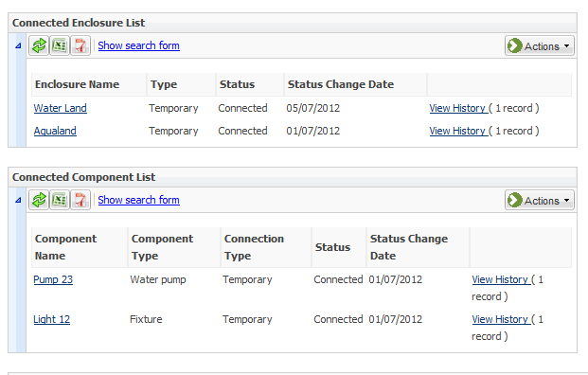
Life Support – attach to Enclosure
While your components can be
physically attached to create only
one Life Support, one Life Support
can be physically attached to
multiple Enclosures. This Life
Support is attached to two
enclosures, Water Land and
Aqualand. In addition, you can
view what components make up
the life support. You can view any
disconnected enclosures or
components by using the search
form.

Slide 33
Life Support – Associated Life Support Tree
Another quick and easy way to see if an
enclosure has a life support attached to
it is to view the Associated Life Support
Tree under Enclosures. Here we can
quickly see that the Aquatic Life support
is attached to the two enclosures –
Aqualand and Water Land. There is also
a separate tree that will display from the
Life Support view.

Slide 34
Water Quality
Water Quality is a large part of your Aquarist’s day, and hugely important in maintaining the health of your animal collection. ZIMS allows you to record water quality measurements on your Enclosures, Life Supports and
Components. Simply recording measurements on your enclosures, life supports and components is not usually enough. You want to keep the measurements within specific minimum and maximum ranges for the health of
the animals. In ZIMS you can record
your desired ranges for your water
quality and make these ranges
specific to enclosures, life supports
and components using the
Measurement Range Template.

Slide 35
Out of Range Notification
If a measurement is outside the range set
there is a warning regarding this. You can
save the measurement anyway, or go back
and correct if it was an error. But whoever
does the data entry has been given a heads
up that this measurement is not a desired one.
In addition, in the measurement grids, these
out-of–range measurements are displayed
in red.

Slide 36
Email Notification
Once you have recorded a measurement, the Set Email Notification button will be
activated. This allows you to select staff that will receive an Email when the
measurement is outside the desired range that was recorded in the Range Template.
They can receive daily summaries or instant alerts.

Slide 37
Water Quality Template
You can create Templates for quick recording of measurements. The Enclosures, Life Supports or Components are listed on the left hand side and the measurements across the top. Simply record the measurements taken without having to open each record.

Slide 38
Measurements - Graphs
You can also produce a graph of your water
quality measurements. By hovering over the
dot on the graph you can view the actual
date and measurement recorded. By adjusting
the From and To dates you can expand or
limit the range of the graph.

Slide 39
Measurements – Multiple Graphs
You can create graphs for multiple measurements on multiple enclosures or
life supports. Each entity has its own color (1). The measurements display on
the Y axis (2)

Slide 40
Collection Trips
Although terrestrial animals such as reptiles and birds
are often collected on trips specifically organized to do
so, aquariums depend highly on organized trips to
replenish their exhibits. ZIMS allows you to track your
trips with a simplified accession screen for accessioning
animals collected, caught and released, or that died in
transit.

Slide 41
Collection Trip - Details
You can gather a lot of information about
these Collection Trips, with a wide range
of search fields to retrieve this information
at a later date. You can track and retrieve
who was the Trip Lead as well as staff
members who participated in the trip.
You can record a general location such
as a country or major geographic area,
or record the Longitude and Latitude or
the GPS co-ordinates. You can record if
you used an institutional vehicle, a
donated one and who donated it, or if
you rented one specifically for the trip.
And tracking the legal aspect of your
collecting by associating appropriate
permits with your trip gives you easy
reference to these documents.

Slide 42
Collection Trip – Accession Log
Provides easy recording of your catch
Outcome
Accession
Only these records will receive a GAN
Caught and Released
Death in Transit
By-catch
Collection Method
You can also associate a previous accession with a Collection Trip

Slide 43
Aquarist Daily Log
The Aquarist Daily Log is a template where you can track and record on the tasks you need to do on your enclosures, life supports or components. On the left is the entity. On the right are the Data Fields to include. If a field is restricted to an entity type it is noted in red. Feed Logs and Barrier Voltage are only appropriate for Enclosures whereas Total Volume only applies to Life Supports or Components. The Template can be shared or editable by others.

Slide 44
Aquarist Daily Log
You can use the Move Down and
Move Up arrows to arrange the
order of the entities and the Data Fields to match the order you desire to make your data entry go faster.

Slide 45
Using the Daily Log
When using the ADL, any actions that are not appropriate for the entity are greyed out and you cannot enter data in them. The Template saves as a draft every 60 seconds so you do not have to complete your entries all at one time. If you select Cancel (not Save) you will be asked if you want to save the data as a draft to finish later.

Slide 46
Wild Acquisition Report
The Wild Acquisitions Report was designed to assist Aquariums with their reporting requirements. You can run the report for specific Water Types or Collection Methods which are often specified on these reports. The various Sort options help you organize the report.

Slide 47
Enclosure Activity Report
The Enclosure Activity Report lets you select by Enclosure or by Enclosure Lists. The Event Type is multiple select so you can include what Events you want to see.

Slide 48
ZIMS for Aquatic Management!

