Slide 1
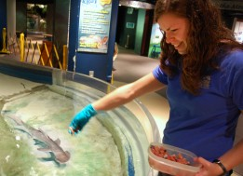
Aquarist Daily Log
Recording all you do all day!

Slide 2
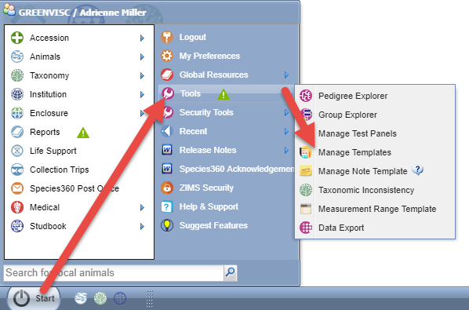
Creating the ADL Template
To save you time you can create
an Aquarist Daily Log to help you
remember all the environmental
and water quality measurements,
enclosure feedings and more that
you need to capture during your
day in one easy to use screen.
To create a template for this log go
to Start > Tools > Manage Templates.
Or you can access it from the Enclosure
module > Batch Measurements.

Slide 3
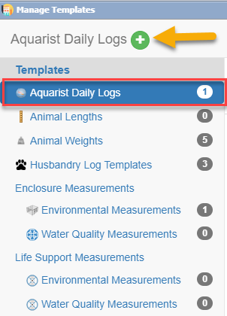
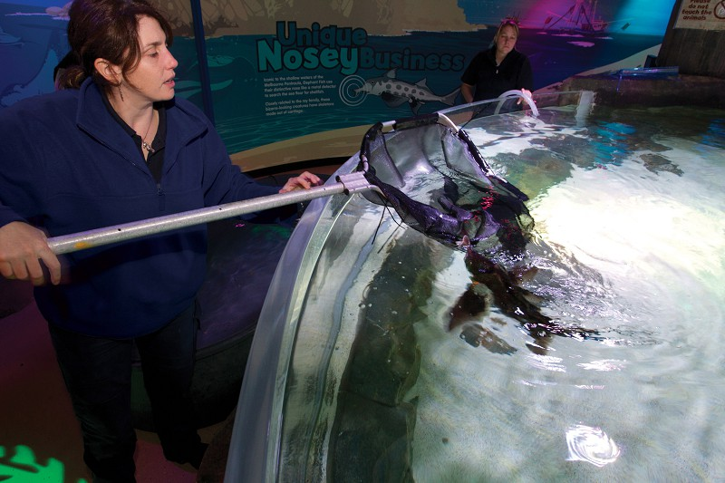
Creating the ADL Template
Either approach will open the Manage Template screen. Highlight the Aquarist Daily Log and select the Add New icon.

Slide 4
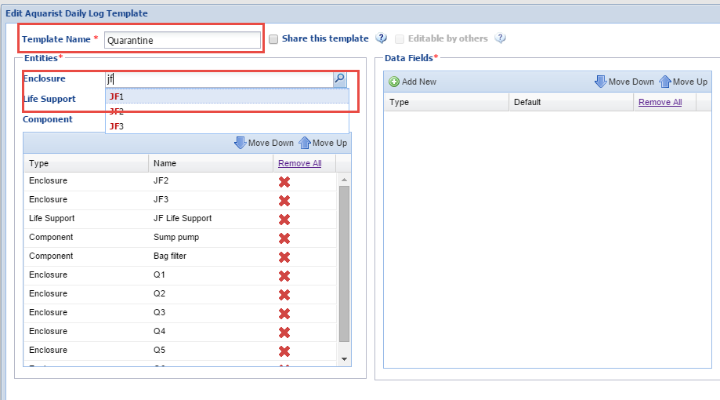
Creating the ADL Template
Create a unique name and select
what Enclosures, Life Supports or
Components that you will be
gathering data on during your day.
If you want others to be able to use
the template check the Share This
Template box. Checking this will
activate the Editable by Others box
should you want other staff to be
able to edit the Template.

Slide 5
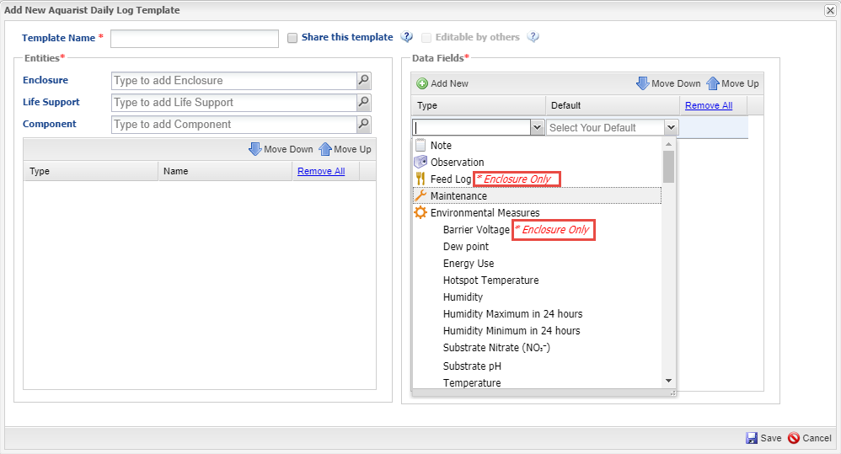
Creating the ADL Template
You will then select the Data Fields
you want included in the template.
Commonly selected fields are Notes &
Observations, Measurements, Feed
Logs and Maintenance. Any data fields
that are specific to an entity will be
noted in red. Here Feed Log and Barrier
Voltage can be applied only to Enclosures.

Slide 6
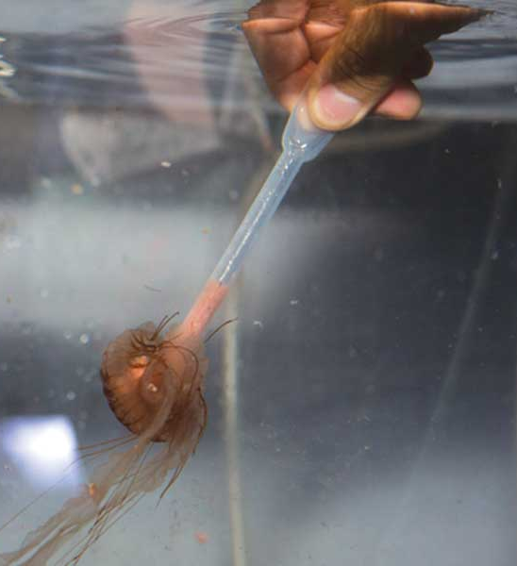
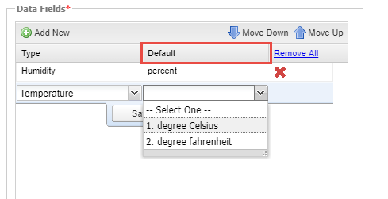
Creating the ADL Template
For any measurements you will
need to select your default
Units of Measure.

Slide 7
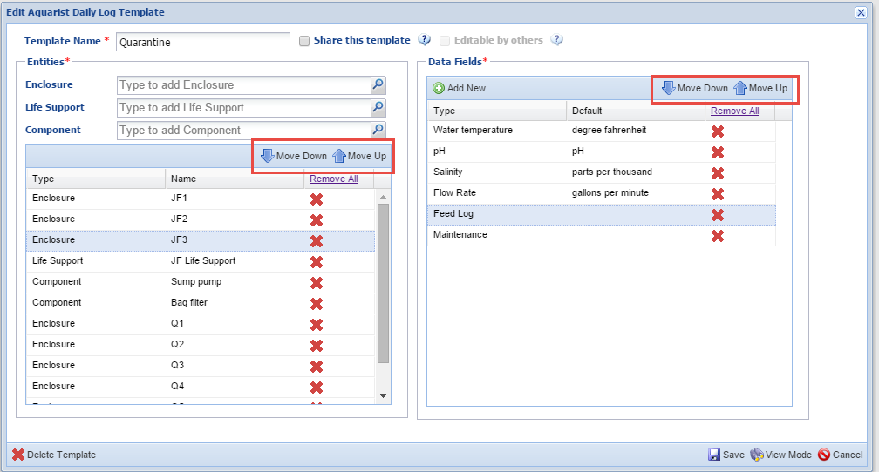
Aquarist Daily Log
Using the Move Down and Move Up arrows in both Entities and
Data Fields you can arrange the sequence as desired so that the
template works for you as you move from tank to tank.

Slide 8
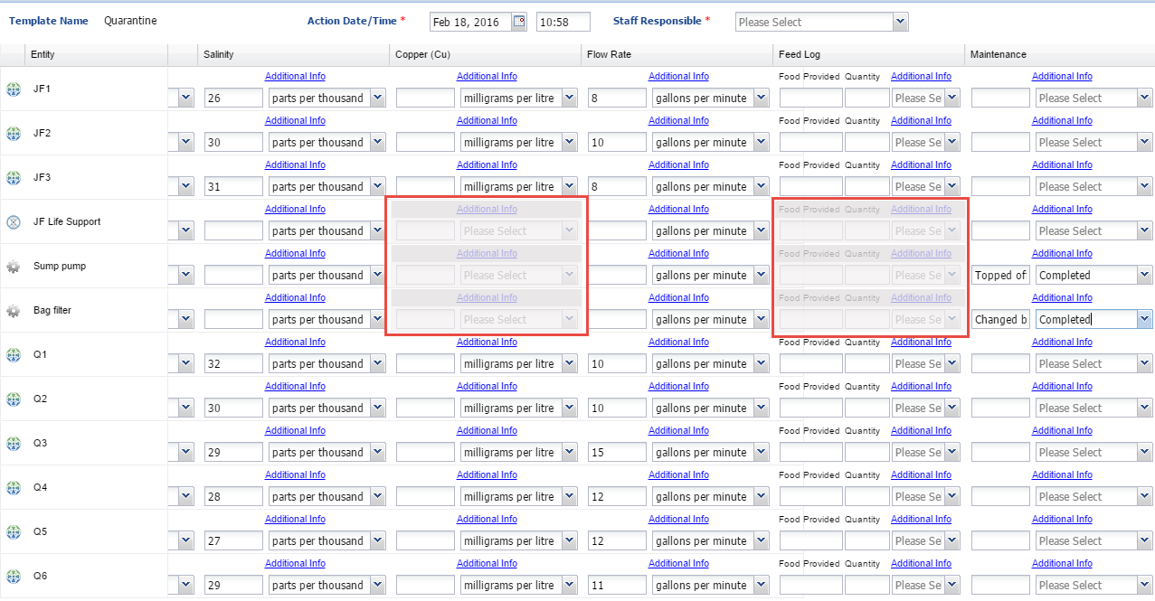
Take measurements using the log
To use the Aquarist Daily Log go into Manage Templates, highlight the ADL and select the desired template from the list. Any Data Fields that are not appropriate for an Entity will be greyed out and not editable. Record your measurements or actions as appropriate.

Slide 9
Take measurements using the log
Move through your data entry quickly by using the TAB button to jump to the next data entry field.
When you press TAB, the template will automatically skip the ‘default unit of measure’ box, and will jump straight to the next data entry field.

Slide 10
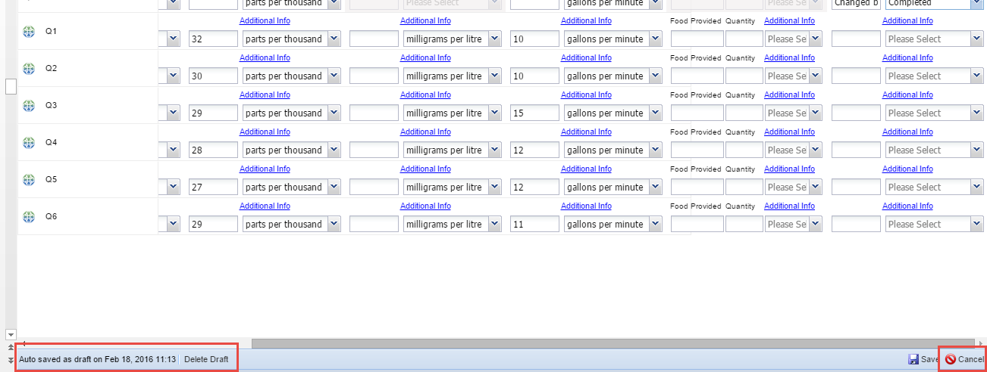
Save the draft
Because you have more to add to the template as you go about your day you do not
want to Save it yet. The template auto saves every 60 seconds. You can save it as a
Draft by selecting Cancel instead of Save. You will be asked if you want to save your
work as a Draft.

Slide 11
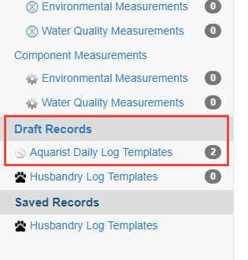
Finding Drafts
Drafts are found at the bottom of
the Manage Templates screen.
Open the template you want to
complete, record your data and
select Save. The information
recorded will go directly into the
record of the entities you
selected.

Slide 12
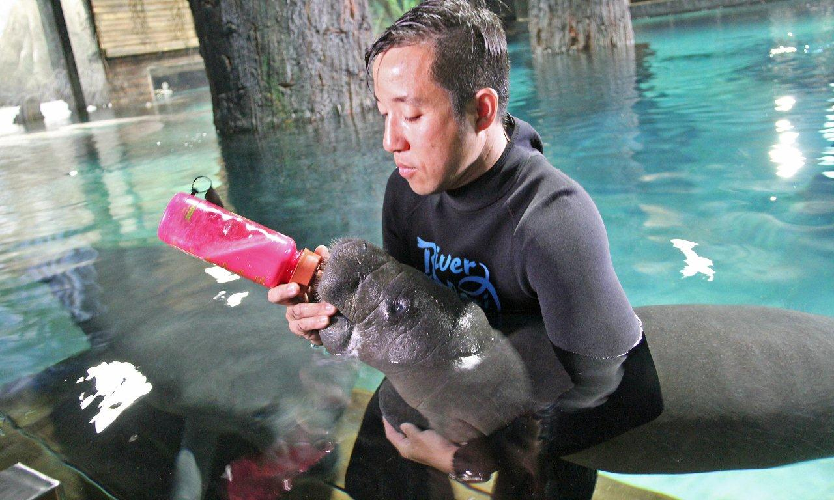
Aquarist Daily Logs
Making your day easier!

