Slide 1
An Aquarist’s day in zims!
Using zims throughout your day

Slide 2
ZIMS Updates!
This PowerPoint is up-to-date as of:
april 18 2019
ZIMS is developed in an “agile” method
This means that it is updated every two weeks, sometimes with additional releases in between!
Use the link below to see if there have been any updates to this topic since the date above:
http://training.species360.org/updates/

Slide 3
The scenario
You are an aquarist responsible for covering six quarantine tanks and tw0 behind the scenes breeding tanks
We will follow you throughout your day
  checking water quality measurements
  Feeding tanks
  Recording enclosure treatments
  Performing maintenance on tank
Collection team arrives with new fish to record
You run reports for your day’s activities

Slide 4
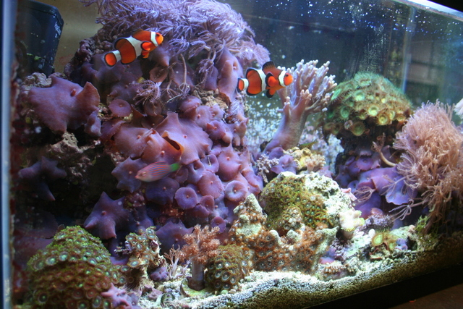
8:00 am – morning rounds check water quality on your tanks
(create a measurement range template and an aquarist daily log first!)

Slide 5
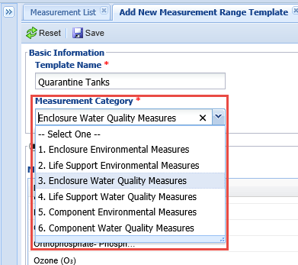
Measurement range template
Just recording your water quality
measurements is not enough. You
want them to be within a specified
range. To create a Measurement
Range Template for these ranges
go to Start>Tools>Measurement
Range Template>Add New
Measurement Template. Give your
template a unique name. What you
select in the Measurement Category
is very important because only entities
that match that Category will be
available to assign the template to.
We are creating this template for some
aquatic tanks so we have selected
Enclosure Water Quality Measures.

Slide 6
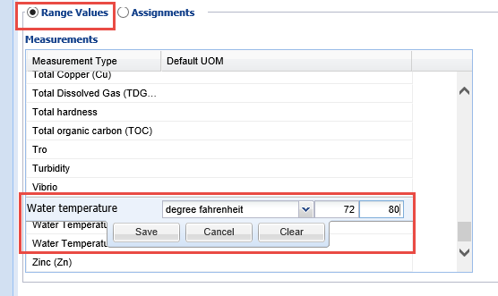
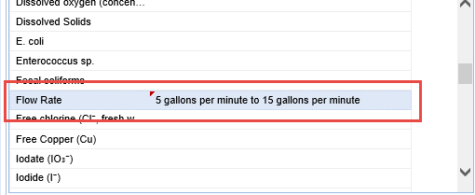
Measurement range template
With the Range Values radio
button checked, select the
measurement, the unit of
measure and the desired Min
and Max measurement. Confirm
that your selection shows up in
the grid. If it does not you did
not Save it correctly.

Slide 7
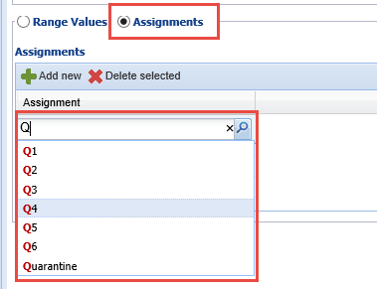
Measurement range template
Now, with the Assignments checked you
can select the enclosures to assign
this range to. Only entities that match
what you selected for Category will
appear here. We selected Enclosure
Water Quality Measures so only those
enclosures that are aquatic will display
in the dropdown list to select from.
Remember to Save each assignment.
When done Save the entire template.
With this Template whenever you record
a measurement included in the template
on one of the assigned tanks you will be
notified if it is outside of your desired
range.

Slide 8
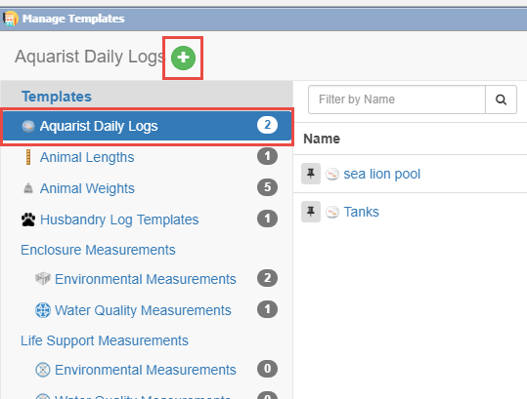
Aquarist daily log
To save you time you can create
an Aquarist Daily Log to help you
remember all the measurements,
and more! that you need to take,
or do, on your tanks. To create a
template for this log go to Start>
Tools>Manage Templates. Highlight
Aquarist Daily Log and select the
green plus icon.

Slide 9
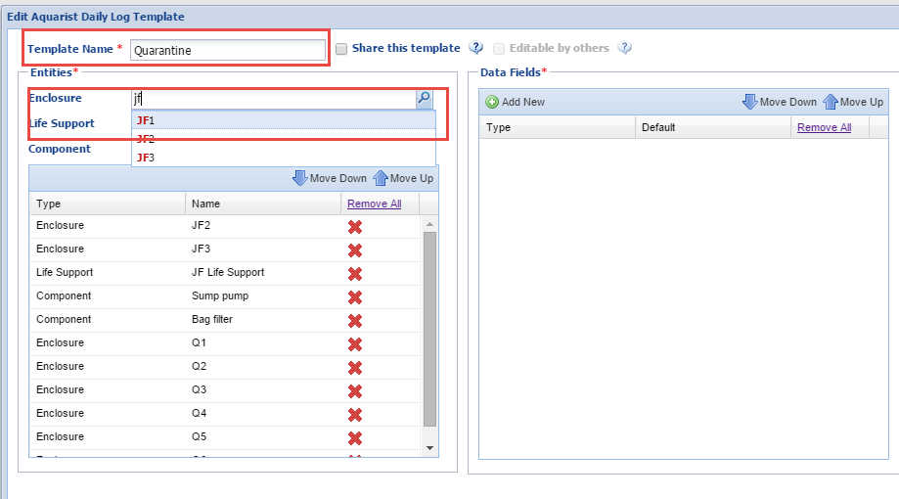
Aquarist daily log
Create a unique name and select
what Enclosures, Life Supports or
Components that you will be
gathering data on during your day.
You can also select to share the
template with others and allow
others to edit it.

Slide 10
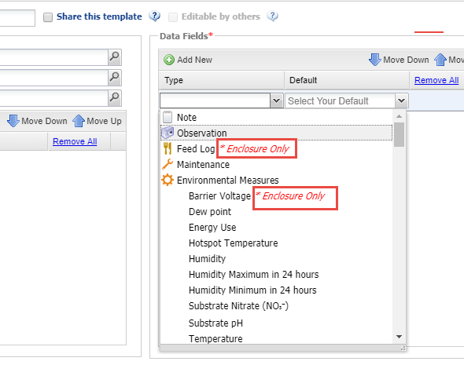
Aquarist daily log
You will then select the Data Fields
you want included in the template.
Any data fields that are specific to
an entity will be noted in red. Feed
Log and Barrier Voltage can be applied
only to Enclosures. For measurements you
will select your desired default unit of
measure.

Slide 11
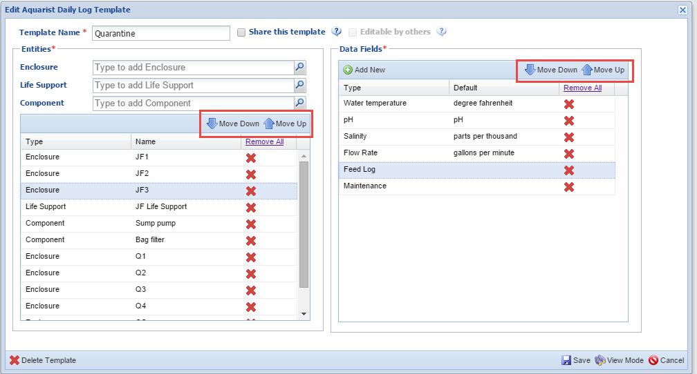
Aquarist daily log
Using the Move Down and Move Up arrows in either box you can
arrange the sequence of Entities and Data Fields as desired so
that the template works for you as you move from tank to tank.

Slide 12
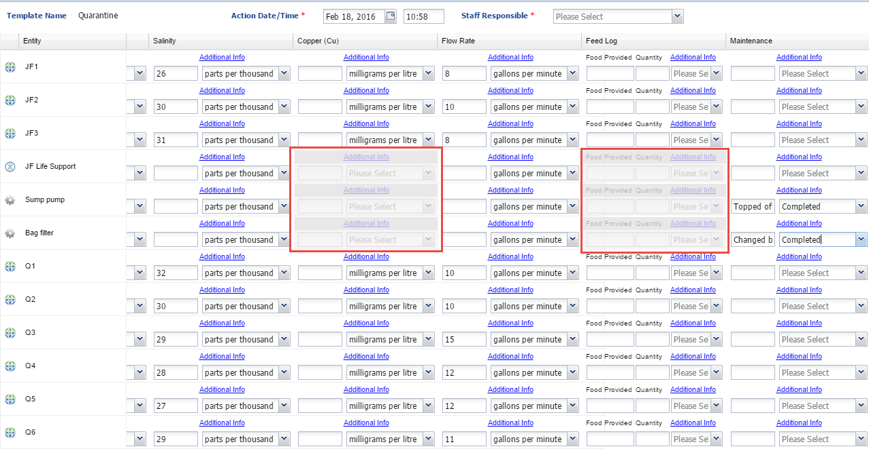
Take measurements using the log
To use the Aquarist Daily Log, select it from the list in Manage Templates or from
the Batch Measurements tab in the Enclosure, Life Support or Component record. Any Data Fields that are not appropriate for an Entity will be greyed out and not editable. Record your measurements or actions as appropriate.

Slide 13
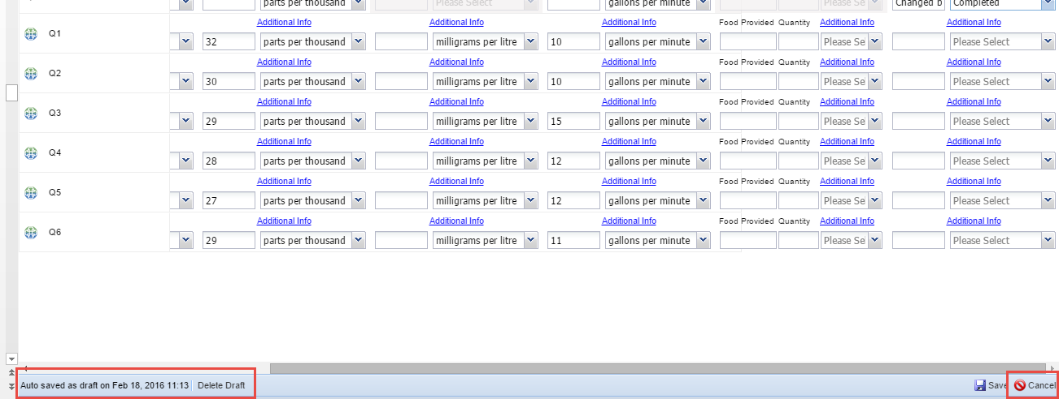

Save the draft
Because you have more to add to the template as you go about your day you do not
want to Save it yet. The template auto saves every 60 seconds. You can save it as a
Draft by selecting Cancel instead of Save. You will be asked it you want to save your
work as a Draft? Drafts can be found under Manage Templates>Draft Records. Once
you complete the template as desired select Save. The data will then go into the record.

Slide 14
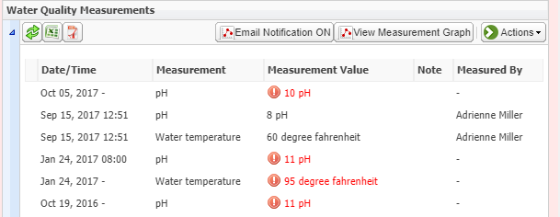
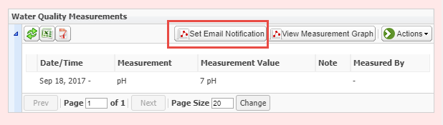
Email notification
For any measurements that are out of your desired measurements range you will receive
a warning at the time of data entry and the measurement will display in red within
the record itself. If you want someone notified of this you can Set Email Notification.

Slide 15
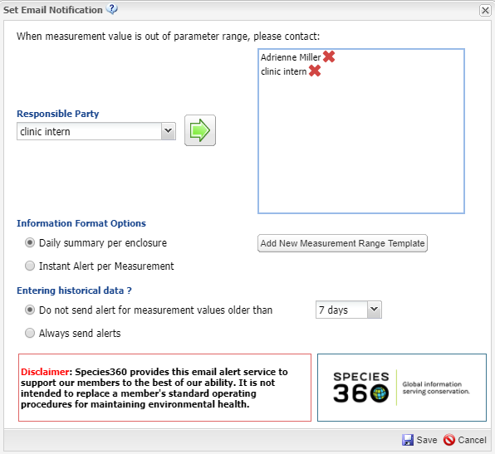
Email notification
Select who you want to receive the
Email notification. Then select if you
want a daily summary sent or
an instant alert. If you are entering
old measurements you can also
select not to send alerts that are
for measurements taken a specified
number of days ago. You can also
create a new Measurement Range
Template directly from this screen.

Slide 16
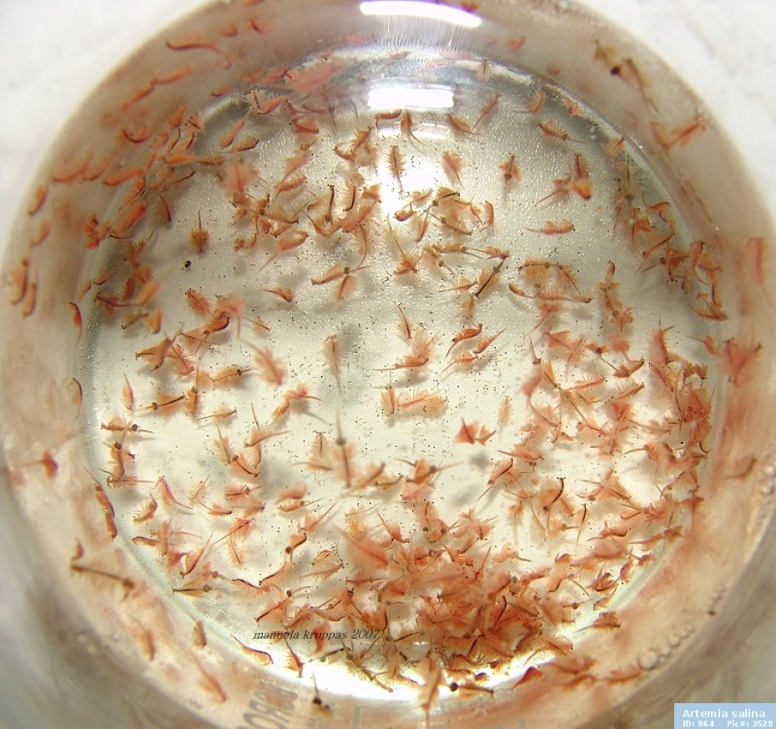
8:45 am – feed juvenile fish tanks
(and create some lists to save time later)

Slide 17
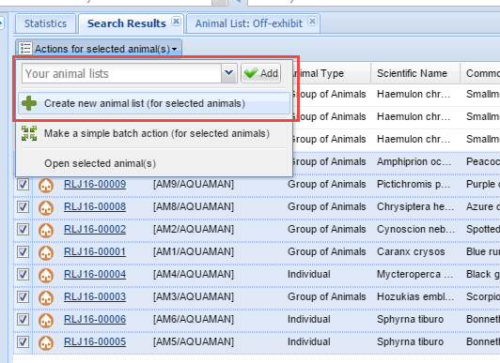
Create animal lists
It is time to feed your juvenile small mouth grunts. You realize that it will
save you time in the future if you create lists of the animals in the tanks
that you care for. These lists will help you perform Batch Actions such as
feeding quicker. The easiest way to create a list is to search for the
desired animals and select them from the Search Results. Select Actions
for Selected Animals>Create New Animal List.

Slide 18
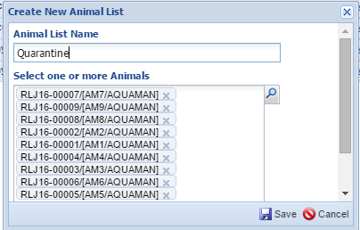
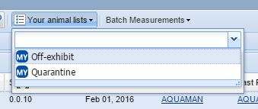
Create animal list
The animals will prefill and all you have to do is create a unique
name for the list. This list will be shared by default but you can
restrict editing to only yourself. You will find the list in the dropdown
under Your Animal Lists.

Slide 19
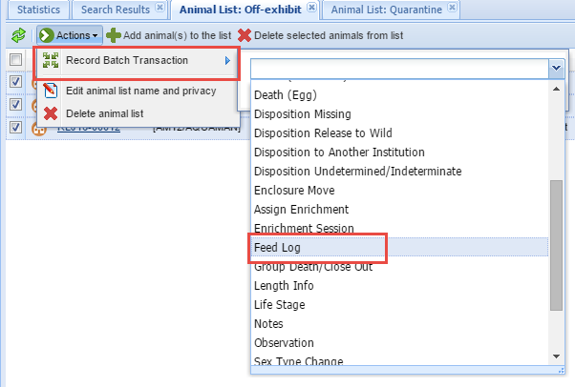
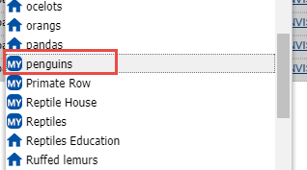
Using the list for a batch action
You want to use a list to record your Feed Log for your penguins. You find
the list in the dropdown list under Your Animal Lists. Select Actions>Record
Batch Transaction>Feed Log>Custom Entry for Each Animal. A Single Entry
for all Animals would result in the identical information going into each record.

Slide 20
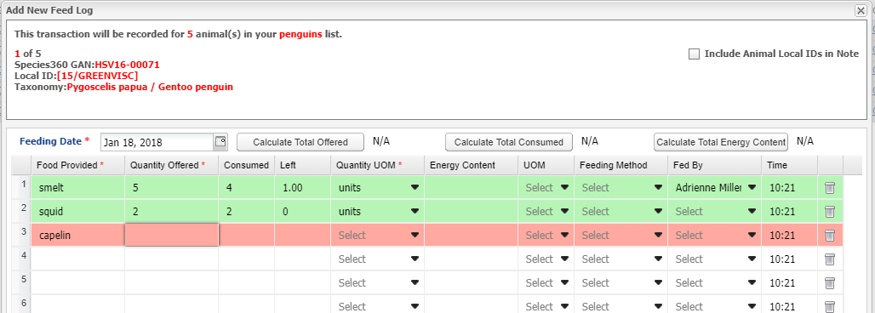
Recording a batch feed log
What record you are in will be indicated in the upper left hand corner by
the GAN, Local ID and taxonomy. If you want to include all the Local IDs you
can check the Include Animal Local IDs in Note checkbox. Once the mandatory
Fields have been records the line will turn green. Only lines that are green will
Be saved. The information will go directly into the appropriate animal record.

Slide 21
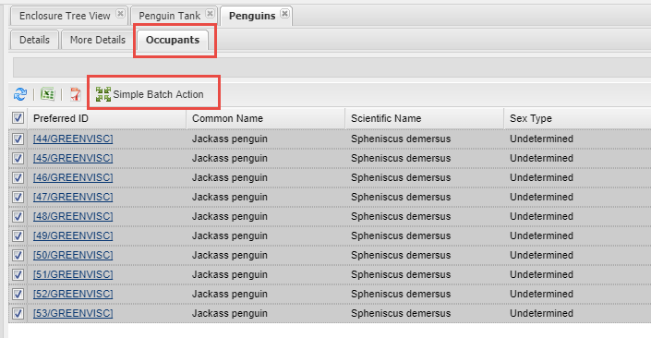
Batch from occupants
Animal Lists are static and do not
update as animals move from one
enclosure to another. If you want to
record Batch Actions on the enclosure
Occupants you can open the
enclosure record, select the Occupants
tab and select Simple Batch Action.
The Occupants tab does update as
animals are moved in and out.

Slide 22
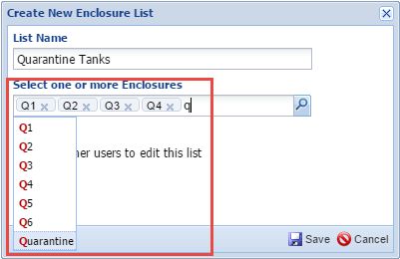
Create enclosure lists
Lists can also be created for enclosures, life supports and components.
Under Your Lists in those modules select Create New List. Enter a unique
name for the list and select the desired enclosures. These lists can also
be created from Search Results just like the Animal Lists previously. If you
set up your Enclosure Lists by areas or assignments, you can use them to
create one Daily Report to suit your needs.

Slide 23
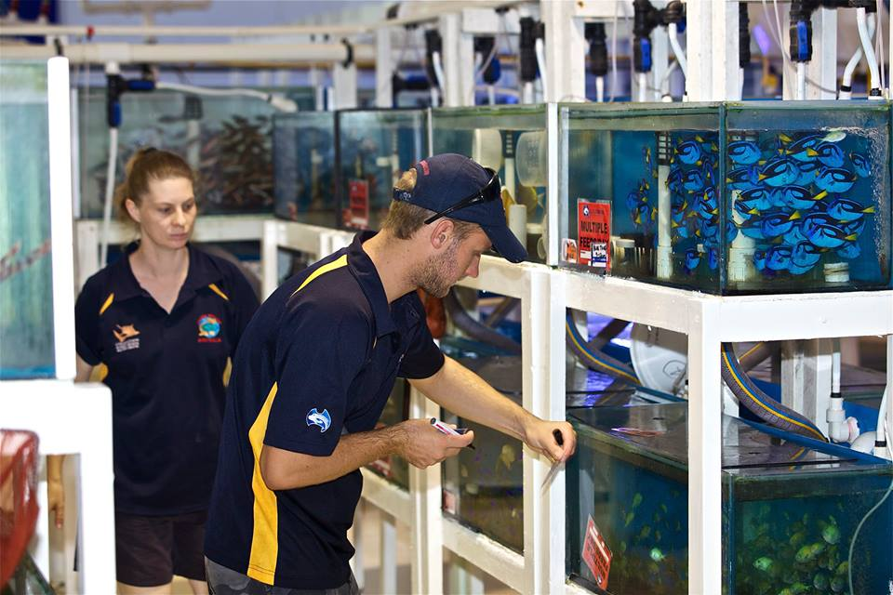
9:00 am – check copper levels and record enclosure treatments

Slide 24
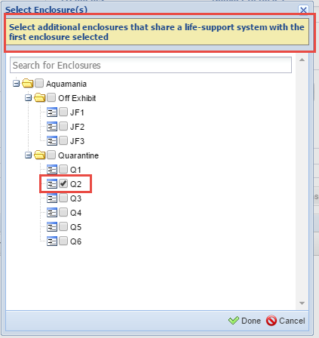
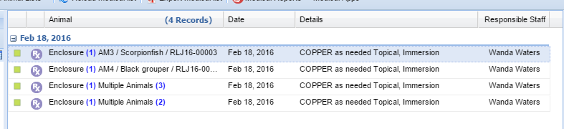
Record enclosure treatments
In order to record a treatment on an aquatic
enclosure you must first create an Aquatic
Enclosure Prescription from within the Medical
module. If several enclosures share a life support
you can select them all in one action. Any
prescriptions, measurements or treatments on one
will go into all records automatically. If your
enclosures/tanks do NOT share a life support
you will need to create each prescription
separately. Below we have prescriptions for
Copper for four tanks.

Slide 25
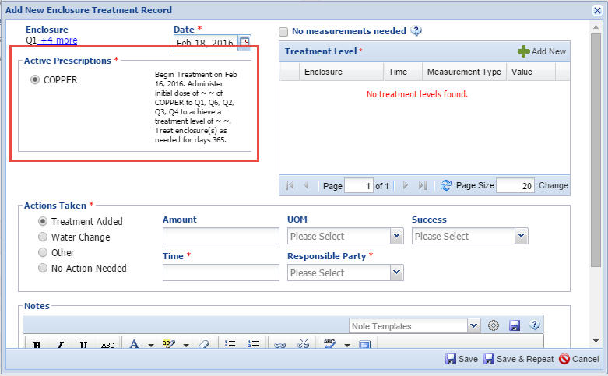
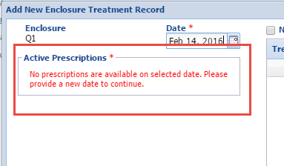
Record enclosure treatments
To record an Enclosure Treatment go into the enclosure record
in the Husbandry module>Details>Enclosure Treatment>Actions>
Add New. If there is a current prescription for the enclosure it will
display in the upper left hand corner (left). If the date is outside
of the date range of the prescription the box will display as no
prescriptions available and you cannot treat the tank.

Slide 26
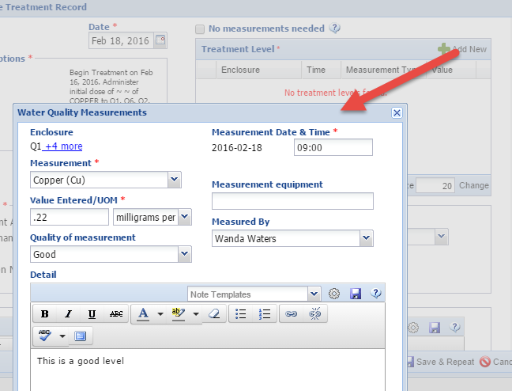
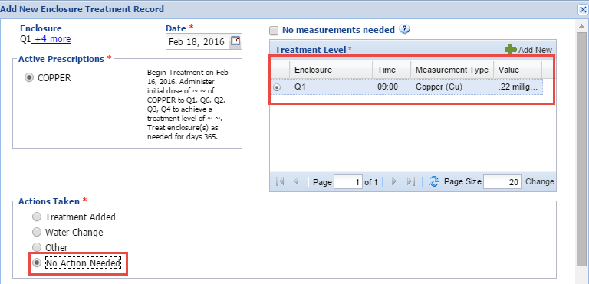
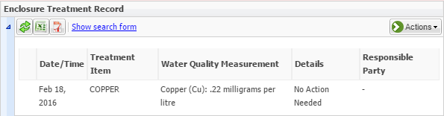
Record enclosure treatment – q1
You first take a measurement to see if an Action is needed by selecting Add New in the Treatment Level box. This is a good copper level so you check No Action Needed. This
displays in the enclosure record.

Slide 27
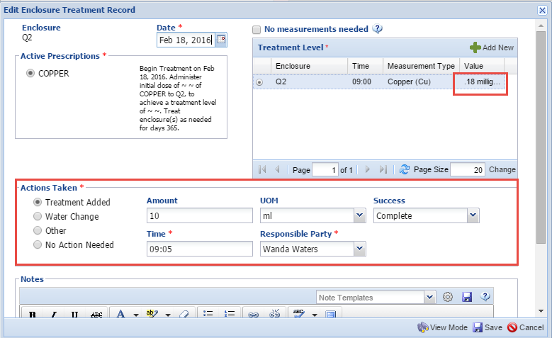
Record enclosure treatment – q2
The copper in your second tank is low (.18 mg/L) so you take an Action of
dosing with 10 ml copper.

Slide 28
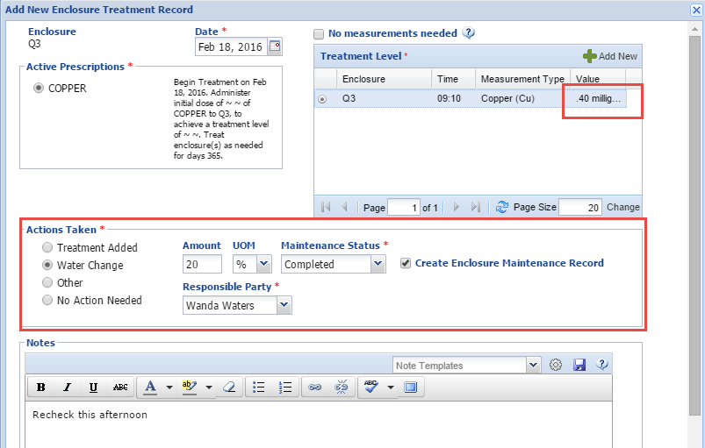
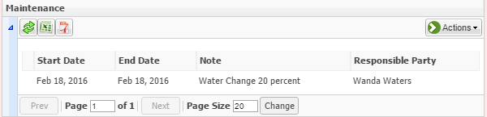
Record enclosure treatment – q3
Your copper measurement is too high in tank Q3. You take an Action of a 20% water
change and will recheck in the afternoon. Because you left the “Create Enclosure
Maintenance” box checked, a maintenance record is automatically created.

Slide 29
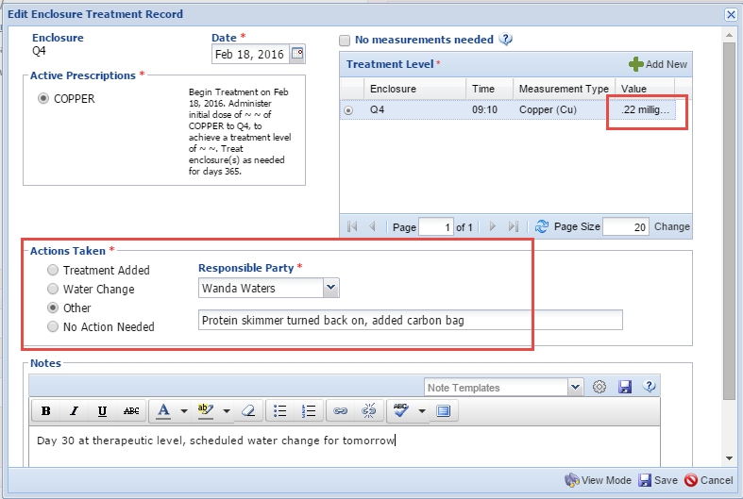
Record enclosure treatment – q4
It is Day 30 for the therapeutic copper treatment in tank Q4. You turn the protein skimmer
back on and schedule a water change for tomorrow.

Slide 30
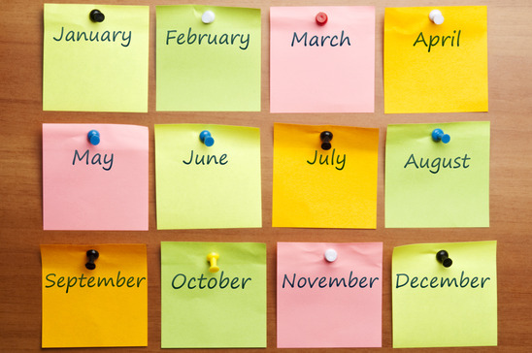
9:20 - Create calendar tasks

Slide 31
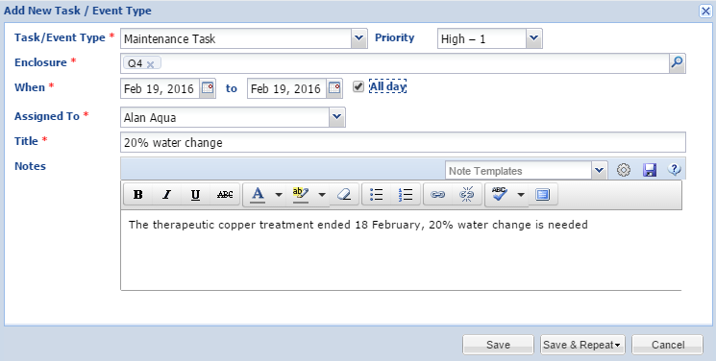
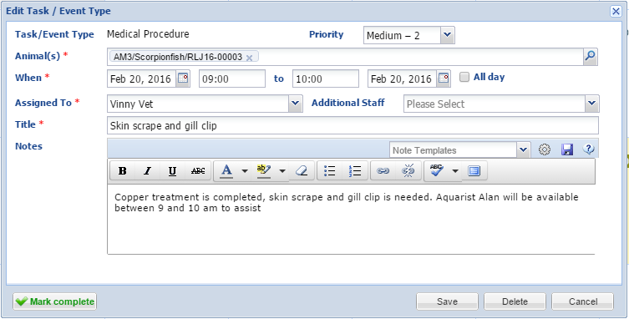
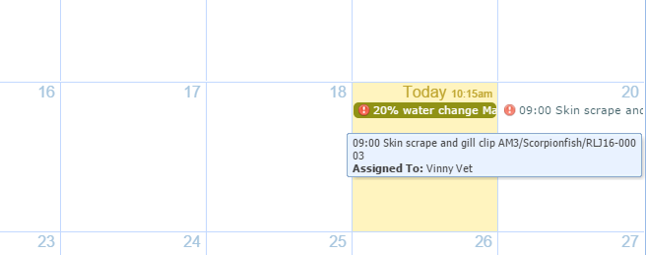
Schedule water change and vet check
Using the Calendar you create a task
for Maintenance (a water change) on
Tank Q4 and assign to Alan Aqua. You
also create a medical procedure task for
the animals held there for the Vet to
perform a skin scrape and gill clip on the
occupants within Q4.

Slide 32
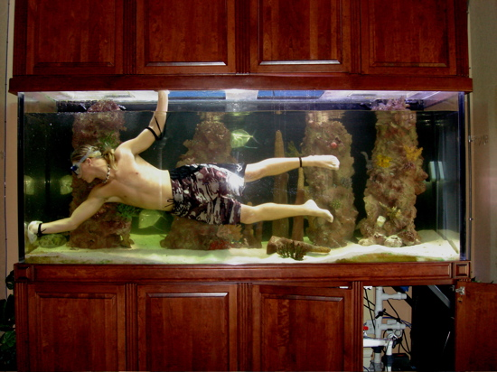
9:30 am – perform maintenance and add a maintenance request

Slide 33
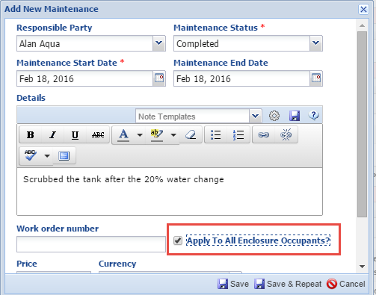
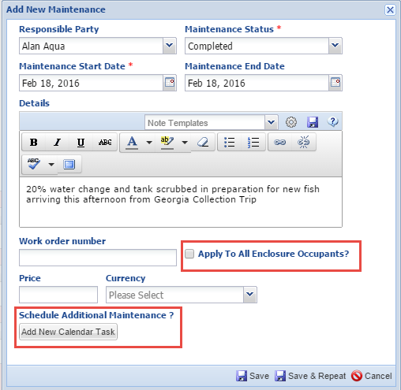
Perform maintenance on q3 and q5
After the 20% water change in Q3 you
scrub the tank. Because you want this
maintenance to display not only in the tank
record but also the record for the black
grouper who occupies the tank, you check
the Apply To All Enclosure Occupants checkbox.
You also perform a 20% water change on Q5
and scrub the tank in preparation for new
fish arriving this afternoon. Because there are
currently no animals in the tank you do not
check the Apply to Occupants checkbox.
You also do not need to schedule additional
maintenance on the tank.

Slide 34
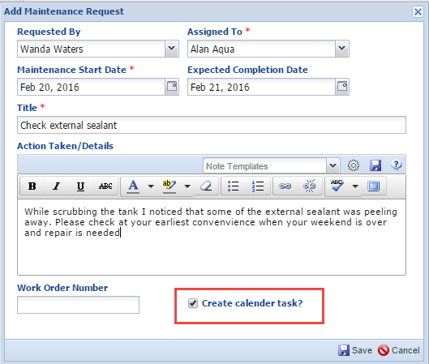
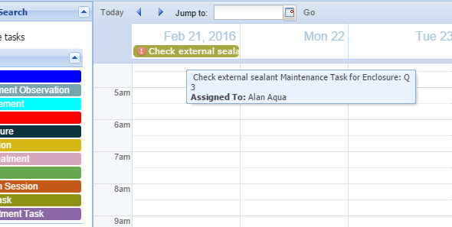
Schedule a maintenance request
While you were scrubbing Q3
you noticed some of the external
sealant may be peeling off.
It does not appear to be
compromising the tank so you
create a Maintenance Request
that it be checked and fixed if
needed. Checking the Create
Calendar Task checkbox will
automatically add the task to
the Calendar

Slide 35
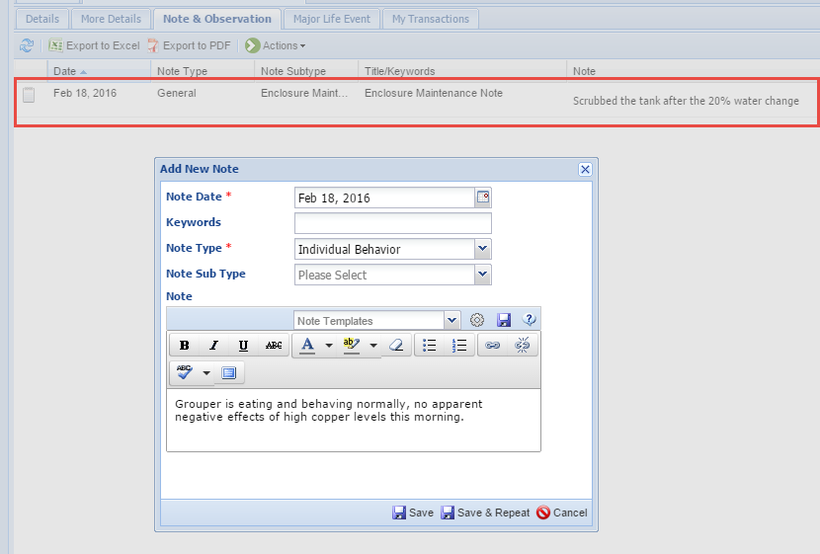
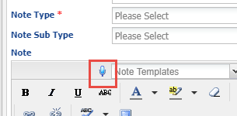
Add a note to animal record
You also add a note to the
record of the black grouper
who was in tank Q3 with the
high copper reading. It is
doing fine. You also see that
the note generated from the
enclosure record entry regarding
maintenance of the tank has
successfully gone into the
animal record. To save you
typing time, anywhere there is
a microphone icon you can simple
talk and ZIMS will record what
you say directly into the field.

Slide 36
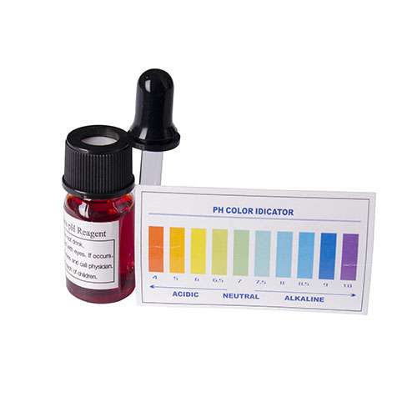
11:00 am – recheck parameters on quarantine tank in preparation for new arrivals

Slide 37
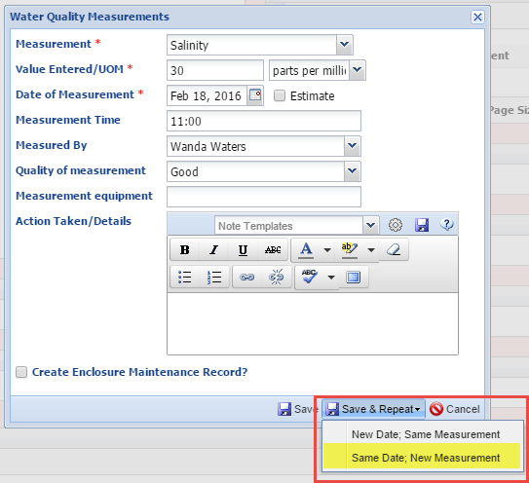
Record the measurements
In preparation for new arrivals you
check the water quality parameters on
the empty Q5 Tank. You save time by
using Save & Repeat>Same Date New
Measurement. You text the Collection
Team that you have recorded them
and they log into ZIMS to communicate
any differences between in-house and
field measurements. You then begin
food preparation.

Slide 38
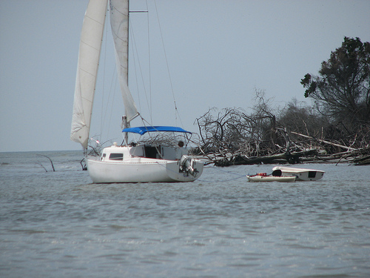
11:15 am – collection team confirms field location ph is lower than tank level

Slide 39
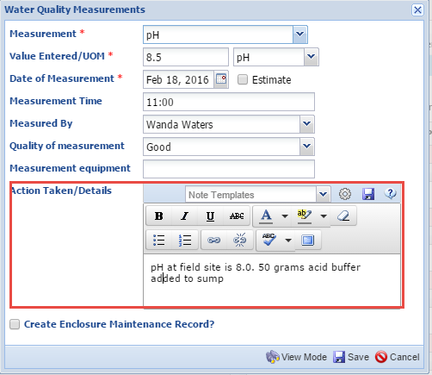
Correct the ph
The field team confirms that all the measurements are okay except the pH is lower (8.0) at the field site than in-house (8.5). You need to make adjustments to help the new fish better acclimate. You edit the entry for the pH and note that 50 grams acid buffer was added to the sump under Actions Taken.

Slide 40

11:30 am – feed quarantine tanks

Slide 41


Use the aquarist daily log to record
You re-open the draft of your Aquarist Daily Log to record the Enclosure Feed Logs for the fish in the quarantine and off-exhibit tanks. Selecting Additional Info brings up a screen where you can add more details such as the Feeding Method and consumption as well as check the very important Apply to All Enclosure Occupants checkbox. When done you Cancel and Save as a Draft again.

Slide 42


Feed grouper during a training session
Your black grouper is being trained to target for better husbandry and the
feeding sessions are used as rewards for this training. On the upper right you
Recorded the Feed Log food provided, amount consumed and details that it was
part of a training session. On the left you recorded the training session details
involving the stuffed squid.

Slide 43
12:30 pm – feed aquarist

Slide 44

1:30 pm – field team arrives with new animals – enter collection trip details into zims

Slide 45


Add collection trip basic info and personnel
While the team is acclimating their fish
you create a new Collection Trip record
(top). After saving you then record who
participated in the Collection Trip. The
trip was lead by Fish Guy. Fish Girl and
Invert Expert were participants. Members
of a Collection Trip do not need to be
given access to ZIMS but they will need
to be entered as Staff members so they
can be selected from the Responsible
Party dropdown list.

Slide 46


Record collection trip location
You then record the details
on the location of the Collection
Trip which was to Sapelo Island,
Georgia

Slide 47


Record vehicle used
You then record the vehicle(s) used on
the Collection Trip. The Type is a
cascading dropdown list where you
can be very generic (boat) or specific
(rowboat or motorboat). For this trip
you used the Trip Lead’s rowboat and
rented an amphibious vehicle from the
island’s boat rentals.

Slide 48

Associate a permit with the trip
You then associate the permit that was required for the Collection Trip.
You are surprised to note that it expires in four days (today is Feb 18,
2016). You make a mental note to talk with the Registrar about applying
for a new permit as you intend to return to the island later in the year.

Slide 49



Record the animals collected
You use the Collection Trip Accession Log to record the animals collected. The Collection Date can only be a date that is within the date range of the Collection
Trip (here 15-18 February, 2016). The Collection Outcome can be Accessioned and the animals will become part of your collection. Caught & Released
will display in the grid but will not be accessioned into your collection. Died in Transit will also display in the grid but will not be accessioned into your collection.
Under Terms, By-catch means that the animal was unintentionally collected while trying to collect something else.

Slide 50

Collection trip accession log
You record the following information:
Group of 28 striped killifish collected by seine accessioned
Group of 18 mummichugs collected by seine that survived to accession
One mummichug died in transit
Group of 2 juvenile oyster toadfish caught by seine and accessioned
Group of 6 juvenile lookdowns caught and released
Group of 3 knobbed whelk caught by hand and accessioned
Two individually identifiable stone crabs caught by hand and accessioned
Group of 4 feather blenny caught by hand net and accessioned
Group of 10 blue crab caught and released
1 large Southern flounder caught and released

Slide 51


Run a wild acquisitions report
Your Curator wants a list of
what was collected on the
trip. You could just export the
Accession Log, but he prefers
the layout of the Wild
Acquisitions Report. You run
this report for the date range
of the trip sorted by Collection Method. You export the report and email it to him.

Slide 52


2:00 pm – while fish are acclimating scrub floors and change over bleach barrels

Slide 53

Set up the enclosure tree
Try to set up your Enclosure Tree so that you
can capture the information you need and
also retrieve the information that you need
to. As presented in the scenario, you work
in a building that contains the quarantine
tanks and some off exhibit holding tanks.
With a tree as shown here you can pull up the
animal records for all tanks by selecting the
Off Exhibit Building (including sub-enclosures)
or just the off-exhibit tanks or the quarantine
tanks or individual tanks. It also will allow you
to enter information on your Parent enclosure,
the Off Exhibit Building.

Slide 54


Perform maintenance on the building and create a calendar task
You have some time while the fish
are acclimating to do some cleaning
on the building in general. You notice
the door to the outside is squeaking.
The supply room is closed until Monday
so you select to remind yourself to get
some WD40 by creating a Calendar
Task for the day that it re-opens to pick
some up to fix the squeak.

Slide 55

2:30 pm - Add enrichment to Grouper tank

Slide 56


Create an enrichment item and session
While scrubbing the floor you notice that your lone grouper looks bored and is bumping his nose along the tank sides. You decide to create a fake
seaweed hide spot out of carwash strips tied to a dive weight. You assign the item to
the grouper and create a session. The enrichment item had a positive animal reaction and was highly successful.

Slide 57


ADD A HOUSE NAME
Because you want to be able to
quickly find this grouper in search
results and reports you decide to
give it a House Name (a logical
identifier) and mark it as the
Preferred Identifier. This will now
display instead of its Local ID.

Slide 58


3:00 pm – transfer new arrivals into quarantine and observe

Slide 59


Do a batch enclosure move
Your new arrivals are ready to be put into their quarantine tank. Using an Advanced Animal Search by Acquisition Date range you select the appropriate animals from the results grid and make a Simple Batch Action of Enclosure Move>Single Entry for
All. With one action all the new
arrivals are placed into their
quarantine tank, Q5.

Slide 60


Update your animal list
You need to update your Animal List for
your quarantine animals. You find the list
under Animal Lists and using Add Animal(s)
To the List you search by Q5 and select all
results. The Quarantine List is updated with
all your new arrivals.

Slide 61


4:00 pm – afternoon feeds and system rechecks

Slide 62

Make final entry on ADL and feed tanks
You clean the protein skimmer on Q6 and make your final entry in
today’s Aquarist Daily Log. This time you select to Save it. You receive a
message that you have not recorded measurements for everything in the
template but that is fine so you Go Ahead and Save. Using Your
Animal List you bring up the animals In Off-Exhibit tanks and record
a Custom Entry Feed Log of 1 tsp flake food for JF1 and JF2 and 5 ml
naup/brine shrimp slurry for JF3.

Slide 63

4:30 pm – recheck new fish and schedule entry checks for vet

Slide 64

Add some furniture to q5
You recheck the new fish before
end of day – all are behaving
normally. You add some PVC
spare parts to Q5 tank for
hiding spots and using the
Furniture grid in More Details
you record this addition.

Slide 65

Schedule vet exam for new fish
From the Calendar you schedule skin scraping and Vet visual check for
a day when the Vet is on staff.

Slide 66

4:45 pm – run daily report with notes for coverage aquarists and go home
Before you leave you run a Daily Report for today using the
Quarantine & Off Exhibit Enclosure List that contains all of
the tanks that you are responsible for. You add a non-ZIMS
note for your coverage aquarist to check the new fish right
away and to restock krill when they get a chance. You print
the report and place in the binder. You can also export it and
file electronically or email if you want to go paperless.

Slide 67

Any questions?
On an aquarist’s day

