Slide 1
4005 –
Managing Templates
Saving Data Entry Time!

Slide 2
ZIMS Updates!
This PowerPoint is up-to-date as of: November 20th 2018
ZIMS is developed in an “agile” method
This means that it is updated every two weeks, sometimes with additional releases in between!
Use the link below to see if there have been any updates to this topic since the date above:
http://training.species360.org/updates/

Slide 3
Types of Templates
Templates help you save data entry time and also help you remember your tasks
They are also very helpful when other Staff such as Keepers are doing their own data entry
Templates are found under Start > Tools
Manage Templates
Aquarist Daily Log
Track your tank tasks
Animal Measurements
Quickly record weights and lengths
Husbandry Log
Track your animal and enclosure tasks
Enclosure/Life Support/Component Measurements
Quickly record environmental and water quality measurements
Manage Note Template
Remember it all!
Measurement Range Template
Tracks desired minimum and maximum measurements for enclosures/life support/components

Slide 4
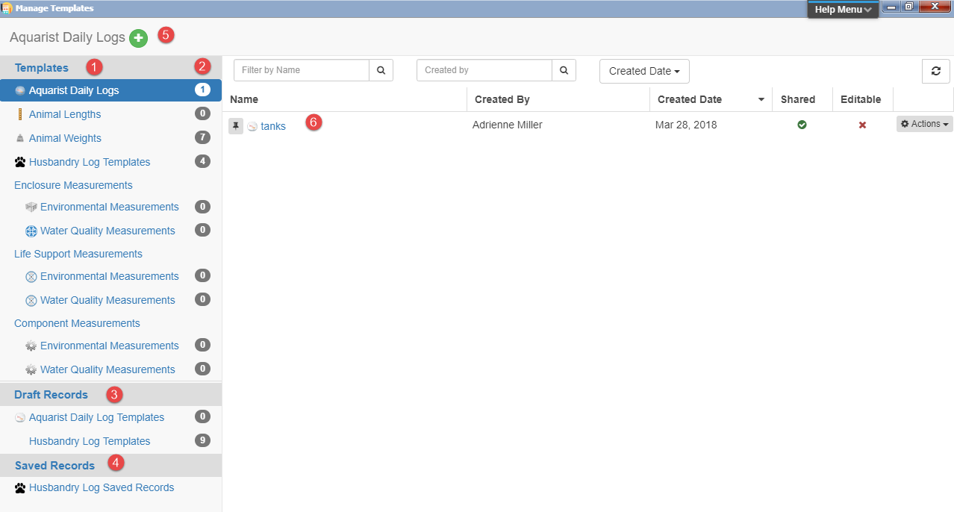
Manage Templates
When you select Manage Templates this screen will appear.
1.The Templates available are listed.
2.If you have created any Templates of that type the number
of Templates will display.
3.Draft Records display any Templates you have used and saved
as Drafts.
4.Saved Records allow you to find any Templates you have used
and saved.
5.To create a new Template, highlight the type and select the
green “+” icon.
6.Any Templates of the type highlighted will display here.

Slide 5
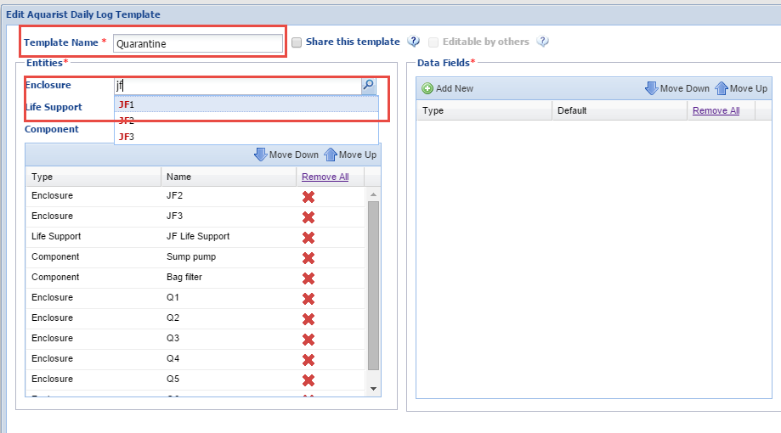
Aquarist Daily Log
To save you time you can create
an Aquarist Daily Log to help you
remember all the measurements,
and more, that you need to take,
or do, on your tanks. Create a
unique name and select what
Enclosures, Life Supports or
Components that you will be
gathering data on during your day.

Slide 6
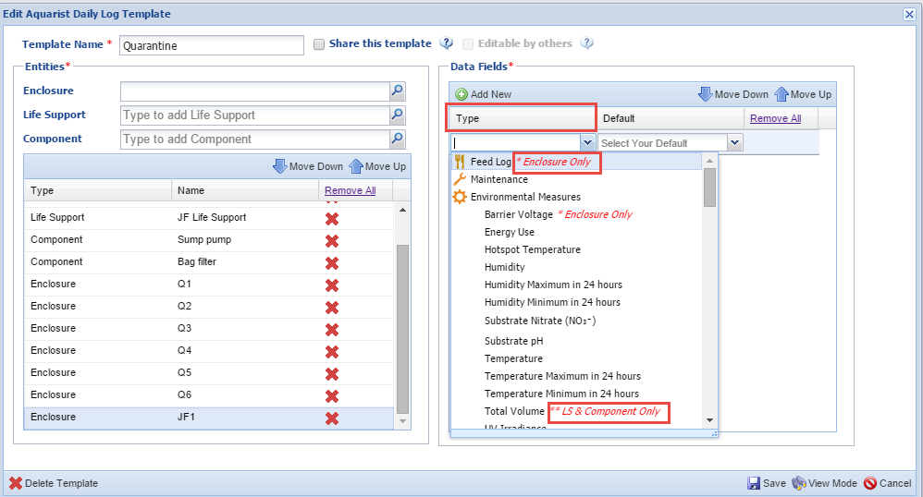
Aquarist Daily Log
You will then select the Data Fields
you want included in the template.
Any data fields that are specific to
an entity will be noted in red. Feed
Log can be applied only to Enclosures
and Total Volume can be applied only
to Life Supports and Components. For
measurements you will select your
desired default unit of measure.

Slide 7
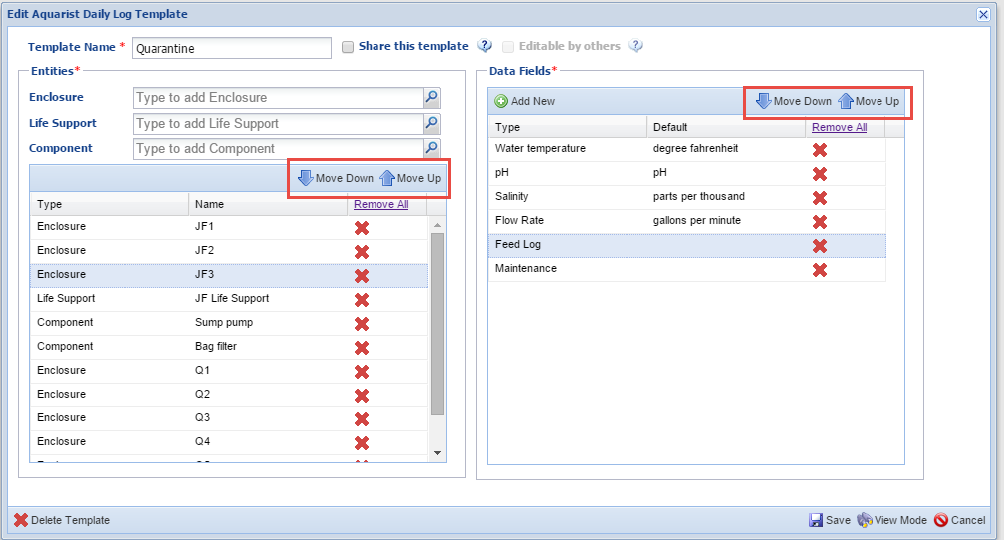
Aquarist Daily Log
Using the Move Down and Move Up arrows in either box you can
arrange the sequence of Entities and Data Fields as desired so
that the template works for you as you move from tank to tank.

Slide 8
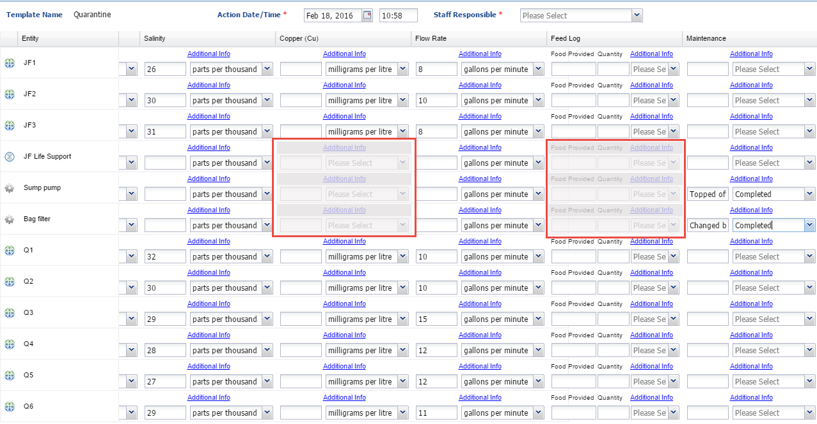
Use the ADL
To use the Aquarist Daily Log, select the appropriate log from the list.
Any Data Fields that are not appropriate for an Entity will be greyed out and not editable. Record your measurements or actions as appropriate.

Slide 9
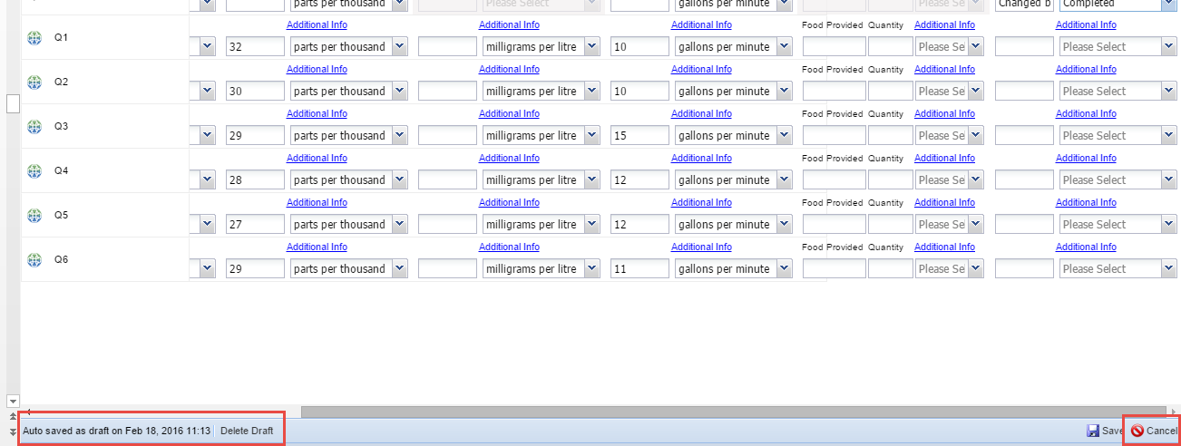
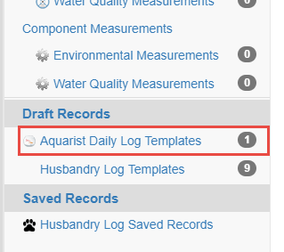
Save the Draft
Because you have more to add to the template as you go about your day you do not
want to Save it yet. The template auto saves every 60 seconds. You can save it as a
Draft by selecting Cancel instead of Save. You will be asked it you want to save your
work as a Draft. Drafts can be found below the list of Templates. Once you complete
your data entry, select Save and the data will go into the appropriate record.

Slide 10
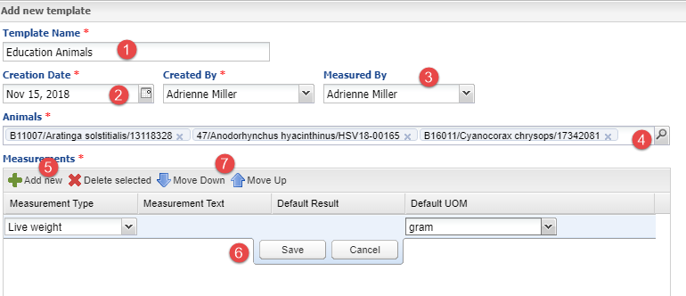
Animal Measurements
Animal Measurement Templates can help save you data entry time when entering animal
weights or lengths as well as make sure you don’t forget to measure someone!
1.The Template Name must be unique.
2.The Creation Date will not limit the dates you can use the Template for.
3.If the same person does the measuring you can save time by entering them here.
4.Enter the Animals you want the Template to apply to.
5.Select your measurements and UOM.
6.Remember to Save before adding another.
7.Use the arrows to arrange the order of the measurements.

Slide 11
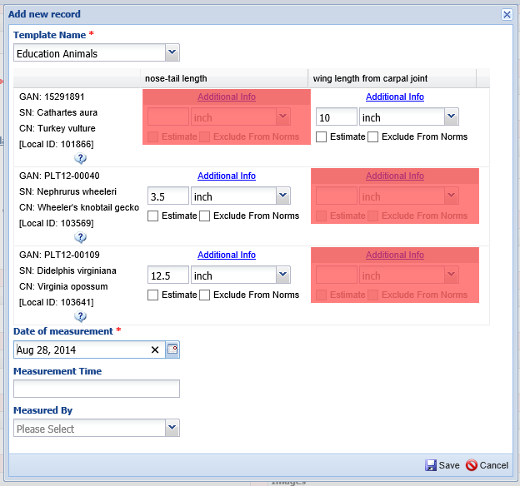
Using the Template
To use the Template, select it from the list. Any inappropriate measurements for the Taxonomy will be un-useable and highlighted in red. In this example nose-tail length is not an appropriate measurement for a vulture and wing length is not an appropriate measurement for a gecko or an opossum. If you leave a measurement blank you will get a warning but can save anyway.

Slide 12
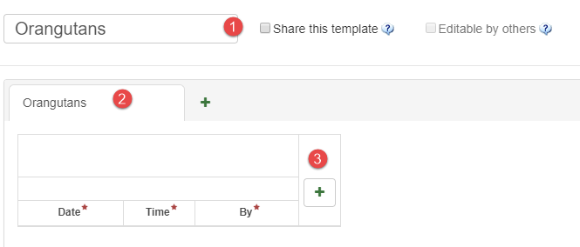
Husbandry Log
The Husbandry Log Template allows you
to quickly record data on both your
animals and your Enclosures/LS/Components.
1.As for the other Templates the name must
be unique and you can select to share or allow
edits.
2.Remember to name your sheets.
3.To add entities select the green “+”.

Slide 13
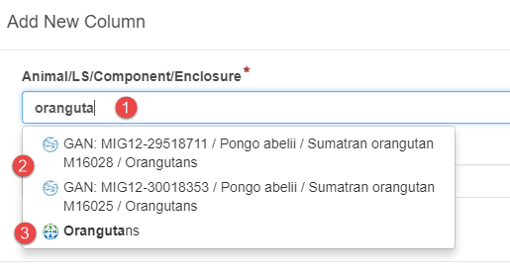
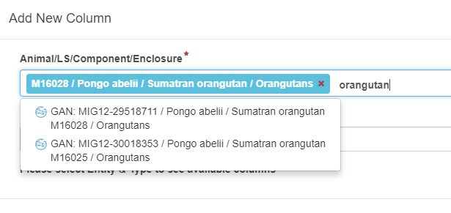
Husbandry Log
The first sheet will be our animals.
1.Since we have not yet selected an
entity, when we type “orangutan”,
2.both our animals and
3.their enclosure display to pick from.
We selected an orangutan. Now when
we type only the animals are
available for selection. The sheets
cannot be of mixed entities such as
animals and enclosures.

Slide 14
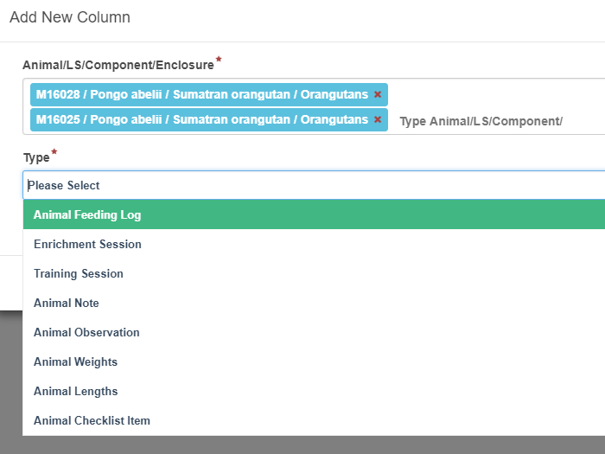
Husbandry Log
Since we selected animals
for this sheet, the Types
available are animal related.
We select Animal Feeding Log.

Slide 15
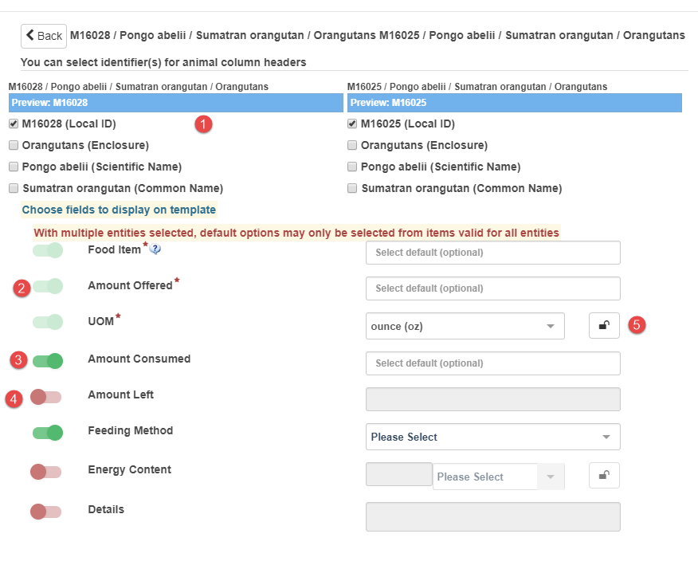
Husbandry Log
1.Select what identifiers you
want to display in the column
header.
2.Any mandatory fields have
already been activated.
3.We activated Amount Consumed
and Feeding method. Any fields
in green will be available to use
in the template.
4.Any fields in red will not be
displayed in the template.
5.If you lock a field you will not
be able to edit when using the
template.

Slide 16
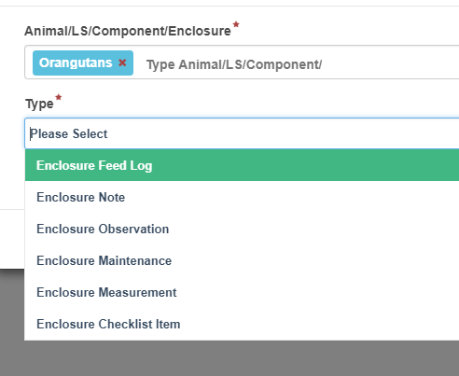
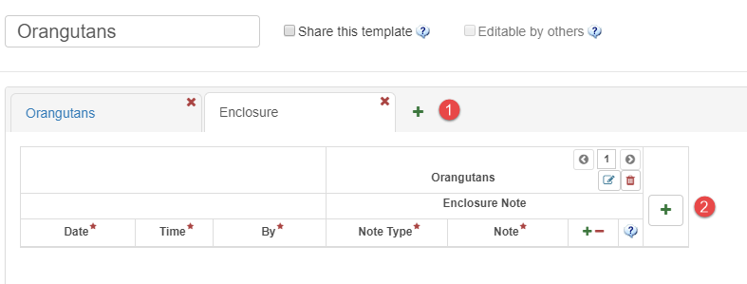
Husbandry Log
By selecting the green “+” beside the
animals tab we add a sheet for the
enclosure.
1.You can continue and add more
sheets.
2.To add more fields select this.

Slide 17
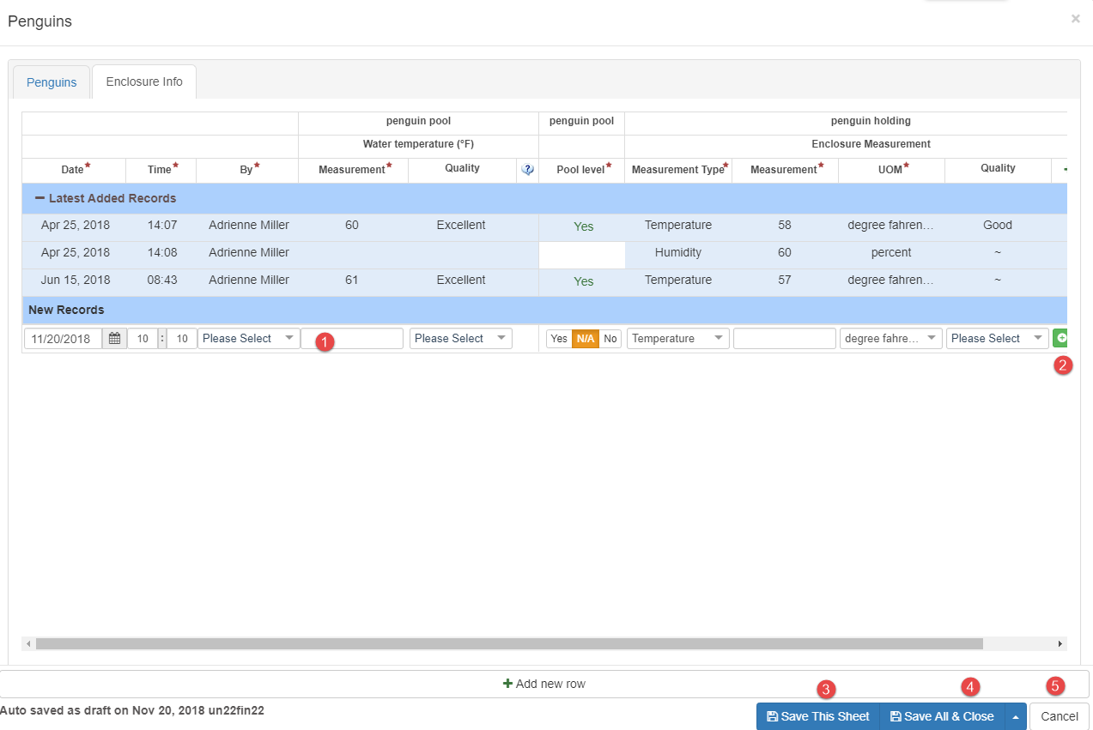
Husbandry Log - Using
To use the template select the hyperlink from your list.
1.Start completing the fields.
2.To add a new row select the “+”.
3.Save This Sheet will save your entry but keep the template open for additional
entries on another day.
4.Save All & Close will allow you to save as a draft if you want.
5.Cancel will also allow you to save as a draft or simply exit without saving.

Slide 18
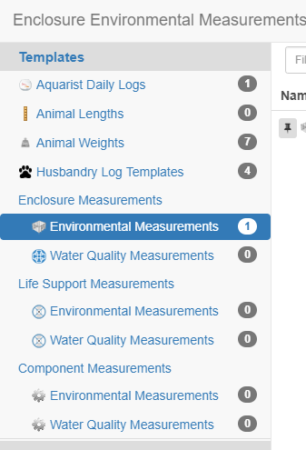
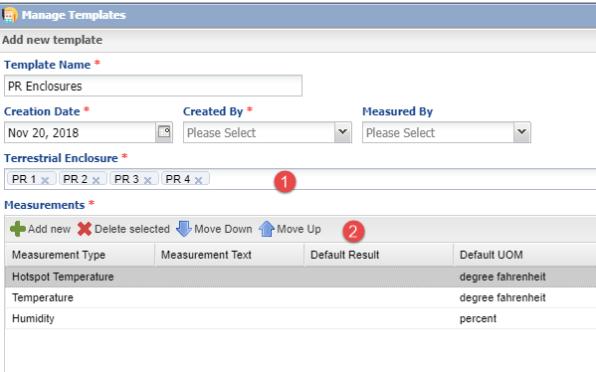
Enclosure / Life Support / Component Measurements
1.What entity you select for your Template will impact
what Enclosures/Life Supports/Components can be
selected to be in your Template.
2.Use the arrows to order the Measurement Types.

Slide 19
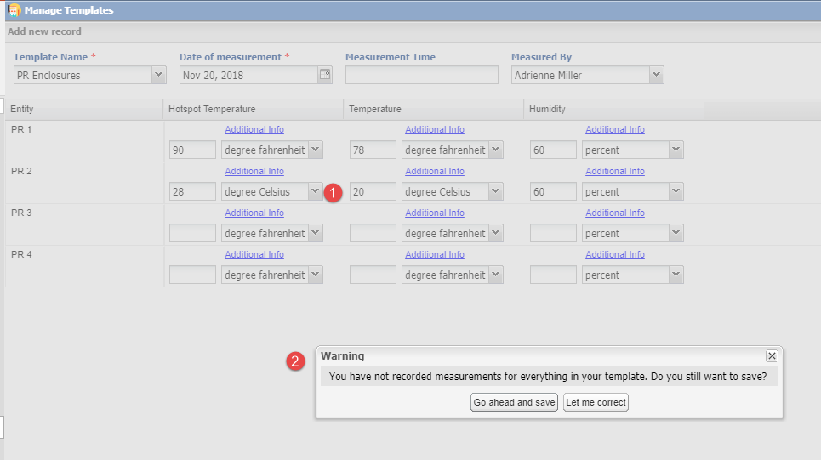
Using Measurement Templates
1.When using the Template you can
edit the Unit of Measure as needed.
2.You will receive a warning if you do
not complete all fields but you can
still Save.

Slide 20
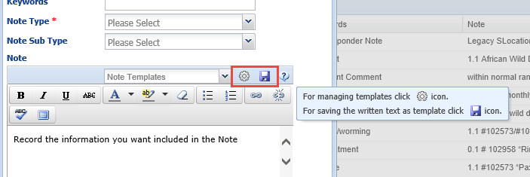
Note Templates
Note Templates help to make sure that you gather all the information
you want on a specific topic. Note Templates can be created and managed
from within the Animal Husbandry animal record or the Medical animal
record. If you have Note Templates created already they will appear in the
drop down list to select and use. If you wish to create a new one simply
type the information into the Note box and select the Save icon. To manage
the templates select the wheel icon.

Slide 21
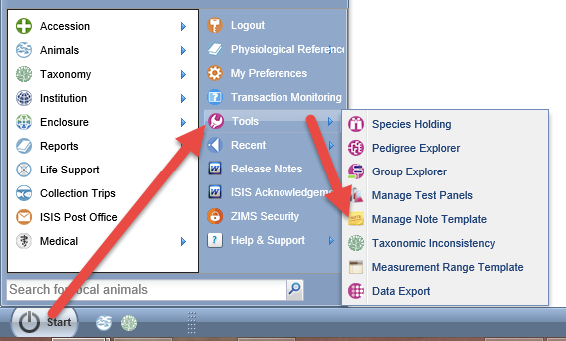
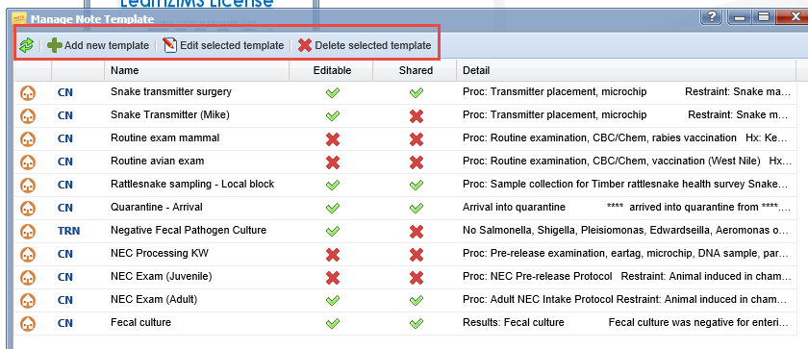
Note Templates
Note Templates can also be created and
managed from the Start Menu>Tools>
Manage Note Template. The grid displayed
from the Start menu is the same one that is
displayed if you select to manage (wheel icon)
your templates from the Notes (previous slide).
The grid will display the type of template (left
column), whether it can be edited by others
and if it can be used by others. Your options
are to Add a New Template, Edit the Selected
Template, or Delete the Selected Template.

Slide 22
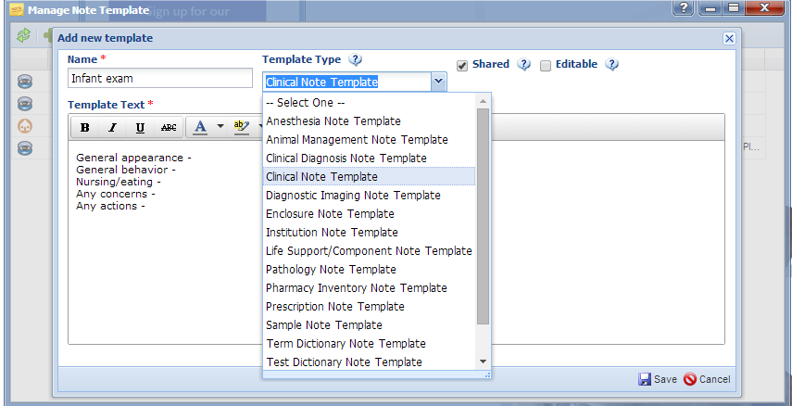
Note Template – Add New
Here we are creating a new Note Template for an animal’s first exam after birth or hatch. The Name should be unique. You will need to select the Template Type from the dropdown list. This template will ONLY be available for the type of note selected. In this example, this template will ONLY display if you are recording a Clinical Note in the Medical module. This template will be shared with others, that means other staff members can use it. However, it is not editable by any other staff members other than its creator as the Editable box is not checked. In the Template Text record what information you want to collect in this type of note. HINT: when creating lists such as this example, use Shift/Enter to avoid extra spacing between the lines.

Slide 23
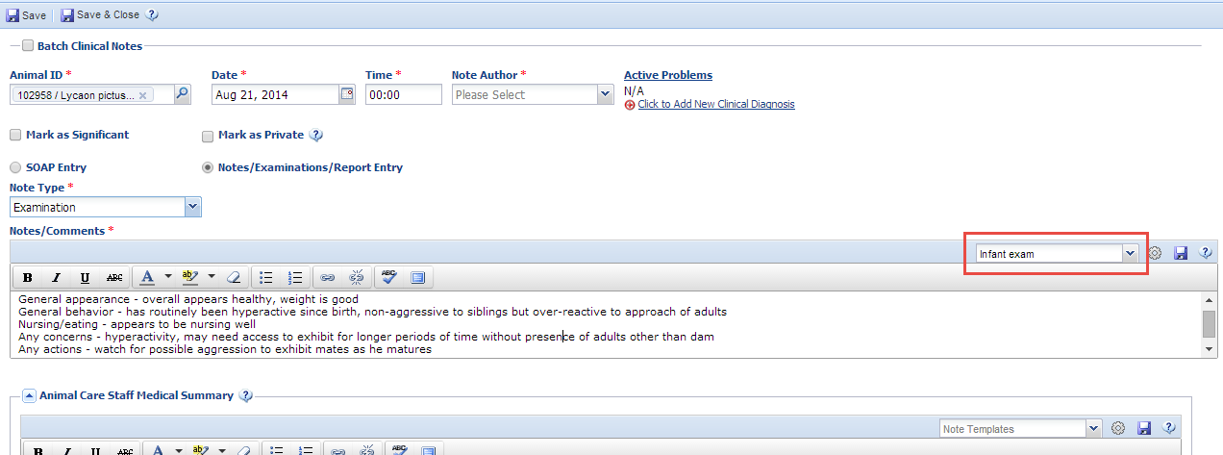
Note Templates - Using
To use the Note Template select it from the dropdown list. The information you
recorded will prefill in the text box where you can add the information. Note
Templates are easiest used for Notes/Examination/Report entries or for Animal
Care Staff Medical Summary. If used for a SOAP entry you will have to put your
curser in each box and select the appropriate template individually.

Slide 24
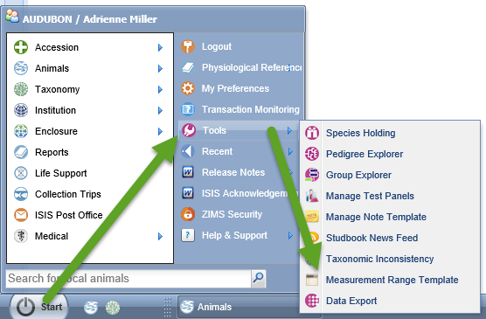
Measurement Range Template – Enclosure or Life Support
The Measurement Range Template is found under Start>Tools>Measurement Range Template. Using this Template allows you to record desired ranges for your various environmental and water quality
measurements. Especially for aquatic life, it is very important to their survival that measurements remain within an appropriate range.

Slide 25
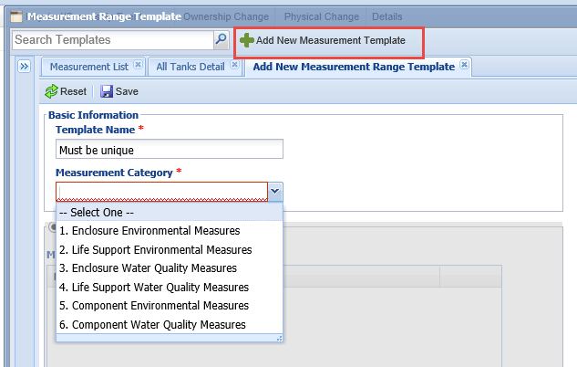
Measurement Range Template – Creating
Select Add New Measurement Template.
The Template Name must be unique. It
is VERY important that you select the
correct Measurement Category as this
determines what Enclosures, Life Supports
or Components you can associate this Template
with, as well as what measurements can be taken.

Slide 26
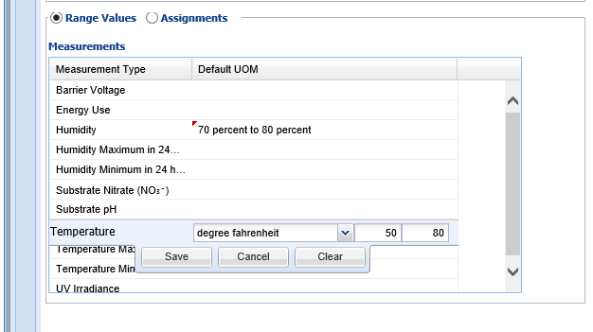
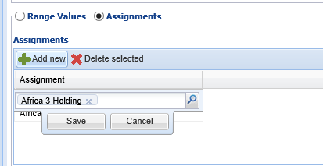
Measurement Range Template – Creating
You then record the Minimum and
Maximum values you wish to have.
Remember to Save between each
addition.
You will then assign these value to
one or more Enclosures, Life Supports,
or Components. If what you want is
not available then you may have
selected the incorrect Category.
Remember to Save the final Template
once created.

Slide 27
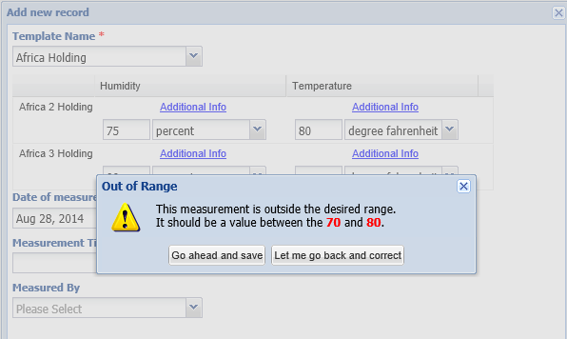
Measurements Out of Range
Because you have created a
Measurement Range Template
for these Enclosures and
Measurements, the application
will cross check the values you enter with it. If the measurement
recorded is out of your desired
range you will receive a warning.
Also, the measurement will display
in red in the measurement grid.

Slide 28
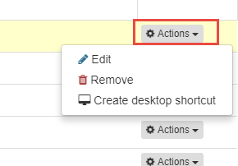
Actions on all Templates
All Templates can be edited or
removed by using the right
hand Actions options. You can
also create a desktop icon
for those frequently used
Templates.

Slide 29
That’s Managing Templates
Data entry made easy!

