Slide 1
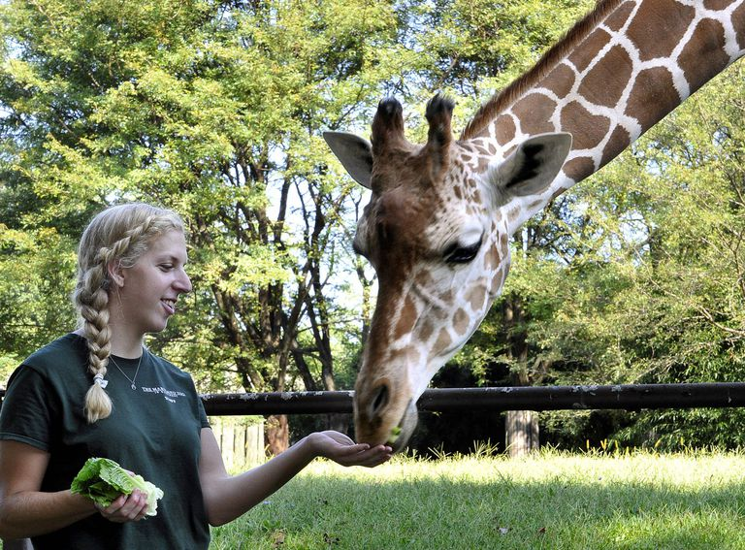
ZIMS for Care and Welfare

Slide 2
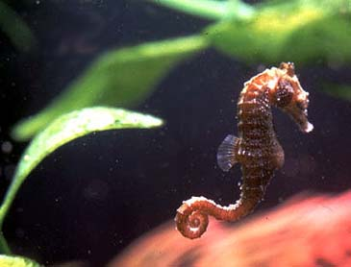
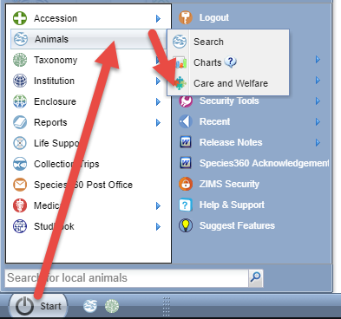
What is Care and Welfare?
The ZIMS for Care and Welfare project,
sponsored by 23 members, streamlines
access to critical key care and welfare
indicators by enabling ZIMS to systematically
track and monitor inputs and outputs of animal
care. This community project expanded insights
available to our community in support of animal
care, while following WAZA's 5-Domain model for
welfare by monitoring behavior, physical health,
environment, nutrition and mental domain.
This is done by creating templates and configuring
indicators. These templates and indicators are
institution specific so you design templates for
YOUR needs. Access to the module is under Start >
Animals > Care and Welfare. You may want to drag
it to your desktop for easy access.

Slide 3
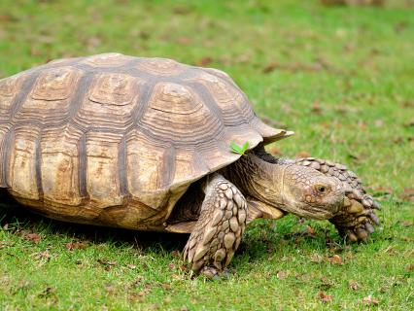
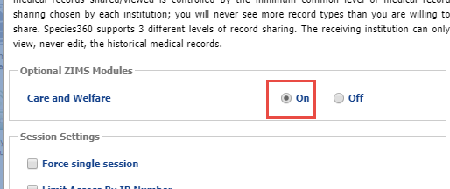
Activating Care and Welfare
The functionality is available by default
Your Local Admin will need to turn it on
  Institution Preferences > ZIMS Accessibility & Features

Slide 4
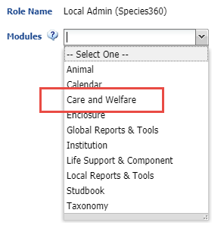
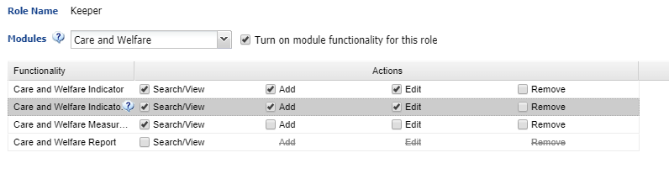
Access via Roles
As with all ZIMS functionality the access to Care and Welfare is via your Role
Local Admin is the only Species360 template that has access to it
For all others you will need to create, or add it to, a custom Role
Add/Edit Indicator and Indicator Value are required to be able to manage Indicators

Slide 5
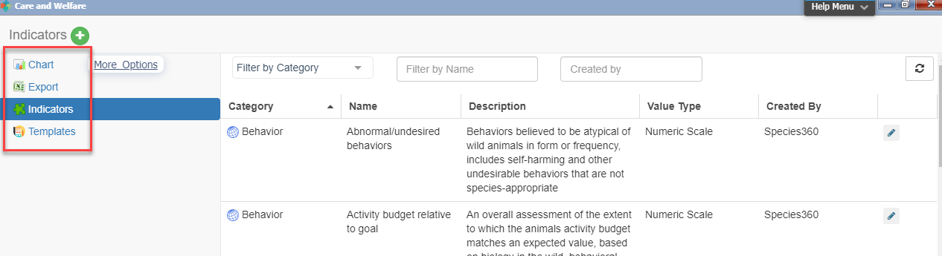
Care and Welfare Dashboard
When you open the Care and Welfare module the dashboard is displayed. On the left you see four options – Templates, Indicators, Export and Charts. The Templates and Indicators have filter options at the top.

Slide 6
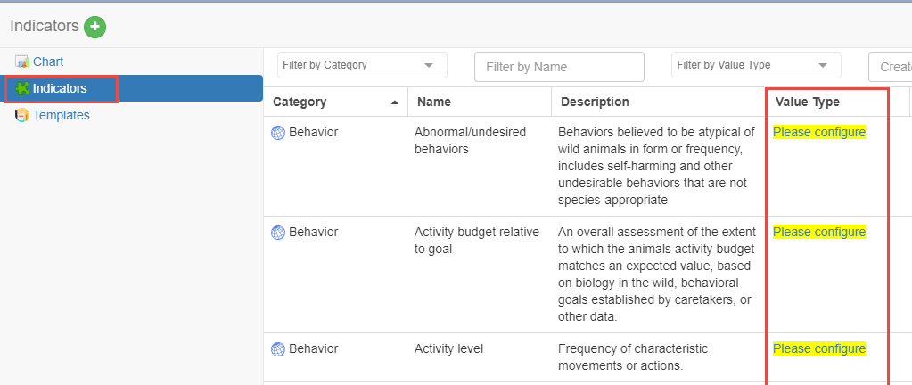
Configure Your Indicators
You will first need to
configure your Indicators.
Select Indicators from the
upper left to activate. If the
Value Type says “Please
Configure”, that Indicator has
not yet been configured. You
do not need to configure
all the Indicators, only those
you decide to use in your
Templates. Indicators will not
appear for selection in Templates
if they are not configured.

Slide 7
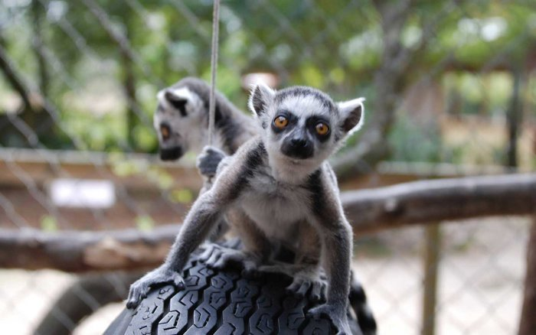
What Indicators to Select
Any Accreditation requirements
Any legal requirements (does your state or city require certain monitoring?)
What your Board wants to know
What your Staff wants to know

Slide 8
Five Categories
The five categories were taken from the “Five Domains” model from “Caring for Wildlife – the World Zoo and Aquarium Animal Welfare Strategy”
http://www.waza.org/en/site/media/publications-1264077522/waza-strategies
Behavior
  Indicator’s that reflect the animal’s responses to their surroundings
    Activity level, aggression, reproductive, parenting
Environment
  Indicators that relate to environmental parameters
    Enclosure access, shelter, external impacts
Mental Domain
  Indicators that reflect the affect or disposition of the animal as observed by caretakers
    Attitude, use of environment, general assessment
Nutrition
  Indicators that reflect the animal’s interaction with food and feeding processes
    Consumption, food choices
Physical Health
  Indicators related to the animal’s physical and physiological responses to factors such as disease, parasites, injuries, and developmental abnormalities
    Evidence of discomfort, fecal quantity & quality, mobility and appearance

Slide 9
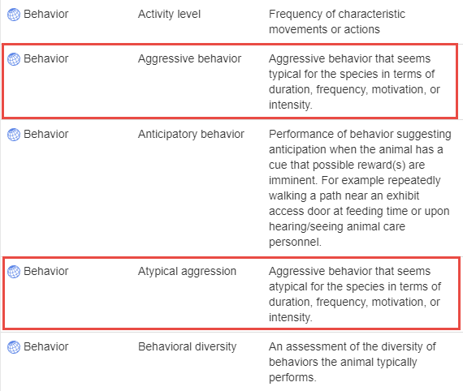
Understand the Descriptions
You should read all the
Descriptions to help you
select the correct Indicator
and Name. For example,
you have a Board directed
requirement to track all
aggression that is outside
the norm for the species.
Reading the definitions you
would select Behavior / Atypical
Aggression and NOT Behavior /
Aggressive Behavior due to the
Description.

Slide 10
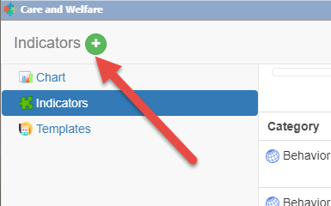
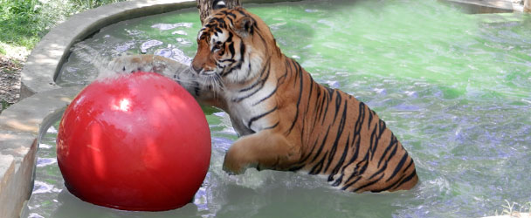
Adding Local Indicators
If you do not find an Indicator and a
Description that meets your needs
you can add a local one by selecting
the green circle/plus sign Add New
icon. We will discuss adding local
Indicators after we cover Value Types.

Slide 11
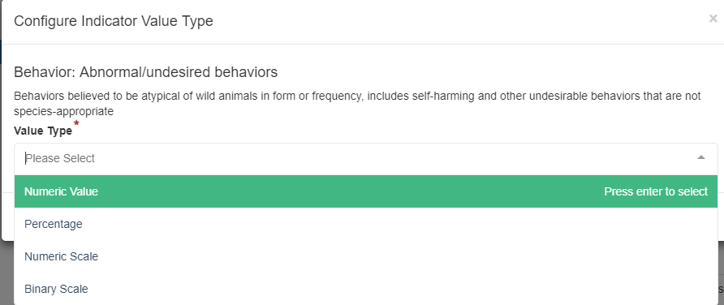
Indicator Value Type
The first thing you will be asked when you select the Please Configure option
is to select the Value Type you want assigned.

Slide 12
Four Value Types
What information you hope to record will drive the Value Type
  Binary
    Yes or No options as defined
  Numeric Scale
    Numbers with definitions. Example a “1” means excellent whereas a “5” means poor, or negative, neutral or positive
  Numeric Value
    Free choice numbers with no definition
  Percentage
    A rate out of 100

Slide 13
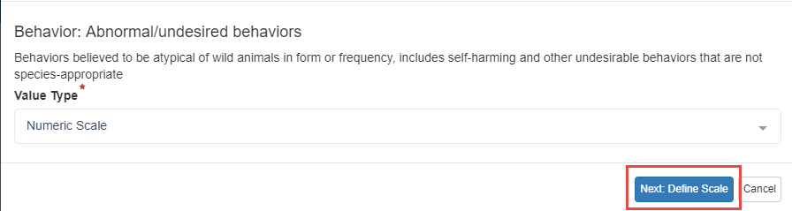

Numeric Scale
In our example for Behavior: Abnormal/undesired behaviors we selected Numeric Scale. We chose this Value because it will allow
us to capture the degree of these behaviors, from none to many.
We are then asked to “Define Scale”.

Slide 14
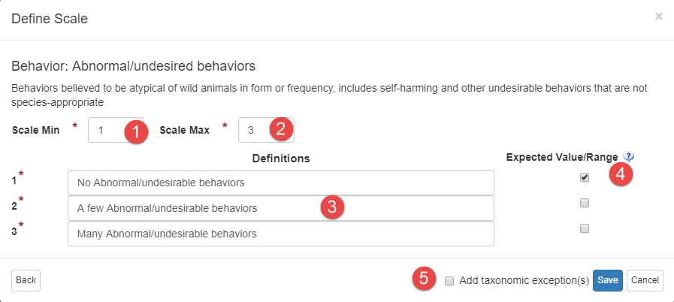
Define Scale
Use Scale Min to reduce the number of lines (1). Use Scale Max to increase the number of lines (2). Define what the numbers mean (3). Select what you want as the Expected Value (4). Although indicating the Expected Value is optional, if anything other than that is entered you will get a warning in red that it is not what you desired it to be. HINT: When defining Scale be consistent, don’t define lower numbers as what is desired in some Indicators and higher numbers as what is desired in others. This will help make interpretation of the Charts easier. To define a different scale for a different taxonomy check this box (5). We will select this option later.

Slide 15
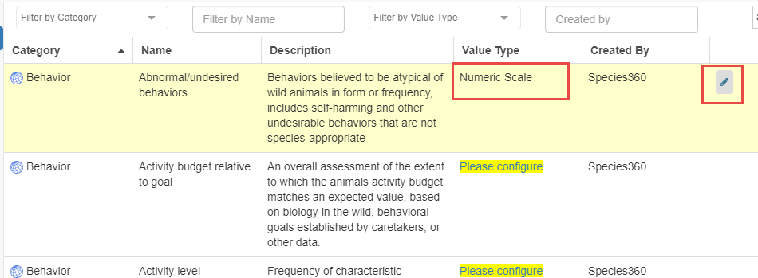
Value Type Configured
Once the Value Type is Configured the Value will display in that column.
If you want to edit the Value Type select the Edit icon. For most of our
animals we want to capture only the 3 Values. But for our Primates we
want more detail. We select to Edit.

Slide 16
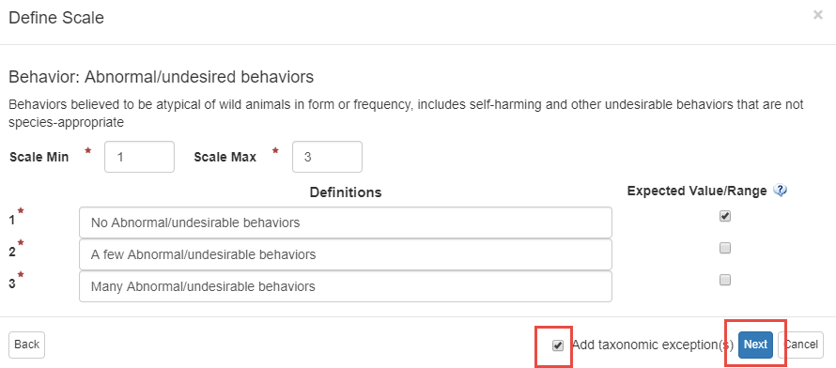
Add Taxon Exceptions
In the Define Scale screen we check the Add Taxonomic Exceptions box.
The taxonomy selected can be at any node of the tree and you can select
to include taxa below or not. Note that the Save button now says Next.

Slide 17
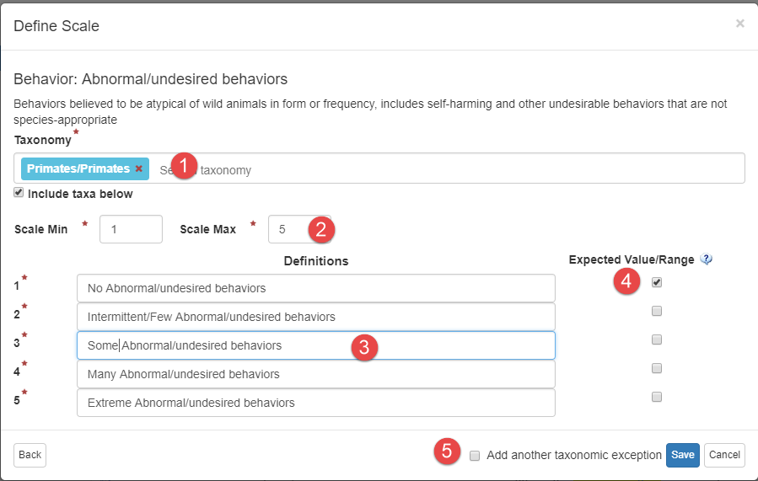
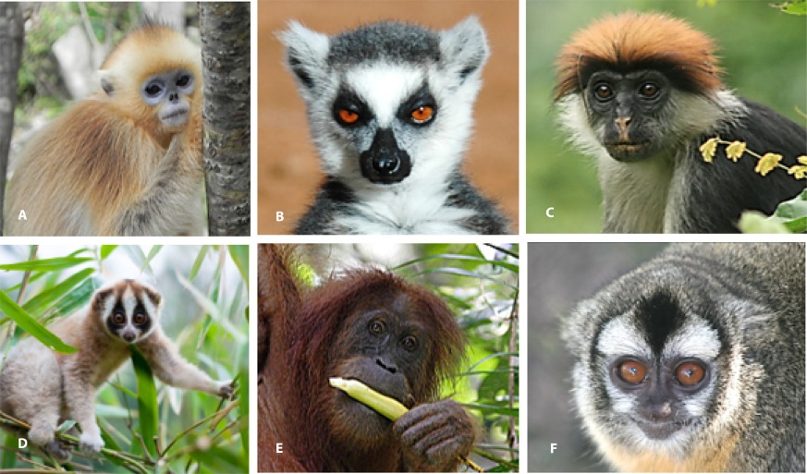
Add Taxon Exception
Because we want more detail in what we gather for our Primates (1) we have expanded the lines from 3 to 5 (2). We redefined the number scale (3) and checked our expected value (4). We do not want to add another taxonomy exception so we have unchecked that box (5) and Save.

Slide 18
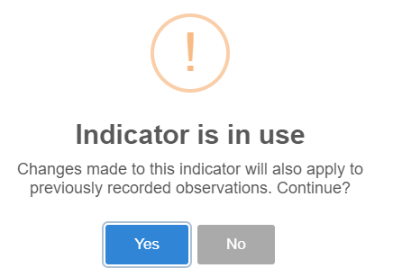
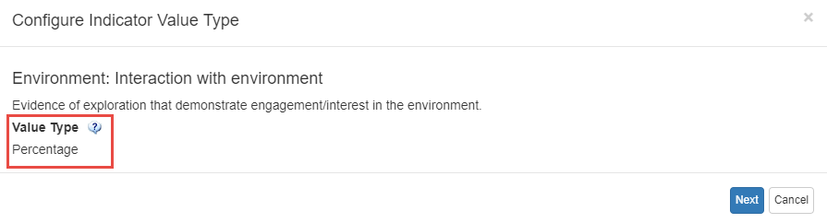
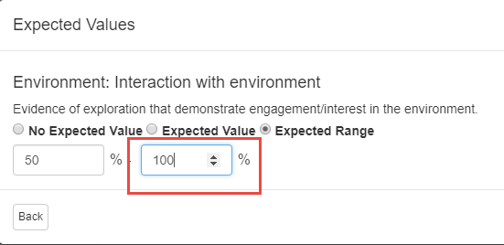
Editing an Indicator
For Environment: Interaction with
Environment we have chosen a
Value of Percentage. However, we
recorded an Expected Range of
50-80% and we want to change it.
When we select to edit we receive
a warning that the Indicator is in
use (top). We select Yes, understanding
that any changes will also apply to
previous records. Because the Indicator
has been used in previous records we
cannot edit the Value Type (middle).
We can, however, change the Expected
Values and we change the Expected Range
maximum from 80 to 100, meaning we
would like to see the animal use the
entire enclosure.

Slide 19
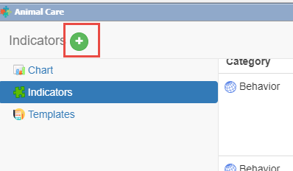
Creating a Local Indicator
The keepers have noticed that some members of our penguin colony are exhibiting excessive vocalizations. They would like to capture and compare it with other factors to see what may be causing it. There is not a Global Indicator that captures this so we will create a Local one. We select the green plus Add New icon.

Slide 20
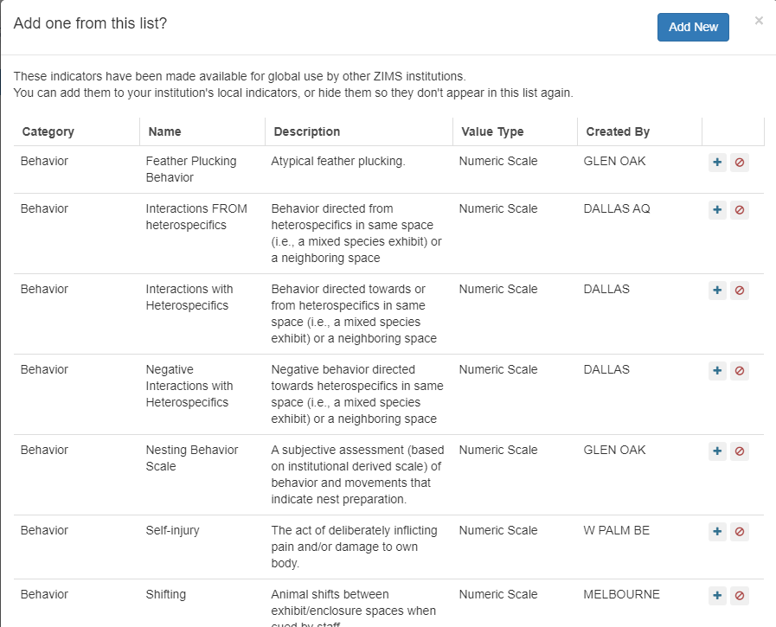
Shared Indicators
The first screen will display
any Indicators that have been
configured by other
institutions that they have
marked for global sharing. If
you want to make one of these
Indicators a local one, select the
green “+”. The only data you
can edit is the Expected Values
or Ranges. You can also add
Taxonomic Exceptions. If you
do not want to continue to see
the Indicator in this list you
can remove it using the red circle. Select Add New.

Slide 21
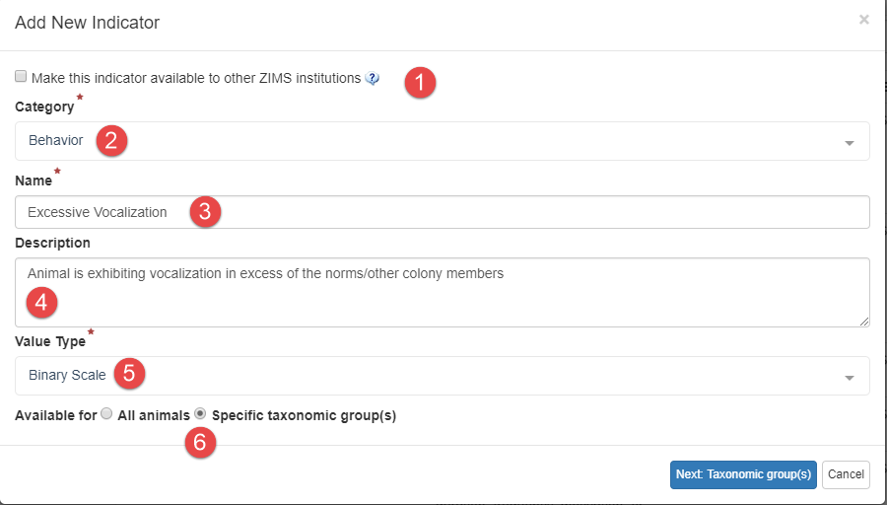
Creating a Local Indicator
1-If you want to share the Indicator with other Institutions check the box
2-Select a Category from the five options
3-Name it so you can find it. You may want to develop a naming convention.
4-Describe what you are trying to capture
5-Select Value Type. We have selected a Value Type of Binary because we want a simple Yes or No for the behavior.
6-We want this Indicator available only for our penguins so we check the Specific Taxonomic Groups checkbox.

Slide 22
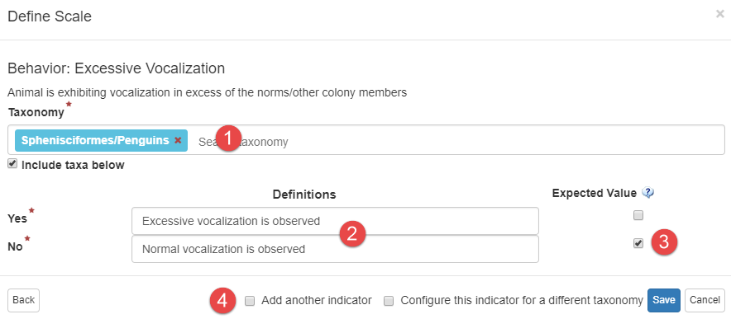
Defining Scale
We limit the Taxonomy to penguins (1). We then define the Yes or No responses (2),
checking the desired Value of normal vocalization (3). We then have the options to
add another indicator or another taxonomy. We are done so we Save.

Slide 23
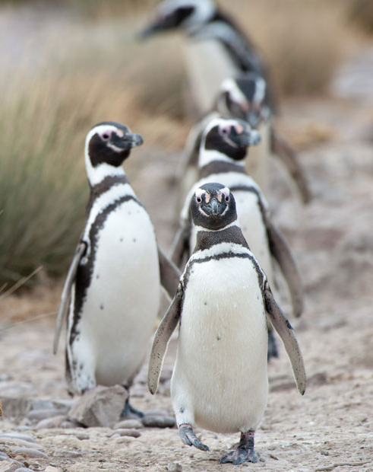
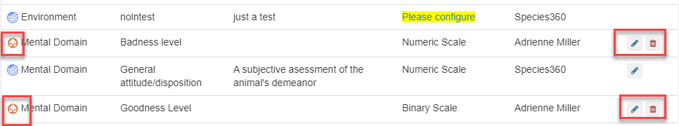
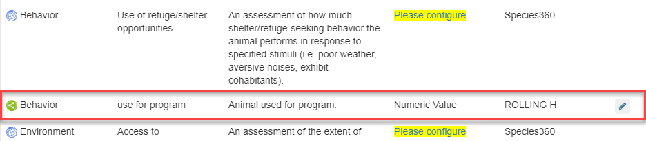
Added to Indicator List
The Behavior is added to your list of Indicators. The house icon indicates that it is a Local Indicator. You can edit and delete these Indicators. Only your institution will have this Indicator available as a selection because you did not check the sharing box. A shared Indicator that you adopted as Local will display the green shared icon. You can
edit but not delete these Indicators.

Slide 24
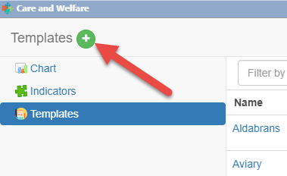
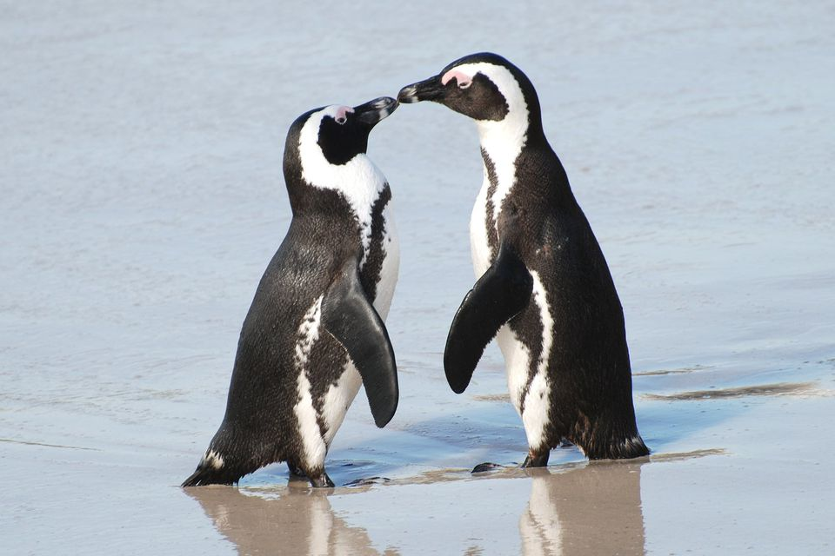
Create a Template
To create a Template using the
Indicators that you have configured,
select Templates and the Add New
icon.

Slide 25
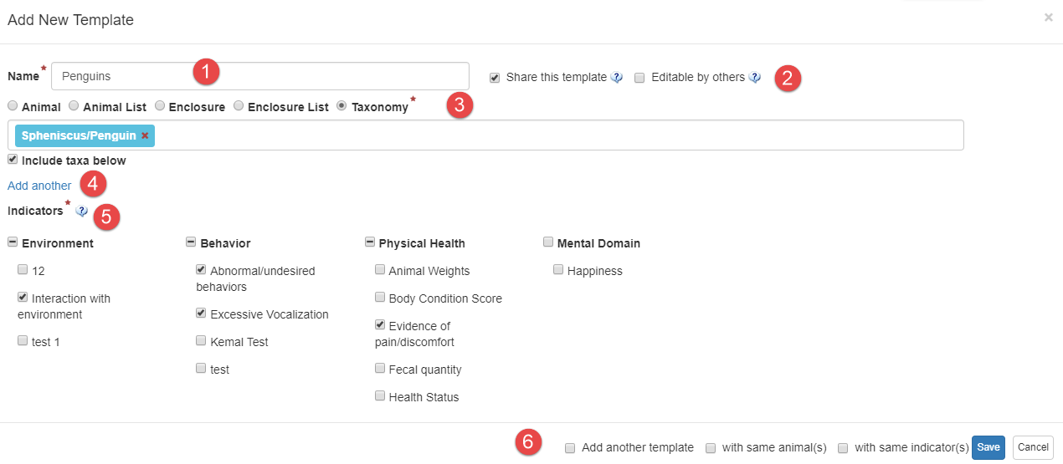
Create a Template
1-The name must be unique.
2-Select if you want to share with others or allow others to edit the template.
3-Select the entity you want the template to cover. If you do not have Animal or Enclosure Lists those options will not display for selection.
4-If you want to add another entity select Add Another. You can mix and match Animals, Enclosures and Taxonomy. When selecting Enclosures it will pull from the current Occupants.
5-Select your Indicators. Checking the top level Category will select all the Indicators under it.
6-You can easily Add Another Template from here. You can select the same animals and/or the same
Indicators.

Slide 26
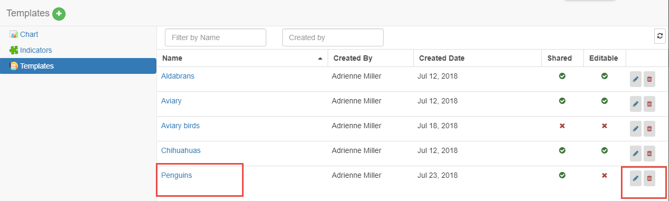
Using the Template
To use the Template select the hyperlink from the list of Templates.
this is also where you would edit or delete a template.

Slide 27
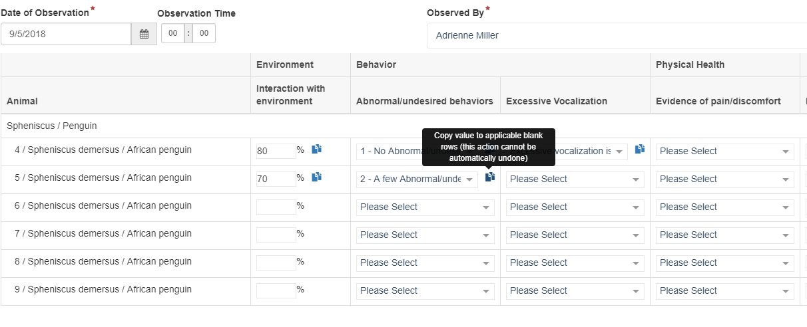
Using the Template
Complete the template. Selecting the copy icon will copy the value in the
remaining records in that column for any animals with the same Configuration
for that Indicator. You do not have to complete all the fields to Save. Save and
Repeat will save the data and keep the template open for additional entries.

Slide 28
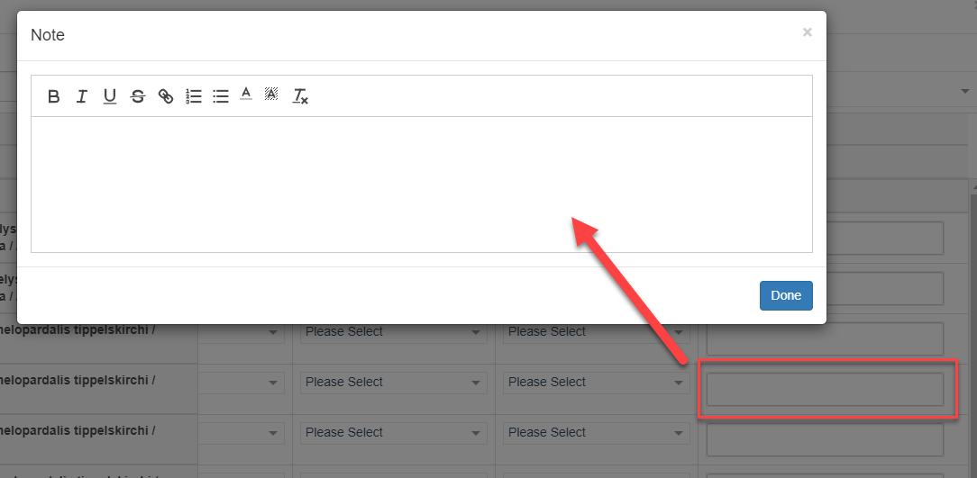
Using the Template
Selecting the Note field will open up a free text box for additional notes. This is a
single notes field and it applies to all columns.

Slide 29
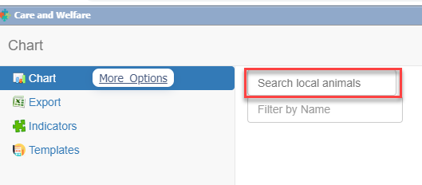
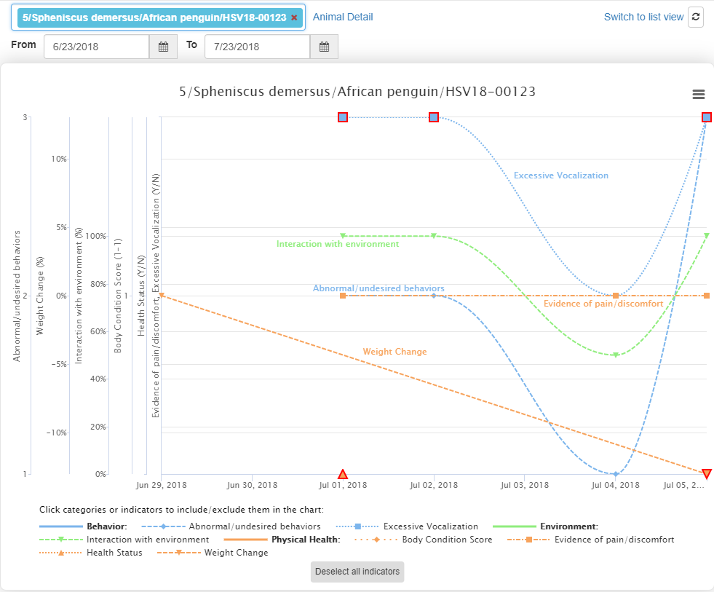
Viewing the Chart
To view the Charts, select Chart
and enter a GAN or other
identifier (above). The Chart will
display the data recorded during
the selected date range.

Slide 30
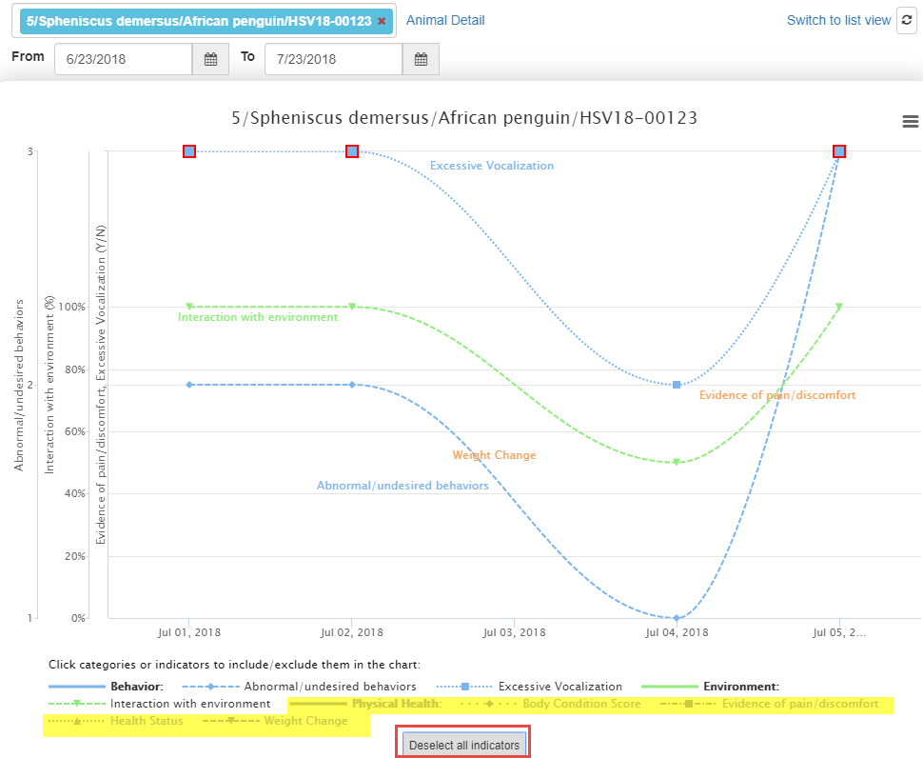
Filtering the Indicators
You can filter the Indicators
to make the Chart easier to
read by clicking on them
(see yellow below). If they
are greyed out they will not
display in the chart. By
removing some Indicators
we can easily see that
Excessive Vocalization,
Interaction with Environment
and Abnormal/Undesired
Behaviors appear to be
related.

Slide 31
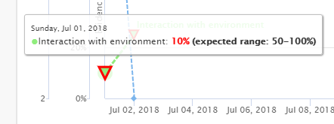

Outside of Expected Values
If an Observation is outside
the desired Value/Range it
will be outlined in red on the
graph. Hovering over will display
the desired Value.

Slide 32
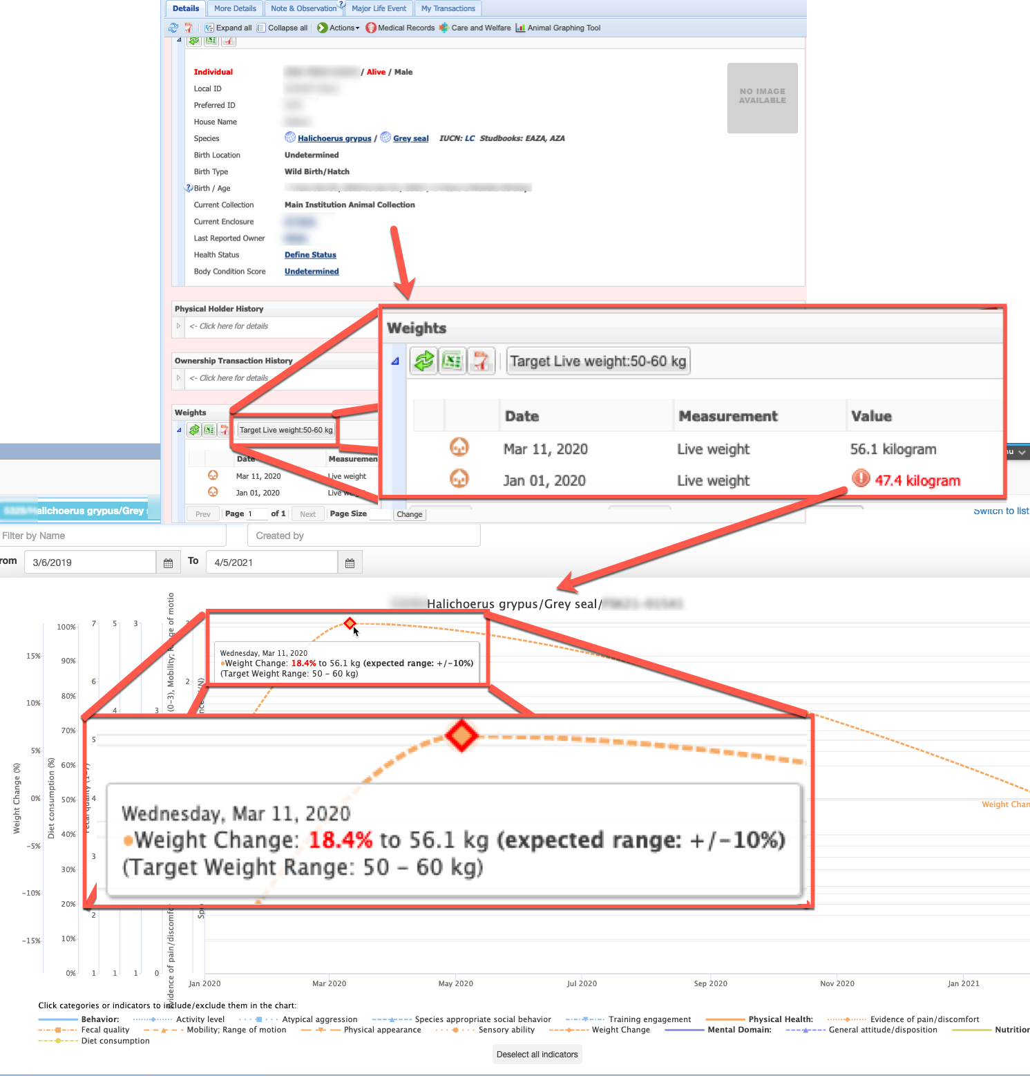
Target Weight Range
In addition to weights entered on the animals Basic Information screen in ZIMS for Husbandry, if a Target Weight Range is set up the animal being graphed in Care and Welfare, this range information will display as well.

Slide 33
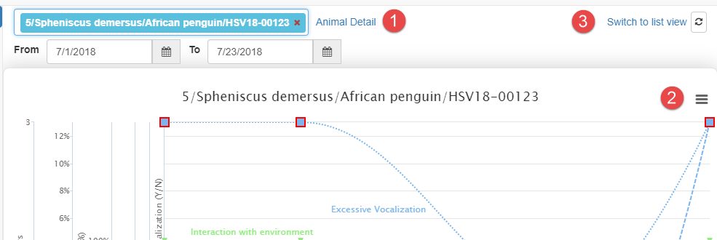
More Options
1-Selecting Animal Detail will take you directly into the animal record
2-Selecting the hamburger icon allows you to print the Chart
3-Switch to List View will change the view

Slide 34
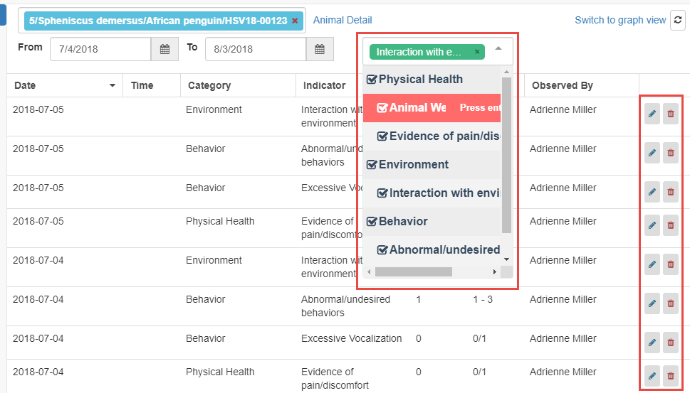
List View
List View shows the Observations in a list. The columns can be sorted in ascending or
descending order. If you want to filter the list to fewer categories simply uncheck (or
press Enter when highlighted) the categories you do not want to see. You can edit or
delete the Observation from List View. List View is where any Notes will display.

Slide 35
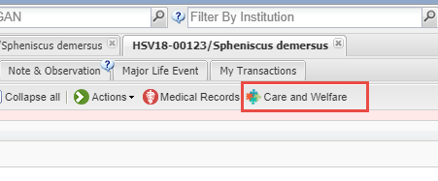
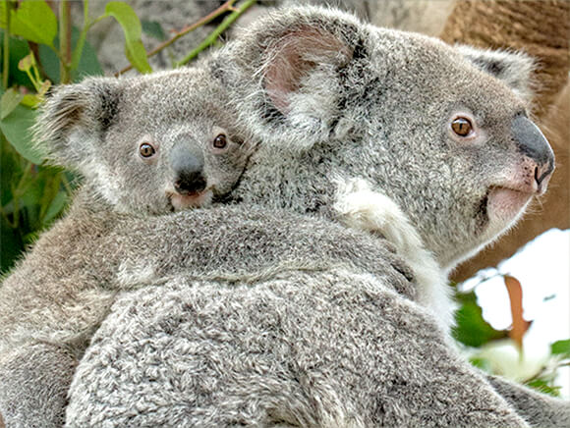
From the Animal Record
From within the animal record
you can open the Chart and have
access to the List View by selecting
the Care and Welfare tab at the top
of the record.

Slide 36
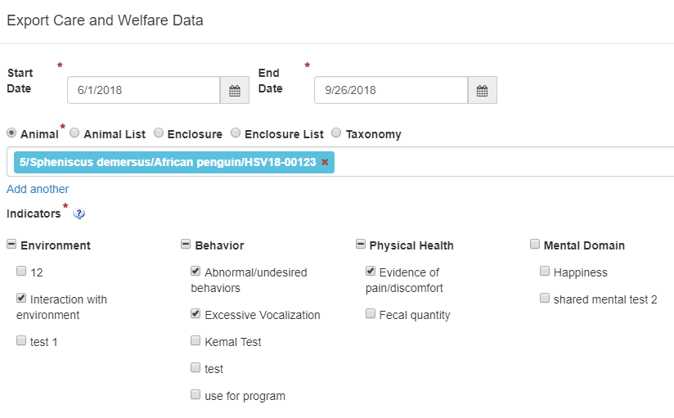
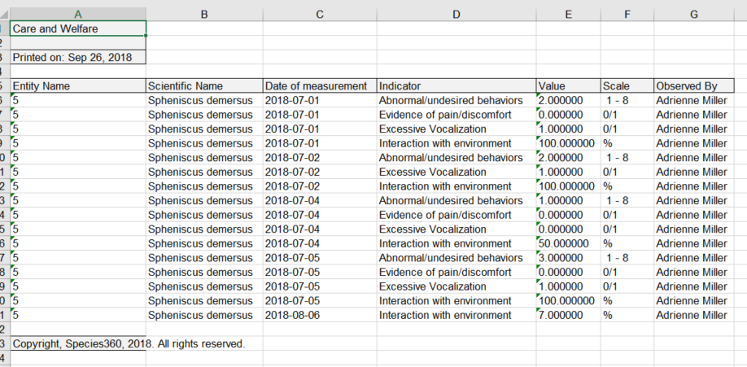
Export
The Export option allows you to export data for an
animal. You can export for multiple animals by using
Animal Lists, Enclosures or Taxonomy.

Slide 37
External Sharing
The Care and Welfare module is Local view only for data recorded through Care and Welfare Templates. It is not shared.
Any notes that are recorded through a Care and Welfare template are not even displayed in the husbandry module, they stay within that module only (this is a future functionality).
If Weights, Target Weight Range, Body Condition Score and Health Status are recorded through Care and Welfare, they will display in the husbandry and medical modules with an icon to show they were recorded in Care and Welfare.

Slide 38
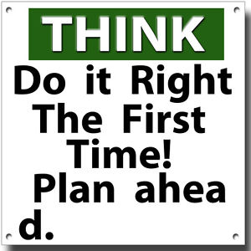
Some Best Practice Suggestions….
Try to get the involvement of all
Staff members who will be using
the Care and Welfare module to help
plan how it will be used and who
will be using it. You only want to
configure the Indicators and
create the Templates once. The
expected usage is:
1-Indicators are owned by the welfare
officer at your institution
2-Templates are used by the animal
care staff
3-Charts are Curatorial, Veterinary
and others with animal collection
oversight

Slide 39
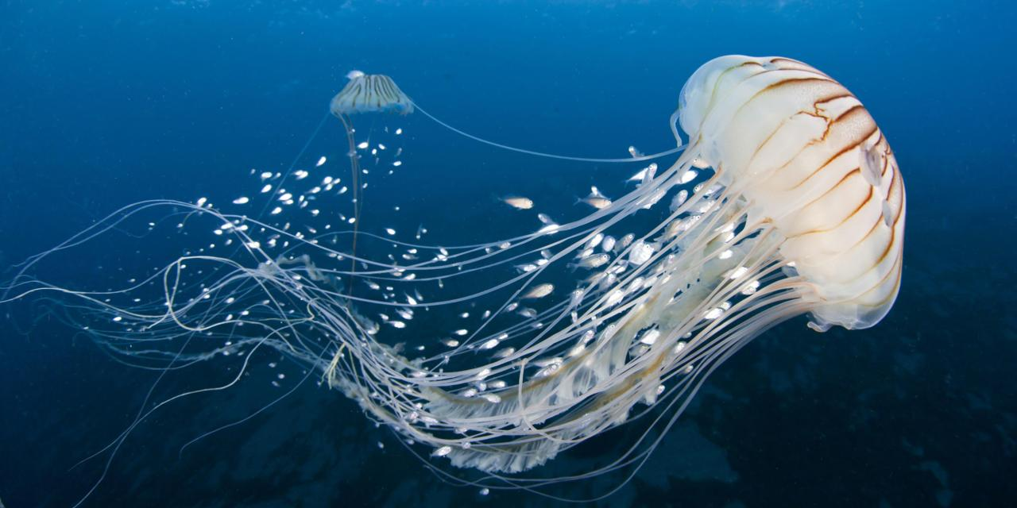
BP – Use Global Indicators
Whenever possible try to use the Global Indicators
Care and Welfare information is not currently shared but hopefully it will be in the future
Using standard Global Indicators will assist with this sharing

Slide 40
BP - Creating Local Indicator
Try to use the default of assigning to All Animals when possible
Taxonomic exceptions cannot be added or removed after observations are recorded for that indicator
If “specific taxonomic group(s)” is used you cannot go back and select All Animals – you would need to create a new Indicator
Indicators can be set now and add/edit expected values later

Slide 41
BP - Editing an Indicator
  Before data entry all fields can be edited
  Once data has been recorded for Indicators, the following fields CAN be edited
    Category (warning will be given if associated with records)
    Description (warning will be given if associated with records)
    Explanation
    Value Definition
    Expected Value/Range
  Once data has been recorded the Indicators, the following fields CANNOT be edited
    Name
    Value Type
    Add/remove Taxonomic Exceptions
  If an Indicator is edited, you should add a batch Note to animals affected that includes what was changed on date “x”

Slide 42
Taxonomic Exceptions in Templates
All of the Indicators that have been Configured will display to select from when creating a template
If an Indicator has been used for a taxa, you cannot remove that taxa from the exception
When actually using the template, if a taxa is not included in the indicator the data entry will be greyed out and a “NA” displayed by default, data cannot be recorded

Slide 43
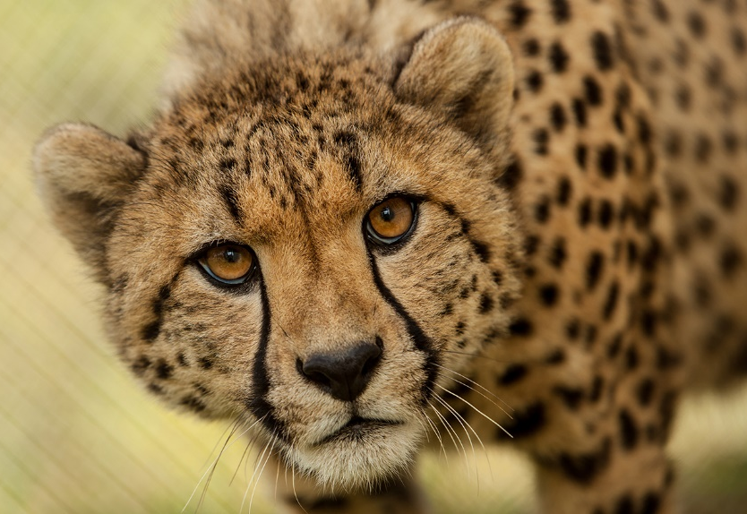
BP – An Example
Indicator A
  Numeric scale is 1-5
  Taxa exclusion = cheetah
    Numeric scale for cheetah is 1-10
Data is recorded on cheetah
Oops – you really wanted cheetah to be 1-5
  Not going to happen – skews data already recorded
Oops – you don’t care about cheetah being an exception
  Not going to happen – skews data already recorded
Numeric Scale can only be changed BEFORE data entry has occurred
Expected Value/Range can always be changed

Slide 44

BP – Deleting an Indicator
Care and Welfare data does not go into the animal record, they are retained in the module
Deleting an Indicator will delete all the observations recorded using it
You have 3 months to “Roll Back” a deletion using Data Entry Monitor

Slide 45

Chart Considerations
Weight, Target Weight Range, Health Status and Body Condition Score automatically populate the Charts
  They do not display on List View
List View allows you to edit the date, time, value and observed by fields
List View is also where any Notes will display

Slide 46

ZIMS for Care and Welfare

