Slide 1
Batch Actions from Enclosure Occupants List

Slide 2
ZIMS Updates!
This PowerPoint is up-to-date as of: December 9 2019
ZIMS is developed in an “agile” method
This means that it is updated every two weeks, sometimes with additional releases in between!
Use the link below to see if there have been any updates to this topic since the date above:
http://training.species360.org/updates/

Slide 3
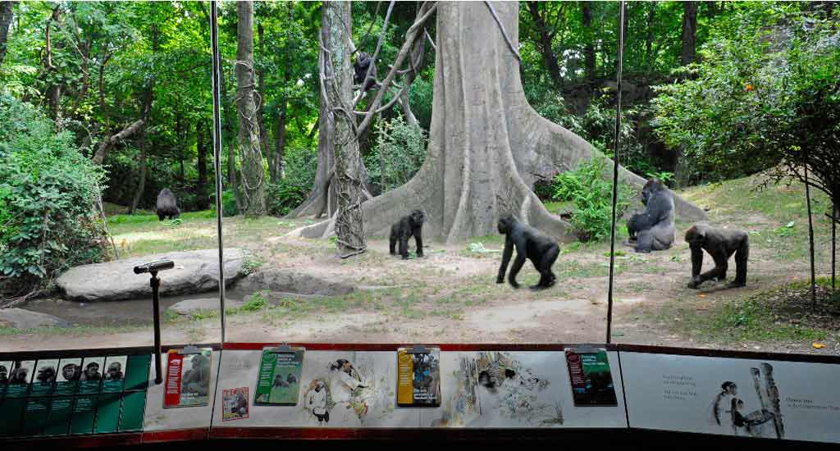
Occupants are not static
Animal Lists are great for
performing Batch Actions
to save you data entry time.
But these lists do not update
as animals change enclosures.
For Batch Actions on all, or
some, of the animals in an
Enclosure use the Batch
Actions from Enclosure
Occupants option.

Slide 4
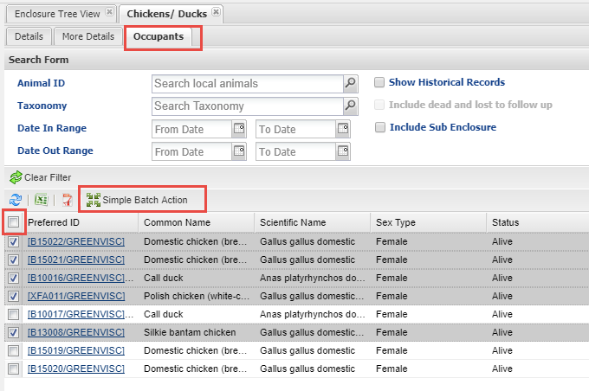
Occupants tab and Search
To use this functionality
open the Enclosure record
and select the Occupants
tab. The results grid will
display the current animals
in the enclosure. If you need
to include historical occupants,
or want to filter the list, use
the Search form. Check all the
appropriate records. You can
Check All or Uncheck All by
selecting the box at the top
of the list. Then select Simple
Batch Action.

Slide 5
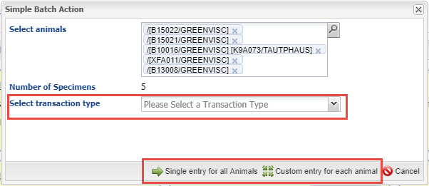
Create the Batch Action
Select the Transaction Type and whether you want a Single Entry for all or a
Custom Entry. You can add more animals to the list using the lookup or by
simply typing the GAN or an Identifier into the Select Animals grid.

Slide 6
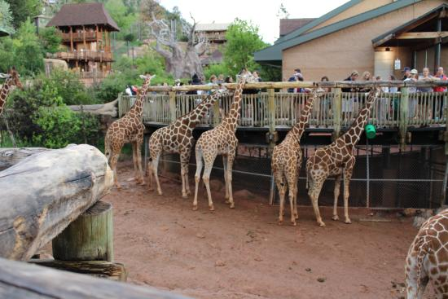
Complete the Batch Action
Then complete the
Batch Action! Since
the Enclosure Occupants
list automatically updates
as animals come in or go
out you don’t have to
think about keeping an
Animal List based on an
enclosure updated!

Slide 7
Batch Actions on Enclosure Occupants
A real time saver!

