Slide 1
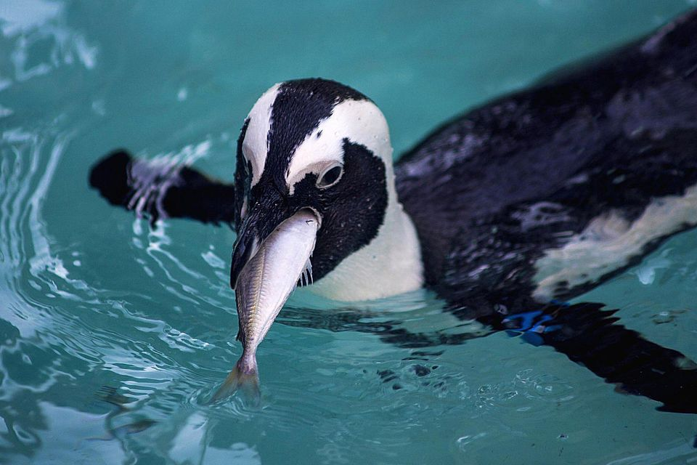
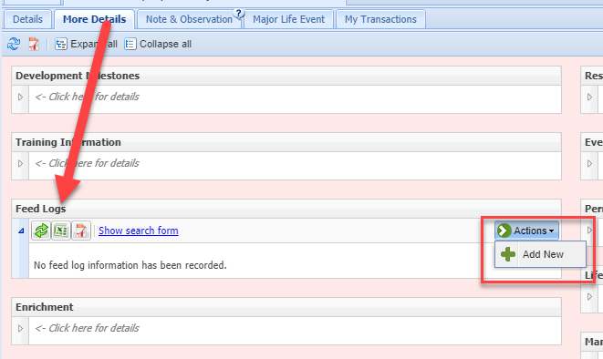
Feed Log Grid
The Animal Feed Log is an
easy to use grid found in the
More Details tab of an animal
record. Select Actions > Add New
to create a Feed Log record.

Slide 2
Completing the Grid
You can record feeding multiple different types of food, the amount given
and the amount consumed or left. The grid line will remain red until you
have recorded data in all the mandatory fields (as top screen). The line will
turn green once all the mandatory fields are completed (bottom screen).
Only those lines that are green will be saved.

Slide 3
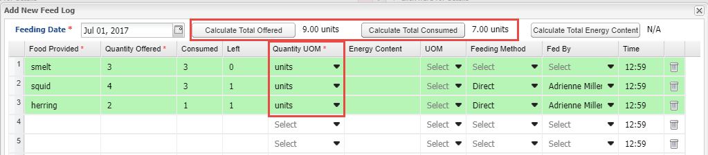
Calculations
If the Units of Measure are the same you can Calculate the Total Offered as well
as the Total Consumed. If you know the Energy Content you can record that and
calculate Total Energy Content also if the Units of Measure are the same. If you
need additional lines select the green plus icon. To record another feeding session
for the same date, select the Add New Feeding Session option.

Slide 4
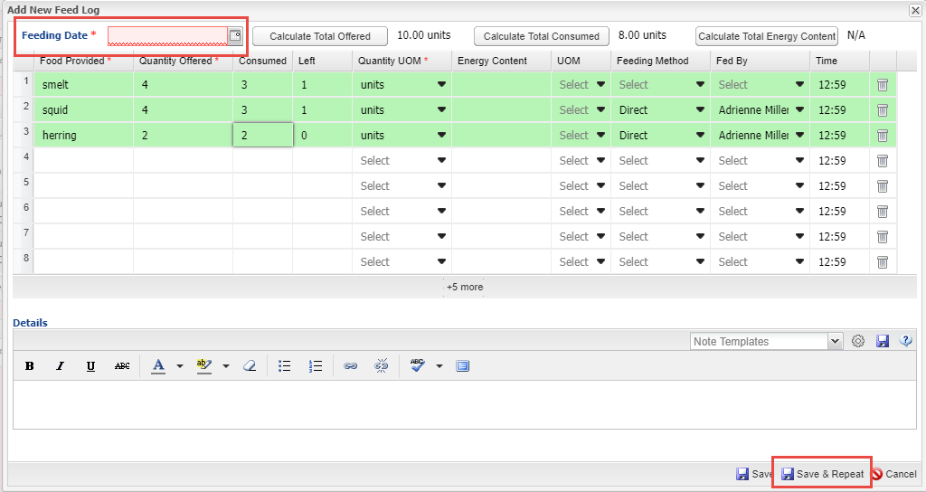
Save & Repeat
If you are entering multiple days worth of Feed Logs you can select the
Save & Repeat option. You will be required to enter a new date. You can
keep the data as recorded in the original entry or edit, add or delete as
appropriate.

Slide 5
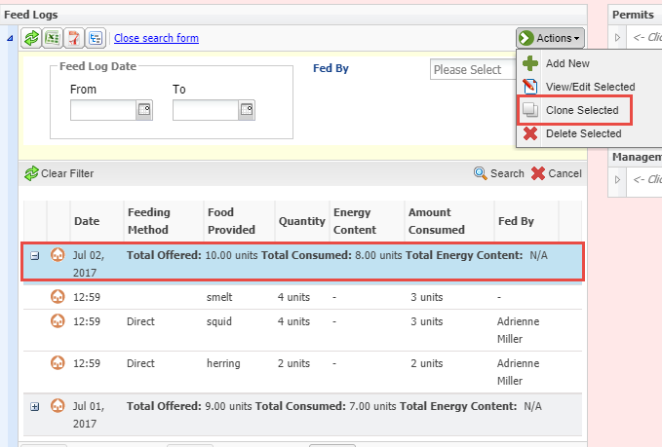
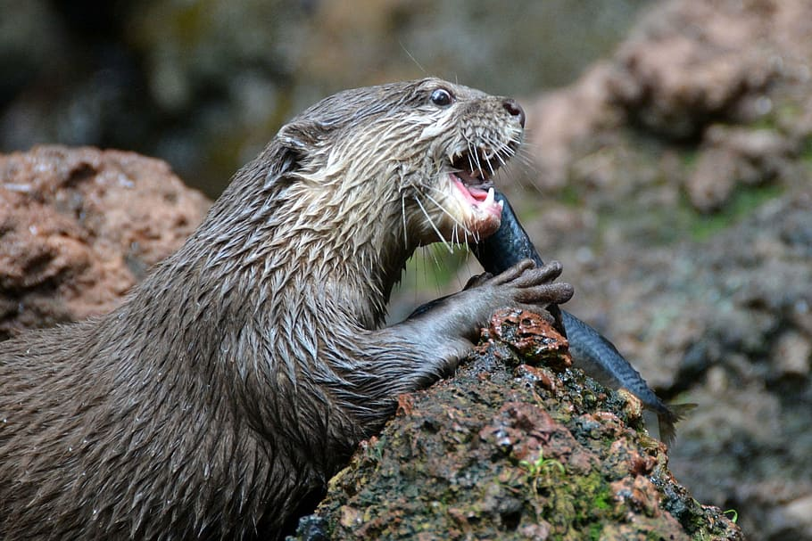
Clone Selected
Another time saver
should you frequently
feed similar food items
and amounts is to
select Clone Selected
from the Actions
Menu.

Slide 6
Clone Selected
The data from your selection will prefill. You will need to record a new feeding date.
Then you can add, edit or delete data as appropriate. There is no Save & Repeat for
a cloned record.

Slide 7
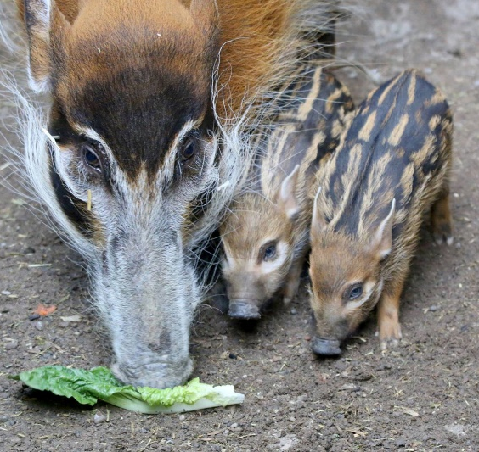
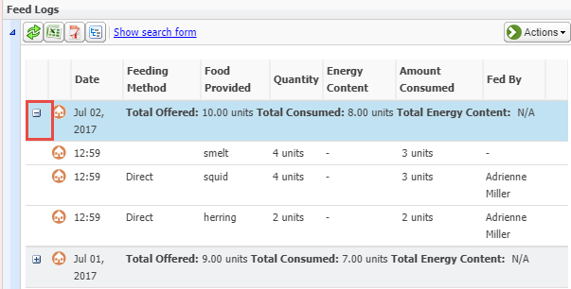
Display in Record
The record will display as
collapsed (top). To look at the
complete record details you can expand each line separately using the “+” (bottom).

Slide 8
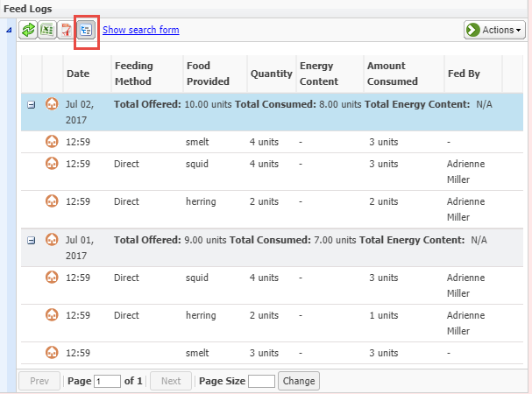
Display in Record
You can also use the
Expand All button at
the upper left to
expand all of the records
in one click. If you export
the record to Excel or PDF
the details will export
regardless of whether the
grid is expanded or not.

Slide 9
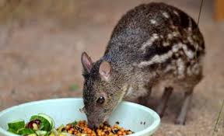
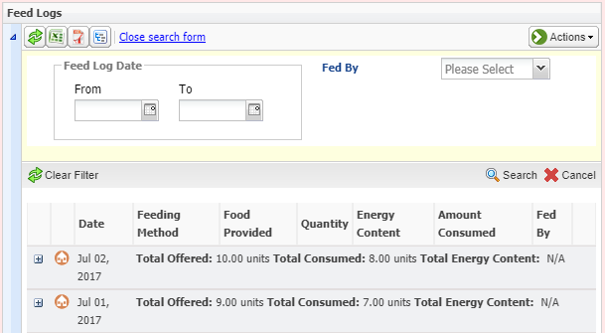
Search Form
The Search Form allows
you to search by a Date
Range or a specified
Fed By. The results of
this search are all that
will export should you
wish to filter your
exports.

Slide 10
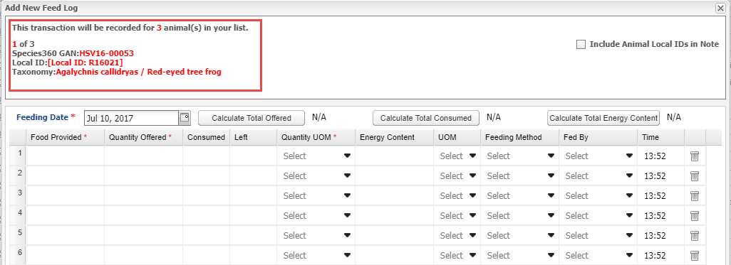
Batch Feed Log Entries
Feed Logs are available as a Batch action, with either a single entry for all
or a custom entry for each record.

Slide 11
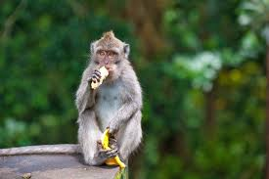
Feed Logs in ZIMS!

