Slide 1
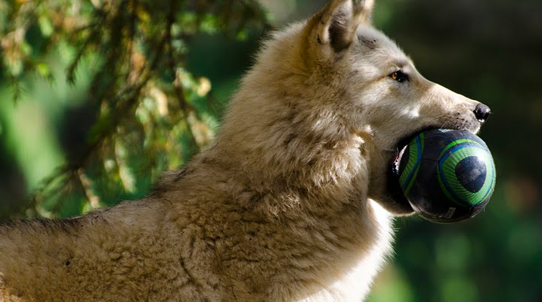
Enrichment in ZIMS
Create Items, Assign these Items and Track Sessions

Slide 2
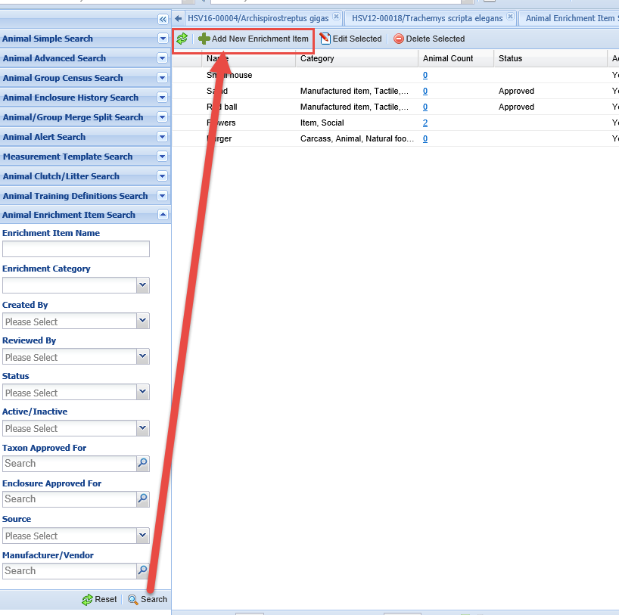
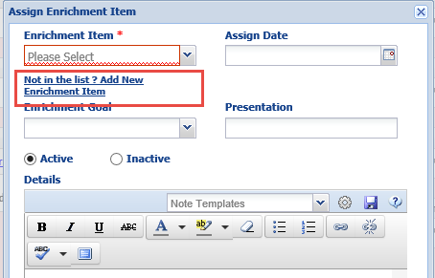
Enrichment Grid – Add Item
You first need to create an
Enrichment item. You do this
from the results grid for the
Enrichment Item search (left)
or from within the animal
record by using the Not
in the List? link (right).

Slide 3
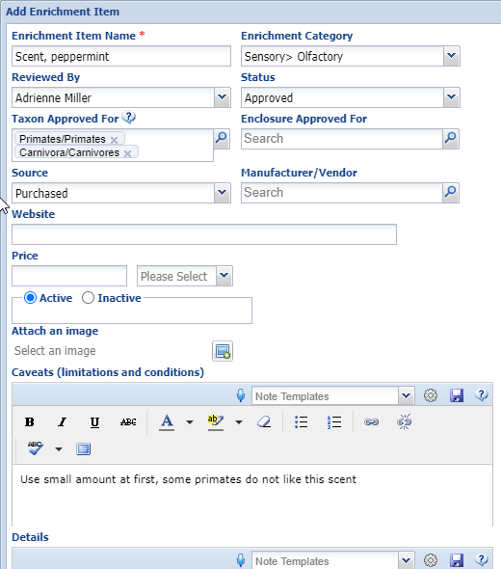
Enrichment Grid – Add Item
You can capture a lot of information in the
Enrichment Item grid but only the Enrichment
Item Name is mandatory. Because the Item
search looks at the beginning of the name, it
is recommended that if you have different
types of similar items you name them by type
first and then the specifics. Here we are adding a scent that is peppermint. We could also add a scent, lilac and scent, orange. If the Status is Not Approved it cannot be assigned to anyone. If you assign an Item to a Taxon you will be able to assign the Item only to members of that Taxon, or below. You cannot assign this item to a bongo as it is assigned to Primates and Carnivores. The Enclosure Approved For and the Active/Inactive buttons are for your information only, they do not drive any assignment options.

Slide 4
Active versus Inactive
The following Rules apply to Active/Inactive:
Active
Can be Assigned and Sessions added at any time after the Assignment date to the appropriate taxa
Inactive
If already Assigned
Sessions can be added on dates between Assignment date and date it was marked Inactive
If not already Assigned
It cannot be Assigned
Workaround for historical data
Mark Active – Assign to Record – Mark Inactive
Sessions can be added between Assignment/Inactive dates

Slide 5
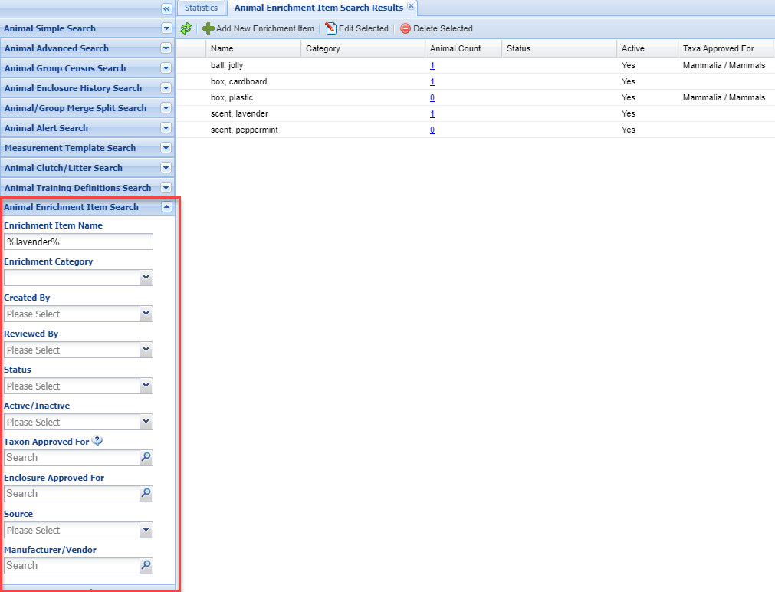
Search Results Grid
To find your Enrichment Items use the Animal Enrichment Item Search in the Animal Search box. If you are searching for a term that is not the beginning of the name (here we will be searching for “lavender” scent) put a % before and after the term. Your Enrichment Items will appear in the Enrichment Items Search results grid. This is where you can Edit or Delete any Items in addition to adding more.

Slide 6
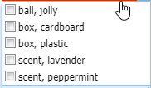
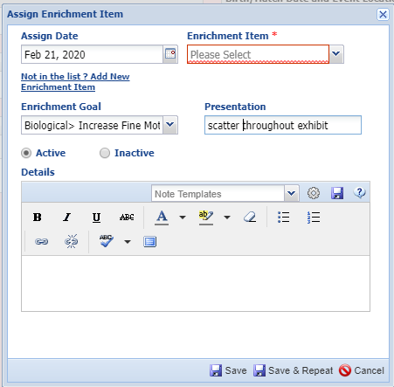
Enrichment Grid – Assign Item
You then need to assign the item(s) to
an animal. Go to More Details >
Enrichment grid > Actions > Assign Item.
You cannot create an Enrichment Session
for a date prior to the Assignment Date.
Only Items assigned to the species
(or a higher taxonomy) or with no
Assignment will display in the Assign
Item grid. Select all items as desired.
The Goal is a cascading multi-
select dropdown and the Presentation
is a free text field. If you have selected
multiple items the Goal should be the
same for all. If not, they should be
assigned individually.

Slide 7
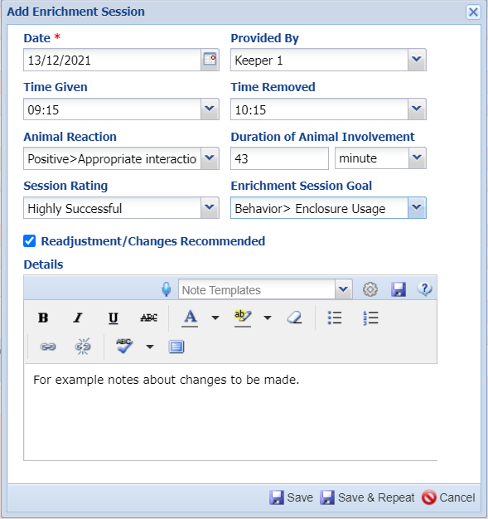
Enrichment Grid – Add Session
You then add an Enrichment
Session using the Item. Select
Add New under Sessions columns
for the item. As mentioned,
the Date cannot be before the Item
was assigned. Date is the only
mandatory field. The Animal Reaction
is a multi-select cascading dropdown.
If adjustments need to be made you
can record them in the Details box,
or use this free text field as needed.

Slide 8
Enrichment Grid – View Sessions
You can view the Sessions from the View/Edit link. You can Add a
New Session, or Edit or Delete a Session from this grid.

Slide 9
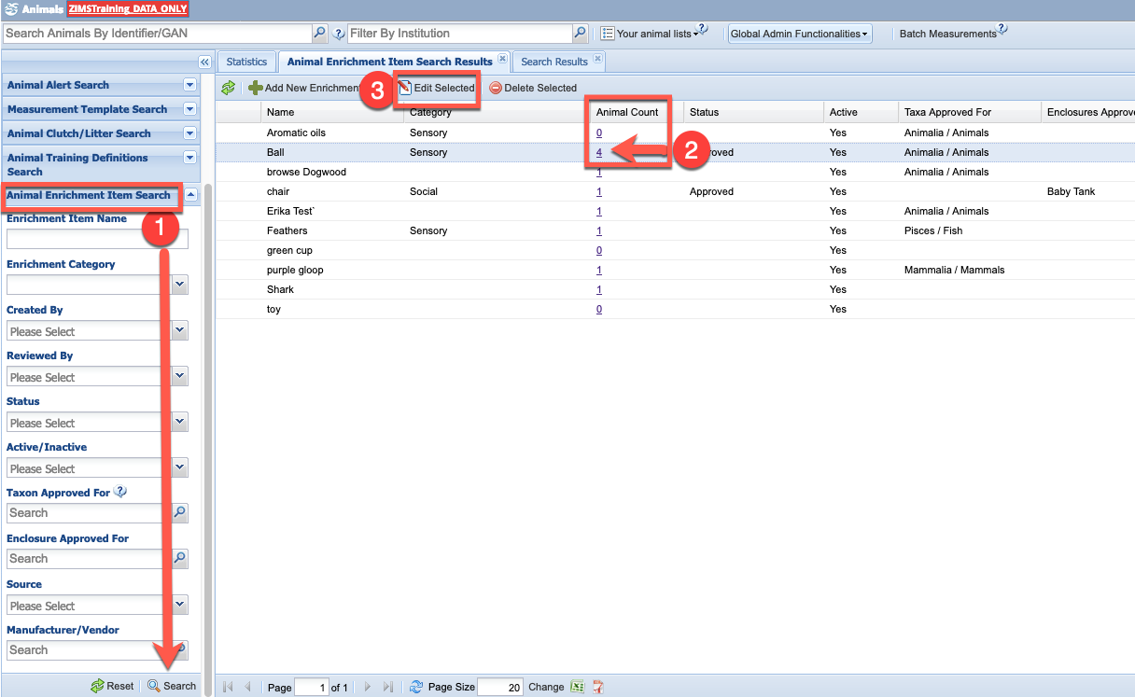
Enrichment Grid – Edit Items
To edit existing enrichment items, you must have appropriate role rights and need to be aware that previously entered sessions may be impacted. Always add a note to impacted animals records when editing an assigned enrichment item – 1) From Animals module, left hand Enrichment Item Search, 2) Find item to edit, see impacted animals (consider a Batch note) 3) Edit selected item

Slide 10
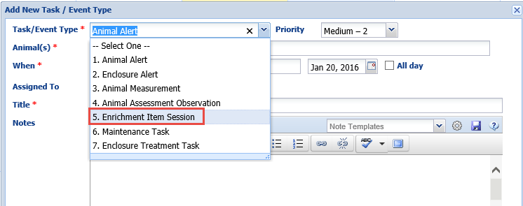
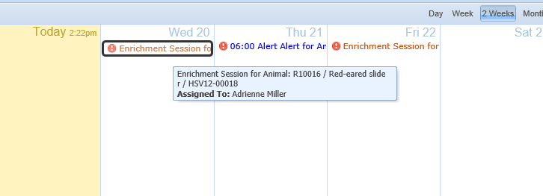
Enrichment in Calendar
You can also schedule Enrichment Sessions using the Calendar Task
Functionality.

Slide 11
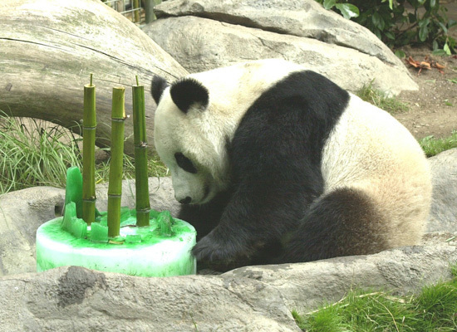
And that is Enrichment in ZIMS

