Slide 1
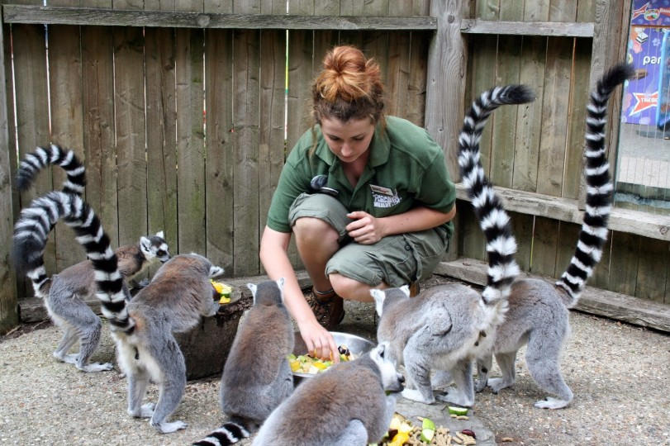
4002 – ZIMS for Keepers

Slide 2
ZIMS Updates!
This PowerPoint is up-to-date as of: November 12th 2018
ZIMS is developed in an “agile” method
This means that it is updated every two weeks, sometimes with additional releases in between!
Use the link below to see if there have been any updates to this topic since the date above:
http://training.species360.org/updates/

Slide 3
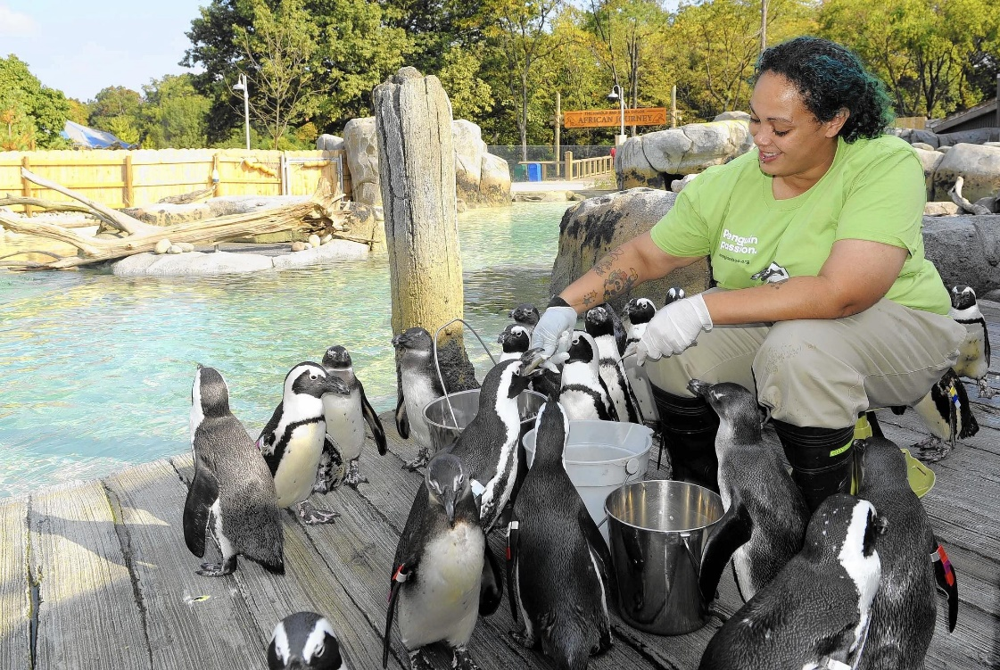
Saving data entry time is an important need of ZIMS Users.
Allowing Keepers to enter data into your database will provide
you cost savings and will enhance your team’s ability to collaborate.
The main features of ZIMS that relate to Keeper duties vary from
institution to institution. This presentation covers the most typically
mentioned features that our users report as being ‘keeper
responsibilities’.

Slide 4
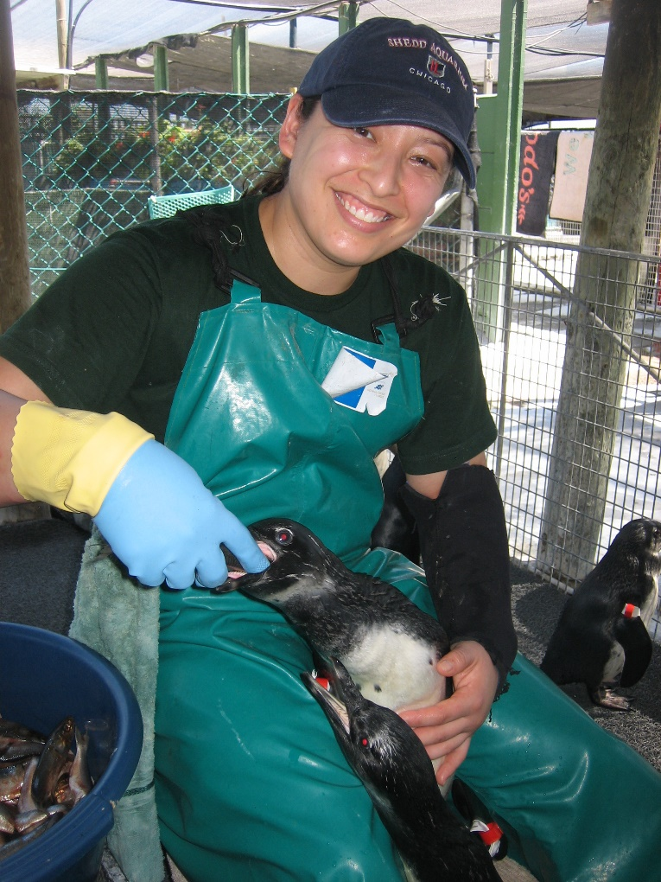
Provisional Data Entry
When Keepers start entering their own data
into ZIMS they may be given a role for
entering Provisional data. Provisional data does
not become part of the true ZIMS database
until it is approved by a staff member with the
access to do so. It is an important tool to help
get Keepers used to data entry without the
risk of creating errors in the true ZIMS database.
Provisional data is something that your Local
Admin oversees.

Slide 5
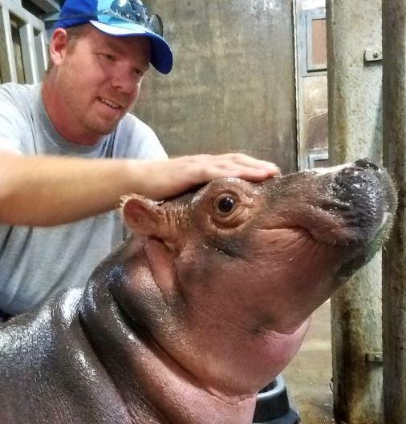
Possible Keeper Data Entry
Incomplete Accessions
Notes/Observations
Weights/Lengths
Training
Enrichment
Feed Logs
Animal Lists
Calendar Alerts
Prescription Administration
Daily Report

Slide 6
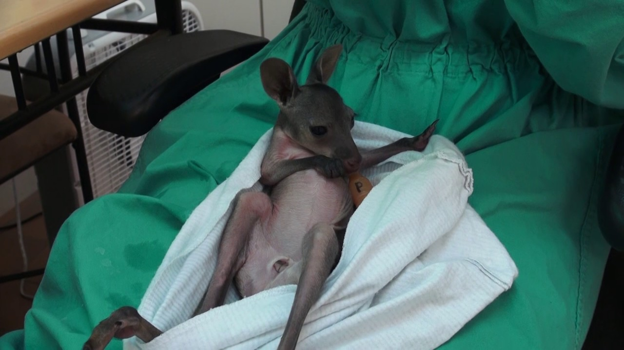
Incomplete Accessions
Incomplete Accessions are the capability in ZIMS where a non-registrar can create the basic record necessary to record husbandry data such as Notes and Weights. The primary records manager will be able to review all incomplete accessions and complete a full acquisition or associate with the appropriate record already on file.
This is especially helpful for new births/hatches and when any unexpected arrivals
occur and the Registrar is not available to enter a full accession.

Slide 7
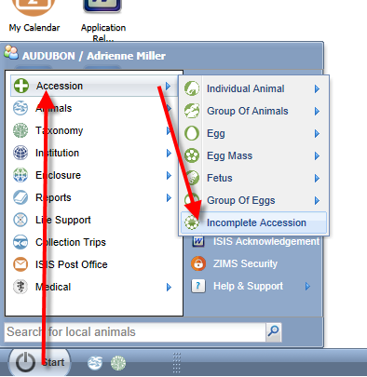
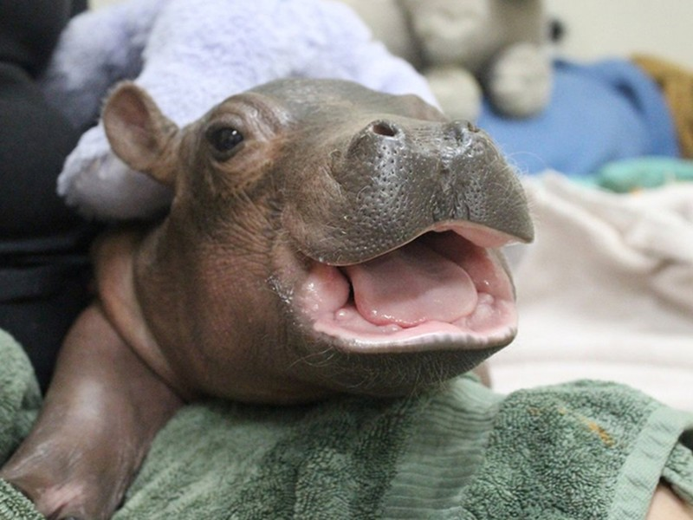
Starting an Incomplete Accession
Incomplete Accessions are found under the Start menu and Accession.
You will not select an entity type.

Slide 8
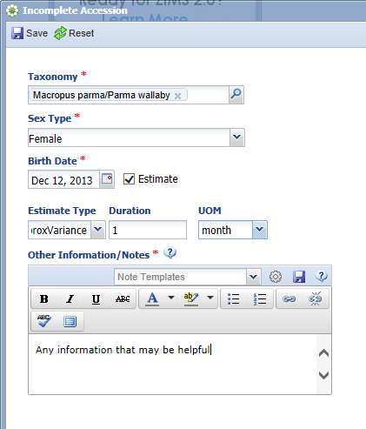
Creating an Incomplete Accession
Minimal information is required for
an Incomplete Accession. The taxonomy,
sex, birth date and appropriate notes
are the only information gathered.
All of this can be edited when the
permanent accession is created.
An Incomplete Accession receives a
temporary GAN (Global Accession
Number). Note that this GAN ends with
“IA”.

Slide 9
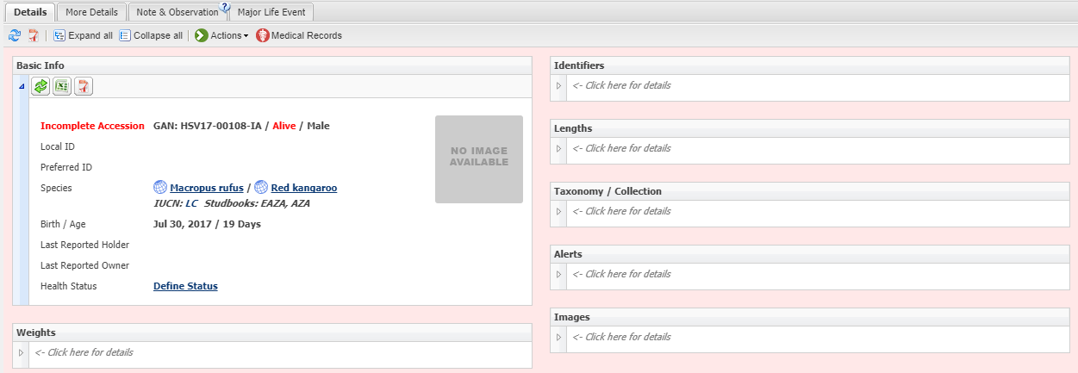
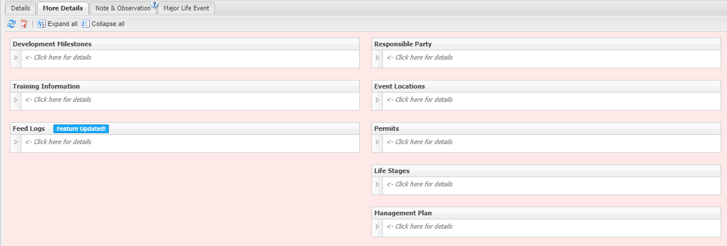
Recording Data on an IA
You can then start recording data
into the Incomplete Accession
record. Commonly this data is
Notes/Observations and animal
measurements such as Weights.
Medical data can also be recorded.
All information entered will be
copied into the record once the
full accession is created.

Slide 10
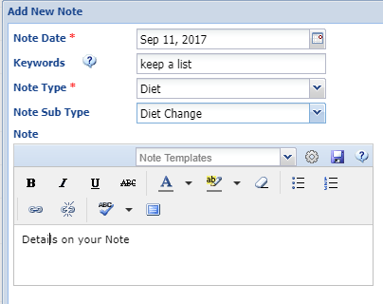
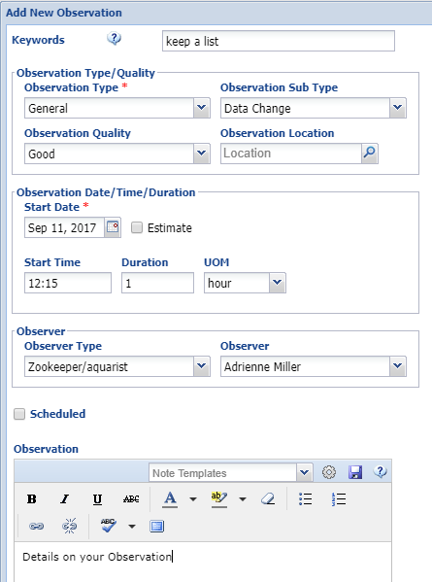
Notes & Observations
Recording Notes and Observations
on your animals is often a major
part of a Keeper’s ZIMS data entry.
Note data entry is fairly simple (top
screen). Observation data entry is
more complex (bottom screen).
Developing a list of Keywords can
aid with data retrieval.

Slide 11
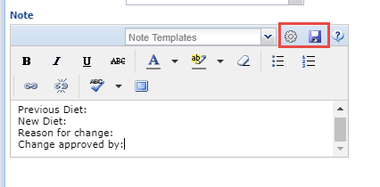
Note Template
Creating Note/Observation Templates can help make sure that you are
capturing all the required information. This is a Note Template for a
Diet Change. Once the Template is saved (using the Save icon) it will be
available to select in the Note Templates dropdown list. You can manage
your Templates by selecting the gear icon.

Slide 12
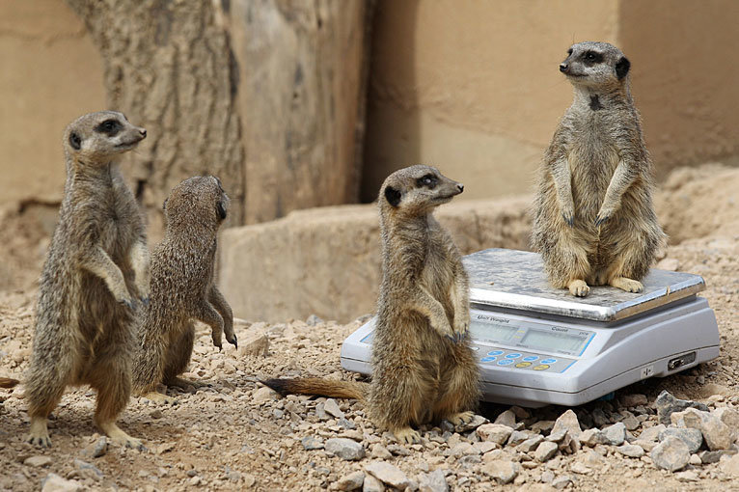
Weights and Lengths-
Vital indicators of successful husbandry
Weights are used in multiple ways:
Weight Comparison Report
Normal annual variations
Specimen Report
Prescriptions in Medical module
Both measurements can be visualized with graphs

Slide 13
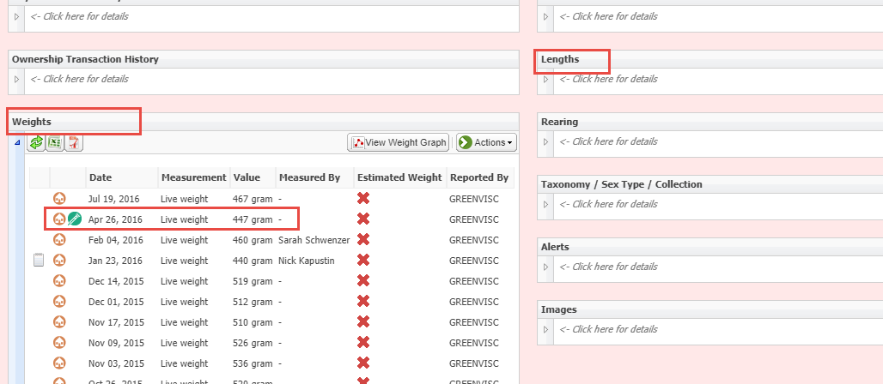
Recording Weights/Lengths
In the Animals Module you will see Weights and Lengths in two separate grids. The Actions Menu provides the option to add/edit or remove entries depending on your permissions. Any weights that are sourced from the Medical module will display with the syringe icon. Those weights can only be edited/deleted from the Medical module.

Slide 14
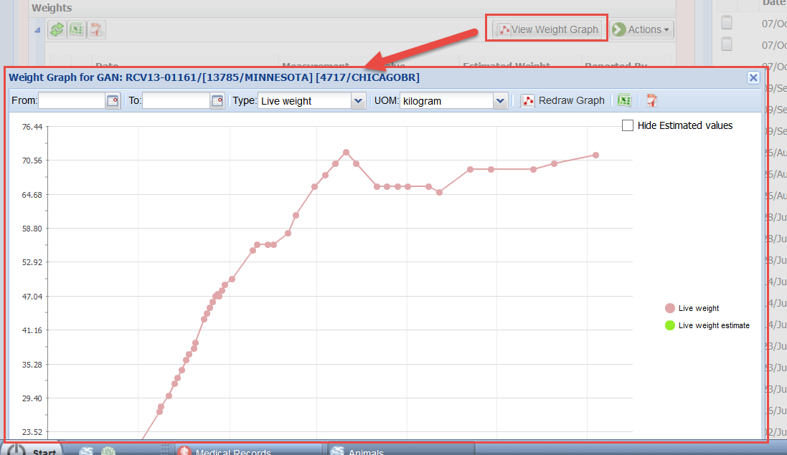
Measurement Graphs
When enough weight or length data has been recorded, ZIMS provides you with immediate visualization of trends.
Keepers can quickly see annual weight changes allowing them to be more active in changing diets or engaging with medical staff if concerns arise.

Slide 15
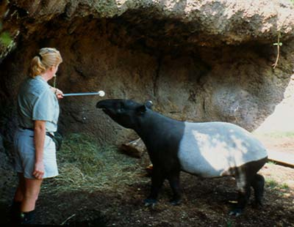
Training Information
The Training grid allows you to document
the behavioral routines that your animals
are learning. You first define the behavior
to be trained. You then assign this
behavior to an animal(s). You then record
Training sessions for this routine.

Slide 16
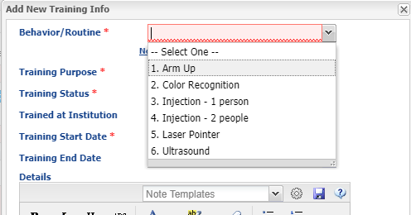
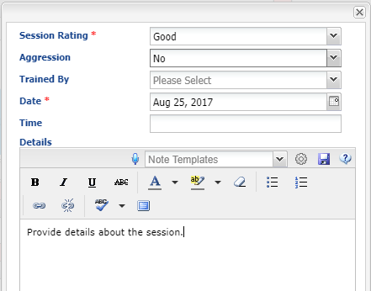
Recording Training Information
In the Animals Module you will see Training Information on the More Details tab. After you define a behavior it will appear in the drop down list to select from to assign to an animal(s). Once a behavior is assigned you can record sessions for the training.

Slide 17
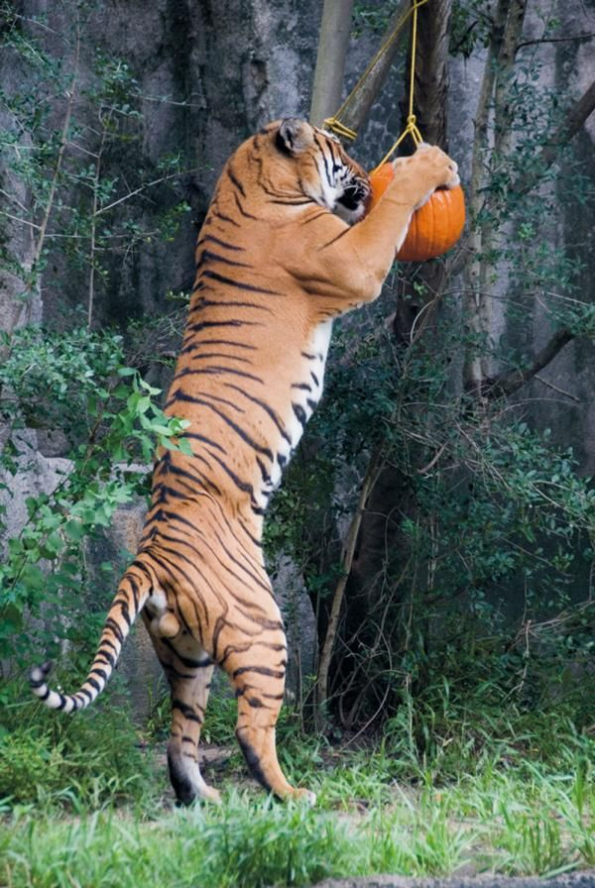
Enrichment
Enrichment is also found under the
More Details tab in the animals record.
Animal Enrichment functionality is
very similar to the Training functionality.
You first define an Enrichment Item. You
then assign it to an animal(s). Once
assigned you will create enrichment
Sessions using the Item.

Slide 18
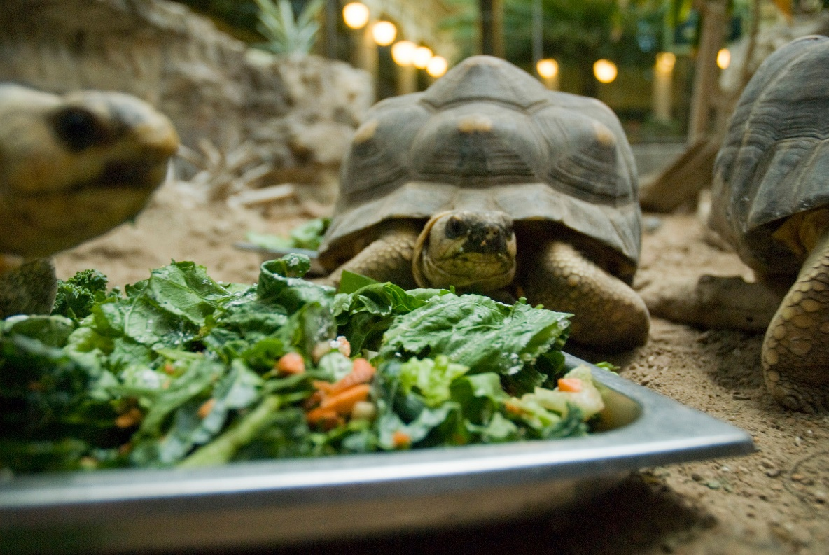
Feed Logs
Feed logs are a simple way to show the
health of your population over time.
When tracked accurately, understanding
the consumption needs of your animals,
in association with the weight trends over
time, your Keepers can be empowered to
look for health issues, breeding readiness,
pregnancy, disease and seasonal diet shifts.

Slide 19
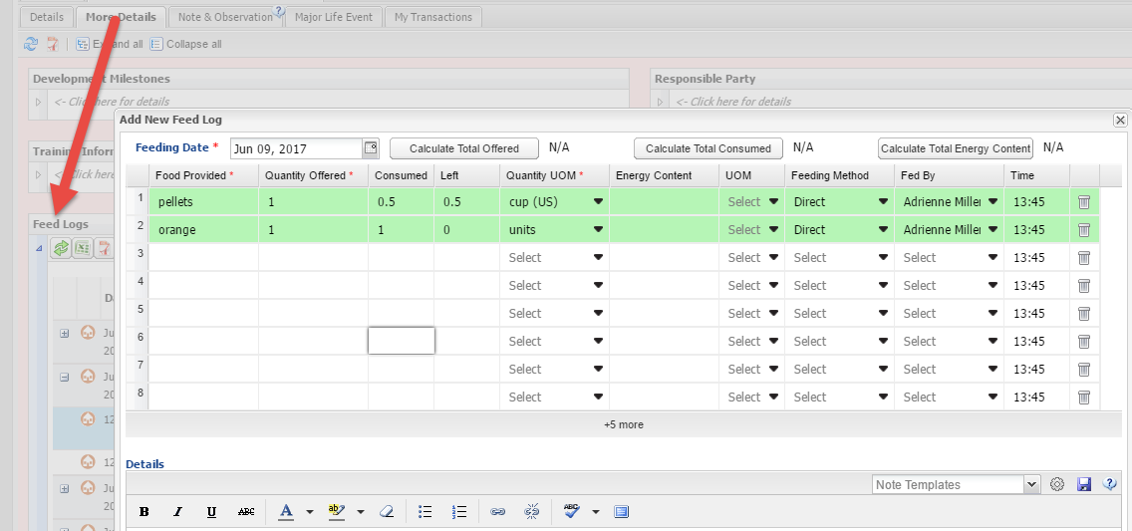
Feed Logs – Animal
In the Animals Module under the More Details tab you will find the Feed Log grid. Keepers can log the food provided at a specified time and the amount consumed.
If the Units of Measure are the same you can also calculate
the Total Offered and Total Consumed.

Slide 20
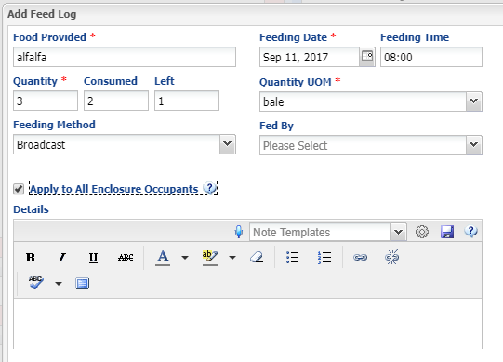
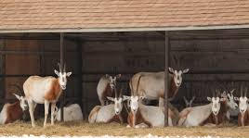
Feed Log – Enclosure
In the Enclosure Module the Feed Log is
found under the Details tab. Keepers can
log the food provided at a specified time and the amount consumed. Selecting the
“Apply to All Enclosure Occupants” box
will record the entry into the record of all
animals occupying the enclosure on the
Feed Log date.

Slide 21
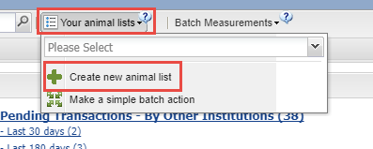
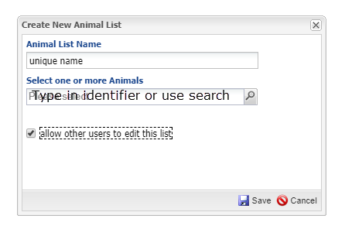
Create a List
To make a new list go to Your
Animal Lists > Create new animal
List. The name must be unique.
To add animals to the list you can
enter identifiers or use the
Lookup search to find several
animals at once. Animals will
not automatically be removed
from any lists they are on if
they die, are dispositioned or
change enclosures.

Slide 22
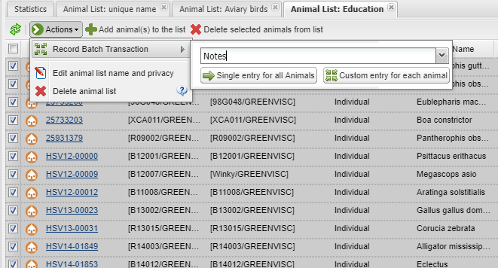
Using the Lists
To use the lists to perform batch actions select the desired list from
the dropdown. Uncheck any animals you do not what to record the
data on. Select the type of batch action from the list. Then select if
you want a Single entry for all animals or a Custom entry for each
animal.

Slide 23
Single or Custom Entries
Single Entry – duplicated in all records with a single click
Blah Blah Blah
Blah Blah Blah
Blah Blah Blah
Custom Entry – scrolls through each record and data is editable
Blah Blah Blah
More Blah Blah
A lot of Blah Blah

Slide 24
Animal Lists
Finding an animal in an entire collection may be difficult for your keeper staff to navigate
Lists in ZIMS are pre-defined, filtered collections of animals that can be quickly acted on
You can have lists for different enclosure, teams and keeper strings
Lists can be used to perform batch actions - an additional time saver
Lists can be managed by Local Admin or Keepers
Notes:
Lists are the feature of ZIMS that can be the largest time saver for Keepers. Instead of having to search the entire database of animals, a specific list of only the animals that a keeper, team or department are responsible for can be created and is quickly accessible from the top of the Animals Module in ZIMS. Managing the lists can be done centrally by the primary records manager, or can be done by each keeper.

Slide 25
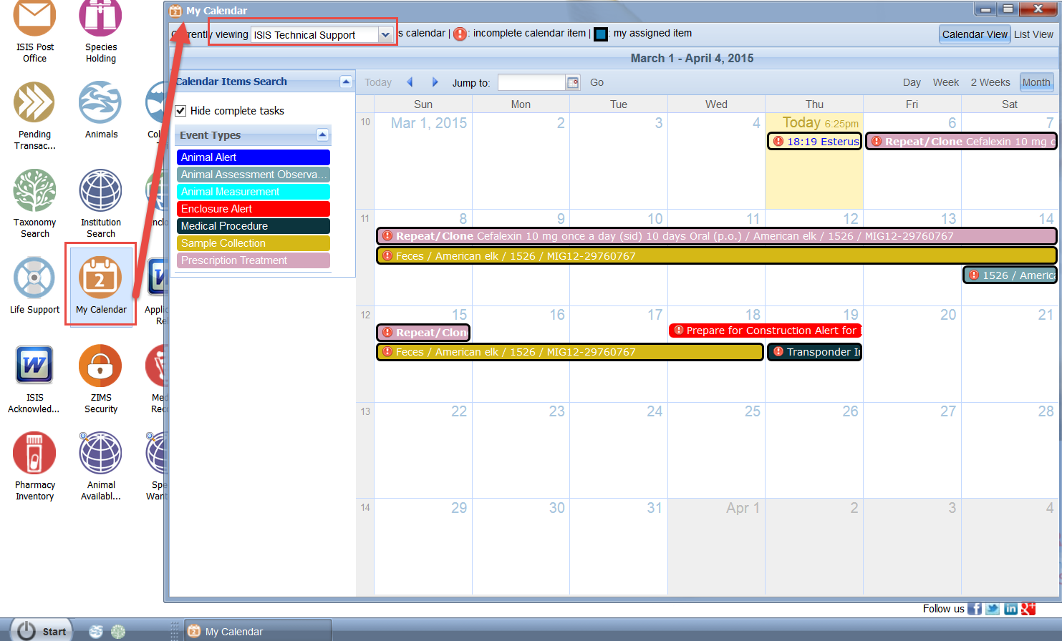
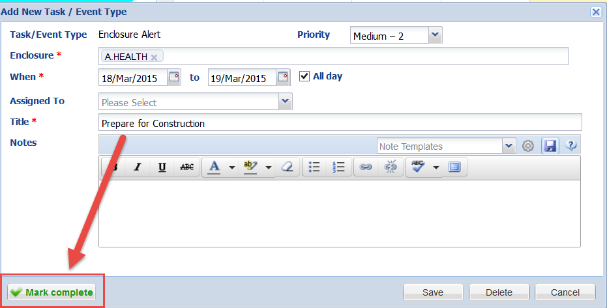
Calendar – Alerts
The Calendar module allows you to
create and view any alerts that may
be assigned to you or your Team.
All active alerts that are assigned
to a specific keeper or Team will be visible. Once the alert activity is
finished it can be marked as Complete.

Slide 26
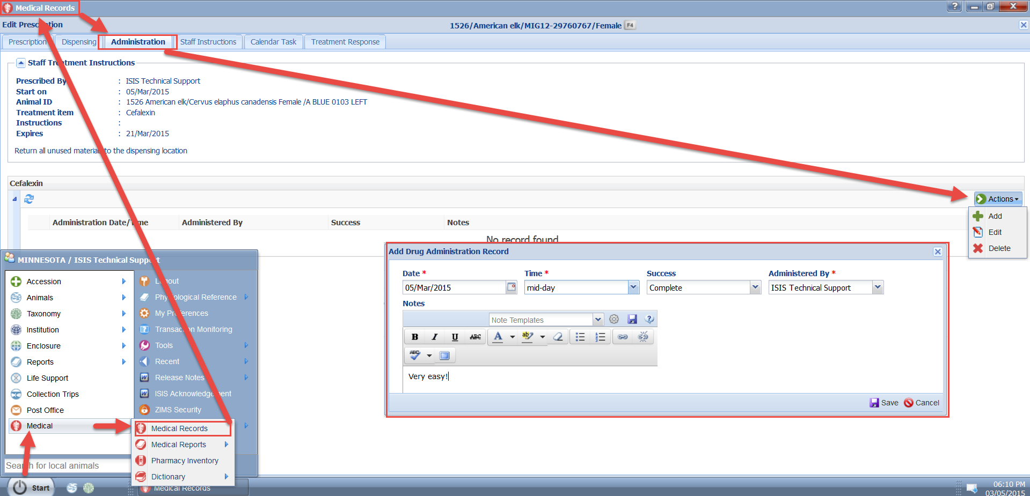
Prescription Administration
In the Medical Module, under the “administration” tab of an active prescription, Keepers can be given the access to
record the administration of a prescription(s) with details on
the success or failure of the administration.

Slide 27
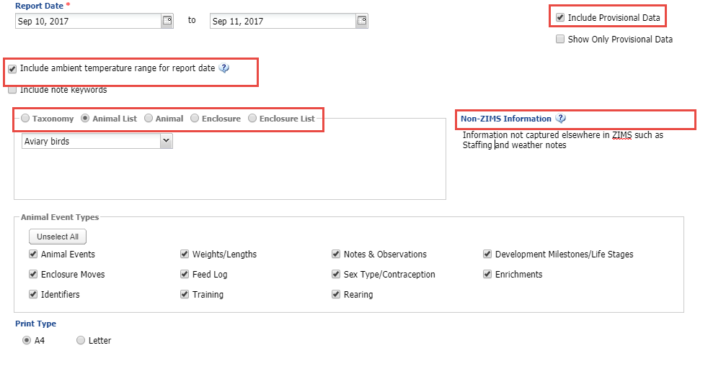
Daily Report
The Daily Report is found under Start > Reports. Some special things to note about it are:
You can include the temperature range for the day (sourced from measurements taken
on your top level enclosure of your institution)
You can choose to include Provisional data or show only Provisional data
You can run the report from a variety of sources including Animal or Enclosure lists
There is a Non-ZIMS Information box where you can enter information not captured
elsewhere in ZIMS

Slide 28
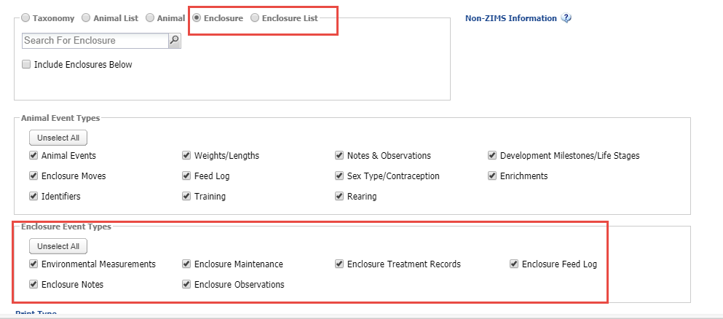
Daily Report
If you select to run this report by Enclosure or Enclosure List the Enclosure
Event Types filters become activated.

Slide 29
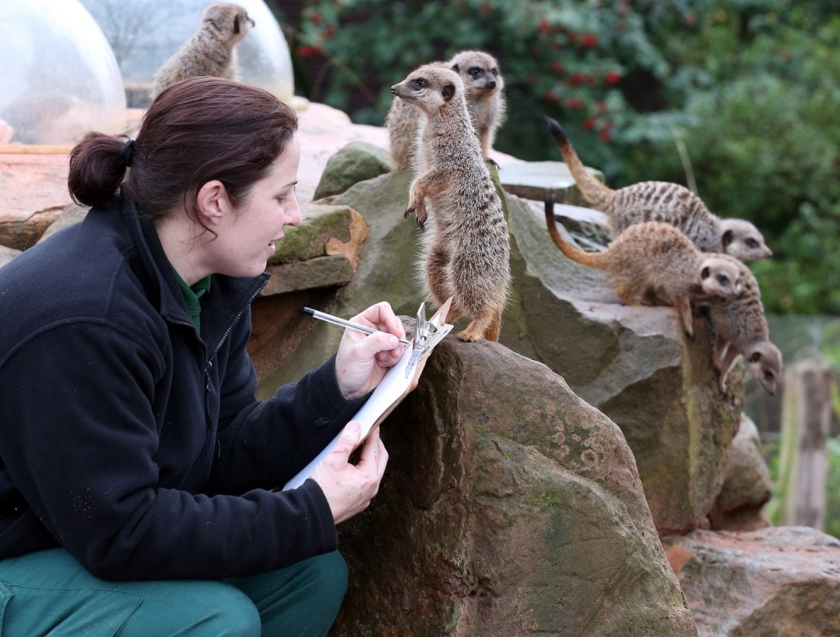
ZIMS for Keepers
Contact: support@Species360.org Training: http://training.Species360.org/

