Slide 1
Best Practices for Recording Notes & Observations in ZIMS
A guide for non-records keeping staff

Slide 2
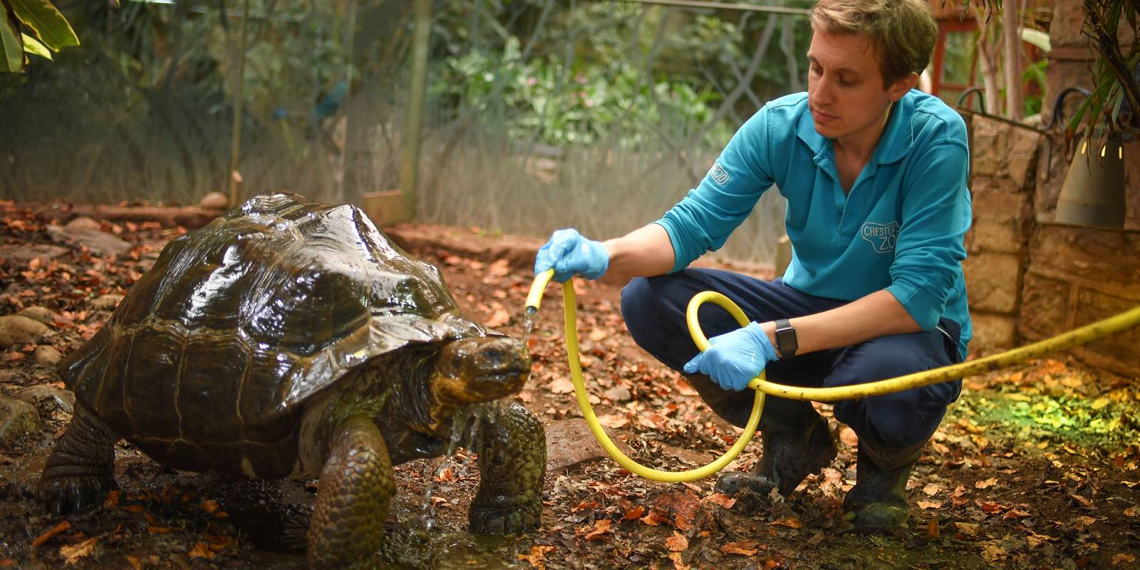
Doing your Own Data Entry!
ZIMS was designed to allow multiple staff members to enter their own data
directly into ZIMS. Not only does this free up some time for the Registrar/Records
Keeper to perform other tasks, it helps other staff members understand the impact
of the data they are collecting. Recording Notes and Observations is often the
starting point for learning ZIMS data entry. In order to successfully retrieve the
information recorded (which is what it is really all about), Notes & Observations
need to be recorded in a standard manner following Best Practices.

Slide 3
What are Notes & Observations?
Free text data entry fields with almost unlimited length
65,000 plus characters can be entered
They can be formatted for easier reading or to draw attention to an important bit of data
Font color, highlights, bold, italics, underlining, bulleted lists
Templates can be created to help enter the text in a standard way and not forget anything!
Spellcheck ability

Slide 4
Where Can You Enter Notes?
The Note & Observation tab is the usual starting place for staff new to ZIMS data entry.
If you have been given access to enter data into other fields (such as Rearing, Parents, Sex and Weights), there is also a Details box for free text entries.
Any Notes entered on these screens will also display in the Notes & Observations tab
However, it doesn’t work in reverse. For example, if you enter a note on Parents in the Notes & Observations tab, that note is not displayed in the Parents grid.

Slide 5
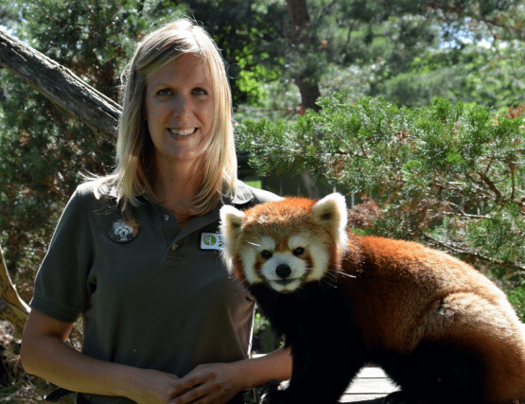
What is a Note?
Free text field that captures information not recorded elsewhere in ZIMS, or further defines/explains data recorded elsewhere
Documentation of how you made a decision such as why you estimated a date or changed a sex
A Note Contains these fields:
Date (required)
Usually the date the event occurred
Keywords
More on these later
Note Type (required)
General Topics
Note Sub Type
Filtered by the Note Type
Note
The actual text

Slide 6
What is an Observation?
A free text field used to describe something that was seen, heard or noticed
An Observation contains all the fields in Notes as well as:
Observation Quality
The degree of excellence
Observation Location
Sourced from Enclosure Tree
Start Time/Duration/UOM
When did it start and how long did it last?
Observer Type
Select from various job types
Observer
Sourced from staff list unless Visitor is selected for Observer Type
Scheduled (checkbox)
Check if this was a planned Observation

Slide 7
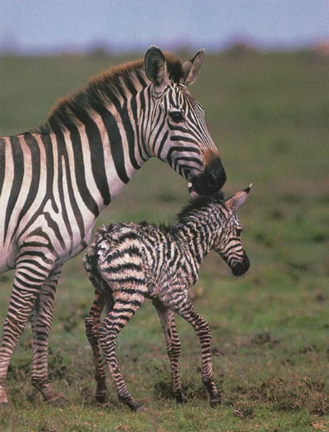
A Note Scenario
Looking at similar scenarios we can see
the difference between when you might
record a Note and when you might record
an Observation.
You are doing morning checks on your
zebra herd. Although she was not due for
another week, you see that Zelda has
given birth and all is well. You record a
note in the dam’s record. As soon as the
Registrar accessions the newborn you
also record a Note in the offspring’s record.

Slide 8
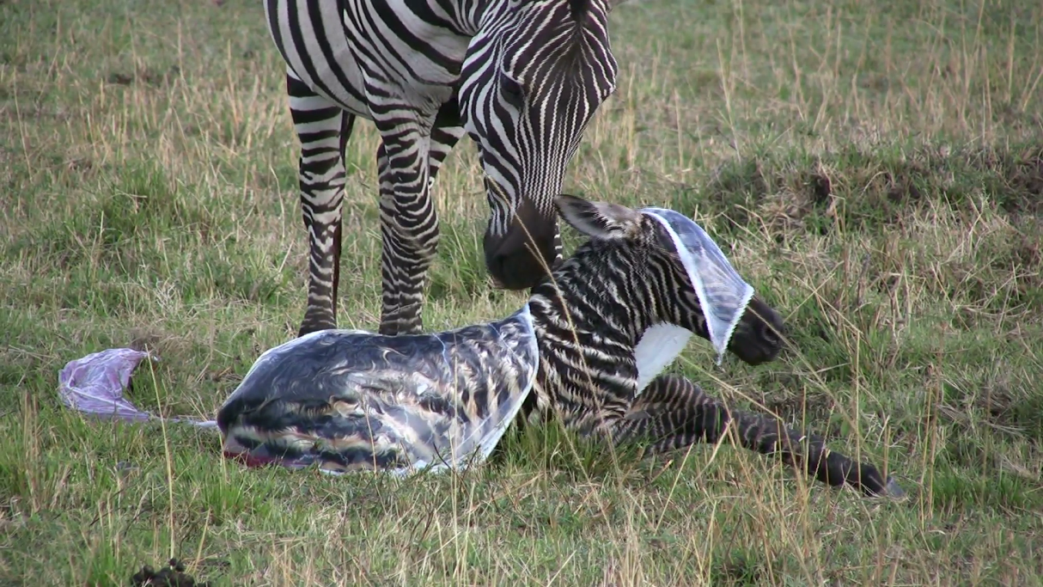
An Observation Scenario
Zippy had trouble delivering her last foal. At evening check she appears to be
having contractions. You receive the okay to stay and watch the progress.
Happily, three hours later there is a healthy foal on the ground. You record an
Observation of Excellent Quality (you were right there all the time and are an
awesome observer), with a Duration of three hours starting at 5:00 pm. In the
free text box you record the timing of the contractions, when the feet appeared,
when the foal was out, parental care post-birth and when the foal stood and nursed.

Slide 9
Note or Observation?
There are no hard and fast rules from Species360 for when a Note should be used versus on Observation.
But your institution should develop your own guidelines for consistency.
It should not be a random choice by the person doing the data entry.
Some institutions use one or the other and some use both.

Slide 10
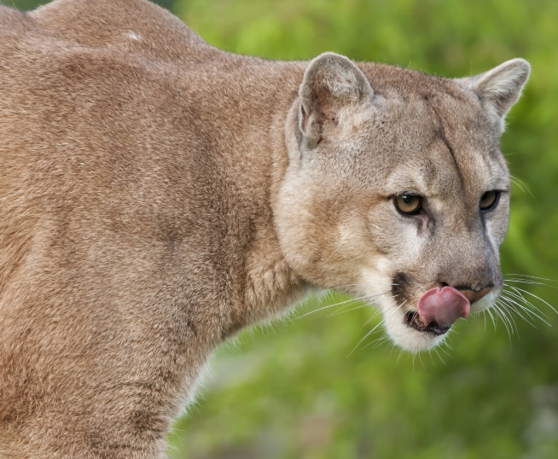
Is it just Semantics?
Semantics is the study of meaning in language
For example, what is the common
name for this animal?
Mountain lion
Puma
Cougar
Panther
They all refer to Puma concolor. The scientific name ties them all together.

Slide 11
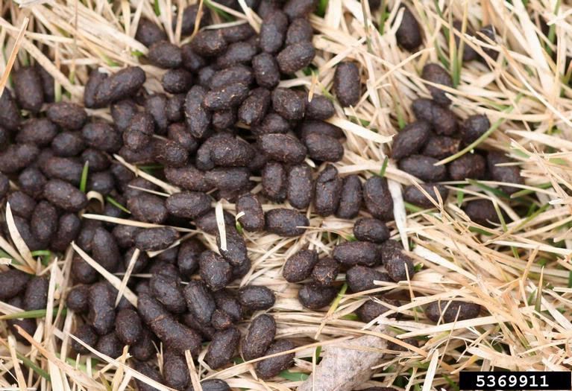
What is This?
This is a picture of
Poop
Scat
Shit
Feces
Defecation
Dung
Excrement
Stool
Crap
BM
What does it matter? It’s just semantics, they all refer to the same thing. But unlike Puma concolor, they are not tied together by one term.

Slide 12
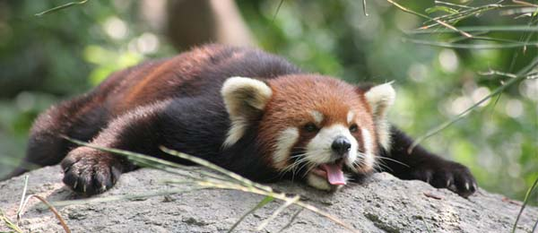
Why Semantics Matter
Your red panda has been suffering bouts of very loose stool (or one of those other words meaning the same thing). The Vet wants the keepers to record daily on the condition so she can try to interpret the possible cause(s).

Slide 13
What is Recorded
Monday – Kendra records “stool” is loose
Tuesday – Fred records “feces” is normal
Wednesday – Sally records “defecation” is extremely loose
Thursday – Kendra (who can’t make up her mind) records “poop” is normal but a weird reddish color
Friday – Steve records “scat” appears normal but not in the usual amount

Slide 14
What is Retrieved
On Saturday the Vet wants to see all the days that the feces (her preferred term) for the red panda was recorded as being normal.
She runs a Note Retrieval Report using a Text String of “feces” and “normal”.
The only entry that pulls up is Fred’s Tuesday entry because the other days it was normal it was called “poop” or “scat”.
The Vet could run a Note Retrieval Report for Note Type “Fecal Observation” and Text String of “normal”, but there is no way for her to know that the original results were incorrect.

Slide 15
Regional Spelling
Watch out for regional spellings!
You may be speaking the same language but you may spell it differently
Searches will not return results for words spelled “almost” like what you requested
Favourite or Favorite?
Estrous or Estrus?
Develop conventions for how words like these will be spelled

Slide 16
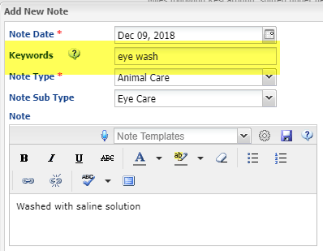
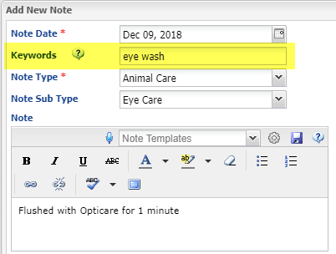
Keywords
Developing a list of Keywords is also very helpful for information retrieval of Notes & Observations.
Below we have used Keywords of “eye wash” to define a specific type of Animal Care > Eye Care.
Although the text does not contain the words “eye wash”, the information can be retrieved using the Keywords.

Slide 17
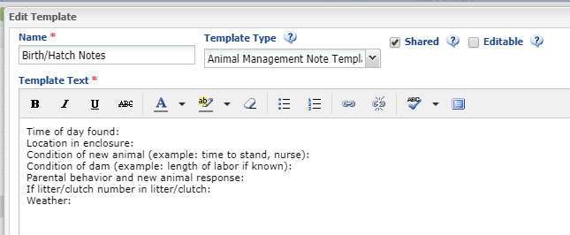
Note Templates!!!
If you are having trouble remembering all that should be entered into a Note (for example, what do you include in a Note about a birth or hatch?), work with your records person to develop Note Templates.
Below is an example of a Note Template for new births/hatches:

Slide 18
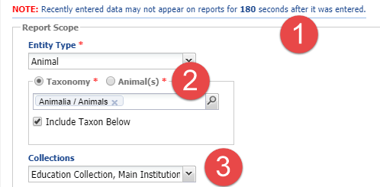
Using the Note Retrieval Report
The Note Retrieval Report (Start > Reports > Note Retrieval) allows you to find a specific keyword or word or text string in a Note or Observation. It is a good example of why the text needs to be entered in a standardized way.
1-If you just entered the data, wait at least 180 seconds before trying to find it on the report.
2-You can search by entire Taxonomies or specific animal(s).
3-The default is all Collections but you can filter by specific ones.

Slide 19
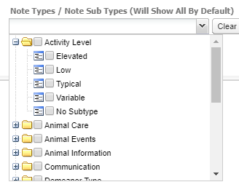
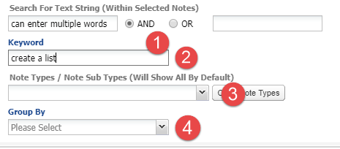
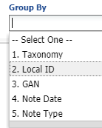
Using the Note Retrieval Report
1-You can enter a single word or a text string. It is important to note that the word order must be exact. If you select AND, what is entered in both fields must be found in the text. If you select OR, only one of the words or text strings must be found.
2-If you have created Keywords they can be entered here. It is a good idea to create a list you can reference.
3-Note Types/Sub Types is a multiple select cascading dropdown where multiple Types can be selected at various levels.
4-You can select how to group the report results.

Slide 20
Some Additional Hints for Entering Good Notes & Observations
The following slides offer some additional hints about how to enter good Notes &
Observations in your Animals, and don’t forget Enclosures, records.

Slide 21
Make it Clear
The text must be clear and understandable
Ask yourself would you understand it in 5 years?
Ask yourself if someone who knew nothing about what you recorded would understand it
Some ideas
Go back and re-read some Notes you entered awhile ago. Do you still understand it?
Have another staff member review some of your entries to make sure they are clear
If your Note was read aloud at a staff meeting would you be proud or embarrassed?

Slide 22
Things to Avoid!
Avoid using acronyms, abbreviations, slang and texting terms
Acronyms and Abbreviations can have multiple meanings!
If you must use them a suggestion is to define them the first time you use them
Slang is not the same everywhere
There are regional and country differences and change over time
Texting Terms are a No!!
2nite and 2moro
BTW
GR8

Slide 23
Be Professional
Maintaining a professional tone will actually help you write better notes
Use proper grammar, spelling and punctuation
If a word is misspelled it won’t be found in searches
Notes can be used in a court of law or can be part of a record that is FOIAed
Make sure they are factual and scientific
For example – use “immobilized” or “anesthetized” instead of “knock down” as that could be misinterpreted
Use “copulation” instead of “making whoopy”

Slide 24
Global Sharing
Some Notes are globally shared by default when another institution is looking at an animal record.
All Notes will be displayed to institutions that you are sharing the record with.
Your name may be attached to a shared Note. You could look bad if you apply elsewhere in the future if your entries are not professional.
Make your institution look good to others with great Notes!!

Slide 25
To be Extra Clear
It might be a good idea to include an Identifier in the text. This may sound silly, you are entering the Note into that animal’s record right? But what if it was entered into the wrong record? Doing this makes it easier to identify the mistake.
The Date should be the date of the event, not the date of data entry. Exceptions may be entering historical notes when you may want to use the data entry date.

Slide 26
Develop Conventions
Decide which Note Type and Sub Type you will use so that similar information is recorded the same way each time.
Decide what terms you will use in the Note (remember the feces example earlier?
Develop a list of Keywords and use them consistently

Slide 27
Changes in Text and Data
If you significantly edit a Note or Observation you may want to keep the original text (with an explanation as to why it was changed) as part of the Note
This clarifies for others who may remember the original entry and be confused that it is no longer there.
If you edit other data, such as sex or identifiers, Notes can be used to describe why you made the change

Slide 28
Work Together!
The Registrar and all staff who are entering Notes & Observations must work together so all have buy-in to the process and understanding of the impact of incorrectly or poorly entered text.

Slide 29
And that is Notes & Observations in ZIMS!

