Slide 1
Education Specialist/ Program Animal Keeper's Day in ZIMS
Zoological Information Management System

Slide 2
ZIMS Updates!
This PowerPoint is up-to-date as of: November 12th 2018
ZIMS is developed in an “agile” method
This means that it is updated every two weeks, sometimes with additional releases in between!
Use the link below to see if there have been any updates to this topic since the date above:
http://training.species360.org/updates/

Slide 3
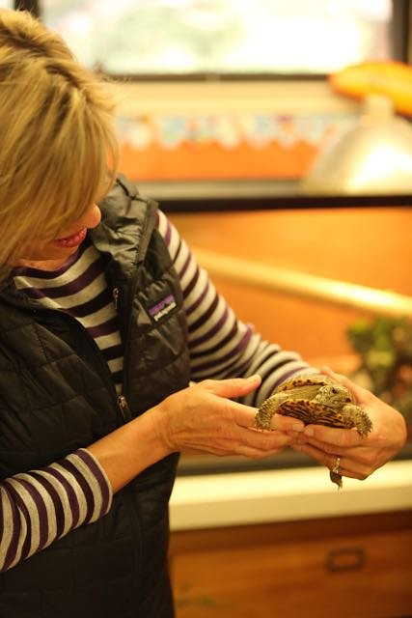
What can ZIMS do for you?
You can record daily animal use, staff time and programs.
Reports can show how often animals are working and when it’s time for an animal handler to get recertified.

Slide 4
How do we get started?
First, you will need to ask your registrar for a little help setting things up. You will need:
An Animal List of your Program Animals
Note Templates- one for Outgoing Animals and one for Returning Animals

Slide 5
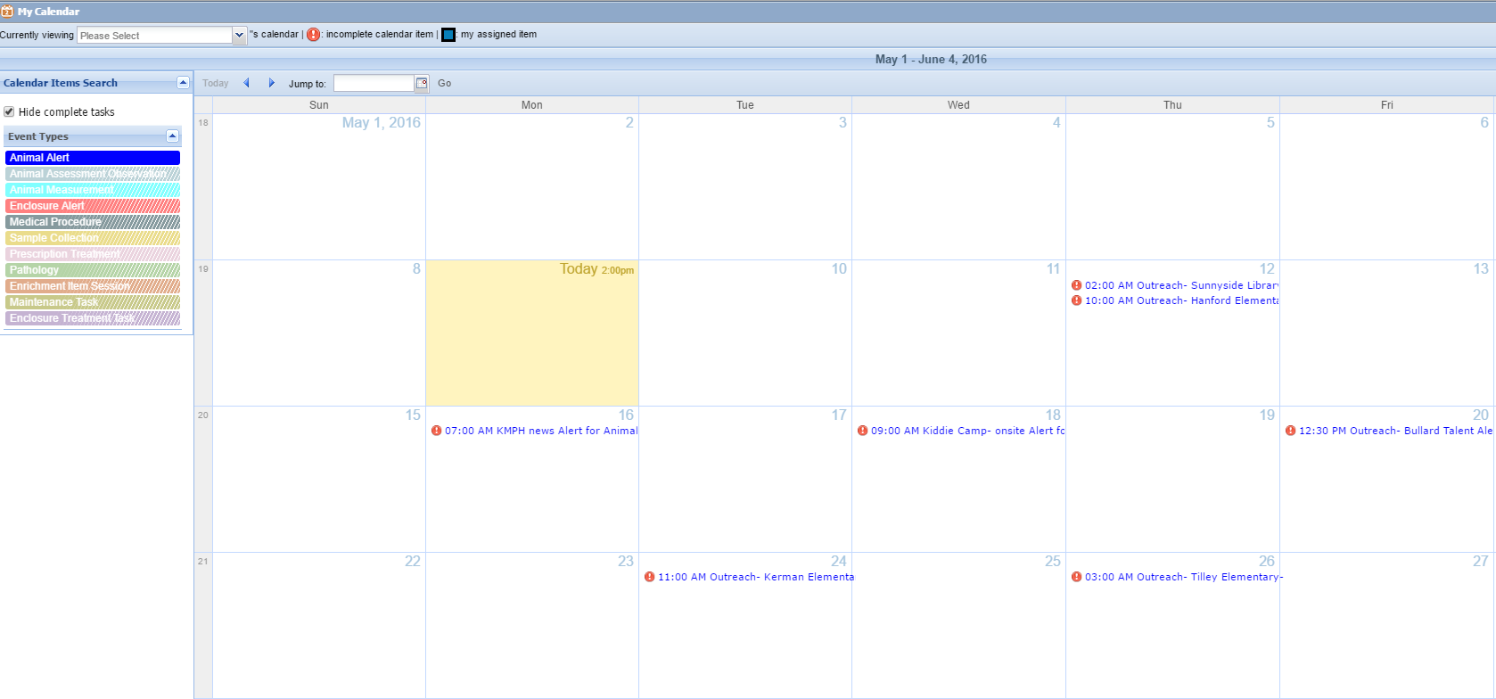
Calendar Functions
Later we will address Calendars and Alerts, but asking your registrar to also assign you a role with access to the Calendar to Add Alerts can be helpful!

Slide 6
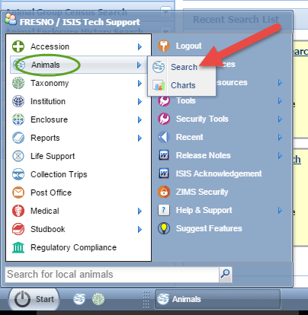
Finding your Animal List
Click on the Start button > Animals > Search
Now the Animal Module is open.
Then, at the top of the screen:
Click on Your Animal List > Scroll down to find the list.
In this scenario, it is the list titled Program Animals. Click on it and it will open.

Slide 7
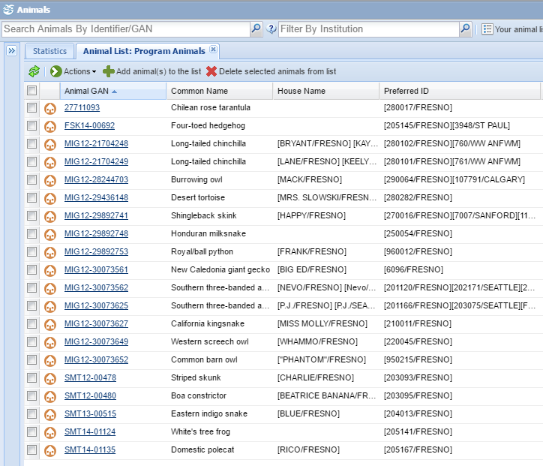
The Animal List
Once you have an Animal List, you can customize the order of the columns. This way the information you want to see is easily visible.
In this scenario-Common Name, House Name and Preferred ID are all next to each other for easy viewing.

Slide 8
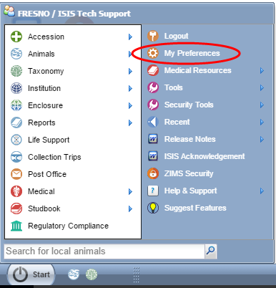
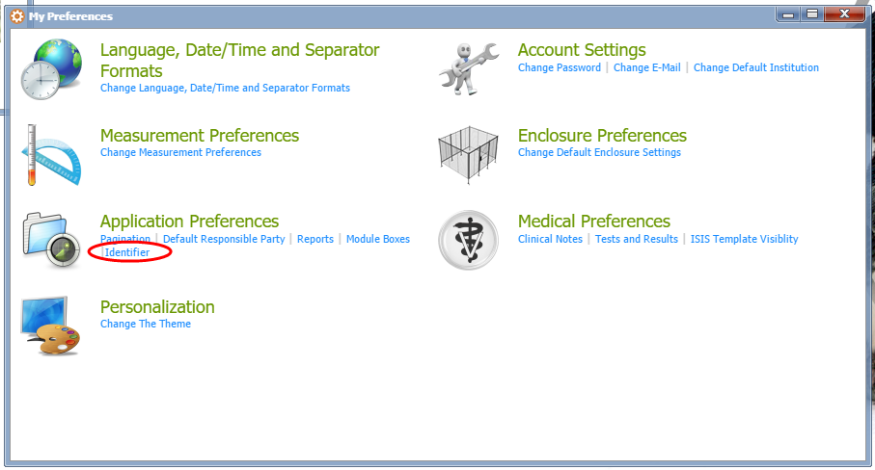
My Preferences
To change your preferences for viewing Identifiers, click Start > My Preferences. Then click on Identifiers

Slide 9
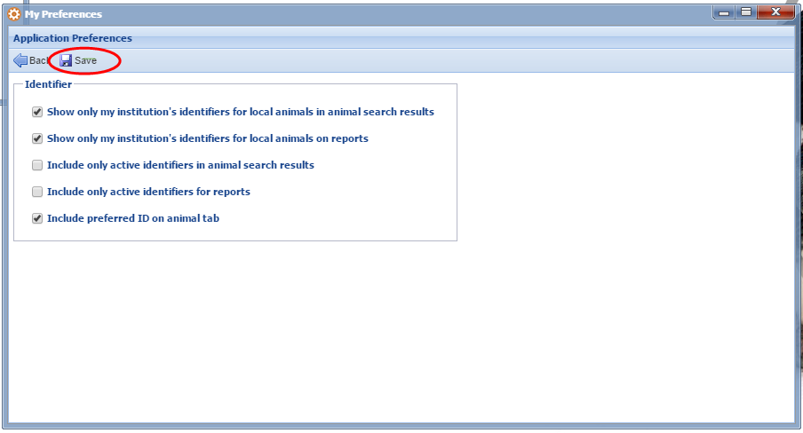
My Preferences- Identifiers
Checkmark the options you want and click Save

Slide 10
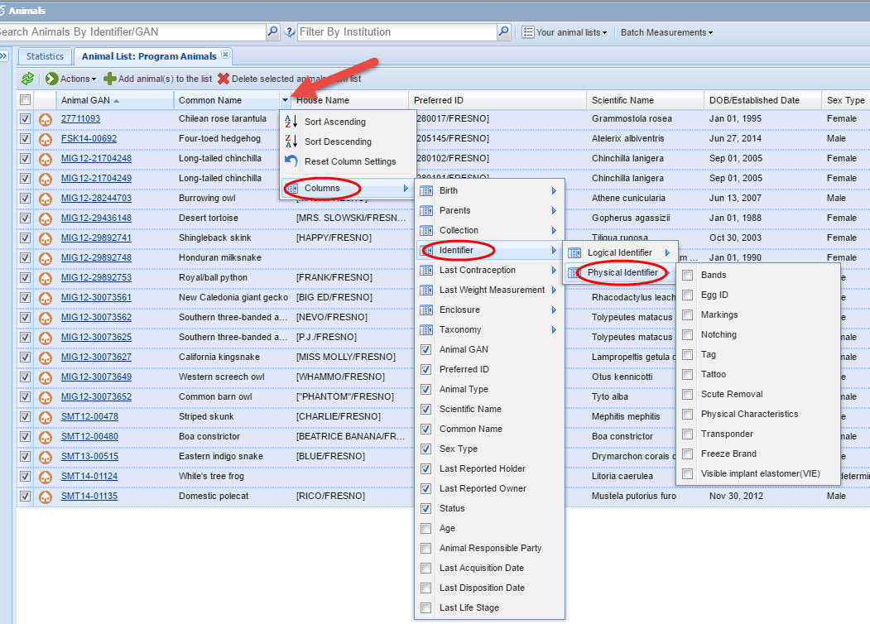
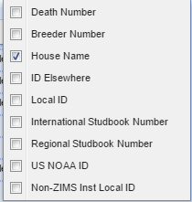
Column Customization
Click the arrow to the right of a Column Header to see more options. You can add columns for more Identifiers- either Logical or Physical by adding checkmarks next to the desired identifier

Slide 11
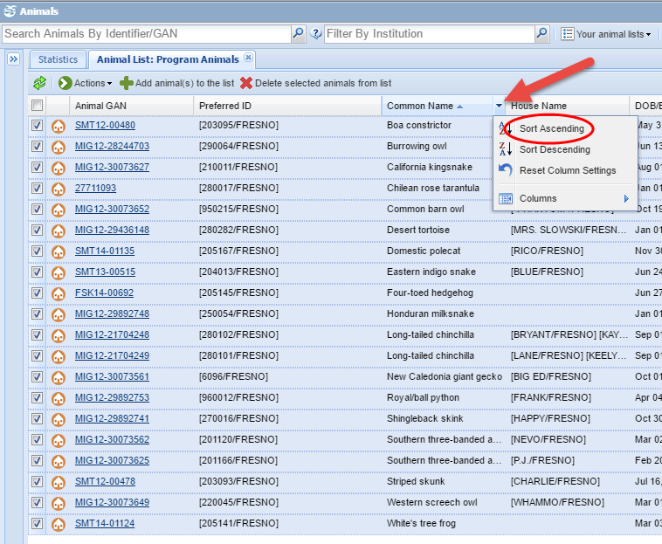
Column Customization
To change the display order of the List: Click on the arrow to the right of the column header.
In this example > Sort Ascending was selected.
The Common Name Column is listed in alphabetical order.

Slide 12
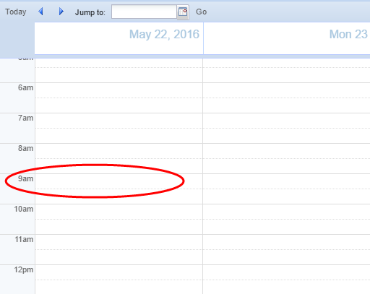
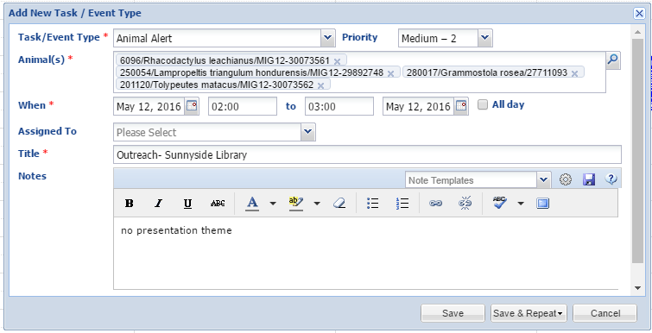
Using the Calendar
To use the calendar > click on the Calendar icon. Next, select the day and time to record an Alert on the Calendar. Click the magnifying glass for Animals to help find the desired animals.

Slide 13
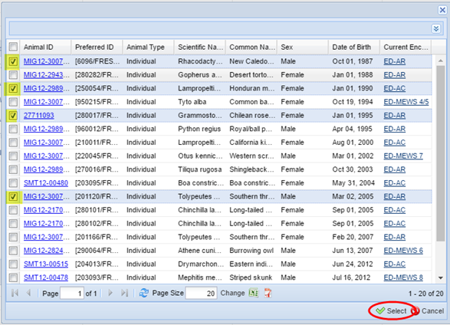
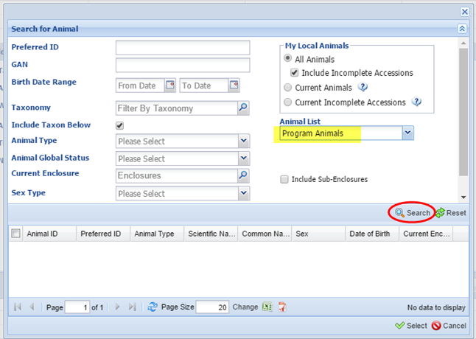
Using the Calendar
Select Program Animal List to find animals for the Calendar entry. Click Search
Checkmark the desired animals and click Select

Slide 14
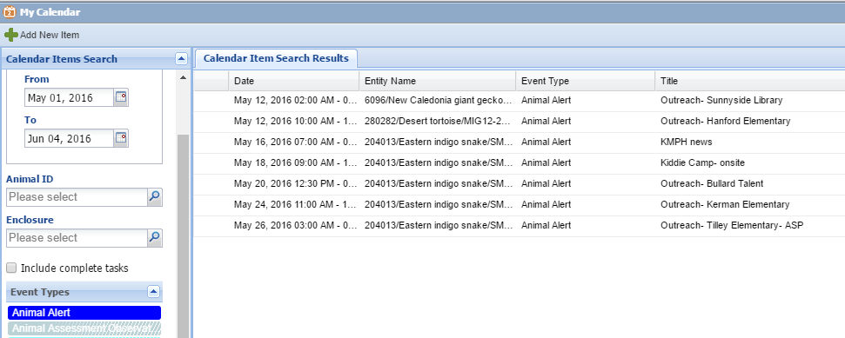
Calendar View
View the calendar in Calendar View or List View.
Can Search a Date range and Event Type

Slide 15
Animal Alerts
Animal Alerts added to the Calendar also display on the Individual Animals Detail page > Alert grid

Slide 16
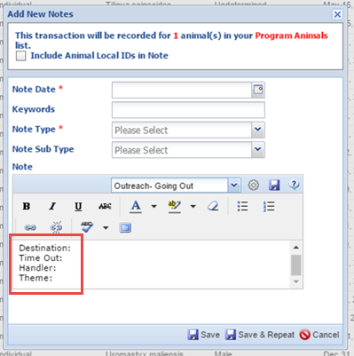
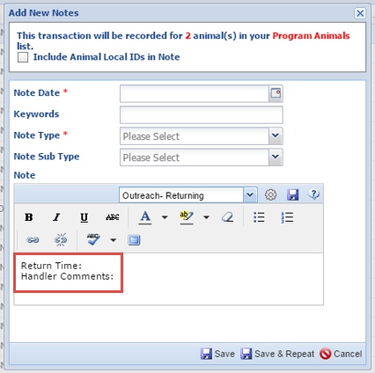
Note Templates
This Outgoing Note Template is recording the Destination, time the animals are taken out of the enclosure, who is handling the animals, and the theme of the presentation.
This Returning Note Template is recording the Time the Animals returned to the enclosure and any comments the handler has regarding the animals.
You can customize your Note Template to record the information that is important to your institution.

Slide 17
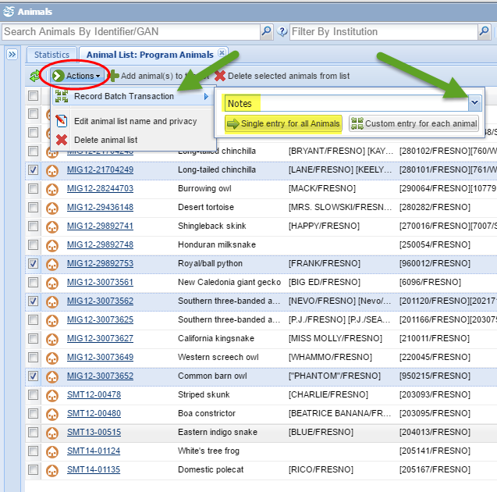
Let’s get started!
To Record a Batch Note from the Animal List, check mark the animals you want to include in the note.
Click Actions > Record Batch Transaction > Select Notes > Single Entry for all animals

Slide 18
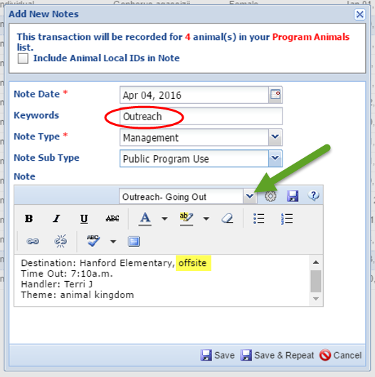
Outgoing Note Details
In this scenario Outgoing Notes all have the Keyword ‘Outreach’
This will help later when running a report.
Select the Note Template by clicking here
Using a specific term in the Note will also enable more options for Reports. In this scenario, Notes are differentiated with “offsite” or “onsite”

Slide 19
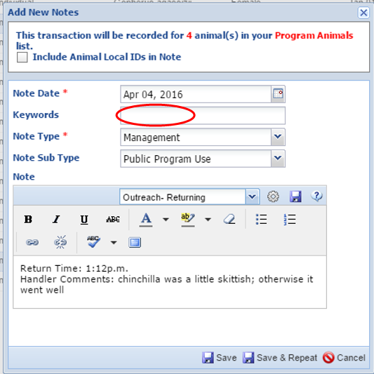
Returning Note Details
On the Note for Returning animals, the Keyword field is left blank. (You can select another keyword if desired.)
The Note Type > Management and Note Sub Type > Public Program Use, are used with both Note Templates.

Slide 20
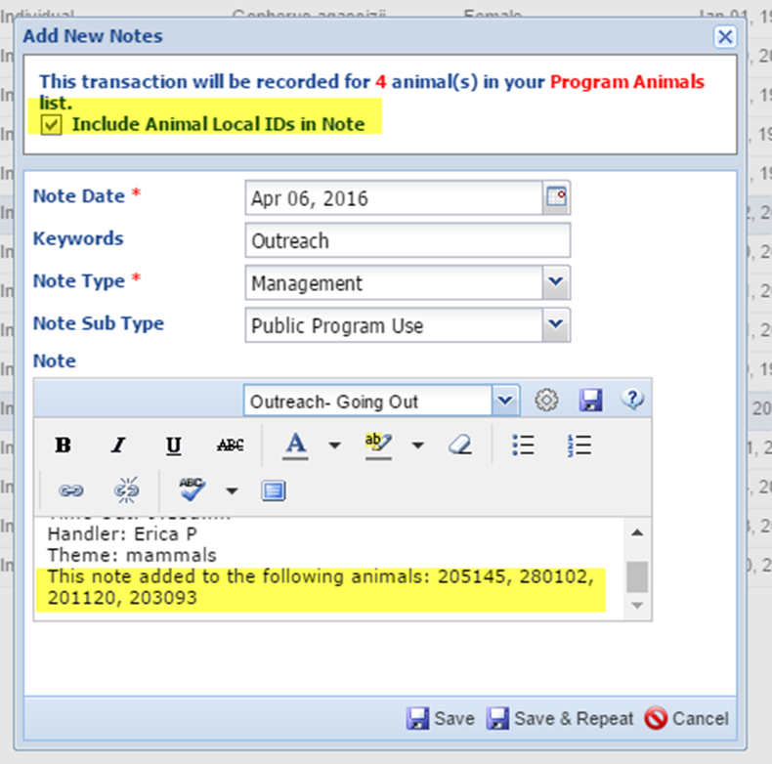
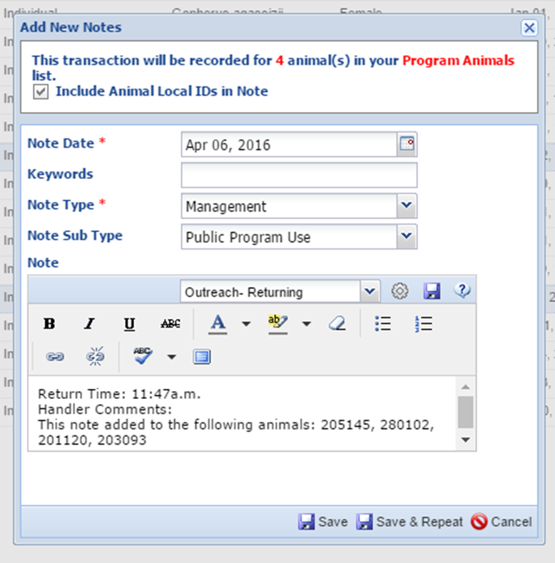
Notes can also include Local IDs
Checkmark to include Local IDs in Note. This will add Local IDs into the text field of the note.

Slide 21
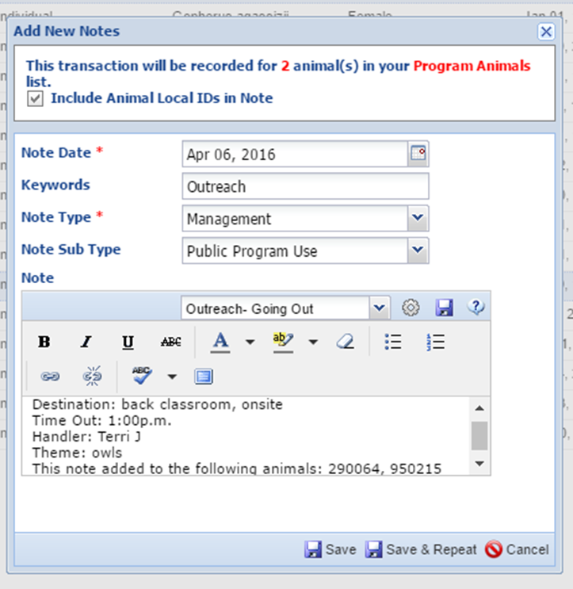
Last program of the day
In this scenario, an Outgoing Note was created with a Single Entry for all Animals.
When the animals Return, we need to create a custom note for one of the owls.

Slide 22
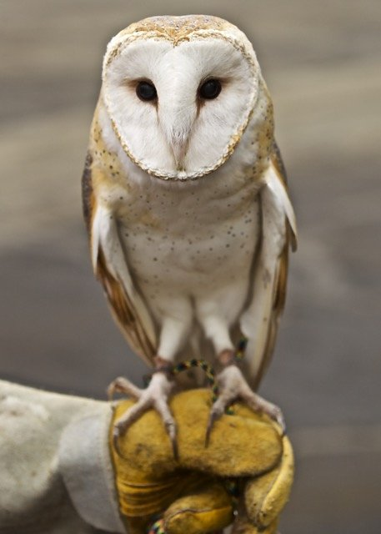
While Phantom was out on a program, her talons got caught on a towel inside the crate.
This needs to be recorded in the Note.

Slide 23
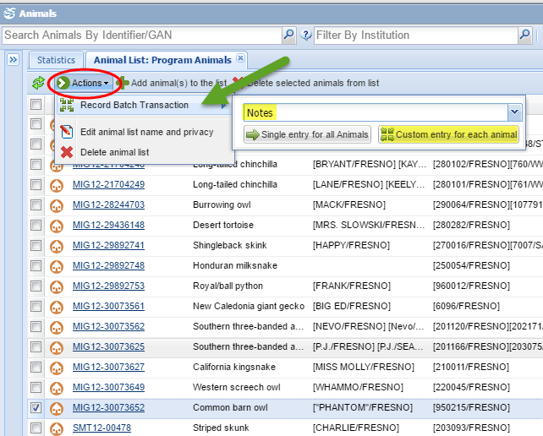
Custom Batch Entry Note
To Record a Batch Transaction with Custom Entry: Select the Animals from your List
Click Actions > Record batch Transaction > Notes > Custom Entry for each Animal

Slide 24
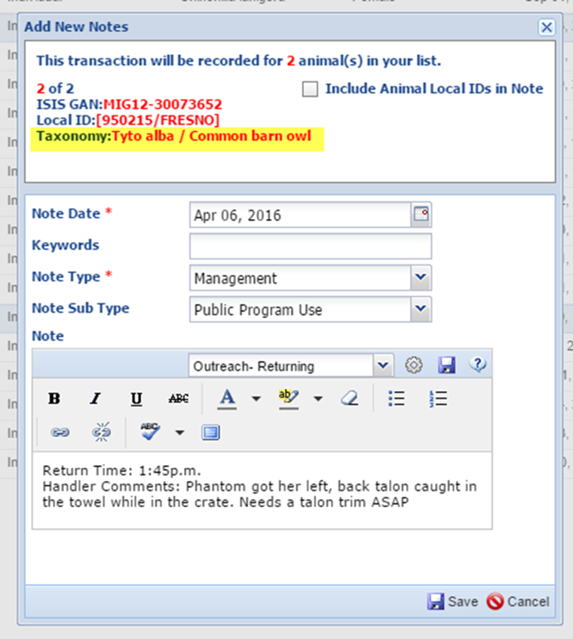
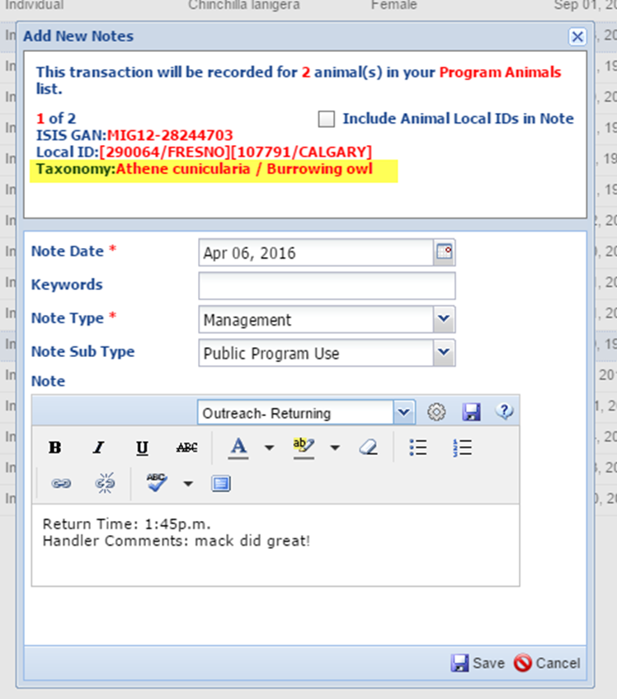
Custom Notes
Each Note will be recorded separately. The top of the Note displays which animal the Note is being recorded for.

Slide 25
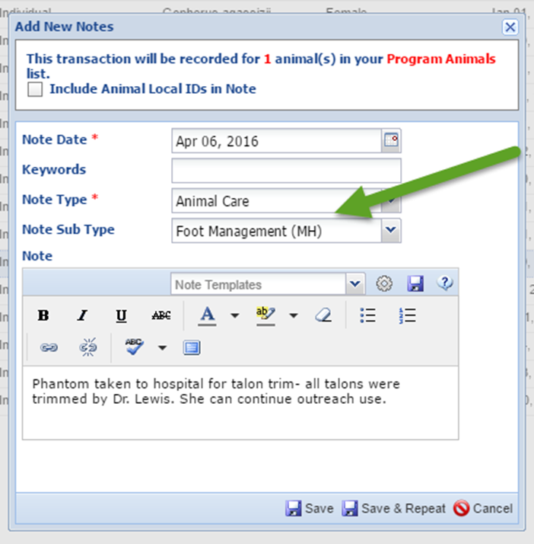
Note Types
Here, we are creating a different Note type to record the procedure that was done.
For this Note, it is Note Type > Animal care and Note Sub Type > Foot management.
A note can also be added from the Details page for that animal

Slide 26
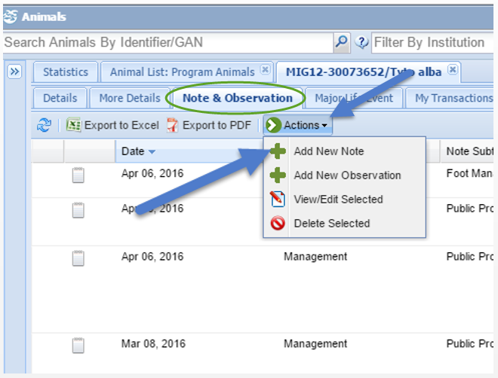
Adding an animal Note from the Animal Record
To Add a Note from the Animals Detail page > Click on the Note & Observation tab > Actions > Add New Note

Slide 27
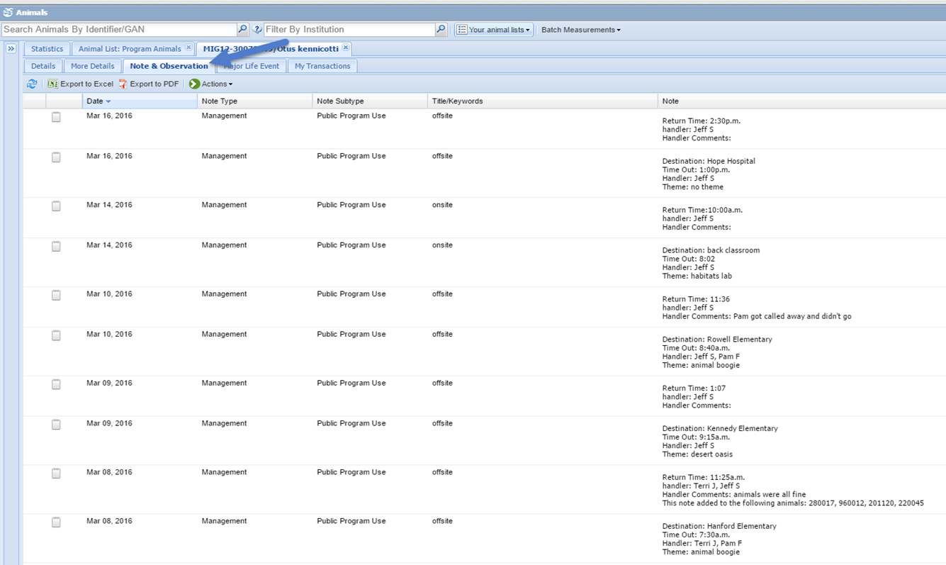
Note & Observation tab
From the Note & Observation tab for this animal, you can see a full picture of all the Notes that were entered

Slide 28
Now you want to run reports: What information can you find and how does this help you?

Slide 29
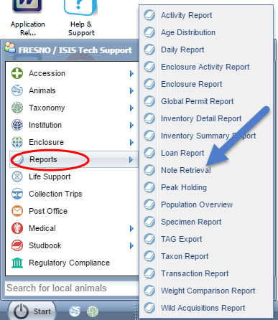
Note Retrieval Report
From the Start menu: Select Reports > Note Retrieval

Slide 30
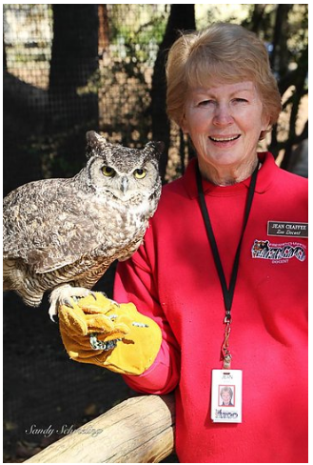
How often is an animal going out on programs?

Slide 31
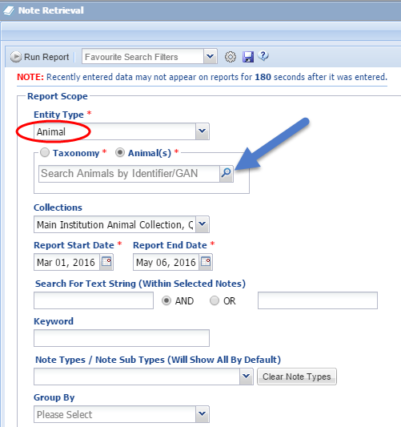
For this Report, we are looking at program use for an individual animal. Search by Animal. If he has a house name, you can type that or you can use Local ID or GAN number.
If you need help finding the animal, click on the magnifying glass to search.

Slide 32
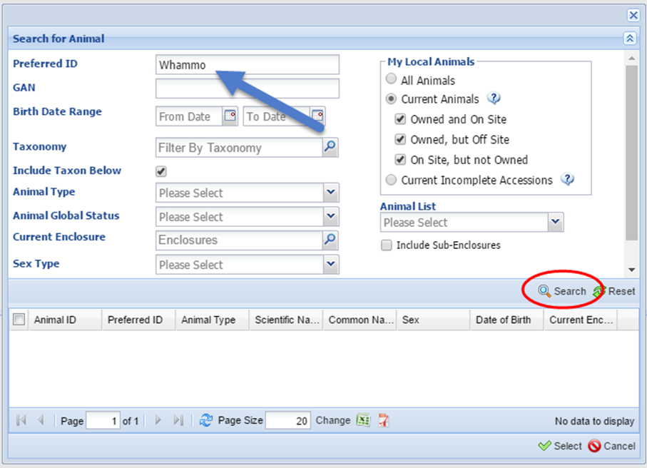
Reports: Finding the Animal
Here, we are searching by the animals name and looking at Current Animals. You can also use the other fields to narrow down your search.
Click Search to see the results.

Slide 33
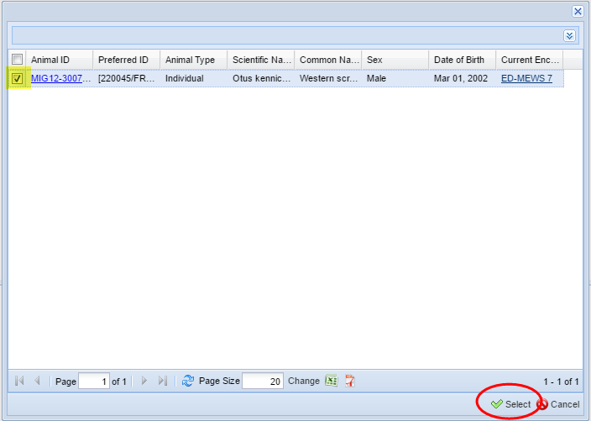
Check mark the individual you want for the report > click Select

Slide 34
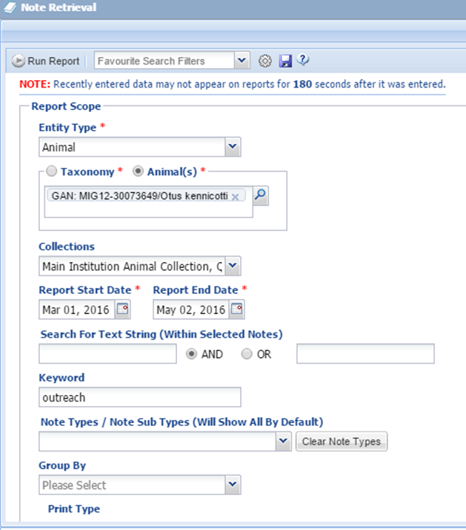
Select your Report criteria: Include Keyword
For this Report, we only want to see how many times the animal was used for programs.
Using the Keyword > Outreach will provide all of the offsite or onsite programs this individual participated in.

Slide 35
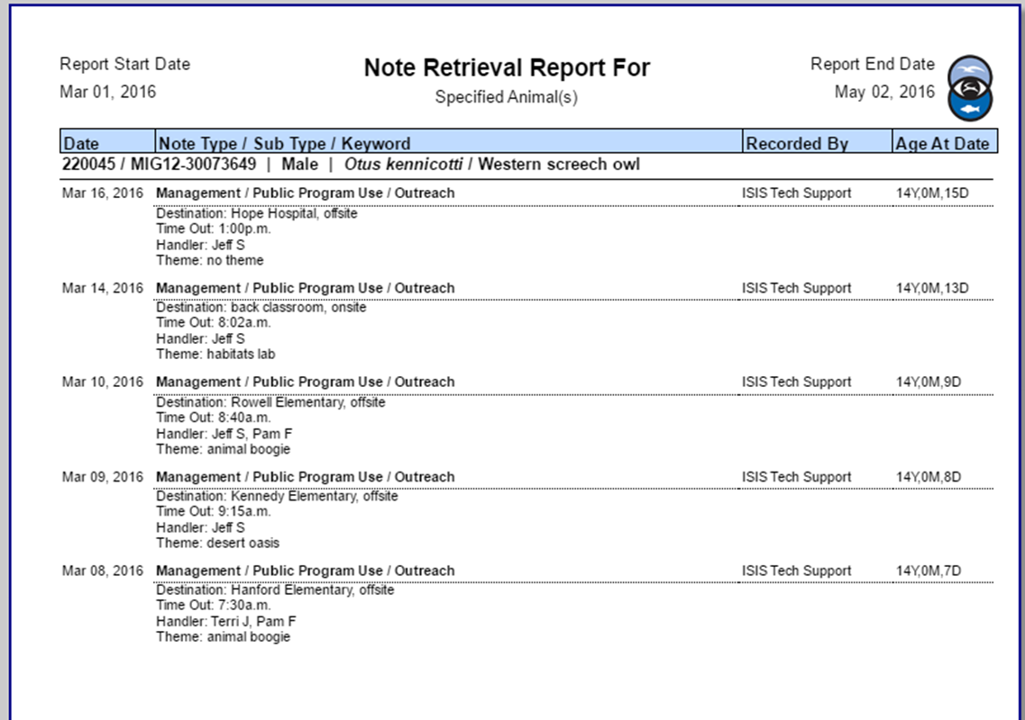
The Report
This report displays which days Whammo was in programs.
If you have a policy for how often an animal works vs. day of rest, you can see this animal worked 3 days in a row.

Slide 36
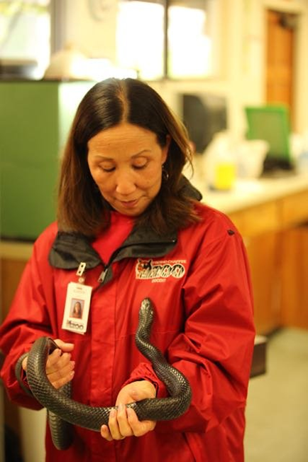
Using a Report to track Animal handlers

Slide 37
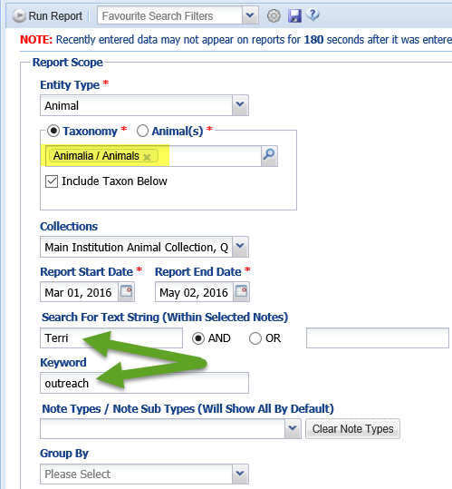
Using a Report to track Animal Handlers
Now you decide to look at a report to see which animals Terri has been handling. You want to make sure she doesn’t need a refresher class for animal handling.
Search in Text for the name > Terri
Keyword > Outreach
Note type > management > Public Program Use

Slide 38
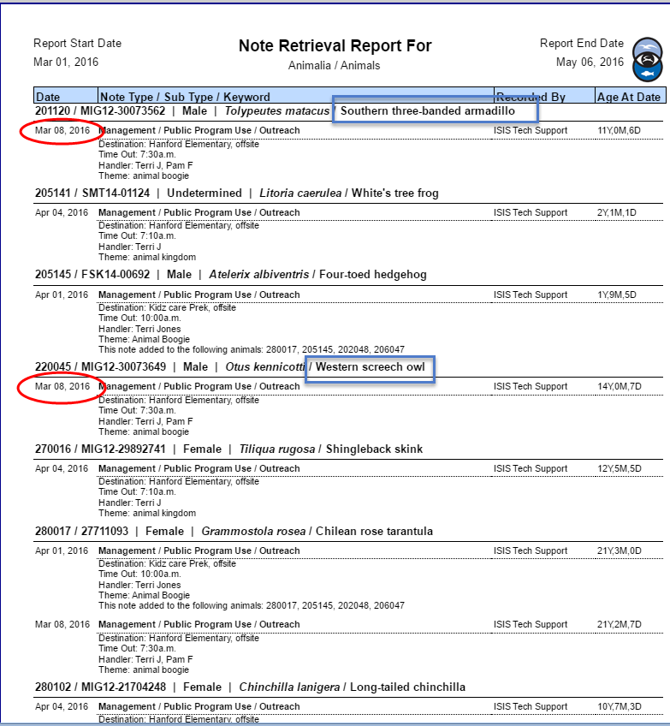
This report separates the results by animal.
You notice the last time she handled the three-banded armadillo and screech owl was March 8, 2016. You have an 8 week policy, so she needs a refresher course to handle those animals.

Slide 39
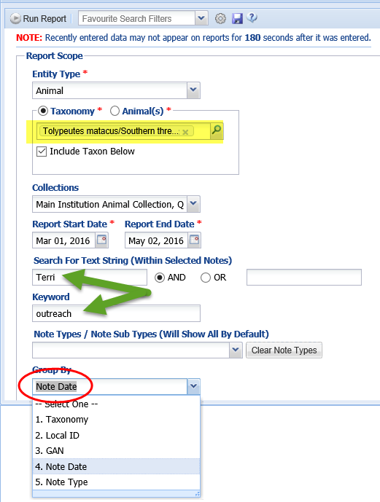
Another way to run this report is looking at a specific taxonomy and handler.
Group By > Note Date

Slide 40
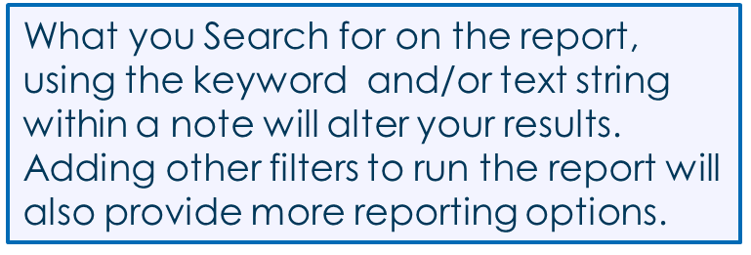
You can see the last time she handled the three-banded armadillo was March 8, 2016

Slide 41
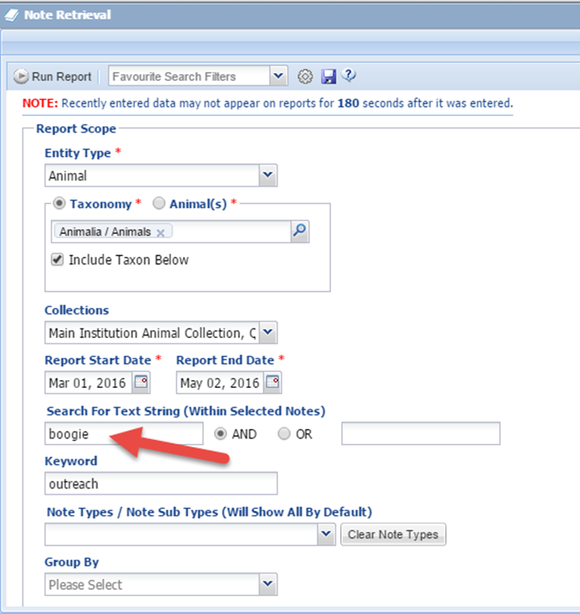
Next you check how often the program “Animal Boogie” was used.
In Outgoing Notes, you always include the presentation theme, so here you can search for “boogie” in the Search For Text String field

Slide 42
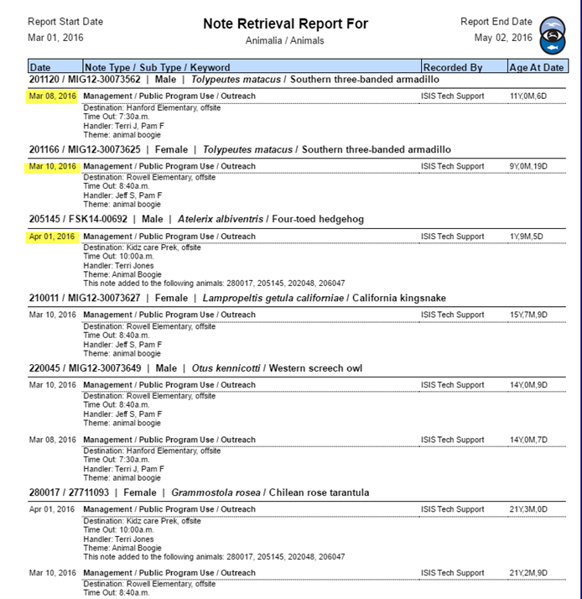
A quick scan of the Note Retrieval report shows you the topic “boogie” was used 3 days. You can also see which animals were used for those presentations.

Slide 43
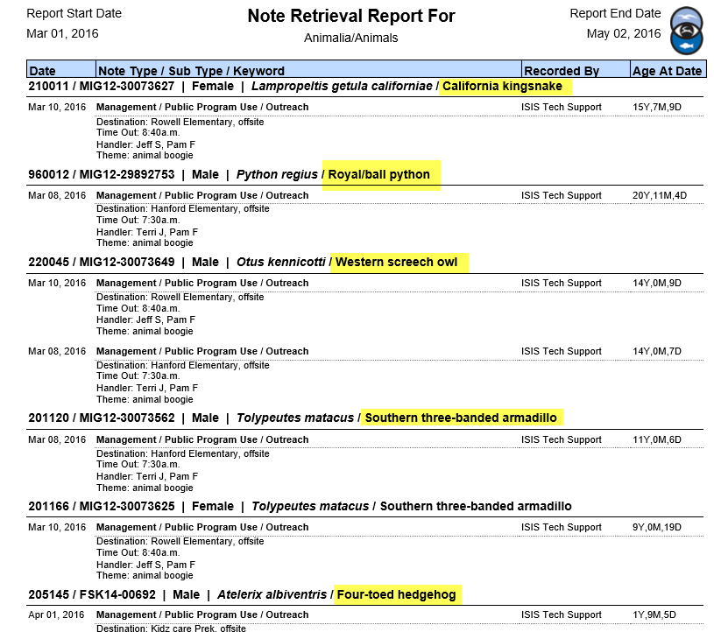
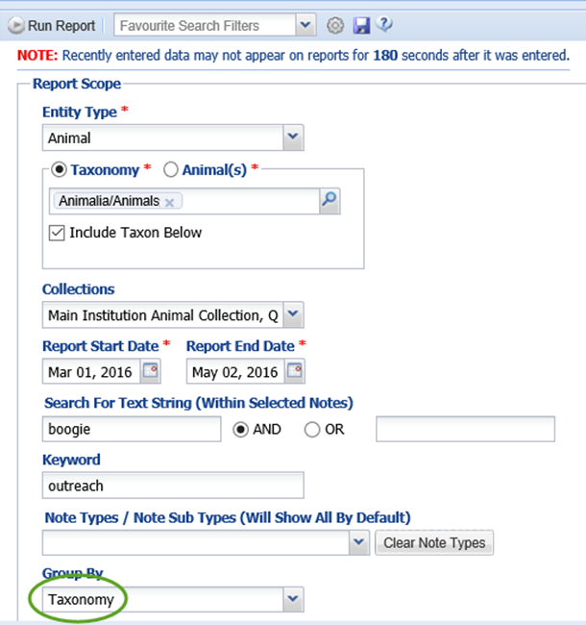
By running the same report, but adding the filter to Group BY > Taxonomy, you get a clear picture of which animals were used for this topic.

Slide 44
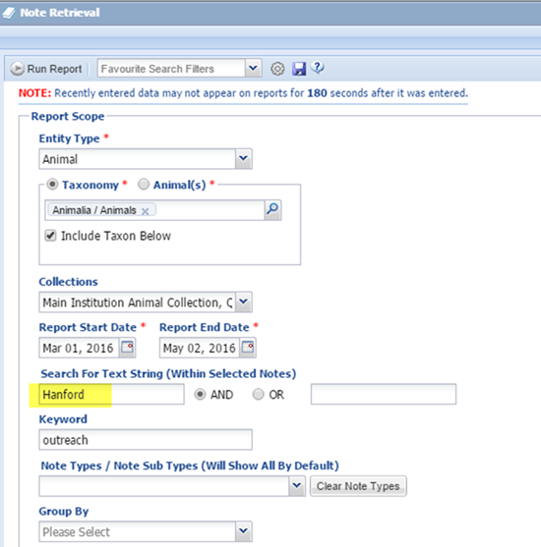
Report for selecting which animals to use
In this scenario, you have another program scheduled for Hanford Elementary. You know animals have visited the classes 2 times already and you don’t want to send the same animals, so you run a report for Hanford.
Search for Text String > Hanford
Keyword > Outreach

Slide 45
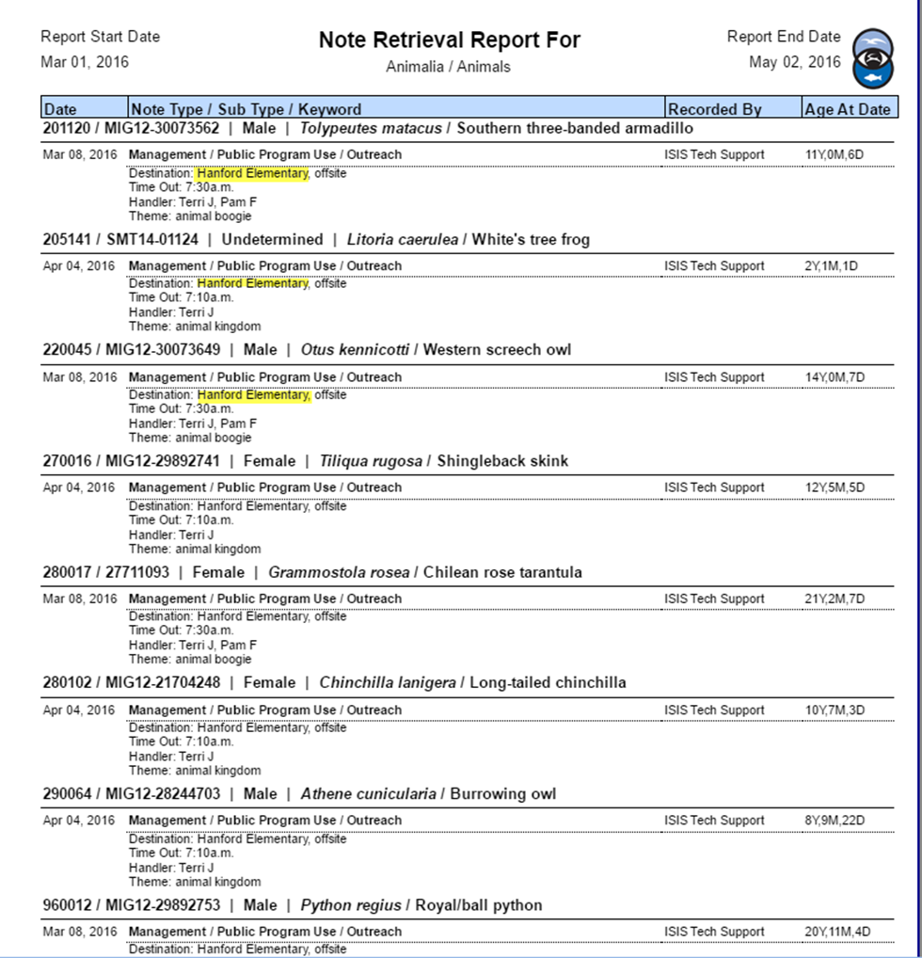
Now you have a list of all the animals that visited Hanford Elementary since March 1, 2016

Slide 46
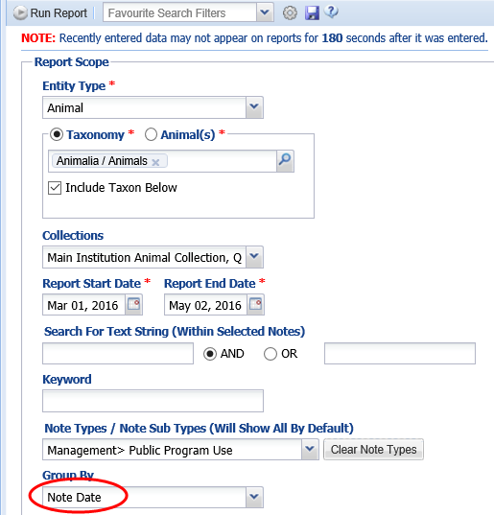
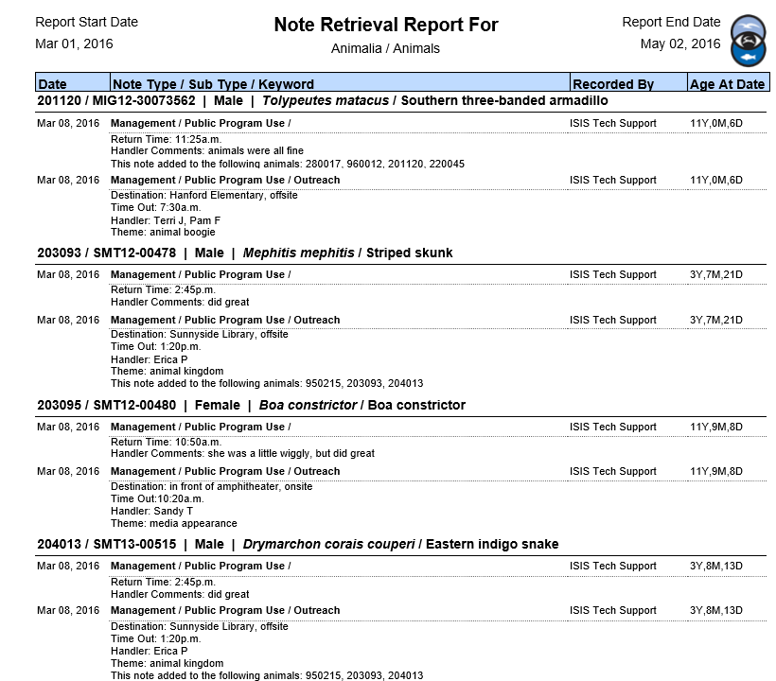
Searching just by Note Type: Management > Public Program Use, you will get results for all outgoing and Return type Notes.

Slide 47
The possibilities are endless! Whatever your needs are for tracking information on program animals, ZIMS can help!

Slide 48
Questions?

