Slide 1
A Zookeeper’s Day in ZIMS

Slide 2
ZIMS Updates!
This PowerPoint is up-to-date as of: November 12th 2018
ZIMS is developed in an “agile” method
This means that it is updated every two weeks, sometimes with additional releases in between!
Use the link below to see if there have been any updates to this topic since the date above:
http://training.species360.org/updates/

Slide 3
The Scenario
You are a swing keeper at a small institution
It is a Tuesday morning (March 15) and you have just come back from your weekend.
Today you are filling in for several keepers who are on vacation so you will be working with all different species throughout the facility
Your ZIMS Role is a custom one that allows mainly Provisional Data entry
Provisional Data allows “temporary” data entry that does not become a part of the ZIMS database until your Local Admin “Approves” it
In addition, some Calendar functions have been provided as regular access
In the real world you would probably do the ZIMS entries at the end of the day but here we will show the data entry at the time you perform your daily tasks

Slide 4
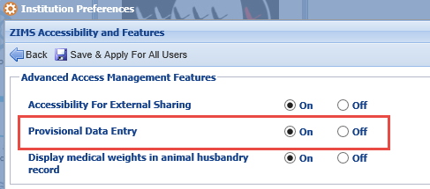
Notes on Provisional Data Entry
Provisional Data allows entry of information that does not become part of the real ZIMS database until it is Approved by a Local Administrator
This functionality must be activated for your institution by an ISIS Global Administrator
Then your Local Administrator must turn it on in Institution Preferences under ZIMS Accessibility and Features

Slide 5
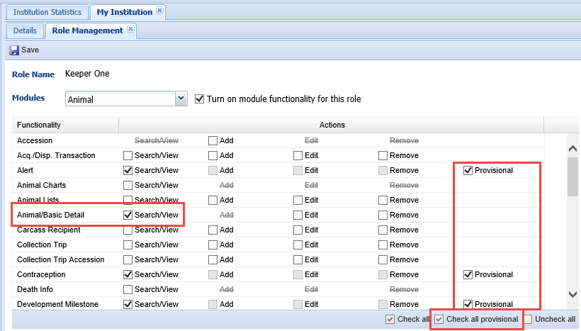
Custom Role Must be Created
Provisional Data is not assigned to any ISIS Template Roles, your institution must create a Custom Role
If Provisional is checked, by default Search/View is checked and Add, Edit and Remove are inactivated
You must also remember to check the Basic Details-Search/View in any modules for the User with that Role to actually see it

Slide 6
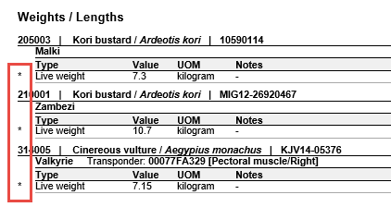
Provisional Data Display
In the record (left) Provisional Data will display as greyed out
Hovering over the “?” will also indicate that it is Provisional
In the reports (right) that have the option to include Provisional Data it will be marked with an asterisk
Only Users with Provisional Data access can edit Provisional Data
Once Approved the data becomes part of the ZIMS database and can no longer be edited by a User with Provisional Data access

Slide 7
7:45 am - Grab some caffeine, read the last two day’s Daily Reports and check My Calendar

Slide 8
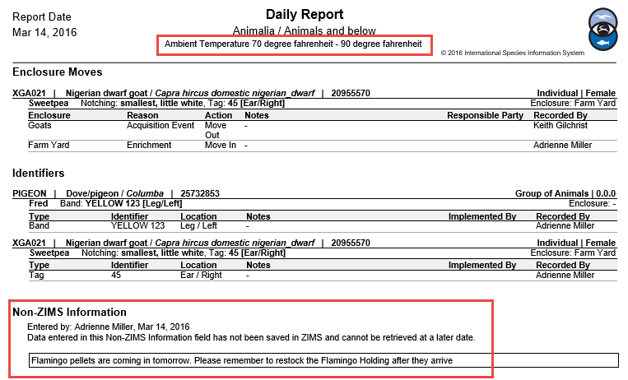
Daily Report
You are a small institution and your Daily Reports are stored in a binder in the Keeper lounge so they are available for all to read. In addition, they are exported and saved to a networked drive. You note two things of interest on yesterday’s Daily Report. First, the ambient temperatures recorded yesterday were much higher than normal. You make a mental note to watch for any remaining heat stress on the animals housed outside. Second, there is a Non-ZIMS
note that flamingo pellets need to be restocked.

Slide 9
Read Animal Care Staff Medical Summary
The Daily Report also noted a health issue with your giant tortoise.
You read the Animal Care Staff Medical Summary for the animal that
was entered by the Vet in the medical record. This lets you know that
you will need to apply Nolvasan solution to the abscess site.

Slide 10
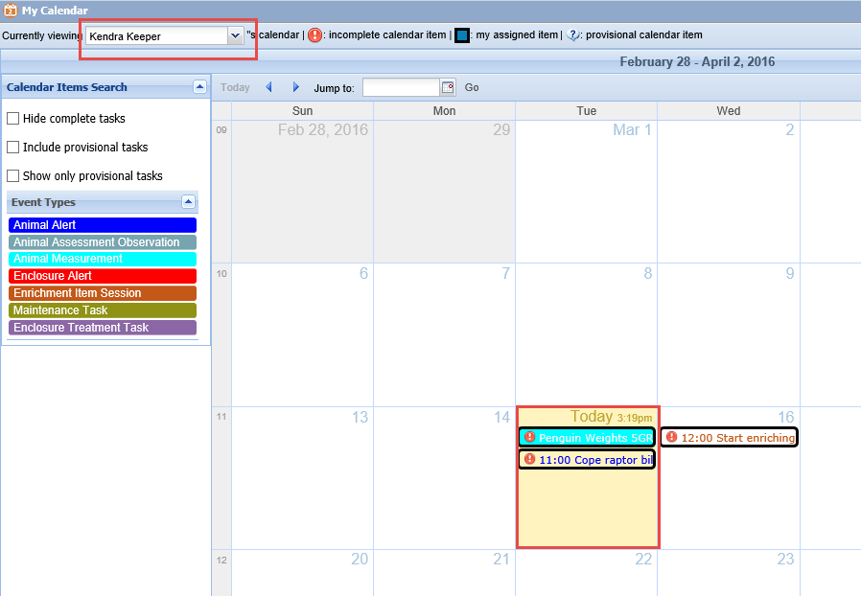
My Calendar
You then check for any Calendar items assigned to you. Filtering the “Currently Viewing”
to yourself (Kendra Keeper) you see two assignments for today. If you do not filter by
your name any tasks assigned to you remain outlined in black whereas those assigned to
others are not. The penguin task does not have a time associated with it whereas the
coping task does (11:00).

Slide 11
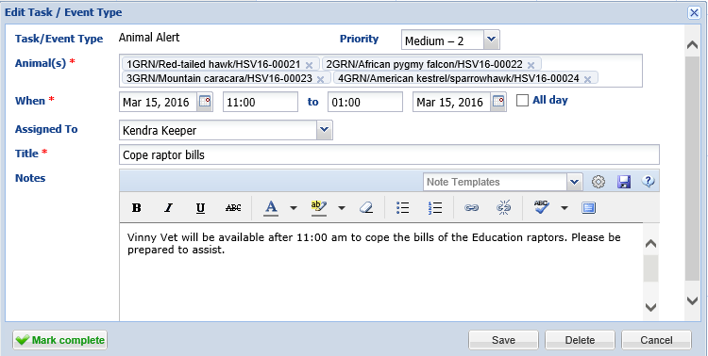
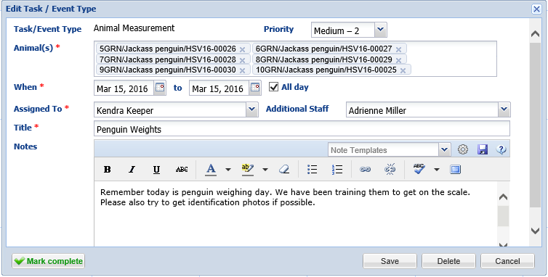
Calendar Tasks
You open them both to view the
details such as the animals
affected and any further notes
associated with the task. You need
to be ready after 11:00 am to
assist the Vet with the bird beak care
and sometime during the day you
must weigh the penguins.

Slide 12
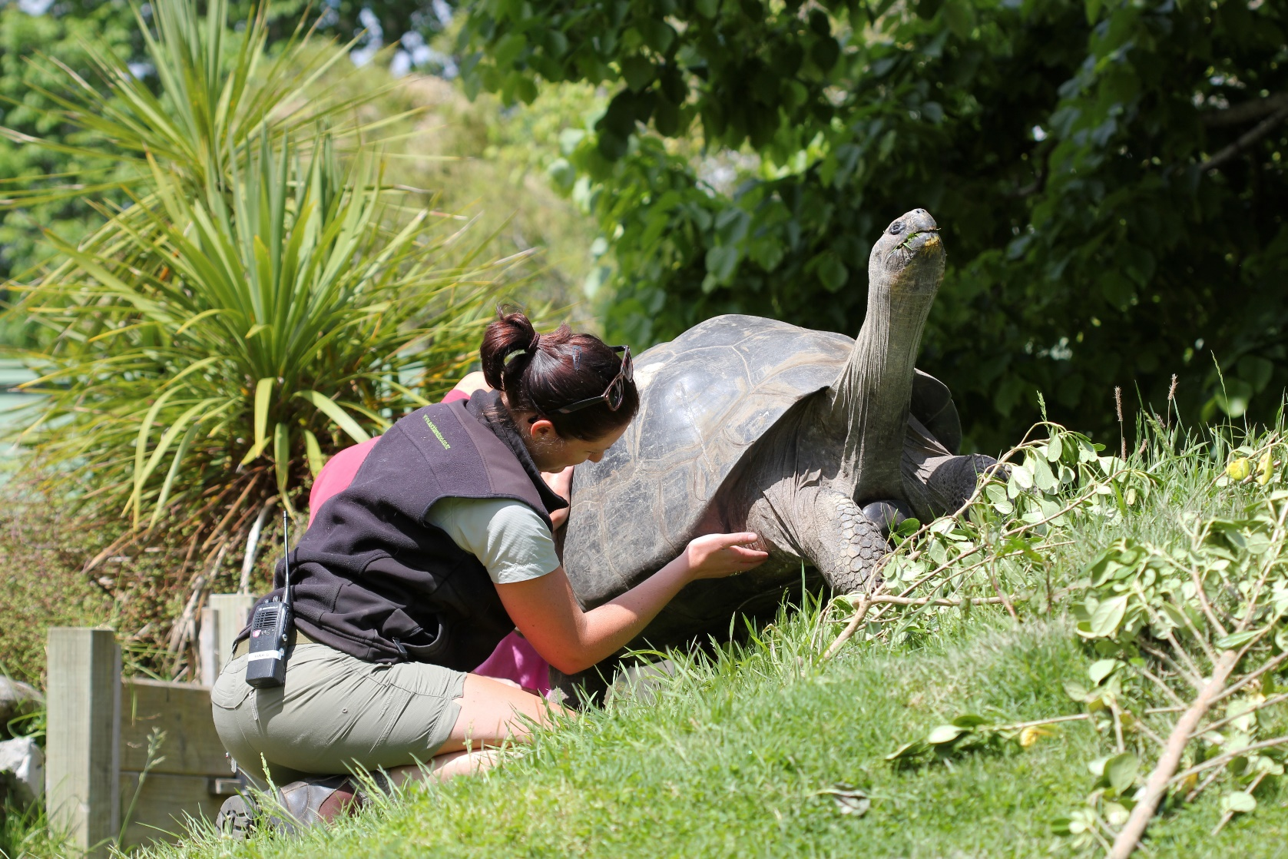
8:10 am -Start Morning Animal Check

Slide 13
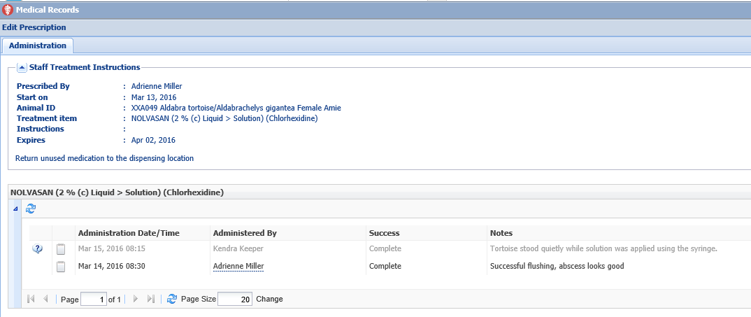
Tortoise Medical Treatment
Because you know that the tortoise needs to be checked and treated you head there
first. To record the successful flushing of the abscess with Nolvasan you will go to the Medical Records tab in the record, highlight the Prescription and select Edit. Because
this is a Provisional Data entry it will display as greyed out in the record until Approved.

Slide 14
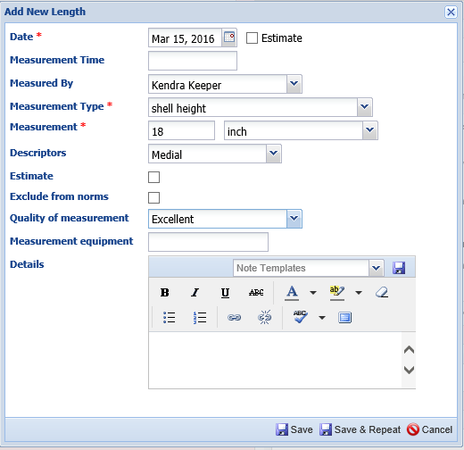
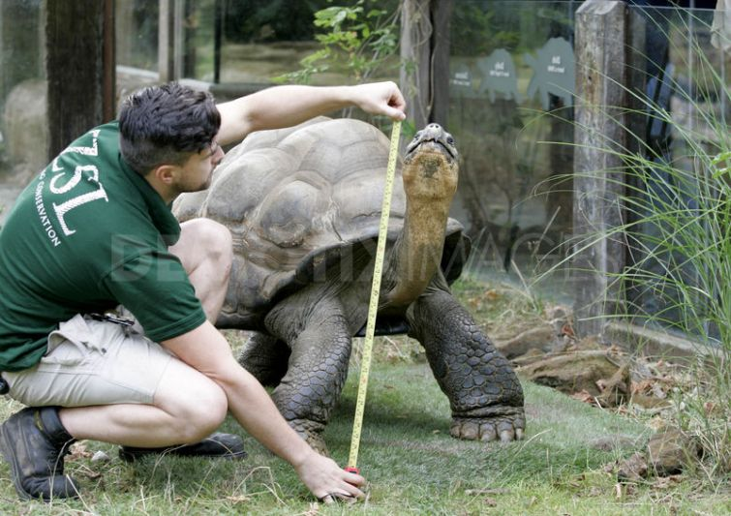
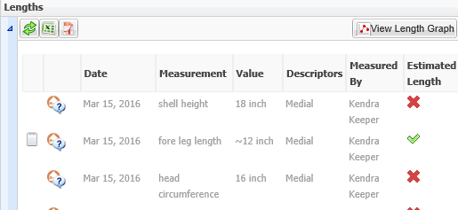
Record Lengths
Your Public Relations person wants to
know if your male tortoise is one of
the biggest ones in captivity. While
you are at the exhibit you take the
measurements she asked for. The fore
leg measurement had to be estimated
as the tortoise was not cooperative
with holding still.

Slide 15
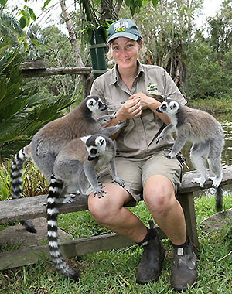
8:30 am – Give Female Lemur Contraception

Slide 16
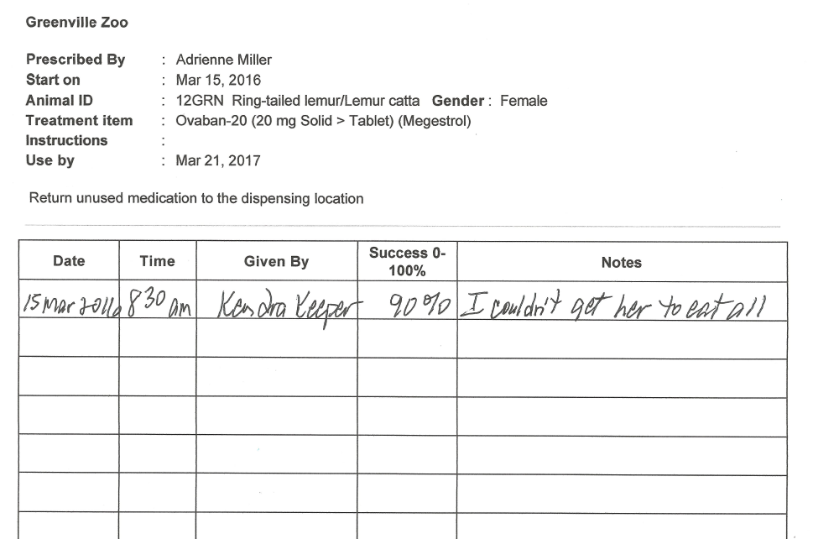
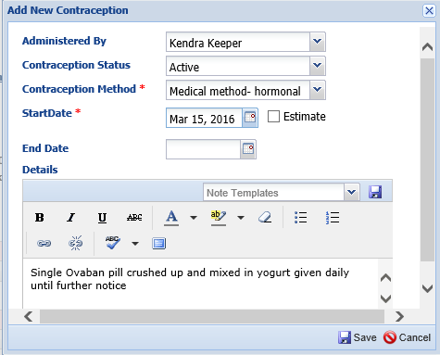
Contraception
Today you are starting your female
ring-tailed lemur on oral contraception.
At the lemur house you crush the pill
into yogurt and hand feed it to her.
You start completing the Treatment
Sheet and record the start of the
contraception into her record.

Slide 17
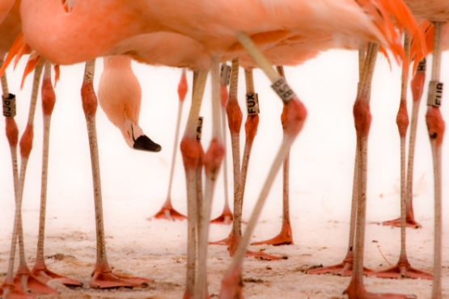
8:45 am - Check Flamingos & Let Them Out

Slide 18
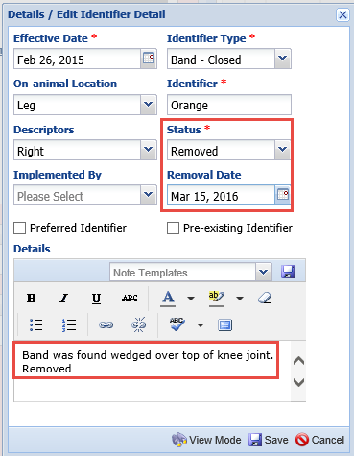
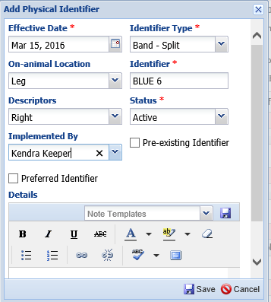
Change Leg Bands
Before you let them out into their exhibit you visually check all the flamingos. The leg
band of one has wedged itself over the top of the knee joint. You radio for assistance
and restrain the bird to remove the band and replace it with a better fitting one.
(NOTE: The ability to record this identifier change is not part of Provisional Data.
Your Role has been given regular access to do this.) You record the band as Removed and the date along with Details as to why. You then record the new band.

Slide 19
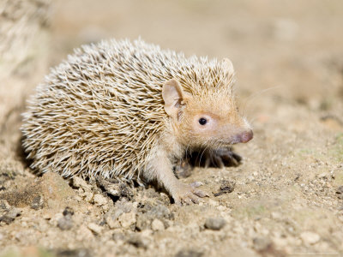
9:15 – Check tenrec babies

Slide 20
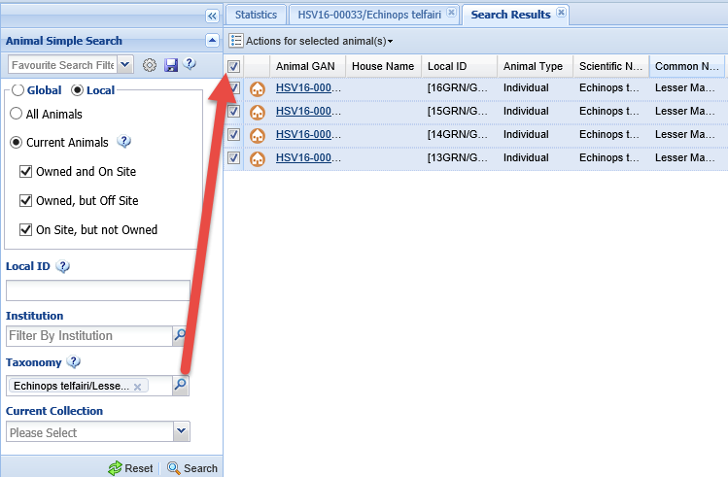
Observe the dam and offspring
Your female Madagascar hedgehog tenrec gave birth nine days ago. This tenrec was found in a box at the front gate and was apparently pregnant at the time. You check on them. There is a lot of activity going on in the tank where they are. You decide to watch for awhile to see if things calm down. After, you record an Observation comment
on the behaviors that you observed into the records of the dam and the three babies. To find the animals you do a Simple Search by taxonomy and check them all.

Slide 21
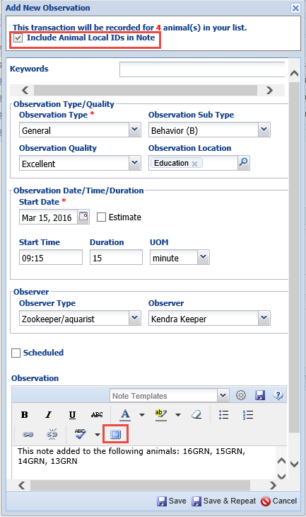
Record the Observation
Under Actions you select Make a Simple Batch
Action for Selected Animals and select Observation>
Single Entry for All. You cannot tell the babies apart
yet so the same entry will be going into all records.
Using the Fullscreen icon you can expand the text box
so you can see your entire entry. You selected to Include
Animal Local IDs in the Note. When you do this it is
recommended that you record your information in
front of them so you get the details first.

Slide 22
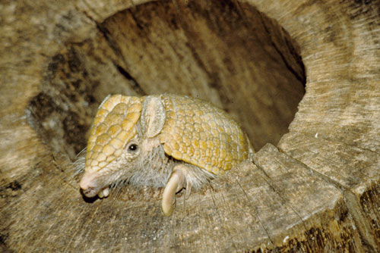
9:30 Check Education Animals

Slide 23
Feed Log Check
You count that 10 crickets remain in the food dish for your three-banded armadillo. Checking the Feed Log from yesterday you see that was the total number provided. You open the Feed Log and complete the entry by recording that 10 were left. The application will automatically calculate the number consumed, in this case none. You also add a note about trying some egg tonight.

Slide 24
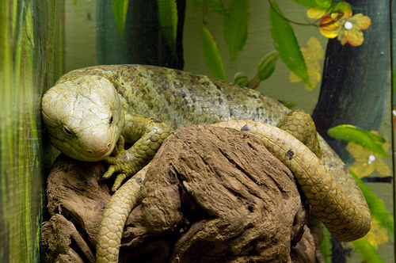
10:00 Time to Clean Exhibits!

Slide 25
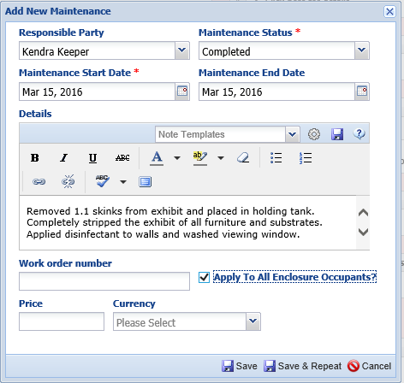
Strip and Disinfect Skink Exhibit
Your prehensile-tailed skink
exhibit needs major maintenance.
You remove the animals and all
the logs and branches as well as
the substrate. You then disinfect
the exhibit. You also check the
Apply to All Enclosure Occupants
Checkbox as this is a major
cleaning and the animals were
removed.

Slide 26
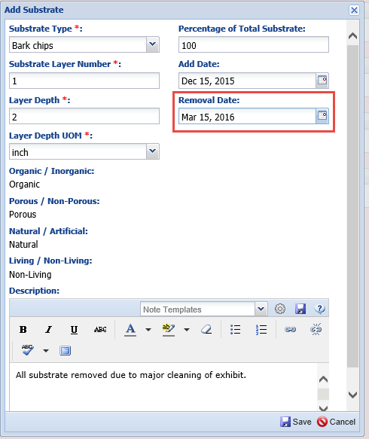
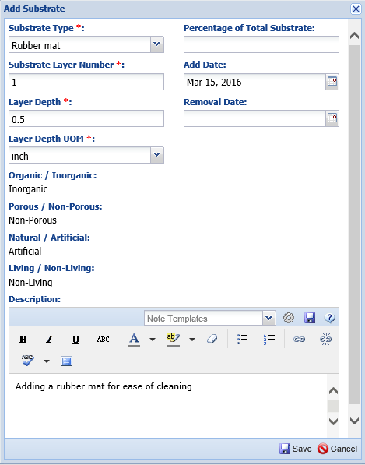
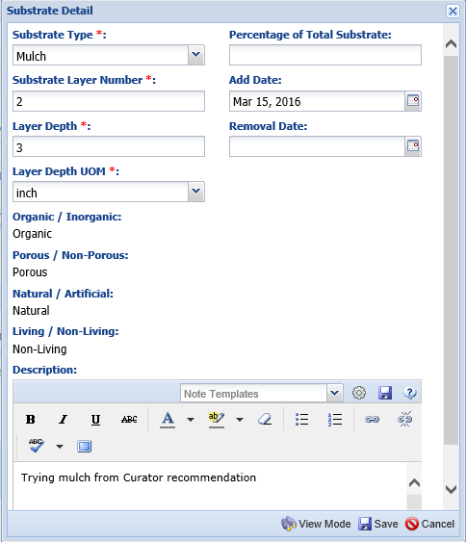
Remove and Add Substrate
Because you did a complete Substrate change you want to capture that in the
Substrate grid. First, record a Removed Date for the current bark chips. Then
Record adding the new substrates. This time you put down a rubber mat first
(Substrate Layer 1) and then you add 3 inches of mulch (Substrate Layer 2).

Slide 27
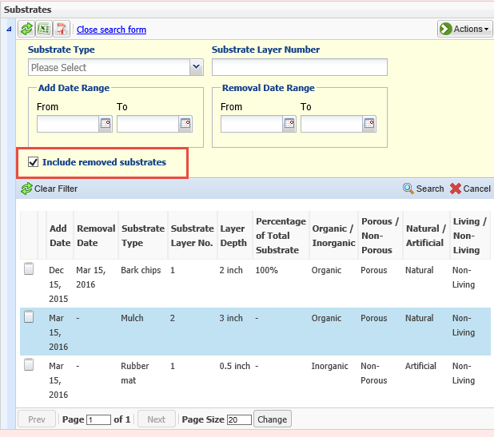
View Substrate History
Only the current Substrates will
appear in the grid. If you want to
see a history of the Substrates in
the enclosure you will need to
check the Include Removed
Substrates checkbox.

Slide 28
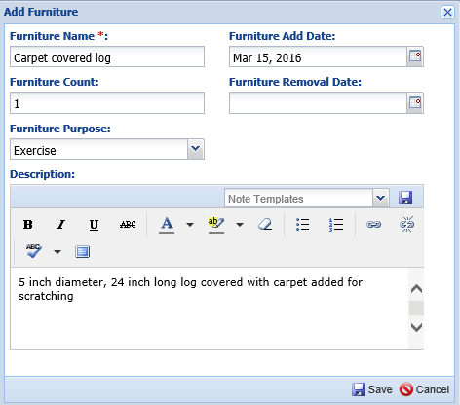
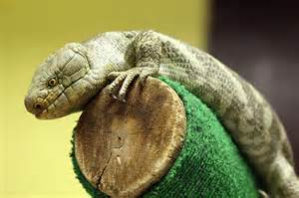
Add Some Furniture
You record removing all of the old branches and
adding new ones. In addition you add a carpet
covered log for scratching. Because the January 4
entry had not yet been approved you can record
a removal date. Otherwise, someone with access
will have to record it.

Slide 29
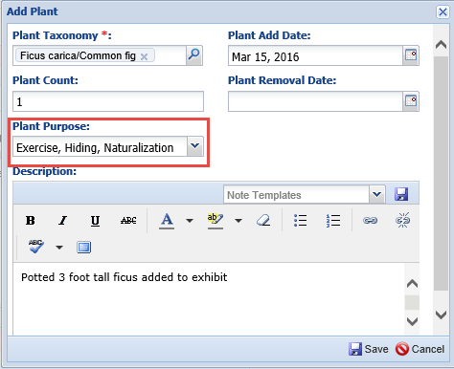
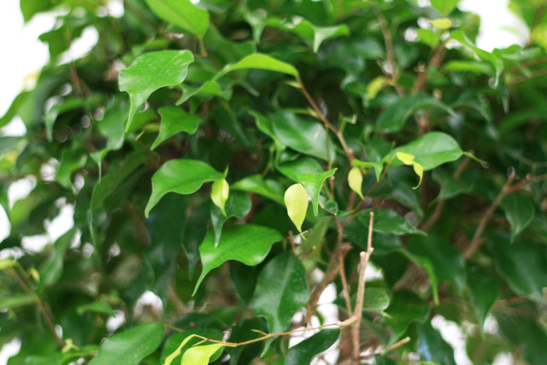
Add a Plant
To naturalize the exhibit, and to
encourage exercise and provide
hiding areas you add a small
potted ficus plant to the exhibit.

Slide 30
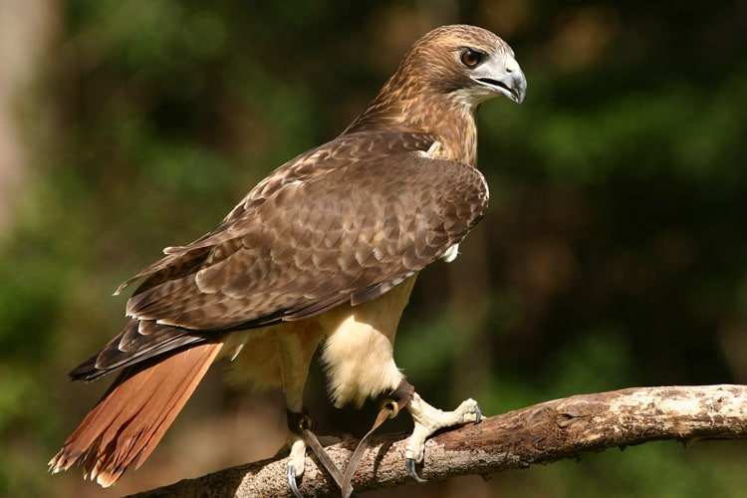
11:30 am – Meet Vets for Bird of Prey Beak Care

Slide 31
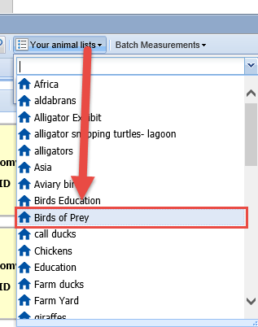
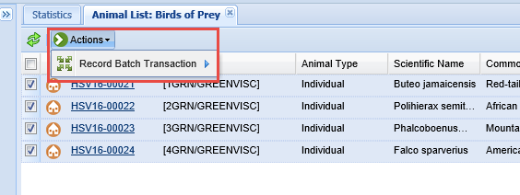
Record the Beak Care
The Vets are ready for the beak coping at 11:30 so you head over to the Bird of Prey mews. The beaks are trimmed successfully. To record this you find the Animal List “Birds of Prey” that has been created by your Local Admin. From the results grid you can select or unselect any animals to retain only the appropriate members of the list. Select Record Batch Transaction under the Actions menu, Notes and Custom Entry.

Slide 32
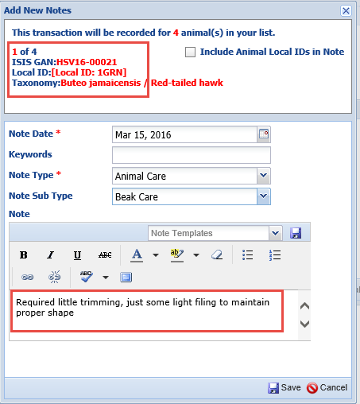
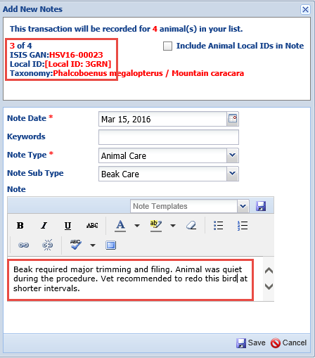
Record Custom Entry
The application will scroll through the animal records allowing you to record custom
comments into each one. What record you are in will display at the upper left. If you
want to automatically include all the Animal Local IDs that are associated with the
Note you can check the box.

Slide 33
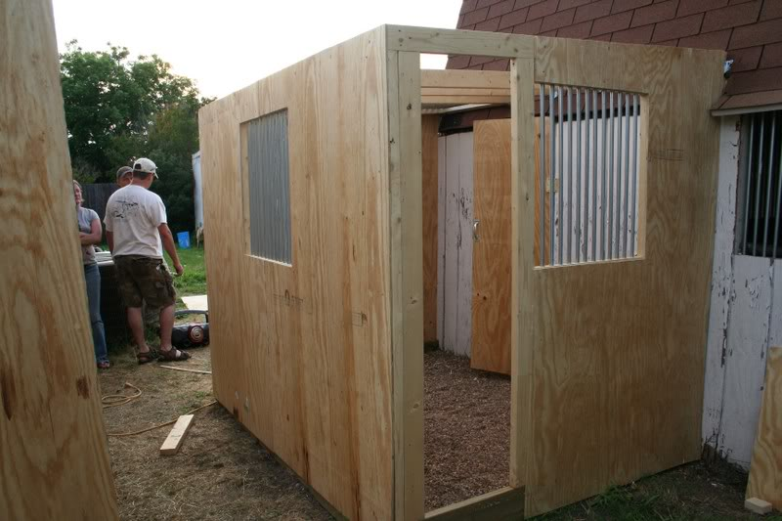
Record Enclosure Information

Slide 34
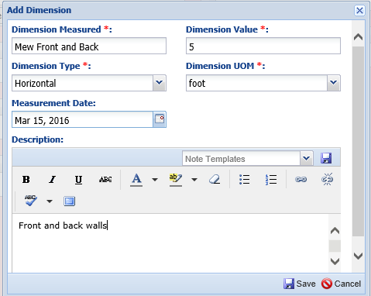
Dimensions and Barriers
While you are at the mews you record
enclosure information on the new
mew being built for the incoming
Swainson’s hawk to send to the
rehab facility where you are getting
it from. You record both Dimensions
and the material for the Barriers.

Slide 35
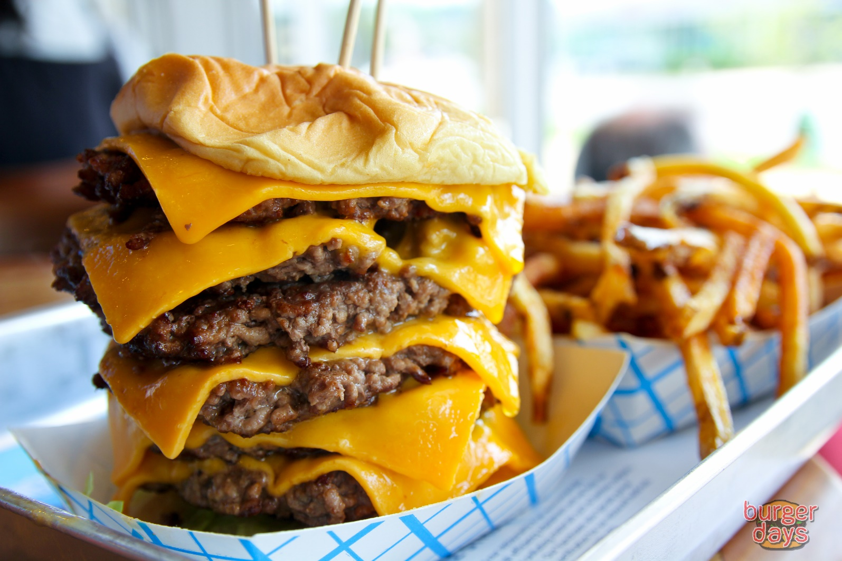
12:30 pm – Time for a Quick Healthy Lunch!

Slide 36
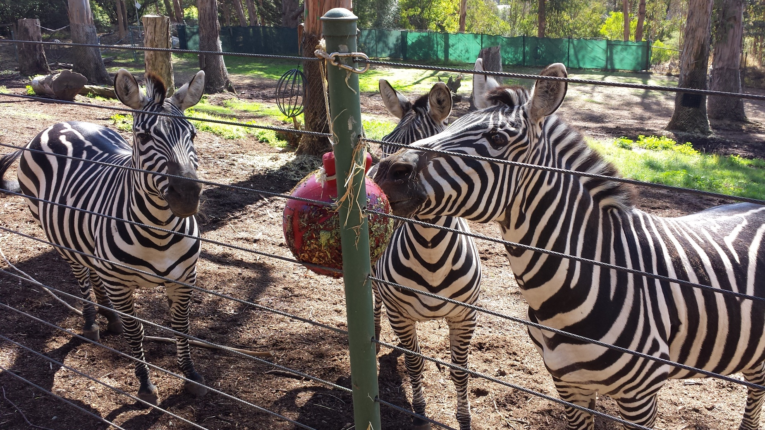
1:15 pm – Give the Zebras Enrichment

Slide 37
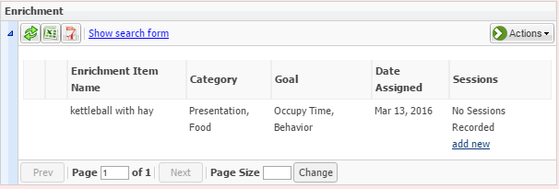
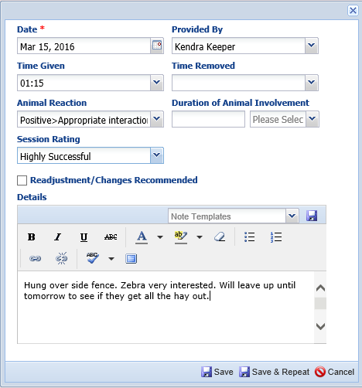
Record the Enrichment
Your lunch is cut short because you remember
that you were supposed to give the zebras the
enrichment item that the Zoo Camp kids had
put together last week. Your Local Admin has
already assigned the item to the zebras so you
will see it in the grid and you can record a
session against it.

Slide 38
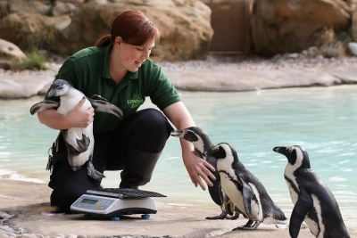
1:30 pm – To Penguins for Feeding, Training, Weighing and a Photo Shoot

Slide 39
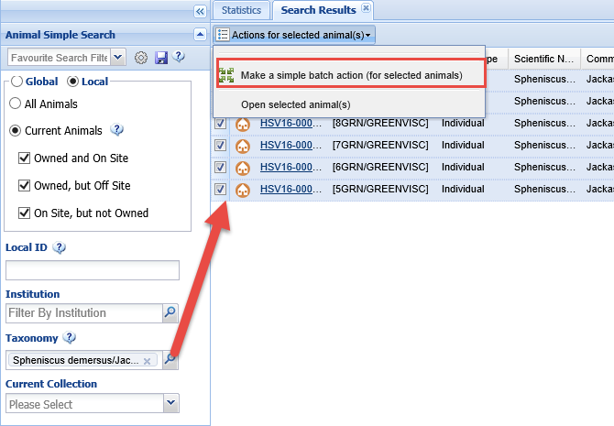
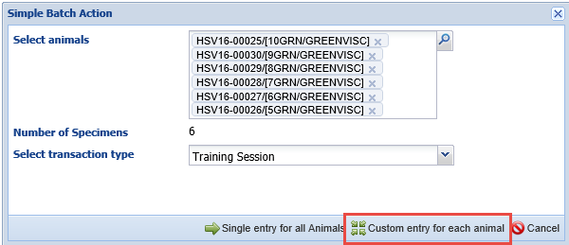
Training
To record the scale training session you search for your
current penguins, select them all and then select Make
a Simple Batch Action of Training Session. Because all the
penguins responded differently you select Custom Entry
for each animal. You make a mental note to ask your
Registrar to make an Animal List of the penguins.

Slide 40
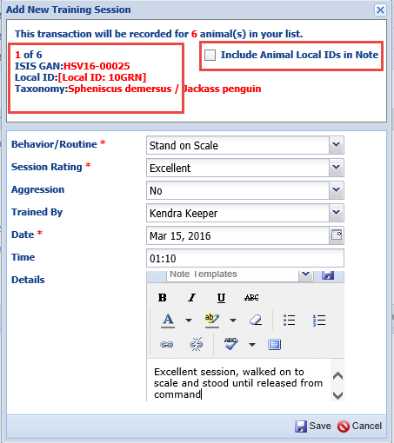
Training
Because you have selected a Custom
Entry for each animal the screen will
display which animal record you are
in so you can record the appropriate
information. If you wanted to Include
the Local IDs of all the penguins in
the note you could check the box.
This penguin had an excellent scale
training session.

Slide 41
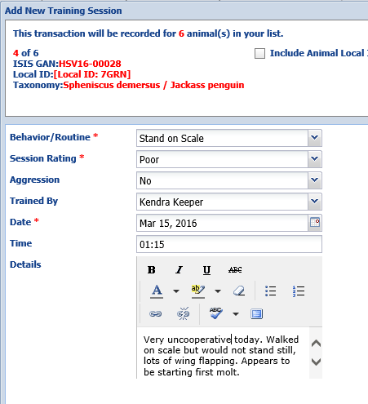
Training
This young penguin that just
started training did not have
a very good session and it is
noted that molting has begun.

Slide 42
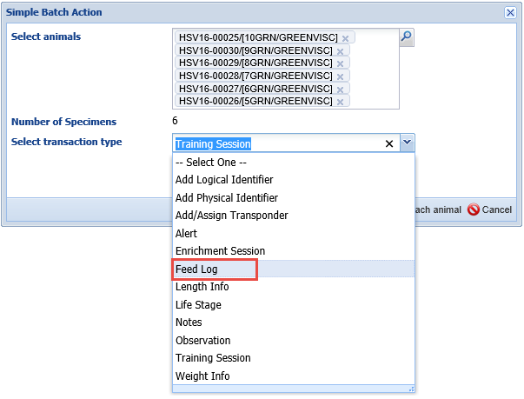
Feed Log
After you record the Training
Session you stay in the Batch
Entry screen and select Feed
Log to record what each penguin
ate, again selecting a Custom
Entry for each animal.

Slide 43
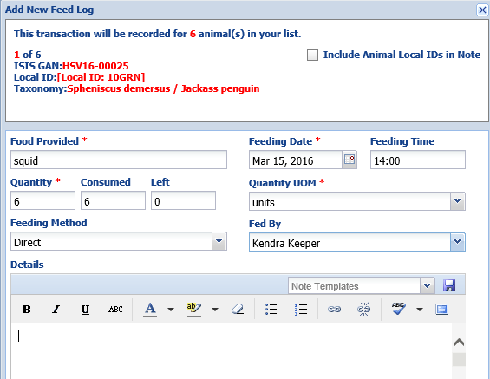
Record the Feeding
Scrolling through the six penguins
you record what was fed, how much
was fed and either how much was
consumed or how much was left.
You also add Details as needed.

Slide 44
Batch Measurement Template
Because you weigh the penguins every month your Local Admin has created a Batch Measurement Template “Penguins” for your six penguins with a Measurement of Live weight in kilograms. You select Batch Measurements>Add New Record>Penguins.

Slide 45
Using the Template
Using the template you can quickly record
the weights taken on the penguins. You can skip
a weight if you want and will get a message
when you Save to confirm that you want to
continue or go back and record. One penguin
(7GRN) was not co-operative (as noted in the
Training Session) so you used the Additional
Information box to record why the weight was
an Estimate and should be Excluded from Norms.

Slide 46
Development Milestones
During the session with the penguins
you noted that 7GRN has begun its
first molt as recorded in its Training session
Details. You record Molt-first in the
Development Milestone grid.

Slide 47
Add Image
During the session with the penguins
you also took some photographs.
Using Add New Image you download
the photos into the appropriate records.
Provisional data access does not allow
you to make these photos visible to
other ISIS members or to Set as Profile
Image, but they are visible to you in the
Images grid.

Slide 48
Profile Images
Once the Local Admin approves
the Image you imported they can
then mark it as a Profile Image
so that it displays in the record.
This is a great help in ensuring
that you are in the correct
record when doing data entry.

Slide 49
2:00 pm - Pool Maintenance

Slide 50
Pool Cleaned and Skim Boxes Emptied
Yesterday’s high temperatures have caused the trees around the pool to drop a lot of leaves into the pool. You use a net to clear the floating leaves and the vacuum to clean the bottom
of the pool. In addition you empty the three skim boxes of captured leaves.

Slide 51
Filter Backwashed
You also do a long backwash
on the filter component to help
clean it so it will better keep the
pool clearer. Recording tasks like
this on the components allows
others to view and track component
maintenance.

Slide 52
Water Temperature Checked
Your Curator has asked that you start
taking weekly Water Temperature
Measurements on the pool. You record
a temperature of 65 degrees F. When
you save you are surprised to see that
measurement is outside the desired
temperature range of 40 to 60 degrees F.
This information is sourced from the
Measurement Range Template the
Curator had created. You save the entry
because it is correct.

Slide 53
Notice a Problem
Looking at the measurements
that have been recorded on the
pool water temperature you
see that they have been steadily
increasing. Looking at the
Measurement Graph makes it
even more obvious to you that
there may be a problem with
the chiller.

Slide 54
Add an Action
You check the chiller and it is making intermittent
screeching sounds. It also has some debris piled
around it. You remove the debris in hopes that
will help but it does not. You reopen the
measurement record to record your Actions Taken.
In addition you check the Create Enclosure
Maintenance Record. This will automatically place
the information you entered in the Details box
into the Maintenance grid.

Slide 55
Schedule a Maintenance Task
Using the Calendar you
schedule a task for
maintenance to repair
the malfunctioning water
chiller. You can tell this was entered under a Provisional Role as the “?”
is displayed.

Slide 56
3:30 Record a Life Stage Change

Slide 57
Update the Record
After the penguins you walk by your tanager Aviary and note that a hatchling you had been
watching has fledged. The record currently has it as a Hatchling with no End Date. When you record the Fledgling the End Date will automatically
be filled in. It cannot be marked as a Current Life Stage until Approved by your Local Admin.

Slide 58
3:45 pm – Record a Rearing Change

Slide 59
Update the Record
When you check on the tenrec babies again you find
that one is outside of the nest. You try to put it back
With the dam but she pushes it back out. Because
the baby will be hand reared for a few days you need
to update the record. Because Provisional Data does
not allow editing of regular information, someone with
that access will need to update the End Date for the
Parent rearing record. You take the baby to the hospital.

Slide 60
4:00 pm Run Daily Report
You radio the other keepers and they are done with their day’s work. You run a Daily
Report for the institution. To do this you select to run by Enclosure (your top level institution)
and check Include Enclosure Below. The Include Ambient Temperature is sourced from
measurement entries made on your institution record. You add some Non-ZIMS notes
regarding the penguin chiller and the baby tenrec. This report can be printed or saved.

Slide 61
Mark Calendar Task as Complete
Because you completed the tasks assigned to you in the Calendar you want to mark
them as such. You open up the penguin task and select Mark Complete. When a task
is marked as complete the red “!” will go away. You can also choose to hide from view
any tasks that have been marked as completed.

Slide 62
4:10 pm Go Home to Care for Your Own Family

