Slide 1
A Curator’s Year in ZIMS

Slide 2
ZIMS Updates!
This PowerPoint is up-to-date as of: November 12th 2018
ZIMS is developed in an “agile” method
This means that it is updated every two weeks, sometimes with additional releases in between!
Use the link below to see if there have been any updates to this topic since the date above:
http://training.species360.org/updates/

Slide 3
The Scenario
You are a Curator for the Australasian section of your institution
Your ZIMS Role is a Custom Role that allows Viewing all data (both Husbandry and Medical) and Add/Edit/Delete rights to selected institution, animal and enclosure fields
We will go through your year and highlight how ZIMS can help make your job easily and more effective

Slide 4
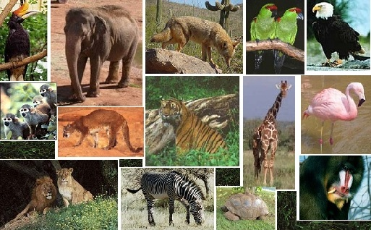
JANUARY Run Reports
After a joyful New Years Eve celebration you are back to work for the new year. First thing to do is run a Loan Report to check that you have received updates on all your Out on Loan animals.

Slide 5
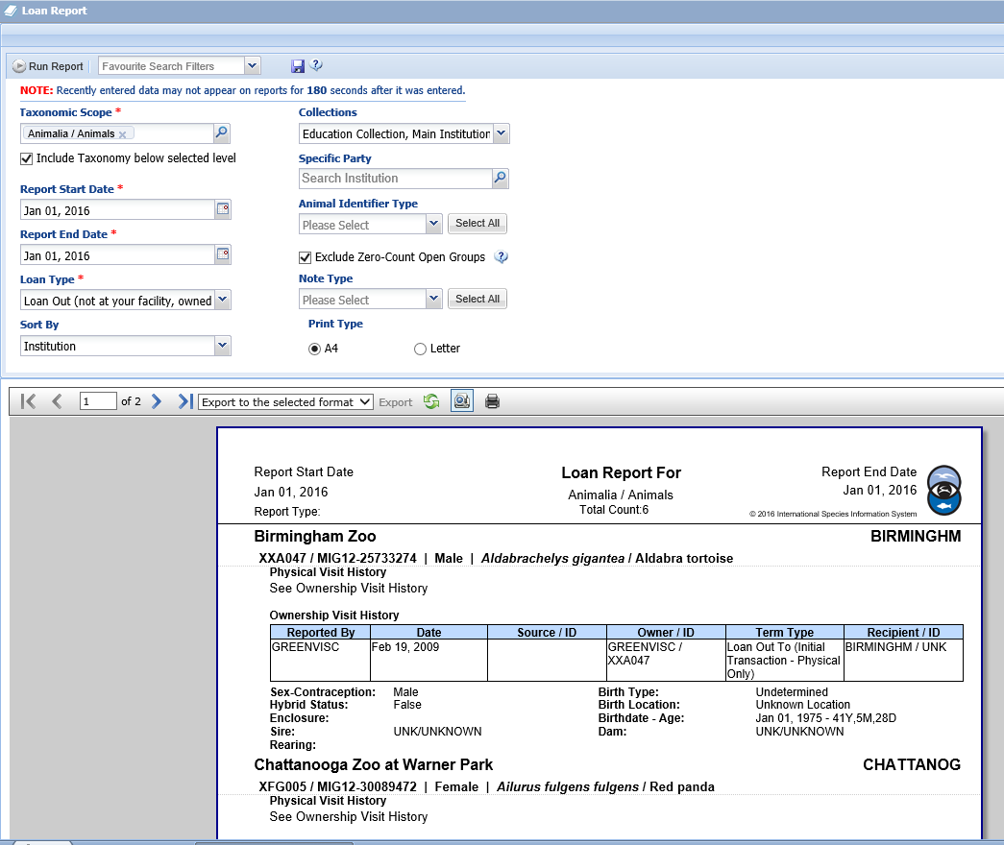
Loan Report
The Loan Report can be run for either animals
you have In on Loan or Out on Loan. By default
all Collections are included but you can exclude
by unchecking. If Specific Party is left blank the
report will indicate all animals of the selected
Loan Type, or you can select a single Institution
to run the report for. You have six animals Out on
Loan. Checking their Notes you see you have
received paper updates on three. Two are sharing
their records with you so you can review any
recent data entered on them. You have had no
update from one. You will need to confirm that the
two sharing records wish to continue with the loan.
You will need to try once again to get an update from
the remaining facility

Slide 6
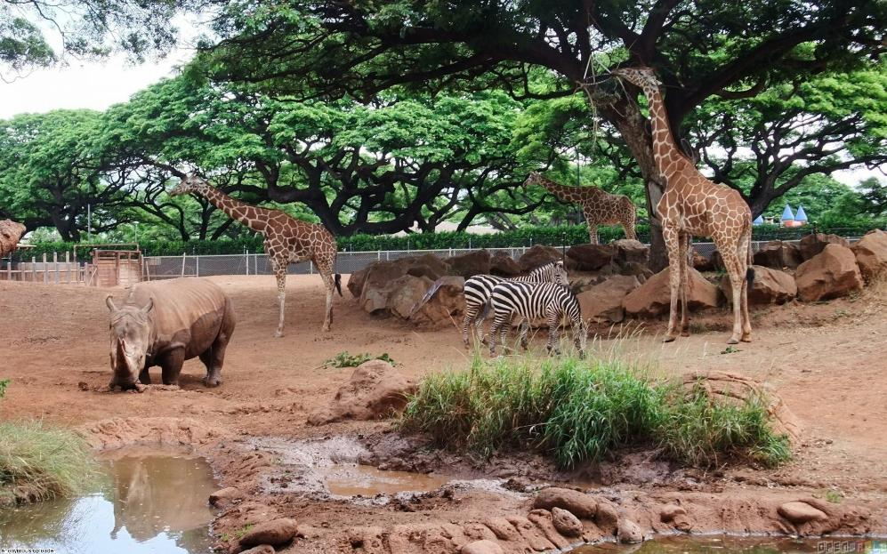
FEBRUARY Collection Planning
February is when you routinely review your Collection Plans for the upcoming years with the other Curators

Slide 7
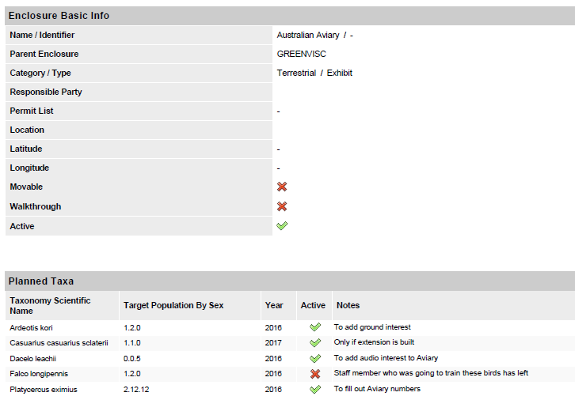
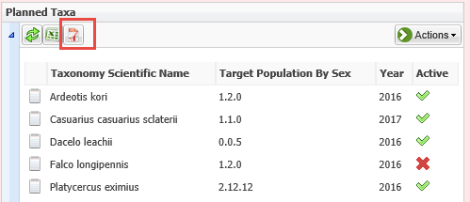
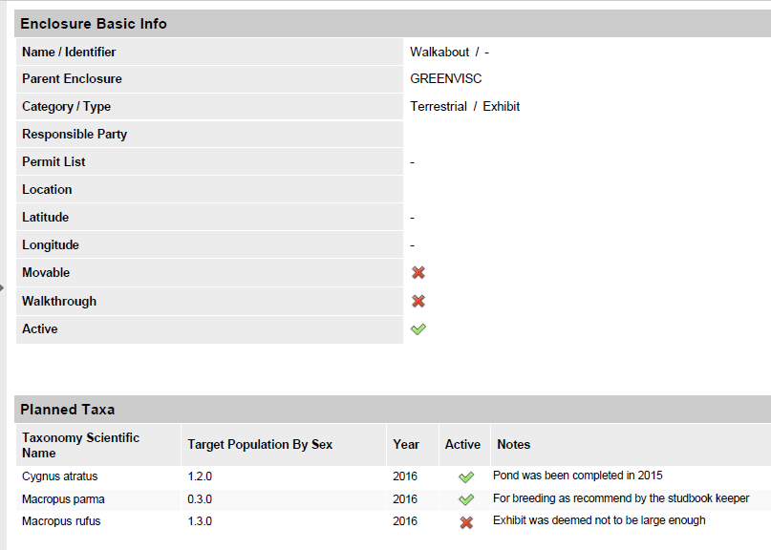
Planned Taxa
Before the meeting you export the Planned
Taxa that you have added to your Enclosure
records. You have recorded taxa for both the
Australian Aviary and the Walkabout exhibit.
You can track planned species that you
changed your mind on by not checking the
Active checkbox. This can save you time in
the future should that species come up in
discussions for that exhibit again. You export
the information to take with you into the
meeting.

Slide 8
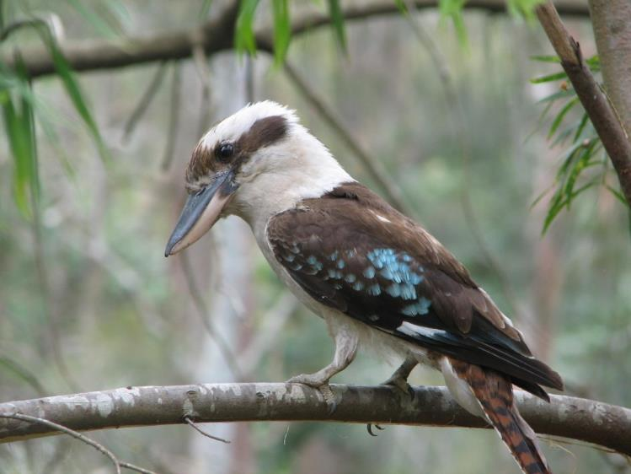
MARCH Update SW and check AA
Your Planned Taxa was approved at the Collection Planning meeting so you want to update your list of Species Wanted and check Animals Available list for any that may be available

Slide 9
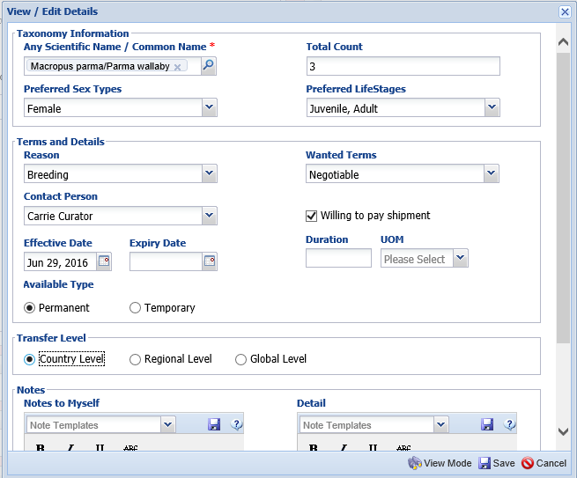
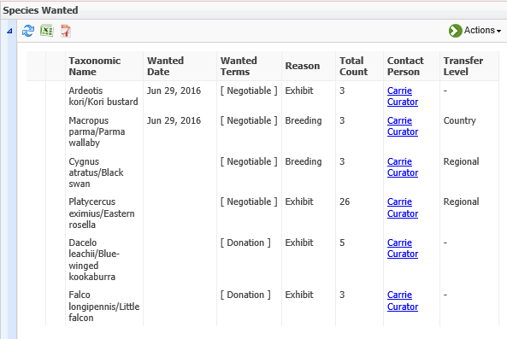
Add Species Wanted
You start by entering the three female Parma wallabies for the Walkabout exhibit. You would prefer juveniles or adults. Your terms are negotiable and you are willing to pay shipment, but
you would prefer a transfer from
within your country to avoid possible permitting delays. You then add the
rest of your desired species.

Slide 10
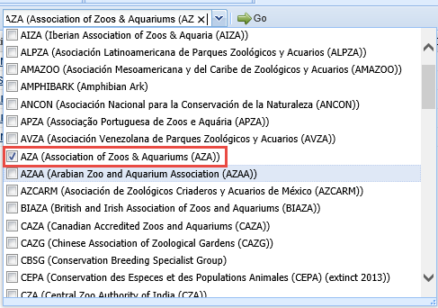
Check Animals Available
You then check Animals Available to
see if any of the species you want to
add to your collection are available.
There are five black swans listed but
they are all in the European region.
You do not want a global transport
so you select to check only the AZA
box (you are in North America) for
your next searches.

Slide 11
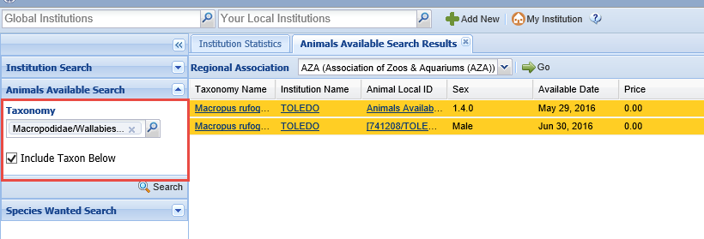
Check for Alternate Species
Unfortunately none of your species are listed as Available in your region at this time.
You decide to expand the search for Parma wallabies by looking at all Macropods
listed (remembering to check the Include Taxon Below box). You see that Toledo
has a group of 1.4 red-necked wallabies available. Using the hyperlink a list of the
animals is displayed and using the GAN hyperlink you can look at their global records.
This species may be a viable option for your Walkabout needs.

Slide 12
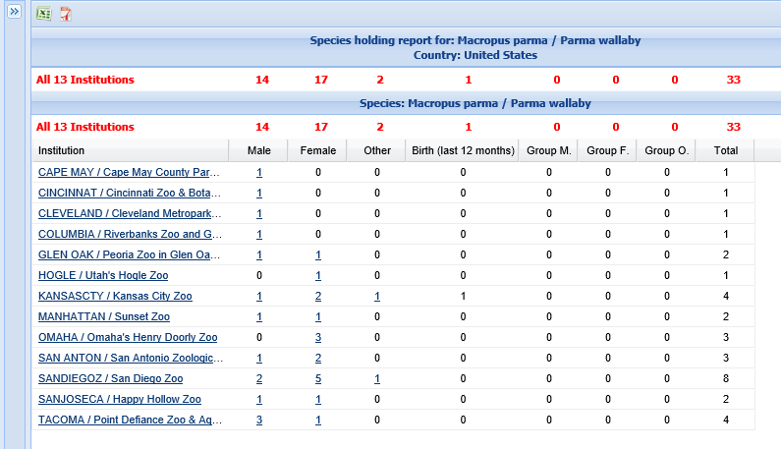
Check Species Holdings
You are still interested in
obtaining Parma wallabies so you check species holdings at your Country level. At first
glance it looks like only San Diego Zoo may have surplus animals unless others are willing to close out the species. The red-
necked wallabies may be
a better option.

Slide 13
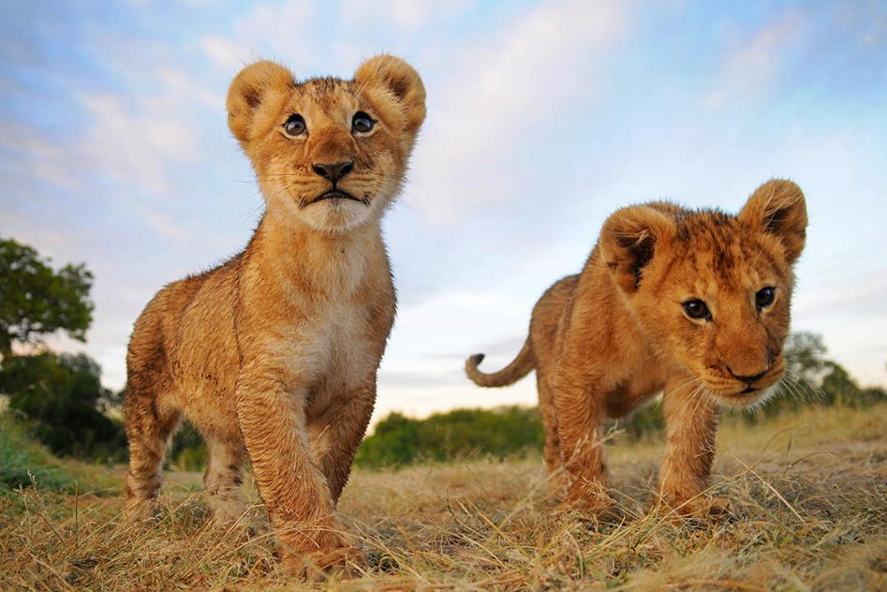
APRIL TAG Meeting
In preparation for the annual Felid TAG meeting you run TAG Export and Population Overview Reports

Slide 14
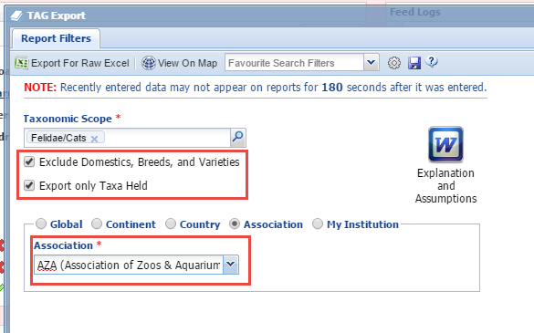
TAG Export
For the TAG Export you select to Exclude Domestics,
Breeds and Varieties and to Export Only Taxa that
are currently held at institutions. This will help the
report display only those species of interest. You also
select to run it at the Association level.

Slide 15
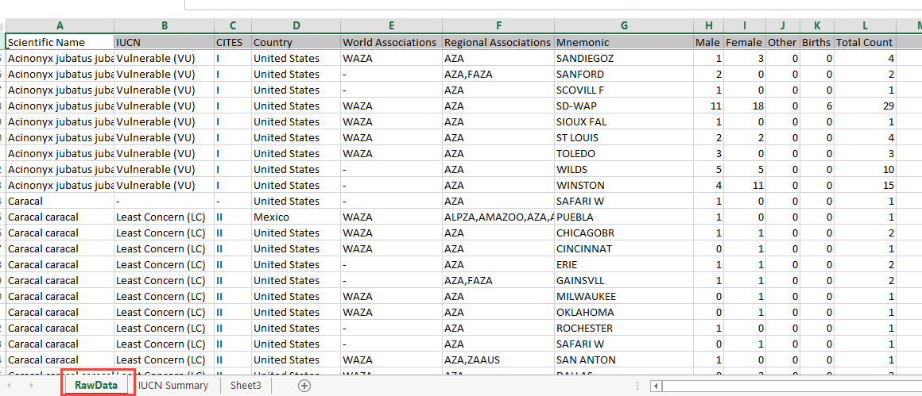
TAG Export
You export the report to Excel. On the Raw Data sheet you remove any columns
you don’t need.

Slide 16
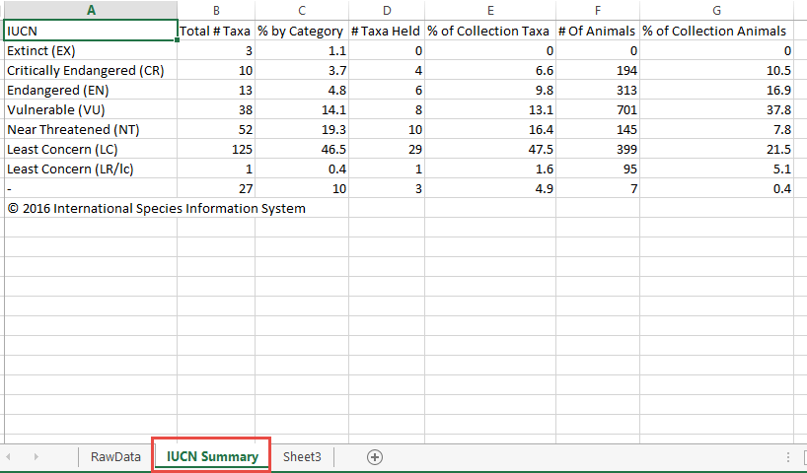
TAG Export
On the IUCN Summary sheet you adjust the columns and quickly
review the statuses. You save the report and email it to the other
TAG members for their review prior to the meeting.

Slide 17
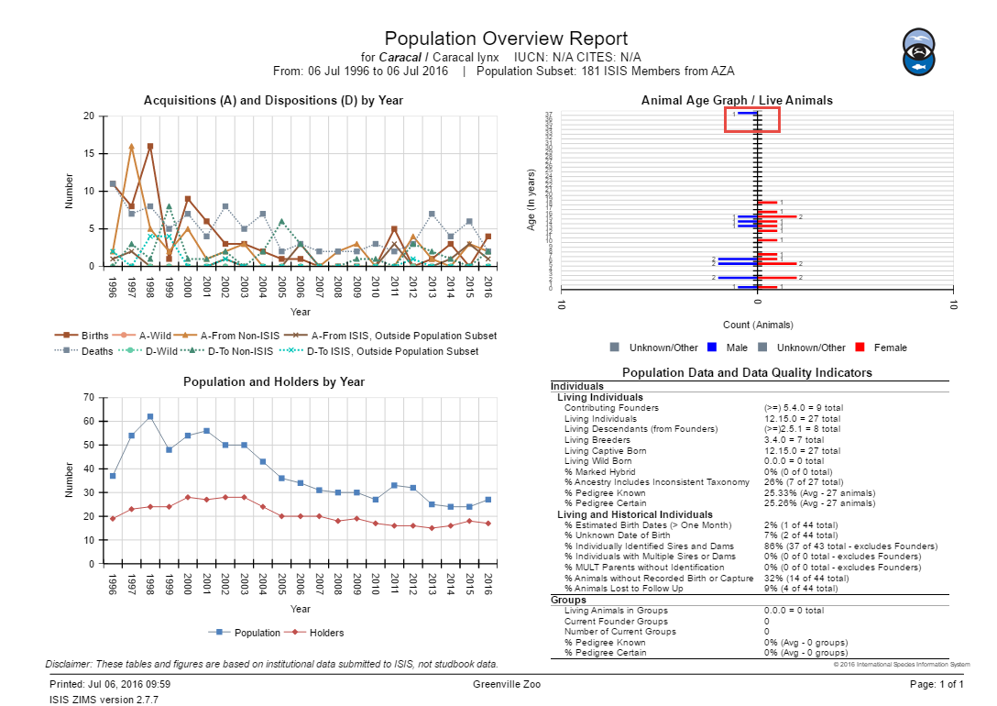
Population Overview
You run a Population
Overview report for
all of the species of
interest. The caracal
population appears
to have stabilized.
However, there is an
older animal that
should be identified
as it is probably a
records error and is
deceased.

Slide 18
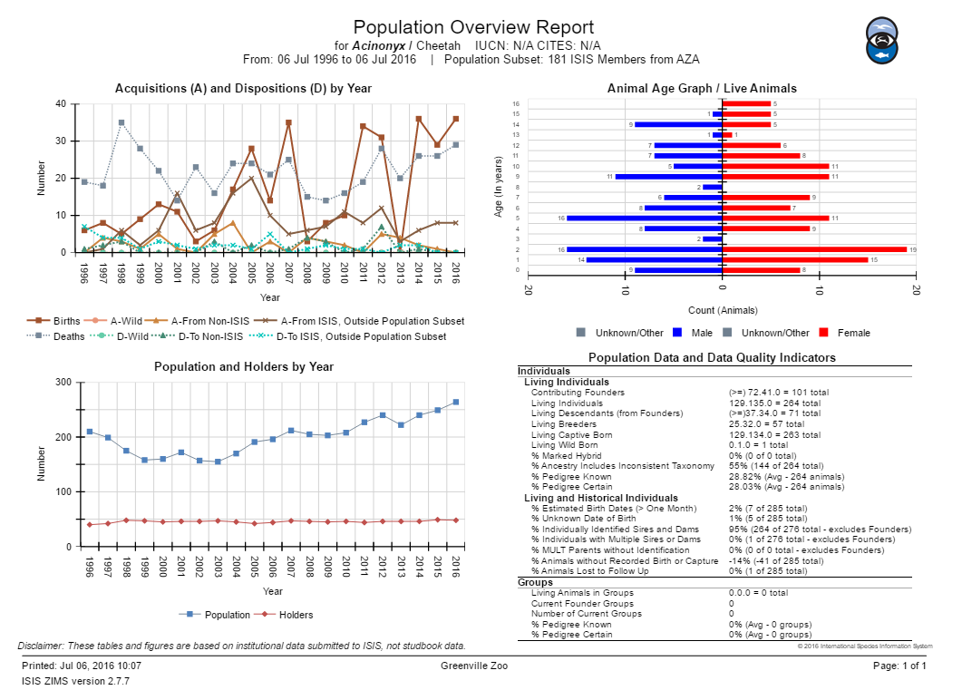
Population Overview
The cheetah population
appears to be strong
and the Age Pyramid
is good for future offspring.

Slide 19
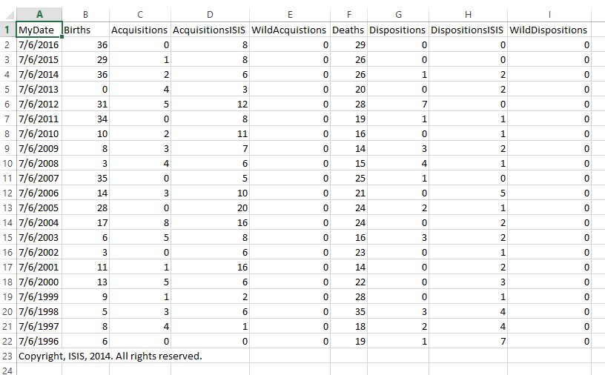
Population Overview
You also Export these
reports to Raw Excel
for actual numbers
that can be used in
your TAG discussions.

Slide 20
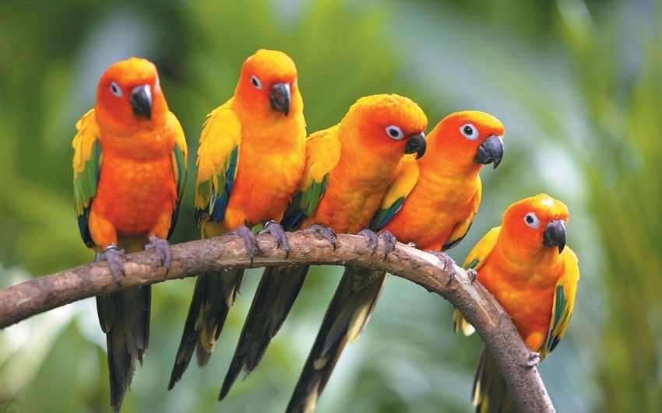
MAY Share an animal record
Shipping season is here! You will be sending a brown lemur to the Audubon Zoo and all of your sun conures to Philadelphia.

Slide 21
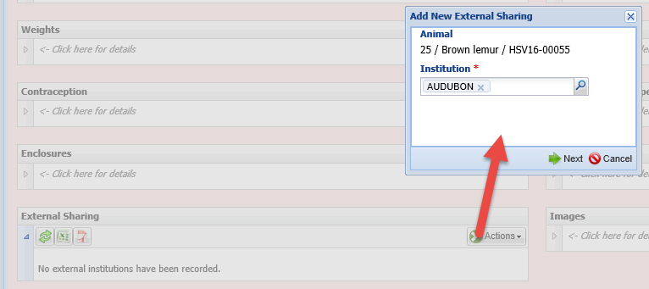
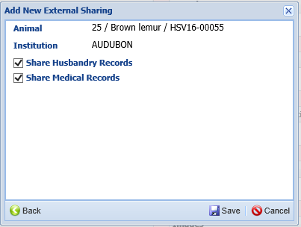
Share From the Record
Sharing a record allows other institutions
to see more of the record than the global
view allows. This is useful for viewing a
record of an animal you will be receiving,
or keeping up-to-date on animals you have
Out on Loan. The Species360 Global Administrator
must activate sharing for your Institution.
Your Local Admin then turns it on.
Individual records can be shared from within the record itself.
You simply need to record the institution you wish to share a
record with and then select if you are sharing the Husbandry
records, the Medical Records or both. Medical records have
three tiers of sharing and you can only view the records to the
lowest common denominator of sharing between the facilities
involved.

Slide 22
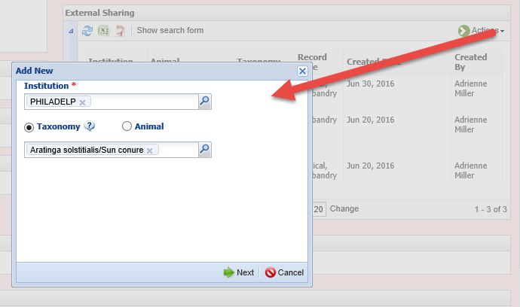
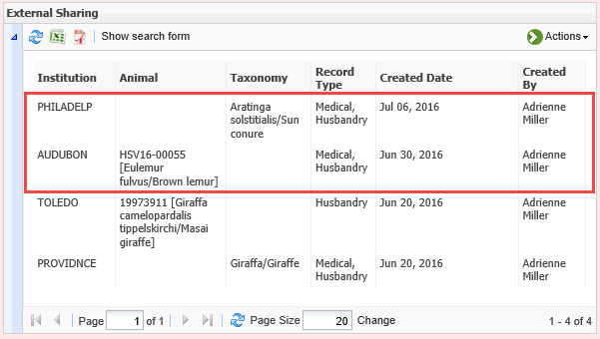
Share from My Institution
Sharing an entire taxonomy must be
done from within the External Sharing
grid in My Institution. You can also
share a single record here. All your
active shared records will display in
this External Sharing grid as well as
within the animal record itself. The
record will continue to be shared until
you delete it from either the record or
the My Institution grid.

Slide 23
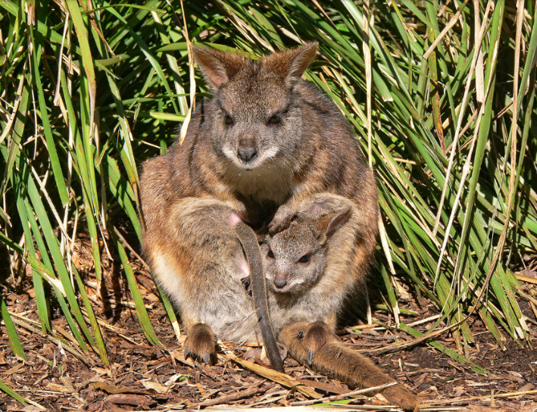
JUNE Update your studbook
You have just been awarded the studbook for Parma wallabies. The previous studbook keeper had it up-to-date but you need to check the Studbook News Feed for recent activity.

Slide 24
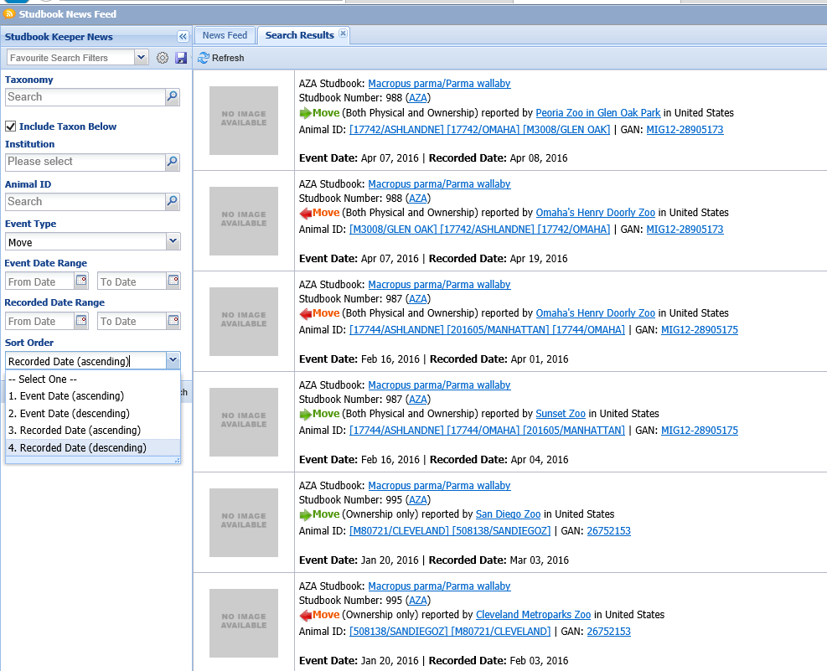
Studbook News Feed
You want to look at recently recorded
Moves, so you filter by Event Type of
Move and Sort Order by Recorded Date
to capture any previous moves that may
have been recently recorded.

Slide 25
JULY USDA Inspection
Ack! Your USDA inspector unexpectedly arrives! He wants to know your last years holdings and has some questions on your exhibits.

Slide 26
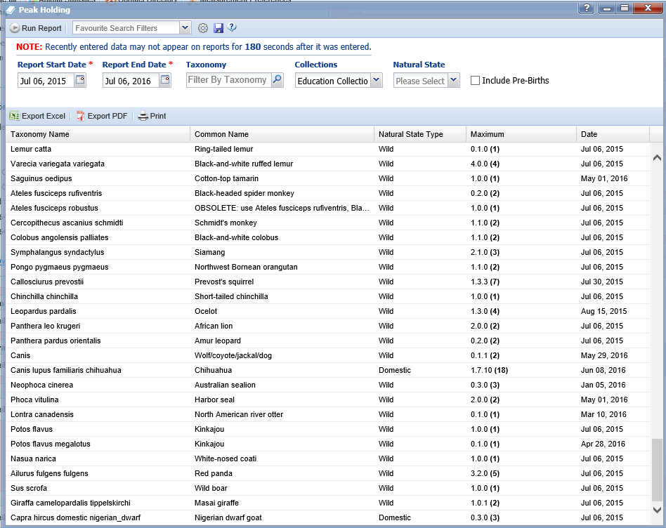
Run a Peak Holdings Report
This report indicates the highest
number of animals you held and
the date this number was held.
You can filter by Wild or Domestic
Natural State. You print this report
for your inspector. In addition he
would like it emailed so you export
it to pdf (or Excel).

Slide 27
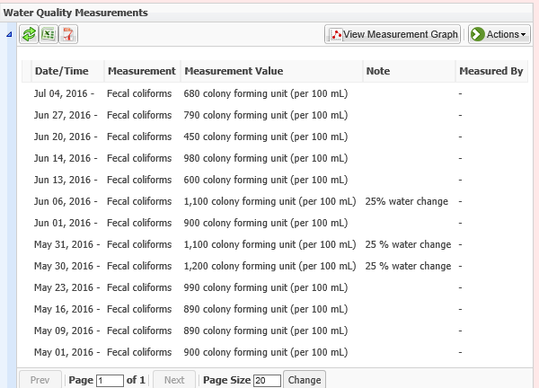
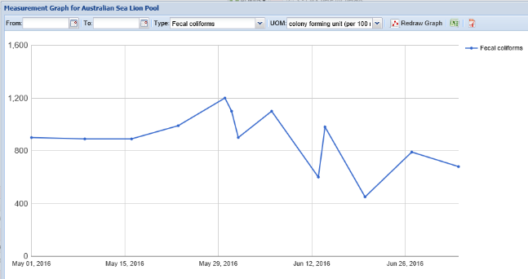
Coliform Control in Sea Lion Pool
He also wants to review your coliform test
results in your sea lion pool and what actions
you took should the reading be >1,000 CFUs.
Looking at the Measurement Graph can give
a quick view of how you are doing.

Slide 28
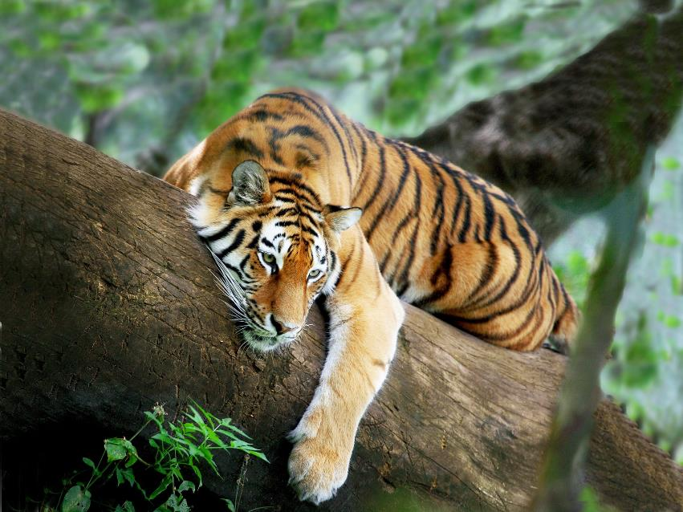
AUGUST Accreditation Visit
Soon after your USDA inspection you get visited by the AZA Accreditation inspectors!

Slide 29
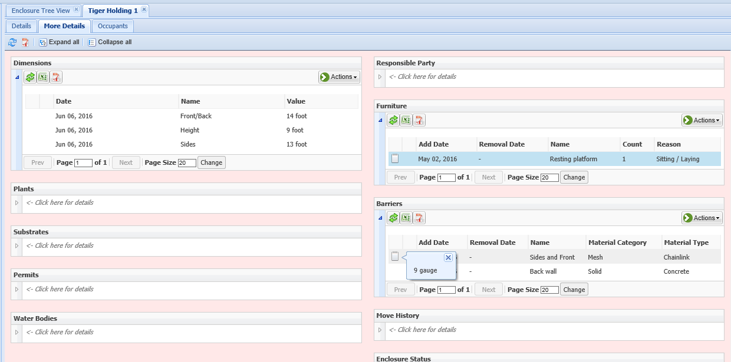
Tiger Holding
One of the items on the visiting team’s list is to assure that the facilities for your tigers are meeting the requirements in the updated tiger husbandry manual.
Since you have entered details into your enclosure records you can very quickly answer their questions. First they want to know your holding area size, stall barriers and any furnishings. The dimensions meet
the 12x12x8 requirements. There is the required resting platform also. However, the new requirements for chain link is a minimum of 8 gauge. You have 9 gauge. You will need to replace all of the chain link in your tiger holding.

Slide 30
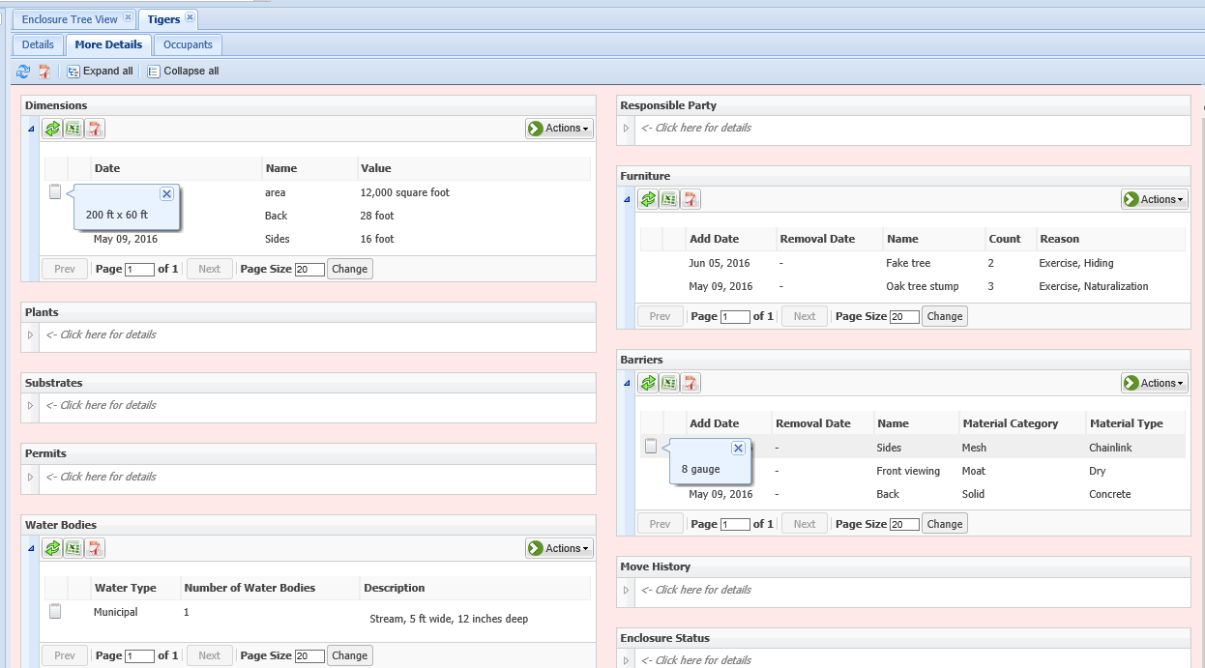
Tiger Exhibit
You then look at your tiger exhibit. The area is 12,000 sq feet (200 ft x 60 ft). There are fake trees for climbing and real stumps for scratching and scent marking. The chain link on the sides meets the requirements at 8 gauge. There is a stream water feature.

Slide 31
You use ZIMS to help answer many more questions during the visit
Aquatic water quality
Your Collection Plans
Current Inventory
Animals In on Loan or Out on Loan
Exhibit maintenance programs
Staff listing
Details on animal identification system
Controlled substances
Enrichment & Training
Animals involved in managed programs
Education animal collection

Slide 32
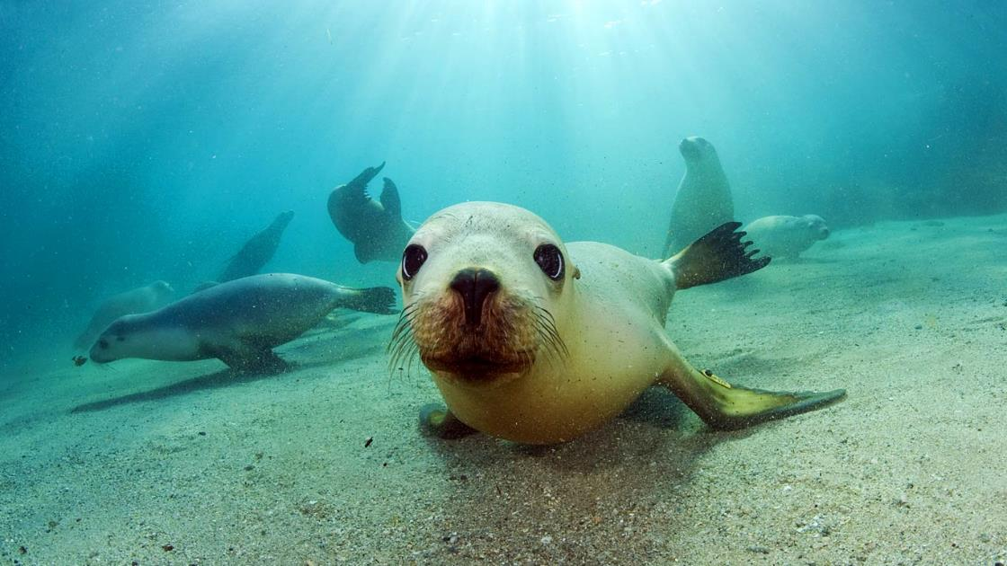
SEPTEMBER
You finally heard back from the company that will be doing the repairs on your sea lion pool with dates. You add a maintenance task to your calendar.

Slide 33
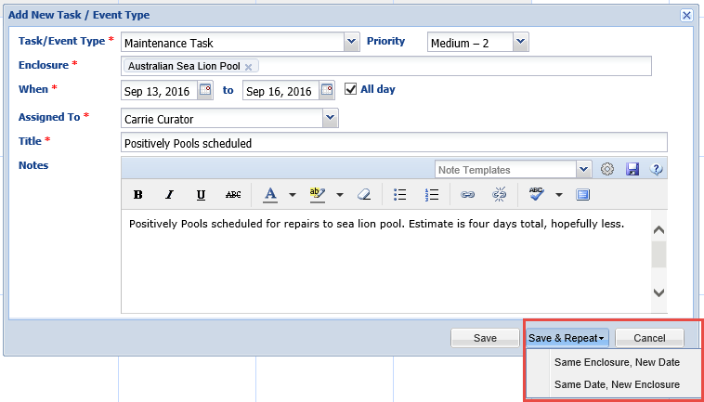
Schedule Maintenance Task
You first schedule the dates when Positively Pools
will be coming. Using the Save & Repeat function
you can then select Same Enclosure, New Date to
schedule that maintenance has to drain the pool
the day before.

Slide 34
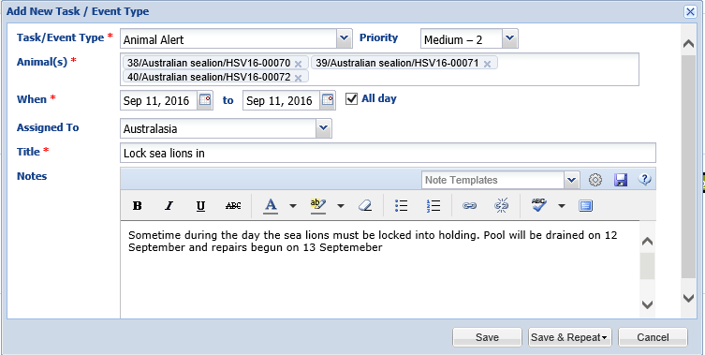
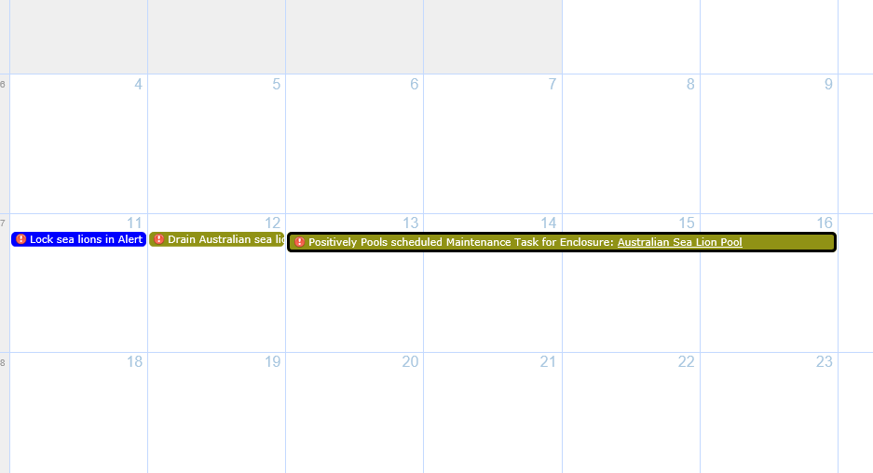
Schedule Animal Alerts
You then schedule Animal Alerts for the three sea
lions and assign to the Australasia Team. They must
be locked into holding so the pool can be drained.
You can easily view these tasks on the Calendar.

Slide 35
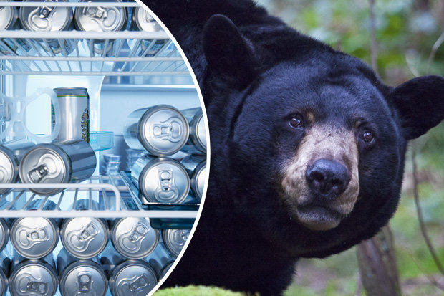
OCTOBER Local Newspaper Article
Your local newspaper is running an article about your zoo in preparation for your annual Octobear Fest. They have several questions for you.

Slide 36
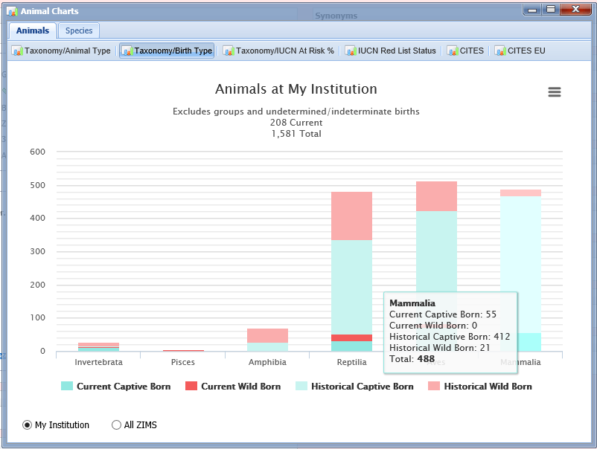
Animal Charts – Taxonomy/Birth Type
Their first question is
how many of your animals
are Captive Born versus
Wild Born. This question is
very easy to answer using
the Animal Charts
found under the Animal
Statistics tab in My
Institution. Hovering
over the columns will
give actual counts that
you can provide for the
article.

Slide 37
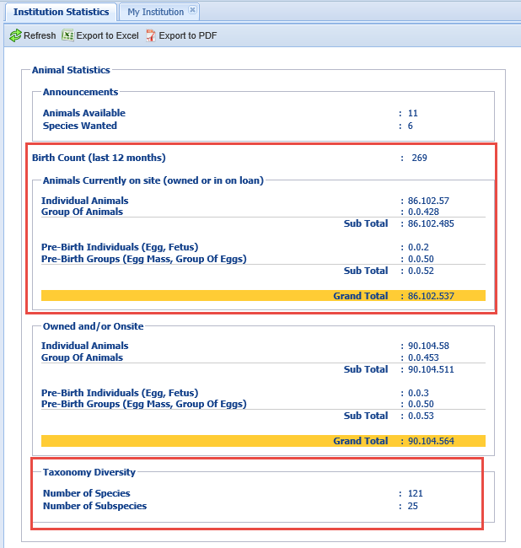
Institution Statistics
They then asked for how many
births you’ve had in the past year,
how many animals you have in
the zoo and how many species you
are caring for. You find quick
answers to all of these questions
on the Institution Statistics tab
in My Institution.

Slide 38
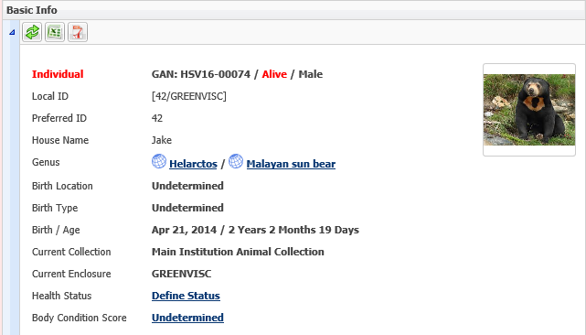
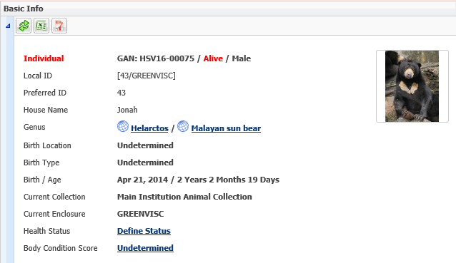
Provide Images
They also want some details on your two sun bears and ask how you tell them apart. Jake and Jonah have very different chest markings. Since you have included images in ZIMS you simply copy and send them so the article can include that visual and visitors will be able to know who is who.

Slide 39
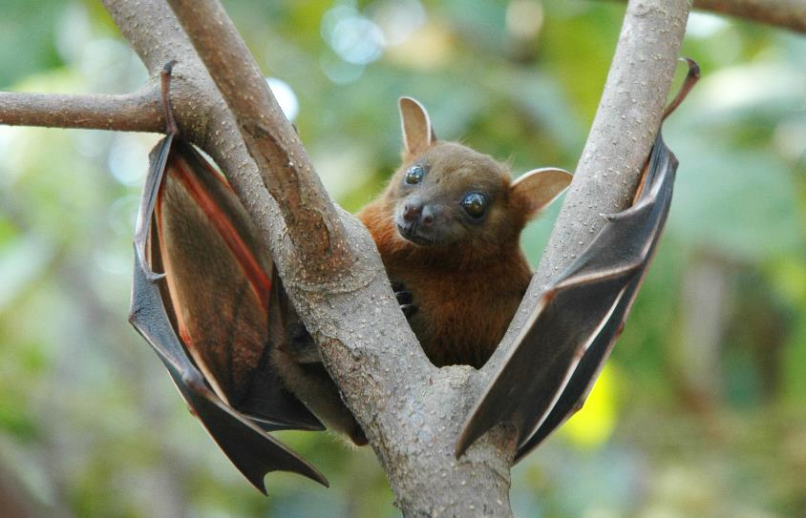
NOVEMBER Check status of a permit
You are hoping to add some fruit bats to your collection early next year and you want to check the status of the permit

Slide 40
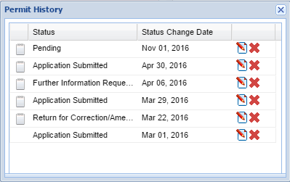
View Status
In the Permits grid you
open the View Status
History for the permit.
You are happy to see
that the permit will be
issued. However, you
decide that you will
prepare the next permit
as it was returned twice.

Slide 41
DECEMBER Weight Comparison Report
Your new Lead Primate Keeper is concerned that “Bob” the orangutan is underweight

Slide 42
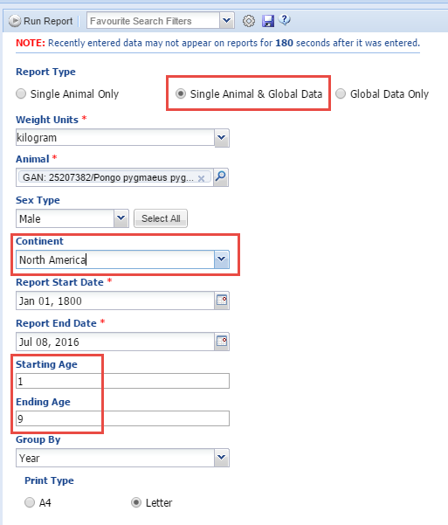
Select the Filters
You want to check Bob’s weights
against other male orangutans
in the ZIMS database. You select
Single Animal & Global Data.
You also filter by North America
to compare with other weights
In your region. Bob is 9 years old
so you select an ending age so as
not to have a lengthy graph with
no related weights.

Slide 43
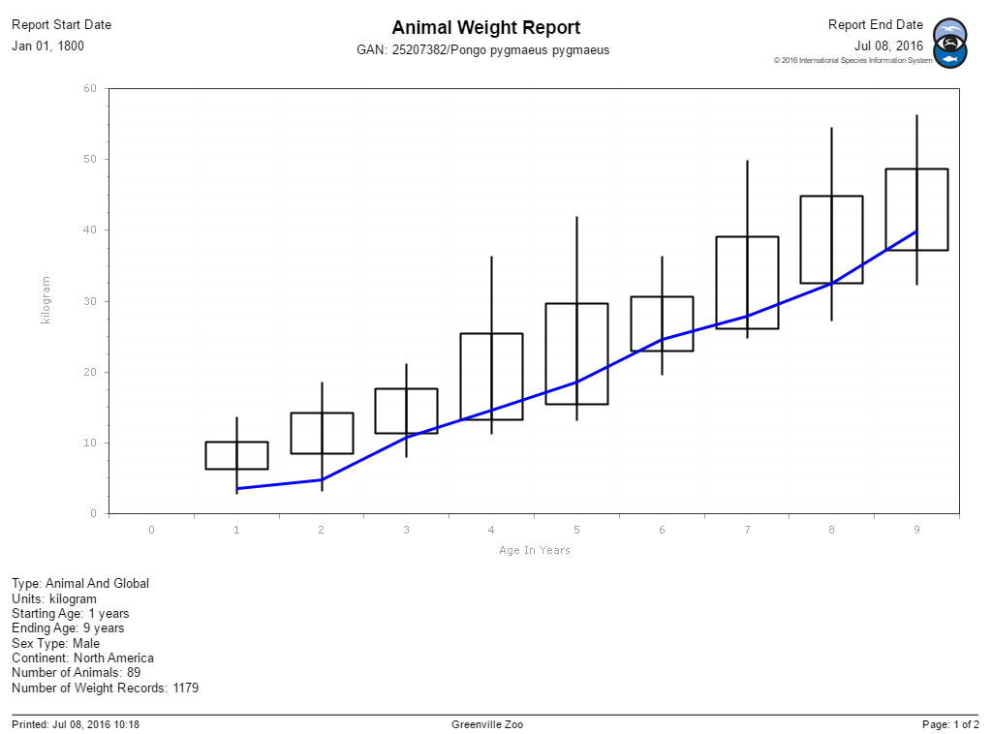
Compared to Global Data
Bob has been on the light side
for his entire life so he is
probably at a weight that is
appropriate for him. His
yearly physical is scheduled
for the beginning of the
year so you can discuss this
with the Veterinarian.

Slide 44
December 31: Sit back and toast to the New Year with a glass of a fine malt Scotch….tomorrow is another year in ZIMS!

Slide 45
On a Curator’s Year in ZIMS
Any Questions?

