Slide 1
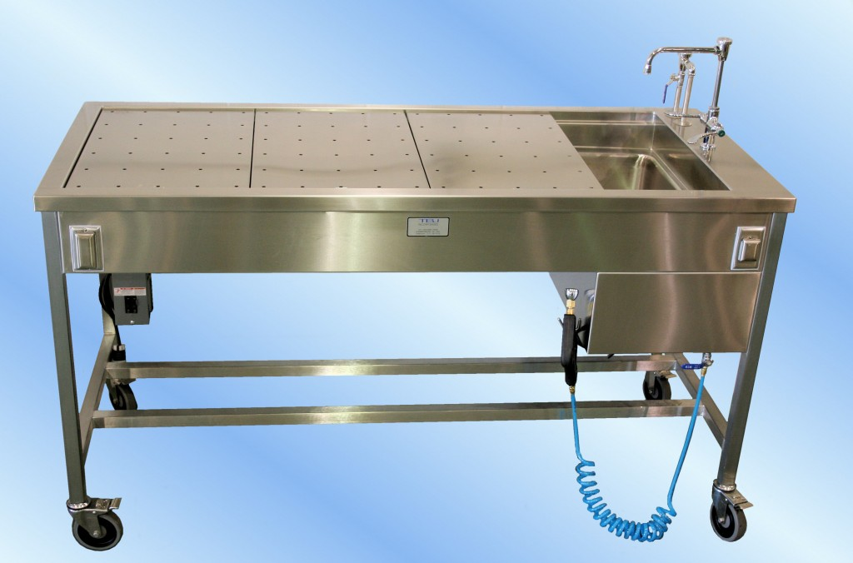
2009 – Necropsy and Biopsy
In ZIMS

Slide 2
ZIMS Updates!
This PowerPoint is up-to-date as of: August 2 2019
ZIMS is developed in an “agile” method
This means that it is updated every two weeks, sometimes with additional releases in between!
Use the link below to see if there have been any updates to this topic since the date above:
http://training.species360.org/updates/

Slide 3
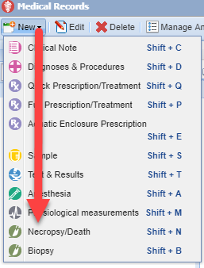
Necropsy - Getting Started
Some of the information on a Necropsy is shared between the Husbandry and the Medical modules. From the Medical Dashboard in ZIMS you can initiate a Necropsy record from the New menu dropdown or with the keyboard short cut (left). This will create an Incomplete Disposition in the Husbandry record. If a death is recorded in the Husbandry record before a Medical Necropsy is submitted, some information in the Medical Necropsy record will be prefilled (right).

Slide 4
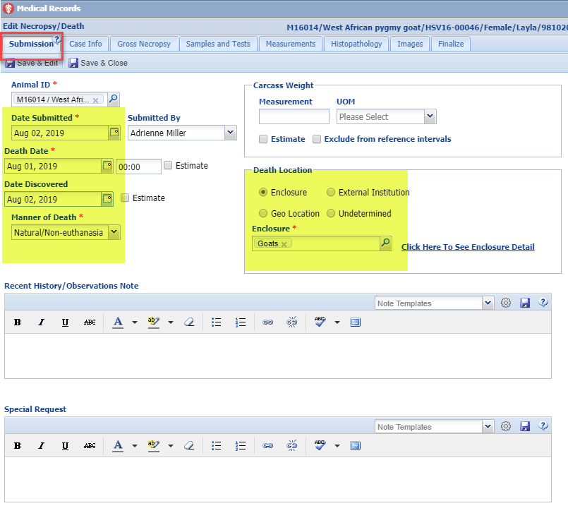
Necropsy - Submission
The Submission information tab captures the core details on the animal who has died. If a death was recorded in the Husbandry module first, the highlighted data will prefill but is editable. If a death has not yet been recorded in the Husbandry module, saving the information in this tab will create a pending death disposition event (Incomplete Disposition) in the Husbandry record. If the Necropsy is for a group record there will be a carcass count option.

Slide 5
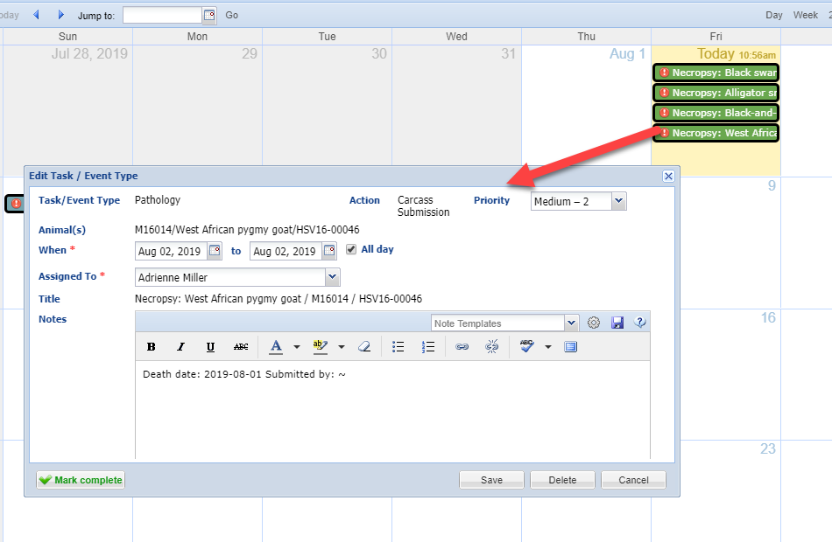
Calendar Task
When the Submission tab is saved,
an automatic Calendar Task is
added to the Calendar. You can
set the Pathologist this task is
assigned to in Institution Preferences.

Slide 6
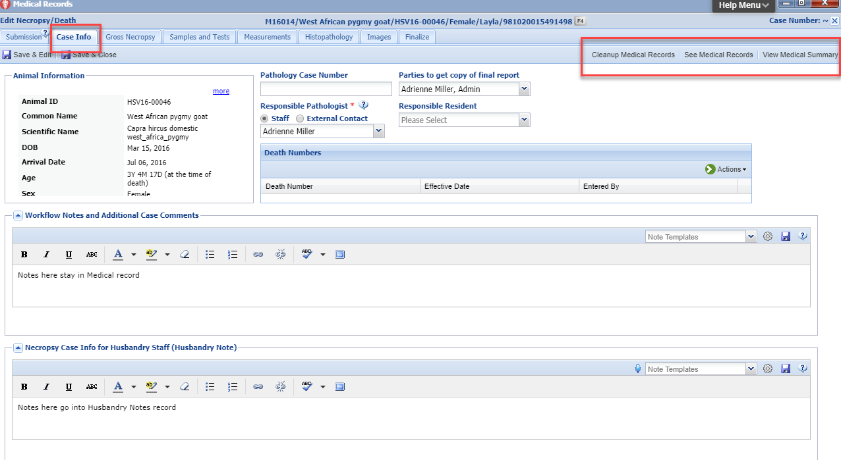
Necropsy – Case Info
Once the Submission tab is saved the remaining tabs become activated. Case Information captures the business information about the death (death number, pathology number) and additional aspects of the business processes surrounding death records. The Responsible Pathologist can be set to default in Institution Preferences. Notes entered into the Case Info for Husbandry box will be copied into the Note in the Husbandry record. You also have the options to Cleanup the Medical Record (resolve active problems, terminate active prescriptions and remove future Calendar tasks), view the Medical Records or view the Medical Summary from this screen.

Slide 7
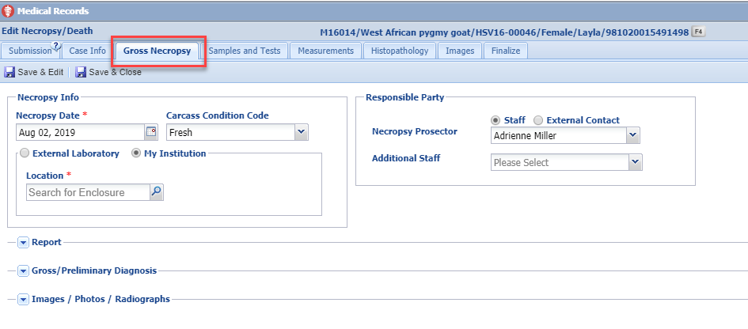
Necropsy – Gross Necropsy
The Gross Necropsy tab captures the initial details of the Necropsy. If External Contact is selected for the Responsible Party they must be entered as a Contact. If an External Lab is selected it must be entered into your Institution List. The Report is a free text field to capture the initial Necropsy findings and interpretations.

Slide 8
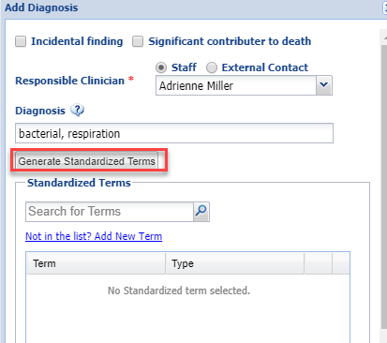
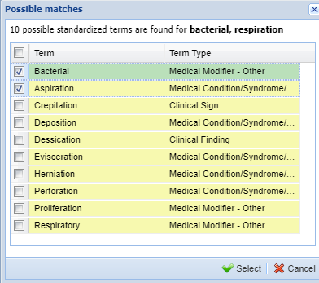
Necropsy – Gross Necropsy cont..
When adding Gross/Preliminary Diagnosis you can select if it was an Incidental finding or one that was a Significant Contributor to the death. Any marked as Incidental will not appear on the Finalize tab to select. In the Add Diagnosis screen you can type your terms (using commas in between) and then generate Standardized Terms. You can also add Local terms to the list. Both your entry and the standardized terms will display.

Slide 9
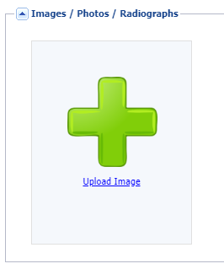
Necropsy – Gross Necropsy cont..
At the bottom you have the option to add digital copies of images/photos. These should be copies of the original files that you’d like available with the digital file and not the only/primary version of the images. The files will display under ‘Images’ tab for easy recall.
There is an institutional limit to the amount of image space available. If this limit is reached, contact support@Species360.org to discuss increasing your limit.

Slide 10
Necropsy – Samples and Tests
From the Samples and Tests tab you can create samples and request tests directly from the Necropsy module. Selecting Add Sample will open the standard Add Samples screen. Selecting Request Test will open the standard Request Test screen. Reporting any samples created during the necropsy. Samples are covered in 2005-Samples and Tests & Results are covered in 2006-Tests and Results.

Slide 11
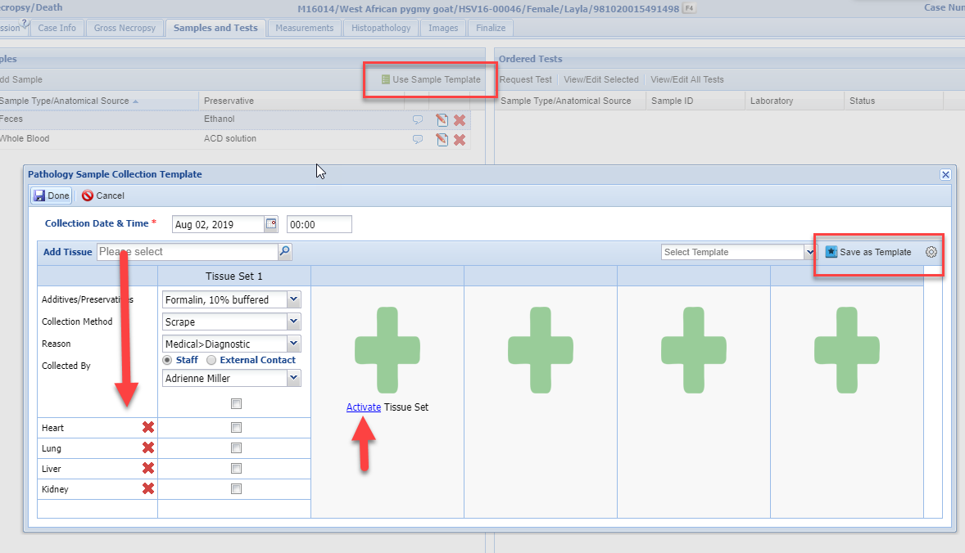
Necropsy – Samples and Tests cont..
You can save time by creating and using Sample
Templates. Enter the tissue and it will add to the
list. You can have more than one sample set if you
are using multiple types of media or multiple labs
by selecting to Activate Tissue Set. What you create
can be saved as a Template for future use.
Using Sample Template

Slide 12
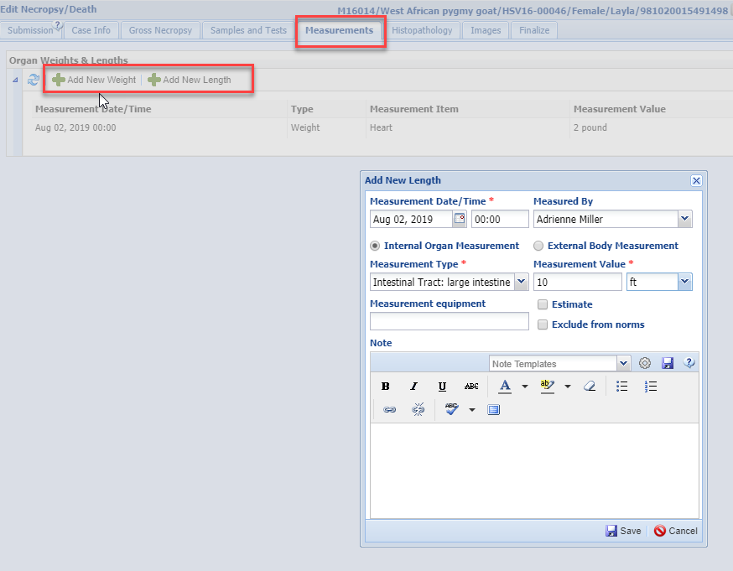
Necropsy – Measurements
The Measurements tab lets you record weights and lengths on the organs and
biomaterials included in the necropsy.

Slide 13
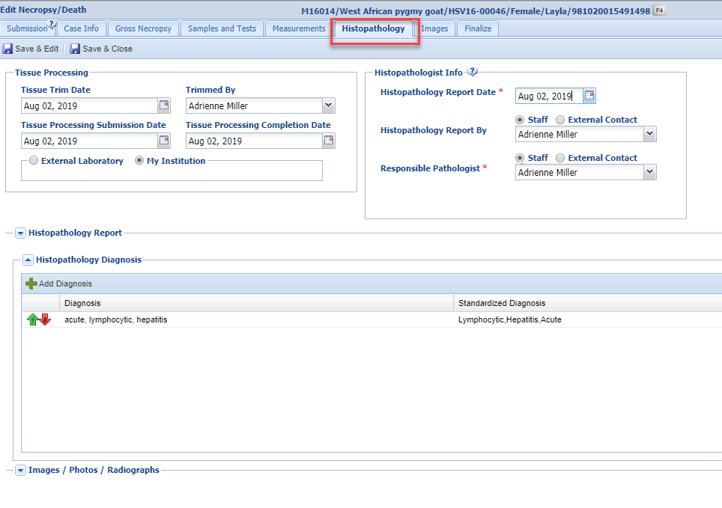
Necropsy – Histopathology
The Histopathology tab allows you to track tissue specific analysis completed in conjunction with a necropsy. If External Lab is selected it must be in your Institution List. If
External contact is selected they must be in your Contact List. The Report is a free text field.
The Diagnosis area functions just as it did in the
Gross Necropsy tab. You can also add Images here.

Slide 14
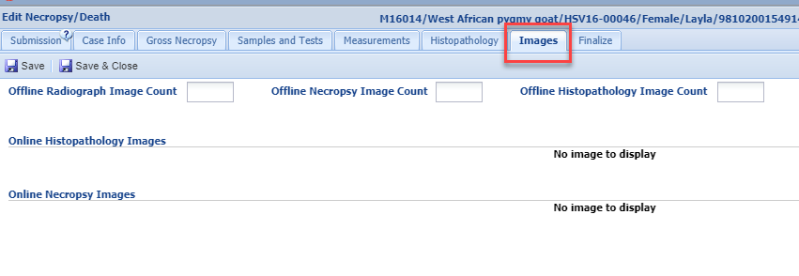
Necropsy – Images
Images added under Gross Necropsy and Histopathology tab display here, along with the ability to note the number of additional offline images that are related but not attached to the ZIMS record.

Slide 15
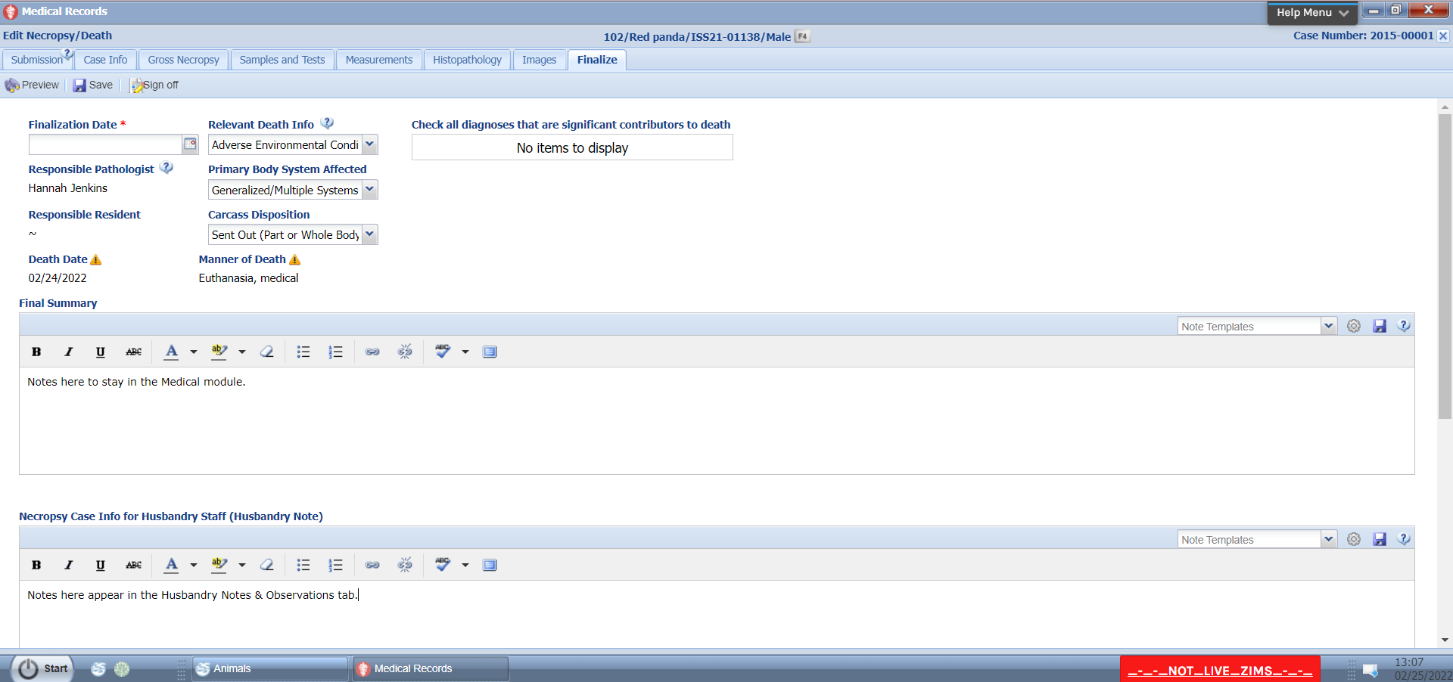
Necropsy – Finalizing Record
The Finalize tab allows you to complete the necropsy case, confirm final diagnosis and lock the record from further editing. Relevant Death Information, Primary Body System Affected and Carcass Disposition may be sourced from the Husbandry record if the death was first recorded there; both are editable. Date of Death and Manner of Death are sourced from the Submission tab and are not editable in this tab. Check any Diagnosis that were significant contributors to the death. Additionally, there are two notes grids, one called Final Summary that contains the physicians final case notes and the Necropsy Case Info for Husbandry Staff that will be visible in the Husbandry module. This is copied from the Husbandry Staff note in the Gross Necropsy tab but it can be updated.
Notes:
Required fields on this screen include:
Finalization Date.
Additional fields on this screen include:
Relevant Death information (copied from initial death report), Multiple-select grid of possible diagnosis sourced from the Gross Necropsy and Histopathology tabs offered as "Significant Contributors to Death".
Additionally, there are two notes grids, one called Final Summary that contains the physicians final case notes and the Necropsy Case Info for Husbandry Staff (R1 Note) visible in the husbandry side of ZIMS and can contain information adapted to the husbandry audience.
Finalization Notes:
-Relevant death information is filled in from death transaction if initiated on Husbandry side of ZIMS.
-Necropsy Case Info for Husbandry Staff (R1 Note) is the exact same field as offered under gross necropsy tab but it is updatable with final notes.

Slide 16
Necropsy – Finalizing the Record
Selecting the Sign Off button will lock the record. This will activate the Addendum and Audit Trail grids. Only the Medical Admin (Species360) role holder at your organization can unlock a record. The Audit Trail displays the activity of locking and unlocking the record. Once locked, no changes can be made. Notes can be added to the Addendum by anyone with access even after the record is locked.

Slide 17
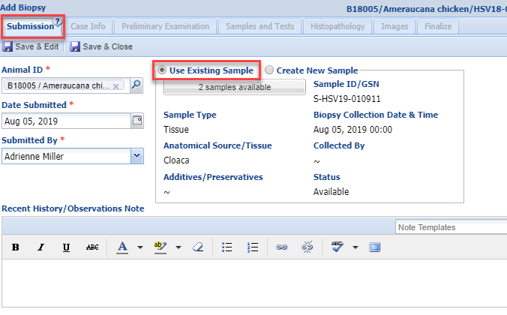
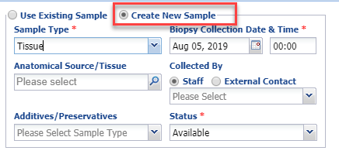
Biopsy - Submission
Similar to Necropsy, the first tab gathers information on the Submission of the Biopsy. You can use an existing Sample or create a new Sample. This screen must be completed and saved before the remaining six tabs become active.

Slide 18
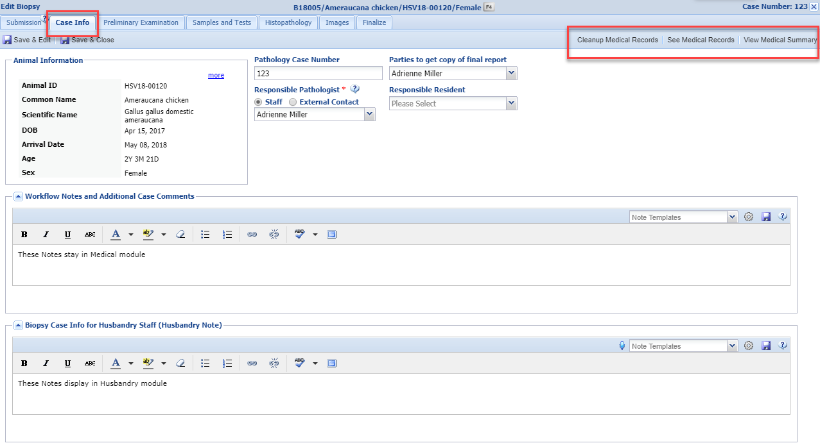
Biopsy – Case Info
The Case Information tab captures the business information about the case. The Animal information copies from the selected animal’s record. You can Cleanup Medical Records from this screen (resolve active problems, terminate active prescriptions and remove future Calendar tasks). You can also see all the Medical Records or View the Medical Summary from this screen. The Biopsy Case Info for Husbandry notes will display in the Notes section of the Husbandry module.

Slide 19
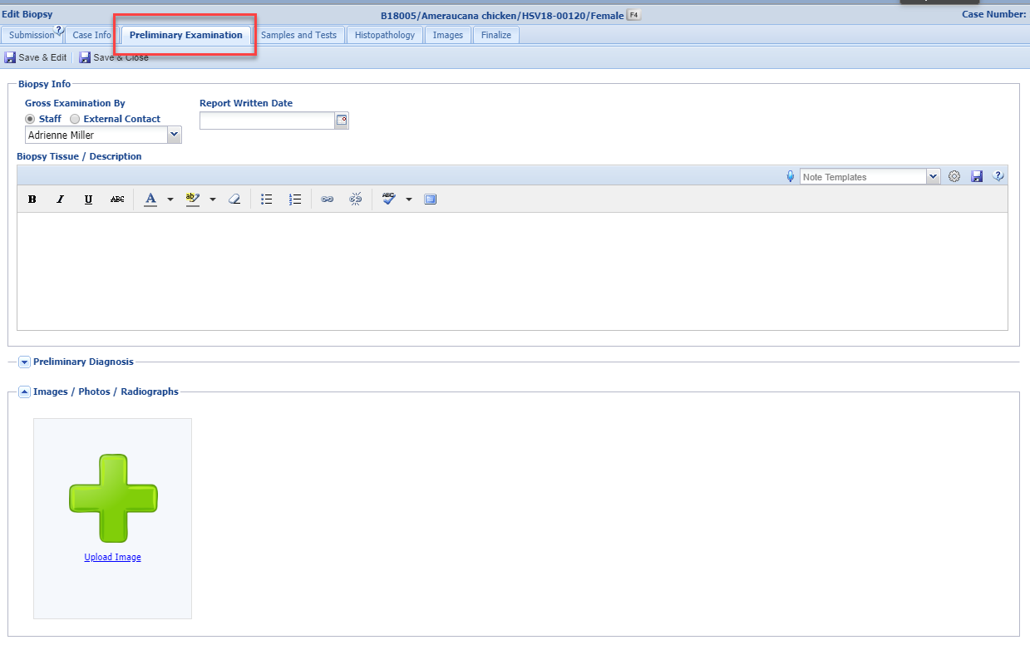
Biopsy – Preliminary Examination
The Preliminary Examination tab lets you record the initial details of the biopsy report along with possible diagnosis and interpretations. There is a free text box for recording a description of the tissue. The Preliminary Diagnosis screens allow you to enter a diagnosis as well as generate standardized terms just like the Necropsy Diagnosis. Remember to use commas between the plain text values entered to help the system in generating standardized terms for use in the diagnosis recording. Alternately, you can search the Standardized Terms for values you know to be present and select them to be added to the Diagnosis. You can upload copies of Images related to the biopsy case. Images attached here will display on the Images tab. The institutional limit to the amount of image space available applies here and if this limit is reached, contact Support@Species360.org to discuss increasing your limit.

Slide 20
Biopsy – Samples and Tests
The Samples and Tests tab allows you to record any samples taken during the biopsy. The Sample will be sourced from the Submissions tab. You can request a test(s) from the Sample by selecting the Request Test button. For more details, Samples are covered in 2005-Samples and Tests & Results are covered in 2006-Tests and Results.

Slide 21
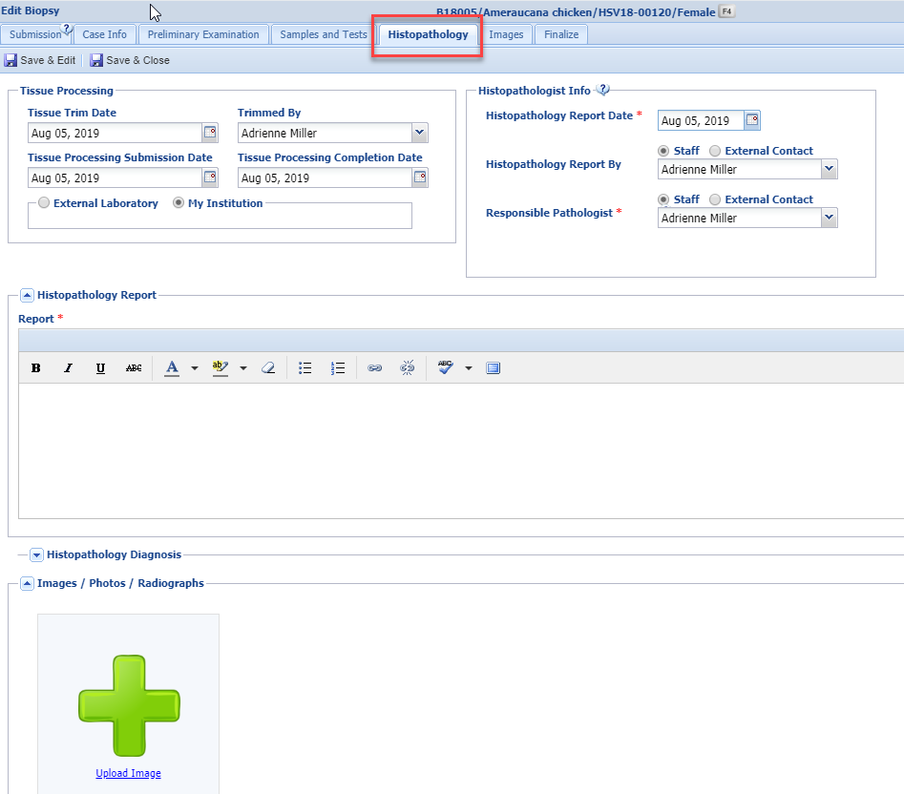
Biopsy – Histopathology
The Histopathology tab helps you track tissue specific analysis that was completed in conjunction with a biopsy report. The Report is a free text field. The Histopathology Diagnosis functions as Diagnosis does in the previous fields and allows you to record your Diagnosis and search for standard terms if desired. You can also attach Images here.

Slide 22
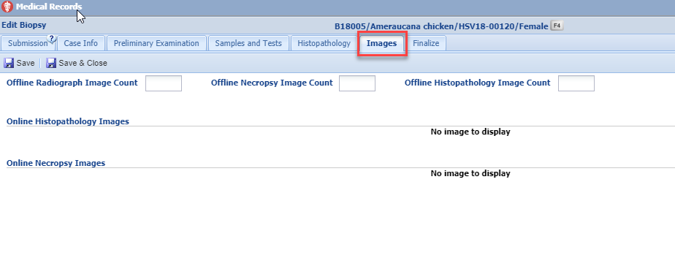
Biopsy – Images
Images added under Preliminary Examination and Histopathology tab show here, along with the ability to note the number of additional offline images that are related but not attached to the ZIMS record.

Slide 23
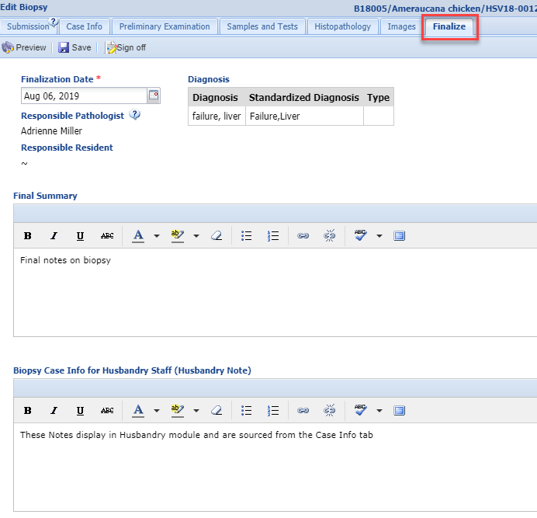
Biopsy – Finalizing Record
The Finalize tab allows you to complete the biopsy case, confirm the final diagnosis and Sign Off (protect) the record from further editing. There is a grid of related diagnosis sourced from the Preliminary Examination and Histopathology tabs. Additionally, there are two notes grids, one called Final Summary that contains the physicians final case notes and the Biopsy Case Info for Husbandry Staff which is sourced from the Case Info tab and can be updated with final notes.

Slide 24
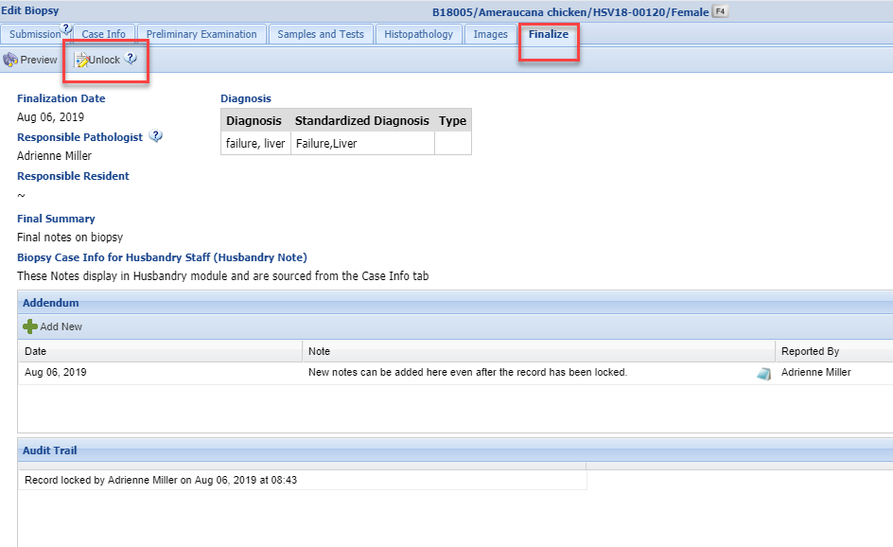
Biopsy – Finalizing Record
When you select to Sign Off on the record, all tabs and data entered are locked and cannot be edited or deleted. Signing Off activates the Addendum and Audit Trail. Notes can be added to the Addendum even after a record is locked. Unlocking a biopsy record can only occur by Medical Admin (Species360) role holders in ZIMS. The Audit Trail will show the actions of locking/unlocking along with the dates and responsible parties.

Slide 25
Necropsy and Biopsy in ZIMS
All good things come to an end…

