Slide 1
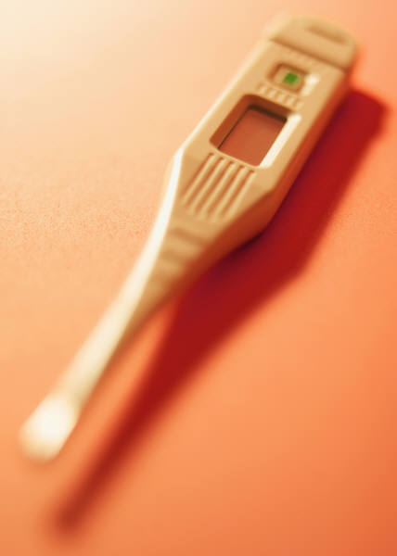
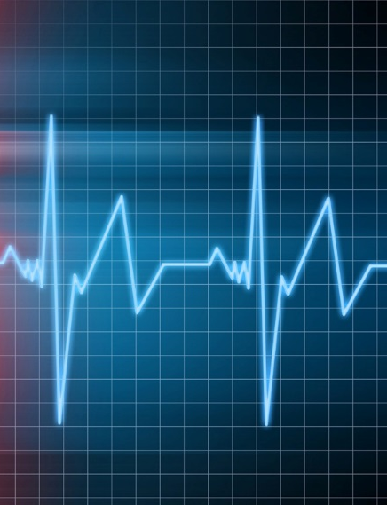
2008 Physiological Measurements
Focusing on measurements that assess the function of the major body systems

Slide 2
ZIMS Updates!
These PowerPoints are no longer updated. Last update is up-to-date as of: Jan 2025
For all topics related to Medical See:
https://training.species360.org/MedicalLibrary/

Slide 3
Measurement Types
Body temperature
Capillary refill time
Diastolic direct blood pressure
Diastolic indirect blood pressure
Diastolic indirect blood pressure
Diastolic indirect blood pressure
End tidal carbon dioxide
End tidal carbon dioxide
End tidal carbon dioxide
End tidal carbon dioxide
Heart rate
Intraocular pressure
Mean direct blood pressure
Mean indirect blood pressure
Mean indirect blood pressure
Mean indirect blood pressure
Oxygen saturation
Respiratory rate
Systolic direct blood pressure
Systolic indirect blood pressure
Systolic indirect blood pressure
Systolic indirect blood pressure

Slide 4
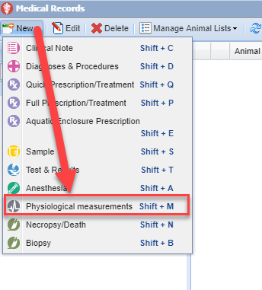
Add New Physiological Measurement
To add a new Physiological
Measurement select the New
button on the left hand side
at the top of the Dashboard.
If the animal GAN is highlighted
(in focus), the GAN will
prefill in the Animal ID field on
the next screen. If it is not you
will need to find the appropriate
animal by entering an identifier
in the Animal ID field.

Slide 5
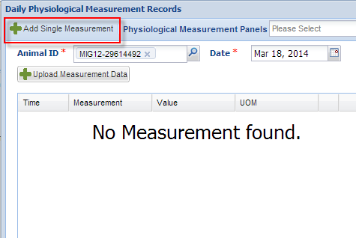
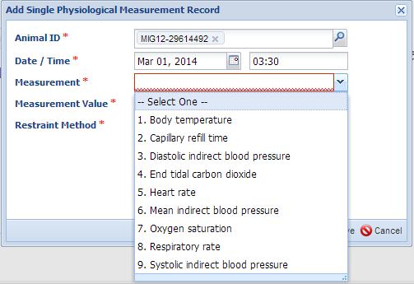
Add Single Measurement
You can add a single Physiological
Measurement by selecting the Add
Single Measurement button. If more
than one of the same measurement is
taken the same day, recording the time
becomes important. There are nine
Physiological Measurements that can
be recorded. Selecting the number will
autofill the selection.

Slide 6
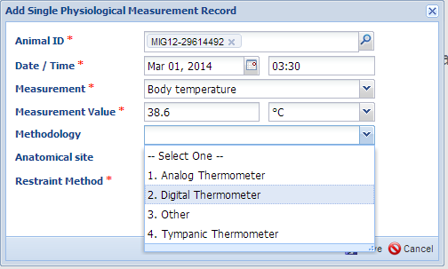
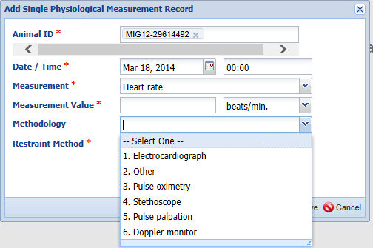
Measurement Drives Methodology
What is selected for the Measurement
field will filter what is available to select
from for the Methodology.
Here we have selected Body Temperature
so the Methodology is various types of
thermometers.
Here we have selected Heart Rate so the
Methodology is a different selection of
devices that measure heart rate.

Slide 7
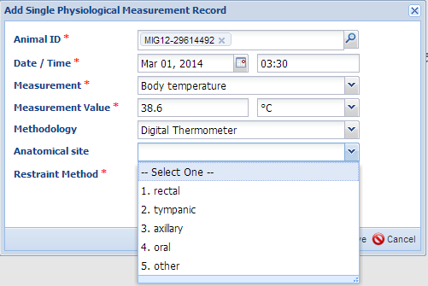
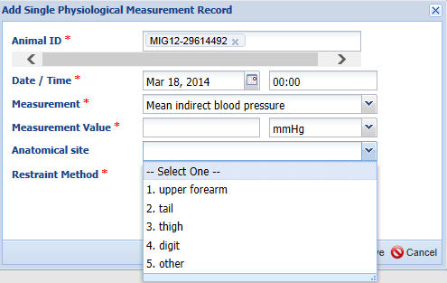
Anatomical Site
For measurements that require
noting where on the animal the
measurement was taken, a field titled
Anatomical Site is activated.
The top example is Anatomical Sites
for measuring Body Temperature.
The bottom example is Anatomical
Sites for measuring Mean Indirect
Blood Pressure.

Slide 8
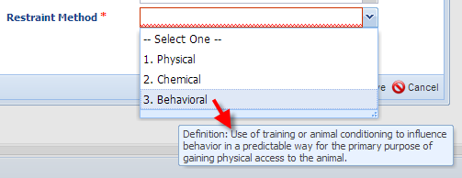
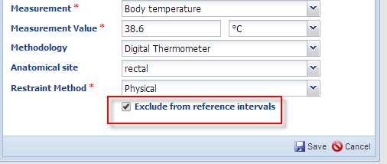
Restraint Method & Exclude
The Restraint Method field is
active for all types of measurements.
Hovering over the term will display
the definition of the method of restraint.
You also have the ability to exclude
the measurement from being
included in reference intervals that
are a compilation of data recorded in the Species360 database. The reference intervals gather information on measurements that are considered normal and various reasons may cause you to wish them to be excluded.

Slide 9
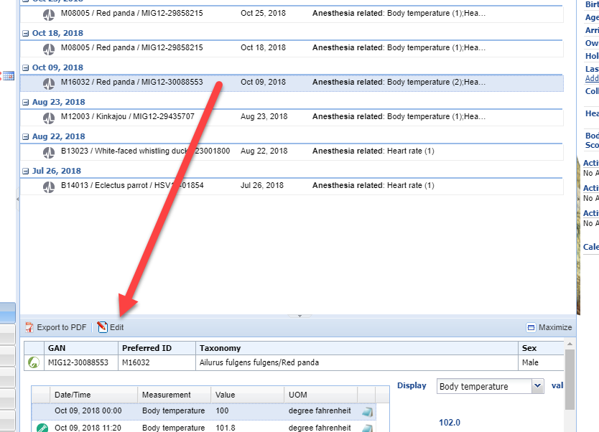
Preview Pane
To edit a record, highlight it in the Dashboard and
select Edit at the top of the Preview Pane. This is
also where you would choose to Export to pdf, or
Maximize it to view the details recorded.

Slide 10
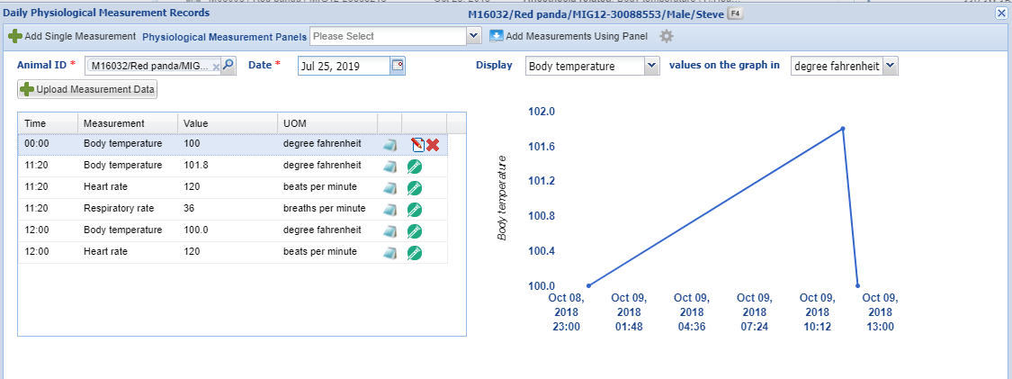
Edit From Source
To edit a record you must do so from the source of the data. The top Body Temperature
was recorded in the Physiological Measurements module, so you can edit or delete it
here. The other measurements were recorded in the Anesthesia module. Selecting the
icon will open the tab in the Anesthesia module were it was recorded and you can edit
or delete it from there.

Slide 11
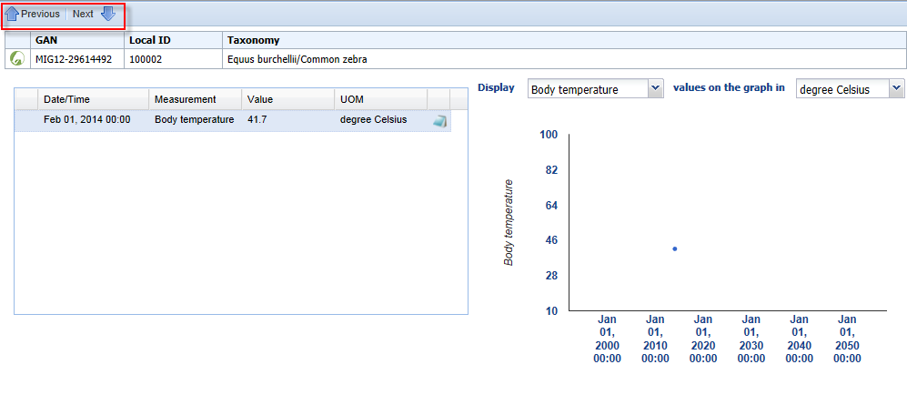
Maximized
The maximized view will display the
measurement recorded and the
measurement in a graph.
Using the Previous and Next arrows,
you can quickly move to measurements
taken on other dates.

Slide 12
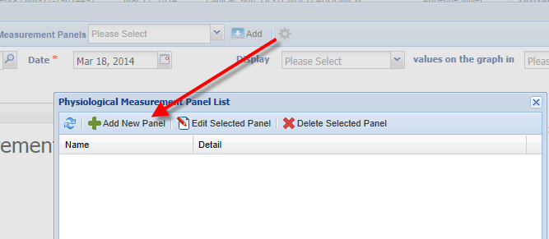
Creating a Measurement Panel
To save data entry time, you can create a Panel for
the Physiological Measurements that are commonly
recorded simultaneously. A Panel fills multiple data
fields and can create multiple records with a single
selection. Open the Add New Physiological Measurements
screen. Select the wheel icon to bring up the Panel List
screen and select Add New Panel.

Slide 13
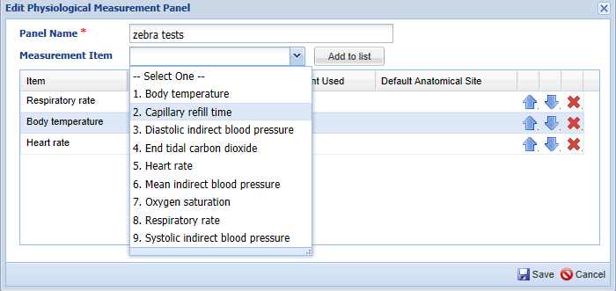
Creating a Measurement Panel
The Panel Name must be unique
within your facility.
Use the dropdown arrow to select
the Measurement Item you want
to have in the Panel. Then select the
Add to List button.

Slide 14
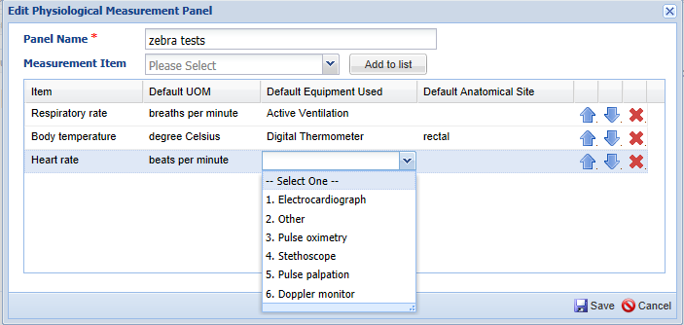
Selecting Default Information
We have selected three measurements to include in our Panel.
To select the Defaults double click in the space to bring up the
dropdown list to select the desired Default.

Slide 15
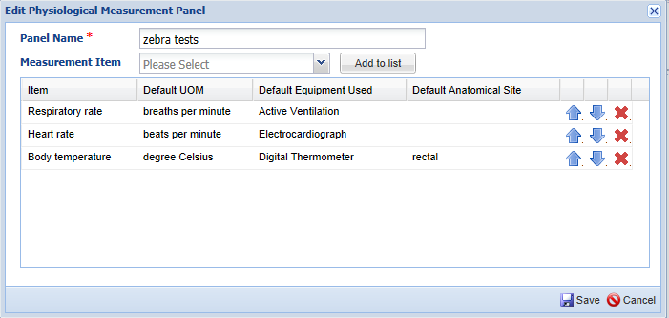
Editing the Panel
You can use the arrows to arrange the measurements
in the order that you want them to appear when using
the Panel.
To delete a measurement from the panel use the red “X”
You can add new Measurement Items anytime by selecting
the measurement and then “Add to List” button.

Slide 16
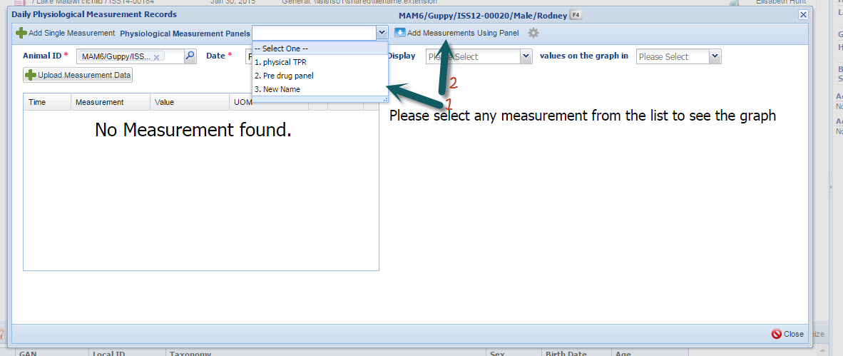
Using the Panel
To use the Panel select it from the dropdown list and then select the “Add” button

Slide 17
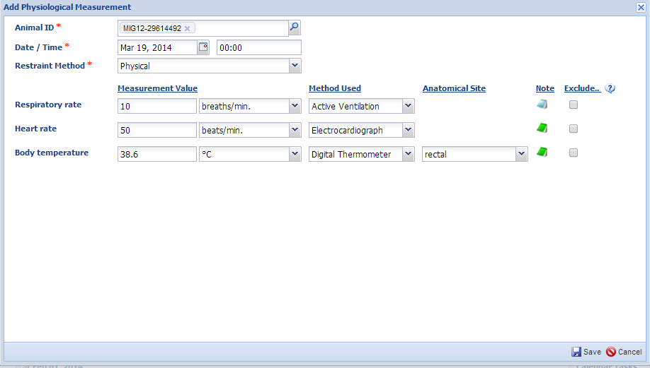
Entering the Data in a Panel
You will need to select the Restraint Method from the dropdown list and you should enter a measurement collection time. The measurements will appear in the order that you selected in the Panel. Any defaults that you selected in the Panel will prefill but they are editable. If you did not collect a measurement that is part of the Panel, you can leave the result value blank and no measurement record will be created when the rest of the Panel is saved. If you want to add notes select the Note icon. If a note has been added this icon will display as green instead of blue. We have added notes to the Heart Rate and the Body Temperature. If you do not want the measurement included in the Reference Intervals then check the Exclude box.

Slide 18
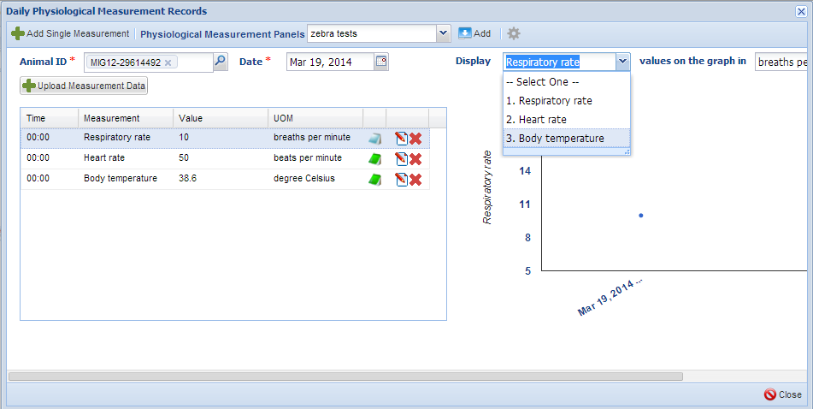
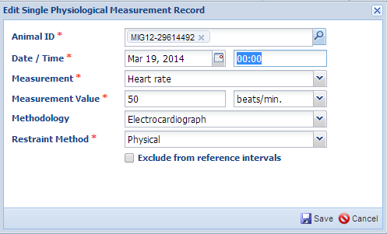
The Display
Once you Save, the information will display.
You can edit or delete individual measurements by selecting the Edit or Delete icons.
You can change what is displayed in the graph by selecting from the display dropdown which includes any measurement types recorded. You can also highlight a record in the grid on the left and the graph will switch to the measurement type of the highlighted record.

Slide 19
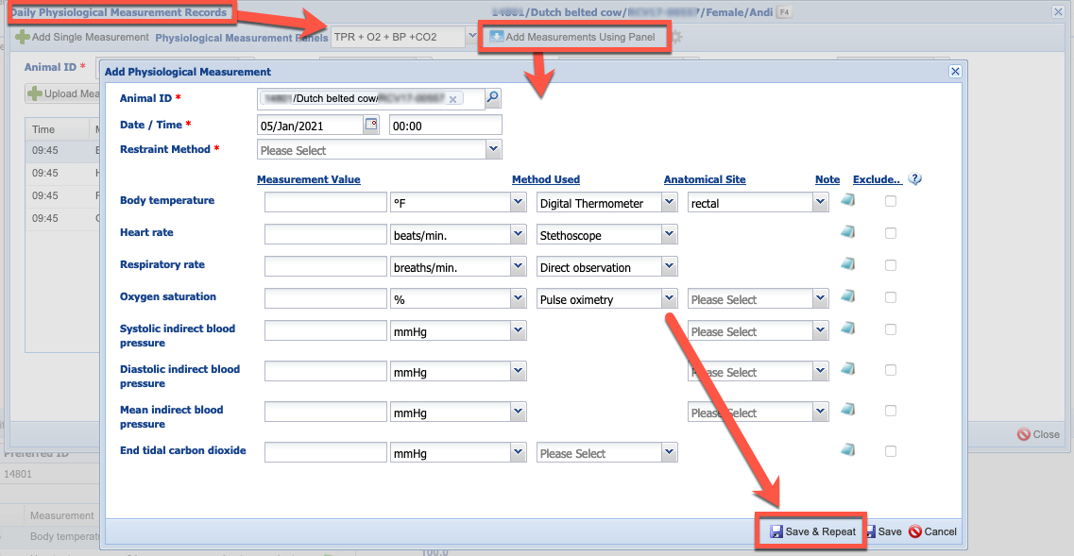
Entering Data – Save and Repeat
When entering data using the panel option from either a Physiological Measurement record or from the Physiological Measurements tab on a Clinical Note or in an Anesthesia record, you will be presented with a Save and Repeat option.

Slide 20
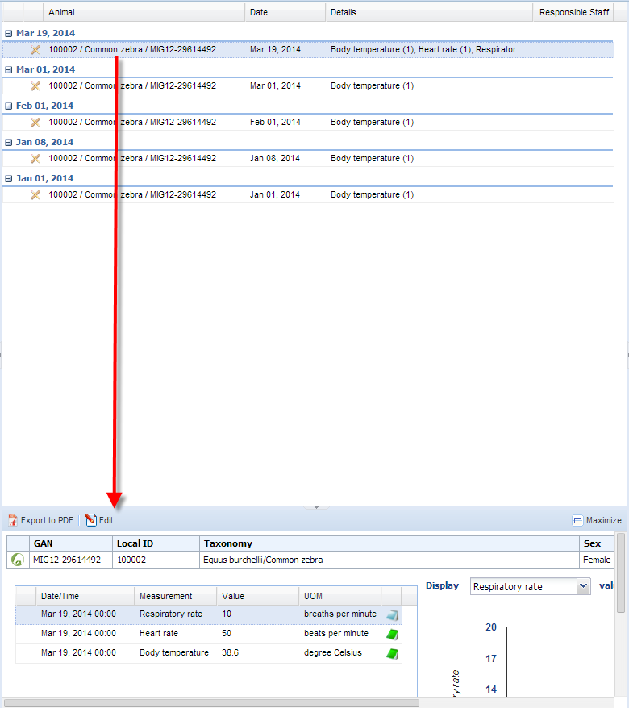
Dashboard Display
The measurements recorded using a Panel will
display in the Dashboard just as single measurements
will display. Highlighting the record will open up the
Preview box at the bottom where you will see all
the measurements taken.

Slide 21
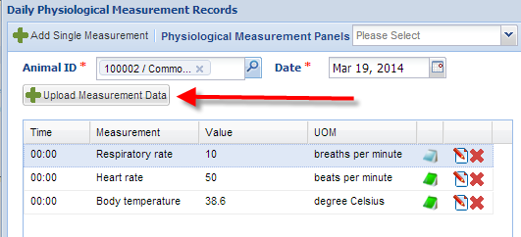
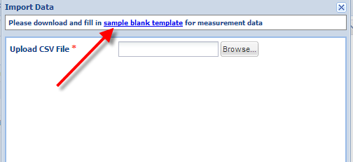
Upload Measurement Data
If you have measurement
data recorded in an Excel
file or you would prefer to
have staff enter data into an
Excel file, you can upload
it into the animal record.
Select the Upload Measurement
Data button.
You will then need to download
a sample blank template. You
can save this template somewhere
so you do not need to download
it every time.

Slide 22
The Excel File
The download will look like the top grid. You will need to complete
it using the terms as they are found in ZIMS. You can make template
files where only the date and measurement value need to be entered.
Make sure the date is entered in the format that is your default date entry
format for ZIMS. Save this file.

Slide 23
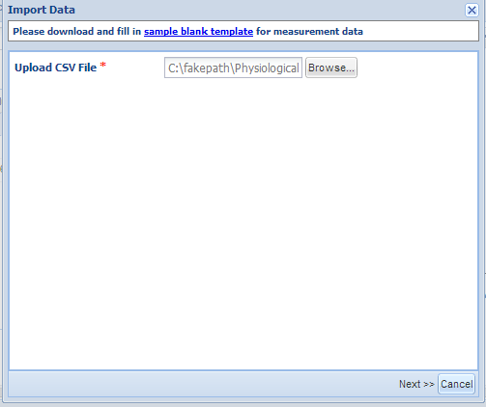
Find the File
You will then browse to the appropriate file and select it.
Then select the Next button.

Slide 24
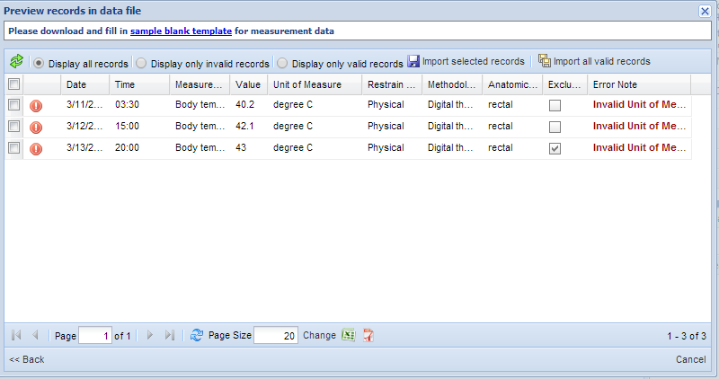
Invalid Information
If any of the information is Invalid, that is it does not match what is in ZIMS, the entry will be marked with a red “!”.
Details about what is invalid will display under the Error Note column.
In this example we have Invalid Units of Measure.

Slide 25
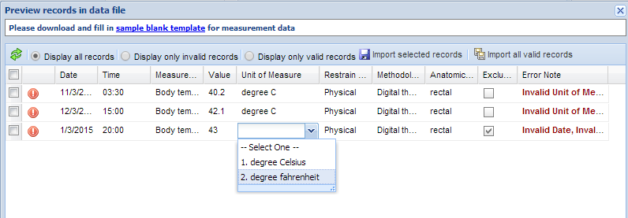
Correcting Invalid Entries
To correct the invalid entries simply click on the entry and the valid
information will appear in the dropdown list where it can be selected.

Slide 26
Selecting What to Import
Once you have corrected your entries the red “!” will turn into a green check. You may need to refresh the grid. You can also choose to display all records, display only invalid records or display only valid records by selecting the appropriate radio button above the grid. If you want to import only some of the records you can check the boxes to the left of the entry for those that you want to enter and select Import Selected Records. If you want to import all of your valid records you can select to Import All Valid Records.

Slide 27
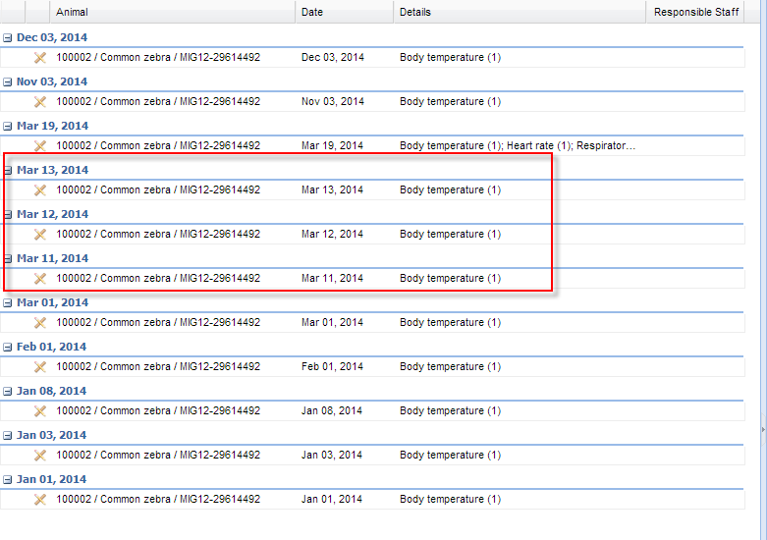
Display in the Record
The imported data
will display within
the record.

Slide 28
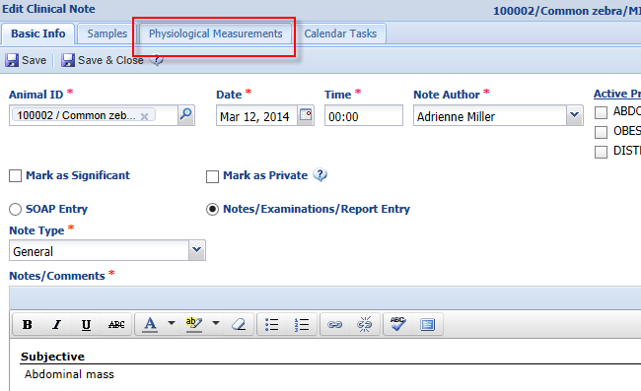
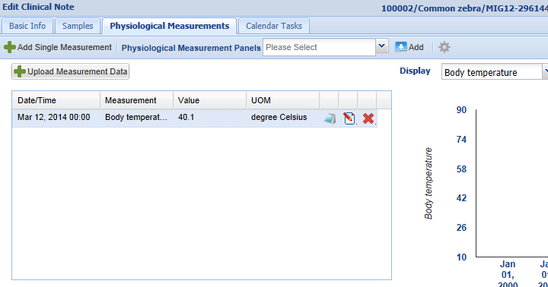
Measurements from Clinical Notes
You can also record Physiological Measurements
directly from the Clinical Notes screen. Once a
Clinical Note has been generated, the Physiological
Measurements tab becomes active and selecting it
will take you to the standard data entry screen for your
measurements where you can add a single entry or
use a Panel.

Slide 29
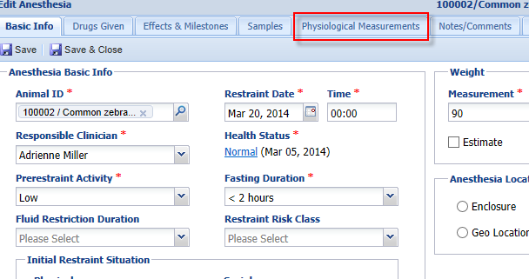
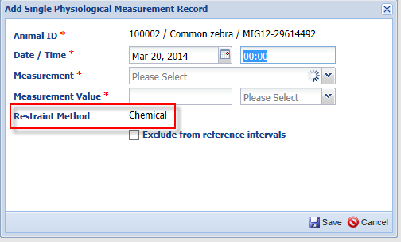
Measurements from Anesthesia
In addition, you can record Physiological Measurements from the Anesthesia screen. Once an anesthesia record is generated the
Physiological Measurements tab becomes active. The difference here is that the Restraint Method field is not activate and is pre-filled
with Chemical restraint and cannot be edited.

Slide 30
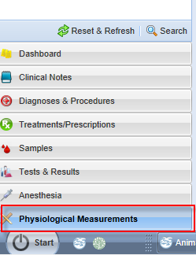
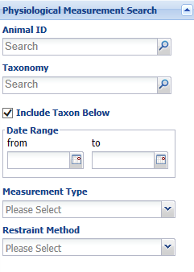
Searching for Physiological Measurements
Selecting Physiological Measurements from the lower left panel will open a screen where you can search for measurements recorded. There is no Simple or Advanced search options as some other searches provide.

Slide 31
Physiological Measurements
Monitoring the health of our animals

