Slide 1
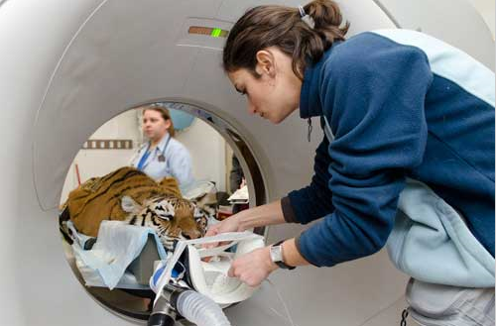
2007 - Anesthesia
In ZIMS

Slide 2
ZIMS Updates!
This PowerPoint is up-to-date as of: August 1 2019
ZIMS is developed in an “agile” method
This means that it is updated every two weeks, sometimes with additional releases in between!
Use the link below to see if there have been any updates to this topic since the date above:
http://training.species360.org/updates/

Slide 3
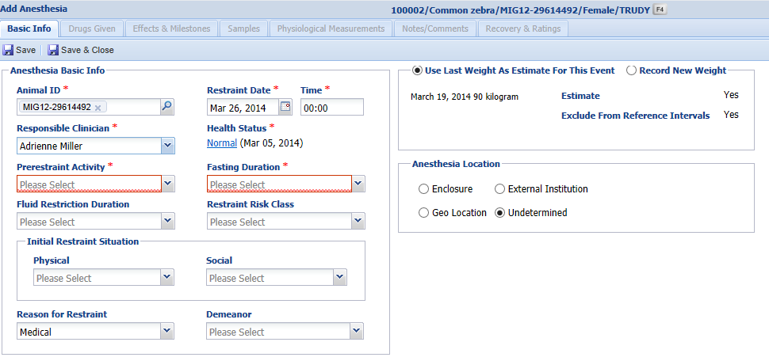
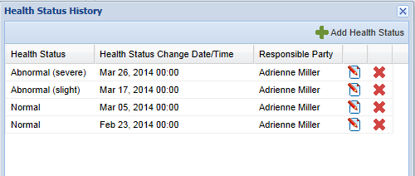
Basic Info
There are seven tabs associated with the Anesthesia module. The Basic Information screen must be completed and saved before the remaining tabs become active. The first seven fields are mandatory, the remaining fields are optional. In this module the time is a mandatory field where it is not in other modules. The Health Status is a hyperlink that will take you to a screen to view the Health Status History or Add/Edit or Remove a Health Status.

Slide 4
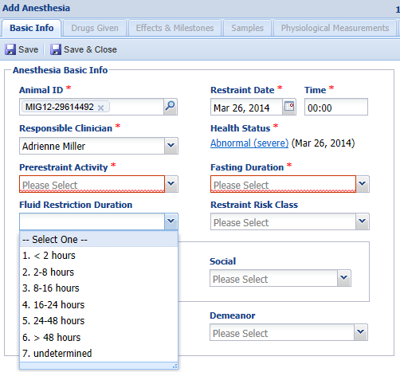
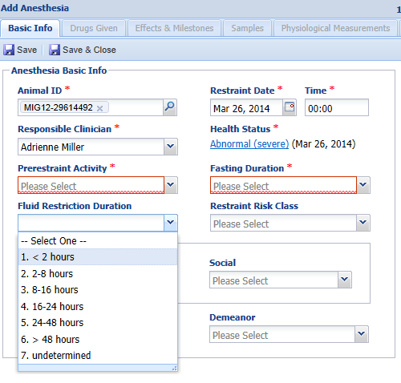
Basic Info
The remaining fields on the left side are data standard lists to
select appropriate terms from.

Slide 5
Basic Info - Weight
You have two options for the weight of the animal. If a weight has previously been recorded on the animal it will display. If Use Last Weight as Estimate For This Event is selected then that weight will be used. However, if you check the Record New Weight radio button then a new weight can be recorded for the anesthesia event. If there is no previous weight recorded you are required to record a new weight. Remember to check the Estimate box and the Exclude button if appropriate. This weight will be copied over into the Husbandry weight grid but it can only be edited from the Anesthesia module.

Slide 6
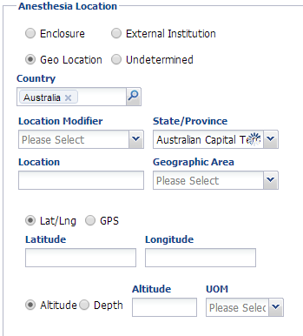
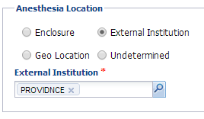
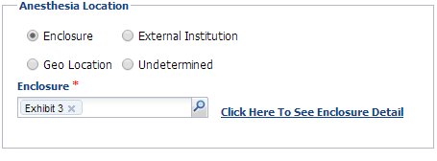
Basic Info – Anesthesia Location
You have three options for recording where the anesthesia event took place. If you select
Enclosure you will record the enclosure at your institution where the anesthesia occurred.
Click Here To See Enclosure Detail is a hyperlink to the enclosure record. External Institution
means that the event took place outside of your facility. This is sourced from the Institution
list so if you commonly use other facilities such as a local Veterinary office you may want to
add them to your Local Institution list. Using the Geo Location can be very helpful for field
immobilizations especially where GPS data is available. If you do not know where the anesthesia
occurred, select Undetermined.

Slide 7
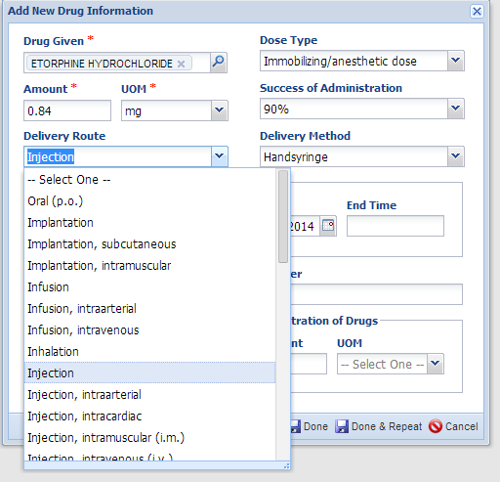
Drugs Given
Once the Basic Info information is saved, the remaining tabs become active.
The only mandatory fields in the Add New Drug Information are the drug,
amount, UOM and the administration times. The Drug Given is a
type ahead lookup or you can search for it using the magnifying glass
lookup. Most of the fields are data standard dropdown lists. The Delivery
Method is filtered by what you selected in the Delivery Route field.

Slide 8
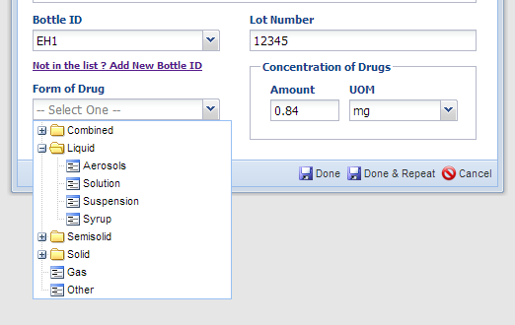
Drugs Given
The Bottle ID is sourced from your drug inventory and is not a mandatory field. The Lot Number will source from that inventory information and will prefill when the Bottle ID is entered. You can add a new Bottle ID to your inventory directly from this screen using the hyperlink to Add New Bottle ID. Bottle ID and inventory control will assist with reporting for regulated anesthetic drugs. The Form of Drug is a cascading dropdown to select from. The Form of Drug and Concentration of Drug may pre-fill from the drug dictionary, depending on the entry selected. If you are finished recording the drugs used select Done. If you want to add more drugs associated with the anesthesia event select Done & Repeat.

Slide 9
Done & Repeat
If you select Done & Repeat the information you recorded on the first drug entry
will prefill except for Bottle ID, Lot Number and Concentration. All fields are editable
and here we recorded a new drug and amount.

Slide 10
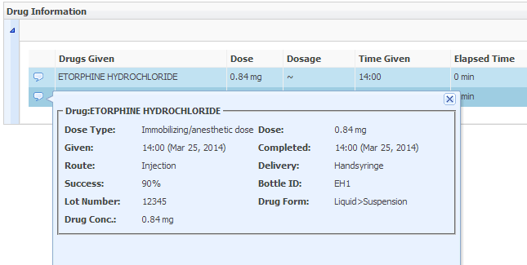
Drug Information Grid
The drug information will display in a grid where you can Copy, Edit or Delete the drug entry. You can also Add New drugs from here. Alt-A shortcut key to Add New Drug is available. Double clicking on the notebook icon allows you to enter a related note.
Hovering over the pop out will display additional details regarding the drug entry.

Slide 11
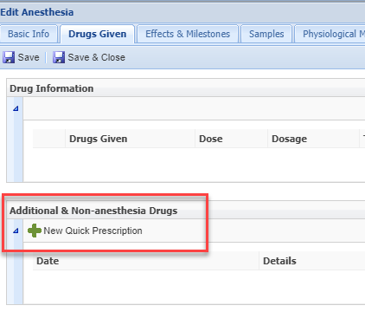
Additional & Non-anesthesia Drugs
Underneath the Drug Information grid
is a grid to add any additional drugs
given during the Anesthesia that were
NOT anesthesia drugs. This is a Quick
Prescription option only – a one and
done – such as a vaccination or
deworming treatment.

Slide 12
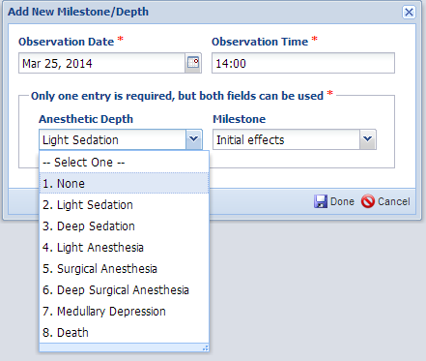
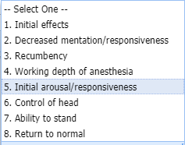
Effects & Milestones
The Effects & Milestones tab allows you to track the reaction to the anesthesia event and the recovery. Whereas the Anesthetic Depth can be selected multiple times, a Milestone can only be selected once for each anesthesia event.

Slide 13
Effects & Milestones Grid
The entries will display in a grid where you can Edit or Delete them
or Add New entries. Double clicking on the notebook icon allows you
to record a related note. If a note is recorded the notebook icon will
display as green instead of blue.

Slide 14
Samples and Physiological Measurements
The next two tabs allow you to record Samples and
Physiological Measurements directly in the Anesthesia
module.
For details on how to record these, Samples are covered
in session 2005 – Samples. Physiological Measurements
are covered in session 2008 – Physiological Measurements.

Slide 15
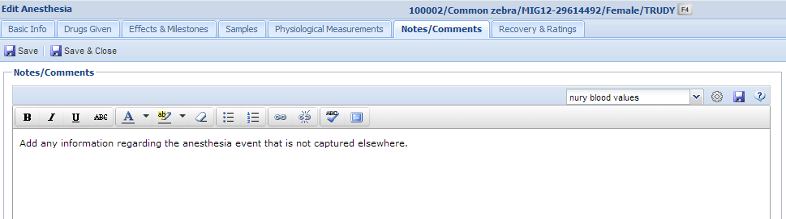
Notes/Comments
The Notes/Comments tab allows you to record any additional information
that has not been captured elsewhere, or to provide more details
regarding the anesthesia. A SOAP note entry is not available here, it is
strictly an open free text box. If you have created any Anesthesia specific
Note Templates they are available for use here.

Slide 16
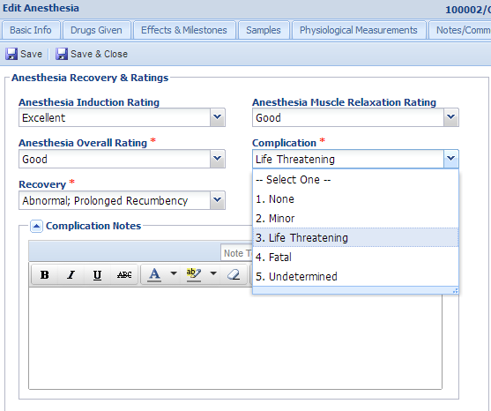
Recovery & Ratings
The Recovery and Ratings tab gathers details on the recovery from anesthesia and the overall rating of the event. The fields are mainly data standard
dropdown lists.

Slide 17
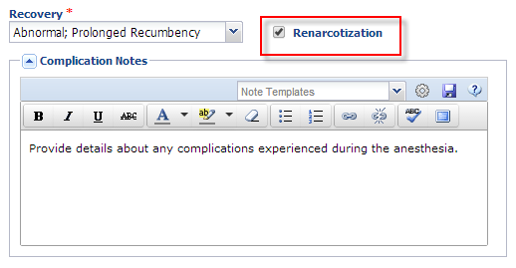
Complications
If renarcotization occurs check the box. You can expand the
Complications Notes field to record details regarding any
complications during the anesthesia event such as seizures,
vomiting, apnea, etc.

Slide 18
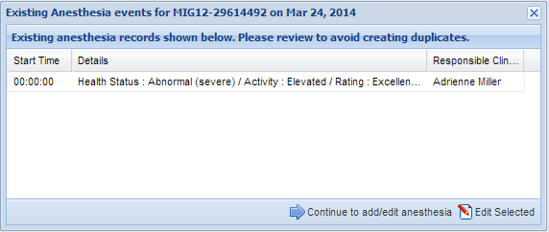
Existing Records
If you have an existing anesthesia record on an animal and you try to
enter a new one on the same date as the existing record you will receive
the message above. This is to help stop the creation of duplicated records.
Selecting to Continue to Add/Edit Anesthesia will open the screen where
you can create a new anesthesia event. If you select Edit Selected it will
take you into the existing record for further additions or edits.

Slide 19
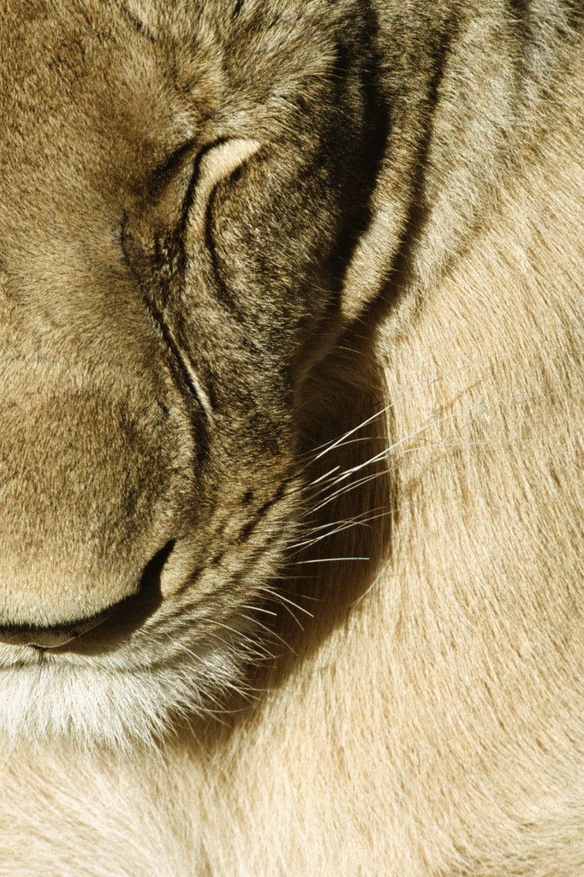
Anesthesia in ZIMS
Feeling sleepy…….

