Slide 1
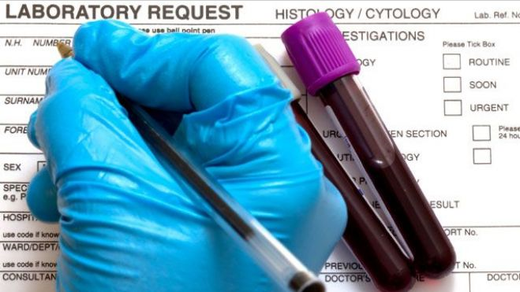
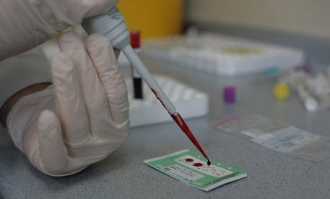
2006 - Tests & Results

Slide 2
ZIMS Updates!
This PowerPoint is up-to-date as of: July 24 2019
ZIMS is developed in an “agile” method
This means that it is updated every two weeks, sometimes with additional releases in between!
Use the link below to see if there have been any updates to this topic since the date above:
http://training.species360.org/updates/

Slide 3
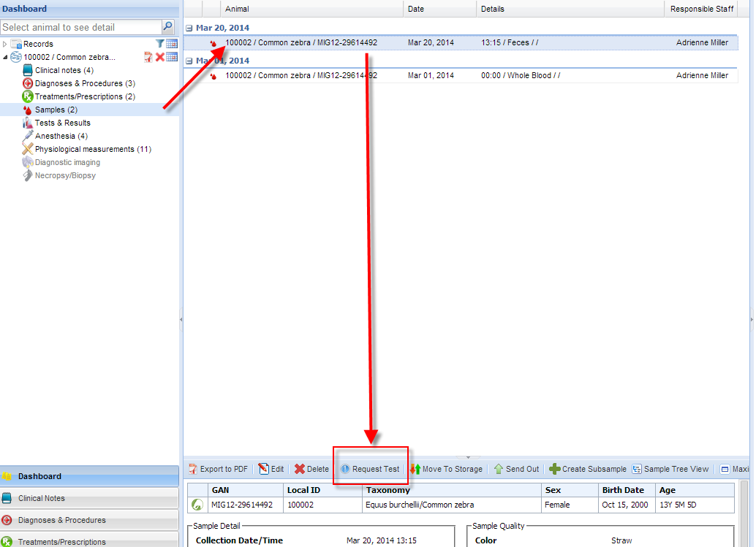
Request Test From Record
There are two ways to request tests on your samples.
The first is from within the animal medical record. Select Samples from the left side dashboard, highlight the appropriate Sample on the main screen and select Request Test.

Slide 4
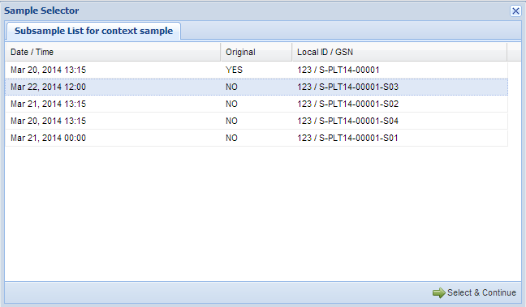
Select Sample
If Subsamples have been created from the original Sample the grid
will display them. Highlight the appropriate Sample and then
Select and Continue. This will take you to the Test Request screen.

Slide 5
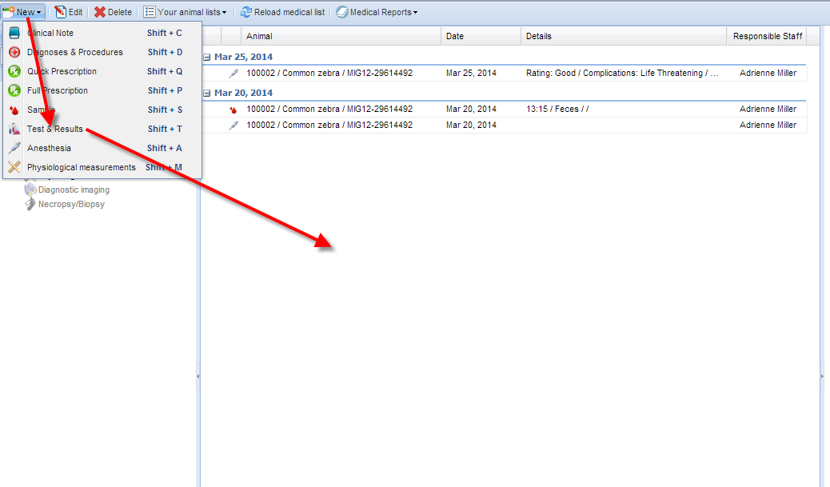
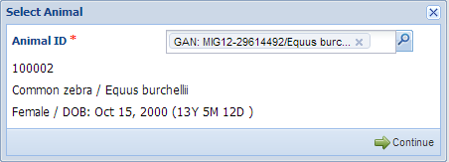
Request Test From Dashboard
The second way is to start from the Dashboard. Select New then Tests & Results. The application will ask you to select the animal. Once selected some details will appear to confirm you have the correct animal.

Slide 6
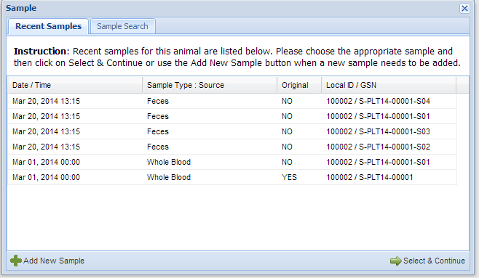
Selecting the Sample
A list of recently recorded samples will appear. If one of these
is the correct sample highlight it and choose Select & Continue.

Slide 7
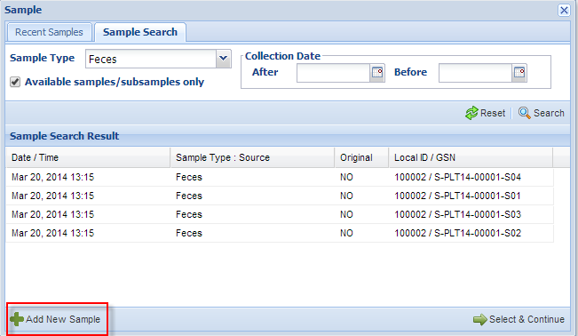
Sample Search
If the appropriate sample does not appear in the Recent Samples tab you can select the Sample Search tab where you can search by Sample Type and Collection Date. Checking the Available Samples/Subsamples Only box will leave out any Samples whose status is Consumed, Discarded or Lost. You can also Add New Sample from either tab. Highlighting the sample and choosing Select & Continue or adding a new sample will take you to the Test Request screen.

Slide 8
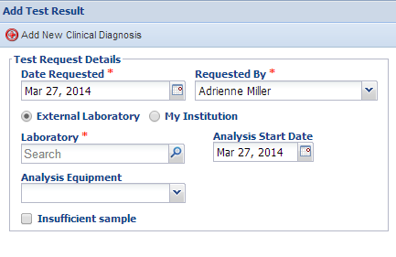
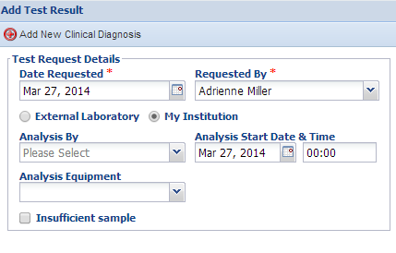
Test Request Details
If External Laboratory is
checked there is a field
to record what laboratory
it was. This is sourced from
the Institution List so if there
is a lab you commonly use
you may want to add it to
your Local Institution list.
If My Institution is checked
there is a field to record who
did the analysis. This is
sourced from your Staff list.

Slide 9
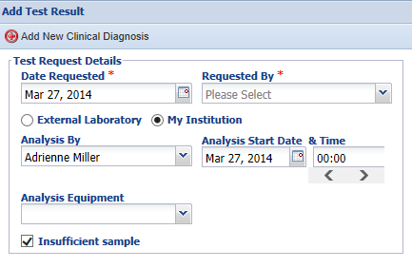
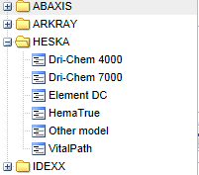
Test Request Details
The Analysis Equipment is not
mandatory and is a cascading
dropdown.
If the sample is too small to
actually test check the
Insufficient Sample box.

Slide 10
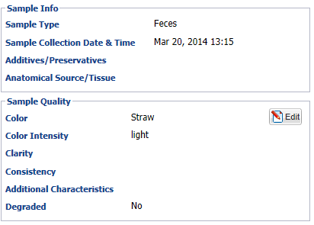
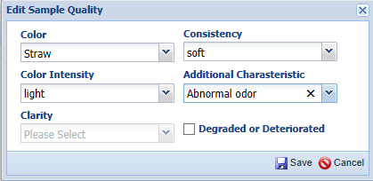
Sample Info and Quality
The Sample Info is not editable and is
only for information. However, since
the Sample Quality may have altered
since collection that data is editable
and will update the record if changed.

Slide 11
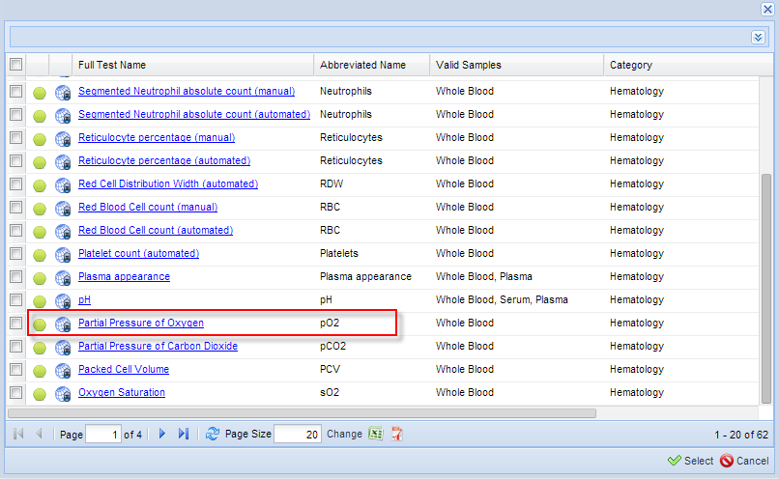
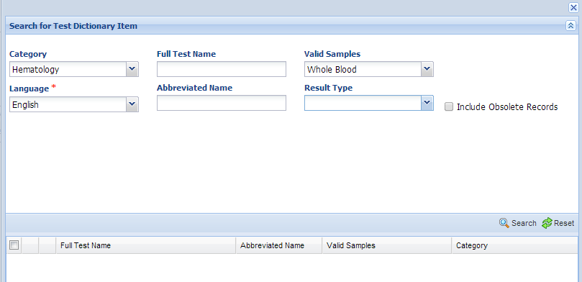
Add New Test
To add a new test you can type into the
Add New Test field if you know the name
of the test you want performed. Or you
can use the magnifying glass lookup to
search for it and select from the results grid.

Slide 12
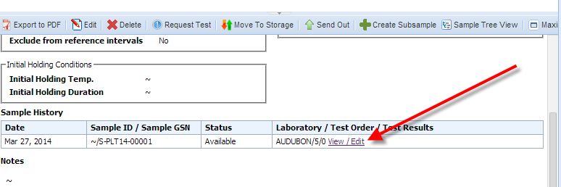
Add New Test
You can continue adding new tests until you have all that are desired. Selecting the
View/Edit hyperlink will take you back to the Test screen where you can add more
tests, remove a test or add Test Results.

Slide 13
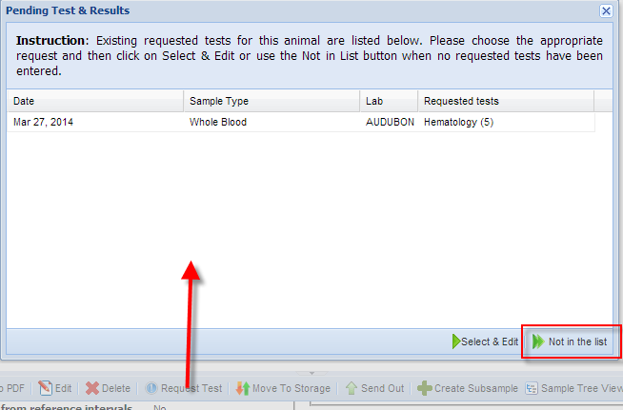
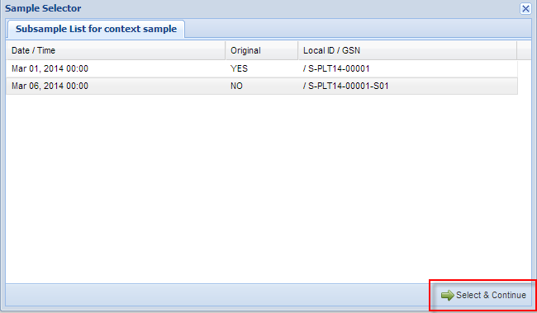
Add Tests for Subsamples
Another way to edit the original
Test Request is to select Request
Test again. Samples with existing tests will be listed and you can select and edit. If the sample is not on the list, for example a Subsample you have not yet created, then select Not in the List
and it will take you to a screen to add it.
The grid will display all samples and you can highlight the correct
sample and Select Continue.

Slide 14
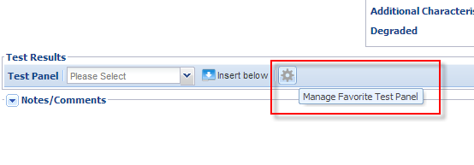
Test Panels
To save data entry time you can
use Test Panels by selecting
Manage Favorite Test Panel. The plan is to have commonly used Test Panels preloaded to
select from.
You can also create your own Test Panels by selecting Add
New Panel.

Slide 15
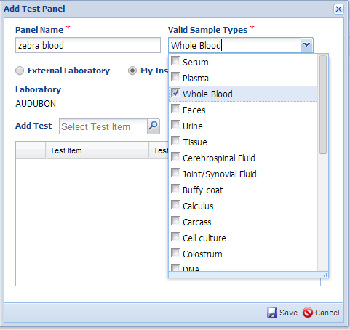
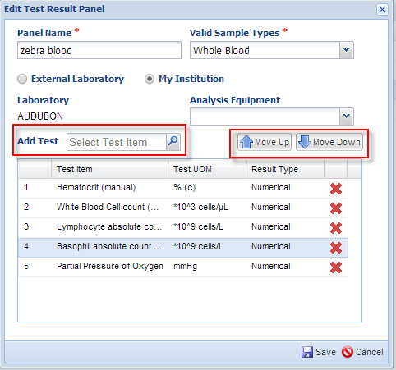
Add New Test Panel
The Panel Name must be unique within your facility. The Valid Sample Type is a multiple select dropdown that allows you to select more than one type. You
are also able to select an external laboratory or your institution to run the test. What you select here (External Laboratory or My Institution) must match what you select when you request a test or the Test Panel will not display in the list to select from.
Add the tests you want on the panel either by typing them into the Add Test field or using the magnifying lookup to search for them.
Arrange the tests in the order that you will want to record the data by using the Up and Down arrows above the list.

Slide 16
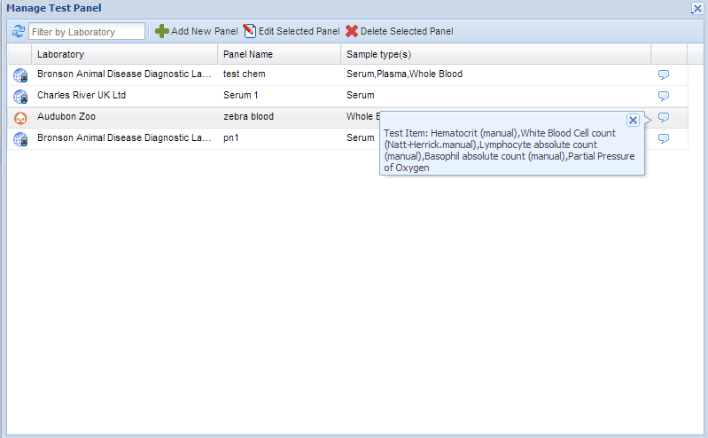
Viewing the Test Panels
In the Manage Test Panel grid, hovering over the right hand side
pop out will display what tests you have created for that Panel.

Slide 17
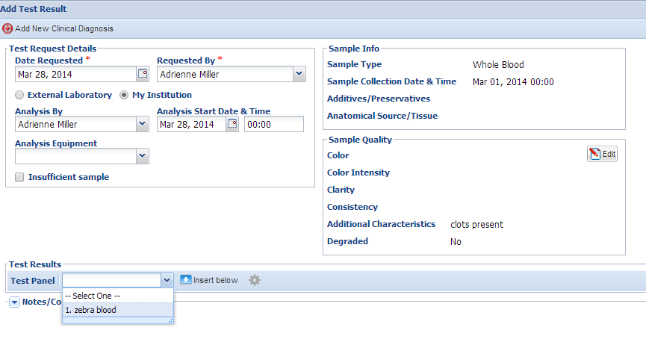
Using the Test Panels
To use the Test Panel select the appropriate sample and complete the
mandatory fields in the Test Request Details. Select the desired Test Panel
from the drop down. Then select Insert Below.

Slide 18
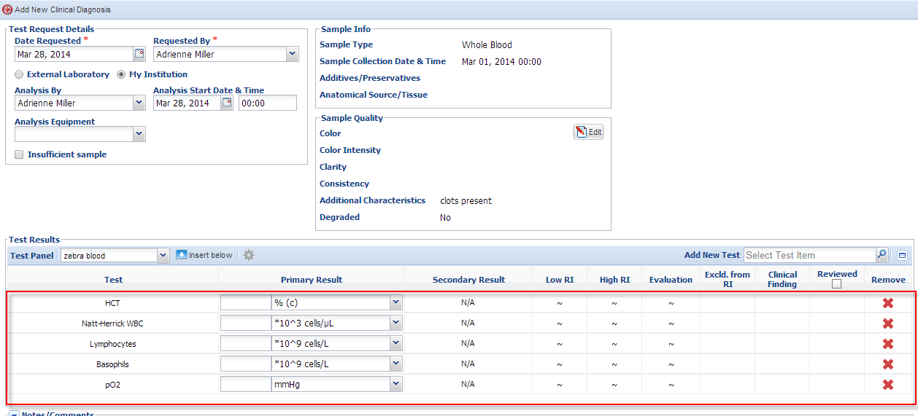
Panel Inserted
The tests you have recorded for your panel will display in the
order that you arranged them in the Test Panel you created.

Slide 19
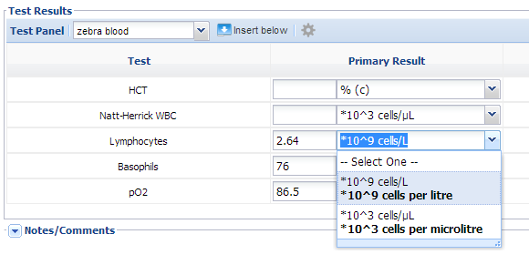
Recording the Test Results
Record the test results. If the default Unit of Measure is not what you desire it to be you can use the dropdown selections to choose the appropriate one. If you do not intend to fill in data for a specific test in a panel being used, remove the record row. Failing to do so will leave this record 'stuck' in the workflow until a valid result is entered or the test type row is removed.

Slide 20
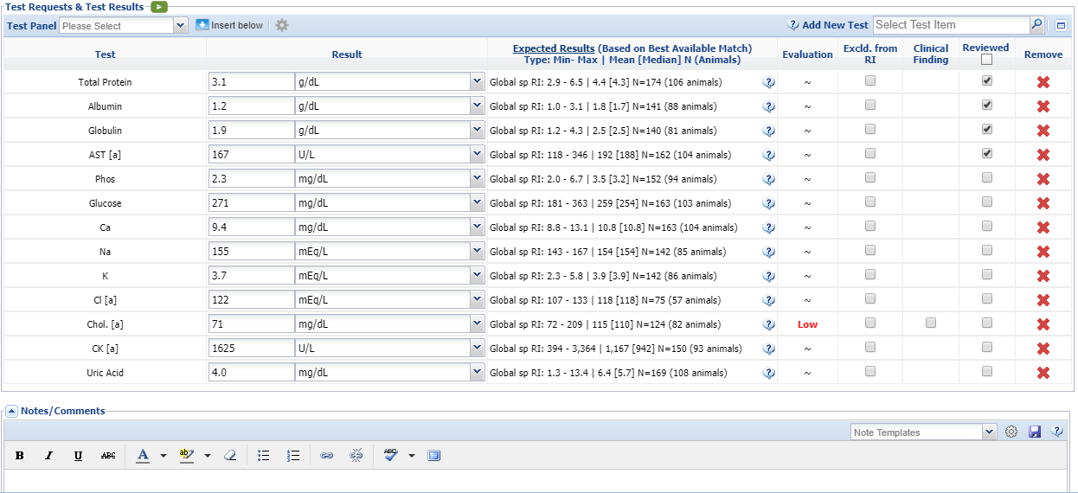
Test Results Grid
Once the results are reviewed you can check the Reviewed checkbox. You can also remove the test from the grid if you wish. Use Notes/Comments to record any data not gathered elsewhere or to clarify any data that may need further explanation. If a bacterial culture test yields a bacterial name, the Secondary Results column becomes active and you can indicate the measure of growth obtained. The Global Expected Results will display and the Evaluation column will indicate is your results are within
those expected.

Slide 21
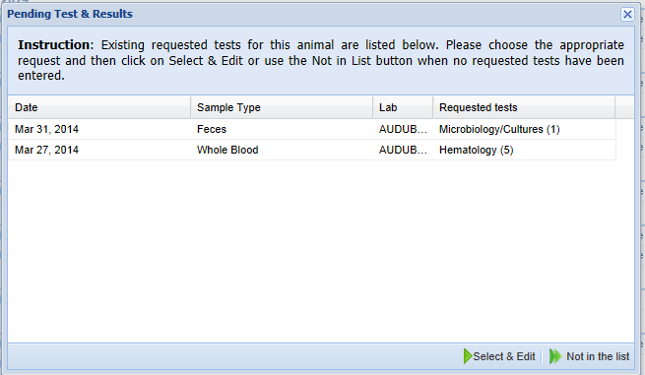
Pending Tests
When you select to create new tests, if there are any existing requests for tests that
have not been reviewed you will receive a list of them. Choosing Select and Edit will
take you into the test screen to edit or review. If it is a new test you want to record,
then select Not in the List and add the new test.

Slide 22
Reviewing Tests
When you have recorded Test Results and reviewed them check the
Reviewed box. Once this is checked, the test will no longer display in
the Pending Tests & Results box. As you can see below, the feces that
was checked as Reviewed above no longer displays in the pending list.

Slide 23
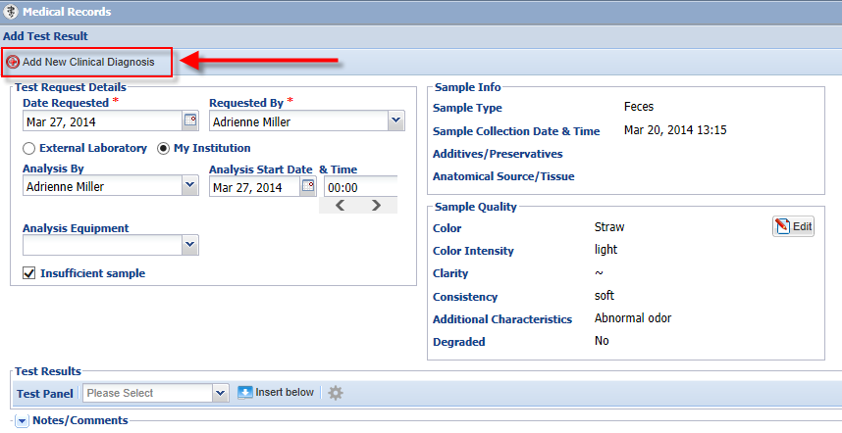
Add New Clinical Diagnosis
You can add a new Clinical Diagnosis directly from the Test and Results screen.

Slide 24
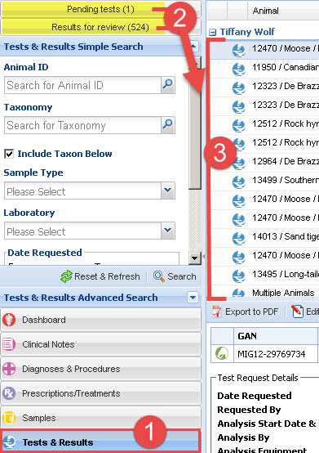
Tests and Results Search
1) From the ZIMS Medical dashboard, to review the tests & results that are pending results or awaiting approval, select the Tests & Results Search in the left hand Dashboard.
2) You have two prefilled search filter options: 'Pending Tests' and a 'Results for Review'.
3) Both of these filters will reflow the main dashboard results window (middle pane) presenting items that are either awaiting results entry or for those with all entry rows fulfilled, awaiting the reviewed column check boxes to be filled.

Slide 25
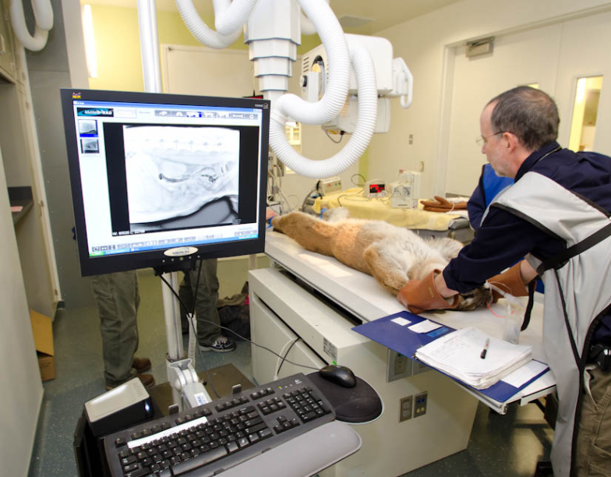
Tests & Results
In ZIMS

