Slide 1
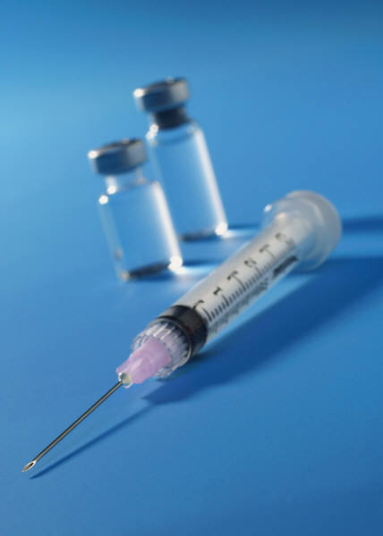
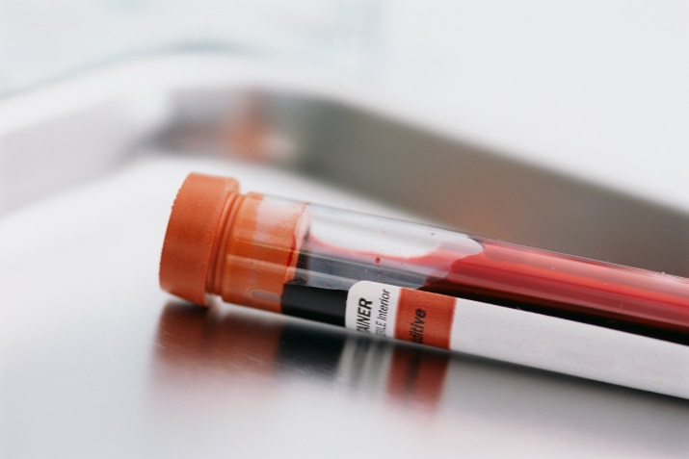
2005 - Samples
Recording and Using Samples in ZIMS

Slide 2
ZIMS Updates!
This PowerPoint is up-to-date as of: July 17 2019
ZIMS is developed in an “agile” method
This means that it is updated every two weeks, sometimes with additional releases in between!
Use the link below to see if there have been any updates to this topic since the date above:
http://training.species360.org/updates/

Slide 3
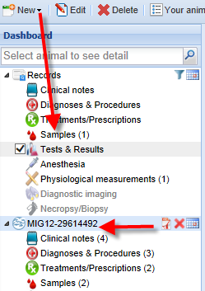
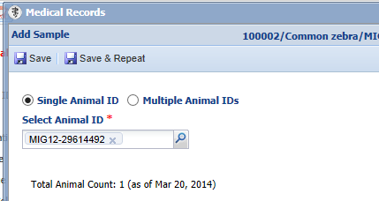
Selecting Single Animal
To add a Sample select the New button and
then Samples. You can select a single animal
to take the sample from. If the record is
highlighted in the Dashboard as on the left,
when you select New Sample it will prefill in
the Select Animal ID field.
If the record is not in focus then you will
need to type in an identifier to locate
the animal record.

Slide 4
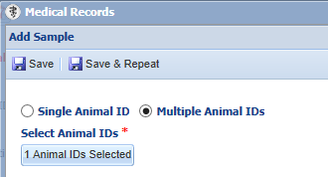
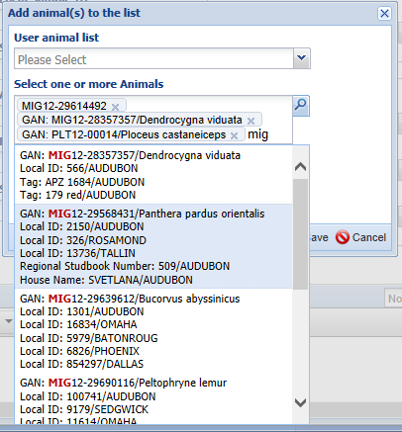
Selecting Multiple Animals
There are three ways to select to record the sample against multiple animal records.
One way is to type the identifiers into the Select Animals field. You can type as many animals into the list as desired.

Slide 5
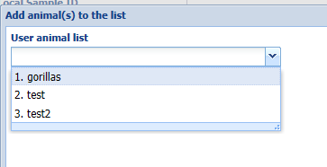
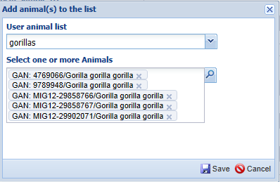
Selecting Multiple Animals - Lists
The second way is to select to use an Animal List that was previously created from either the R1 or the R2 module.

Slide 6
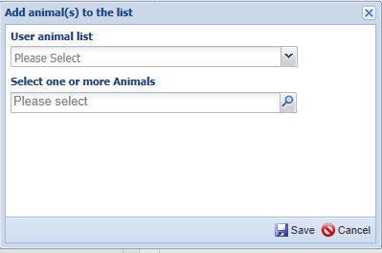
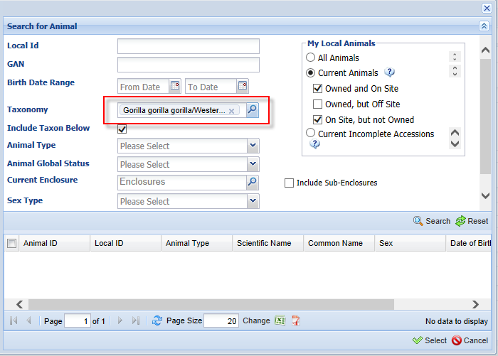
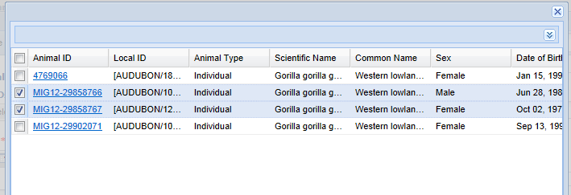
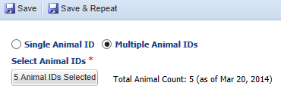
Selecting Multiple Animals - Lookup
The third way is to use the Lookup. This is
very useful for loading by taxonomy (a fecal sample from your giraffe herd) or by enclosure (a fecal sample from the Aviary). You can then select specific animals from the results grid to be included.
When you Save the number of animals will be displayed.

Slide 7
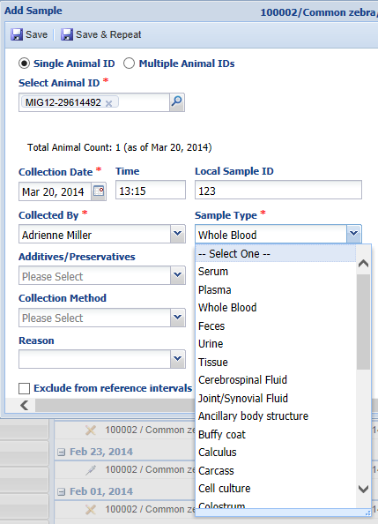
Adding a Sample – Basic Info
The Collection Time is not a mandatory
field but it is recommended that you
record this information in addition to
the mandatory date. The Local Sample ID is also not mandatory but may be an easy way for larger institutions handling many samples a day to track the Sample. Most facilities may opt not to complete this field. If you do record Local Sample IDs you may want to develop a protocol for consistency.
The Sample Type is a data standard drop down list that drives what is available in the Additives/Preservatives and Collection Method fields.

Slide 8
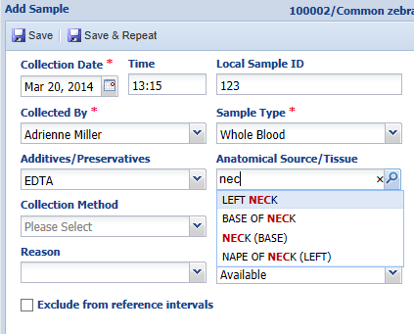
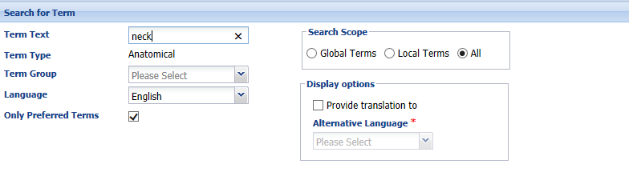
Adding a Sample – Basic Info
The Additives/Preservatives is a data
standard list that is filtered by what was
entered in the Sample Type field.
For the Anatomical Source/Tissue you
can type in and matches will display to
select from. Or, you can use the lookup
function to perform a search for your
desired term.

Slide 9
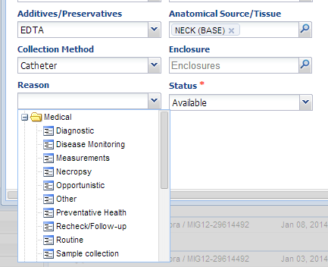
Adding a Sample – Basic Info
The Collection Method is a data standard drop down list. If the sample was collected in an enclosure other than the one the animal usually occupies it can be entered here.
The Reason is a cascading drop down list with major headers of Medical, Miscellaneous and Research.
The Status can be updated as the sample is used. Consumed means that you have used up the sample with requested testing.
If for some reason you do not want this sample included in reference intervals you can check the Exclude box. If the Sample was collected
from a dead animal, check that box.

Slide 10
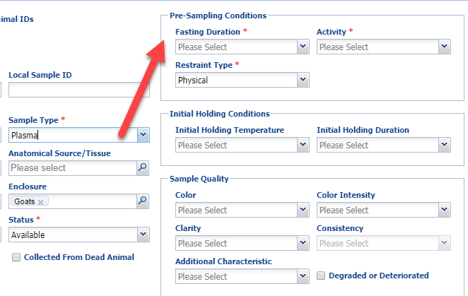
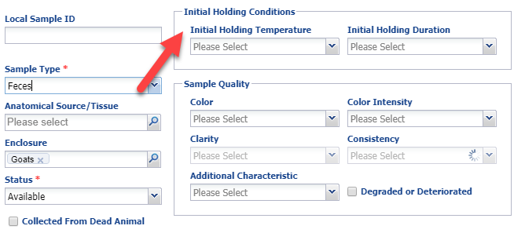
Adding a Sample – Pre-Sampling Conditions
The right hand side fields are filtered
by what was selected for the Sample Type. Note how they are different for Plasma (top) then they are for
Feces (bottom).

Slide 11
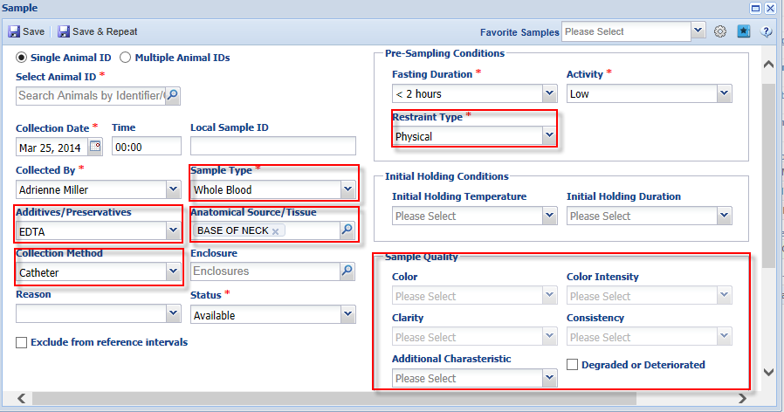
Creating Favorite Samples
Creating Favorite Samples allows you to save time if you have samples that are routinely collected. To create a Favorite Sample open the sample screen and complete the fields. It is important to note that what is entered under Sample Quality as the default will be saved. Since that can vary from sample to sample, remember to edit it if appropriate.

Slide 12
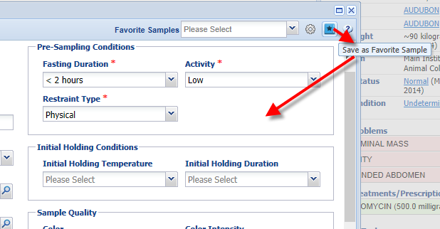
Saving Favorite Sample
When you have recorded your desired information select the star icon
to Save as Favorite Sample. You will be asked to name the favorite and this
name must be unique within your facility.

Slide 13
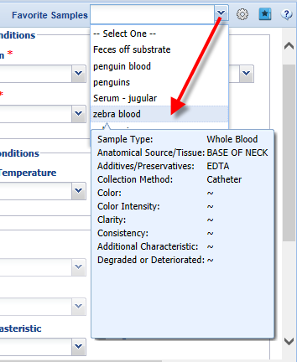
Using Favorite Samples
To use a Favorite Sample you
can start typing the name into
the field and appropriate matches
will be displayed to select from.
Or, you can use the arrow to display
all of your favorites. The details
will display when you hover over
the name.
The Sample screen will then appear
with the information you recorded
prefilled but editable. You then
simply complete the other fields.

Slide 14
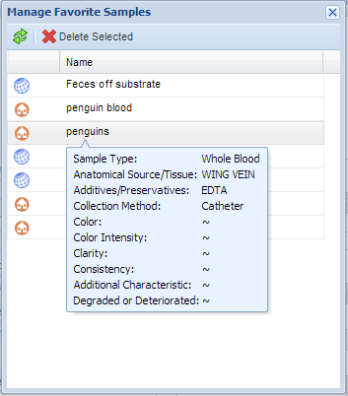
Managing Favorite Samples
Selecting the wheel icon will
allow you to manage your
Favorite Samples. Hovering
over the favorite will display
the details. This is where you
would Delete a favorite.
Editing of the default values is
not supported. If you decide that
a Favorite is not correct, delete it
and create it again.

Slide 15
Using the Sample
Once the Sample is created you can then use it. Highlight it in the dashboard and select
the desired action from the top of the Preview Pane.

Slide 16
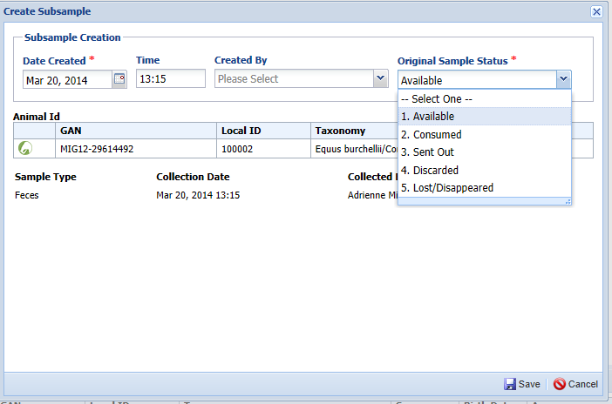
Create Subsample
You can create subsamples, or smaller samples created using the original sample. The only required fields are the date that the subsample was created and the status of the original sample. If you have used up the original sample by creating subsamples, discarded it, or lost it, the status should be updated accordingly and no more Subsamples can be created.
Recording a Subsample that is a different Type than the original Sample is not supported as the rules about which Samples could change into other Sample Types are highly complex. Therefore the Type of the Subsample must match the Type of the original Sample.

Slide 17
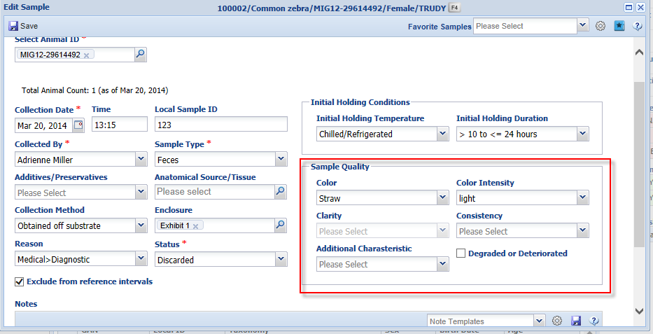
Editing Samples with Subsamples
You can edit a Sample that has Subsamples associated with it and revisions for
most fields will automatically alter all Subsamples with the updated information.
However, Sample Quality is relevant to each Subsample and revision is unique to
each one.

Slide 18
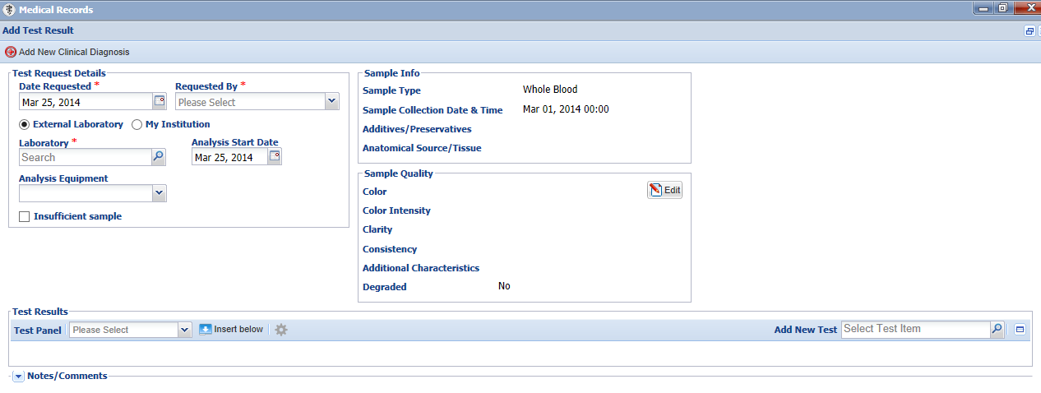
Request Test
You can Request Test for the sample. This will bring up the Test Request Details
and Results screen. Tests and Results are covered in session 2006.

Slide 19
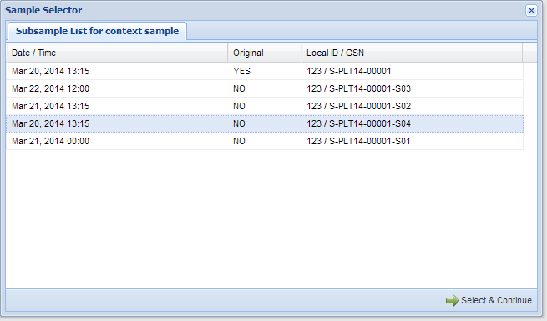
Request Test on Subsample
If you request a test on a Sample that has had Subsamples
created from it a grid will appear that allows you to select
either the original Sample (YES) or a Subsample (NO) to request
a test on.

Slide 20
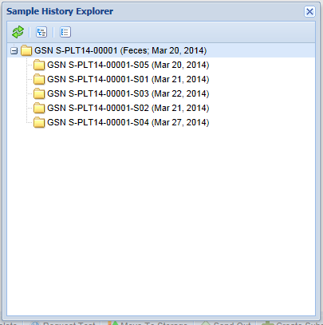
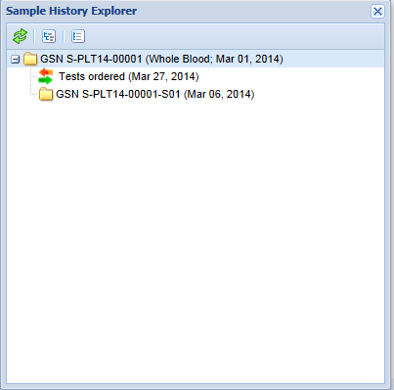
Sample Tree View
If you have created a Subsample of a sample, the Sample Tree
View will display the samples and the Global Sample Numbers
(GSN) assigned to them by the application. In addition, if any
Tests were ordered on the sample they will display.

Slide 21
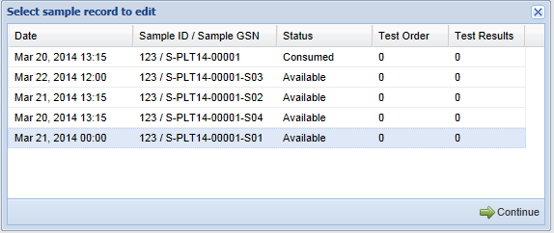
Editing a Sample
The Sample ID
is assigned by you
when creating the Sample.
The Sample Global Sample Number (GSN) is
assigned by the ZIMS application.
If you select to Edit a sample that has Subsamples the entire list will display. To Edit select the original sample or one of the Subsamples and select Continue. The sample screen will appear for editing.

Slide 22
Samples
Tracking them in ZIMS

