Slide 1
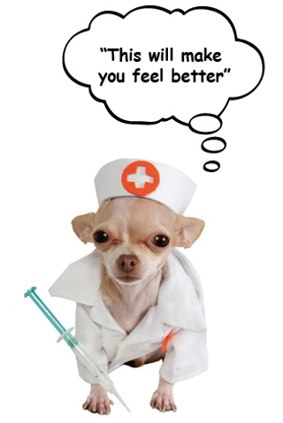
2004 Treatments & Prescriptions
In ZIMS

Slide 2
ZIMS Updates!
This PowerPoint is up-to-date as of: July 29 2019
ZIMS is developed in an “agile” method
This means that it is updated every two weeks, sometimes with additional releases in between!
Use the link below to see if there have been any updates to this topic since the date above:
http://training.species360.org/updates/

Slide 3
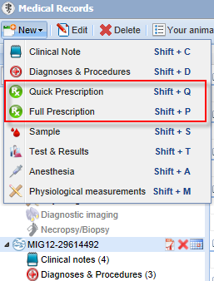
Quick & Full Prescription
There are two types of Prescriptions – Quick
and Full.
Quick is meant to be used for routine
treatments and less information is
gathered. Quick Prescriptions are usually
used for one time treatments such as
vaccinations or single dose de-worming. This is
the type of prescription you would select for Batch
entries. Quick is one and done.
Full Prescription gathers more details on
the treatment. Full Prescriptions are often
administered over a time period such as
antibiotics. You would select Full Prescription
for Multiple prescription entries.

Slide 4
Batch Prescription
You are giving the same treatment to a set of individual animals
One treatment record will be recorded for each animal
Examples:
You vaccinated your Children’s Zoo goat herd
You gave your penguin colony anti-malarial treatment

Slide 5
Multiple ID Prescription
Multiple animals are sharing the same dose
Not all animals may receive the same amount of the dose
Examples
You mixed de-worming medication into the grain that your gazelle herd shares
You added medication to the water of your shark tank

Slide 6
Add Quick Prescription
If you are adding a Quick Prescription for a single animal you will select it on the right
hand side as shown above. If you are adding a Quick Prescription for a Batch of animals
checking the Batch Prescription checkbox will bring up fields where you can either select
an Animal List, type in multiple identifiers, or use the lookup to find your animals. The
Date Written and Start Date do not have to be the same but the Date Written cannot be
after the Start Date.

Slide 7
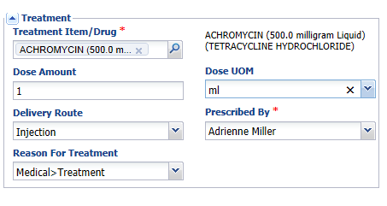
Treatment Details
The Treatment Item/Drug is sourced from the Treatment Dictionary. You
can start typing in the name until it is recognized, or you can use the
magnifying lookup to search for it. Although not a mandatory field,
it is recommended to add the Delivery Route. This field will sometimes
prefill dependent on what is selected in the Treatment Item/Drug box but
it can be edited.

Slide 8
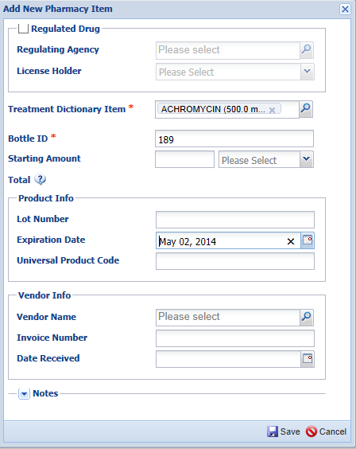
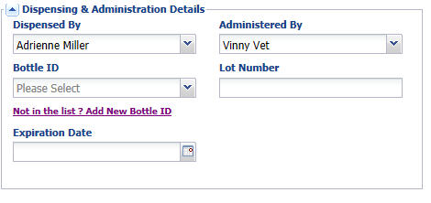
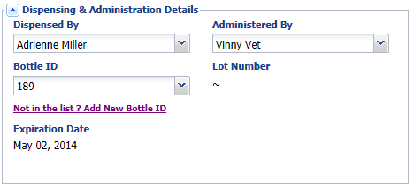
Dispensing & Administration
Administered By will prefill with who is entered into the Dispensed By field but it is editable. Bottle
Information is optional, but if you wish to use it and it has not yet been entered into your inventory you can select the Add New Bottle ID to add it. Once you Save the information will prefill. You can record an Expiration Date without recording a Bottle ID.

Slide 9
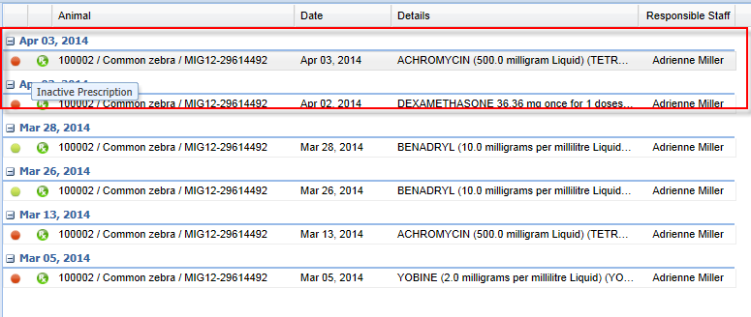
Dashboard Display
The treatment will display in the dashboard. Because a Quick Prescription
is not on-going it will automatically display with a red dot as an Inactive
Prescription.
It is important to note that should you chose to edit a Quick Prescription
the Full Prescription screen is displayed for the editing.

Slide 10
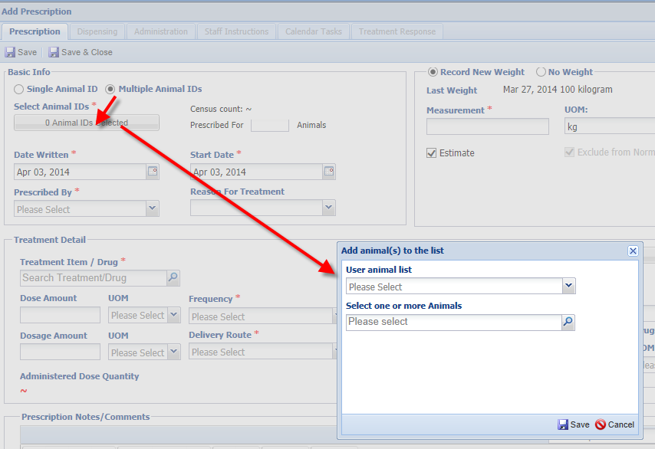
Full Prescription Multiple Animals
If you select to add a new Full Prescription when an animal medical record is in focus the GAN will prefill. If not you will need to enter an identifier or look for it. If you select Multiple Animal IDs (remember this is many animals sharing the same dose of the medication) the Select Animal IDs will display as 0 Animals Selected. Click on that field to activate the field to select your animals either from an Animal List, by typing identifier in or using the lookup functionality.

Slide 11
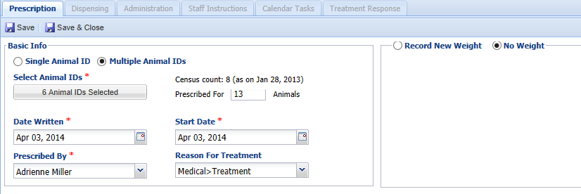
Full Prescription Multiple Animals
The number of Animal IDs selected will display in the Select Animal IDs field.
If any groups are selected then the Census count will display. The total number
of animals the treatment is prescribed for will be automatically calculated.
In the above example we have selected 5 individuals and one group with 8
members, so it is 6 Animal IDs and prescribed for a total number of 13 animals.
You have the option to Record New Weight. However, in this example selecting
the No Weight option would be appropriate.

Slide 12
Full Prescription for Individual
As for a Quick Prescription the Date Written and the Start Date do not need to be the
same date but the Date Written cannot be after the Start Date. For an individual you
have the option to Use Last Weight, Record New Weight or select No Weight. The last
weight is often sourced from what had been recorded in the Husbandry weight grid.
If you select to Record New Weight that data will be copied into the Husbandry weight
grid unless it is an estimated weight.

Slide 13
Treatment Detail
There are two ways to record the treatment detail. One is to enter the
information into the fields manually. Use the Notes/Comments section
to record any information not gathered elsewhere or to provide additional
details on the treatment. The second way is to use the Dose Calculator to
assist with calculations. You can also check your drug Inventory or search
the Global Drug Usage Extract resource from this screen.

Slide 14
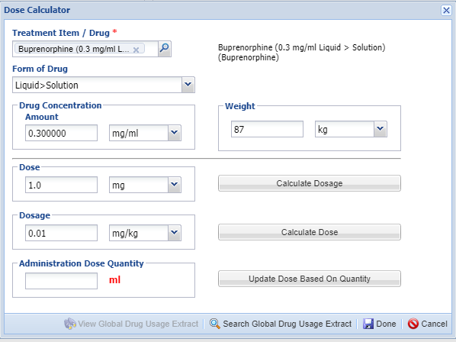
Dose Calculator
To calculate Dosage it requires valid information in both the Dose and Weight Fields. To calculate Dose it requires valid information in both the Dosage and the Weight fields. You can search the Global Drug Usage Extracts from this screen. Select Done when finished. To save the record and continue adding data in the other tabs select Save & Edit.

Slide 15
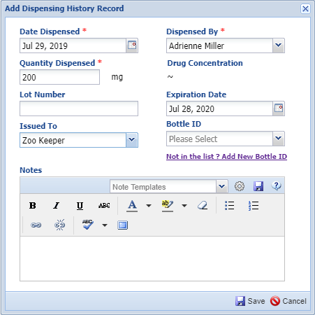
Dispensing
The second tab allows you to record the
Dispensing information. This allows
tracking of who did the dispensing and
who it was dispensed to. If the drug is not
in your inventory and you wish to add it
you can do so here.
Recording this Dispensing information
is not mandatory and will be used
mainly for controlled substances that
need to be more closely monitored.
An example would be dispensing a
specific number of oral Diazepam
tablets to ensure bottle counts are
correct.

Slide 16
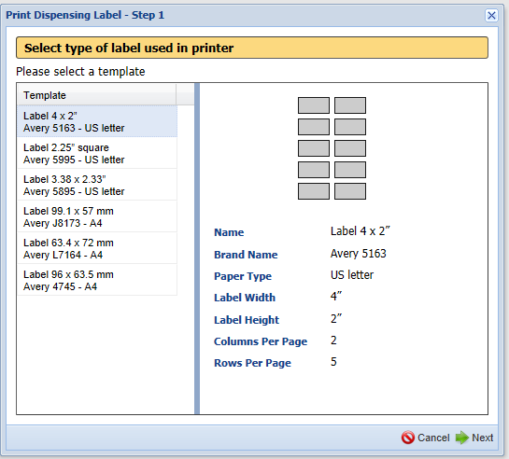
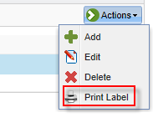
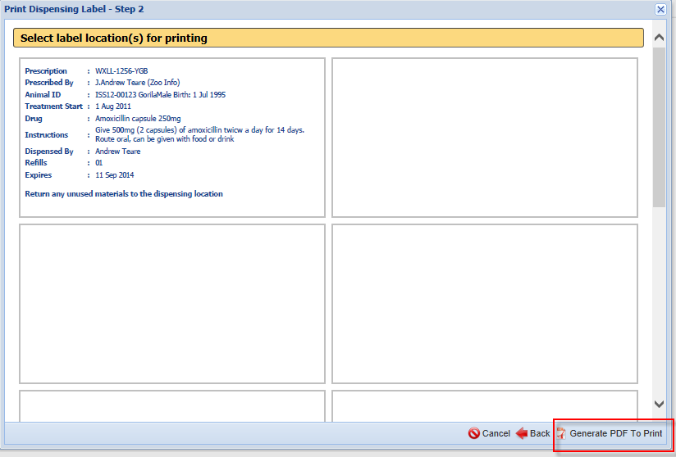
Print Label
An option under the Actions
menu on this tab is to Print
Label. You will select the type
of label and then the location
for Printing. When you select
Generate PDF to Print you
will have the label for the
drug container.

Slide 17
Administration
You can track the success of administering the treatment using the Administration tab.
Use the Notes box to record additional details. The administration records will
display in the grid. Providing keepers with access to view/add/edit this screen will
allow them to enter the details of administration directly into ZIMS.

Slide 18
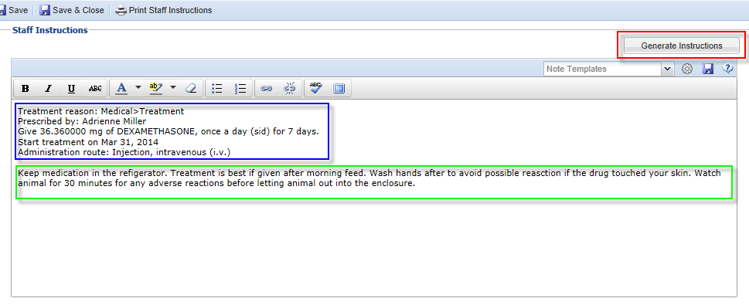
Staff Instructions
Use the Staff Instruction tab to provide detailed instructions to the staff for
administration of the drug. The information in the blue box is sourced from the Prescription tab information and will prefill when you select the Generate Instructions button. Include any special restrictions, including any follow up observations required. The information in the green box is a free text entry. VERY IMPORTANT NOTE: If you are adding additional text to the
instructions select the Generate Instructions first as doing so after will overwrite your free text entry.

Slide 19
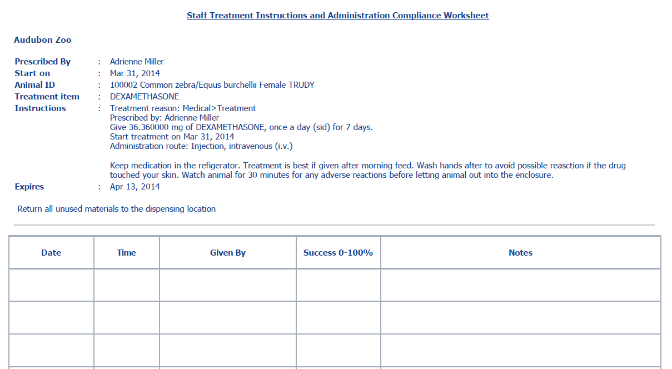
Print Staff Instructions
Selecting Print Staff Instructions will
bring up a sheet with instructions and
space for tracking the administration
of the treatment.

Slide 20
Calendar Task
You can schedule repeated Prescriptions into your Calendar using the next tab.
Select one of the pre-defined schedules or customize the date you want it
repeated.

Slide 21
Treatment Response
The last tab is where you would record the overall response to the
treatment and any adverse effects displayed. Use of the Adverse Effects
Note box is encouraged to record details.

Slide 22
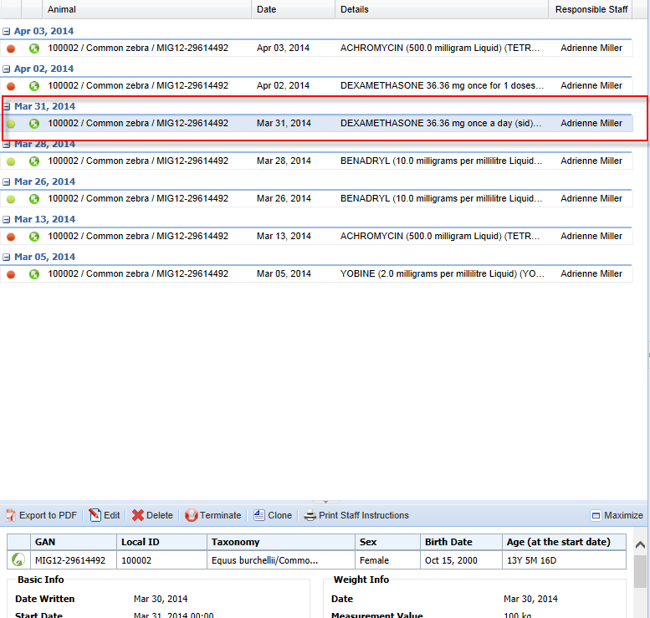
Dashboard Display
The treatment will display in the dashboard as Active (green button)
during the dates recorded for the treatment. Once the treatment
end date is passed the button will turn red (Inactive).

Slide 23
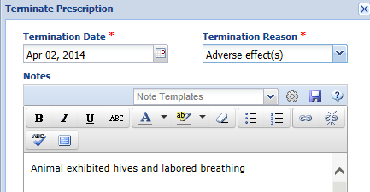
Terminating the Treatment
Should you need to terminate the Treatment
prior to the scheduled date, as for the animal
that exhibited hives and labored breathing,
select the Terminate tab above the lower pane.
The screen allows you to record Details as to
why the treatment was Terminated. You will be
redirected to the Dispensing screen to edit those records if this screen has been completed for this prescription. The treatment will now display as Inactive in the Dashboard.

Slide 24
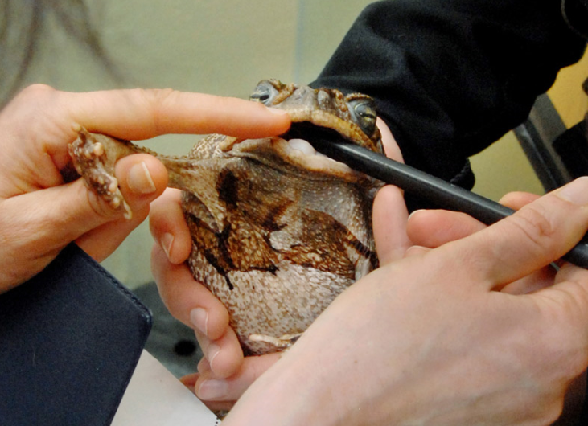
Treat Them Right!
Using ZIMS

