Slide 1
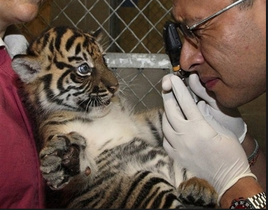
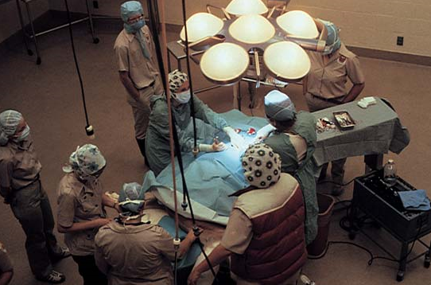
Breaking down a medical diagnosis/procedure in ZIMS
Great Data In, Great Data Out

Slide 2
Basics
Diagnosis & Procedures have complex Business Rules
These Business Rules must be followed or you will receive a warning and not be able to proceed with what you have entered
Duplicate entries will break a Business Rule and will result in an error

Slide 3
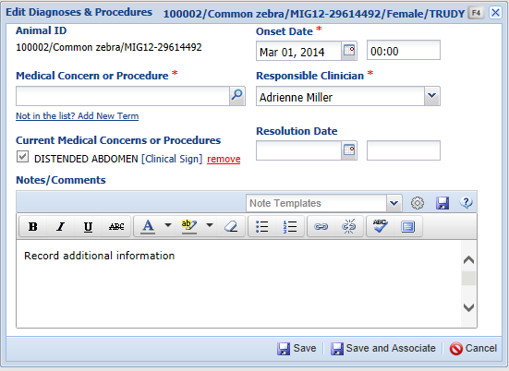
Duplicated Entries
The application will help guard against any duplication of entries.
Here we are trying to add a Clinical Sign (Distended Abdomen) that
is already an Active Problem.

Slide 4
What are the “rules”
A Diagnosis & Procedure must have one but only one medical concern term
Clinical Sign
What the animal is displaying
Clinical Finding
Results of a measurement
Diagnosis
Medical condition, syndrome or disorder
Procedure
Action taken
Only a single Anatomical Location is allowed in each entry
Medical Modifier- up to 8 of each of the following modifiers types are allowed in each entry
Distribution
Duration
Severity

Slide 5
Examples:
Medical Concerns:
Medical Condition/Syndrome/Disorder
Fracture, Pneumonia, Protozoal infection
Clinical Sign
lameness, cough
Clinical finding
Fever, tachycardia, elevated white blood cell count
Procedure
These terms can stand alone as a valid problem. However, you will often want to provide additional details or clarification using modifiers.
“Lameness” tells another clinician what medical problem is present
“Lameness, right front limb, mild” provides a more complete description

Slide 6
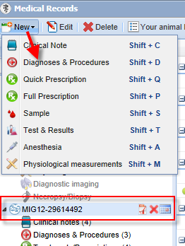
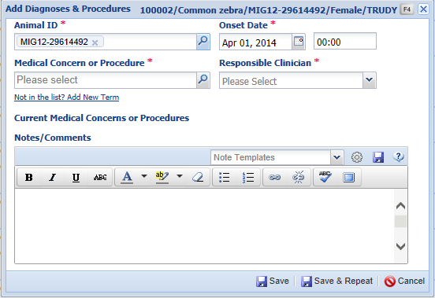
Add Diagnosis & Procedure
If the animal record is in focus then the GAN will prefill in the Animal ID
field. If not then you will need to type in an identifier or use the
lookup to find the animal. Selecting multiple animals is not a functionality
of this module.

Slide 7
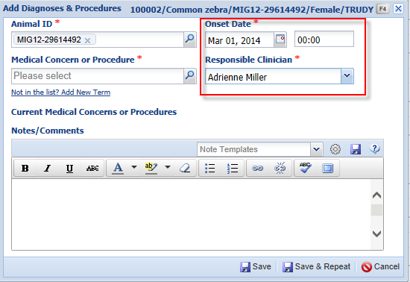
Add Diagnosis & Procedure
The best case scenario is
that the Onset Date is
today’s date. However
in many cases it may be
a previous date for non
life threatening situations.
A time would usually be
entered only for instances
when a problem occurred
acutely.
The Responsible Clinician
sources from your staff
list.

Slide 8
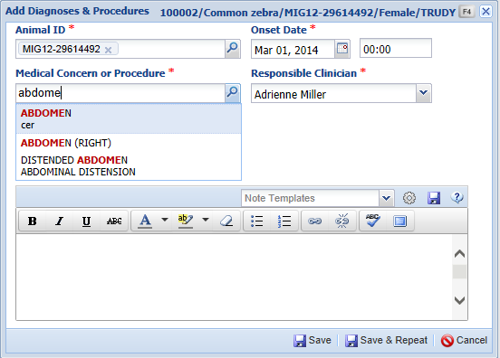
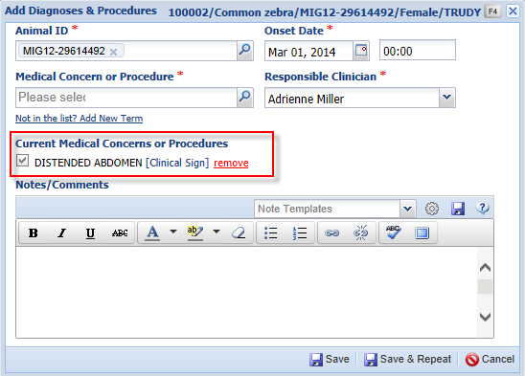
Medical Concern
To select the Medical Concern or Procedure you can start typing until the
desired term is recognized. The concern or procedure will display below.
Here we have a Clinical Sign of a distended abdomen. You cannot enter a
second Clinical Sign in this entry.

Slide 9
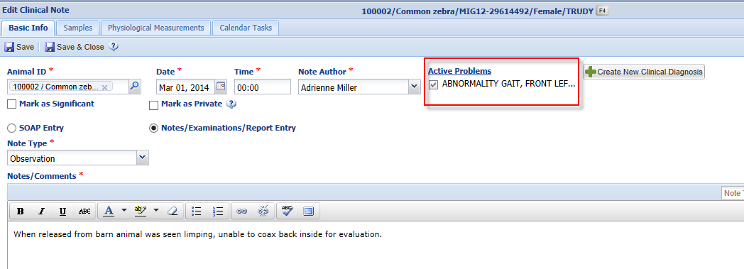
From Clinical Note Record
You can also add another Diagnosis & Procedures entry directly
from within the Clinical Note.

Slide 10
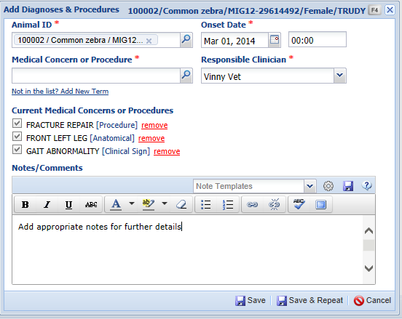
Multiple Issues
As noted, one medical issue term is required, but only one is allowed. In addition, only one Anatomical Location is allowed.
Here we have a Procedure (fracture repair) and a Clinical Sign (gait abnormality) so we receive a warning that this cannot be saved.
Selecting Save & Repeat will
save the current values but
leaves the popup open in edit
mode.

Slide 11
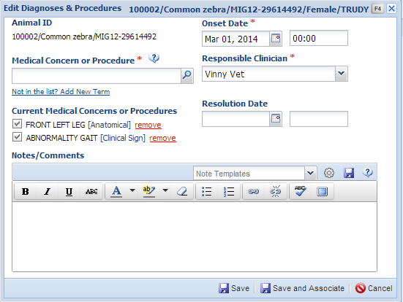
Create Separate Entries
You will need to create separate entries. For this entry we kept only the Clinical Sign (abnormal gait) and the Location
(front left leg). We did not
record a Resolution Date
as the problem is ongoing.

Slide 12
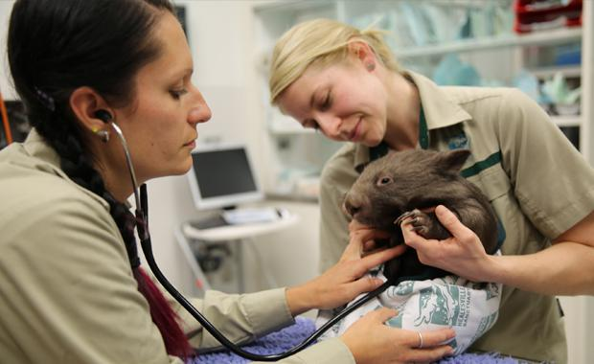
When you have lots of details
For more complete diagnoses you can add up to 8 additional modifiers
Anatomical
Symmetry
Other (distal, proximal, etc.)
Medical
Etiology
Severity
Duration

Slide 13
Modifiers
Modifier Terms can be used to add specificity to the entry
EXAMPLE 1
Bronchopneumonia - This can be a valid diagnosis entry all by itself
Bronchopneumonia, acute, severe, right cranial lobe – This gives a better picture of the medical problem
EXAMPLE 2
Lameness – This is a Clinical Sign that can stand on its own
Lameness, mild, right front limb – This gives a more complete description of the concern

Slide 14
One step further…
You performed a bronchoalveolar lavage and cultured Staphylococcus sp, you have identified an etiological agent.
Staph. will not stand alone as a diagnosis, it needs to be linked to a medical concern
You know the what, but need the where
You can use the new information to further modify the bronchopneumonia diagnosis:
Bronchopneumonia, left caudal lung, moderate, staphylococcus sp., confirmed

Slide 15
Complex problems
You want to enter “flagellates” as a diagnosis and ZIMS won’t let you because flagellates are actually an etiological modifier
There is a solution!
Create a local complex problem
Define it as: flagellate infection
Precisely specify that it is: protozoal infection, flagellates, intestine
You can even say that it is trichomonas sp. If you have that level of detail!
Now you have captured the complete diagnosis, but you can quickly enter the concern at your institution by typing “flagel” and selecting your local term from the drop down.

Slide 16
Create Good Habits
Only add significant procedures (ie: surgery)
What about “blood collection” and “vaccination”?
ZIMS UI allows you to search for these under Samples and Prescriptions/Treatments
Adding them as procedures duplicates data in the system
Adding them again wastes your valuable time
Avoid cluttering problem list with irrelevant procedures- right hand menu only shows the first few!
ZIMS offers solutions to quickly find data, use the system to make your life easier!
Good Data In = Good Data Out!

Slide 17
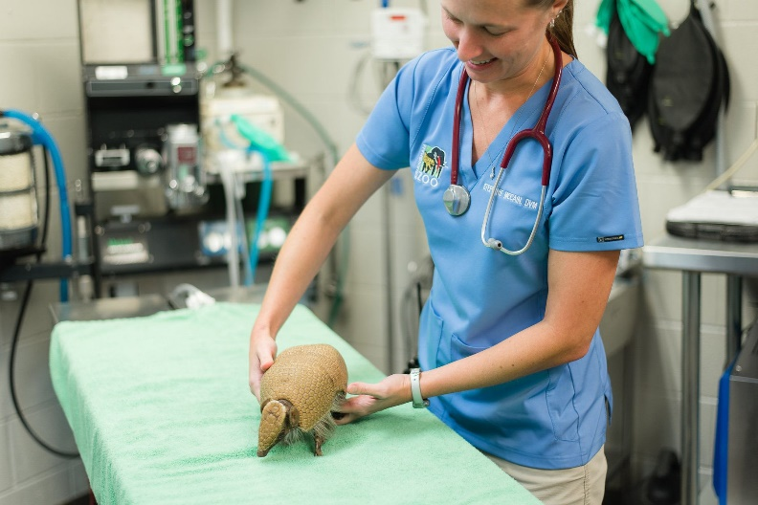
Terms with Durations
The following terms have a Start and Stop date:
Clinical Signs
Medical condition/Syndrome/Disorder (ie Diagnosis)
Procedures
Although most such as surgery start and stop on the same day.

Slide 18
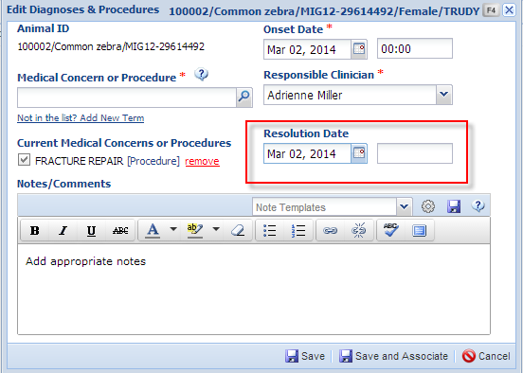
Record Procedure
We record a procedure
to repair a leg fracture.
Because the surgery took
only a part of a day we are
able to record a Resolution
Date.

Slide 19
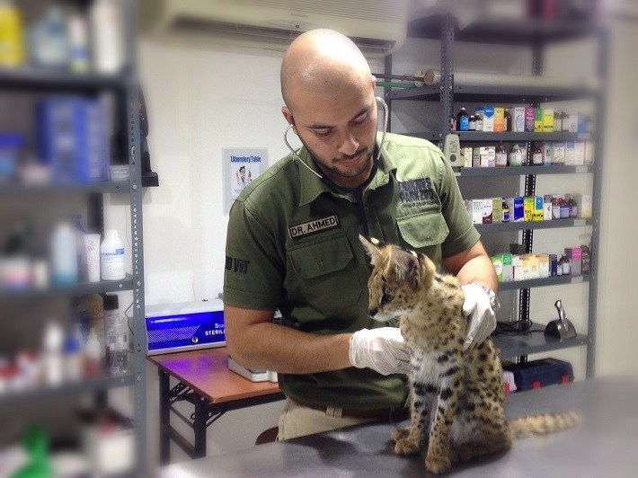
Term with No Duration
Clinical Findings
These are the result of a measurement at a point in time
Start Date = End Date

Slide 20
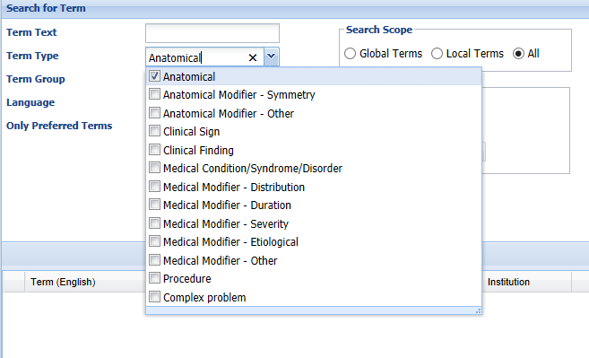
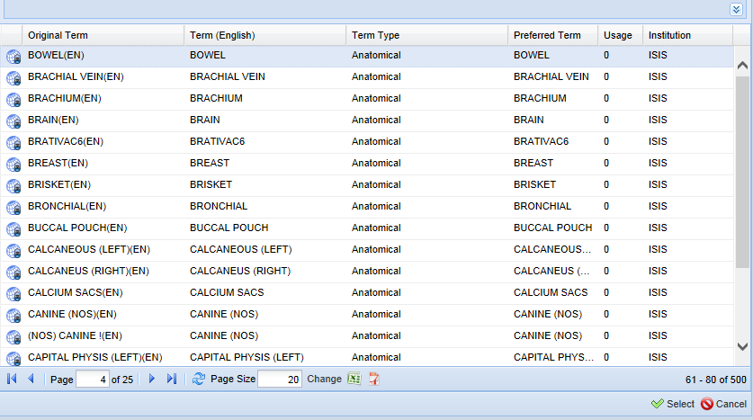
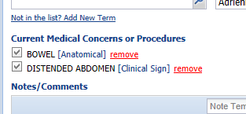
Search for Term
You can also use the lookup to
search for the Term. Term Text is
a free text field. Term Type is a
multiple select dropdown list.
Term Group can be created from
within the Term Dictionary.
Selecting from the list will add the
Term to the concerns or procedures.
The distended abdomen is in the
bowel area.

Slide 21
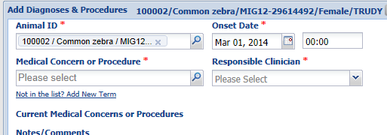
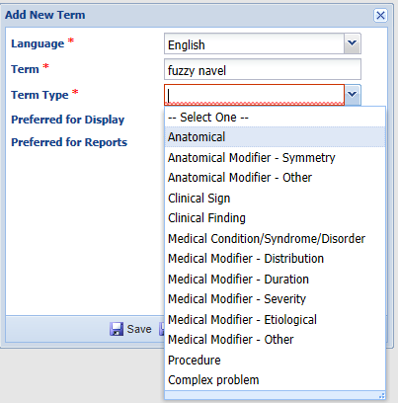
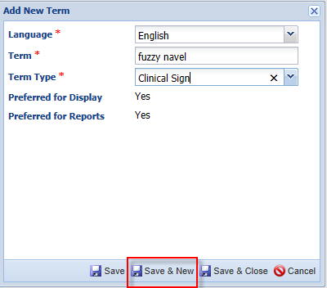
Add New Term
If a Term you are looking for is not
on the list you can add a Local term
by selecting Add New Term. You
will enter the new Term and select
the Term Type from the list. By default
terms you add are Preferred for Display
and Reports. Selecting Save & New will
allow you to continue adding new
Terms.

Slide 22
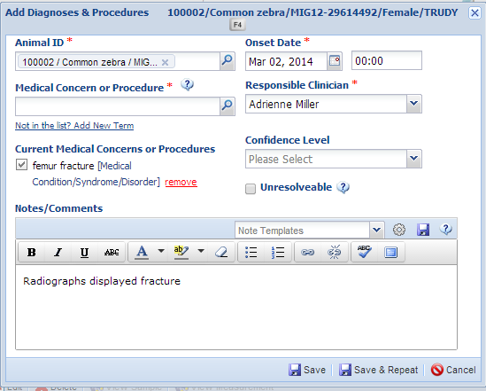
Medical Condition/Syndrome/Disorder
When you record a Diagnosis
(Medical Condition/Syndrome/
Disorder) there are two
additional fields. Confidence Level
allows you to indicate the degree
of confidence that the Diagnosis
is correct. The Unresolvable
checkbox indicates that the
problem is not expected to be
resolved during the life of the
animal.

Slide 23
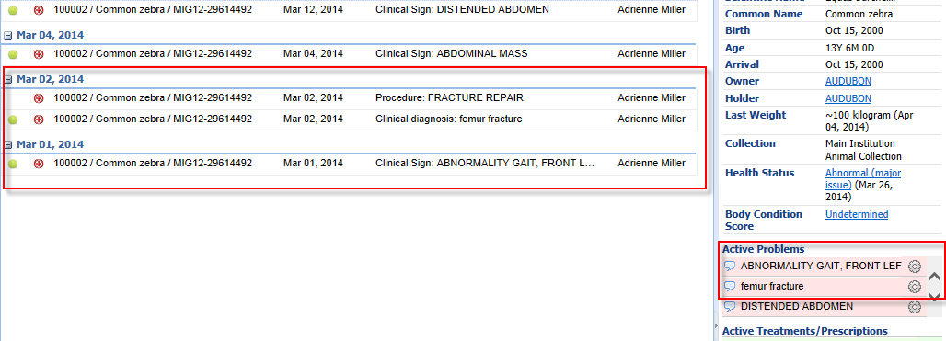
Dashboard Display
In the Dashboard the Clinical Sign (abnormal gait, front left leg) and the Clinical Diagnosis (femur fracture) will display as Active Problems (green circle to the left) and also in the Active Problems list in the right hand panel. The Procedure (surgery to repair the fracture) is not shown as active as it had a Resolution Date.

Slide 24
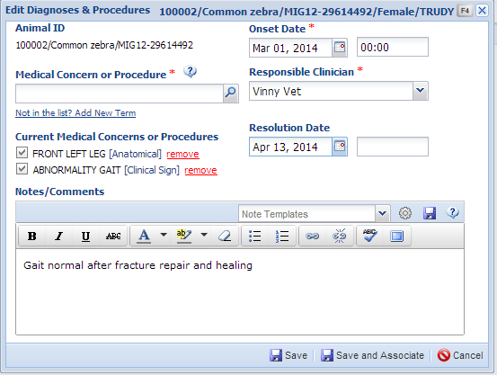
Dashboard Display
A month after surgery the gait has
returned to normal so we can enter
a Resolution Date on that entry.
In the Dashboard it will not display
as Active and it will also no longer
display in the Active Problems list in
the right hand panel as it has been
resolved. When the fracture has
completely healed we can then add
a Resolution Date to that entry and
it will no longer display as an Active
Problem.

Slide 25
Associating (Linking) Entries
Your patient presents with a problem list of clinical signs
Decreased appetite
Cough
Decreased activity level
During your exam you identify clinical findings:
Fever
Leukocytosis
Increased radiodensity of left caudal lung
Your diagnostics confirm the patient has bronchopneumonia (Medical Condition)
Each of these clinical signs or findings can stand alone, but you may choose to associate them because the clinical signs and clinical findings support the diagnosis of the medical condition
All Diagnosis & Treatment entries can be associated with Clinical Notes
The Clinical Note will display entries valid for that date

Slide 26
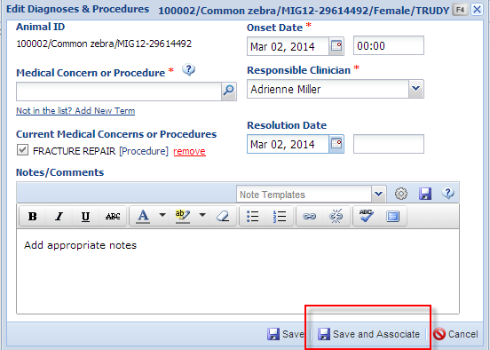
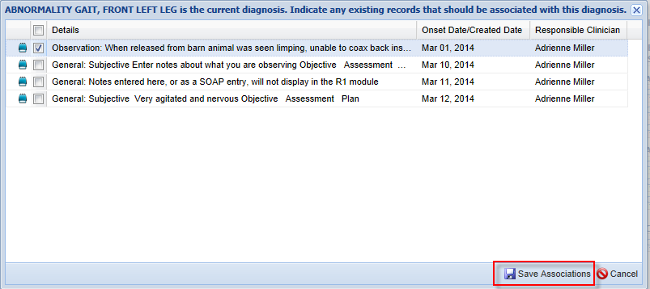
Save and Associate
When you select Save and Associate the application will look for other records that may be related to the Diagnosis. Here there is a Clinical Note regarding the animal limping. Selecting that record and Save Associations will add the information as an Active Problem to the note record.

Slide 27
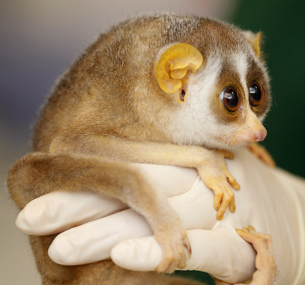
Diagnosis & Procedures

