Slide 1
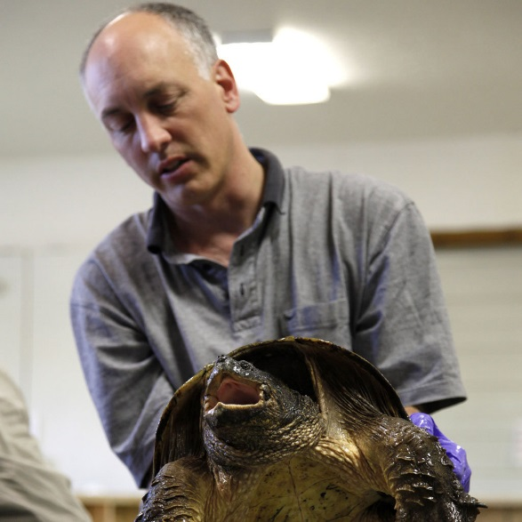

2002 Clinical Notes
Creating Clinical Notes in ZIMS Medical

Slide 2
ZIMS Updates!
This PowerPoint is up-to-date as of:
July 11 2019
ZIMS is developed in an “agile” method
This means that it is updated every two weeks, sometimes with additional releases in between!
Use the link below to see if there have been any updates to this topic since the date above:
http://training.species360.org/updates/

Slide 3
Clinical Notes
Clinical Notes are free text fields
There are two formats for Clinical Notes
  SOAP Entry
    Subjective, Objective, Assessment and Plan
  Notes/Examinations/Report Entry
In addition there is an Animal Care Staff Medical Summary note

Slide 4
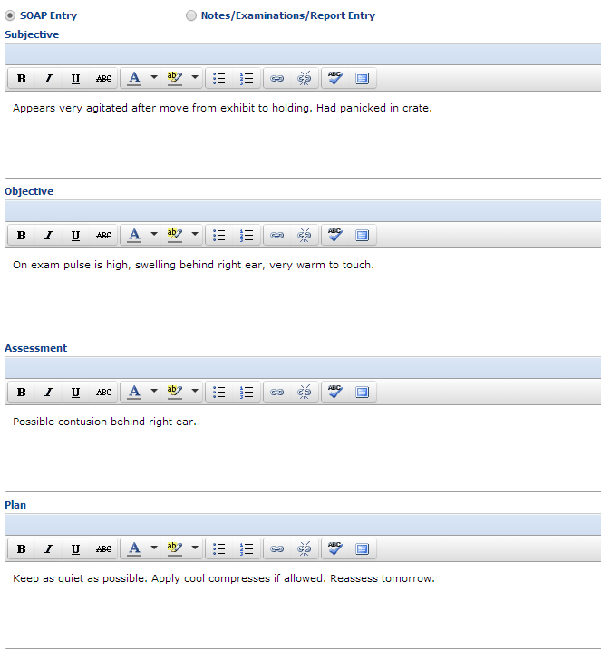
SOAP Entry
Using the SOAP entry format helps to standardize medical evaluations. This note will display ONLY within the Medical module.
S=Subjective
Your interpretations of what the patient
is trying to tell you. This can also be the reported
history from a keeper
O=Objective
Symptoms that can be measured, seen, heard,
felt or smelled such as temperature, pulse, and
swelling
A=Assessment
Summary and medical interpretation of the
significant Subjective and Objective observations
and findings. May include diagnosis or preliminary
diagnosis of the condition presented.
P=Plan
How you intend to treat the animal

Slide 5
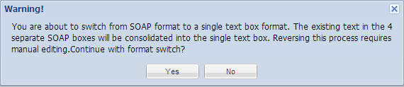
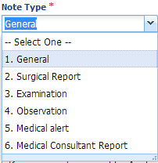
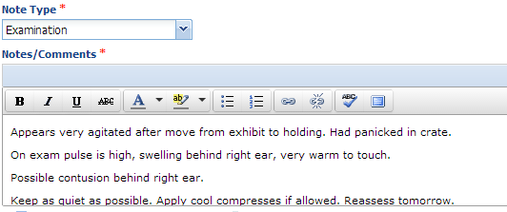
Notes/Examinations/Report Entry
Notes/Examinations/Report Entry notes are not broken down into separate topics
like the SOAP entry and would usually be used for shorter notes. If you create a SOAP entry and decide to switch to this type of Note you will receive a message that you cannot easily switch back to a SOAP entry.
For this type of note you will need to select a Note Type.
This is how the previous SOAP entry looks when converted to a Notes/Examinations/Report Entry note.
This note will display ONLY within the Medical module.

Slide 6
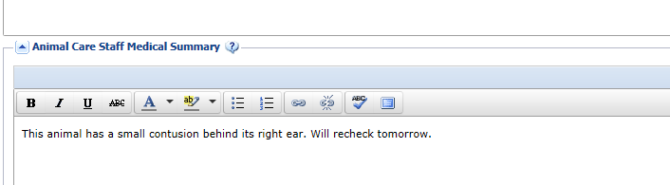
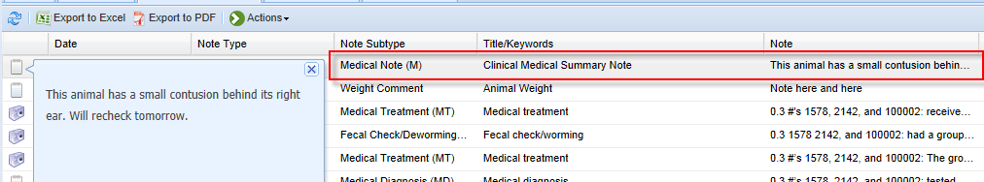
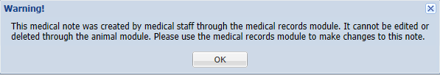
Animal Care Staff Medical Summary
The Animal Care Staff Medical Summary allows notes that are directed more at the animal husbandry staff than the medical staff. These notes do get copied into the Husbandry module Notes & Observations grid and are intended for communication between the medical and husbandry staff by providing a summary of the medical issues. These notes are redundant – a summary of what has already been entered into the Clinical Notes. These notes are usually less technical than the SOAP or Notes/Examinations/Reports entries. They are not searched when Clinical Notes are searched.
These notes cannot be edited from the Animal Husbandry module and can only be edited or deleted from the Medical module.
In My Preferences > Medical Preferences > Clinical Notes,
you can select to have this grid open by default.

Slide 7
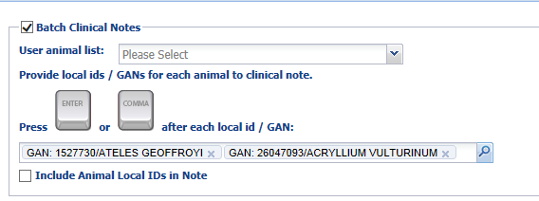
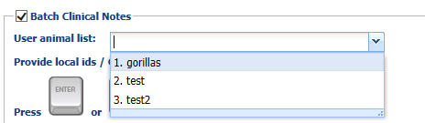
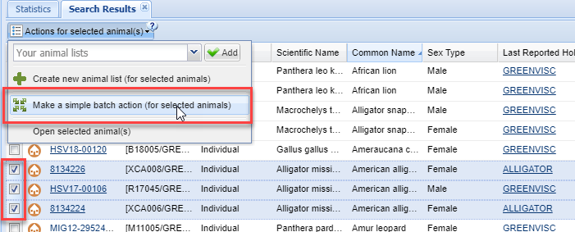
Batch Clinical Notes
To help save time you can choose to enter Batch Clinical
Notes for multiple animals by checking the Batch Clinical
Notes checkbox. Batch Notes allow rapid entry of the same
observation or finding into the medical records of multiple
animals.
There are three ways to select the records that you want
to record the note into.
The first way is to type the Local IDs or GANs into the field.
The second way is to use an existing Animal List that was
created in the Animal Husbandry or the Medical module.
Once the list is selected the animals will prefill.
The third way is from an Animal Search results grid. Select
the animals > Actions for selected animals > Make a simple
batch action for selected animals.
Using the first two ways, the note will be the same for all animals.
Adding a Batch Note from a results grid gives you the option to
record a custom, individualized note in each record.

Slide 8
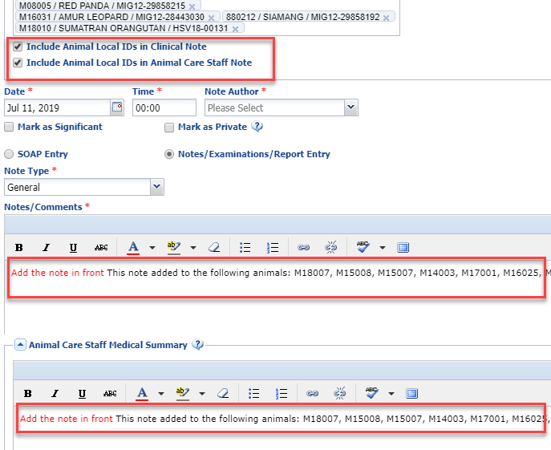
Include Animal Local IDs in Note
For a Batch Note entry, if you want the Local
IDs to display in the note you can check the
“Include Animal Local IDs in Note” checkboxes
for the Clinical Notes and/or the Animal Care
Staff Note.
The Local IDs will appear at the top of the note.
For a SOAP entry they will only display in the
Subjective entry grid.
It is recommended that you add your note text
in front of this note so that the text will display
first in the Details column of the Notes grid.

Slide 9
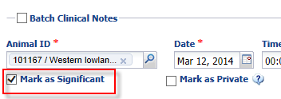
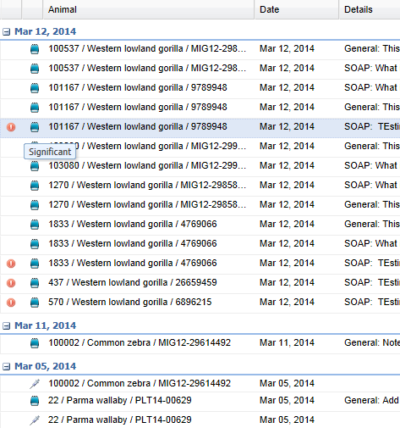
Mark as Significant
You can also chose to mark a Note as significant by checking the “Mark as Significant” checkbox.
Notes marked as significant will display with a red “!” icon so they are easily located in the grid.
Marking a note as significant is similar to marking an email as High Importance. It is not something you should use often but is an indicator that this note contains something of significance.

Slide 10
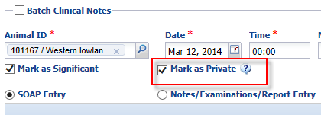
Mark as Private
Checking the “Mark as Private” checkbox means that,
even if you decide to share other Clinical Notes on the
animal with another institution, this Note will not be shared.
It does not mean that the Note is private to the person
who entered it. It does mean that it is private to your
institution and if other staff members have access to view
Clinical Notes they will see it.

Slide 11
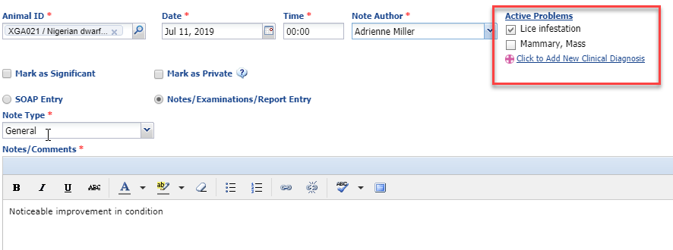
Active Problems
When you add a new Note all Active Problems are associated with that Note by default. However, there can be active problems that the current note is not relevant to. If the problems are not associated with the Note simply uncheck them. This Note relates only to the lice infestation, so the mammary mass is unchecked. You cannot associate a note with a problem that is Inactive on the date of the note. If you want to create a new diagnosis you can select the “Click to Add New Clinical Diagnosis” button and you will be taken to that screen.

Slide 12
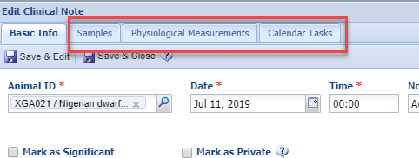
Other Tabs Activate
If you select Save & Edit, the remaining
tabs become active where you can
record Samples, Physiological
Measurements or create Calendar Tasks.
If you select Save & Close, the Note
will be saved and the data entry
screen closed. The next time you open
the Note record the tabs will be active.

Slide 13
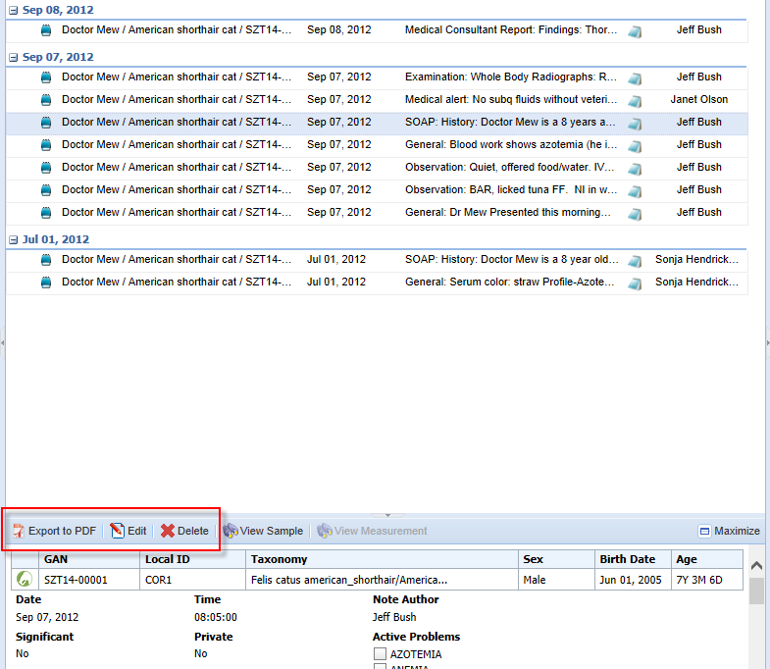
Export, Edit and Delete Clinical Notes
To Export to PDF, Edit or Delete the Note, highlight
the appropriate Note in the grid as above. Then select
the action you wish to take above the viewing pane as
shown below. To Edit you can simply double left click
on the note in the dashboard.

Slide 14
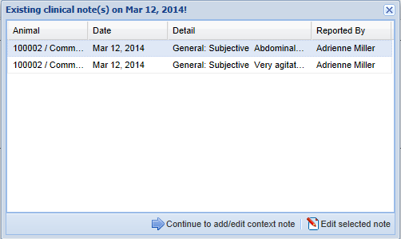
Existing Notes for Same Day
If you have already recorded a note in the animal record and you select to add another one for the same day, you will receive a screen displaying any other Notes that you recorded today for that animal.
You can select to “Continue to add/edit context note” and you will be taken to the Add Clinical Note screen.
Or, you can select to edit that highlighted Note.
This helps guard against duplicated Note entries.

Slide 15
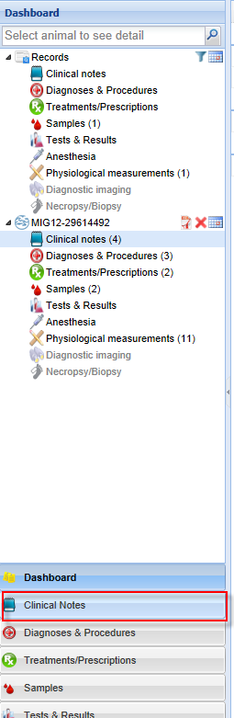
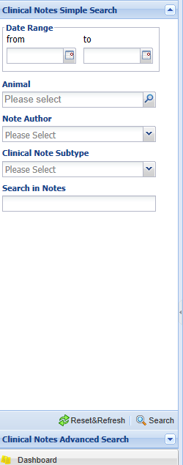
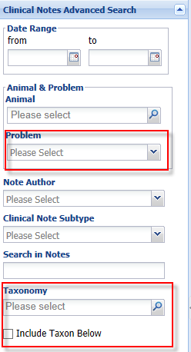
Searching for Clinical Notes
Selecting Clinical Notes from the lower left panel will bring up the Simple Search for Clinical Notes.
Selecting Advanced Search will add the fields to search by the Problem or the Taxonomy.

Slide 16
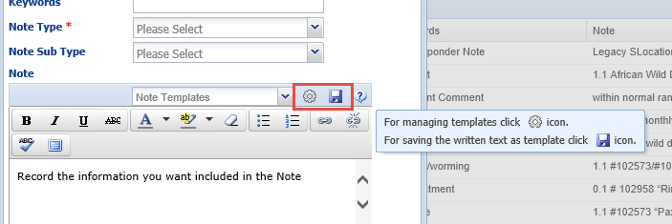
Note Templates
Note Templates help to make sure that you gather all the information
you want on a specific topic. Note Templates can be created and managed
from within the Animal Husbandry animal record or the Medical animal
record. If you have Note Templates created already they will appear in the
drop down list to select and use. If you wish to create a new one simply
type the information into the Note box and select the Save icon. To manage
the templates select the wheel icon. Because you created the Template from
within Clinical Notes, it will by default be a Clinical Note Template.

Slide 17
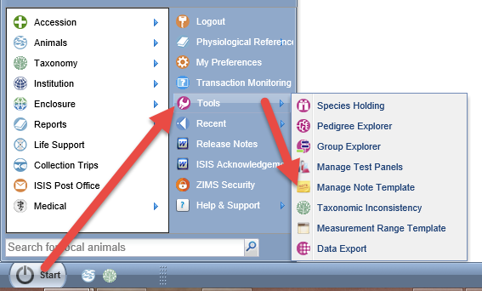
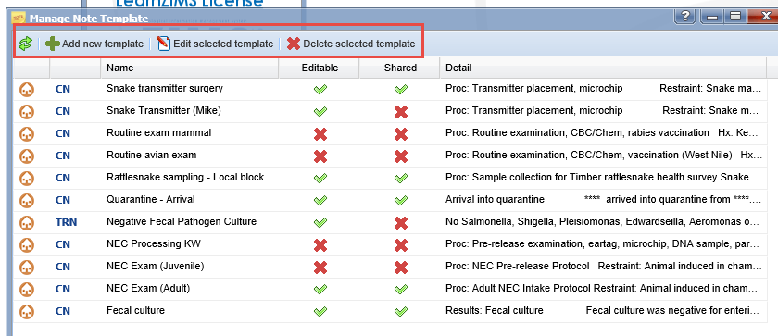
Note Templates
Note Templates can also be created and
managed from the Start Menu>Tools>
Manage Note Template. The grid will
display the type of template (left column),
whether it can be edited by others and if
it can be used by others.

Slide 18
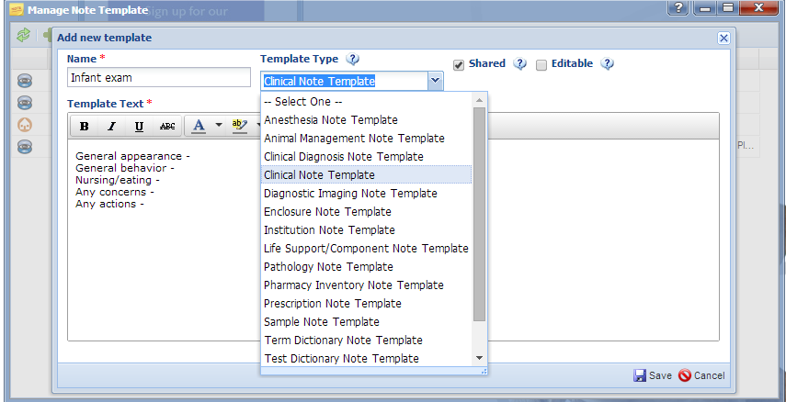
Note Template – Add New
Here we are creating a new Note Template for an animal’s first exam after birth or hatch. The Name should be unique. You will need to select the Template Type from the dropdown list. This template will ONLY be available for the type of note selected. This template will be shared with others, that means other staff members can use it. However, it is not editable by any other staff members other than its creator. In the Template Text record what information you want to collect in this type of note. HINT: when creating lists such as this example, use Shift/Enter to avoid extra spacing between the lines.

Slide 19
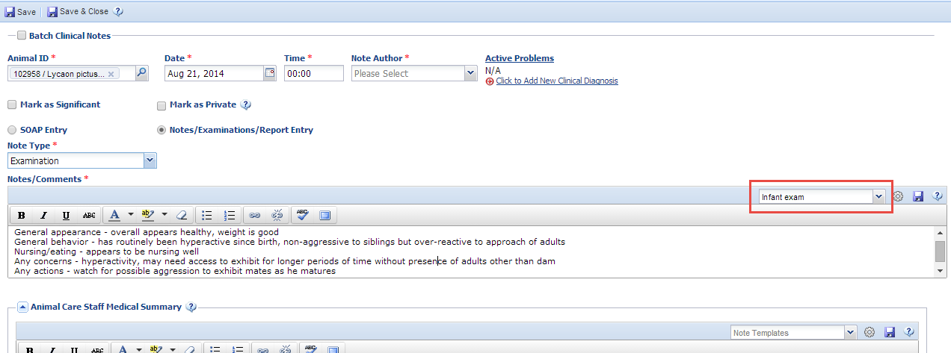
Note Templates - Using
To use the Note Template select it from the dropdown list. The information you
recorded will prefill in the text box where you can add the information. Note
Templates are easiest used for Notes/Examination/Report entries or for Animal
Care Staff Medical Summary. If used for a SOAP entry you will have to put your
curser in each box and select the appropriate template individually.

Slide 20

Clinical Notes
in ZIMS

