Slide 1

Incomplete Accessions
Partial Accession in ZIMS For Medical and Completing the Accession

Slide 2
ZIMS Updates!
This PowerPoint is up-to-date as of:
November 12th 2018
ZIMS is developed in an “agile” method
This means that it is updated every two weeks, sometimes with additional releases in between!
Use the link below to see if there have been any updates to this topic since the date above:
http://training.species360.org/updates/

Slide 3
Incomplete Accessions
Original intent was to allow Veterinary Staff to create a record that they could record medical data into (MedARKS non-accessioned animal)
Curators may also want to use the feature should they wish to record information on an animal that has not yet been accessioned
All information recorded on an Incomplete Accession will be migrated into the permanent accession record
Access to creating Incomplete Accessions is found under My Institution>Institution Roles>Animal module. It is not a Medical Role functionality.

Slide 4
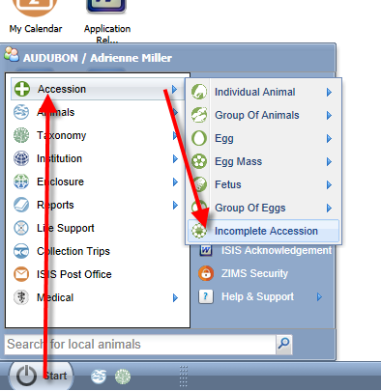
Starting an Incomplete Accession
Incomplete Accessions are found under the Start menu and Accession.
You will not select the entity type.

Slide 5
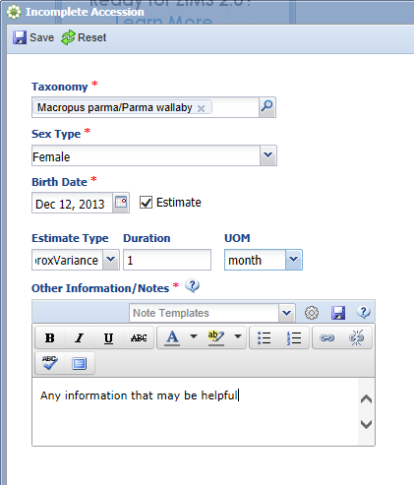

Creating an Incomplete Accession
Minimal information is required for
an Incomplete Accession. The taxonomy,
sex, birth date and appropriate notes
are the only information gathered.
All of this can be edited when the
permanent accession is created.
An Incomplete Accession receives a
temporary GAN. Note that this GAN
ends with “IA”.

Slide 6
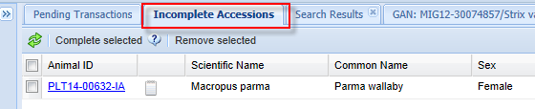
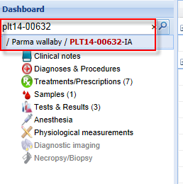
Recording Data in an IA
In the R1 module (above) Incomplete Accessions
are found to the right of the Pending Transactions tab.
Most information that can be recorded in an accessioned animal can be recorded in an Incomplete Accession such as weights and identifiers. To do this the User must have R1 access to the animal. An IA cannot be put into an Enclosure or a Collection, Parent Information cannot be added and subsequent Transactions such as Dispositions or Deaths cannot be
recorded.
In the R2 module (left) the Veterinarian can
find the Incomplete Accession record just as
they can find a permanently accessioned record.

Slide 7
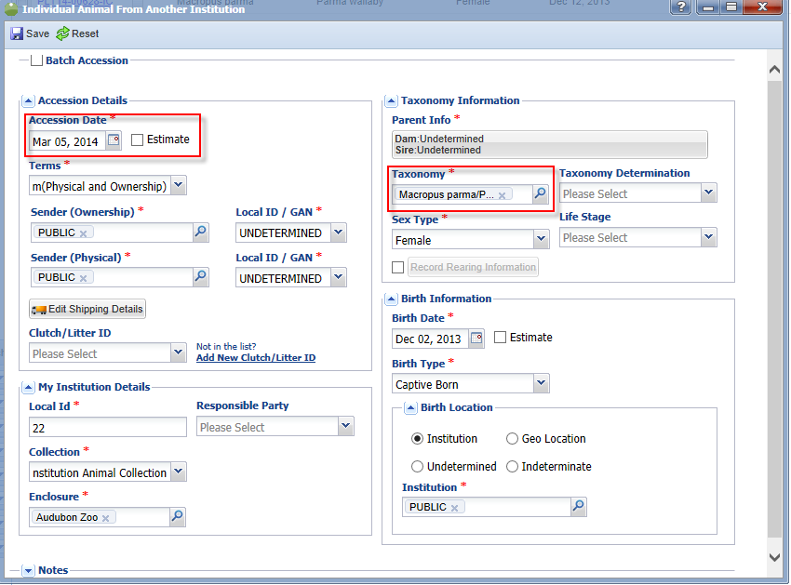
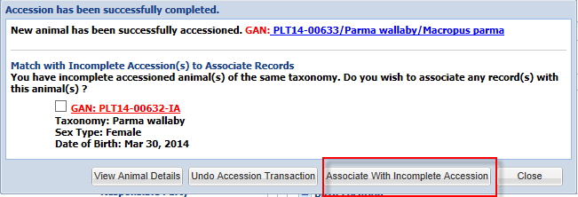
Associating an Incomplete Accession with a Permanent Accession
When a permanent accession is created
if the application finds any possible
matches in Incomplete Accessions you
will be asked if you wish to associate
any of these records with your accession.
Check the appropriate record and select
“Associate With Incomplete Accession”.

Slide 8
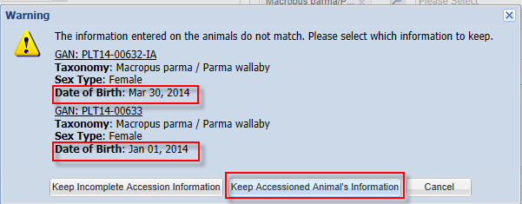
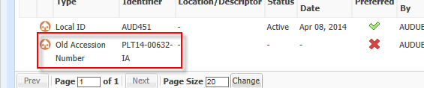
If the Information is Different
If the information for the permanent accession does not match the information recorded for the Incomplete Accession you will be asked which information you wish to keep. In this example the birth date was different. We chose to keep the accessioned animal’s
information. Any data recorded in the Incomplete Accession record will be migrated into the permanent record. The GAN of the Incomplete Accession becomes an Old Accession Number in the Identifiers grid.

Slide 9
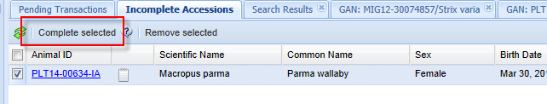

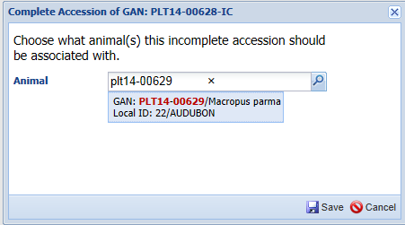
Complete Selected
If you don’t associate the permanent accession with the Incomplete Accession, the Incomplete Accession will remain in the grid. You can select it and choose to “Complete Selected”. You will be asked what animal the Incomplete Accession should be associated with. This method does require that the permanent accession be completed prior to Completing Selected. This is also the method you would use to associate the records should you Confirm a Pending Transaction for an animal that has had an Incomplete Accession created for it.

Slide 10
Entity Selection
Because there is no Entity (Individual, Group, Egg, etc.) selected during the Incomplete Accession, the Entity must be selected during the permanent accessioning process.
There may be times when several animals were received and the person doing the Incomplete Accession created only one record but the Registrar believes these animals should be separate individual records.
In reverse there may be times when several animals were received and the person doing the Incomplete Accession created multiple records but the Registrar believes these animals should be managed as a single group record.
These scenarios can be handled!

Slide 11
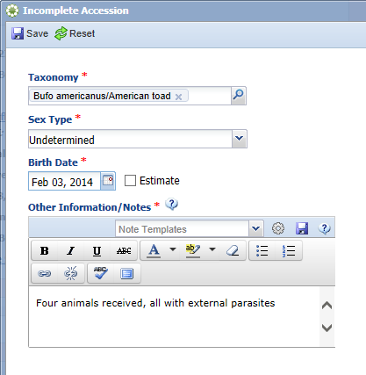
One IA into Multiple Individual Records
For the first scenario four toads were received over the weekend that required some
medical care. The Veterinarian created a single Incomplete Accession. He used the
Other Information box to note that there were four animals received.

Slide 12
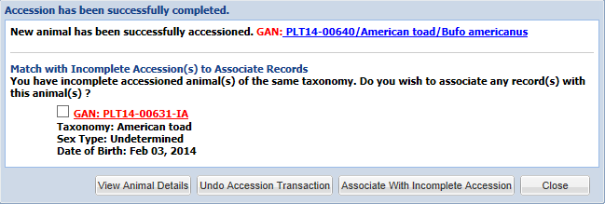
Creating the Permanent Accession
When the Registrar records the first individual accession the application finds the
Incomplete Accession record. The Registrar should NOT choose to Associate With
Incomplete Accession as the medical records would be associated only with this one
record. They should instead select View Animal Details or Close. They should then
complete the remaining three accessions. If they recorded a Batch Accession for the four
toads the application will NOT look into Incomplete Accessions.

Slide 13
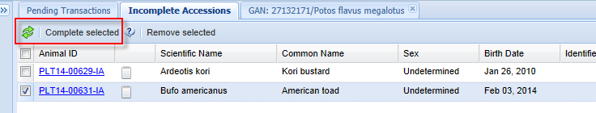
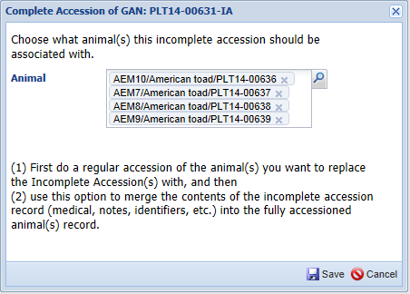
Associating the Single IA Record
To associate the single Incomplete
Accession with the four individual
Permanent accessions you would
go to the Incomplete Accessions tab, check the record and select Complete Selected.
You would then enter the four
individual permanent accessions.

Slide 14
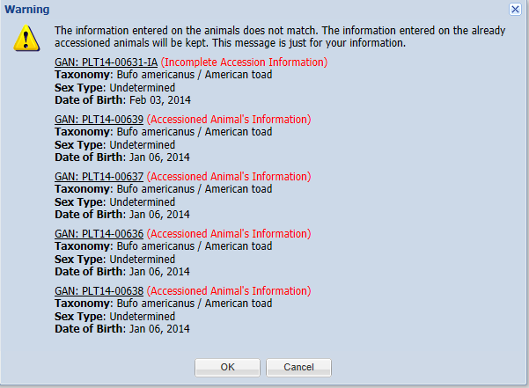
Information that Does Not Match
If the information does not match you will be given notification of such. In this
situation where the single IA is associated with multiple permanent accessions,
you do not have the option to select to keep the information recorded on the
Incomplete Accession, it is simply for your information .

Slide 15
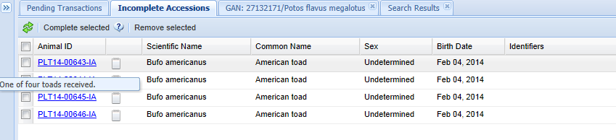
Multiple IAs into One Permanent Accession
For the second scenario four toads were received over the weekend that required some
medical care. The Veterinarian created four Incomplete Accessions. He used the
Other Information box to note that each record was one of four animals received.
There is currently no Batch Accession option for Incomplete Accessions.

Slide 16
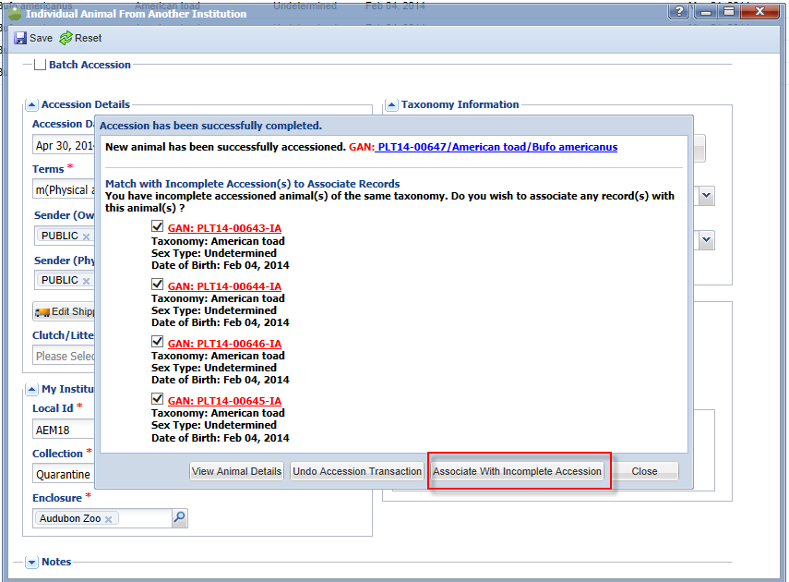
Associating the Multiple IAs
The Registrar has determined that the four toads should actually be managed as a group
record as they are not individually identifiable at this time. The Registrar records a single
permanent accession. The application finds the four possible IAs. All are selected to be
associated.

Slide 17
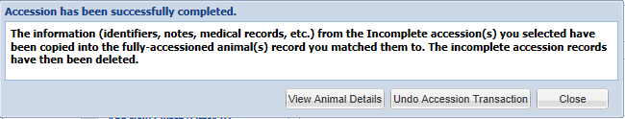
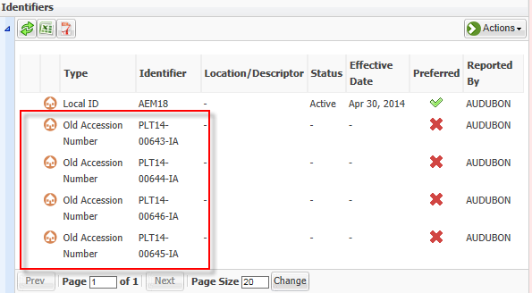
Information is Copied
When you select to associate the records you will receive a message that all information
will be copied into the single permanent accession record. All four of the IAs GANs will
become Old Accession Numbers

Slide 18

Any Questions?
Complete those puzzles!

