Slide 1
Incomplete Accessions
From the Medical View

Slide 2
ZIMS Updates!
This PowerPoint is up-to-date as of: July 5 2019
ZIMS is developed in an “agile” method
This means that it is updated every two weeks, sometimes with additional releases in between!
Use the link below to see if there have been any updates to this topic since the date above:
http://training.species360.org/updates/

Slide 3
Incomplete Accessions
Incomplete Accessions allow Veterinary Staff to create a record that they can record medical data into prior to the full accessioning of the animal or group
Often new births or acquisitions when the Registrar is off duty that require medical care
All information recorded on an Incomplete Accession will be migrated into the permanent accession record

Slide 4
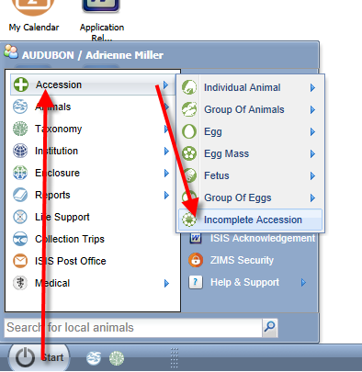
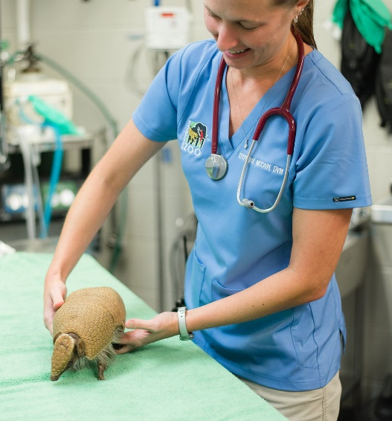
Creating an Incomplete Accession
To create an Incomplete
Accession go to Start >
Accession > Incomplete
Accession. You do not
select an Entity.

Slide 5
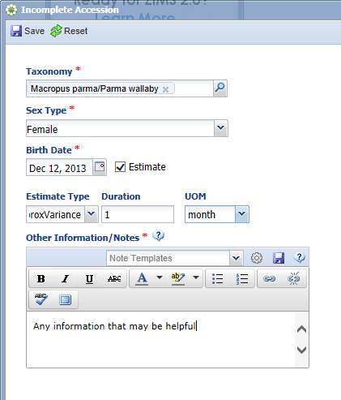
Creating an Incomplete Accession
There is minimal information recorded.
The Taxonomy is how ZIMS will search
to try to match a full accession with an
Incomplete Accession. All data recorded
here can edited when the full
accession is recorded.
An Incomplete Accession is assigned a GAN.
Notice that is ends with “IA”. When the full
accession is completed this GAN will become
an Old Accession Number in the Husbandry
record.

Slide 6
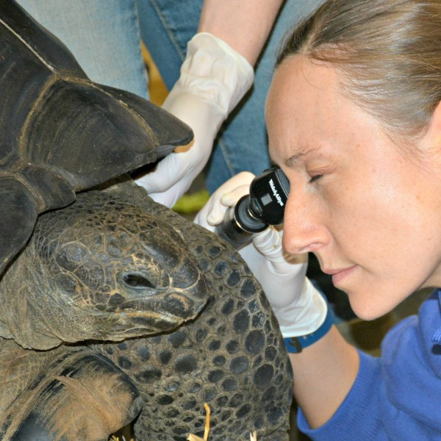
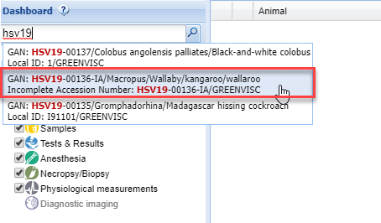
Finding an IA
You can search for an
Incomplete Accession
just like any fully
accessioned animals.

Slide 7
What you Can/Cannot Record
What you can record
What you cannot record
All Medical data
Measurements
Identifiers
Sex
Alerts
Images
Development Milestones
Training
Feed Logs
Permits
Life Stages
Management Plan
Responsible Party
Event Locations
Notes & Observations
Contraception
Enclosure
Parents
Rearing
Collection
Enrichment
Disposition

Slide 8
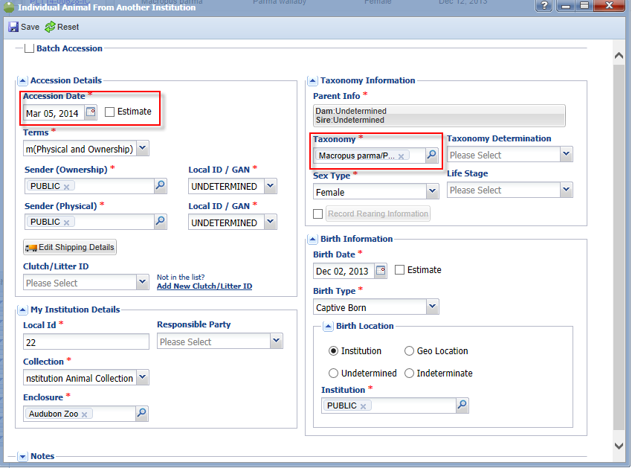
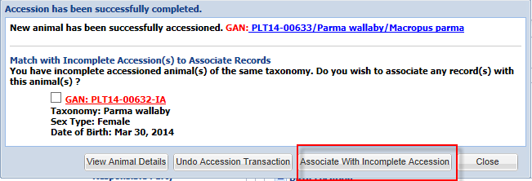
Associating an Incomplete Accession with a Permanent Accession
When a full accession is recorded,
ZIMS will look by taxonomy for
any possible matches in IAs. The
records will be associated and all
data entered in the IA will be
copied into the full accession
record.

Slide 9
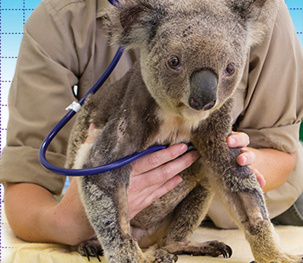
Incomplete Accessions
The Medical View

