Slide 1
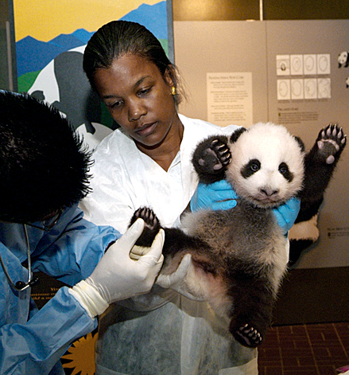
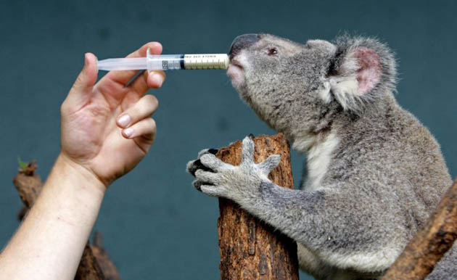
ZIMS Medical
An overview of the Medical Module in ZIMS

Slide 2
ZIMS Updates!
This PowerPoint is up-to-date as of: May 7 2019
ZIMS is developed in an “agile” method
This means that it is updated every two weeks, sometimes with additional releases in between!
Use the link below to see if there have been any updates to this topic since the date above:
http://training.species360.org/updates/

Slide 3
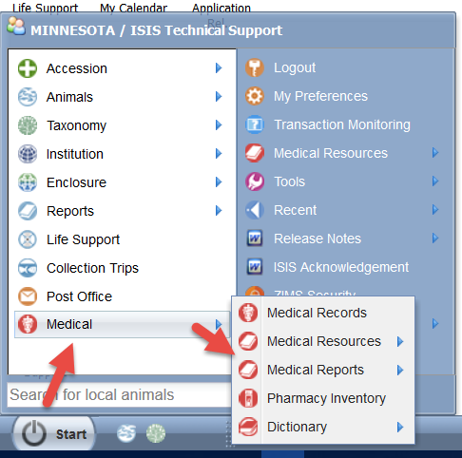
Navigation
The Medical Module is found
under the Start Menu. This will
only display if access has been
provided to you in your ZIMS Role.
There are five sub-menus:
-Medical Records
-Medical Resources
-Medical Reports
-Pharmacy Inventory
-Dictionary

Slide 4
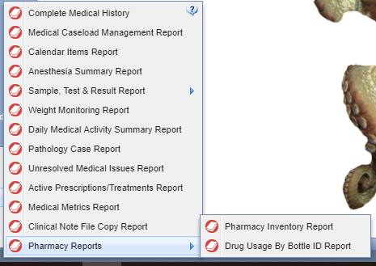
The Five Sub-Menus
Medical Records
All the medical records on all the animals in your collection
You may want to drag and drop this to your desktop if you will be using it a lot!
Medical Resources
Anesthesia Summaries
Drug Usage Extracts
Test Results
Search by Test
Expected Test Results
Morbidity & Mortality Analysis
Medical Reports
15 reports
Pharmacy Inventory
Track controlled substances
Dictionary
Term
Treatment
Test

Slide 5
Medical Preferences
Medical Preferences are available in Institution Preferences (Start > Institution > Institution Preferences) and My Preferences (Start > My Preferences). My Preferences (how your personal account application settings will function/display) will usually over ride what is selected in Institution Preferences (the institutional default for all new users).
Pathology Preferences are an Institution Preference only.

Slide 6
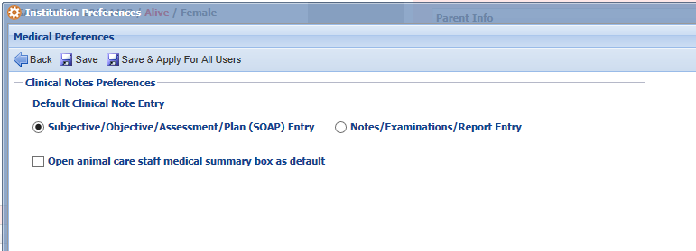
Clinical Notes Preferences
The preferences for Clinical Notes affect the defaults for how the screen
opens. If you seldom make SOAP entries and usually make more free text
entries you will want to change the default from SOAP to
Notes/Examinations/Report Entry. The animal care staff medical summary
box is one way to communicate back to the husbandry staff- this note will
be visible in the animals notes that display on the husbandry side of ZIMS.
Open as default saves you a click…ensuring the box will be open for you
when loading clinical notes.

Slide 7
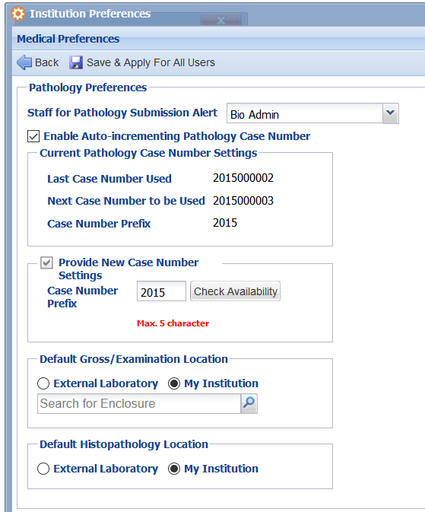
Pathology Preferences
Pathology includes Necropsy and Biopsy records in ZIMS Medical. -Setting the staff for Pathology Submissions ensures that the appropriate staff/team will be notified (via the ZIMS calendar) that a new necropsy has been ordered. -Auto-incrementing path case # simplifies the record entry process if you do not issue these numbers manually. -Defaulting the exam and histopath locations are additional time savers if these are always performed at a specified lab or in-house. You may
need to add the External Lab to your institution list.

Slide 8
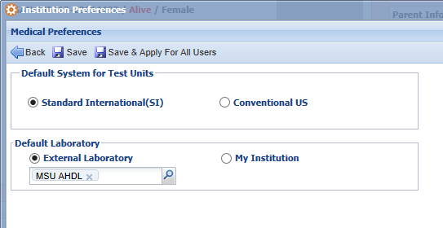
Tests & Results Preferences
Under Tests and Results Preferences allow you to select your
desired measurement type of Standard International or
Conventional US. You can also select a specific laboratory or your
Institution as the default for who is doing the sample analysis.
These can all be edited during the actual data entry.

Slide 9
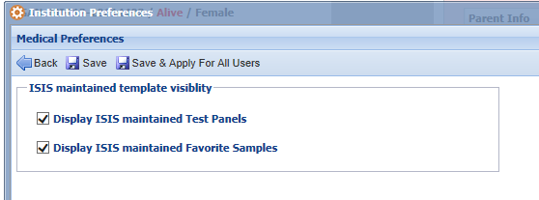
Species360 Template Visibility Preferences
Species360 will be maintaining some standard Test Panels and Favorite Samples
Templates. By default these will display. Uncheck the box if you want only your
locally created Test Panels or Favorite Samples to be seen.

Slide 10
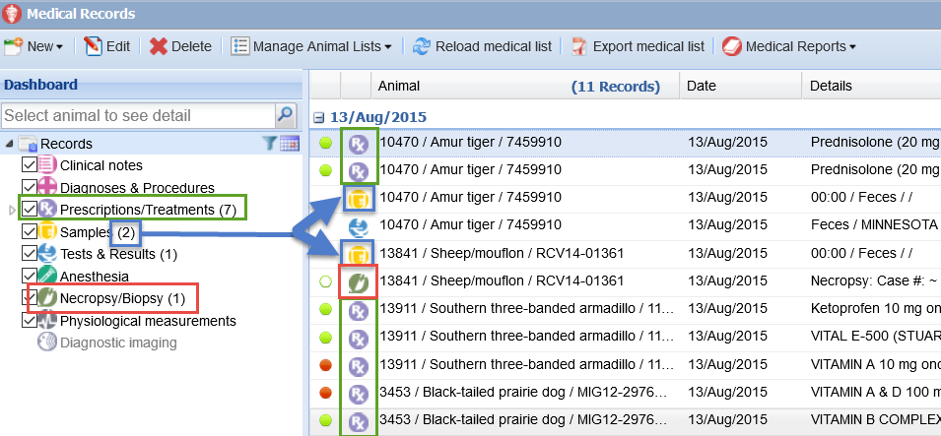
Medical Records – the Dashboard
When you first open the Medical Records module the most recent entries
will display in the middle pane (last 7 days). The left hand side indicates how
many of each type of record are included (blue). Note how the icons allow you
to easily spot different record types. You can easily find the 1 Necropsy/Biopsy
record (red) and the 7 Prescriptions/Treatments (green).

Slide 11
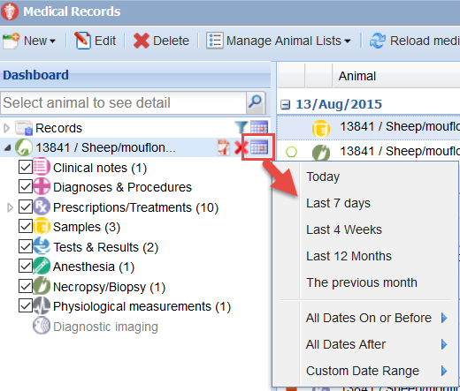
Record Selection
The left side controls the selection of the records you want to view in
the dashboard. To remove them from view simply uncheck them.
The date range default is the last 7 days. Using the calendar icon you can adjust this to your desired date range.
The date range default when an single animal record is selected is the life of the animal.

Slide 12
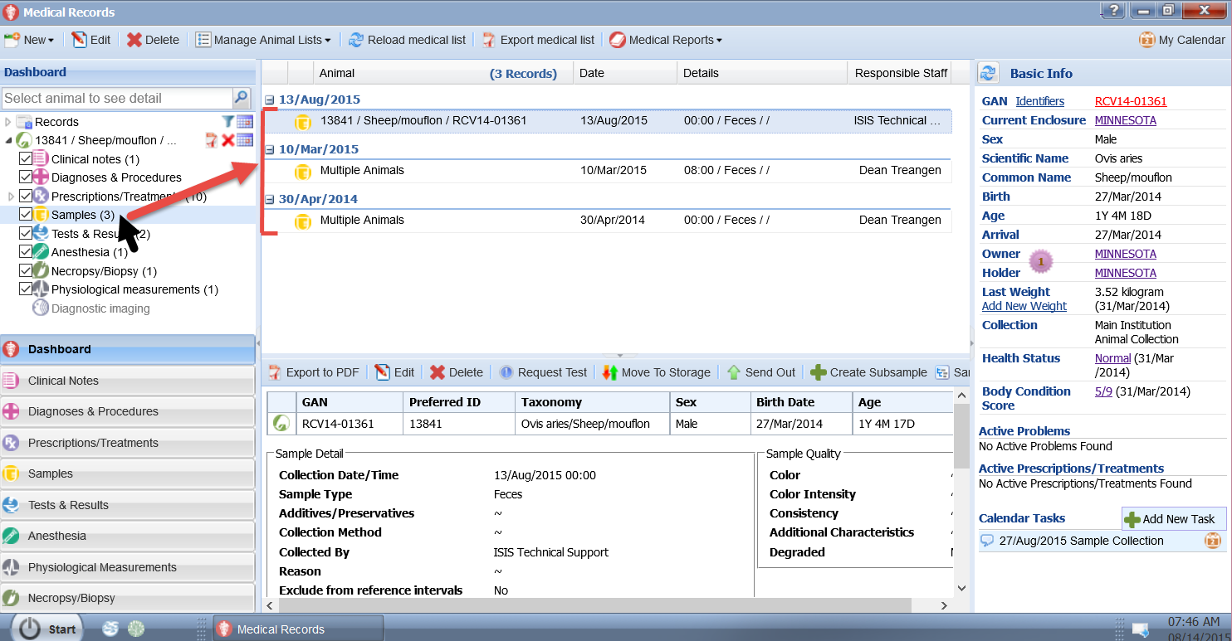
List of Selected Records
If you want to view only one type of record in the dashboard,
click on it. We have selected Samples from the left panel. Only these records will now display with the most recent date
at the top.

Slide 13
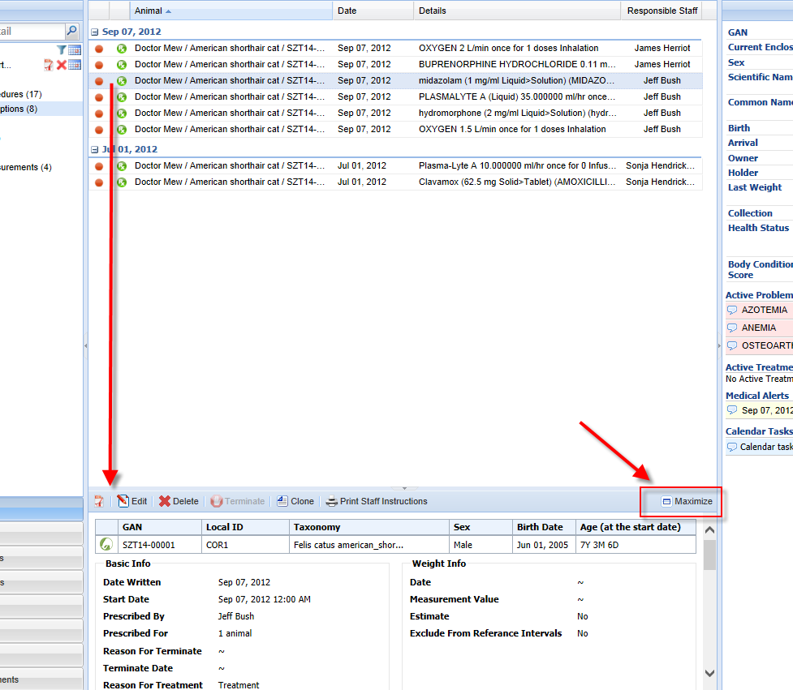
Record Preview Pane
When a record is selected from the list,
the lower center panel becomes a
preview pane for the information recorded.
To view the entire entry select the
Maximize button.

Slide 14
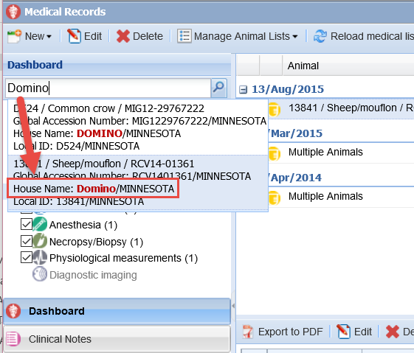
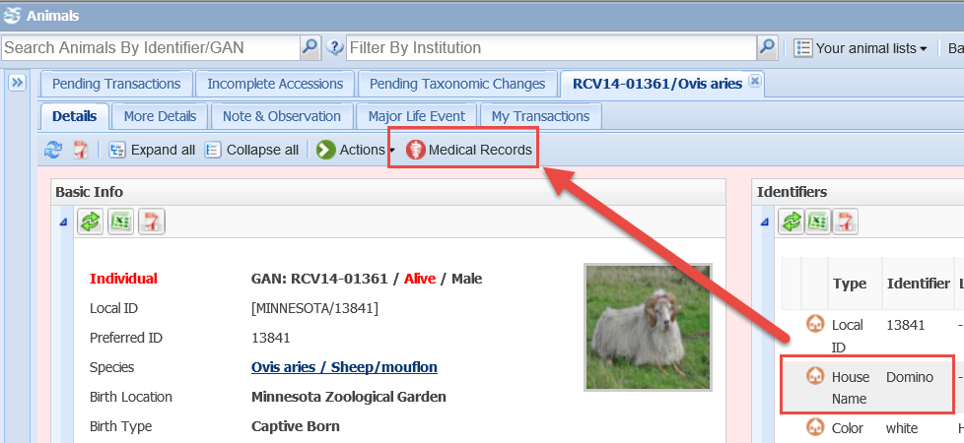
Opening an Animal Medical Record
To open a record for a
specific animal or group
type in the GAN, Local ID,
or other identifier such as
transponder into the search
field.
In addition, you can access
the medical records directly
from the husbandry animal record.

Slide 15
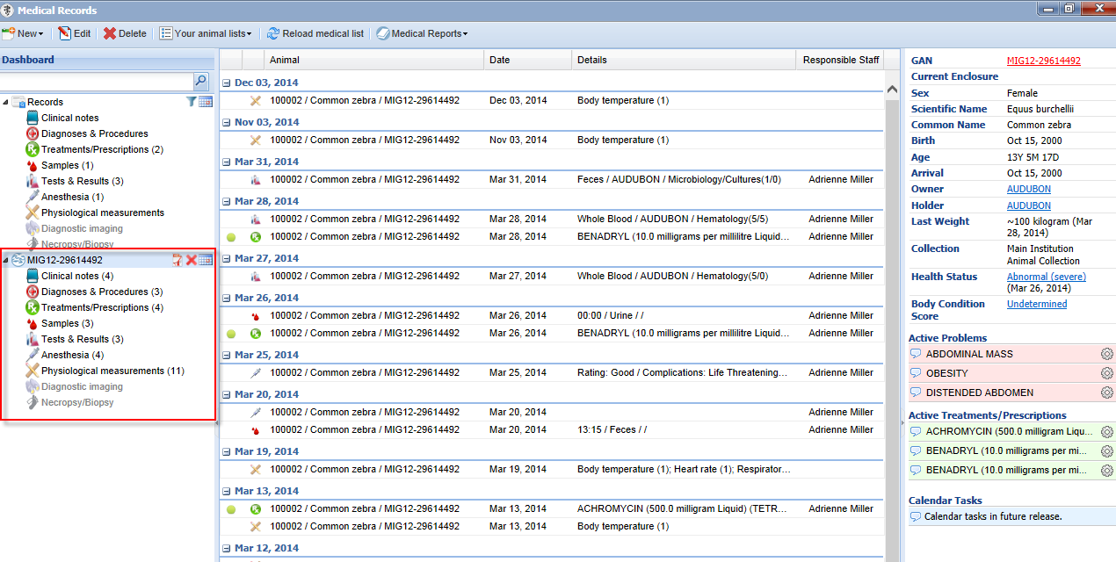
Animal Record
The animal will then appear in the left hand
Dashboard. Only its records will display in the
middle Dashboard and the information in the
right hand panel will relate to that animal.

Slide 16
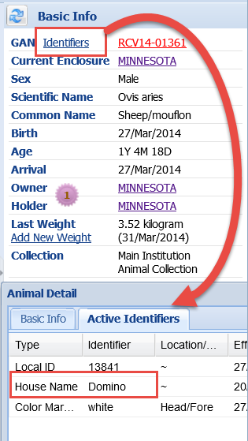
Right Side Panel - Top
The top of the right side panel displays information
that is sourced from the Animal Husbandry module of ZIMS.
-The GAN is a hyperlink to the animal’s Husbandry record.
-The Enclosure is a hyperlink to the Enclosure record.
-The Sex, Scientific Name/Common Name, Birth, Age and Collection are all sourced from the animal’s Husbandry record. -Arrival date is linked to the date of accession
-The Owner and Holder are hyperlinked to the institution record.
-The Last Weight, if any, will display. You can record a new weight here. Medically linked weights are not editable in husbandry. The Unit of Measure will always be the UOM selected in your Preferences, regardless of what UOM was entered for the weight, and converted if required.
-The linked ‘identifiers’ at the top will show other active
Identifiers from the animal’s husbandry record.

Slide 17
Right Side Panel – Health Status and BCS
The Health Status is the current health status,
as of the date displayed, and is a hyperlink to
the full health status history and the screen
where you can add a new Status or edit this one.
The Body Condition Score is as of the date displayed.
It is a hyperlink to the full Body Condition score and
the screen where you can add a new BCS or edit
this one. We use a 9 point scale – 5 points scale can be used by choosing 1,3,5,7,9 accordingly.

Slide 18
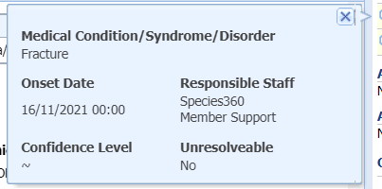
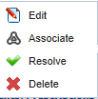
Right Side Panel – Active Problems
The Active Problems are unresolved
medical issues for this animal.
Click on the left side bubble to see more details.
Click on the wheel icon to Edit the record,
associate it with another issue, resolve it or
delete the problem.

Slide 19
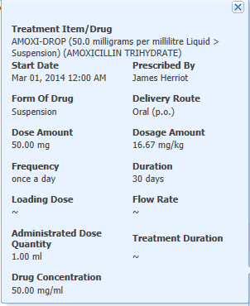
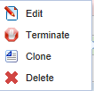
Right Side Panel – Active Treatments/ Prescriptions
Active Treatments and Prescriptions are
those that are currently active or on-going
for the animal.
Clicking on the left hand bubble will
bring up the details.
Clicking on the wheel icon will allow
you to Edit, Terminate, Clone or Delete
the information. Cloning will copy the
information but will allow editing if required.

Slide 20
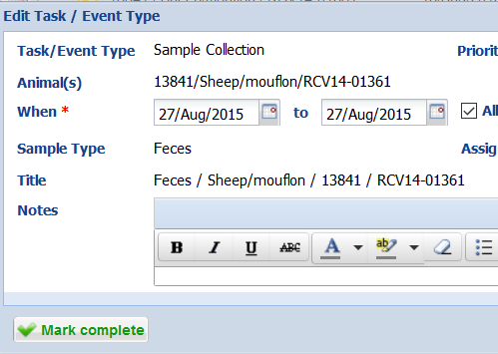
Right Side Panel – Medical Alerts
Medical Alerts are a special subtype of
clinical note that contain critical
information regarding the animal.
These Alerts are different than the
Animal Alerts in the husbandry side as they usually indicate on-going Alerts for
the medical care of the animal. Selecting the left side bubble is an active link to the full text of the Alert.
Calendar Tasks can be added with one click to schedule medical procedures, sample collection or treatments. Marking current tasks ‘complete/incomplete’ is an option
when opening the linked calendar task.

Slide 21
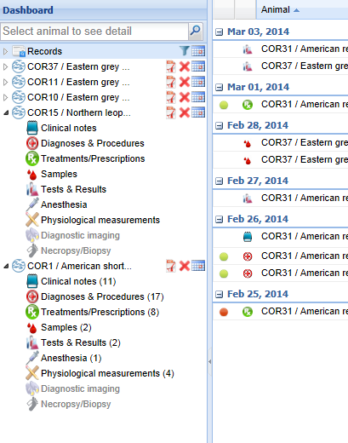
Multiple Open Records
You can keep multiple records open at
the same time for ease of comparison.
Your open records will display as a list
on the left side of the dashboard. You can
expand and collapse by using the arrows.
Using the right side icons you can export
the medical history of the animal,
remove the animal from your list of open
records, or filter the records by date.

Slide 22
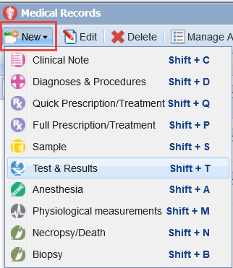
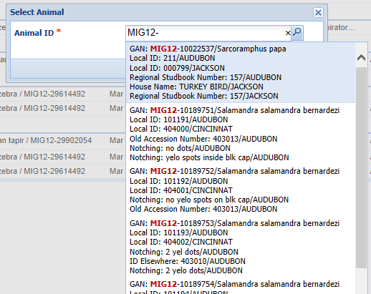
Adding a Medical Record – No Animal in Focus
There are three ways to add a new medical record. If you do not already have an animal record open, from the left hand Dashboard select New and make your record type selection. You will then select the animal by typing in an identifier. It will take you to the appropriate screen to add the medical record.

Slide 23
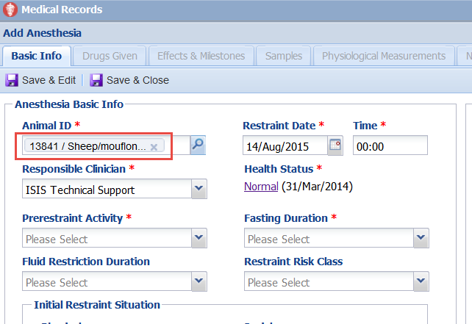
When an Animal is in Focus
If you have an animal record open on the left
hand Dashboard, selecting New and the
required topic will open the screen with the
Animal ID prefilled.

Slide 24
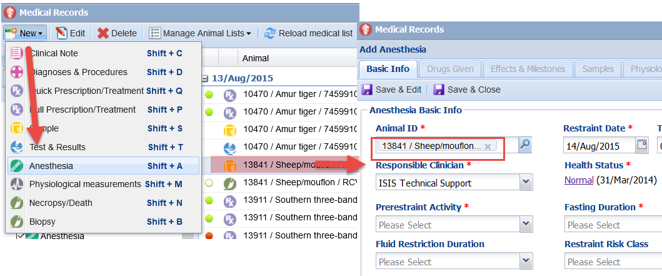
From the Main Dashboard
From the Main Dashboard you can also highlight a record and select New
and the required topic. The screen will open with the Animal ID prefilled.

Slide 25
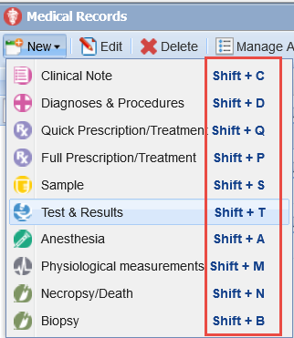
Shortcut (Hot) Keys
To save data entry time take advantage of the shortcut (hot)
keys that are available for adding medical records.

Slide 26
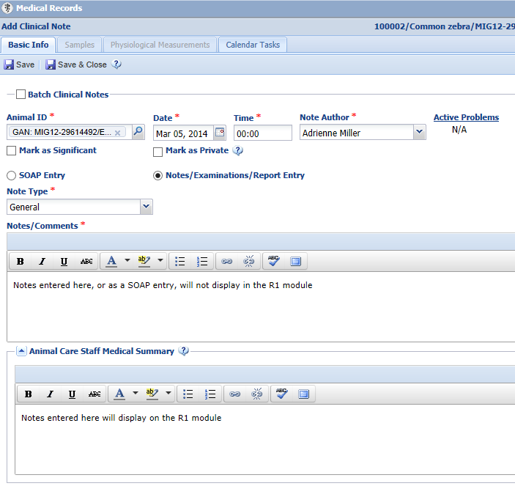
Animal Care Staff Medical Summary
In Clinical Notes there is the option to record
a simple note as selected here, or to select
the SOAP Entry (Subjective, Objective,
Assessment and Plan) button and record a
more detailed comment. The information
recorded either as a SOAP entry or as a
Note/Examination/Report Entry will display
only in the Medical module.
Any information recorded in the Animal
Care Staff Medical Summary will display
in the Husbandry module Notes/Observation grid, as well as within the Medical module.

Slide 27
Husbandry View of Medical Summary
Below is the Husbandry view of the Animal Care Staff Medical Summary information
from the previous slide. You can tell this note was entered on the Medical module
as the title is Clinical Medical Summary Note. You cannot edit or delete this note.
Those actions can only be done from the Medical module because it was entered there.

Slide 28
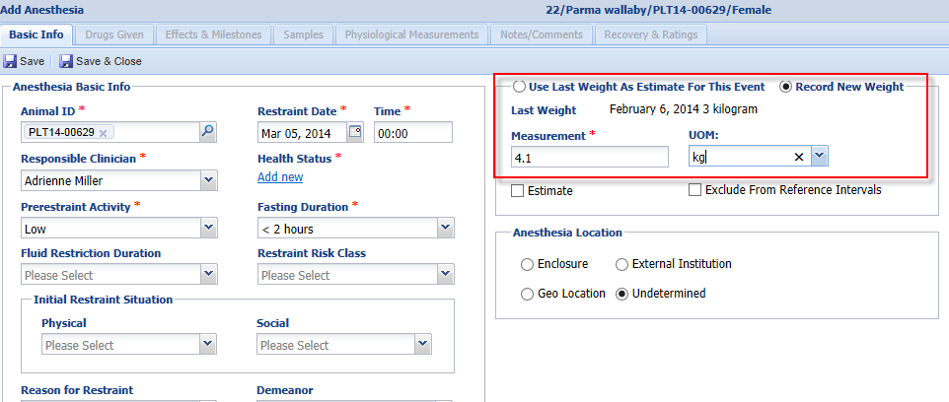
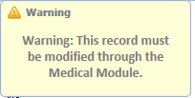
Animal Weights
When recording an anesthesia or treatment event, the Veterinarian has the option to use the last weight recorded which is usually sourced from the Husbandry module weight grid. However, they have the option to record a new weight for the animal. If a new weight is recorded, this information is copied into the weight grid in the Husbandry animal record. If this is an estimated weight recorded during a Prescription it is NOT copied into the Husbandry module. This weight cannot be edited from the Husbandry module and can only be edited from within the Medical record. You can see the weight recorded on 14 August was sourced from a treatment record. If you do NOT want medical
recorded weight to display in husbandry you can use
Institution Preferences to do so.

Slide 29
Medical Display in Transaction Monitoring and Activity Report
Transaction Monitoring
All medical entries
Weights are not separated out as they are recorded during Anesthesia or Treatment
Activity Report
Weights recorded (including estimated weights)
Animal Care Staff Medical Summary note
Other medical entries are not displayed

Slide 30
Incomplete Accessions
Allows your Veterinary staff to start entering medical data without actually accessioning an animal
Similar to the “non-accessioned” animal functionality in MedARKS
When it is time to actually accession the animal the Incomplete Accession information will be tied to the actual accessioned record

Slide 31
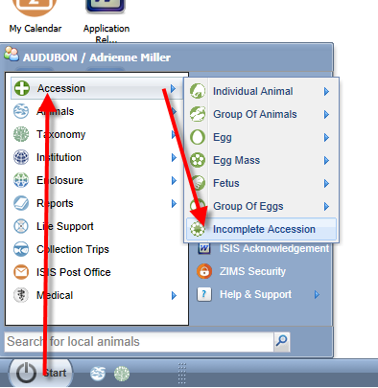
Starting an Incomplete Accession
An Incomplete Accession is intended
to allow the Veterinarian to create a
temporary record so that medical
information can be recorded. An
Incomplete Accession is generally
used when the person who does
accessions is not available to create the
permanent record.
Incomplete Accessions are found under
the Start menu and Accession. You
will not select the entity type.

Slide 32
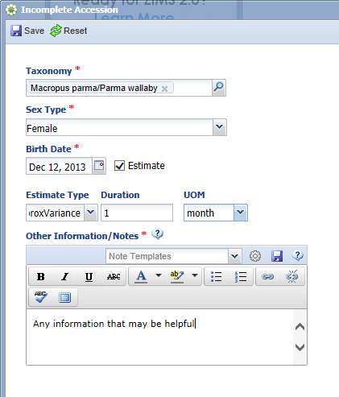
Creating an Incomplete Accession
Minimal information is required for
an Incomplete Accession. The taxonomy,
sex, birth date and appropriate notes
are the only information gathered.
All of this can be edited when the
permanent accession is created.
An Incomplete Accession receives a
temporary GAN. Note that this GAN
ends with “IA”.

Slide 33
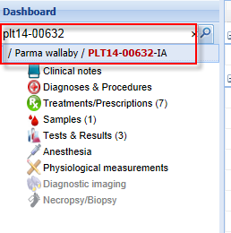
Recording Data in an IA
In the Husbandry module (above) Incomplete Accessions are found to the right of the Pending
Transactions tab.
Most information that can be recorded in an accessioned animal can be recorded in an Incomplete Accession such as weights and identifiers and all medical records. An IA cannot be put into an Enclosure or a Collection, Parent Information cannot be added and subsequent Transactions such as Dispositions or Deaths cannot be recorded.
In the Medical module (left) the Veterinarian can find the Incomplete Accession record just as they can find a permanently accessioned record.
When a full accession is created, all information entered in the IA will be copied over.

Slide 34
Incomplete Dispositions
Allows the ‘death record’ to be started from a Necropsy submission
Guarantees that Husbandry staff will have the ability to confirm death information linked to formal medical necropsy record
If details are not in agreement between the Husbandry and Medical staff these changes can be noted

Slide 35
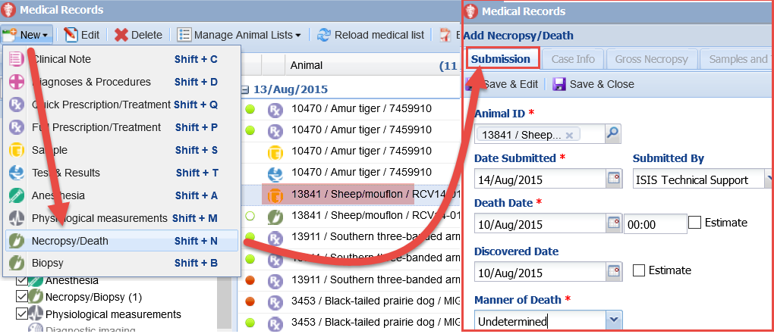
Starting an Incomplete Disposition
Creating a submission under a Necropsy record in ZIMS Medical will trigger the creation of an ‘Incomplete Disposition’ in the Husbandry side workflow. This submission will also create a calendar note to the responsible pathologist defined in your Institution Preferences that a full necropsy is waiting to be
performed.

Slide 36
ZIMS for Medical - Your Medical Data at your finger tips!

