Slide 1
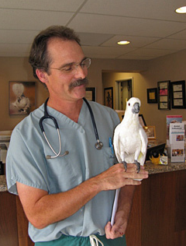
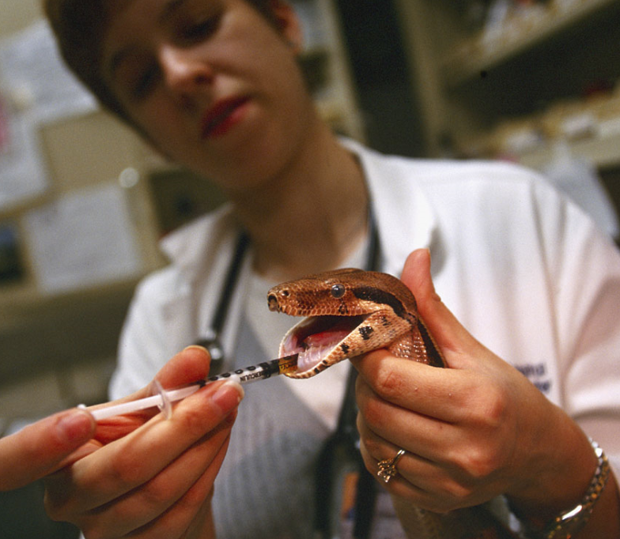
R2 Deployment
A Guide to What You Need To Do and What To Expect From Species360
When You Deploy ZIMS With Medical

Slide 2
ZIMS Updates!
This PowerPoint is up-to-date as of:
November 12th 2018
ZIMS is developed in an “agile” method
This means that it is updated every two weeks, sometimes with additional releases in between!
Use the link below to see if there have been any updates to this topic since the date above:
http://training.species360.org/updates/

Slide 3
Thanks to Our Testing Institutions!
Alexandria Zoological Park
Brookfield Zoo
Bronx Zoo
Copenhagen Zoo
DSI Givskud Zoo
Fort Wayne Children’s Zoo
John Ball Zoo
Minnesota Zoological Park
New York Aquarium
Omaha’s Henry Doorly Zoo
Parc Paysager Et Animalier Du Reynou
Philadelphia Zoo
Roger Williams Park Zoo
Sacramento Zoo
Steinhart Aquarium
Tiergarten der Stadt Nurnberg
The Living Desert
Toledo Zoo
White Oak Conservation Center
Zoo Parc de Beaval

Slide 4
Deployment In a Nutshell
You need to have MedARKS version 5.54.i
Deployment will take about one month
Initial review of MedARKS data (if applicable)
Use of self-paced training
Set up and configuration of Users

Slide 5
Deployment in More Detail
6 to 8 weeks before going Live
  Make sure that you are using the latest version of MedARKS (if applicable)
  Version 5.54.i
    Backup first
    Get everyone out of MedARKS
    Download from MedARKS support page directly into the NEWMED/MEDARKS folder where your MedARKS lives (c-drive or server)
4 weeks before going Live
  Send Species360 an initial backup of your MedARKS data for us to review (if applicable)
3 weeks before going Live
  Begin self-paced training
2 weeks before going Live
  Create medical Users and Roles
The Thursday before going Live
  Stop using MedARKS and send Species360 the final backup of your MedARKS data (if applicable)
The following Monday
  GO LIVE!!!!!!!!!!!!

Slide 6
Self Paced Training
PowerPoints and Interactive Exercises
  http://training.Species360.org/zims/
LearnZIMS general access for worry-free ZIMS practice
  http://training.Species360.org/practice/
License for a training database for staff
  http://training.Species360.org/learnzims/

Slide 7
What is in this current Release?
Clinical notes
Diagnosis & Procedures - the MedARKS master problems list
Anesthesia
Prescription
Samples - not a separate module in MedARKS
Tests and results
Physiological measurements - heart rate, body temp, blood pressure, etc.
Pharmacy inventory - Controlled Drug Tracking in MedARKS
Incomplete Accession – non-accessioned animal in MedARKS
Health status – new to ZIMS
Body Condition Score log – new to ZIMS
Some report and export functions
Dictionaries – Term, Treatment and Test
Pathology Module (Necropsy and Biopsy functionality)
Global Drug Usage Extracts
“Group Plus” view of medical records

Slide 8
What is in a Future Release?
Sample storage
Sample shipment
Diagnostic imaging – MedARKS radiology records
Research requests

Slide 9
How Can I Juggle Two Applications?
After you go Live you will download a “post-deployment” version of MedARKS
This version allows data entry into these modules (the others are disabled)
When the function is available your MedARKS data for those modules will migrate into ZIMS
There is no double-entry of data required

Slide 10
What if I Need Help?
No worries! Your member support Representative will be with you every step of the way.
They will help you complete the pre-deployment activities
and provide support once you are Live.

Slide 11
Deployment Sprints as for R1
R2 will deploy in Sprints just like R1 deployment
Each Sprint will deploy 25 institutions
  20 slots for MedARKS Users
  5 slots for non-MedARKS Users
If you have not scheduled deploying to medical, email support@Species360.org
Species360 will email you with a confirmation of your institution’s Sprint date

Slide 12
What if I am Still Using ARKS?
You will first need to deploy with ZIMS R1 functionality (Animal Husbandry)
4 to 6 weeks later you can then deploy with ZIMS R2 functionality (ZIMS With Medical)

Slide 13

Remember!
Don’t forget!
If you have not yet
contacted Species360 with your request to get medical, please do so as soon as possible by
contacting support@Species360.org

Slide 14

Deploying R2
It’s Easy!

