Slide 1
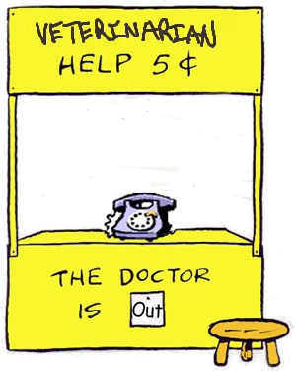
ZIMS Medical - Lite
How ZIMS Medical can support you without a dedicated Vet or Vet-Tech

Slide 2
Health Status + Body Condition Score
Health Status
Can be edited from both the Husbandry and the Medical modules
This is critically important because of the impact on the Global Resources
Only data recorded on an animal with Health Status = Normal becomes part of the resources
You will receive reminders if the HS does not match any medical conditions
Example: HS of Normal but a current medical condition is reported
Body Condition Score
ZIMS uses a 1-9 scale. If you use a 1-5 scale simply use the odd numbers to record
Not as critical as Health Status

Slide 3
Ins and Outs
Incomplete Accessions
Allows medical data to be recorded on an animal/group that is not yet fully accessioned
All information entered will migrate into the full accession record
Incomplete Dispositions
When a Necropsy Submission is created prior to a death being recorded in the Husbandry module, a Pending Transaction for death is created in the Husbandry module
This is a heads up for the Registrar to record a death

Slide 4
Incomplete Accessions
What you can record
What you cannot record
Medical data
Measurements
Identifiers
Sex
Alerts
Images
Development Milestones
Training
Feed Logs
Permits
Life Stages
Management Plan
Responsible Party
Event Locations
Note & Observations
Contraception
Enclosure
Parents
Rearing
Collection
Enrichment
Disposition

Slide 5
Incomplete Accessions
How it helps:
Limitations:
Pair with ‘provisional’ for a distributed team when Registrar not available
Empowers contract vet to use ZIMS, they can create an animal and record medical data without needing to ‘know the collection’
Similar to Provisional, requires a responsible person to ‘complete’ the process

Slide 6
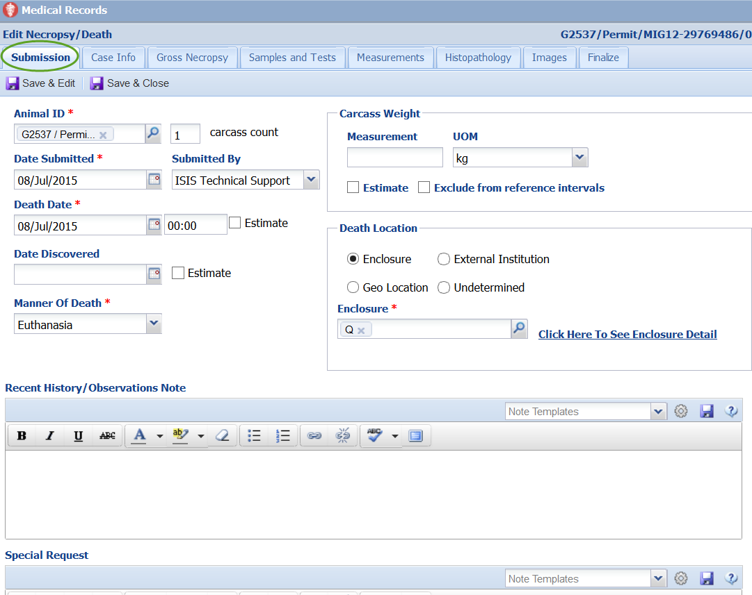
Incomplete Dispositions
Necropsy - Submission
The death screens in ZIMS Medical include tabs for:
Submission (Required First- Can be initiated by husbandry staff)
Case Information
Gross Necropsy
Samples and Tests (associated with the Necropsy)
Measurements (associated with the Necropsy)
Histopathology
Images
Finalization of the record
Submission information: captures the core details on the animal who has died. Creating a necropsy record triggers the death disposition event that will be entered into the pending dispositions/transaction tab of the animals main husbandry record.

Slide 7
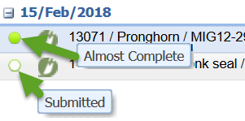
Incomplete Dispositions
How it helps:
Limitations:
Allows staff to ‘begin’ a death record without modifying transactions /inventory records
Creates calendar entry for assigned pathologist
Can add ‘animal care summary’ note from Pathology record for husbandry
Complete record can be ‘locked’
Submission tab may be the only use of Necropsy for your team - searchable
Similar to Provisional, requires a responsible person to ‘complete’ the process
Tests/Results as a part of Necropsy are kept apart from ‘live’ records.
Necropsy ‘takes knowledge and time’.
Morbidity and Mortality global resources is sourced from this information

Slide 8
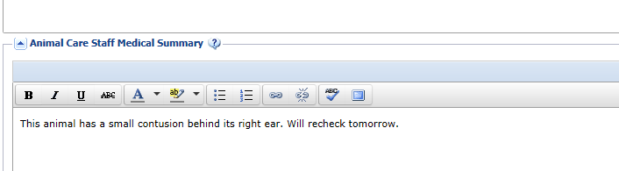
Notes Notes Notes… Everything is Notes.
The Animal Care Staff Medical Summary allows notes that are directed more at the animal husbandry staff than the medical staff. These notes do get copied into the Husbandry module Notes & Observations grid and are intended for communication between the medical and husbandry staff by providing a summary of the medical issues. These notes are redundant – a summary of what has already been entered into the Clinical Notes. These notes are usually less technical than the SOAP or Notes/Examinations/Reports entries. They are not searched when Clinical Notes are searched.
These notes cannot be edited from the Animal Husbandry module and can only be edited or deleted from the Medical module.

Slide 9
Clinical Notes
Animal Care Staff Medical Summary
How it helps:
Limitations:
Medical statement entered by, or transcribed from, vet kept apart from husbandry
Interpreted statement copied over ‘read only’
As easy as ‘sending an email’ for a contract vet
Mark as significant and mark private options – Searchable!
Can link to known ‘active problems’
Requires vet log-in
Creating ‘problem list’ and resolving takes knowledge and time.

Slide 10
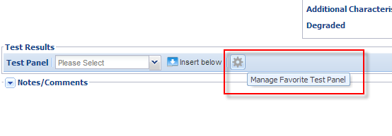
1 Samples -> 2 Tests -> 3 Results
Save data entry time by using Test Panels. Set these up early and Manage Favorite Test Panels actively.
You can also create your own Test Panels by selecting Add
New Panel.

Slide 11
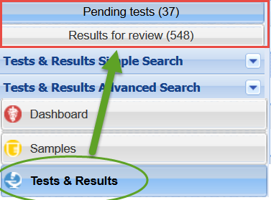
1 Samples -> 2 Tests -> 3 Results
Samples, Tests and Results
Limitations:
How it helps:
Test results panels need to be created (contact support)
Entering values take time
Test Results global resource is sourced from this information
Samples alone can be added – searchable
Tests and or Results can be reported later
Manage typical sample types and standard test panels
Can link to known ‘active problems’
ZIMS tracks the process from request→review

Slide 12
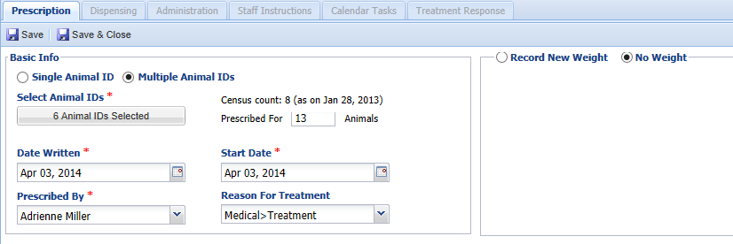
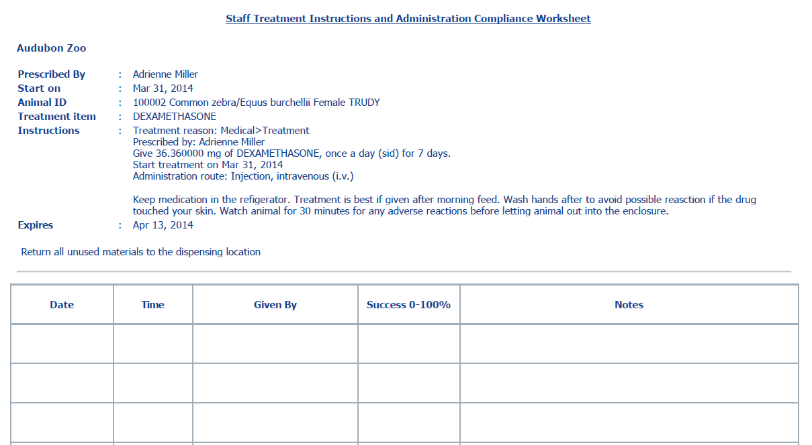
Prescriptions
Full
Quick
Selecting Print Staff Instructions will
bring up a sheet with instructions and
space for tracking the administration
of the treatment.

Slide 13
Prescriptions
Quick (vaccines) or Full
How it helps:
Limitations:
Quick Rx are for ‘one and done’ entries like vaccines
Full Rx can be easily filled out with vet’s script, tracking required ‘follow up’ on calendar
Can ‘batch’ enter
Supports paper processes, add staff instructions and print with exact dosage sheets
Controlled drugs in inventory for DEA reporting linked to Rx/Anesthesia
Searchable!
Entering Rx take time
Drug Usage Extract global resource is sourced from this information

Slide 14
It can be Done!
Medical Without a Vet

