Slide 1


Global Medical Resources
High quality medical information summaries, extracted from ZIMS medical records entered by member institutions
Funded by IMLS award #: MG-30-14-0039-14

Slide 2
ZIMS Updates!
This PowerPoint is up-to-date as of:
May 30 2019
ZIMS is developed in an “agile” method
This means that it is updated every two weeks, sometimes with additional releases in between!
Use the link below to see if there have been any updates to this topic since the date above:
http://training.species360.org/updates/

Slide 3

Medical Resources
These resources provide the same type of information that could be obtained by contacting a colleague and asking about their experience with a vaccine, their preferred anesthetic drug combination or the most common medical problems within a specific taxonomic group. It is just done here on a larger scale, with these resources summarizing information from millions of medical records, about thousands of different species, that were submitted by hundreds of colleagues.

Slide 4

Resources are Global
The information presented in Medical Resources is extracted from records entered by our members from around the world
All resource data is designed to be anonymous, protecting the privacy of medical information recorded by our member institutions

Slide 5
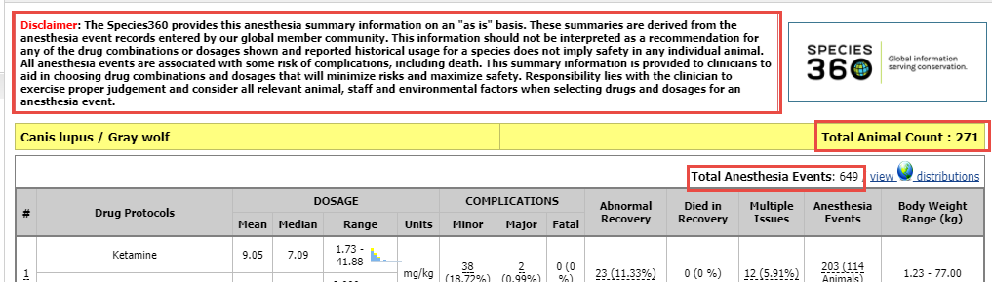
Resources are Global
The Resource outputs are manually validated, but with millions of medical records in ZIMS, a full review of all the resources is not possible. Please read the disclaimer in the header of each Resource to help you properly interpret the data.
The total number of records and the total number of animals represented are indicated in that statistics page for each resource.

Slide 6

Resource Access
Access to the Medical Resources is controlled by your ZIMS Role. Permission to search and view these features must be granted by your Local or Medical Administrator. If a Local or Medical Admin is not available, your Support Representative can give you access with your Director’s approval.

Slide 7
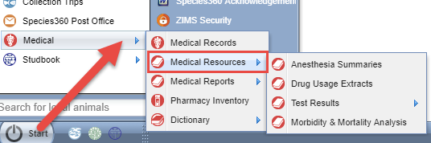
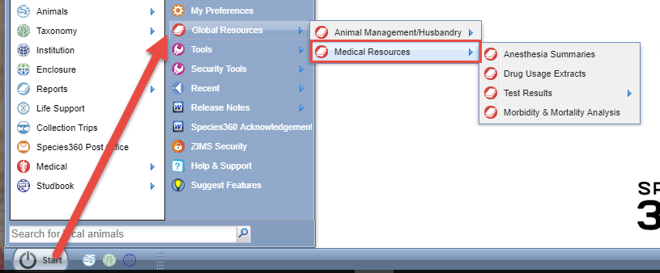
Resource Access
The Medical Resources are accessed from the Start Menu
Start > Medical > Medical Resources
Or Start > Global Resources > Medical Resources

Slide 8

Anesthesia Summaries
A species level summary of the injectable drug combinations and dosages used to anesthetize their animals
Displays up to 5 different drug protocols (drug combinations) for each species, ranked using a combination of total usage and recent usage
Provides frequency of reported anesthetic complications and recovery information to assist with risk assessment for each protocol

Slide 9
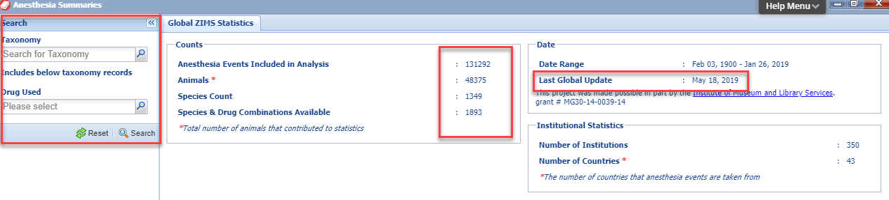
Anesthesia Summaries
Search/Filter options:
Taxonomy (includes taxonomy below)
Drug Used (only displays protocols containing the specified drug)
Global ZIMS Statistics tab:
Counts of Events, Animals and Species
Date of the last Global Update

Slide 10
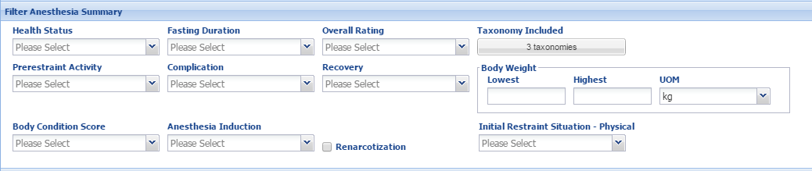
Anesthesia Summaries
Additional Search/Filter options are available once you run a Search by using the expandable search grid above the results:
Most of these fields are multiple select lists where you can select all that apply
Results will be recalculated based on the specific filter options selected by the user (e.g., use only anesthesia events rated as good or excellent)

Slide 11
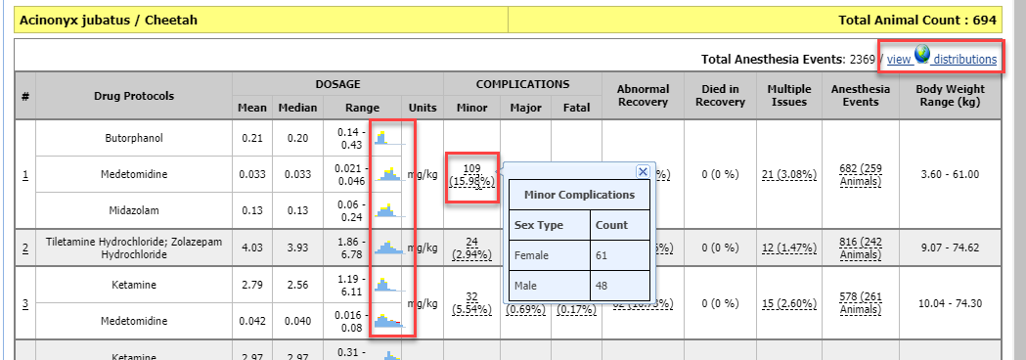
Anesthesia Summaries
Remember to read the disclaimer
Underlined data and histogram icons indicate that additional information is available when you ‘hover over’ the item
Results can be exported to PDF
Selecting the “view distributions” hyperlink will take you to……….

Slide 12
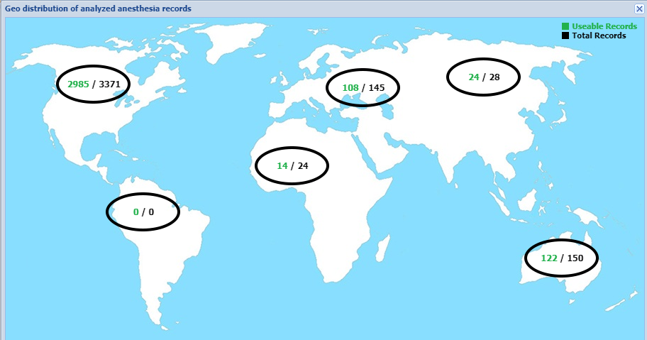
View Distributions
a map that displays the number of records from each region

Slide 13

Drug Usage Extracts
A summary of drug and vaccine usage information
This is NOT a drug or vaccine recommendation, nor an indication of treatment effectiveness!!!
It is presented for clinical reference and may often be combined with consultation between colleagues.

Slide 14
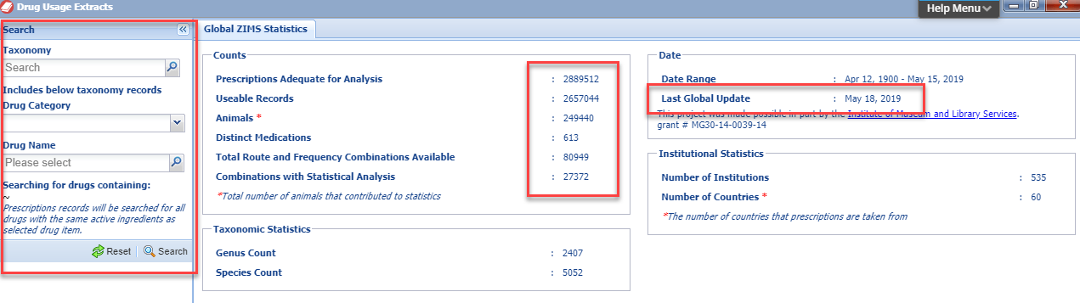
Drug Usage Extracts
Search/Filter options:
Taxonomy (including taxonomy below by)
Drug Category (e.g., antibiotics)
Drug Name (e.g., Enrofloxacin)
Global ZIMS Statistics tab
Number of Prescriptions and Useable records
Number of Animals and Medications
Date of last Global update

Slide 15
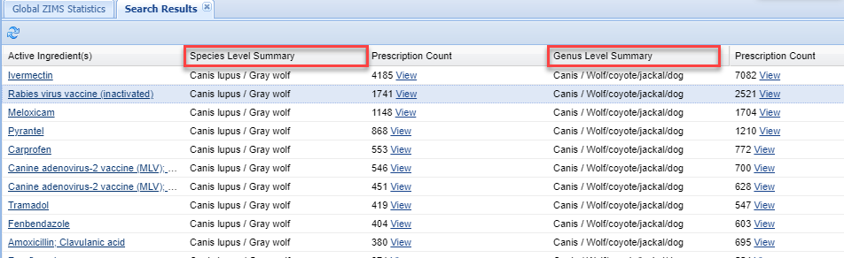
Drug Usage Extracts
You can select to View the results at the Species level or at the Genus level

Slide 16
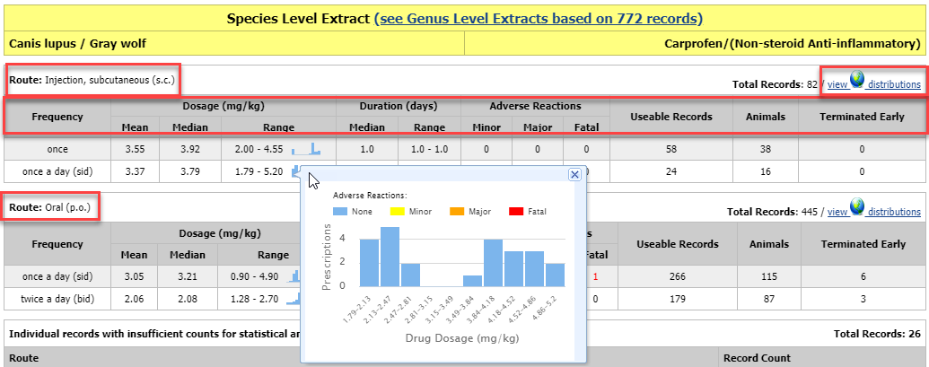
Drug Usage Extracts
The data is grouped by the drug administration route
Data columns include frequency, dose, duration, adverse reactions, useable records, number of animals and number of early terminations
There are no additional filters available for this resource
Underlined data and histogram icons indicate that additional data is available when you ‘hover over’ the item
Reports can be exported to Excel and PDF
View Distributions will display the regional count of records

Slide 17
Test Results – Search by Test verses Expected Test Results
Search by Test
  This resource will return raw data results for animals with any Health Status
  It is designed to provide Users with some information about Test Results when there is not enough information in the system to perform a Reference Interval calculation
  These are often tests not commonly performed or species not held in large numbers or too small to test routinely
  At least 2 different institutions must have reported results to help maintain the anonymity of the institution
  Reference Intervals are not calculated
  This resource is valuable for comparison with conspecifics or banked samples
Expected Test Results
  This resources uses data ONLY from animals with a Heath Status of Normal
  Global Species or Subspecies Reference Interval
    Calculated from at least 40 results
    Reference Intervals are calculated and include a statistical estimate of the 95% range for the population with normal health.
  Global Basic Statistics
    Calculated when the data set contains only 15-39 results
    Valid reference intervals cannot be calculated, but the mean, medium, high and low values are displayed.

Slide 18
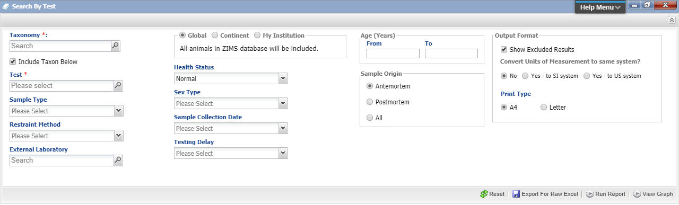
Test Results – Search by Test
There are multiple filters available for the initial search
Scope of the search can be changed
Use Export for Raw Excel to manipulate the data
There is the ability to run a report or view in a graph form

Slide 19
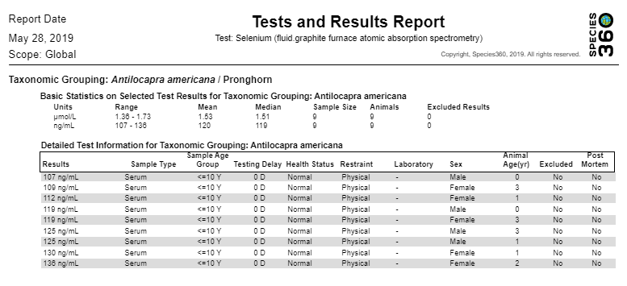
Test Results – Search by Test
The report below was run for selenium in pronghorn
The range, mean and medium are displayed
Once run the report can be exported to various formats
Because the sample size is less than 15, this data would not be found using Expected Test Results

Slide 20
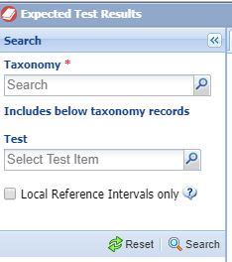
Test Results – Expected Test Results
The initial search is filtered only by Taxonomy and Test.
You can limit the results to those recorded by your institution

Slide 21
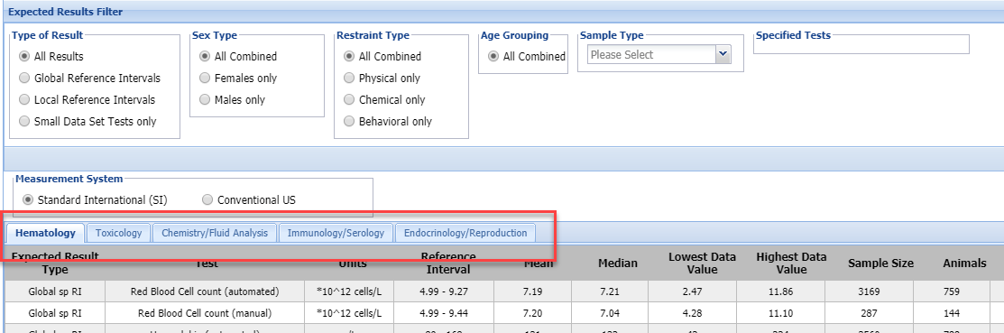
Test Results – Expected Test Results
Once run, you have the ability to further filter and refine your results
There are tabs for Hematology, Toxicology, Chemistry/Fluid Analysis, Immunology/Serology and Endocrinology/ Reproduction as appropriate for the Test
There is a colum for the Reference Intervals

Slide 22

Mortality and Morbidity Analysis
This Resource has three independent tools:
Most Common Clinical Issues
Relevant Death Information Analysis
Search by Diagnosis (local animals only)

Slide 23
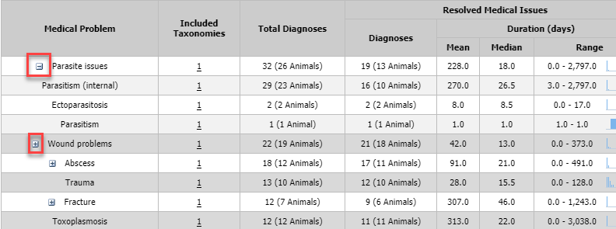
Most Common Clinical Issues
Search is by Taxonomy only
Columns are divided into Resolved Medical Issues and Active Medical Issues, with Diagnosis and Duration columns for each
Selecting the “+” to the left of the Medical Problem will break up the Problem into further details

Slide 24
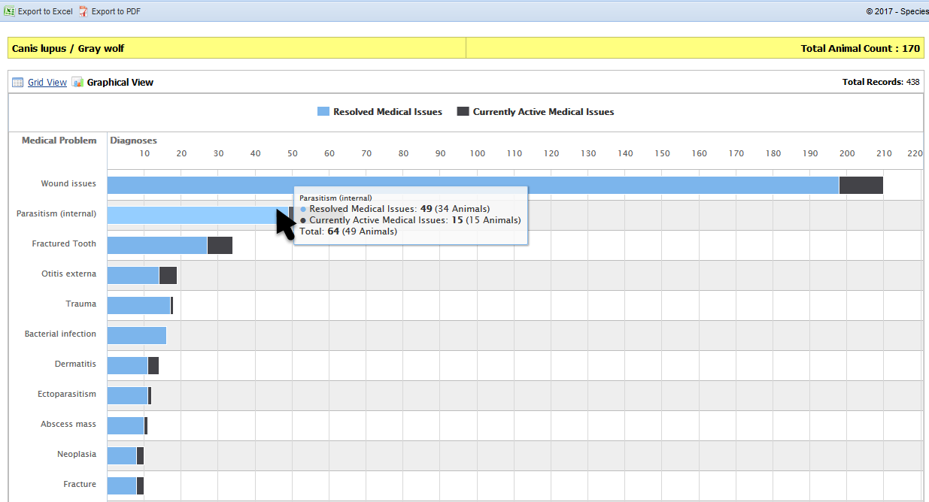
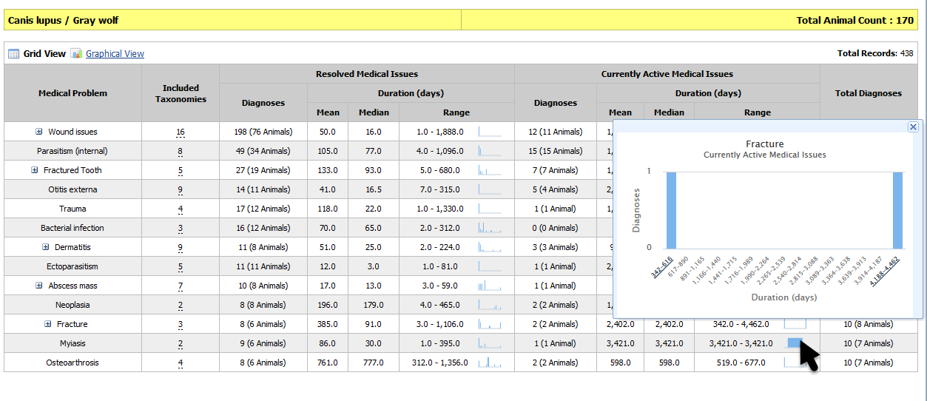
Most Common Clinical Issues
Report options:
Underlined data and histogram icons indicates that additional information is available when you ‘hover over’ the item
Reports can be printed but not exported
Both a Grid View (default) and a Graphical View are available
Graphical View
Grid View

Slide 25
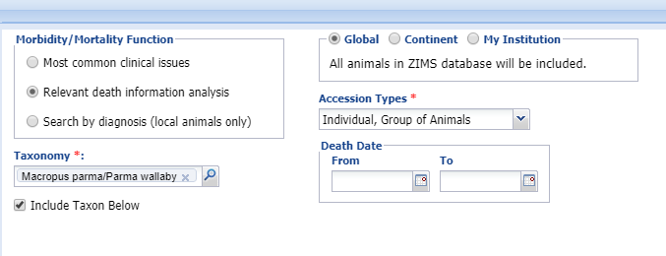
Relevant Death Information
Performs analysis on the Relevant Death Information associated with the Husbandry death records or the Medical necropsy record
Data scope filters include:
  Taxonomy: including taxonomy below is optional in this resource
  Geography: Global, Continent or User’s Institution
  Accession Types (Individual, Group, etc.)
  Death Date Range
The output is in a graphical form only

Slide 26
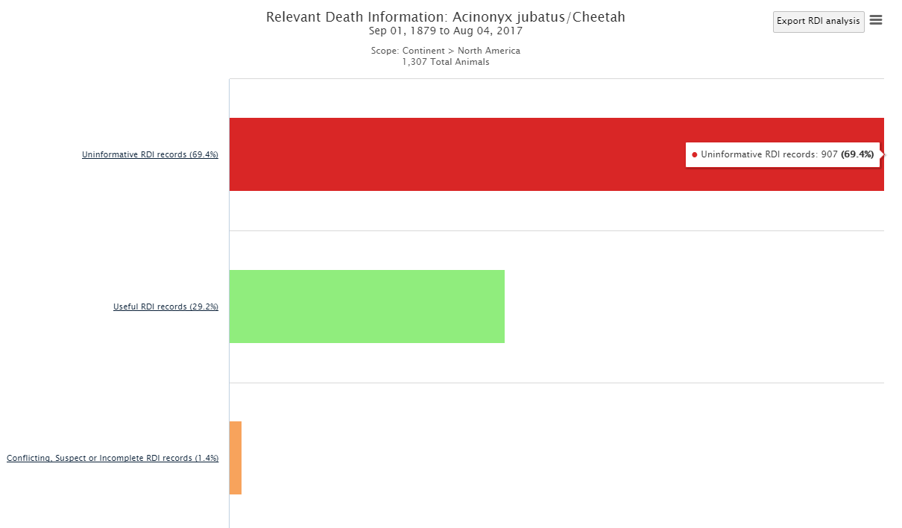
Relevant Death Information
Analysis output is an interactive bar graph that displays Uninformative RDI records, Useful RDI records and Conflicting/Suspect or Incomplete RDI records.

Slide 27
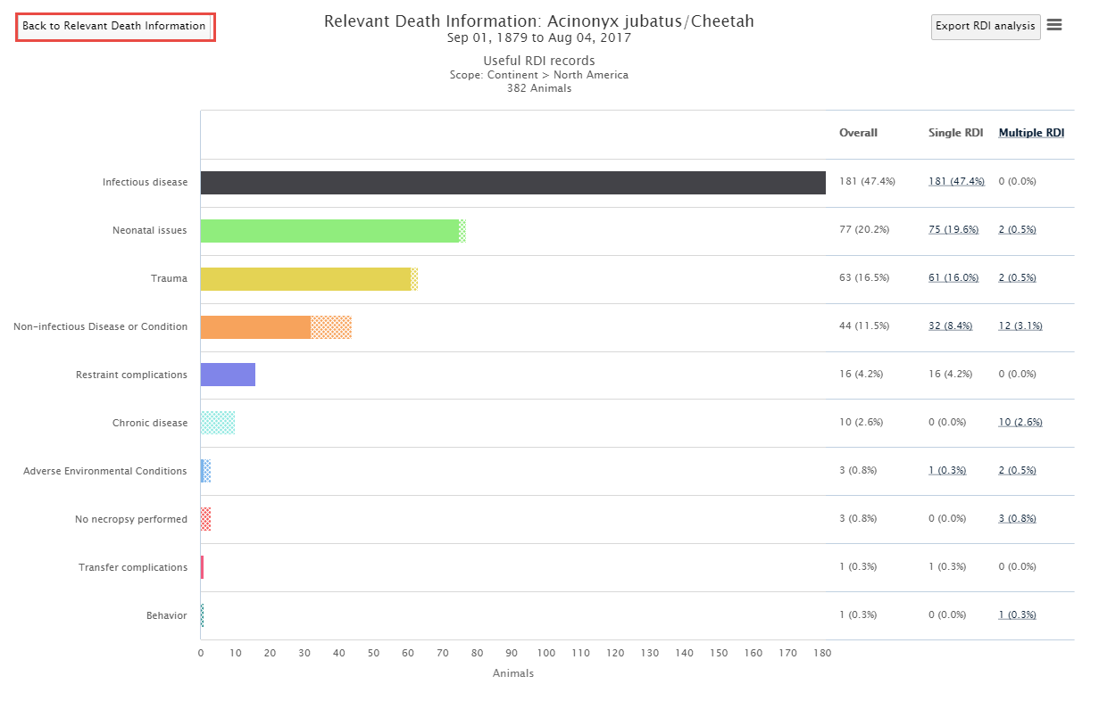
Relevant Death Information
Clicking on the Useful RDI label or bar opens a new graph displaying more details about the RDI recorded. Each level has a “back” button to return to the previous analysis level

Slide 28
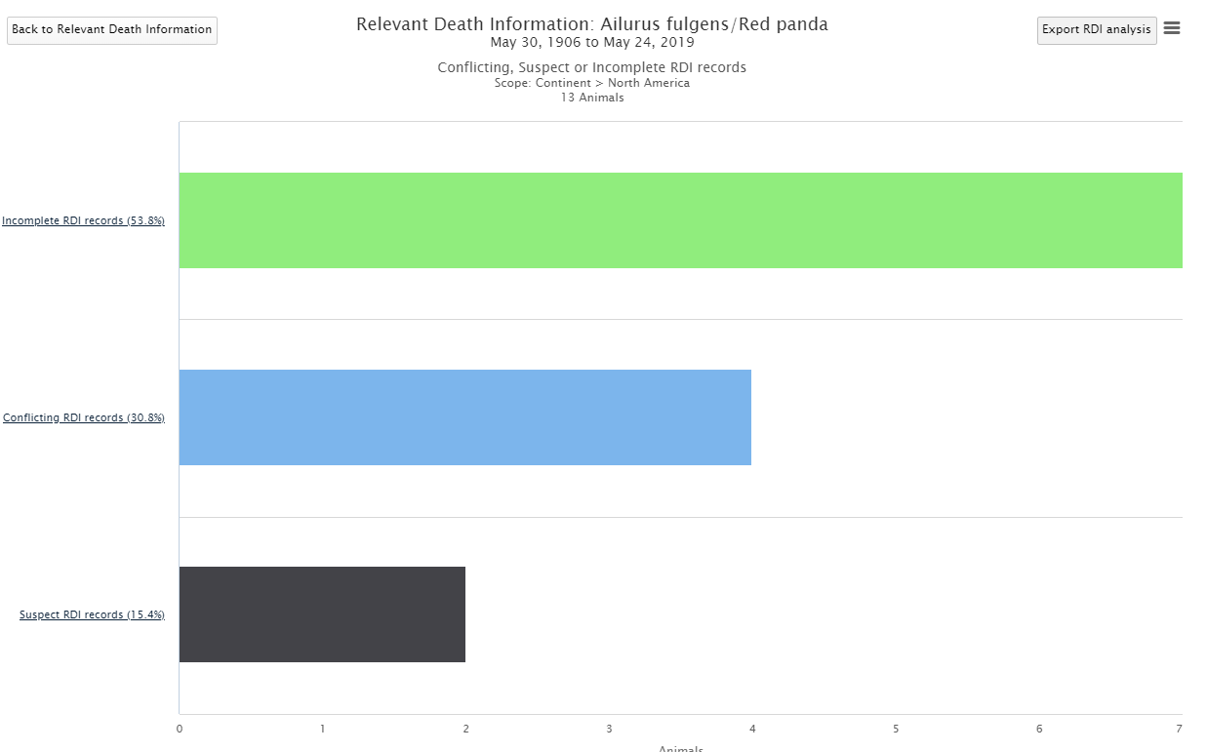
Relevant Death Information
Clicking on either Uninformative or Conflicting, Suspect or Incomplete RDI bars will break the topics down further. Here we opened up the Conflicting, Suspect or Incomplete RDI bar.
Important Note! If you run this resource at the My Institution level you can drill down to a results grid of the records involved so they can be corrected!

Slide 29
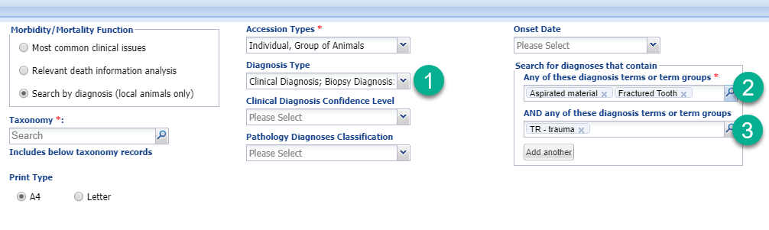
Search by Diagnosis
This can only be run at the Local level
This report searches for local diagnoses that contain specific medical terms
Your data set can be filtered by Taxonomy, Diagnosis type (clinical or pathology), Confidence level and Onset date.
1) Multiple Diagnosis Types can be entered
2) If multiple diagnosis are entered here they are joined by “or” logic, if any of the terms are found there will be results displayed
3) If any terms are also entered here they are joined by “and” logic, meaning all terms must be found to get results

Slide 30
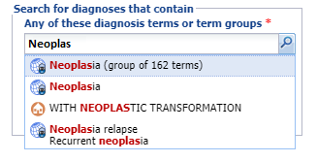
Search by Diagnosis
Using Term Groups to make searching easier
  Term groups are lists of related, but separate, medical terms
    Example: a term group could be the list of all the types of neoplasia (cancer) in the medical term dictionary
  Term groups are created through the Term Dictionary
  When you type into the search field, the list produced will include matching Term Groups; these groups are indicated by a count of terms included
Neoplasia (group of 162 terms) is Term Group created by Species360 that contains a list of terms for specific types of neoplasia
Neoplasia is a single global medical term for the generic disease process
  Searching using a Term Group is exactly the same as typing in each term in the list into the search field, but it is easier to choose just the term group
    Example: to search your entire collection for every diagnosis specifying a type of neoplasia, use the existing Species360 term group Neoplasia combined with Taxonomy = Animalia

Slide 31

THANK YOU!
Institute of Museum and Library Services (IMLS)
Thanks to a grant from IMLS, Species360 was able to generate these Medical Resources, providing unique metrics on medical care for thousands of exotic species to our member institutions.

