Slide 1
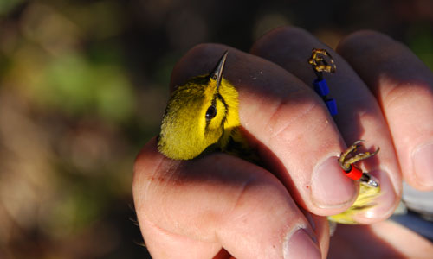
Accepting Another Institution’s Identifier
A time saver for you!
Notes:
The ability to accept another institution’s identifier not only saves you time but also reduces possible data entry errors such as mistyping a transponder number

Slide 2
ZIMS Updates!
This PowerPoint is up-to-date as of: November 12th 2018
ZIMS is developed in an “agile” method
This means that it is updated every two weeks, sometimes with additional releases in between!
Use the link below to see if there have been any updates to this topic since the date above:
http://training.species360.org/updates/

Slide 3
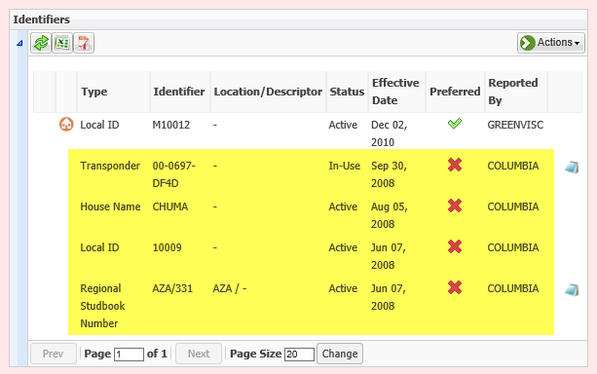
New Arrival
Notes:
You just received a male lion from Riverbanks Zoo. He has 4 identifiers that were entered at Riverbanks - 3 logical identifiers (a house name, a Local ID and a studbook number) and one physical identifier (a transponder). Because you have the Preference checked to show only your Local identifiers in searches and reports you will need to either re-enter the identifiers you want to see or adopt them as a Local identifier.

Slide 4
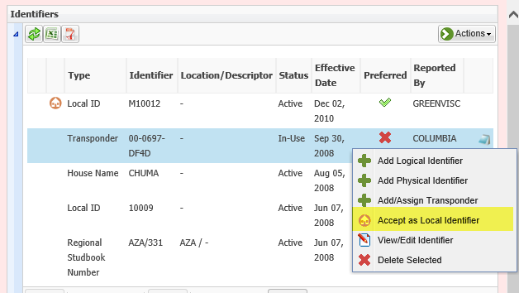
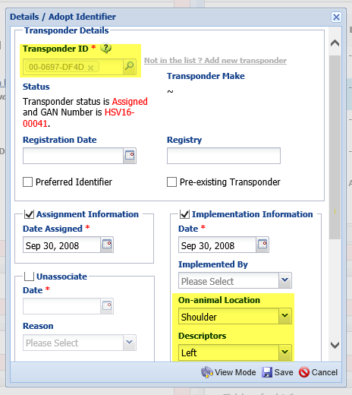
Accept as Local
Notes:
Highlighting the transponder you select the option to Accept as Local Identifier. What this does is makes a Local copy of their identifier. In the edit mode you can edit any information except for the actual transponder number. You can keep the date as 30 September 2008 because that is when Riverbanks implemented it in the animal. Or, you can change the date to reflect the date that you accepted it as a Local identifier. The location of the transponder was not entered so you can record that information.

Slide 5
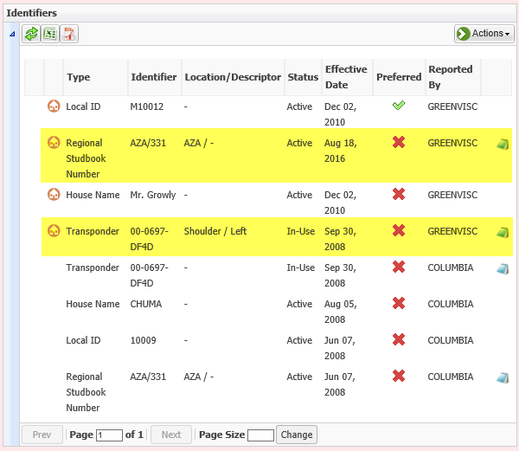
Now they are Local
Notes:
You also accept the Regional Studbook Number. You can see on the grid that they are now Local and will display in your reports. You don’t want to call him Chuma so you do not accept that and instead enter your own house name of Mr. Growly. The only identifier you cannot accept from another institution is their Local ID. You can make any edits to, or even delete, any of these accepted identifiers just as you can an identifier that you entered from scratch yourself.

Slide 6
Any questions?
On accepting an identifier

