Slide 1
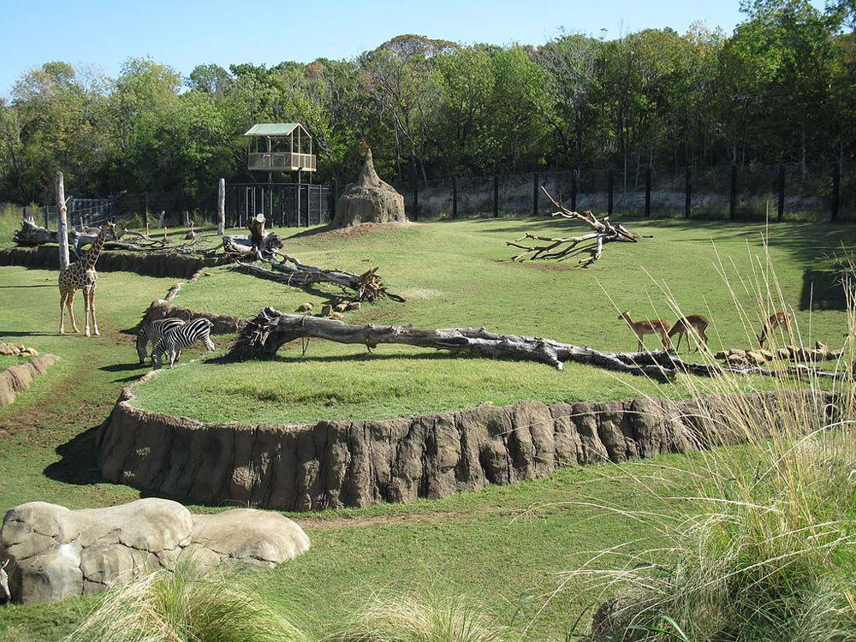
Enclosure Details
All the information you can record about your Enclosures!
The Enclosure module in
ZIMS offers much more than
simply places to put your
animals. Properly used, it can
be an integral and vital part
of your Animal Management
Program. This PowerPoint will
give you some ideas how to
use the Enclosure module to
its fullest.

Slide 2
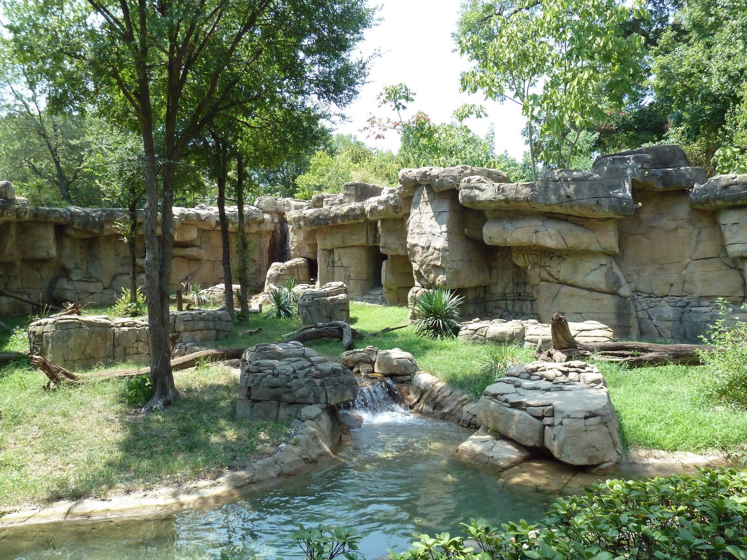
Planned Taxa
This was a great exhibit for
your river otters but you
know the group is getting
old. What species do you
have planned for the exhibit
should it become empty?
Planned Taxa lets you track
what you may, or may not,
want to fill the exhibit with.

Slide 3
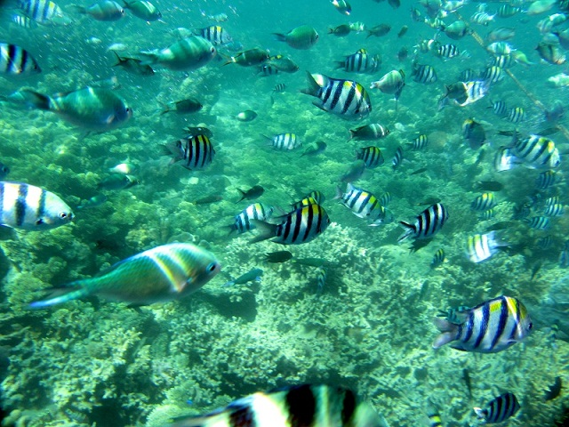
Feed Logs
Have a mixed species exhibit
where you broadcast the
food and then remove what
wasn’t consumed? Use the
Enclosure Feed Log and check
Apply to All Occupants. The
information will be recorded
into the Enclosure and the
records of all the occupants.

Slide 4
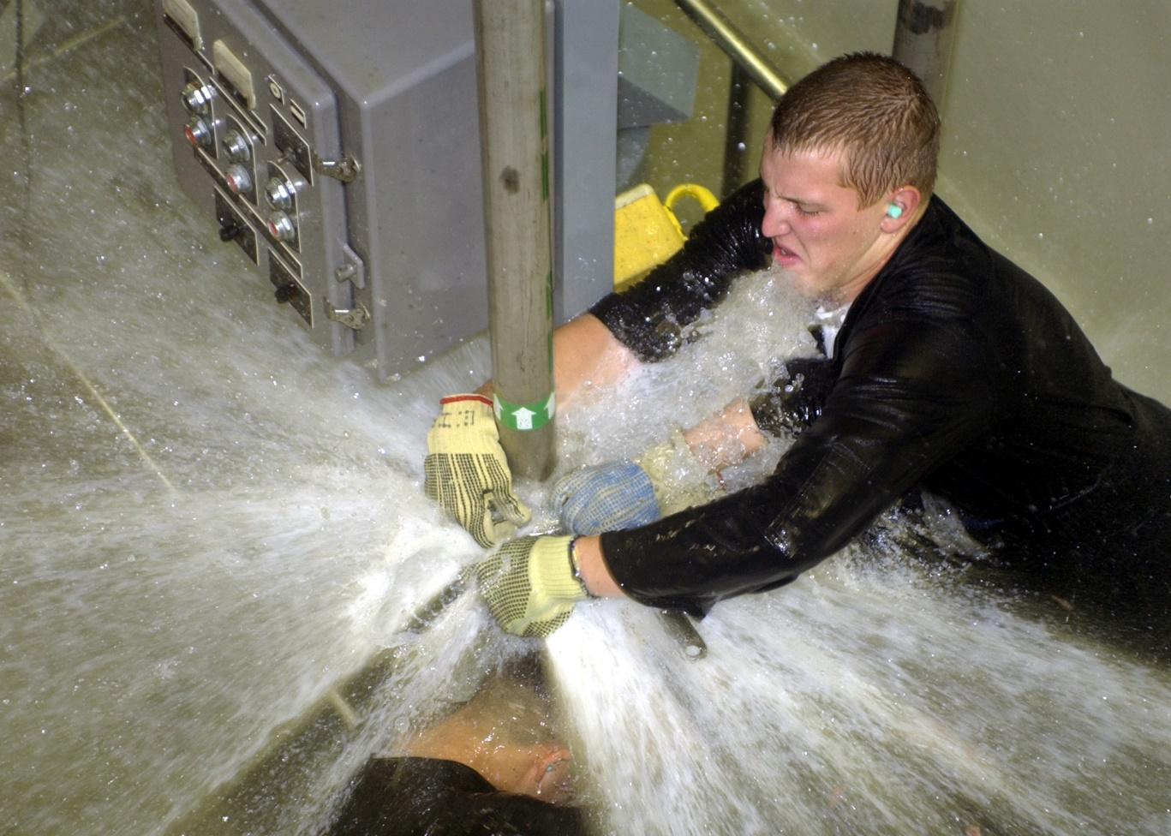
Maintenance & Requests
Had to do some maintenance
on an enclosure? You can
record this maintenance
plus any requests for
maintenance that have
been submitted for the
enclosure. If maintenance
is constant you may need
to reconsider some of the
structure of the enclosure.
You can also track water
changes in the maintenance
grid.

Slide 5
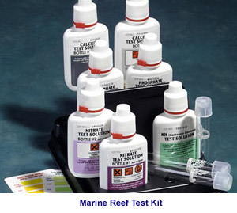
Environmental/Water Quality Measurements and Treatments
You can record Environmental
Measurements that you take on
Terrestrial Enclosures and any
Water Quality Measurements
you take on Aquatic Enclosures.
These measurements are often
paramount to the survival of the
occupants of the enclosure and
to make sure they fall within a
desired range you can create a
Measurement Range Template.
In addition, if you treat an Aquatic
Enclosure you can record that
information.

Slide 6
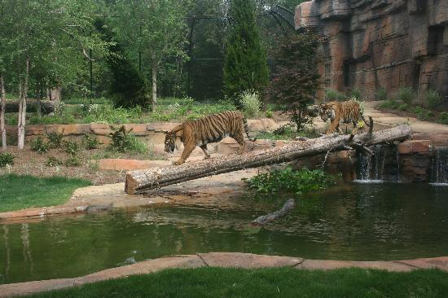
Dimensions
Does the Enclosure size meet
the minimum requirements
for the species? Entering the
dimensions into ZIMS lets you
quickly check should there be
any questions about the
appropriate size of your
enclosure without having
to re-measure.

Slide 7
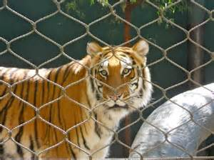
Barriers
Do your barriers meet the
requirements? Is your fence
high enough? Is your chain
link strong enough? For this
tiger holding enclosure you
can quickly check what gauge
mesh is used and the
tightness of the mesh
should requirements change
or you get questions.

Slide 8
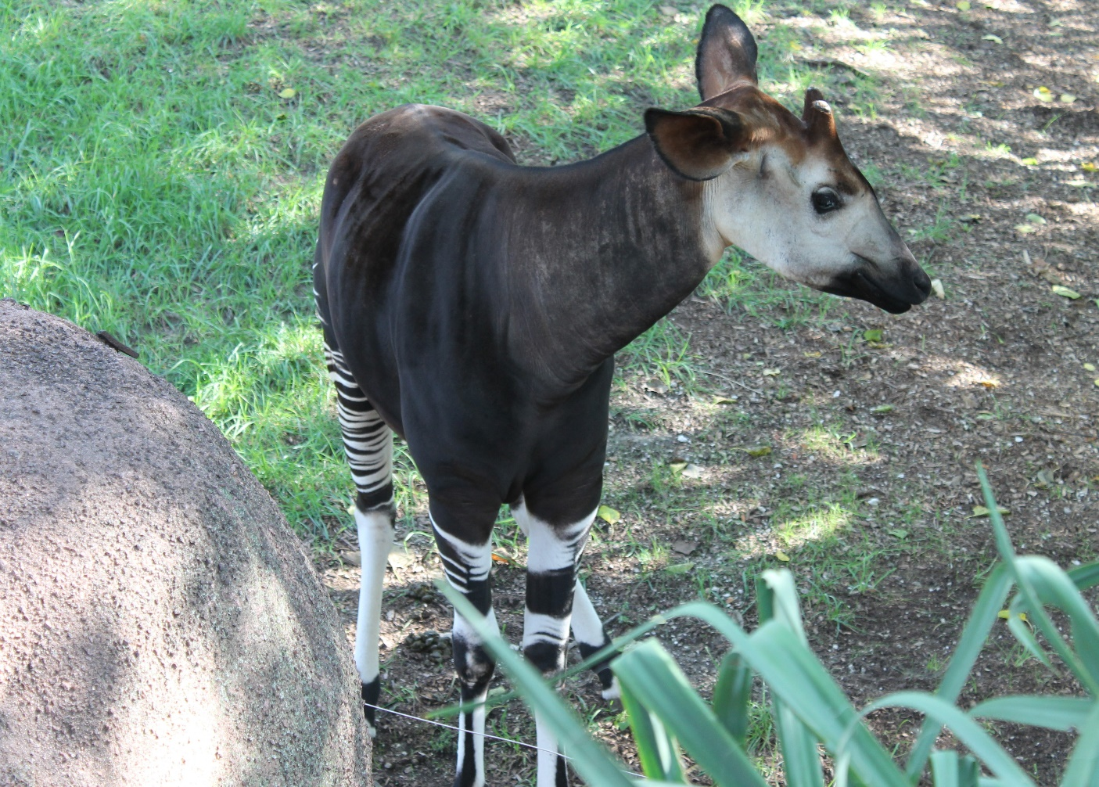
Plants
Your okapi is exhibiting
signs of intestinal distress.
The Veterinarian wants to
know what plants it may
have had access to. One
of the plants that you
recorded as being along
the barrier, but behind
the hot wire, has been
known to be mildly toxic
to hoofstock. Guess you
better remove it.

Slide 9
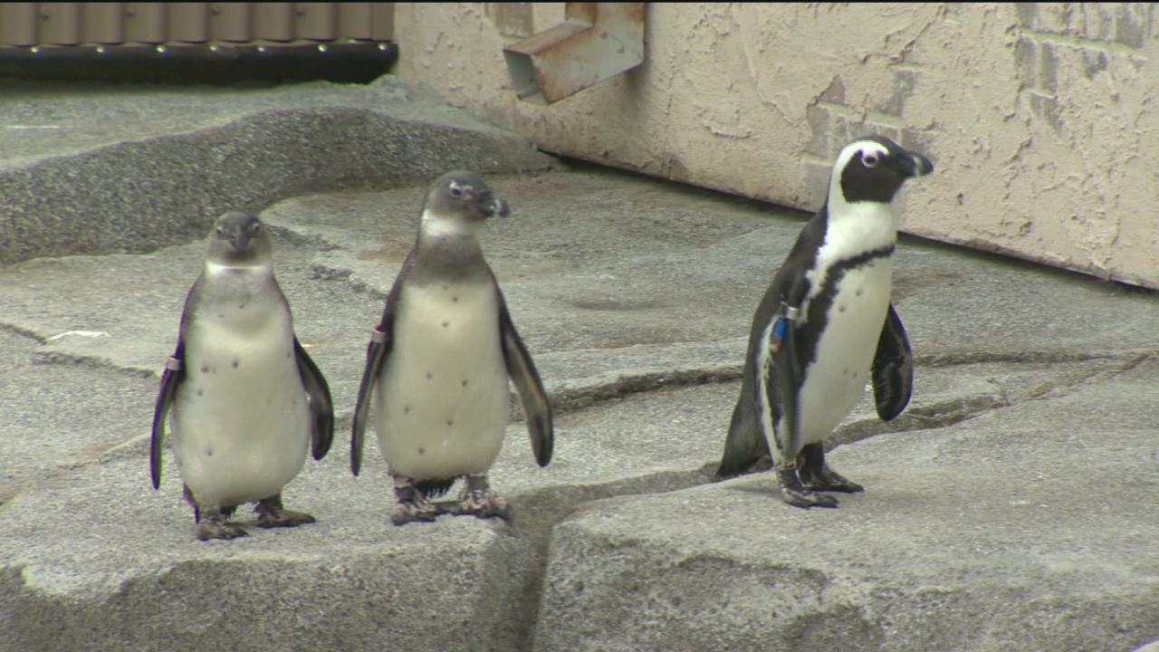
Substrates
Suddenly your penguins have started developing bumblefoot at an alarming rate.
Has anything changed? Yes, the substrate was changed six months ago to a new
type of cement. May want to reconsider.

Slide 10
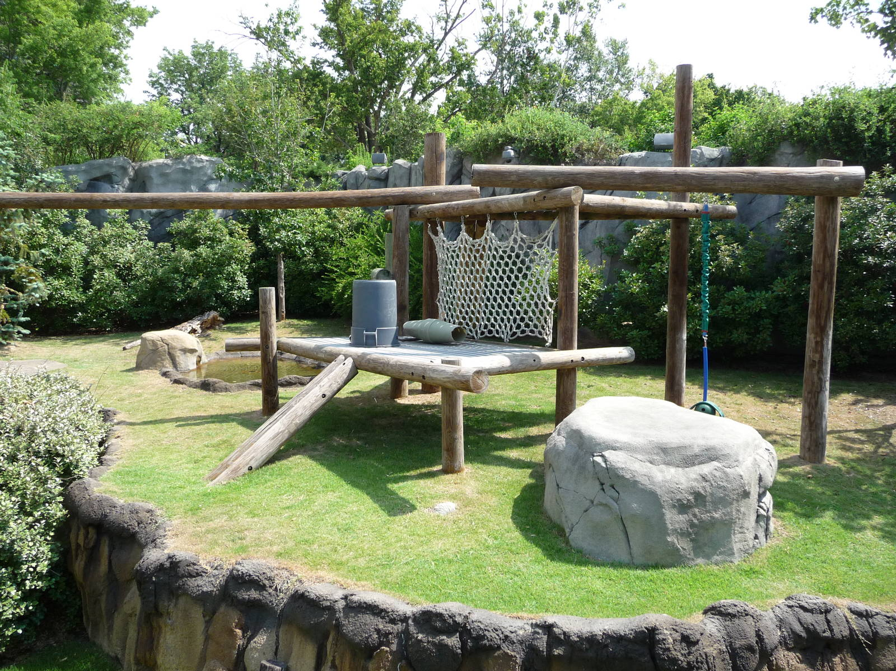
Furniture
The gorillas seem to be
demolishing their climbing
mesh really quickly. You
remember there was a
type of mesh that lasted
quite awhile. Reviewing
the Enclosure Furniture
information you find the
long-lasting mesh and
order some more.

Slide 11
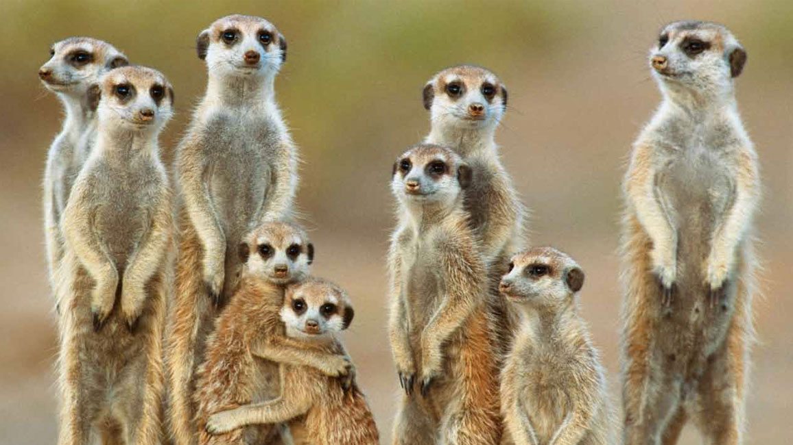
Assign Permits
You just got your Injurious Wildlife permit issued for your upcoming meerkat
acquisition! You can assign the permit to the Enclosure. No hunting around
for the number when your inspector stops by!

Slide 12
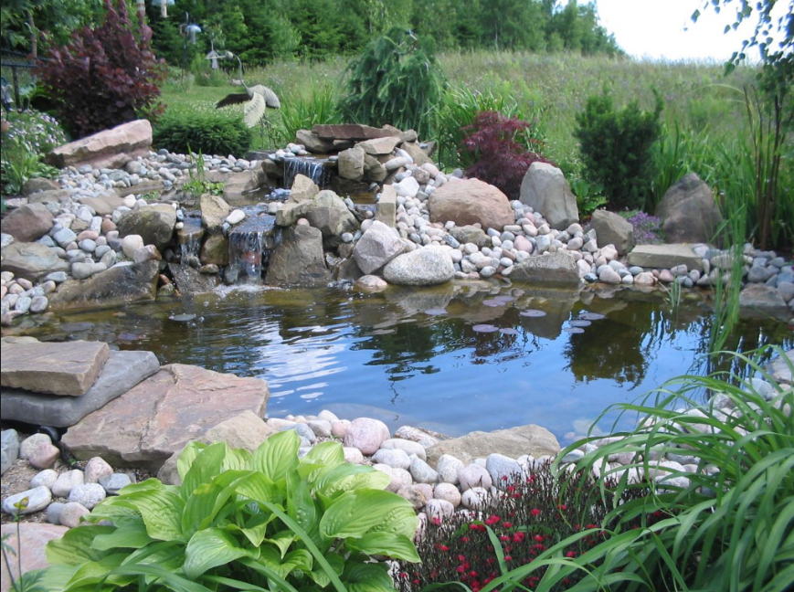
Record Water Bodies
Your crane exhibit has a small
wading pond in the middle.
You don’t want to record
measurements on it but you
do want to note that it is
included in the exhibit and its
dimensions. Record a Water
Body in the Terrestrial
enclosure.

Slide 13
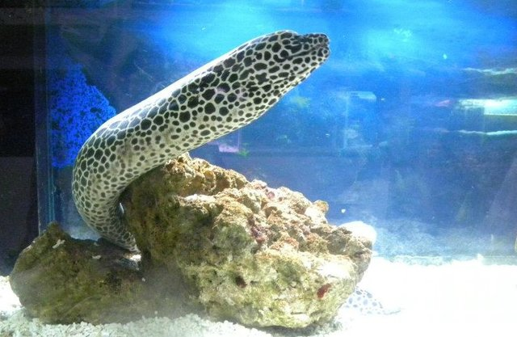
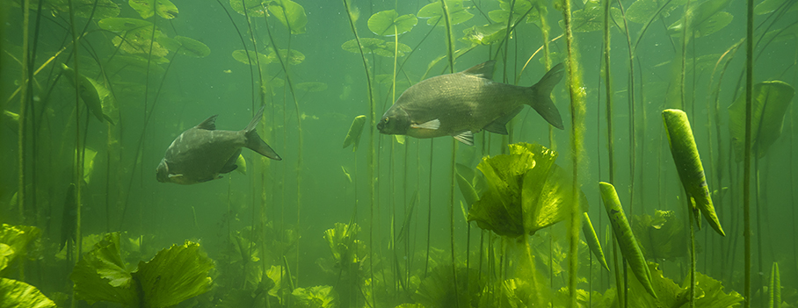
Water Type
Knowing the Water Type of an Aquatic
enclosure is very important for aquarium
management. You are encouraged to
record the Water Type for all of your
Aquatic enclosures.

Slide 14
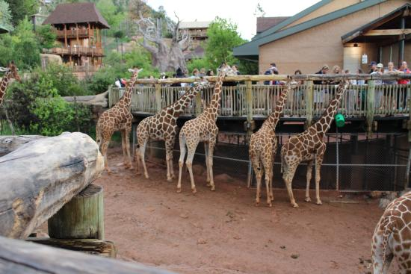
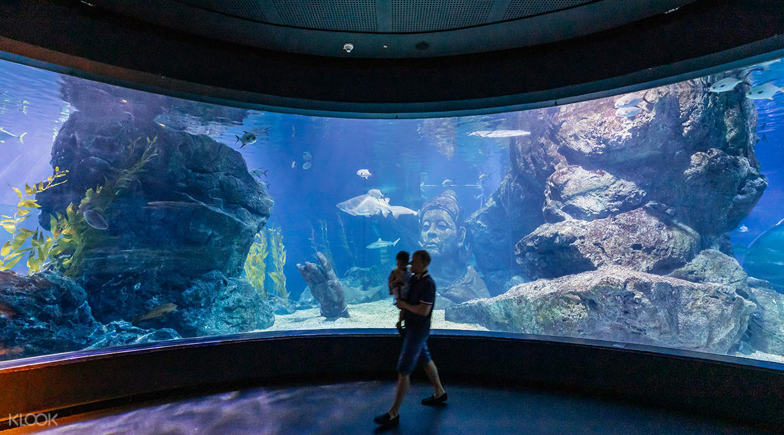
Assign Responsible Party
Knowing who oversees the care
and condition of an enclosure
can let staff know who to contact
if they have questions or concerns.
That person can be assigned as the
Responsible Party for the
enclosure.

Slide 15
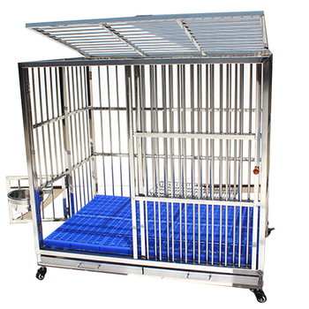
Move History
For enclosures that can be moved
from one Parent Enclosure to another,
you can track those moves using the
Move History grid. For example, during
a room renovation in your Reptile House
you may move all the tanks into
another building temporarily and you
would want to track that. Or maybe a
rolling cage needs repair and you need
to move it from the Clinic into the
Maintenance building. The enclosure
does not have to be marked as
Moveable to be able to move it.

Slide 16
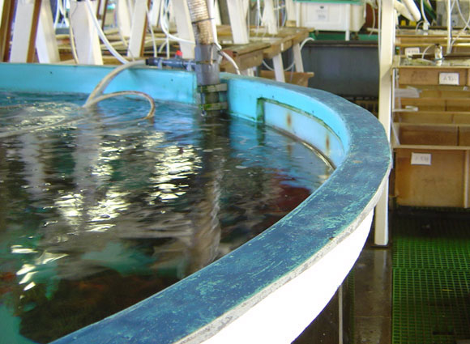
Attach Life Supports
Life Supports help keep
the environment for your
animals optimum. Although
Terrestrial enclosures can
benefit from Life Supports
such as for temperature and
humidity control, your
Aquatic enclosures are
highly dependent on these
systems to maintain the
good health of their
occupants. Life Supports
can be created and attached
to Enclosures.

Slide 17
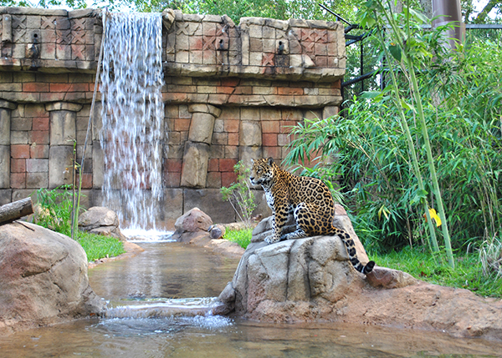
Alerts and Calendar Tasks
The sponsor for your new
Cat Canyon exhibit area is
coming to preview it before
your grand opening! Give the
area Staff a heads up by
creating a Calendar Alert to
get the animals out and the
holding areas cleaned by 9:00
am the day of the visit.
Calendar tasks can be used
for scheduling many routine
tasks such as maintenance too.

Slide 18
And That is Enclosure Details!

