Slide 1
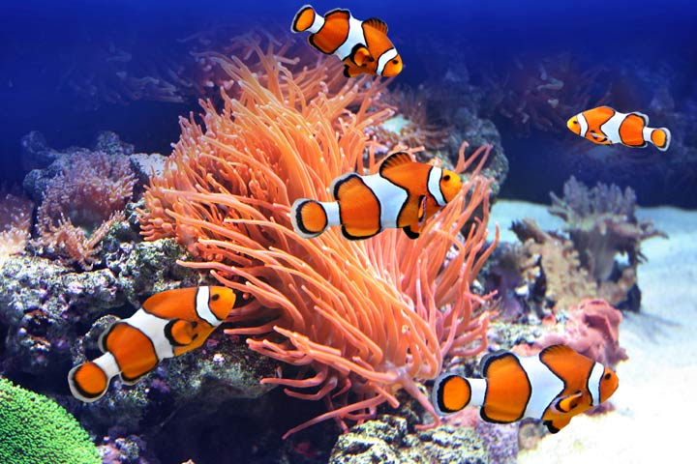
1003
Advanced Group Management

Slide 2
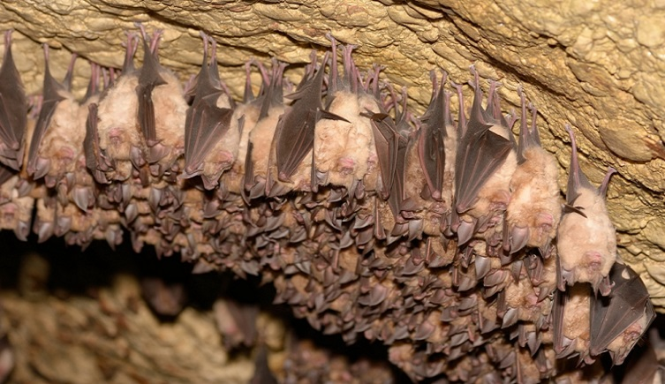
Topics Covered
For information on basic groups please reference 1003-Simple Group Management
1003- Simple Group Management
For information on Colonies please reference ZIMSHELP-Colony Management
Help Page: Animals-Colony Management
Topics covered here include:
  Recording Census
  Partial Group Transactions
  Show Group History
  Closing Out a Group
  Group Explorer

Slide 3
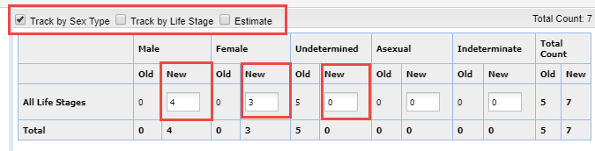
Census – Use to Change Tracking
If you want to change the Tracking for an existing Group, you must record a New or Edit an existing Census
Details > Census Info > Actions > Add New/Edit
Check the desired Tracking boxes and record the new Census

Slide 4
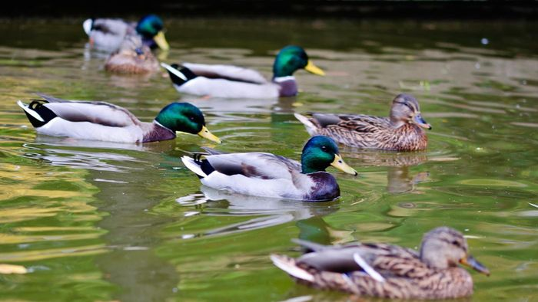
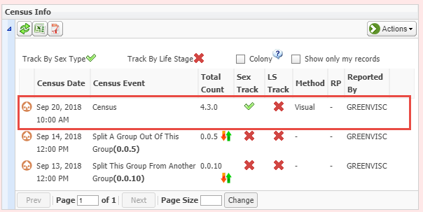
Display in Grid
The Census and the change in Tracking will display in the grid

Slide 5
Census – Use as a Group Count Reset
Recording a Census results in a hard reset of the numbers
The Census is used by the application for calculations for subsequent group numbers
    Births/Acquisitions/Merges will increase the number count
    Deaths/Dispositions/Splits will decrease the number count
  Nothing recorded on a date prior will affect this census count

Slide 6
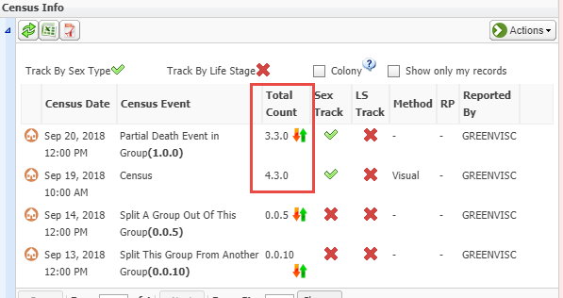
An Example – Post-Census
For our group of ducks we recorded a Census of 4.3 on 19 Sept 2018
We recorded a Death on 20 September
ZIMS used the Census to recalculate the numbers to 3.3.0 due to the Death

Slide 7
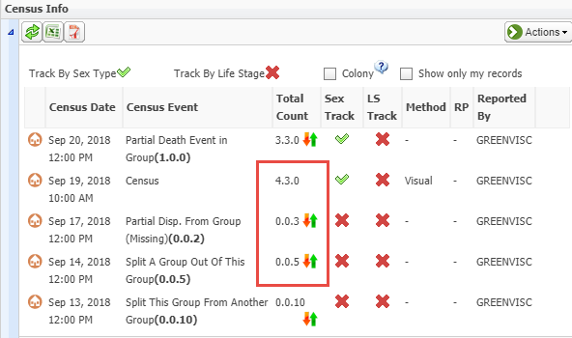
An Example – Pre-Census
For the same group of ducks you get a note that 2 escaped on 17 September have not yet been recovered
You record the escape
This brings the count of the Group down to 0.0.3, but because you recorded a Census (a Group Count Reset) on 19 September, that number, and the subsequent numbers after the Death, are not affected.

Slide 8
Full Versus Partial Transactions
Full Transaction (covered in 1003 – Simple Group Management)
  What happens impacts the entire Group
  Usually for a Disposition (all die, missing or are transferred)
  Rarely for a Acquisition (except for Retrieval or Recapture)
Partial Transaction (covered here)
  What happens impacts only some members of the Group
    Add Members
      Births
      Acquisitions
      Merging another existing Group or Individual into the Group
    Remove Members
      Some die or are transferred to another facility or released
      New Group or an Individual Split Out of the Group to create a new record
      New Group Transferred to an existing Group

Slide 9
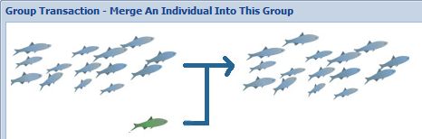
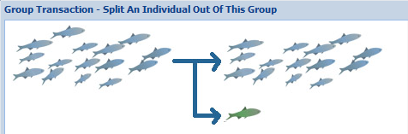
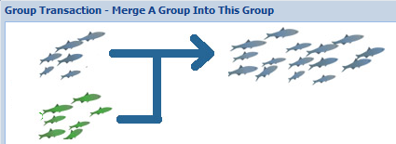
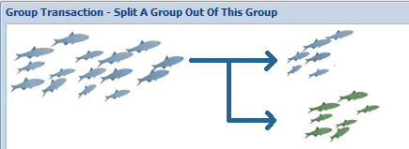
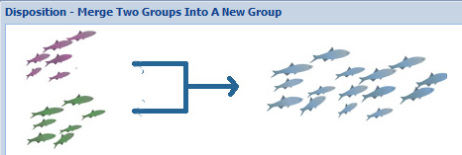
Recording a Partial Transaction
Go to My Transactions > Add Transactions > Acquisitions or Dispositions > Partial > select Transaction
Some of the Transaction screens have graphics to help you understand what you are doing

Slide 10
Partial Disposition May Create a New Record
Most Partial Dispositions require you to record a new Local ID because a new group is created EXCEPT
  Transfer to Another Group because the group immediately goes into another existing group at your facility
  Split Previously Merged Animal from this Group because the Local ID was recorded in the initial split
  Split is a Missing, Release to Wild or Undetermined/Indeterminate

Slide 11

Some Time Savers
Partial Dispositions
  You can split more than one individual out at a time by selecting the Batch checkbox
Partial Acquisitions
  You can merge multiple groups into a group
  You can merge multiple individuals into a group

Slide 12
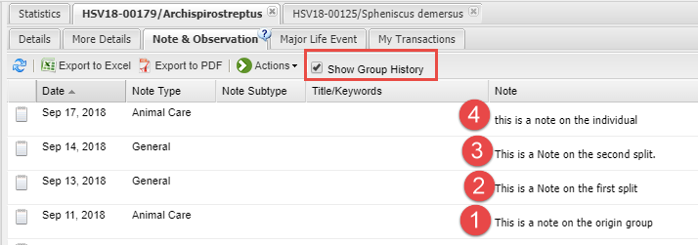
Show Group History
In the Notes & Observations tab there is a checkbox for Show Group History. Checking this box will display the Notes/Observations for any Groups that Individual/Group has been associated with.
  A Note was recorded in the origin Group record
  A Group was Split from that Group and a Note recorded
  A Group was Split from the second Group and a Note recorded
  An Individual was Split from that Group
All Notes recorded on any of the Groups that the Group/Individual was associated with are displayed
This option is also available on the Specimen Report

Slide 13
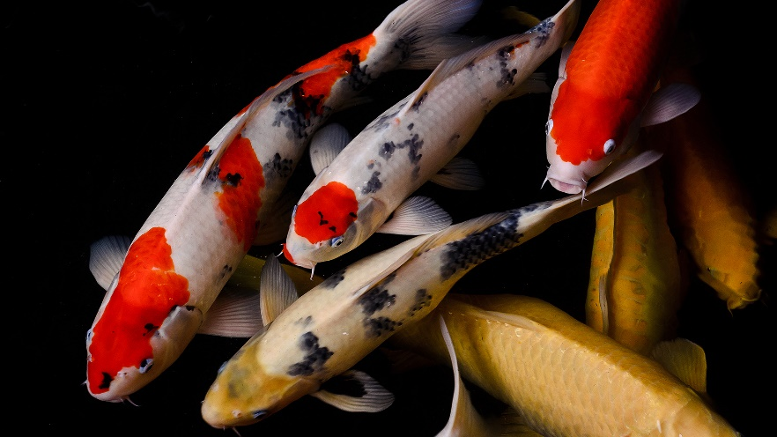
Zero Count Groups – Open
If you perform a Partial Disposition that brings the Group count down to zero the Group will continue to have a Status of “Open”
Can continue to perform transactions on it
Will continue to display in reports as 0.0.0
If new members are added the medical and genetic tracking is lost

Slide 14
Zero Count Groups - Closed
If you perform a Full Disposition that brings the Group count down to zero the Status will be “Closed”
Recording a Census of 0.0.0 will not automatically Close Out the Group
Cannot perform any transactions on it
Closed Out Groups will not display on reports unless there were members in it during the selected date range.

Slide 15
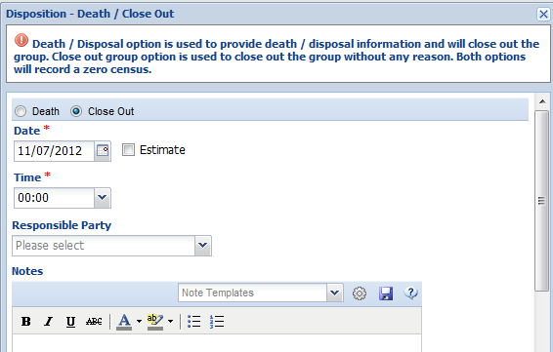
Closing Out a Group
To Close Out a Group select a Full Disposition of Death/
Close Out
Select Close Out
No Reason is required
Group count does not have to be 0.0.0 to Close Out

Slide 16
Finding Groups to Close Out
To find any groups that you may want to Close Out do an Advanced Search for your Current Groups
Sort by the Sex Type column
Any Groups with a Sex Type of “-” should probably be Closed (from ARKS migration)
Any groups with a Sex Type of 0.0.0 should be reviewed and possibly Closed
Notes:
Read slide

Slide 17
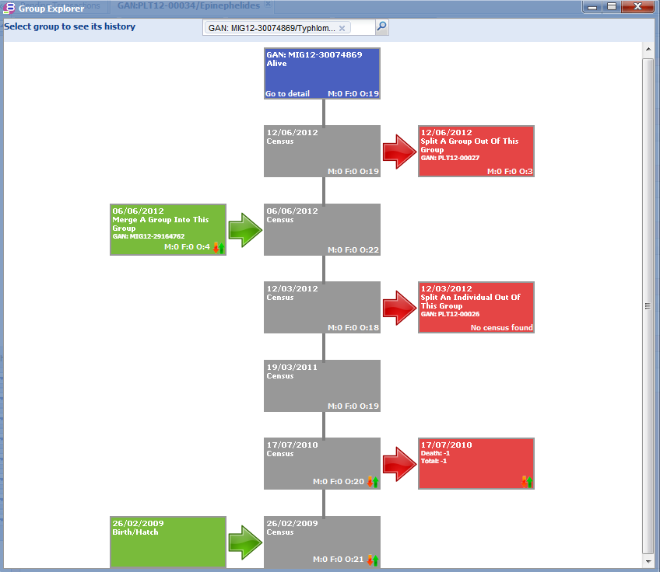
Group Explorer
Group Explorer is found under
Start > Tools
It is a visual look at the Splits,
Merges and Censuses of the Group
in focus
Additions to the Group are on
the left
Deletions from the Group are on
the right
Censuses recorded are up the middle
The boxes are hyperlinks into
the related transaction

Slide 18
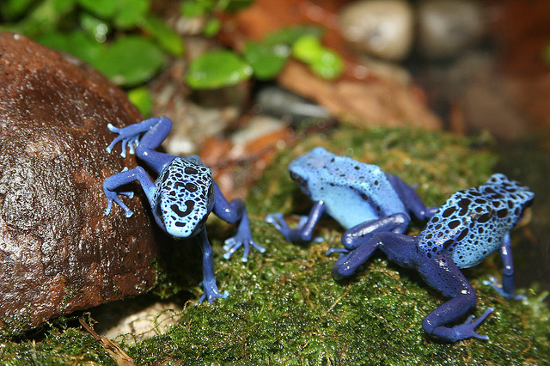
And that is Advanced Groups in ZIMS!

