Slide 1
1002 Individual Animal Transactions in ZIMS
Acquisitions and Dispositions

Slide 2
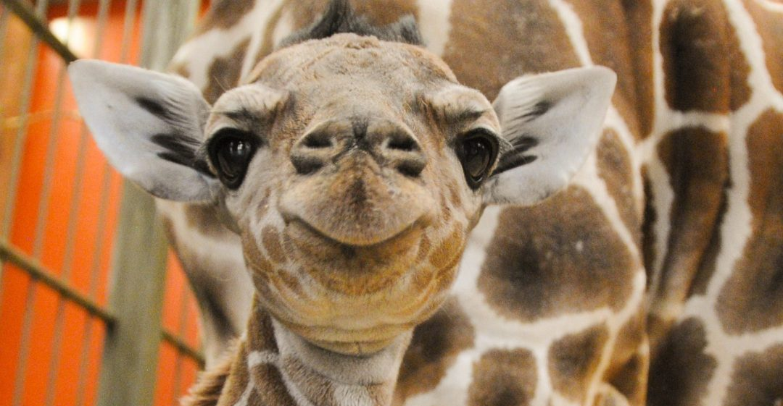
Single Accession & Record
An animal is accessioned into ZIMS only once
Subsequent transactions create Visits
This creates a single record for each animal
Initial Accessions are:
From Another Institution that is NOT a Species360 member. You may need to confirm that the animal was not previously at a Species360 member institution as you would then create a Visit and not a new Accession.
Collected From Wild (unless it was released by a Species360 member and is therefore already in the database)
Rescued
Appeared
Birth/Hatch
From Lay
Fetus Identified
Undetermined/Indeterminate
Visits are:
From Another Institution that IS a Species360 member
Collected From Wild when a Species360 member released it

Slide 3
Physical and Ownership are Separated
For both new Accessions and Visits you need to record:
Who is sending you the animal (Physical Info)
Who is giving up or retaining legal title to the animal (Ownership info)
My Transactions tab
Displays all transactions with your institution
Details Tab
Physical History - all locations animal has been held
Ownership History - all facilities that had legal title

Slide 4
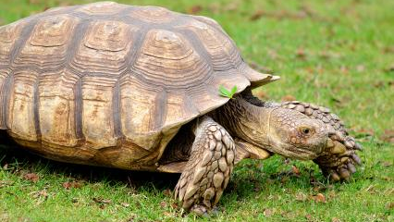
Transactions Between non-Species360 versus Visits Between Species360 Members
Non-Species360 member
No confirmation required by the other facility
Species360 Member
Requires confirmation/denial by the other facility
Pending Transactions are created
By My Institution – you must take an action
By Other Institution – the other institution must take an action

Slide 5
Automatic Search for From Another Institution
If you are performing a new Accession for From Another Institution, ZIMS will automatically look in the database to see if the animal record already exists. It searches for a match of Institution and Local ID or an existing GAN.
If no animal is found in the database you will complete the accession screen.
If an animal IS found in the database you have the options to:
Accept it and complete only Local Information
Taxonomy , Sex, Parents, Rearing and Birth Info are already recorded
Don’t accept it and complete the entire Accession

Slide 6
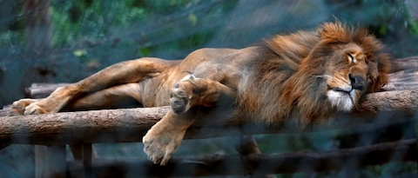
What do you Accession or Create a Visit For?
Any animal that you have physically held OR have legal ownership of
This is because you have taken physical or legal responsibility for it
Some exceptions – native wildlife, live rock, feeder animals
Develop a policy and stick with it

Slide 7
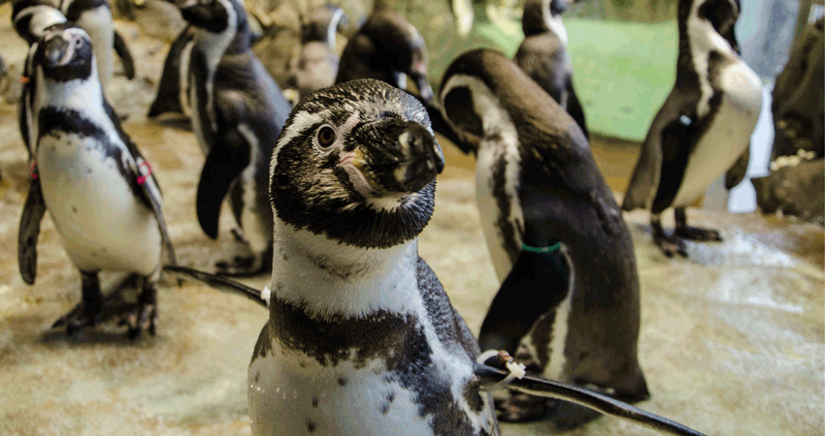
What Date do You Use?
The Accession/Visit date should be the date you either first obtained the physical animal OR the date you first got legal title to it.
Once again, you have taken responsibility for it.
Possible exception is animals Collected From Wild.
Some institutions use the date the animal arrived at their facility and some use the collection date.

Slide 8
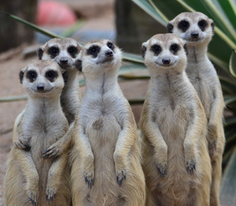
Time Saving Tips
If animals are individually identifiable they should be entered as individual animals. If you receive multiple animals there are 3 options to save you data entry time:
Batch Accession Checkbox
All records will be duplicated from the first entry
You can edit any differences later
Use Batch only when there will be few edits
Cannot Batch Accession from a Species360 member
Save & Repeat
This will save the transaction and keep the accession screen open for any edits
Use this option when there will be many edits
Take a Copy
Replicates a record already saved
Useful for litters/clutches when you are not sure of the numbers

Slide 9
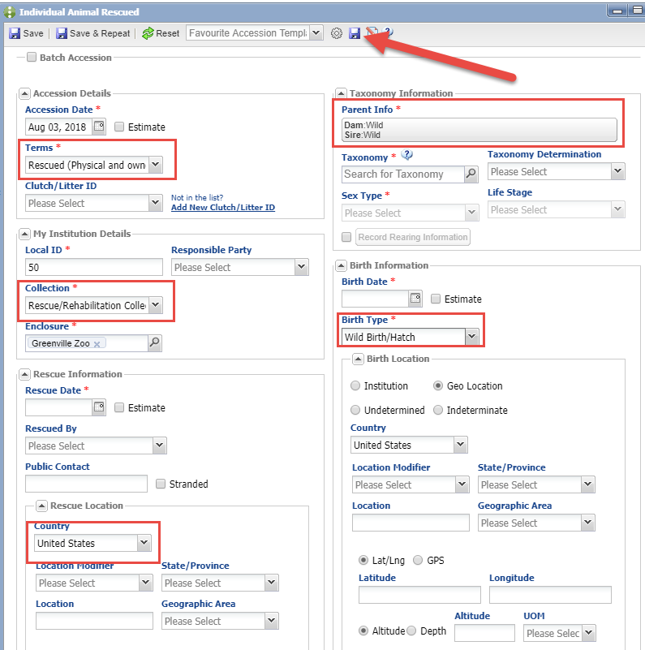
Favourite Accession Templates!
Favorite Accession Templates
are also a great time saver. In
this example we are a rehabilitation
center. The information in red is
always the same and we don’t
want to have to enter it for each
accession so we are saving it as
a Favourite Accession Template.

Slide 10
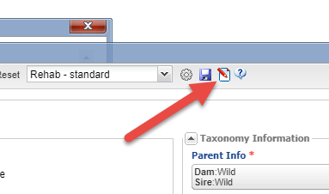
Favourite Accession Templates
Give it a unique name that will
identify what accessions it is
for. The Template will now appear
in your list of favourites and, if
selected, will prefill with the
information. If you need to edit
the Template, simply open it, make
your changes, and select the Update
Template icon. The Favourite
Templates will only be available for
the accession type it was created for.
For example, this template will not
appear in From Another Institution.

Slide 11
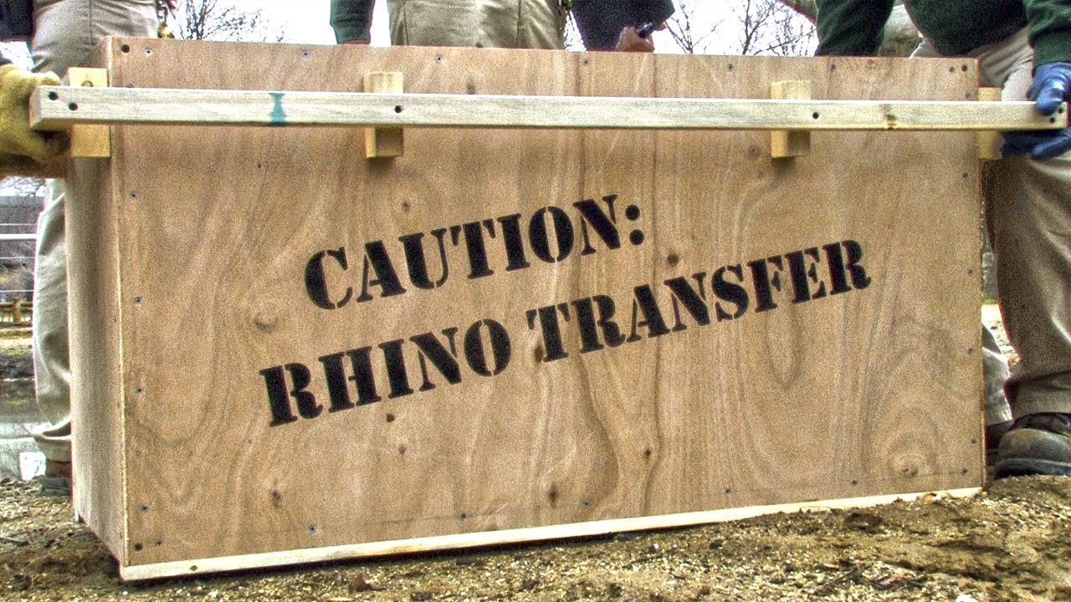
How about Dispositions and Deaths?
Eventually everything you have accessioned will need to be Dispositioned either by a transaction, missing or release, or a death.
Date should be when the event actually happened, or your best estimate
Notes:
>

Slide 12
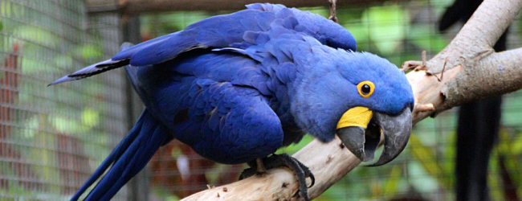
The First Scenario
Animal is donated by a member of the public
Animal is dispositioned to a Species360 member institution as a Loan Out
Receiver Confirms

Slide 13
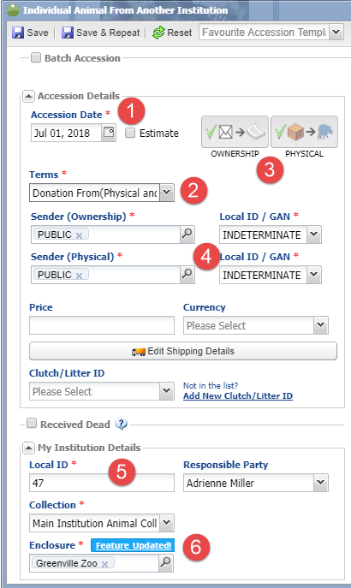
Step 1 – Accession – left side
This animal is not yet in the ZIMS database so
you will perform a new accession.
Go to Start > Accession > Individual Animal.
Mandatory fields are marked with a red “*”.
1-Date is the date you received the animal.
2-What you select for terms will …
3-Drive the icons for Ownership/Physical.
4-It will also drive what fields are displayed for
Ownership and Physical.
5-You can select to auto-increment your Local
IDs in Institution Preferences.
6-You can also select what your default
Collection and Enclosure are in My
Preferences.

Slide 14
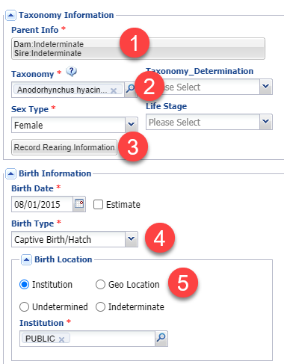
Step 1 –Accession – right side
1-The parents were not identified and never will
be so you select Indeterminate.
2-If you captured taxonomy when recording the
parents this field would prefill.
3-Add rearing information by selecting the button.
4-What you select for Birth Type………..
5-Will drive the fields available under Birth
Location.
When you are done select Save (upper left hand
corner).

Slide 15
Step 1 – Accession – View Details
1-Once you save you will receive a message that the accession was successful
and what GAN was assigned.
2-You can select to View Animal Details. This will open the record and is highly
recommended to check the correctness of your entry.
3-You can Undo Accession Transaction. This will take you back into the screen to
correct any incorrect entries.
4-You can close the screen. This will still save the record but it will not be
opened for review.

Slide 16
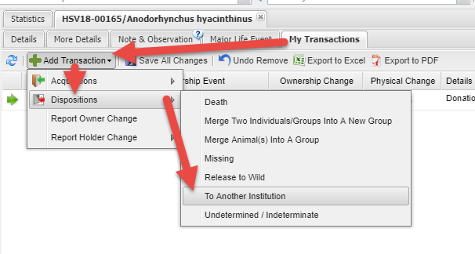
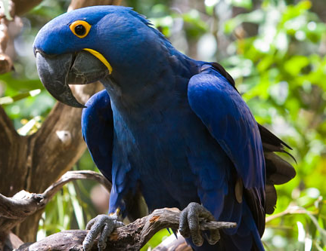
Step 2 - Disposition
To disposition the animal go to My Transactions tab > Add Transaction >
Dispositions > To Another Institution.

Slide 17
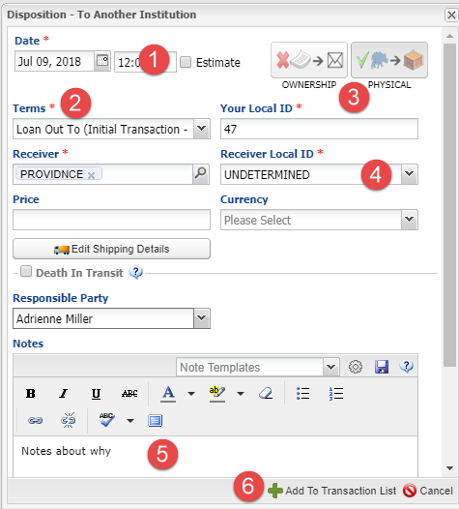
Step 2 - Disposition
1-The date should be the date the animal
left your facility.
2-You are sending this animal as a Loan
Out To.
3-Note how the Ownership/Physical icons
display the fact that the Ownership is not
being transferred.
4-You do not know the Local ID the
receiving institution will assign so you
record Undetermined. This can be edited
later.
5-Any notes regarding the disposition,
such as your reason for dispositioning the
animal, are helpful.
6-Then Add to Transaction List.

Slide 18
Step 2 – Save the Disposition
1-Remember to Save All Changes.
2-Hovering over the circle lets you know that PROVIDNCE (the receiver) needs
to confirm.
3-The Ownership Status remains as Owned but the animal is now Off Site.
BELOW-In Animal statistics a Pending Transaction-By Other Institution is created.

Slide 19
Step 3 – Receiver Confirms
ABOVE-When PROVIDNCE logs in they have a Pending Transaction-By My Institution
for the animal. Selecting the GAN hyperlink opens the My Transactions grid BELOW.
1-The yellow highlight lets you know this transaction is Pending.
2-You also receive a message that you have 1 Pending. You can remove this message
from displaying in the future by checking the “Do not show this warning” box.
3-Select the gear icon to confirm.

Slide 20
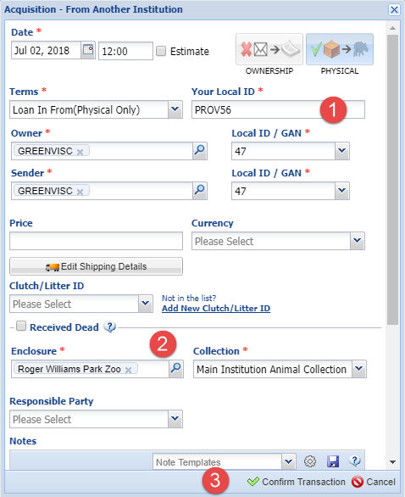
Step 3 – Receiver Confirms
The information that was
recorded by the sender will
prefill but it is editable.
1-PROVIDNCE records their
Local ID.
2-They put the animal into the
appropriate Enclosure and
Collection.
3-They confirm the transaction.

Slide 21
Step 3 – Receiver Confirms
Once they Save All Changes,
the green circle indicates it
was confirmed by the sender
(TOP).
Looking at the record from the
sender’s point of view, you can
see that it is now confirmed by
the receiver (BOTTOM).

Slide 22
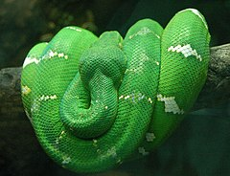
The Second Scenario
Animal is received from a Species360 member institution but they have not yet recorded sending it (Receiver Initiated Transaction)
Sender confirms

Slide 23
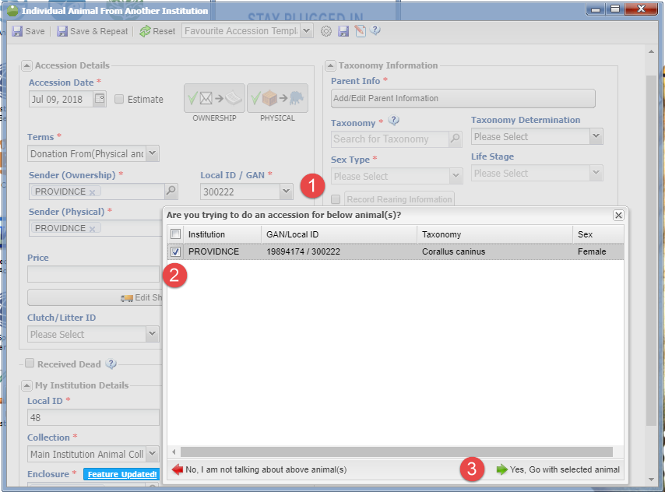
Step 1 – Record Receiving – Option One
In this scenario you are recording a Visit because the animal is in the ZIMS database already. You have received the animal but the Registrar at the sending institution is on vacation and has not
recorded sending the animal to you. There are two ways you can do this. First way, start a new accession.
1-When you record the Sender and the Local ID (or GAN), ZIMS will look for any matches.
2-A match is found. Check the box.
3-Select Yes, Go with selected animal.

Slide 24
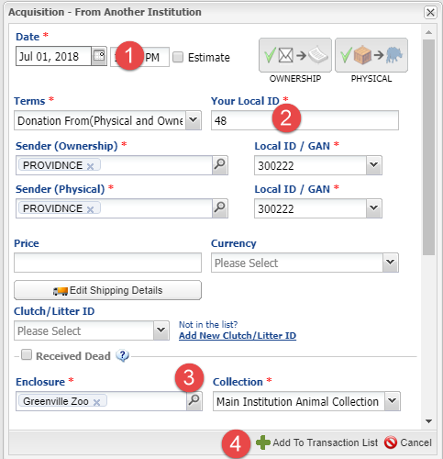
Step 1 – Record Receiving – Option One
This will open the Acquisition
From Another Institution screen.
1-Record the date.
2-Record your Local ID.
3-Put into the appropriate
Enclosure and Collection.
4-Add to Transaction List.

Slide 25
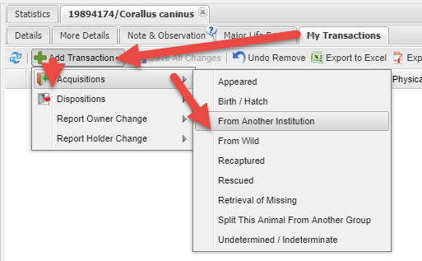
Step 1 –Record Receiving – Option Two
The second way is to search
for the animal in the database
(ABOVE).
Open My Transactions > Add
Transaction > Acquisition >
From Another Institution
(BELOW).
This will open the same screen
that was displayed when you
started a new accession and ZIMS
found a match.

Slide 26
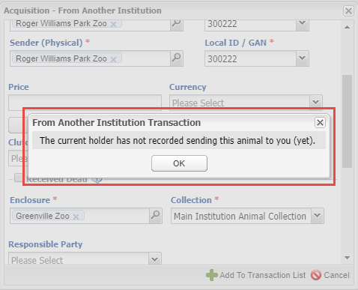
Step 1 – Record Receiving
Complete the screen and select
Add to Transaction List. You will
receive a message that the
holder has not yet recorded
sending the animal to you. This
is correct so select Yes (TOP).
The My Transaction record will
indicate that the sender needs to
confirm (BOTTOM).

Slide 27
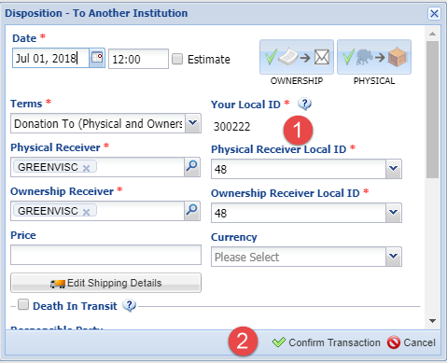
Step 2 – Sender Confirms
The sender has a Pending
Transaction-By My Institution.
(TOP).
They select to confirm (BOTTOM).
1-Note that the receiver’s Local ID
is prefilled and not editable.
2-Once they Confirm Transaction
and Save All Changes, both the
receiver’s and the sender’s records
will indicate that the transaction
was confirmed by both facilities.

Slide 28
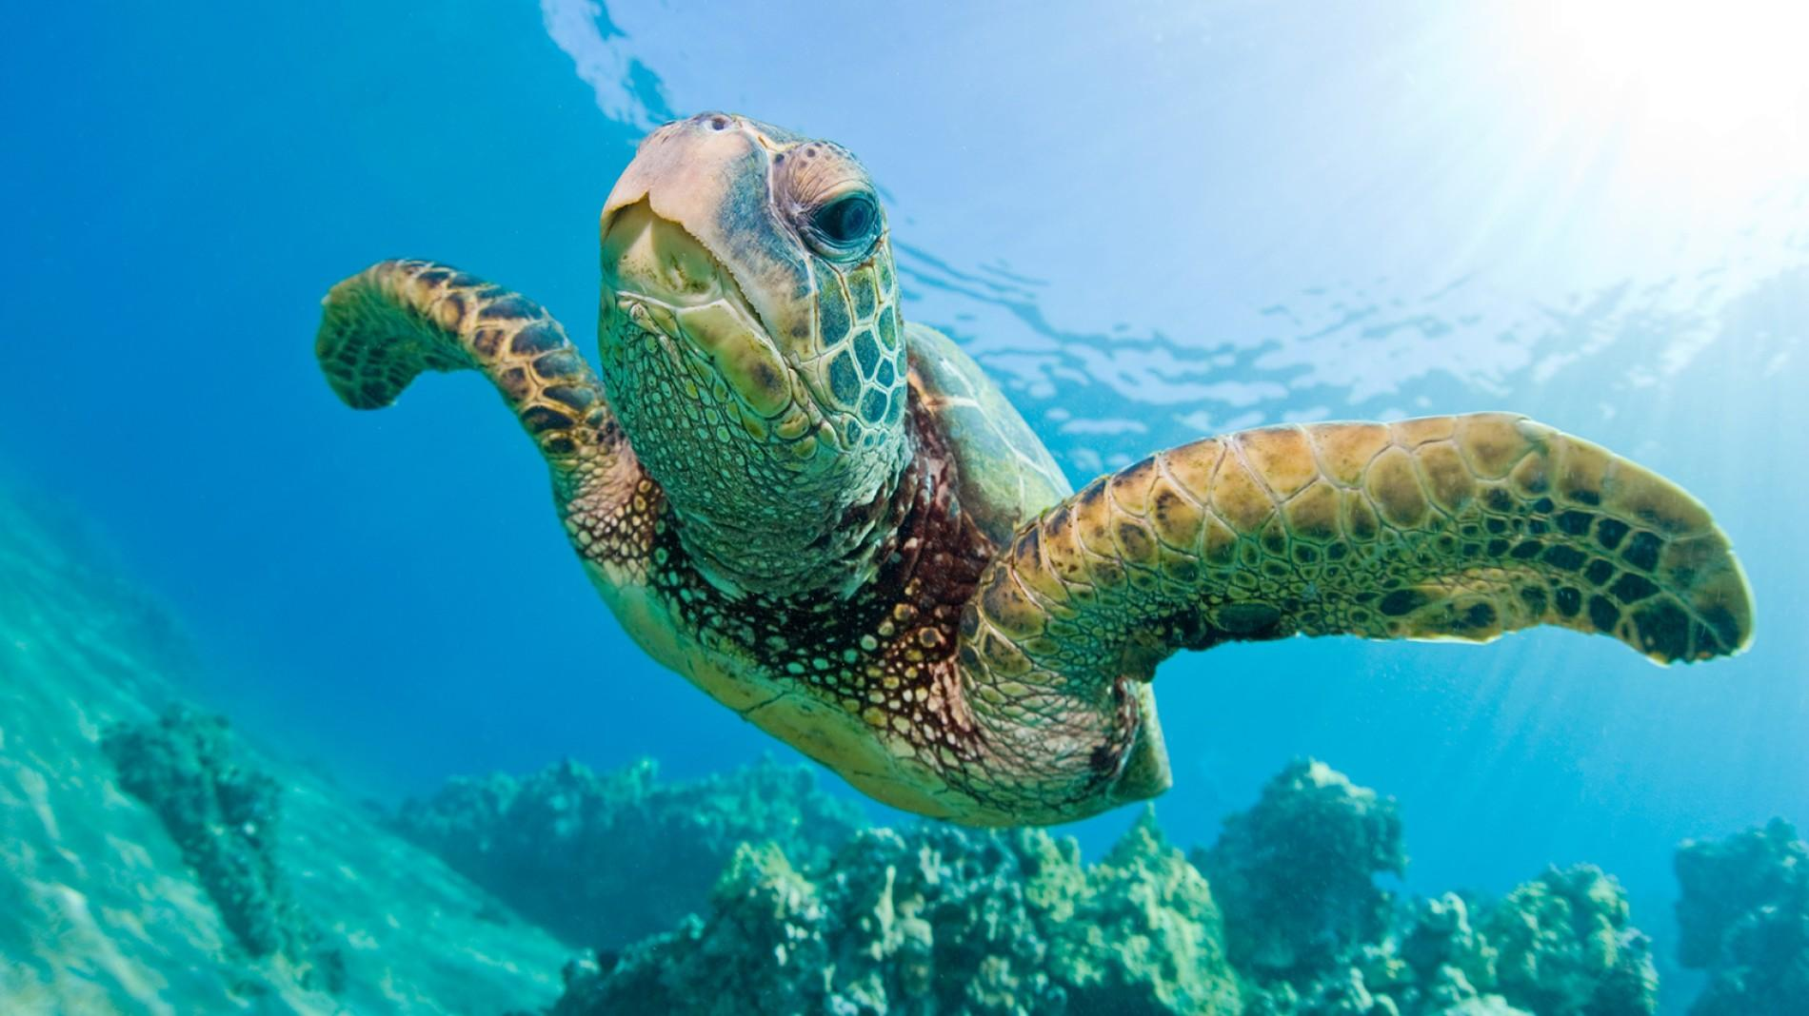
Individual Transactions in ZIMS
Notes:
Are there any questions?

