Slide 1
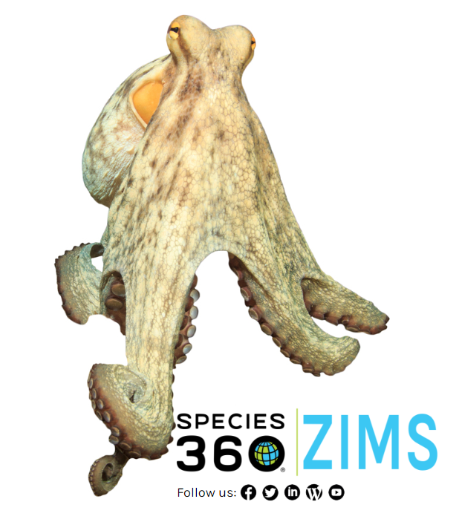
1001 - Local Administrator
An Overview of the responsibilities of a Local Administrator
Local Administrators are charged
with maintaining the Institutional
functionality of ZIMS. This includes
managing Staff and creating Teams
and Departments. They create the
various Collections and can manage
Permits and the Transponder
Inventory. In addition they select
the desired Institution Preferences
for the facility. A very important
responsibility of Local Administrators
is creating and managing the ZIMS
Roles. Local Administrators also have
complete access to all of the ZIMS
functionality.

Slide 2
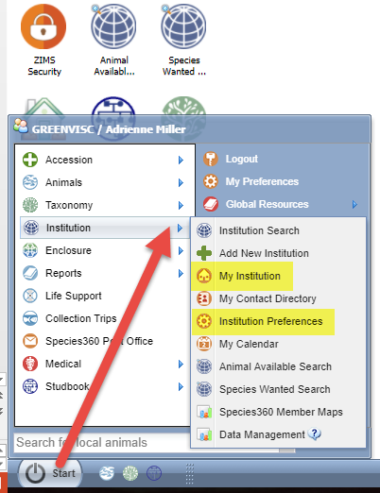
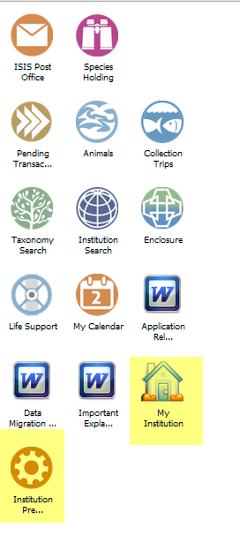
Customize Your Desktop
Most of your time as Local
Administrator will be spent
in two modules – Institution
Preferences and My
Institution. Both of these
topics are found under the
Start menu. To save you
time it is suggested that
you create icons for these
two modules on your
desktop by dragging and
dropping from the Start
menu.

Slide 3
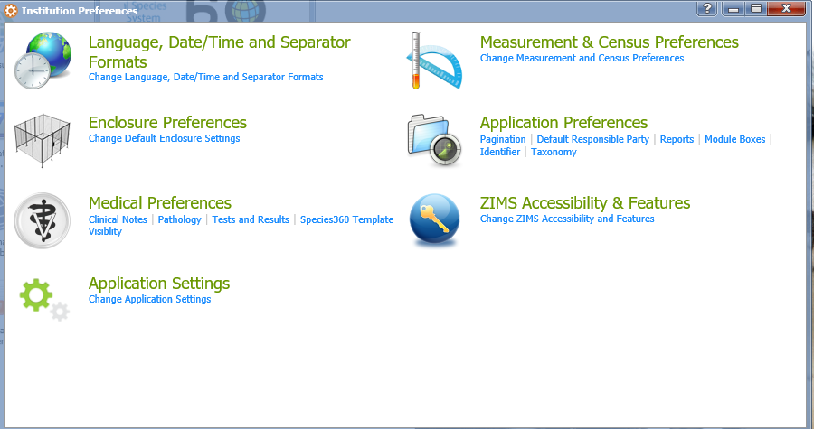
Preferences
Institution Preferences will be the default for all new Users.
However, Users can go in and set their My Preferences which
will over-ride the Institution Preferences. There are two
exceptions to this: 1) there are some preferences that are
Institution Preferences only and cannot be selected by Users,
and 2) if Save & Apply to all Users is selected when an
Institution Preference is changed it will overwrite any of your User’s My Preferences for it.

Slide 4
Preferences Available Only at Institution Level
Default Colony Inventory
Allow Multiple Enclosure Assignment
ZIMS Accessibility and Features
Advanced Access Management
The ability to limit data access by Department
External Sharing (Husbandry)
Medical External Sharing is assigned by the Medical Admin
Provisional Data Entry
Temporary data entry that requires approval
Display of Medical Weights in Husbandry
Force Single Session
Limit Access by IP Number
Allow Re-use of Transponders
Enable Auto-incrementing Local ID

Slide 5
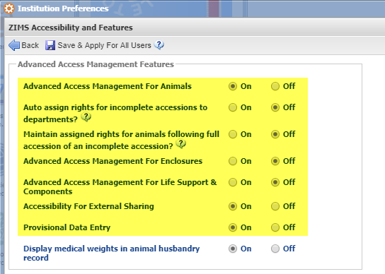
Advanced Access Management Features
The highlighted features must first
be activated by the Species360
Global Administrator. The Local
Admin will then turn them on.
If they have not been activated
they will not appear in ZIMS
Accessibility and Features.
Here the Local Admin has turned
Advanced Access Management on
for Animals but not for Enclosures
or Life Support & Components.
They have also turned on the
external sharing and provisional
data functionalities.

Slide 6
External Sharing
Husbandry records are shared at the same level
If you share a record with another institution all your information can be seen except for some Local information such as Enclosure and Collection.
Medical records have tiered sharing
These are assigned by the Medical Admin
You can select how much of the medical records you want to share by selecting Gold, Silver or Bronze levels of sharing.
This level of sharing is for all medical records
The level of sharing is to the lowest common denominator between the sharing institution and the institution the record is being shared with. You will never see more information than you are willing to share with others.

Slide 7
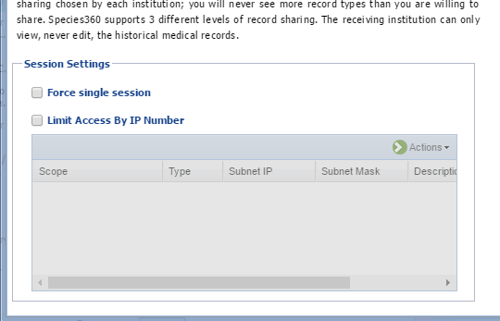
Session Settings
Other options available in the ZIMS
Accessibility and Features preferences
is the ability to Force single session and
limit by IP address. Force single sessions
means Users can be logged into ZIMS
from only one computer at a time. Limit
Access by IP number means Users can log
into ZIMS only from the IP addresses listed.
Although these options are available
institution wide we recommend that you
assign them at the staff level. Assigning
at the institution level means that your
access is also limited and, especially with
Limit by IP number, you run the risk of
locking yourself out of ZIMS.

Slide 8
Be careful when you Save
Save Applies to any Users created AFTER the Save Does NOT over ride User’s My Preferences Save and Apply to All Users Applies to ALL Users – current and new DOES over write User’s My Preferences

Slide 9
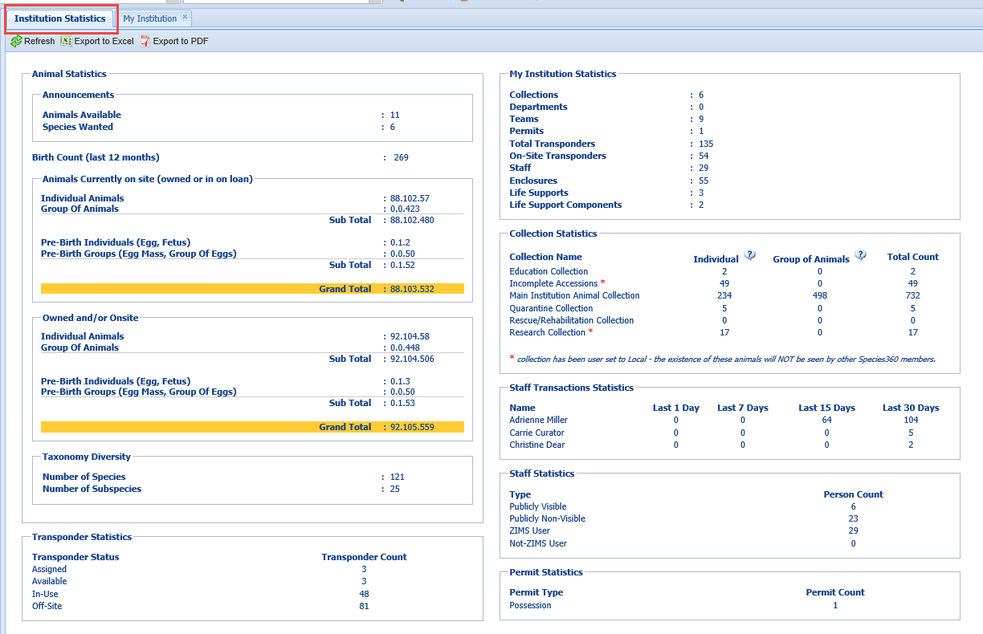
Institution Statistics
The Institution Statistics tab under My
Institution provides a variety of information
about your animal collection such as the
number of births in the past year, the
number of animals you are holding, and
the diversity of your taxonomy. It provides
information on your institution such
as how many Staff members you have
and the number of Collections you have.
It also indicates which staff members
are using ZIMS.

Slide 10
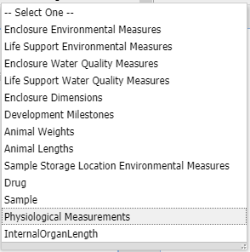
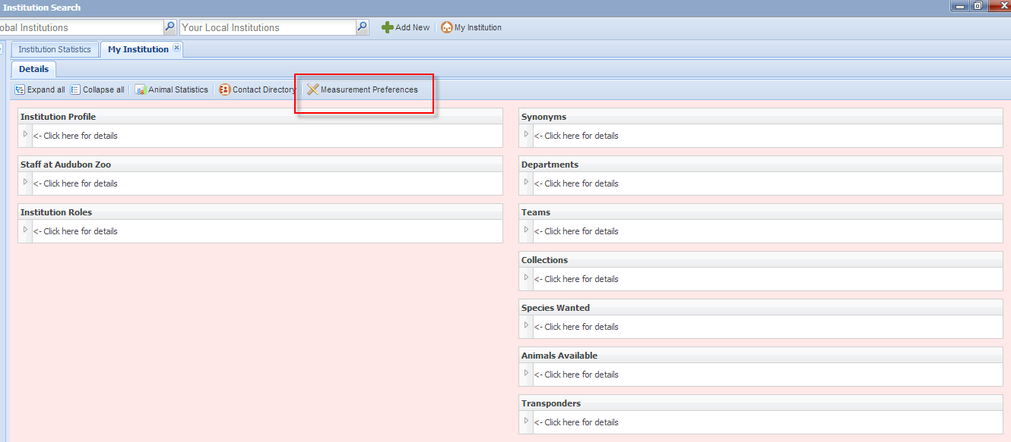
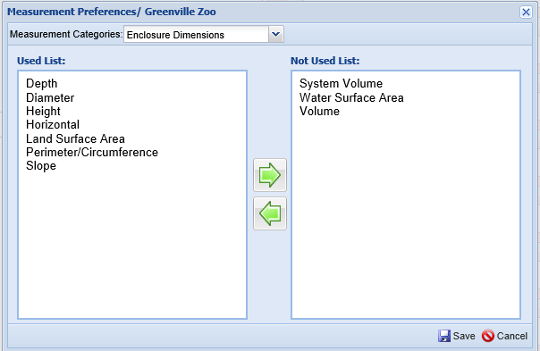
Measurement Preferences
At the top of the My Institution module
are three very useful tabs – Animal
Statistics, Contact Directory and
Measurement Preferences. In addition
to setting preferences to help save data
entry time, Local Administrators can also
shorten some of the data standard drop
down lists and remove terms that are not
used under the Measurement Preferences
option.

Slide 11
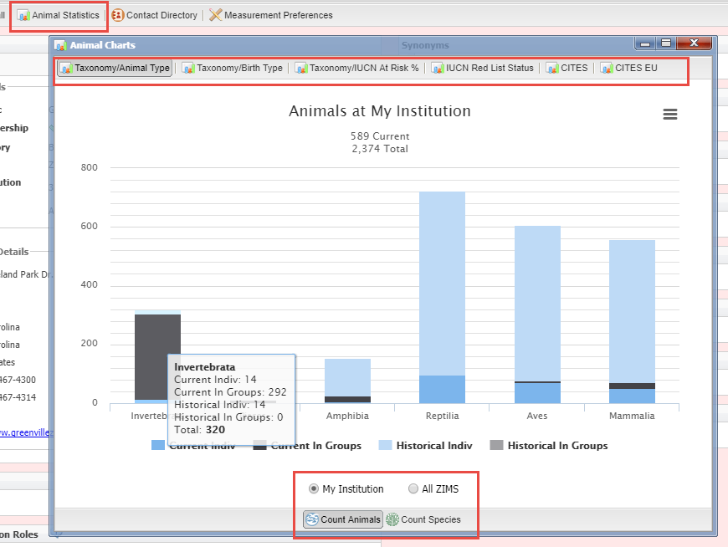
Animal Statistics
The Animal Statistics tab displays six charts by Animals
count or by Species count at your institution or all of ZIMS. Hovering over the columns will give actual counts.

Slide 12
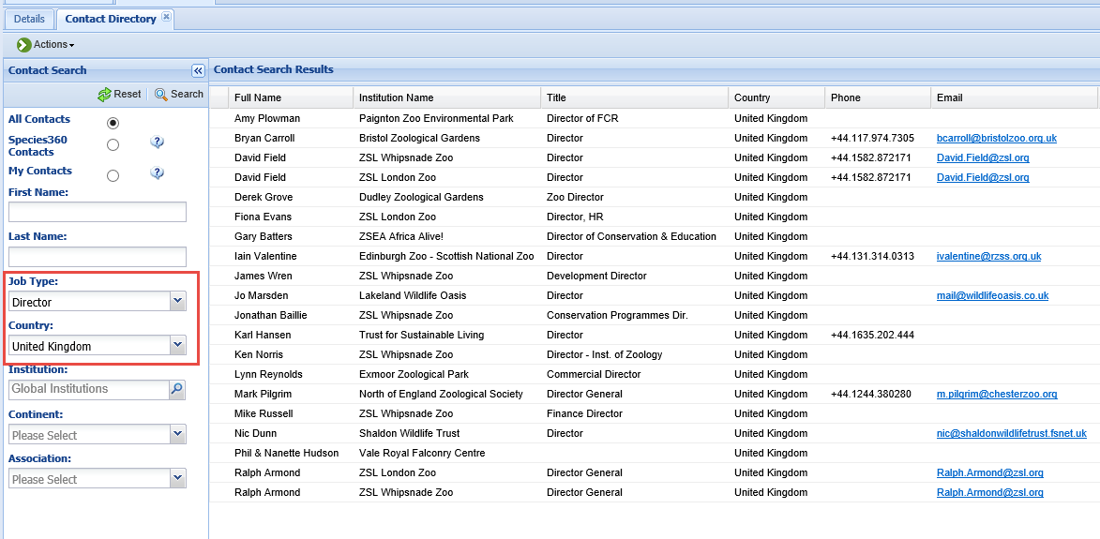
Contact Directory
The Contact Directory, lets you manage your contacts right in ZIMS. You can view All Contacts, just Species360 contacts, or contacts you have added yourself. The Species360 contacts are automatically pulled from the staff list at the various member institutions if the staff member is marked to be visible outside the institution. You can also add your own such as a Horticulture business or a component vendor. Here we searched for all Directors in the United Kingdom. If the institution has recorded their contact information you have a handy way to get in touch.

Slide 13
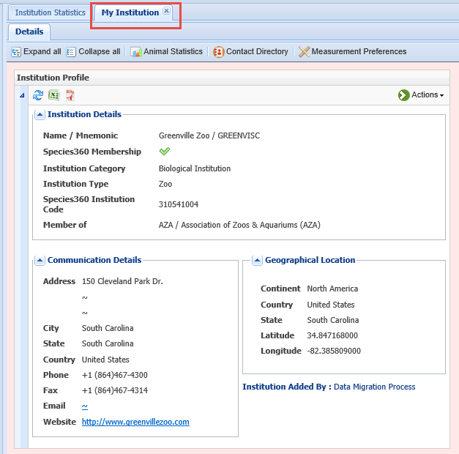
Institution Profile
The My Institution tab contains
all the other topics about your
institution that are managed by
the Local Admin. Completing the
information in the Institution
Profile grid will help your
colleagues find and contact you
as this information is viewed
globally.

Slide 14
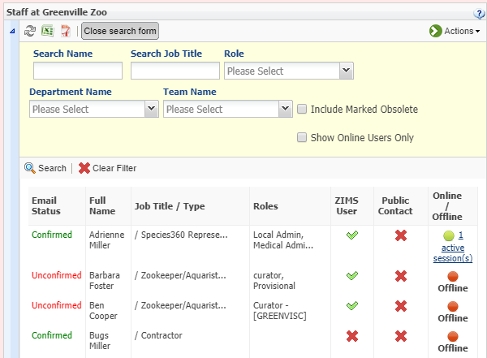
Staff Grid
Managing your Staff and assigning ZIMS Roles is an
important Local Administrator function. Because the
Responsible Party and Observer fields source from
your Staff list, you may want to enter all your Staff
even if you do not assign them a ZIMS Role. You can
see who is active in ZIMS, and you can actually sign
them out if they should not be. The search form
allows you to quickly search for staff using various
filters. You would use this search to find any staff
members that have been marked as Obsolete. It is also
easy to see who has confirmed their email here.

Slide 15
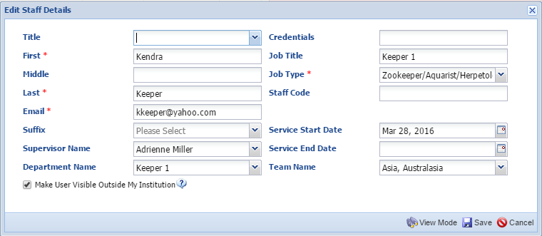
Adding Staff
When adding a new Staff member fill the screen in as much as possible. The Email recorded
must be their true Email and will need to be verified by them before they can log into ZIMS.
Assigning the Staff member to a Department will give them the correct Advanced Access
Management if you are using it. If Make User Visible Outside My Institution is checked,
when others search for your facility the staff will be visible to them and they can also be
found under the Contact Directory. And tracking service dates may prove to be of value.
Job Type and Email are mandatory as that helps us manage Email lists so members receive
the appropriate communications.

Slide 16
Roles
There are 10 Species360 Role Templates
Cannot be edited
Will be updated with appropriate new ZIMS functionality
You can create endless Custom Roles
Can be edited
Must be manually updated with new ZIMS functionality
Can be created from Template Roles, existing Custom Roles, or an empty Role grid

Slide 17
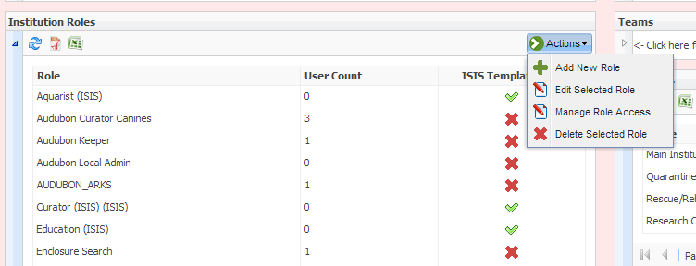
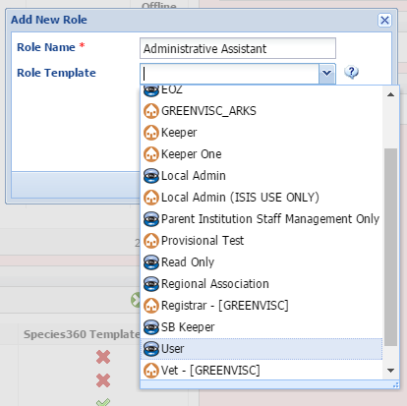
Custom Role From a Template
To create a custom Role, from the Actions
button select Add New Role. This new Role
will have much of the access that the User
Template Role does so select that from
the drop down list under Role Template.
The blue global icon indicates that it is a
Species360 Template. The local house
indicates that is a custom role created
by your institution.

Slide 18
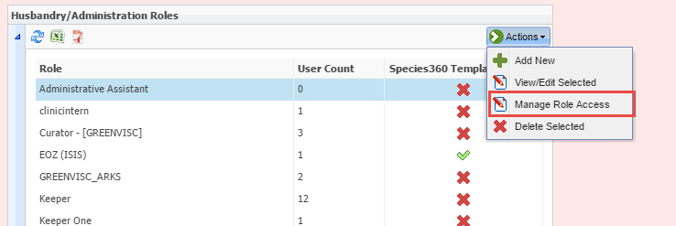
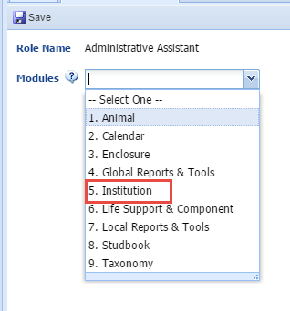
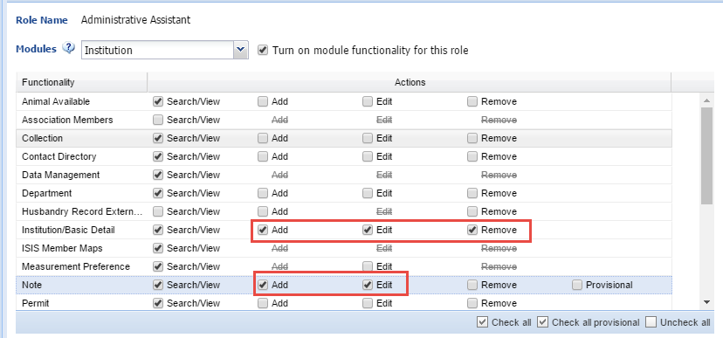
Editing Role Access
The new Role appears in the list . To edit the access
select to Manage Role Access from the Action button.
Select the module and edit the access to the various
functionality as desired.

Slide 19
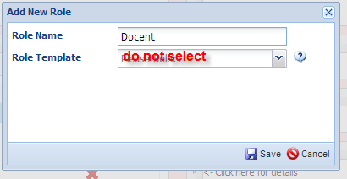
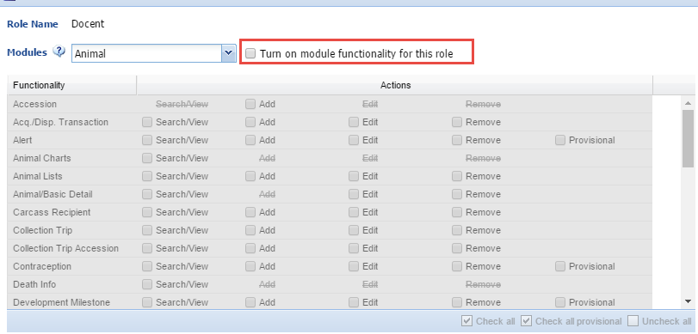
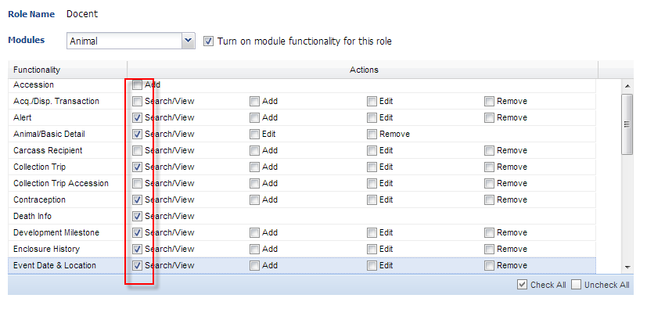
Without a Template
To create a Role without using a template simply name the Role and Save. Under Manage Role Access turn on the functionality
and select access as desired.

Slide 20
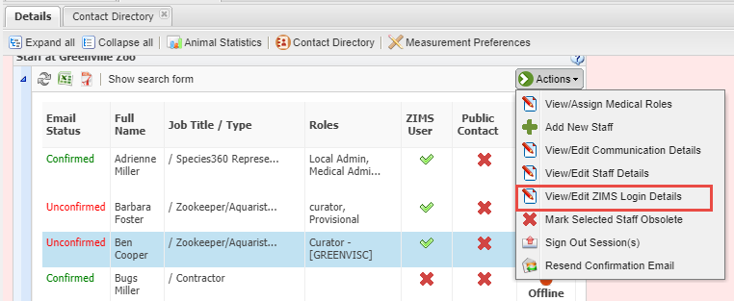
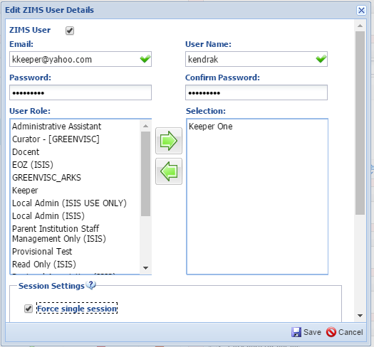
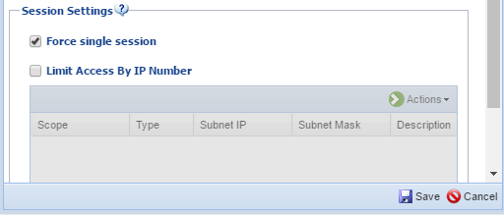
Assigning Roles
To assign the staff member a ZIMS Role select View/Edit ZIMS Login Details. Check the ZIMS User box to activate the screen. The email will prefill and the User Name must be unique.
The User Name and Password can be changed by the User under My Preferences > Account Settings. Select the appropriate Role from the left and move into the right hand box. If you do not want this person to be logged into more than one computer at a time then check the Force Single Session box. Below this is where you would Limit access by IP address for this one User.

Slide 21
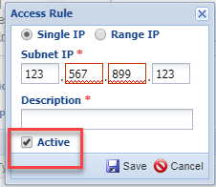
Limit by IP Address
When limiting by IP address,
it is very important to remember
to check the Active box. Otherwise
the limitation will not be
activated.

Slide 22
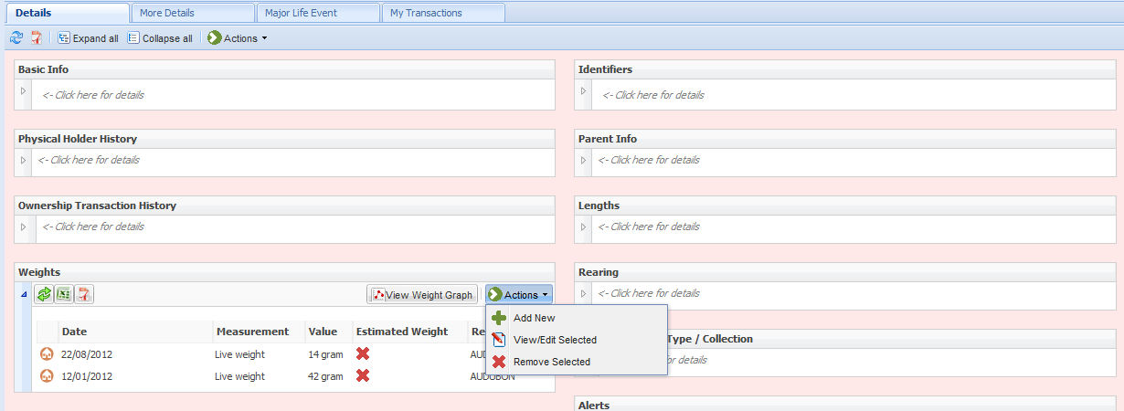
To see how Role Trimming looks,
the User at the top has been
assigned a Role that includes
all animal topics and the ability
to Add, Edit and Remove
information. The User at the
bottom has View only access.

Slide 23
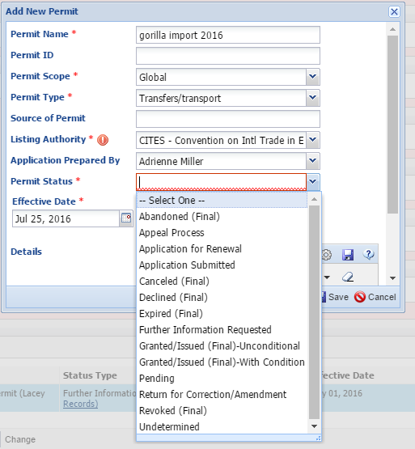
Adding Permits
You can manage all your permits
from within My Institution. You
should come up with a naming
convention so they are easy to
search for. Here we have the
species, the action and the year
as the name. If you select a
Global scope then others will be
able to view the permit when
they are looking at your
Institution or find it using the
Global Permit Report. Using the
Permit Status grid you can track
the permit from submission to
being granted (or declined). And
you can do an easy search by
expiration date so you don’t miss
a deadline.

Slide 24
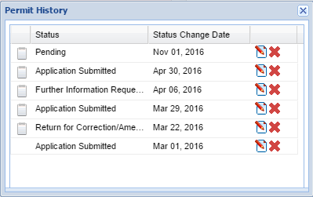
Permit Status
To view the status select the View Status
hyperlink. You can edit or delete a status
from this box. To add a new status select
Update Permit Status in the Actions menu.

Slide 25
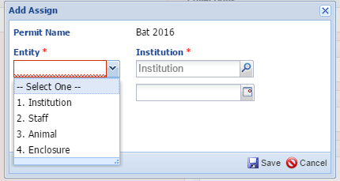
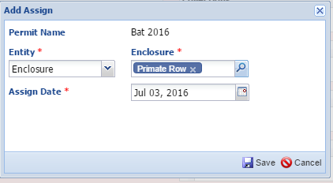
Assigning Permits
The permit can be assigned to an Institution, staff member, animal(s) or enclosure(s). By default it is assigned to your institution. You would assign to another institution should this be a permit where you are a sub-permittee or if it is a blanket permit that you are managing. What you select for the Entity will impact the second field on the screen. You can also assign a permit from within the Enclosure or Animal record.

Slide 26
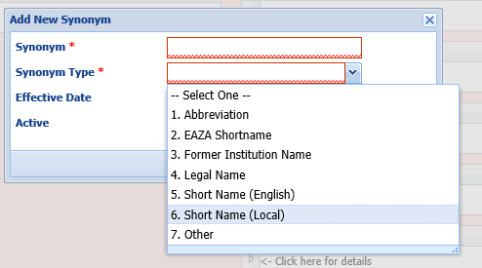
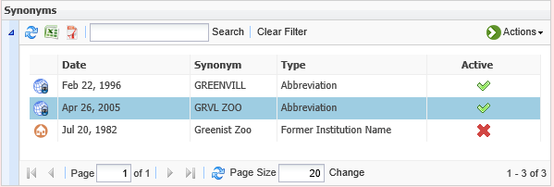
Synonyms
The Species360 mnemonic is automatically a Synonym for your institution. You can add others of various types and if someone searches by the synonym they will find your institution. Here we have marked our former name of Greenist Zoo as inactive.

Slide 27
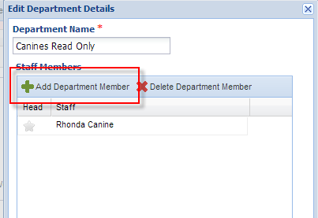
Departments
Departments allow you to organize your staff into major divisions. Departments can be assigned as Responsible Parties when more than one individual is responsible. And a Department Head can be recorded. The most important use of Departments is when Advanced Access Management is used (yellow
highlights above).

Slide 28
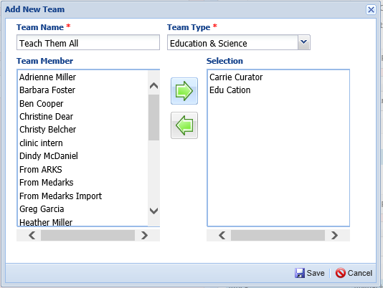
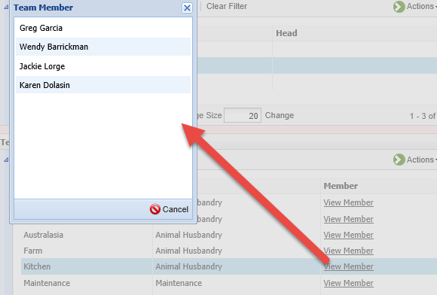
Teams
Teams are slightly different than Departments in that there is no Head and you have to pick a Team Type. Teams can also be assigned as Responsible Parties. Selecting the members is like assigning Roles, you move the desired staff member over to the Selection side. You can quickly view the members of a Team from the View Member hyperlink.

Slide 29
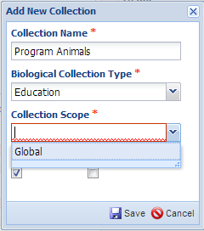
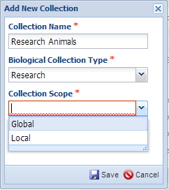
Collections
The various Collections available in ZIMS allow you to organize your animals by the reason for having them. Most of them will go into the default Main Animal Collection. These are your exhibit and breeding animals. But you can also create Collection Types such as Education, Research, Temporary Holding and even Wild if you are continuing to monitor an animal released to the wild. By default, all animal records are viewed globally in ZIMS and for most Collections the only scope choice available is Global. Only Research and Feedstock Collections can be marked as a Local scope.

Slide 30
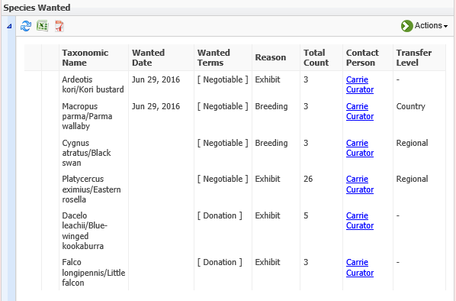
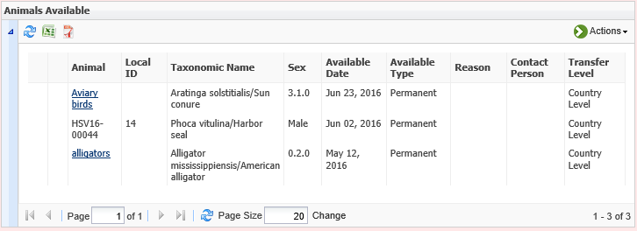
Species Wanted/Animal Available
You can also list species that you are looking to
add to your collection and any animals that
you are looking to place elsewhere in the
Species Wanted or Animals Available grid.
These are searchable by other institutions
either looking for the species you have available
or ones that have a species available that you
are looking for. You can use Animal Lists to
create a single listing of Animals that are
Available such as the alligators and Aviary birds.

Slide 31
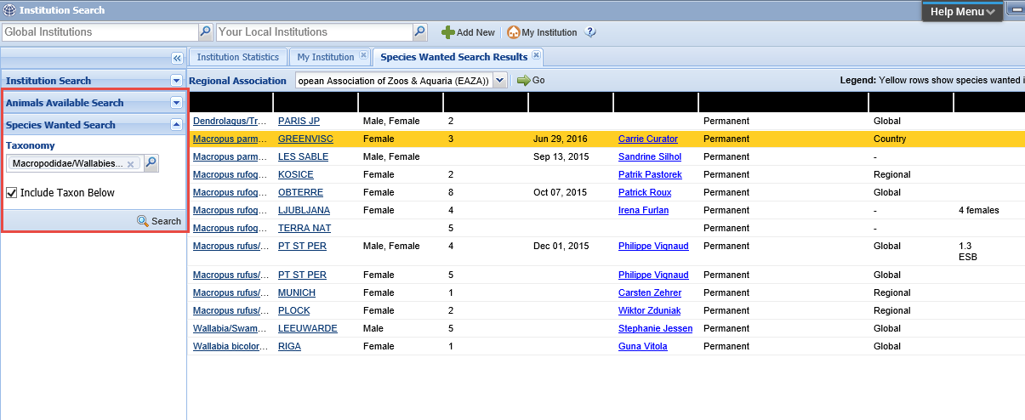
Searching for SW and AA
To find SW or AA you will use the Institution search box. You can limit searches to
various Regional Associations. Anything in your region will display highlighted in orange.

Slide 32
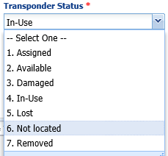
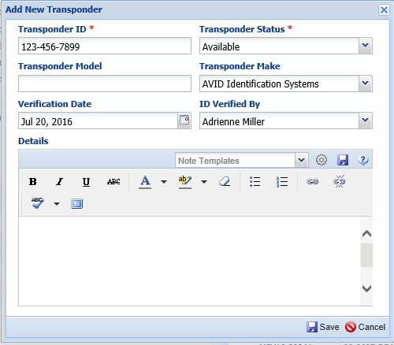
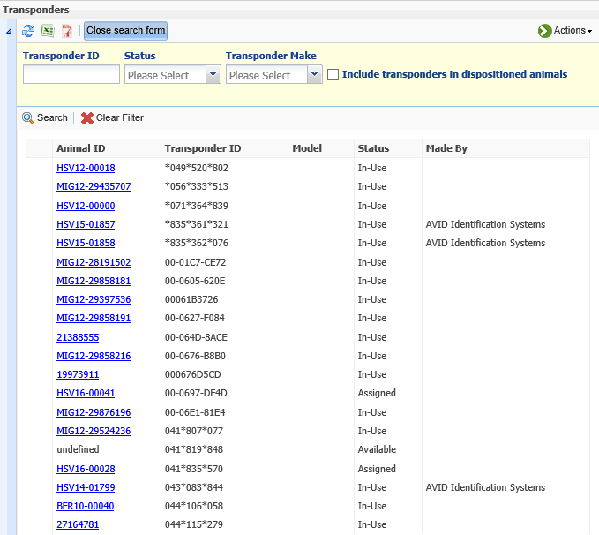
Transponders
A transponder cannot be assigned or
implemented unless it is first entered
into the inventory. From within the
animal record there is also a link to
add a new transponder should you
be trying to assign/implement one
that has not yet been entered into
the inventory. A transponder is
assigned or implemented from within
the animal record.

Slide 33
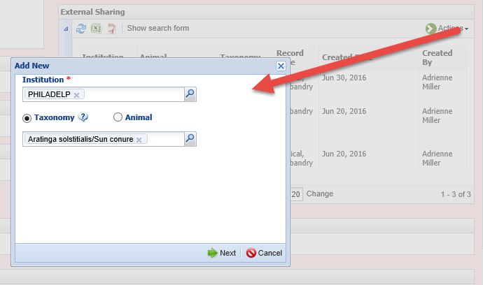
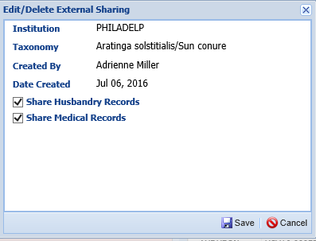
External Sharing
Sharing records is handy during the transaction process and for staying updated
on animals on loan. Records can be externally shared at the single record level or
at the taxonomy level. If you select taxonomy ALL of the records for that species
will be shared. Sharing an entire taxonomy must be done from within the External
Sharing grid in My Institution. You can share a single record from within the record itself.
Once you identify the taxonomy/animal and the institution you must then select if you
want to share Husbandry, Medical or both records.

Slide 34
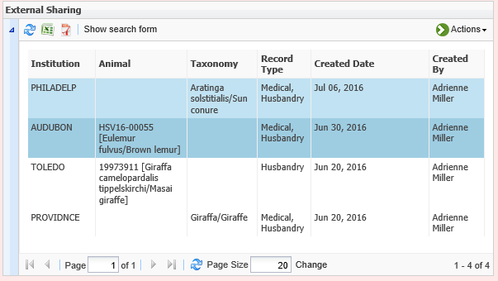
External Sharing
All your active shared records will display in the External Sharing grid as well as within
the animal record itself. The record will continue to be shared until you delete it from
either the record or the My Institution grid. A record can be shared with multiple
institutions. There is no history kept once the sharing is deleted.

Slide 35
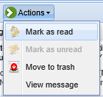
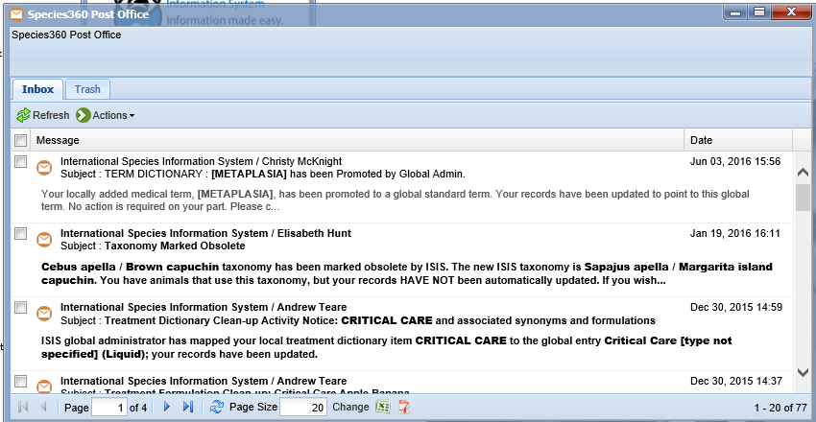
Species360 Post Office
Managing the Species360 Post Office may also be a Local Administrator responsibility. When you log into ZIMS the lower right hand corner will let you know if you have any Unread messages in the post office. These messages are initiated by the application during transactions and are not for institution to institution use. Any staff who has access to record acquisitions and dispositions should also be given access to the Species360 Post Office. It is up to everyone with this access to manage their own Post Office messages, just like managing your own Outlook account. Topics that will create Post Office messages include taxonomy changes, treatment dictionary new terms and cleanup, and if another institution has marked a Pending transaction with you as No Information Available or Not Entered into ZIMS. These transaction related messages are important to receive as those do not create Pendings and the PO is the only way you will know without looking into each record.

Slide 36
Data Entry Monitor
As Local Administrator you will also have access to Data Entry Monitoring
(DEM). DEM is found under the Start menu > Security Tools. DEM allows you
to monitor the Who, When and What of ZIMS data entry. The Log In History tab
displays all transactions (any piece of data entered) recorded except for entries
as Provisional data. The search box lets you search by specific Users, Date Ranges
and Record Types.

Slide 37
Data Entry Monitor
Selecting the hyperlinked Transaction Count will open the results for the
ZIMS session. The notebook icon allows you to view the details. This is where
you can easily roll back data entered in error by selecting the Undo Selected
option. You cannot undo a roll back so be careful using this option.

Slide 38
Provisional Data
The Provisional Records tab under Data Entry Monitoring displays the records entered
provisionally (temporary records) that need to be Approved to become a true part of the ZIMS global database, or Rejected and the data recorded will be removed from the record. Whereas
permanent record entries displayed under the Log In History tab have the option to roll them
back, Provisional Records have the option to roll the information forward by accepting the
data. Double clicking the notepad icon on the left will allow you to view what was entered. The record must be Approved or Rejected as written as Users with “normal” data entry access cannot edit provisional records. If a record needs to be edited you can contact the recorder and they can change it then you Approve. Or, you can Reject and tell the recorder to re-enter the information correctly. Once Approved, a User with Provisional access can no longer edit what they entered. Any edits to that record will now display in the Log In History tab.

Slide 39
Local Admin
Managing Your Institution in ZIMS

