Slide 1
Email Confirmation
Why it is required and how to
confirm

Slide 2
Why? Email Confirmation
ZIMS requires that all Email addresses
are confirmed by the User. You will not
be able to log into ZIMS if it is not
confirmed.
Why is this required?

Slide 3
1. Security
Requiring Users to validate
Emails is a standard security
measure used by almost all
on-line systems. For example,
it helps prevent an inappropriate
person from resetting your
Password.

Slide 4
2.Ensures Accuracy
Validating your Email address
ensures that it was typed correctly
when it was recorded. Example:
John.Smith@gamil.com

Slide 5
3. Emails From ZIMS
ZIMS has the ability to send Emails
directly from the application. For
example, there is the option to send
an Email notification to specified
Staff should a Water Quality or
Environmental Measurement be
outside of your desired range.
We want those Emails to go to a
real address!

Slide 6
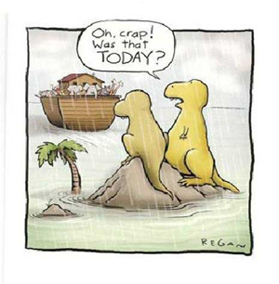
4. Emails From Species360
Finally, this is a way to ensure that
Emails coming from Species360
are actually getting to the right
people. Emails we send out are
often filtered by your Job Type to
make sure that you receive those
Emails that are relevant to your
responsibilities. If they are not
going to a true Email you may be
missing some valuable information.

Slide 7
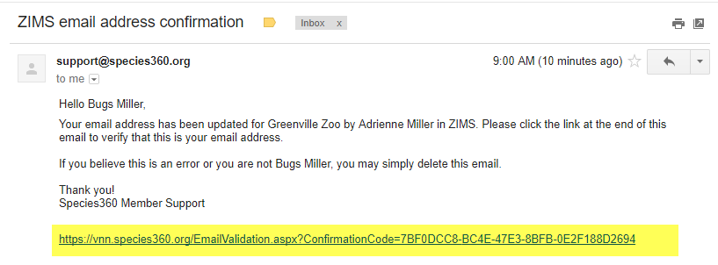
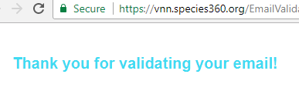
To Confirm Email
When a new User is created
you will get a message that
an Email will be sent.
The Email will come from support and the title will be ZIMS Email confirmation. After you open simply click on the link at the bottom. You will receive a message that your Email has been validated.

Slide 8
Unconfirmed Emails
If you have not confirmed your Email, when you try to log in you will receive a message. You can chose
to resend the confirmation Email. If the Email address is incorrect you are told to
contact your Local Admin
or support.

Slide 9
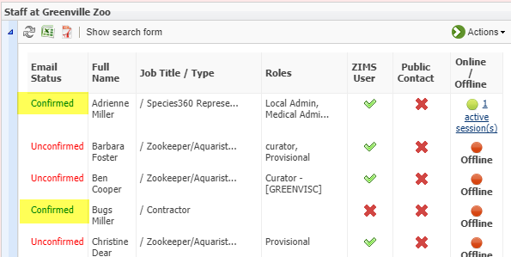
View Confirmed Emails
From the Staff grid you can quickly see who has confirmed their Email and
who has not. All previously entered Staff members will receive Email
confirmation requests, not just new Users.

Slide 10
Additional Help:
Email Confirmation Help document – if you have ‘shared email addresses’ this document will provide a work-around.
Change Email Address – this help document provides support in English, Spanish and Russian
Contact Support@species360.org – for additional assistance

