Slide 1

1000 - Introduction to ZIMS
An Overview of Concepts and Navigation

Slide 2

Concept 1 – Internet based
ZIMS was created using six basic
concepts. The first concept is that
ZIMS is internet based which has
many positives over applications
that need to be installed. First, ZIMS
can be accessed from any computer
that has internet access. No more
vacations! This also makes support
easier as support staff can look
directly into your institution to see
what is happening. Also updates are
automatic so everyone is working in
the same version. Being internet based
allows for global sharing of data which
is a very important part of ZIMS.

Slide 3

Concept 2 – Single Accession and Single Record
The second concept is that an animal or group is accessioned into ZIMS only once. As it moves from institution to institution “Visits” are created in the global
record, there are no additional accessions that need to be linked as animals move. A Global Accession Number (GAN) is
created by the ZIMS application. This GAN will never change even if the animal moves between institutions.
In the end there can be only one.

Slide 4

Concept 3 – Business Rules
Concept 3 is Business Rules. ZIMS
operates following Business Rules
to make sure the User, or the
application, doesn’t do anything
that is illogical. For example if you
have recorded a death of a late
term egg, then you cannot record
a hatch. These Rules were developed
by the programmers to ensure the
application functioned logically
technically and by animal Subject
Matter Experts to ensure the animal
data was logical.

Slide 5
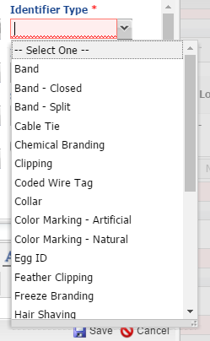
Concept 4 – Data Standards
Another concept was to restrict
the use of free text fields as they
make searching difficult because
you may select different verbiage
than another institution. Data
Standards are pre-filled lists which
Users select from, so everyone selects
from the same terms. These lists were
developed by Subject Matter Experts
and fine tuned by User suggestions as
they find the need for additional terms.
If you want to request a new term in a
Data Standard submit the request to
support@Species360.org. Include
the Data Standard, the term you want
and a definition of the term.
This is a single select Data Standard. You can select only one term.

Slide 6
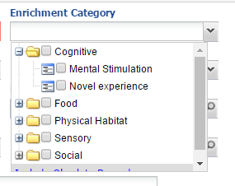
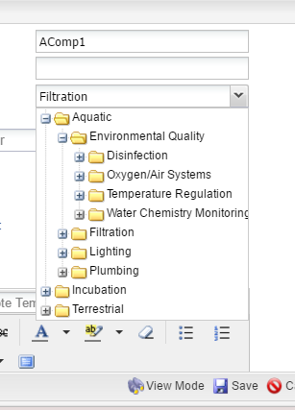
Concept 4 – Data Standards
Cascading Data Standards allow you to select
a term at a high level, or expand the term to
use a more detailed term. The Data Standard
on the left allows selection of only a single term.
The Data Standard above is a multiple select
drop down that allows you to select multiple terms.

Slide 7
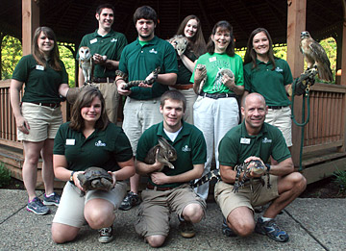
Concept 5 – Institution Management
The fifth concept is that ZIMS is
designed to help you manage
beyond your animal collection.
Your animals are the driving
force behind ZIMS but there
is functionality such as helping
you manage your Permits and
Transponder Inventory, Enclosures
and Life Supports, and your Staff
and Contacts.

Slide 8
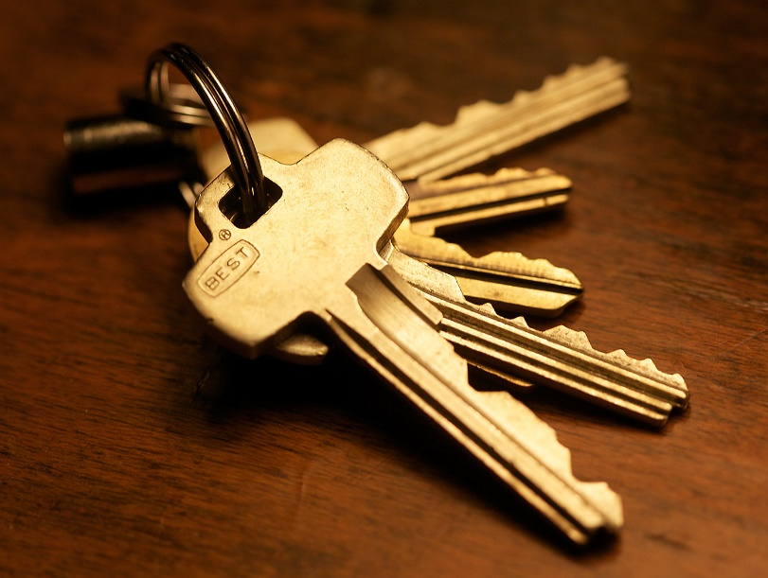
Concept 6 – Role Based Access
Roles are the final concept driving ZIMS.
Roles dictate what access the User has
in the application. Your Role is your key to
whether you can Search/View, Edit, Add or
Remove data. Roles are usually assigned by
your Local Administrator. There are Species360 Template roles which are not editable, or you can create custom Roles which are editable if the template Roles don’t meet your needs. These custom Roles will not be automatically updated when new functionality becomes available so you need to continue to closely monitor these Roles and add any new functionality to them if desired.

Slide 9
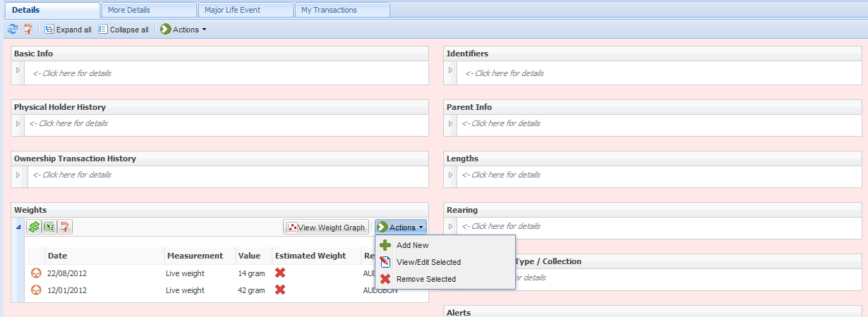
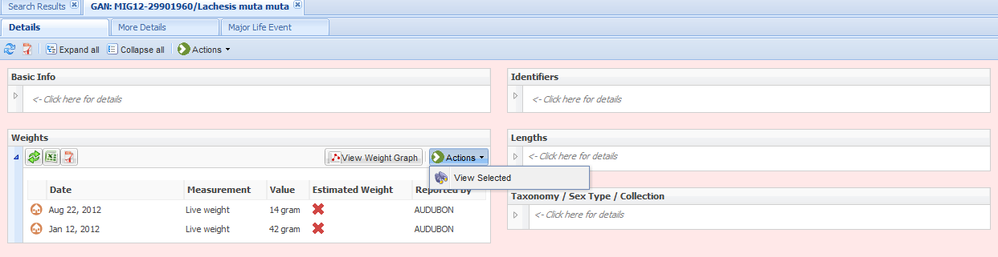
To see how Role Trimming looks we will look at an animal record from
two different Roles. The User at the top has been assigned a Role that
includes the ability to Add, Edit and Remove information on Weights.
The User at the bottom has access only to View the Weights.

Slide 10

The 6 Concepts of ZIMS
Internet Based
  Global sharing!
Single Record
Logical
Standardized
Entire Institution
Role Based Access

Slide 11
Scope - Local or Global?
Because ZIMS is a Global database you have the option to view both your records (Local) and those of others, although less is seen in a Global view
Local records are animals you have either held (physical) and/or have/had legal title (ownership) of
  Screen background is pink
  House icon displayed
Global records are animals that you have never held or had ownership of
  Screen background is blue
  Globe icon displayed

Slide 12

What can you edit?
If your institution recorded it, you can Edit or Remove it if your Role allows
If entered by another facility, you cannot Edit or Remove it regardless of your Role

Slide 13

My Information is Different than Another Institution – What Displays?
Even though a ZIMS record is a single
global one, as animals move
between facilities the data entered
on them may not agree. ZIMS has to
accept what YOU say about YOUR
animals as well as what OTHERS say about THEIR animals. So you may have local information that is different from another institution’s information. How this information is displayed depends on if you are looking at a Local view or a Global view of a record.

Slide 14


Taxonomy
Local View
  Most updated Taxonomy at your Institution
  Your Preferred Synonym
Global View
  First Reporting Institution
  Subsequent holders selecting DNA/RNA Genetic Analysis

Slide 15
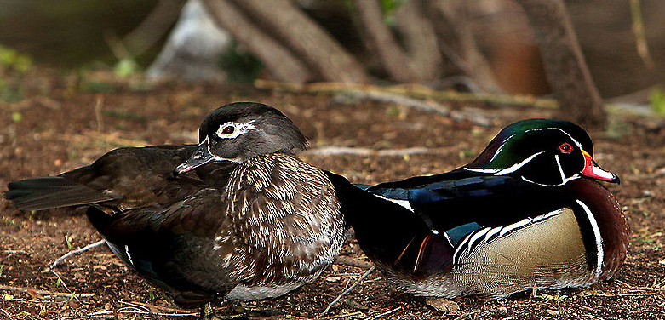
Sex
Local View
  What you recorded
Global View
  Per current/last holder
  Animals are easier to sex as they mature

Slide 16
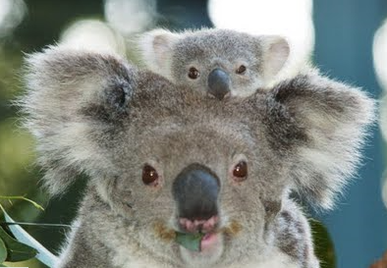
Birth/Hatch Date
Local View
  What you recorded
Global View
  First reporting institution
  Closer to the Birth/Hatch

Slide 17
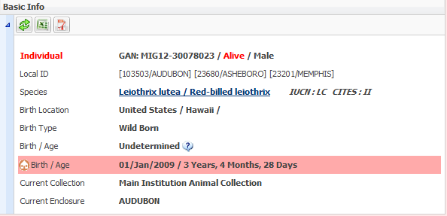
Other Conflicts?
All Information is Displayed
  ZIMS has to accept what every institution says about their animals
Conflicts are displayed in Red

Slide 18
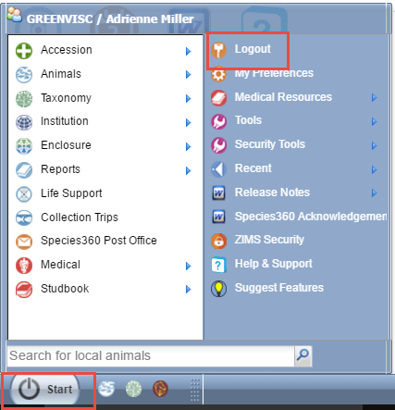
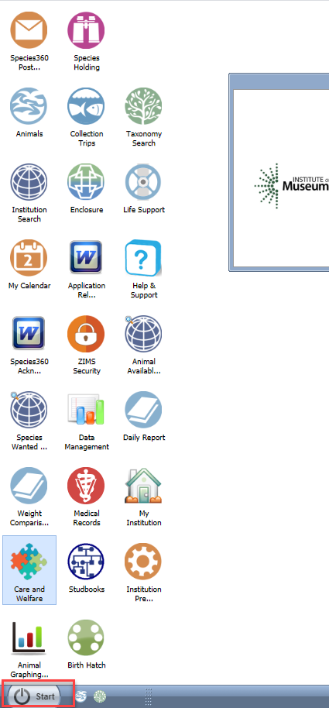
Navigation
ZIMS is designed to have the look and feel of Windows.
On the desktop are icons that will take you into the
modules. The Start menu will also take you to many
of these modules plus additional topics such as
Reports and Tools. To Log Off you would go to Start.

Slide 19
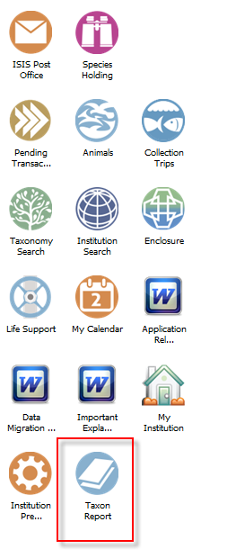
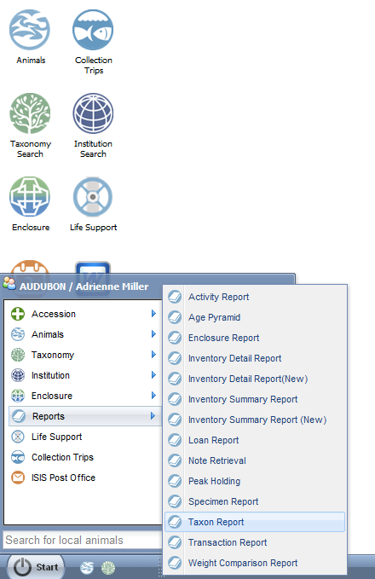
Customize the Desktop
You can also customize
your desktop with topics
from the Start menu. For
example, if you run a lot
of Taxon Reports you can drag and drop it from the Start menu to your desktop.

Slide 20
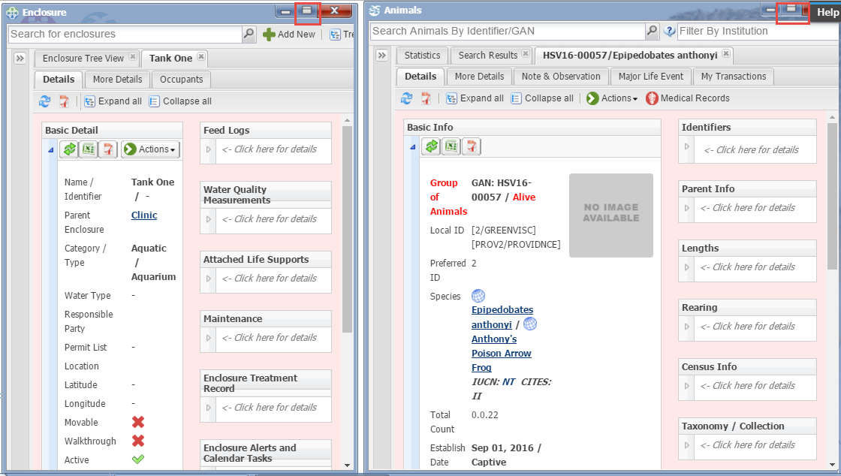
Open Multiple Modules
You can resize the screen for all modules so that you
can have multiple modules open for comparison. Here
we have an Enclosure and an Animal record open at the
same time.

Slide 21
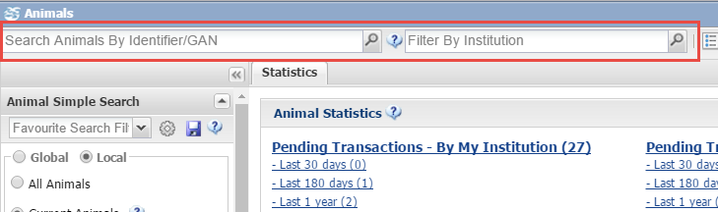
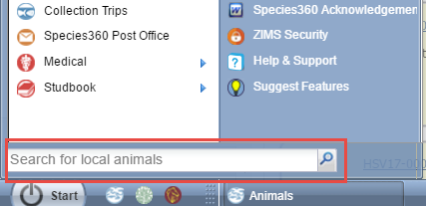
Animal Searches
To search for Local animals you can
enter a GAN, Identifier or Taxonomy in
the “Searchfor local animals” box under
the Start Menu. The search in the upper
left will find both Local and Global animals,
and you can filter by Institution here as well.

Slide 22
Order of results display
Local Search
  Exact match to GAN
  Exact match to my institution’s Local ID
  Exact match to any of my institution’s other identifiers
  Partial match to my institution’s Local ID
  Partial match to any other of my institution’s identifiers
Global Search
  Exact match to GAN
  Exact match to my institution’s Local ID
  Exact match to any other of my institution’s identifiers
  Partial match to my institution’s Local ID
  Partial match to any other of my institution’s identifiers
  Exact match to other institution’s identifiers
  Partial match to other institution’s identifiers

Slide 23
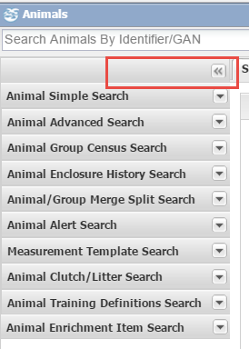
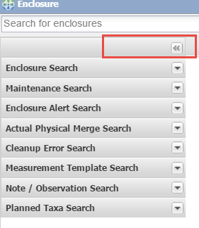
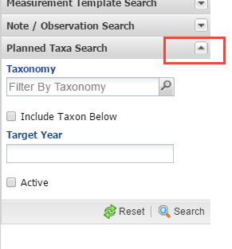
Expandable Search Boxes
Most of the modules have
Expandable/Collapsable
Search boxes on the left as
shown on the two examples
to the right. Use the
dropdown arrows to open
the specific Search screen
to see the various filters as
below.

Slide 24
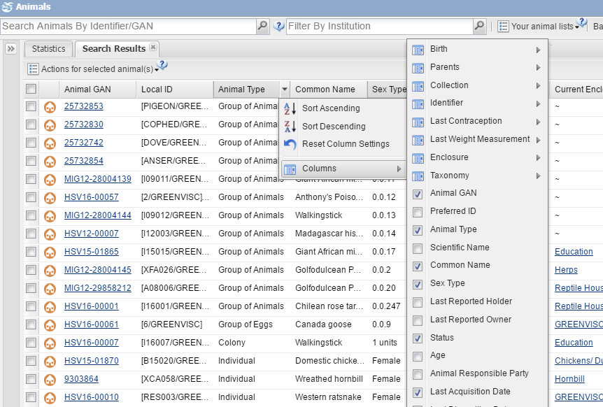
Column Customization
Most of the results grids have customizable
columns. To customize, select the drop down
arrow to the right of any column and select
“Columns”. The various information that can
be displayed for that module are listed for
you to select (check the box) or deselect
(uncheck the box). The column order can also
be changed by dragging the column to its new
location. Your customization will remain for the
next time you open ZIMS.

Slide 25
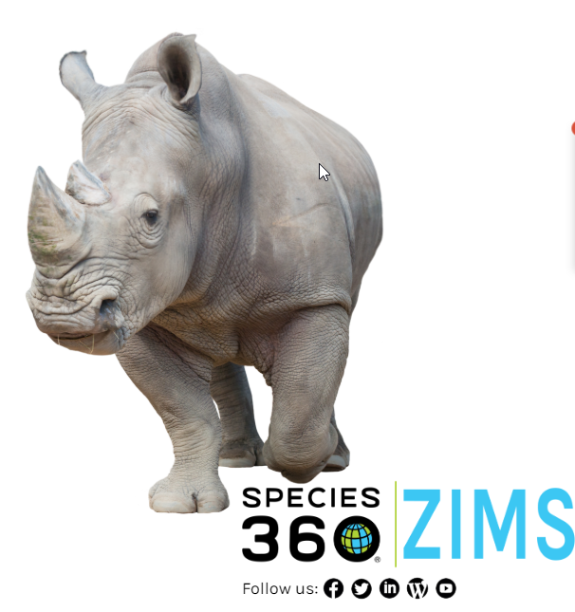
And that is ZIMS!

