Slide 1
Getting Ready for Inventory Time!
November 2020 TNT
Notes:
Welcome to the November 2020 TNT – Getting Ready for Inventory Time. Although most of our inventories or stock counts aren’t due until the beginning of the year, now is the time to make sure that your ZIMS records will reflect an accurate count when the time comes. When you have a deadline to meet, the last thing you want to be doing is scrambling around trying to figure out why the records do not accurately reflect the counts. This is sort of a Fall Spring cleaning!

Slide 2
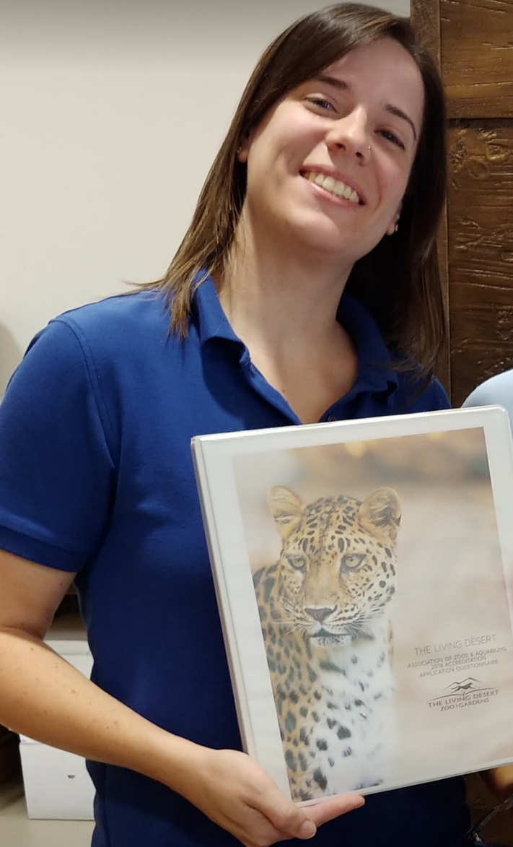
Welcome Brigid Randle!
Notes:
This month I am very excited to have Brigid Randle on the TNT with me. Brigid can give you experienced advise on prepping for inventories. Brigid has been the Registrar at the El Paso Zoo and The Living Desert in Palm Desert. She has been an instructor for AZA’s Institutional Records Keeping course for many years. She continues to be the Slender-horned gazelle International Studbook Keeper and SSP Coordinator. She is happy to answer any of your questions. Welcome Brigid!

Slide 3
What Can You Do Now?
Keep your Taxonomy updated with any changes
Address Your Pending Transactions
Close Out/Correct zero count Groups
Use the Data Quality Tools
Check your Post Office
Get a preliminary update from Keepers
Run a Trial Inventory
Be prepared to Explain Group Counts

Slide 4
The Impact YOU Have
Your corrected ZIMS records can help other facilities correct their errors
Studbook keepers rely on accurately kept institutional ZIMS records to manage populations
Your Inventory can help guide facility management and budgeting plans
Notes:
BRIGID – Going through these inventory checks can have a ripple effect even beyond your own institution. Many things can be impacted with your actions and corrections in your local ZIMS records. When you correct part of a record, you really DRIVE the collective data accuracy another step closer to the ‘best truth’.

Slide 5
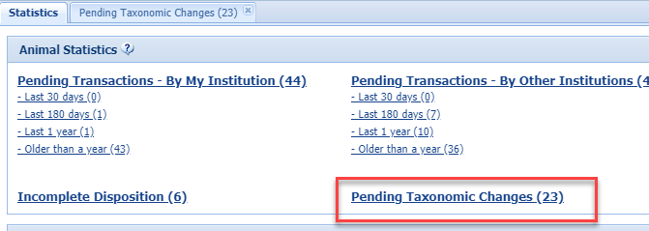
Taxonomic Changes
Notes:
When Global taxonomy is updated, ZIMS will not automatically update your Local records, you will need to do so, but only if you agree with the update! In the Animal Statistics tab, Pending Taxonomic Changes displays the species that need updating and the count of animals impacted which is a hyperlink into the records. If you
choose not to accept the updates, your Local taxonomy will display in your Inventory Reports. You can chose to update all the records in a species, or just some.

Slide 6
Taxonomic Changes
Notes:
To accept the updates for all records of the taxonomy, check the left hand box and select Accept Species360 Taxonomy. The change date for your institution defaults to the most current change date. If you want to capture the date that Species360 recorded the change you should only select records that were changed on the same date. Here the American toad and the marine toad were changed by Species360 on July 24, 2015, but the caracara was changed on August 3 2015. If you accept these updates together, the change date will be August 3 for them all. You can also chose to Archive the records if you want to do further research.

Slide 7
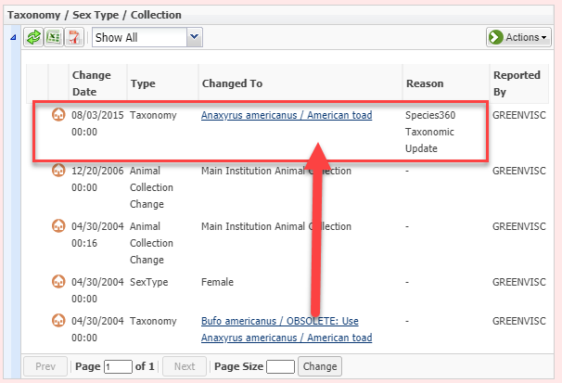
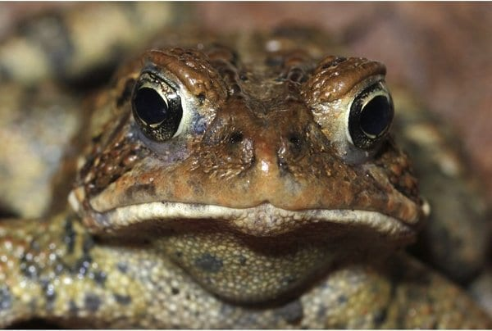
Updated in Record
Notes:
The taxonomy will be updated in the record. Your inventory will now
display as the Global taxonomy.

Slide 8
Update a Single Record
Notes:
To update a single record, select the number hyperlink and open the desired record from the results grid. If you want to update several records from the list you can do a Batch Taxonomy Change by checking the desired records and selecting simple batch action > Taxonomy Change from the Actions menu.

Slide 9
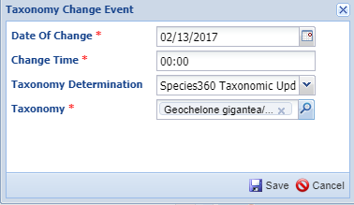
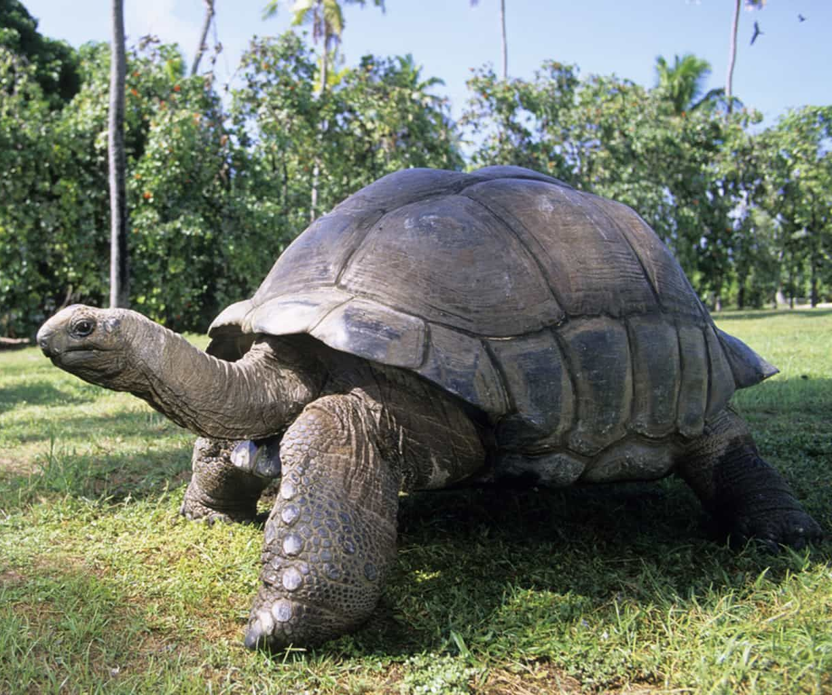
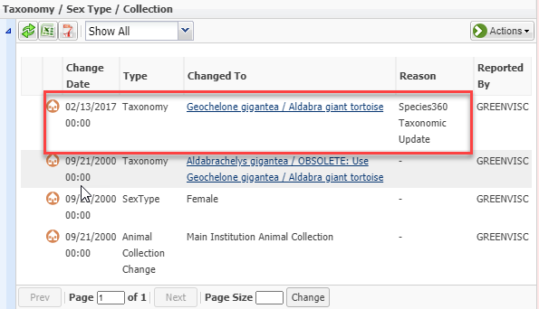
Update From Record
Notes:
The Date of Change should be the date that Species360 made the change. The Taxonomy Determination would be Species360 Taxonomic Update.
The record will reflect the change and your Inventory will display the Global taxonomy.

Slide 10
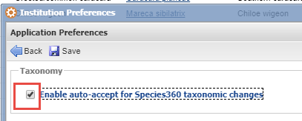
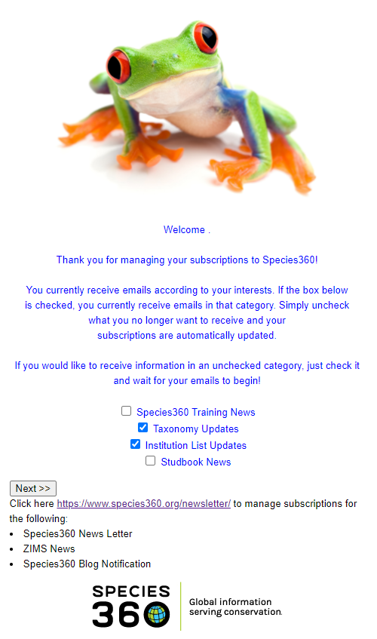
Automatic Updates & Email Notifications
Notes:
If you wish to automatically update your records when ZIMS updates
taxonomy you can check the Enable Auto-accept for Species360
Taxonomic Changes box in Institution Preferences > Application
Preferences > Taxonomy (below). You will still receive a Post Office
message regarding the change.
You can also opt for email notification of Taxonomy Updates so you will be kept informed regarding changes, in addition to notifications for other topics. Type “Subscribe to Species360 Emails” in the Help menu. In addition to Taxonomy updates you can receive are Training News, Institution List updates and Studbook News in addition to receiving the Species360
News Letter, ZIMS News and Blog notifications.

Slide 11
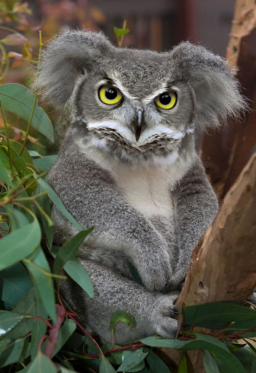
Taxonomic Updates
Notes:
Any thoughts, comments, great ideas, suggestions or questions for Taxonomic Updates?

Slide 12
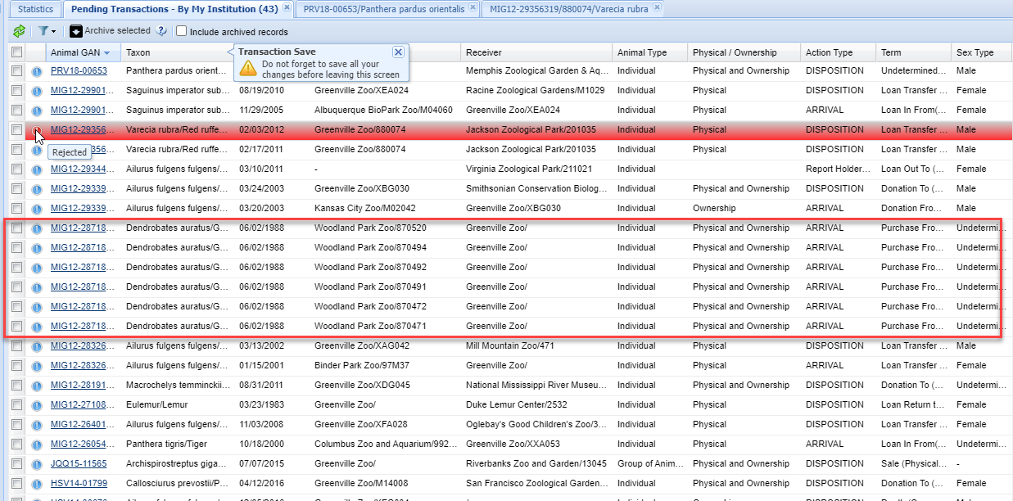
Pending Transactions
Notes:
BRIGID - Unaddressed Pending Transactions – By My Institution can obviously have a large impact on your Inventory. ZIMS will accept what YOU say about your collection so even if a transaction has not been confirmed by another institution in the By Other Institutions Pending, that tab does not have as much impact on your inventory. Watch for any records in red. This means that the other institution Denied the transaction. You might have recorded sending an animal to them or receiving an animal from them and they believe it was an error – possible wrong animal or wrong institution. These should be addressed as soon as possible as your records may have to be changed. Other problems may be disparity between Groups and Individuals.
You recorded receiving a group of poison arrow frogs as a Receiver Initiated transaction (always somewhat risky to do) but the Sender recorded sending you Individuals. The sooner you can address Pendings, the clearer the transaction records will be for all parties involved.

Slide 13
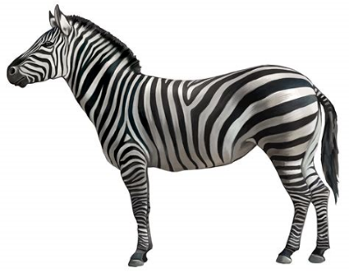
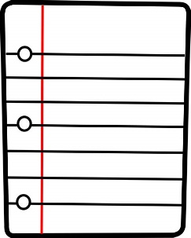
Follow the Flow
½ Physical
ZEBRA
½ Legal
Zoo A
Zoo B
BIRTH EVENT | Zoo A | Zoo B
Ownership Status
Physical Status
Transfer for Breeding to Zoo C
Zoo C
BIRTH EVENT | Zoo A | Zoo B | Zoo C
Ownership Status
Physical Status
Notes:
BRIGID – Resolution of Pendings can be tricky. These are personally my favorite to work on though.
A helpful thing to remember is that each animal is comprised of a physical aspect and a legal aspect, and that they can sometimes go in different directions.
In this example we have a birth at Zoo B. As you can see from your Transaction grid, this is a birth, loan-in. Zoo B physically has the birthed animal, but not the ownership of the animal. The ownership of the animal is with Zoo A. Even though this is ONE animal, there are TWO aspects to keep track of in the transaction flow. Say now this animal gets a breeding recommendation and transfers to Zoo C. The Transaction Grid will update to show a change in the physical status of the animal, but maybe no ownership change if Zoo A maintains it with them.
When working on these, make sure the flow of the physical animal and the flow of the legal animal make sense for each transfer between facilities. Reach out to the facility with the possible data flow ‘hiccup’ and offer what you see as the fix. If they agree and make the resolving data change, you will have reconciled another error and everyone’s data will be better for it.

Slide 14
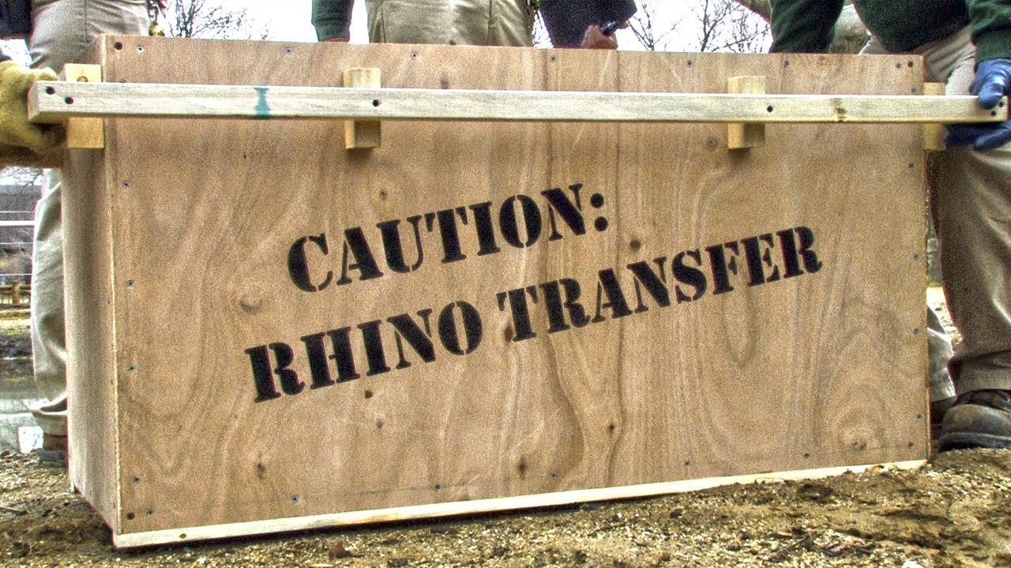
Pending Transactions

Slide 15
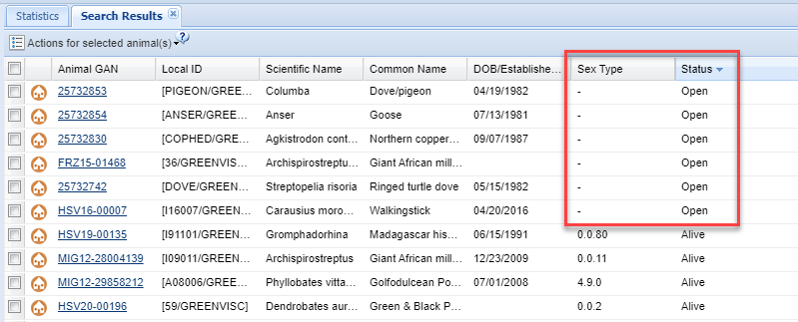
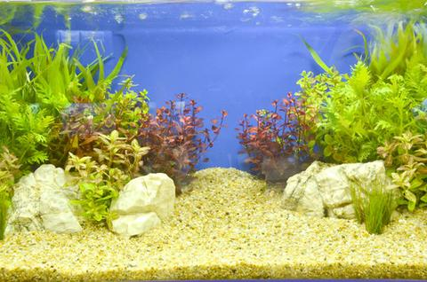
Close Out Zero Count Groups
Notes:
Although Groups that remain Open but have a count of zero will not affect your animal number count, they will affect your Species count and that is usually a part of your inventory. Some institutions want to keep zero count Groups open for various reasons, it is generally considered not to be a Best Practice. Zero count Groups happen in three ways. One, you could have recorded a Census for the Group of 0.0.0 but did not actually Close it out. Two, you recorded a Partial Transaction that brought the count down to zero but you did not Close the Group out. If a Full Transaction brings the count down to zero the Group is automatically Closed Out. Three, the Groups may have migrated into ZIMS from ARKS, the records system prior to ZIMS. Because we could not decide for you if you wanted a Group Closed Out or not, they migrated as Open with a zero count. To find your zero count Groups run an Animal Advanced Search for Groups. Sort the results grid by either Sex Type ascending or Status descending. The results will be the same.

Slide 16
Check Your My Transactions
Census Count
ZIMS Partial Disposition
Migration
Notes:
The top record count was brought down to zero by a 0.0.0 Census count.
The middle record count was brought down to zero by a Partial Disposition in ZIMS. The bottom record migrated from the ARKS legacy system.
You may also want to check any Notes entered that may help you decide if you truly want to Close Out the Group. You may want to edit the last transaction to better reflect what really happened from information you found there.

Slide 17
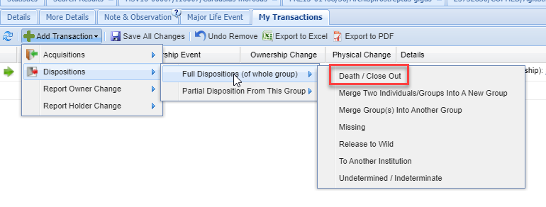
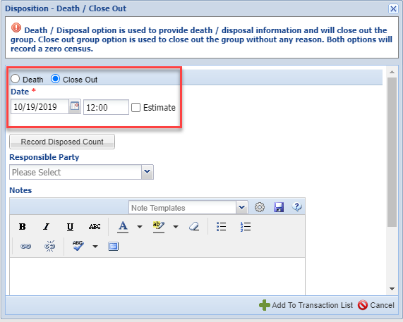
Close Out the Group
Notes:
To Close Out the Group go to My Transactions > Add Transaction > Disposition > Full Disposition > Death/Close Out. Select the Close Out button The only required field is the date. I recommend using the day after the last transaction. Or you can use the day of the last transactions and adjust the time stamp if needed.
Group Close Out is available as a Batch Action but since you have to look at each record to get an idea of what the Close Out Date should be, this may not actually save you time unless you don’t care about the Close Out Date.
Once a Group is Closed Out you can continue to add some data such as Notes and Identifiers even for dates after the Close Out. You cannot, however, record a Census or a Transaction after the Close Out date. You would need to delete the Close Out to do so.

Slide 18
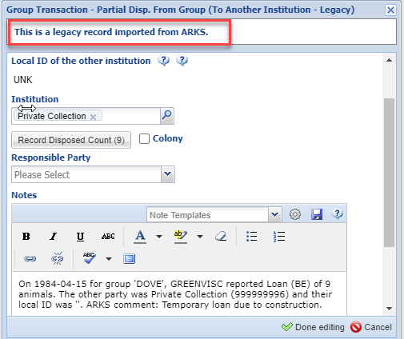
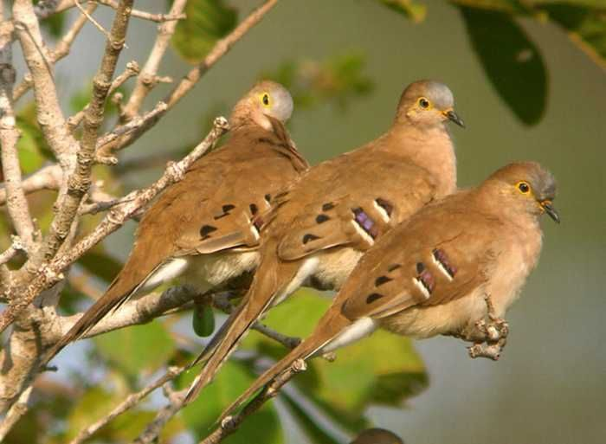
Correcting Records – non ZIMS Using!
Notes:
For final transactions such as Release, Missing or dispositions to NON ZIMS USING institutions you have the option to correct the final transaction. Do not do this if the final transaction was to a ZIMS using institution because you need to delete the entry and then record it properly. This would create confusion as the receiving party would get a notice that you deleted a record relating to them and then a Pending for the corrected transaction.
The record on the bottom was for a disposition of a group of doves to a Private Collection. It is safe to correct this to a Full Disposition instead of a Partial Disposition. You need to delete the Partial Disposition and add the Full Disposition. This can be done in any order before Saving.
We can also correct the record on the top as it was a release and will not affect any other institution’s records. We delete the Partial release and add a Full release. Both of these Group records will not appear as Open because the Full Disposition automatically closed them.

Slide 19
Group Close Out

Slide 20
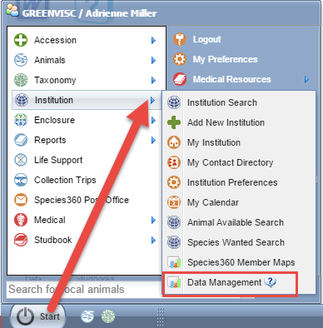
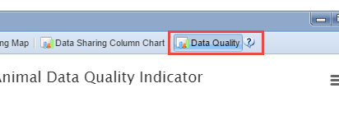
Data Quality Indicator
Notes:
BRIGID - The Data Quality Indicator can also help you get ready for Inventory time. This is found under Start > Institution > Data Management.
Data Quality is the last tab on the right.

Slide 21
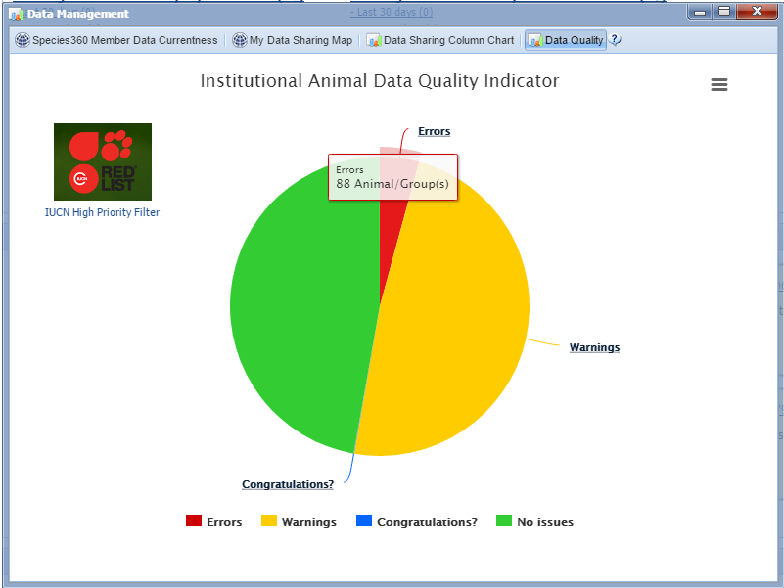
Data Quality Indicator
Notes:
BRIGID - The Data Quality Indicator is a pie chart that displays the records with no issues and those with three types of possible data quality issues. Obviously you want your biggest slice to be green (No Issues) and your smallest slice to be red (Errors). A large Congratulations? slice may not actually be a good thing. Hovering over the slice will display the number of records in each category.

Slide 22
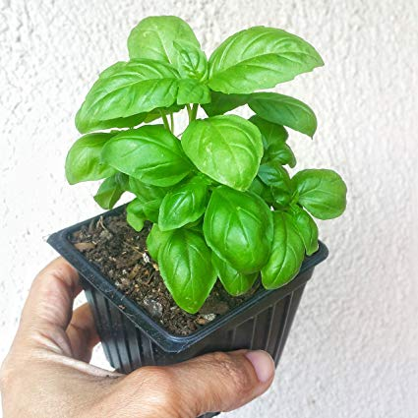
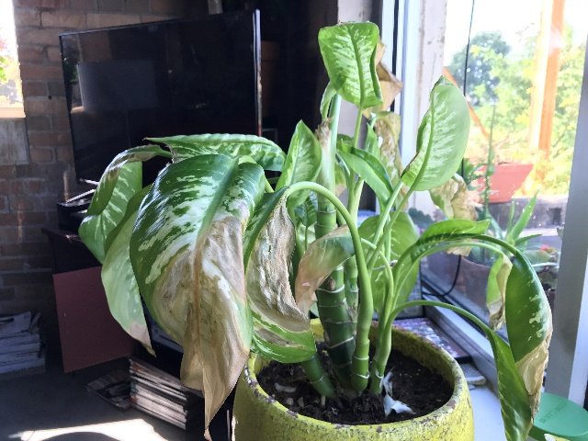
Data Quality Indicator
No Issues (green)
Great! No data quality issues are found
Warnings (yellow)
Of possible concern. You will want to address
Pending Transactions
Really just a heads up
Already covered for Inventory
Parents not in ZIMS
Also just a heads up
No parents recorded
These will need to be fixed
But will not affect the Inventory
Notes:
BRIGID

Slide 23
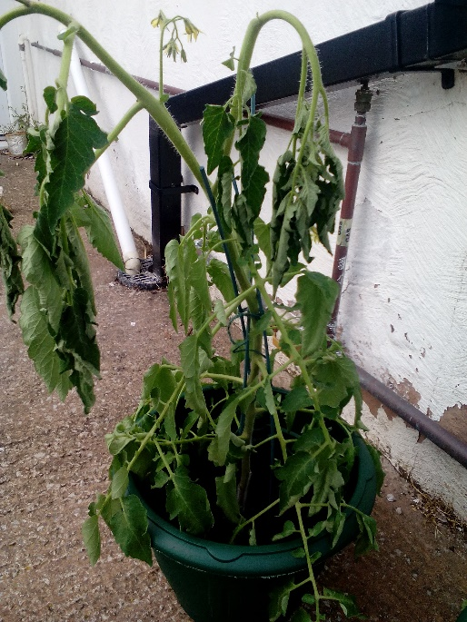
Data Quality Indicator
Errors (red)
Bad! Need to Fix
Obsolete taxonomic name
Already covered for Inventory
Extra Physical transactions
Affects Inventory
Extra Ownership transactions
Affects Inventory
Parent GANS identical to each other
Unrealistic dates
May affect Inventory
Missing Term
Gap Between Parent Death and Offspring Birth
Congratulations? (blue)
Possible oldest animal(s)
May affect Inventory
Notes:
BRIGID

Slide 24
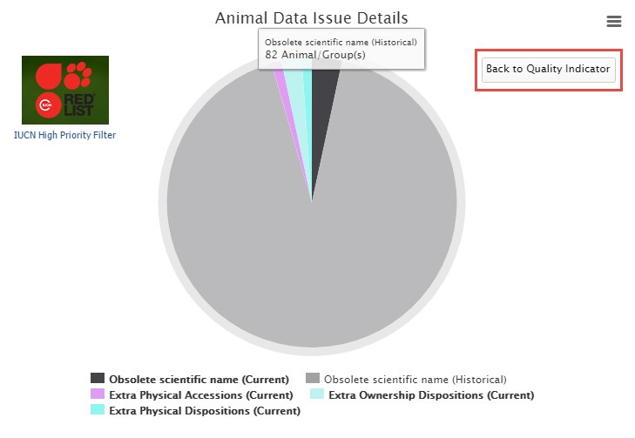
Data Issue Details
Notes:
BRIGID - Left clicking on the pie slice will drill down in the chart for more
details. Here we have selected our Errors. We have current and
historic Obsolete Taxonomic names, Extra Physical Accessions and Dispositions and Extra Ownership Dispositions. You can go back to the previous chart using the “Back to Quality Indicator” button.

Slide 25
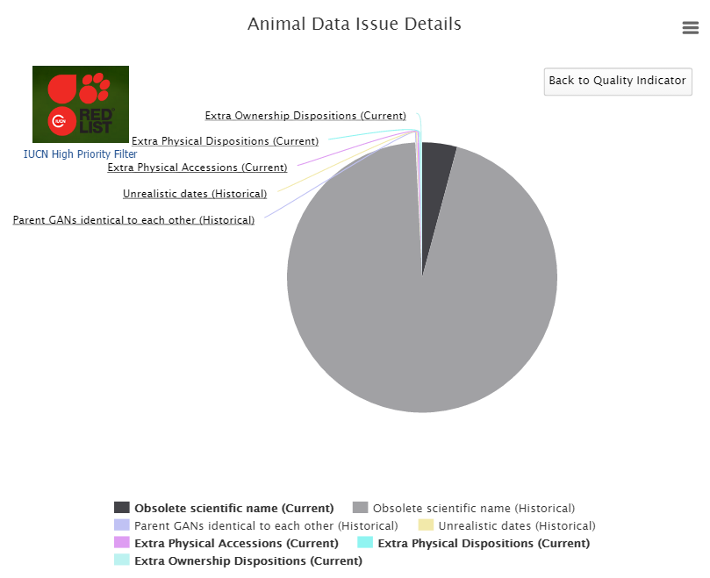
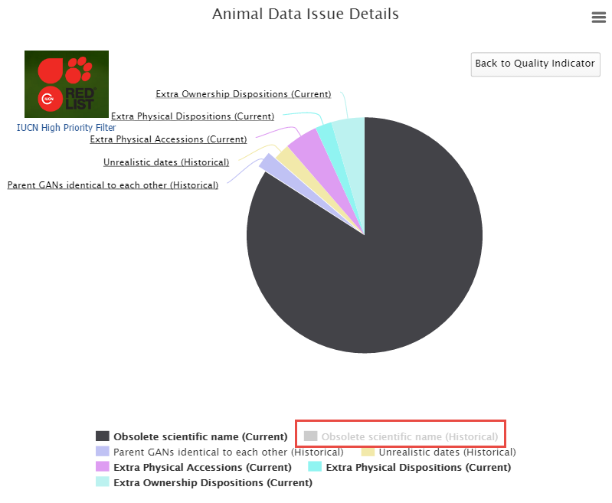
Expanding the Pie Slices
Notes:
BRIGID - If some of your pie slices are too small to read (as on the left) removing other slices by clicking on the topic below the chart will expand the others. Here we have removed Obsolete Scientific Name (historical) (now greyed out) to better view the other slices.

Slide 26
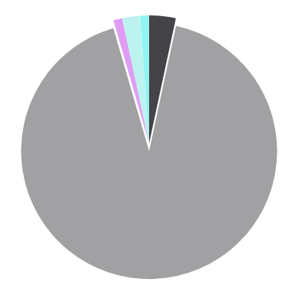
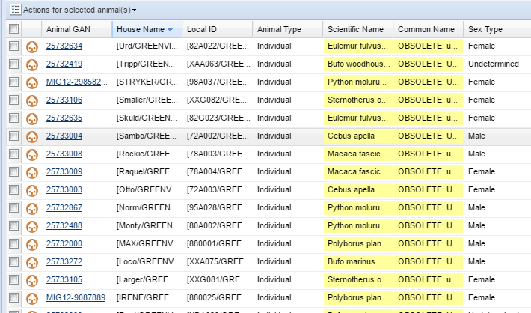
Locating the Records
Notes:
BRIGID - Clicking on the pie slice will bring up a list of the animal records that contain the data that created the Error or Warning. Here we opened the slice for Obsolete Taxonomy (historical). Using the Pending Taxonomic Changes in Animal Statistics should clear these up as we have already covered.

Slide 27
Fixing Extra Transactions
Notes:
BRIGID - Extra Transactions are usually found only in records migrated from ARKS. ZIMS should not allow you to create these. These issues can impact the accuracy of your Inventory counts. At the top you have recorded receiving the animal twice with two slightly different Loan terms. At the bottom you have recorded sending out the animal twice. These should be researched and the incorrect transaction removed if you entered it. If you find that another institution entered to incorrect record you will need to contact them to see if they agree with you and they can fix it from their end. Always add a Note should you have to delete transactions!

Slide 28
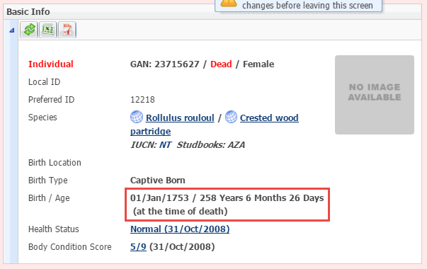
Fixing Unrealistic Dates
Notes:
BRIGID - Finding the Unrealistic Dates may require a bit of detective work as they are not always obvious. But they can possibly impact an Inventory, especially an historical one. Here we have a 258 year old wood partridge (fairly unrealistic). Although My Transaction stream has the Hatch Date correctly recorded as 9 July 2008, the Event Locations grid displays 01 January 1753. This is probably due as result of migration from ARKS where empty dates were switch to this 1753 date. These dates can only be corrected by the originating Institution.

Slide 29
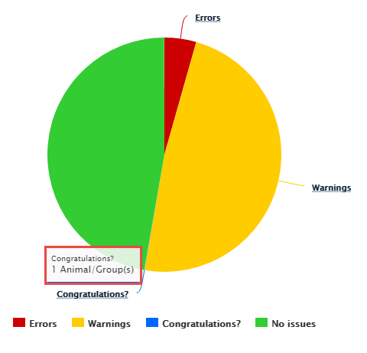
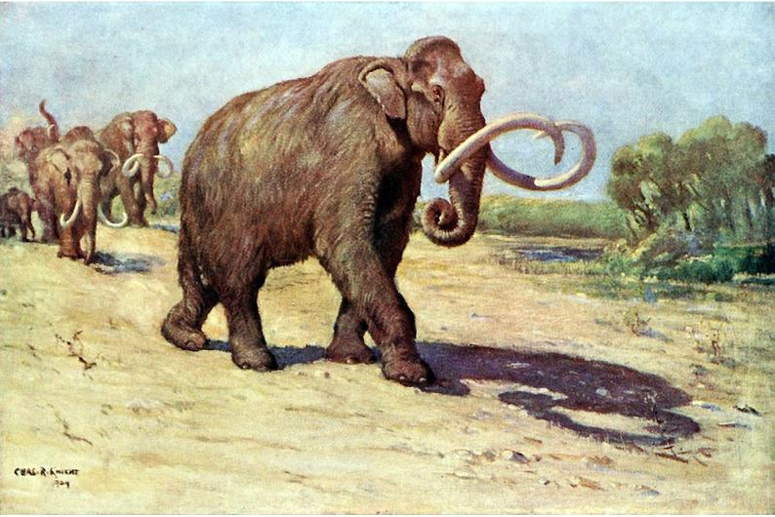
Congratulations?
Notes:
BRIGID - Congratulations? Is an indicator that you may possibly have the oldest individual of a species. To open this (usually very small) pie piece you
click on the hyperlink instead of the pie slice
if there is no slice to open.

Slide 30
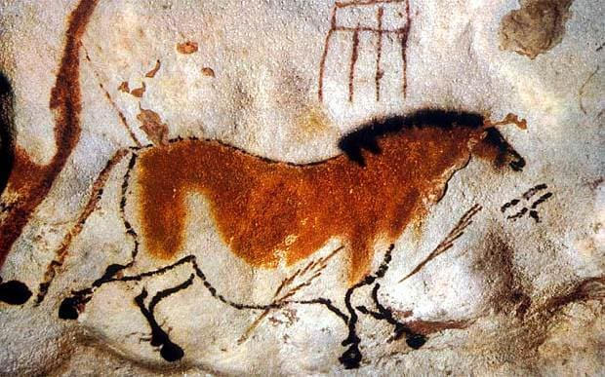
Congratulations?
Notes:
BRIGID - The results grid will display the animals that you may be deserving of a Congratulations! In many cases though, this longevity is due to an error such as not recording a death on the right date, or even not recording it at all! This would definitely impact your Inventory. You may need to review any Notes in the record to determine if the dates are accurate or if they need to be corrected. If the record is indeed correct then congratulate yourself and maybe use it for a Public Relations spot!

Slide 31
Data Quality Indicators

Slide 32
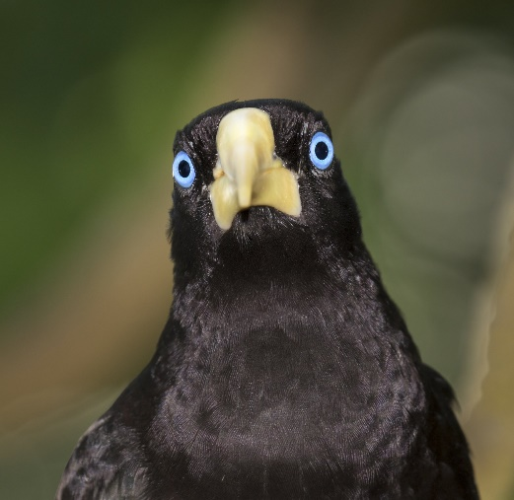
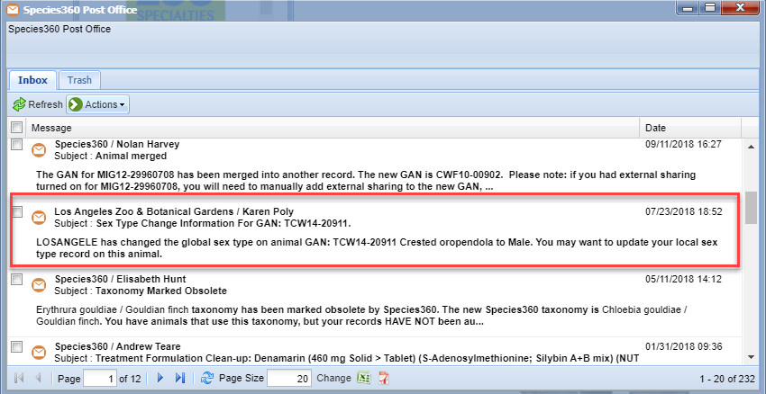
Check Your Post Office
Notes:
An important piece of information that is ONLY available in the Post Office is notification if another institution changed the sex of an animal that is currently or has been in your collection. This is especially important if you have the animal sexed as unknown and it is recorded as both a Sire and a Dam in the record. This may help you clean up those duplicated Parents! To find out if it has been recorded as a Parent run an Animal Advanced Search by Sire/Dam. Even if the animal has not been recorded as a Parent this is important information. A word of caution – do not automatically update your records until you find out WHY the institution changed the sex! For this record we would contact the Los Angeles Zoo and only if we agreed with their decision would we change our records.

Slide 33
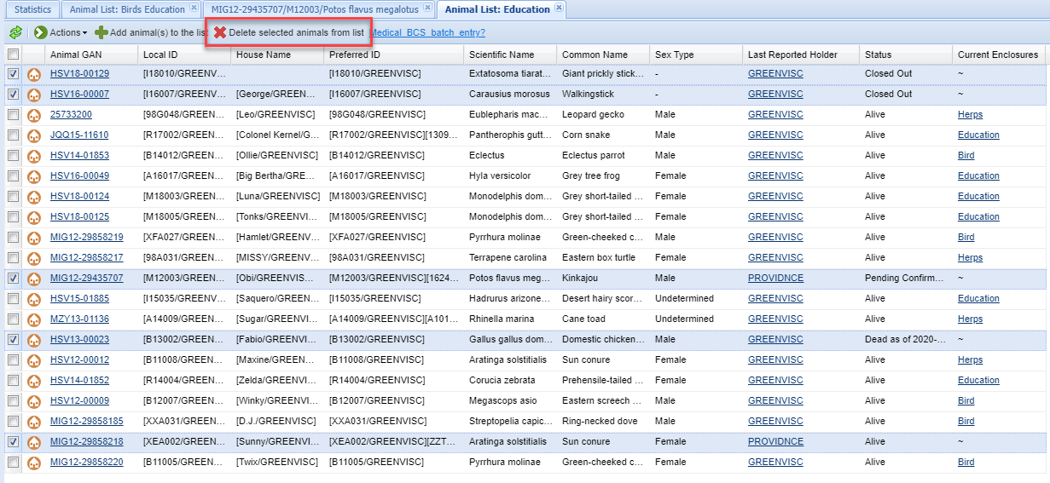
Get a Preliminary Update
Notes:
Although you will want to get your final update closer to the time of your actual Inventory count, it is a good idea to get a preliminary update from the Keepers or whomever can actually count the animals and confirm sexes and identifiers. A good way to do this is to use your Animal Lists if they are created by Teams or Strings. This is also a good time to check that your Animal Lists are up to date. This list has several records that should be removed. Two Groups were Closed Out, a kinkajou has been dispositioned but you are still awaiting confirmation from the Receiver, a chicken has died and a sun conure has been dispositioned and confirmed. To delete them from the list, select the box on the left and then select Delete Selected Animals From List. You may also need to check for animals that need to be ADDED to the list.

Slide 34
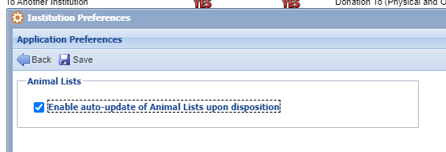
Keep Your Lists Updated
Notes:
Once you get all your lists updated you have the option to keep them so for deaths and dispositions under Institutional Preferences. Go to Application Preferences > Animal Lists. Check the box for Enable auto-update of Animal Lists upon disposition. This preference is NOT available as a My Preference. Make sure you do this AFTER you have updated your lists. If this box is checked and you have animals that SHOULD have been removed but weren’t, ZIMS will not automatically find this and remove them. This functionality is for deaths and dispositions only. Any new animals to the list must be done so manually.

Slide 35
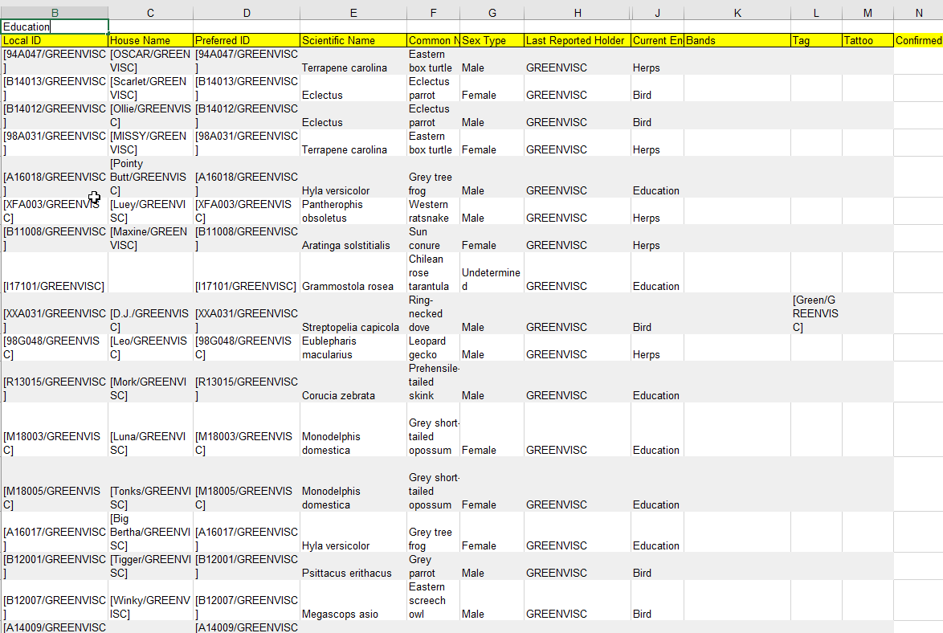
Export the List
Notes:
Customize your columns as you wish and export to Excel. Manipulate the file as desired. We removed the GAN columns and added a Confirmed column. This list can be printed or emailed to Staff to use to check the ZIMS inventory against the actual inventory. It is also a good time to confirm identifiers are still active catch ones that have not been recorded. You will need to repeat this process for your final inventory, but the more you catch now, the easier will the final inventory go.

Slide 36
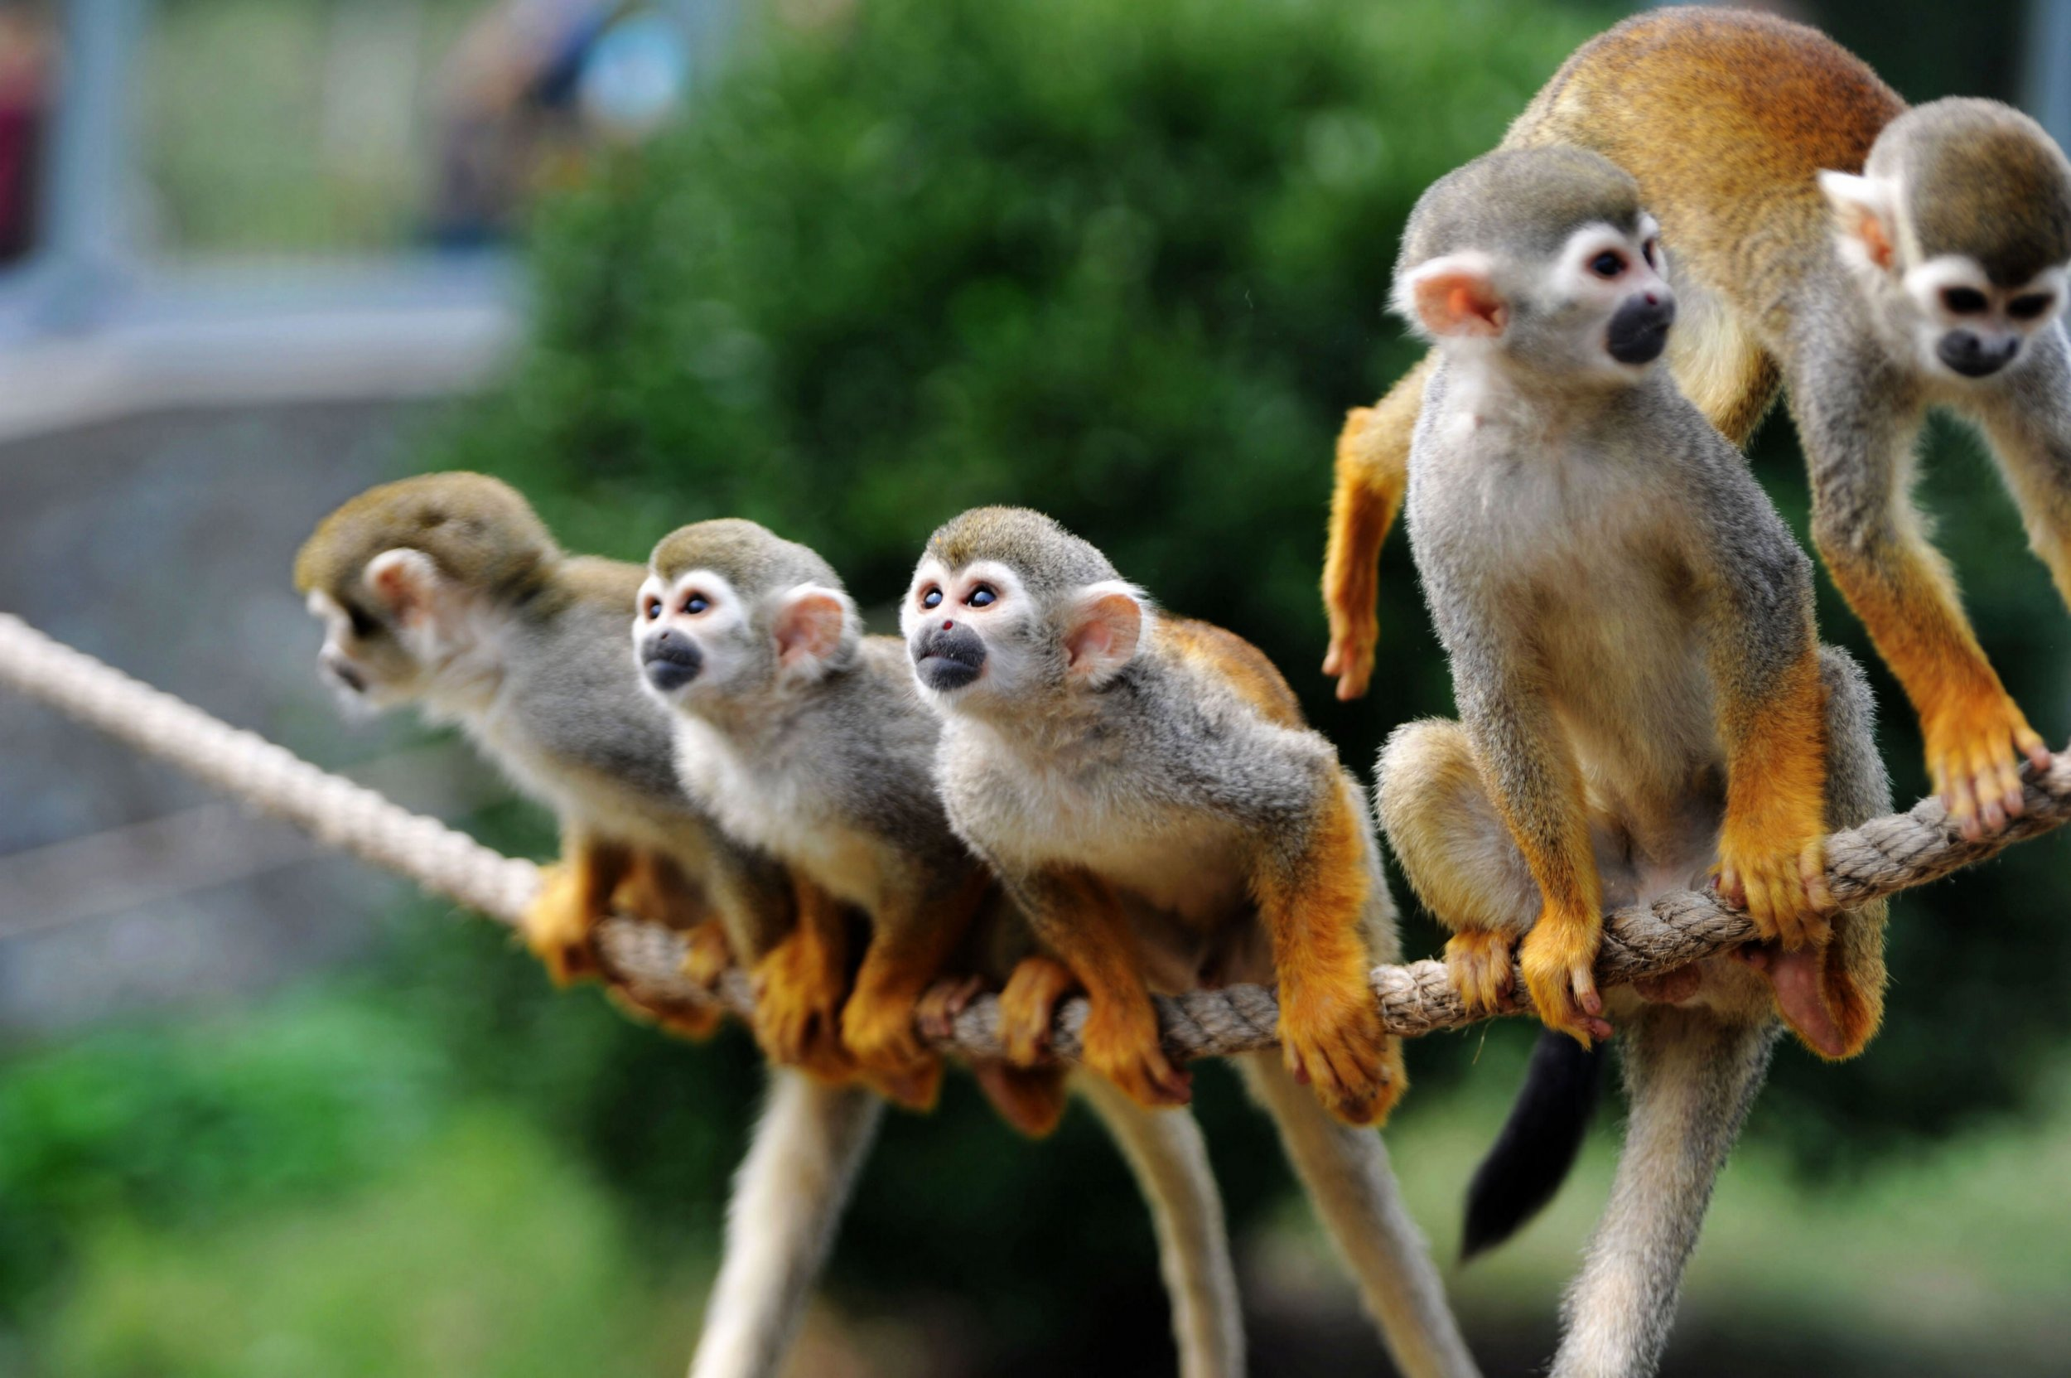
Animal Lists

Slide 37
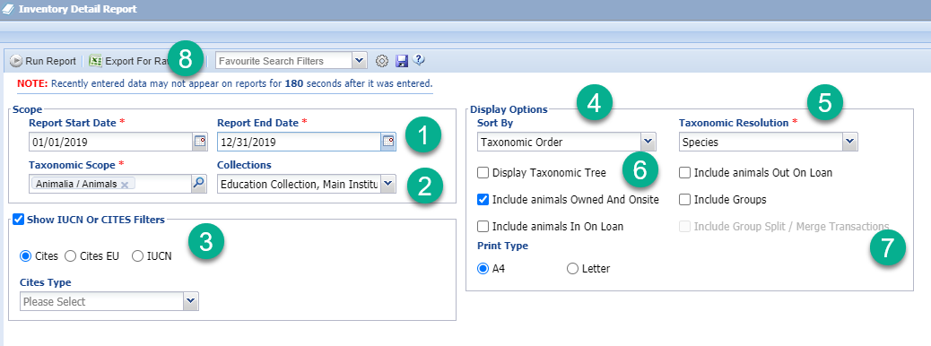
Run a Trial Inventory
Notes:
BRIGID - It is important to understand how the filters selected will affect the report. It is a good idea to run a trial report to make sure you are getting what you want before the crunch is on. 1)Typically an Inventory Report is run from 1 January to 31 December for the previous years, but you may need to run an Inventory for the fiscal year, so check your date range. 2)By default all Collections are included but you may have animals in a Local Collection that you do not want included; if so remove them from the list. 3) The IUCN and CITES status will display even if this box is not checked and Type selected. If you do enter something in the Type field ONLY animals meeting that criteria will be displayed. 4) The sorting is usually via the Taxonomic Tree but you have an option to sort alphabetically by Scientific Name. 5)The Taxonomic Resolution is usually by Species but you can select higher or lower in the Tree. If you have minor breeds or domestics you may want the resolution to be by subspecies or breed. 6)Display Taxonomic Tree will display the where the species is in the Tree. Make sure to check all the physical/ownership relationships you want to include, plus Groups. 7) Include Split/Merges is not active until Groups are checked. Once you get it right you can create a Favourite Filter. We’ll look at some Inventory reports.

Slide 38
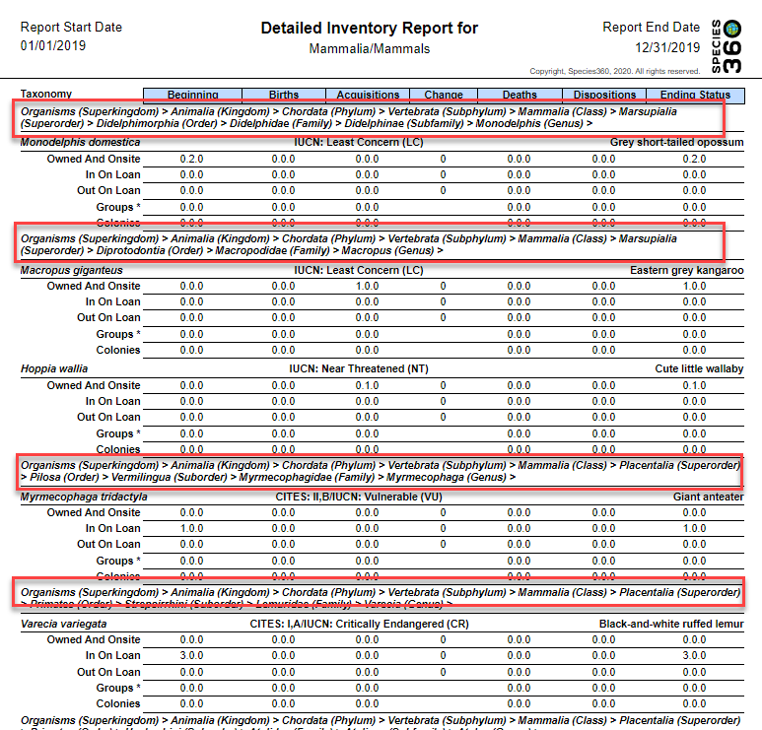
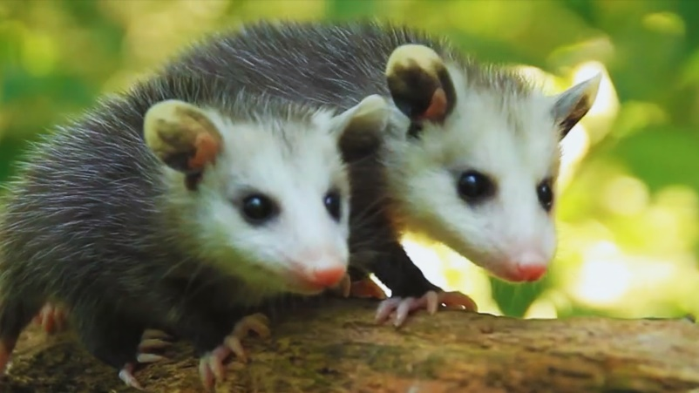
Display Taxonomic Tree
Notes:
BRIGID - This is what the report looks like when Display Taxonomic Tree is checked. I found this option helped a lot when setting up a Taxonomic filing system many moons ago.

Slide 39
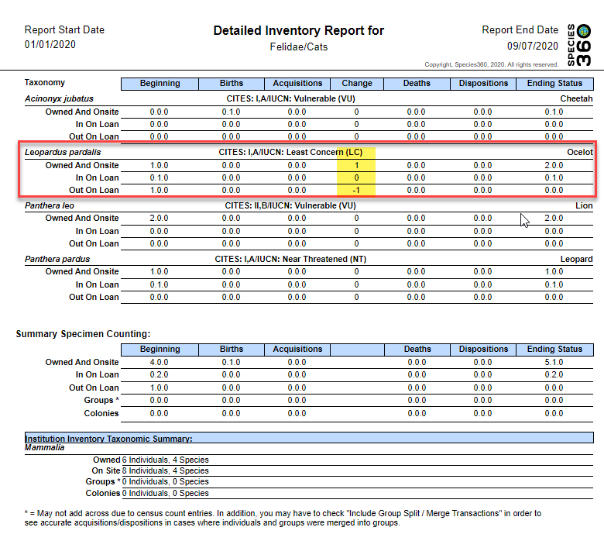
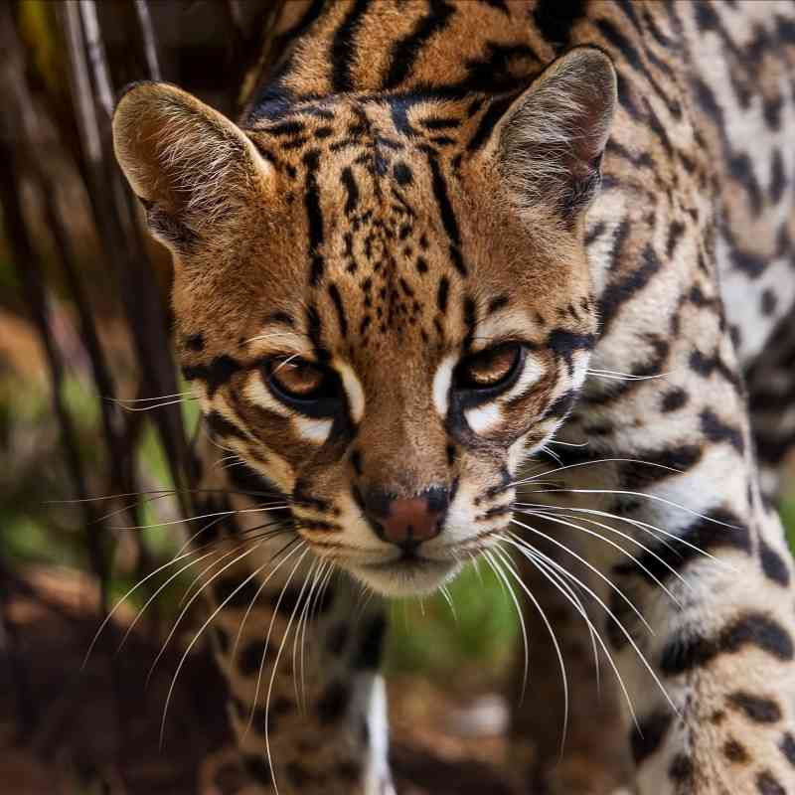
Change Column
Notes:
BRIGID - The Change column will indicate is there has been a change in Physical or Ownership status. In this example we had an ocelot out on loan at the beginning of the year. But between then and now he was physically returned to us. Therefore, the Out on Loan row displays a -1 and the Owned and On-Site row displays a +1.

Slide 40
Be Prepared to Explain Group Counts
Group Counts do not always add up across
Start Number + Births/Acquisitions – Deaths/Dispositions does not always = Ending Number
Why?
Census Counts are not reflected in Birth/Acquisition and Death/Disposition columns
To add up all Group number changes must be made using the My Transaction stream
So you don’t create fiction use Undetermined Partial Acquisition or Disposition if it is important that the numbers add up
Notes:
Separate Group Inventory has been requested at some European institutions.

Slide 41
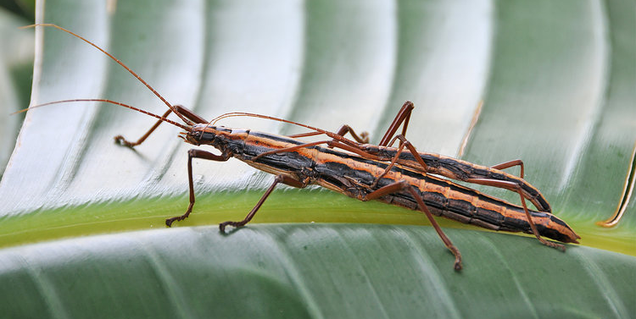
Group Splits and Merges
13 in Group on 1 January
Individual Split out on 5 March
A Group of 6 was Split out on 3 June
New group of 10 arrived and was Merged into the first Group on 5 August
Individual was Split out on September 1
Notes:
Whether or not you select to display Group Splits and Merges will also affect your inventory. This is our scenario.

Slide 42
Group Splits and Merges
Do Not Include Groups Splits and Merges
Do Include Group Splits and Merges
Notes:
The top is how the Inventory would display if you did not select to show splits and merges. The beginning count is 13. The 0.0.2 Acquisitions are the 2 Individuals that were Split out and became Individual entities. The 0.0.10 Acquisition is the new group. The 0.0.2 Dispositions are the 2 Individuals that were split from the group. The ending status is 0.0.21.
The bottom is how the Inventory would display if you DID select to show splits and merges. The beginning count is 13. The 0.0.2 Acquisitions are the 2 Individuals that were Split out and became Individual entities. The 0.0.26 Acquisition is the new group of 10, the addition of this Group to the origin group and the creation of a new group from the split of the 6. The 0.0.18 Dispositions are the 2 Individuals that were split from the group, the Group of 10 merged into the origin group and the new group of 6 split from the origin group. The ending status is 0.0.21.
I would say that the NOT including Splits and Merges as the default was a good idea!

Slide 43
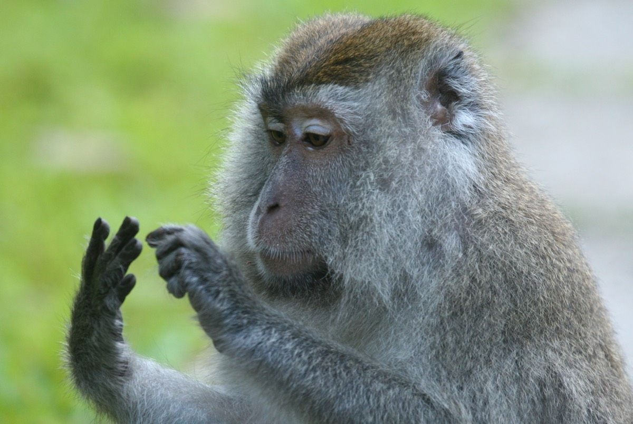
Inventories

Slide 44
Get Ready for Inventory!
Are you prepared?

